Slide 1
Engineering Projects management
Super visor:
Eng. Husain Abu Zant
Mohammad Khader Sultan Radwan
Yassar Abu Baker Ramzi Ashour
Tamer suliman

Slide 2
Case study
Azoun Primary School in Azoun near Qalqilia city.
Three floor the Basement floor with an area equal to 109.25m²,and the other two floor have an area of 537.32m² and the total area nearly to 1206m².
The estimated price of the project which made by the consultant is about (400,000 $), while the available budget is (426,000 $).

Slide 3
Assumptions
Value Engineering using price analysis will reduce the cost of the project.

Slide 4
Objectives
This research is aimed to minimize the price of the project to match the available budget.

Slide 5
Methodology
Study all the nine issues in order to get management skills to be used to achieve the main objective.
To minimize the project price in the research VE could be used.
Interviews for several contractors should be made to achieve the objective.
Interview the carpenter, steel fixer, painter, tier, aluminum fixer), to study the type of material and price of all type to comparative and chose the best alternative.

Slide 6
Value Engineering

Slide 7
Value Engineering definition
Value Engineering is a function oriented, systematic team approach and study to provide value in a product, system or service.

Slide 8
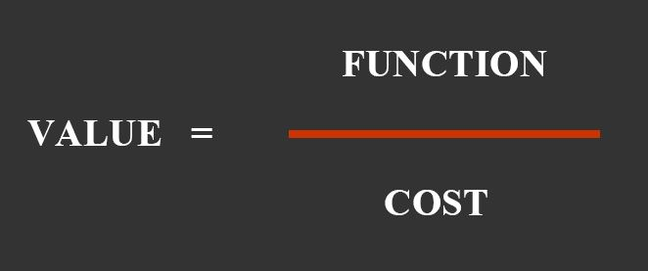
Value Engineering Methodology
Improvement of VE is focused on:
1- cost reduction.
2- customer perceived quality.

Slide 9
Applications of
Value Engineering

Slide 10
Finishing works items to be discussed:
Carpentry work.
Paint work.
Aluminum works.
Steel works.
Tiles works.

Slide 11
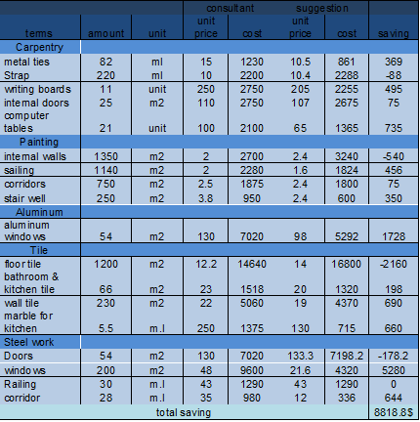
Summarizing Table

Slide 12
Conclusion &Recommendations

Slide 13
Conclusion
Based on Implementation of value engineering methods and price analysis on the original specifications and plans of the contract, the cost was reduced by $7835.
Despite all value engineering methods and price analysis calculations the project was still over budgeted.
This conclusion may be justified by inaccurate pricing by the consultant.

Slide 14
Recommendations
Reduce the area of the project and get rid of the unnecessary works.
Search for new donor to cover the deficit in the budget.
Structurally redesign for main elements of the project.

