Slide 1
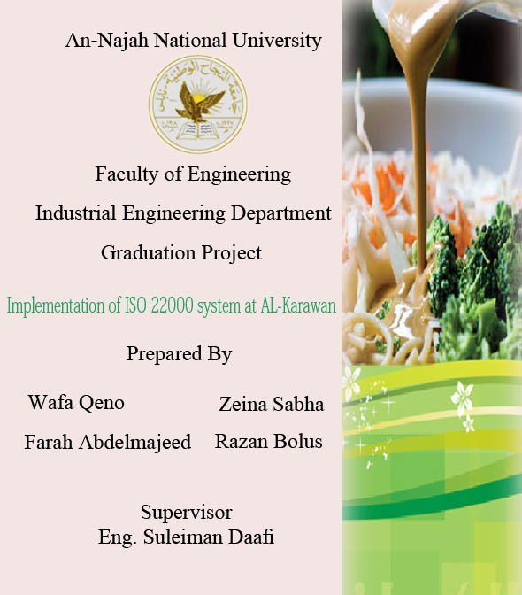

Slide 2
Contents:
Objectives
Al-Karawan Factory
Introduction
Methodology
Implementation
Recommendations

Slide 3

Project OBJECTIVES

Slide 4
Study ISO 22000 System and Food Safety Management System
Planning to implement ISO 22000 System on Al-Karawan Factory
Study the current state of the factory and the production line
Establish Gap Analysis as a comparison between the prerequisite program and the current state
Build the HACCP study
Set the necessarily working procedures that is required in the standard

Slide 5
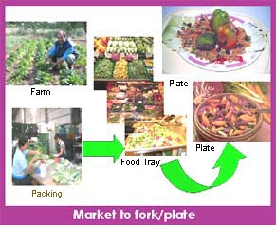
Introduction

Slide 6
Food Safety
Assurance that food will not cause harm to the consumer when it is prepared and/or eaten according to its intended use
Protecting People
Keeping the Employees and Customers
Preventing Food Safety Errors

Slide 7
ISO 22000 system
Management
system elements
HACCP principles
GMP & PRP’s

Slide 8
ISO 22000 system benefits
To enhance customer satisfaction
To enhance food safety
Improved food safety hazard control
To comply with the Codex HACCP principles
To ensure consumer protection
Drive for continuous improvement
Improved documentation
Improved compliance with hygiene regulations

Slide 9
HACCP study
Hazard Analysis And Critical Control Point
The first five preliminary steps
Establish the HACCP team
Product description
Identify product intended use
Construct flow diagram
On-site confirmation of flow diagram

Slide 10
The Seven Principles steps
List all potential hazards, conduct a hazard analysis and consider any measures to control indentified hazards
Determine the Critical Control Points
Establish Critical Limits
Establish Monitoring Procedures
Establish Corrective Action
Establish Verification Procedures
Establish Record Keeping and Documentation

Slide 11
Principles of ISO 22000
Verification
Implementation
Modify
Validation
-requirements
-materials
-processes
-products
-PRP’s
Hazard
identification
Risk
analysis
CCP´s
Control
measures
operational
PRP´s

Slide 12
Food Safety Management System-Requirements
1. Scope
2. Normative references
3. Terms and definitions
4. Food safety management system
5. Management responsibility
6. Resource management
7. Planning and realization of safe products
8. Validation, verification and improvement of the FSMS

Slide 13

Al- karawan factory

Slide 14
Al Karawan Factory for Tehina:
the new building specialize only for Tehina.
The Factory lies on the main street at the Industrial zone in nablus, it has 3 floors one for manufacturing ,others for clothes room kitchen , the third one is a storage.
The factory opened in 2009, it consists of 3 administrators and 9 workers.

Slide 15
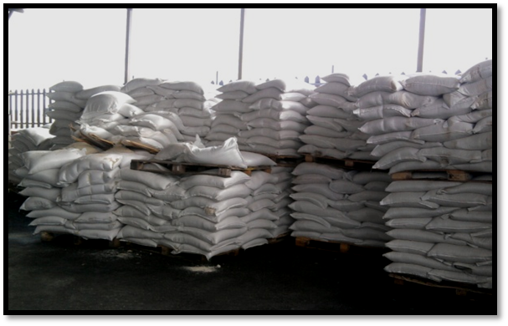
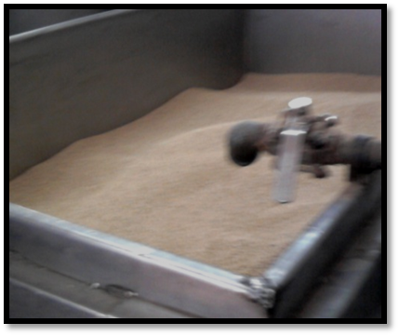
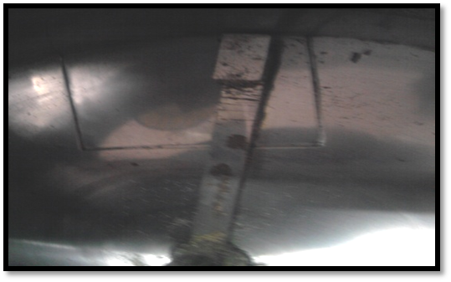
Production Process:
Storage
Soaking the Sesame in water
Peeler

Slide 16
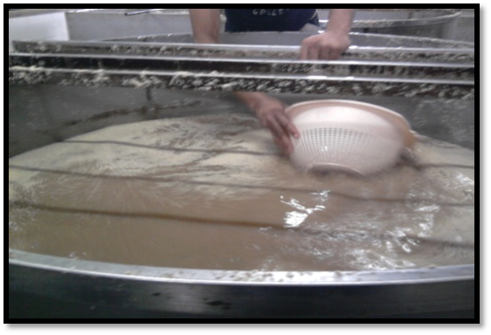
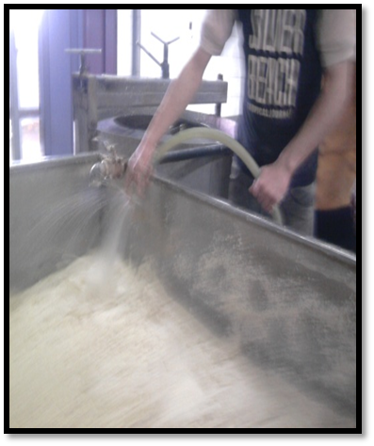
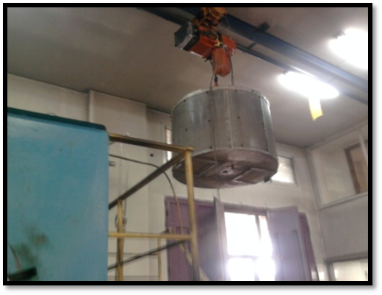
Soaking the Sesame in water and salt
Washing and cleaning Sesame in water
Drying the Sesame

Slide 17
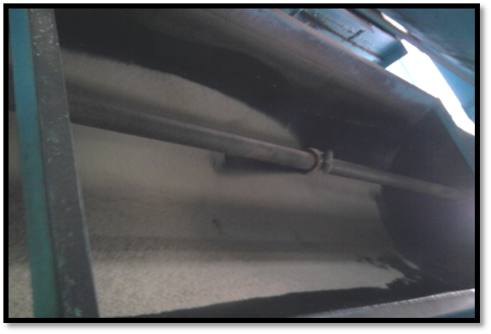
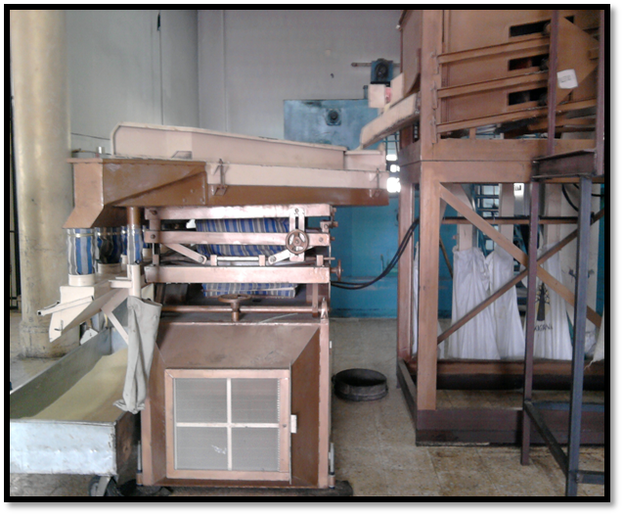
Furnace
Screening and sieving

Slide 18
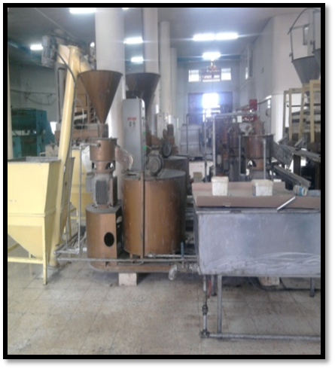
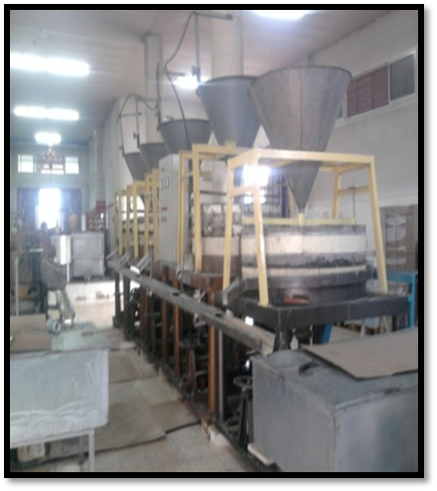
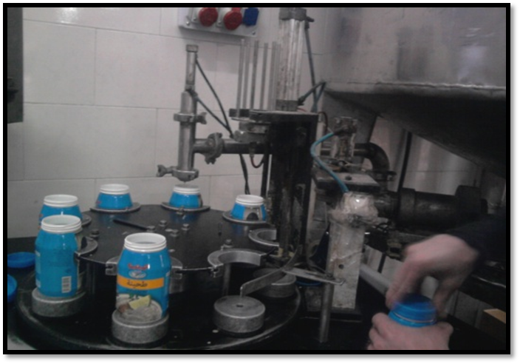
Grinding the Sesame
Packaging

Slide 19

Methodology

Slide 20
Gathering data
Studying the IOS 22000 standard, PRP’s and GMP requirements
Studying the production line
Build the Gap Analysis
For PRP’s
flow diagram
The working environment in the factory
The hygiene practices in the factory
Establish the HACCP preliminary
For GMP’s
HACCP team
Product description
Intended use

Slide 21
Establish the HACCP principles
Determine the potential hazard
Determine the critical control points
Establish critical limits for the CCP’s
Establish monitoring procedures, corrective actions, verification procedures
Documentation
Working procedures
Internal audit
Establish the chick list

Slide 22

Implementation

Slide 23
According to ISO 22000 System, the first step to implement the system is determine the required PRP’s and GMP’s
Management
system elements
HACCP Steps
GMP & PRP’s
By doing the Gap Analysis

Slide 24
GAP analysis:
A tool that project managers, process improvement teams, and even individuals use to see where a person or company is, when compared with where that person .or company would like to be
Gap Analysis steps:
Seek and understanding of the environment surrounding the problem or project.
Take a holistic view of the environment to gain a complete understanding
Determine what framework your team will use for assessment of the problem or project.
Make sure to provide Data supporting the analysis you have undertaken.

Slide 25
Prerequisite programs
(GMP) Good Manufacture Practices
(GHP)Good Hygienic Practices
Waste management systems
Follow the instructions of the Codex
Maintenance
Pest control
Product recall
Registration of consumer complaints
Training
Personal Hygiene(PH)
Control the source of water
Product definition and coding
PRP

Slide 26
Good Manufacture Practices
GMP
Factory site
Design
Buildings and facilities
Walls and roofs
Doors and windows
Dressing room
Bathrooms
Ventilation and lighting
Stores
Equipment, tools and work surfaces
Flooring

Slide 27
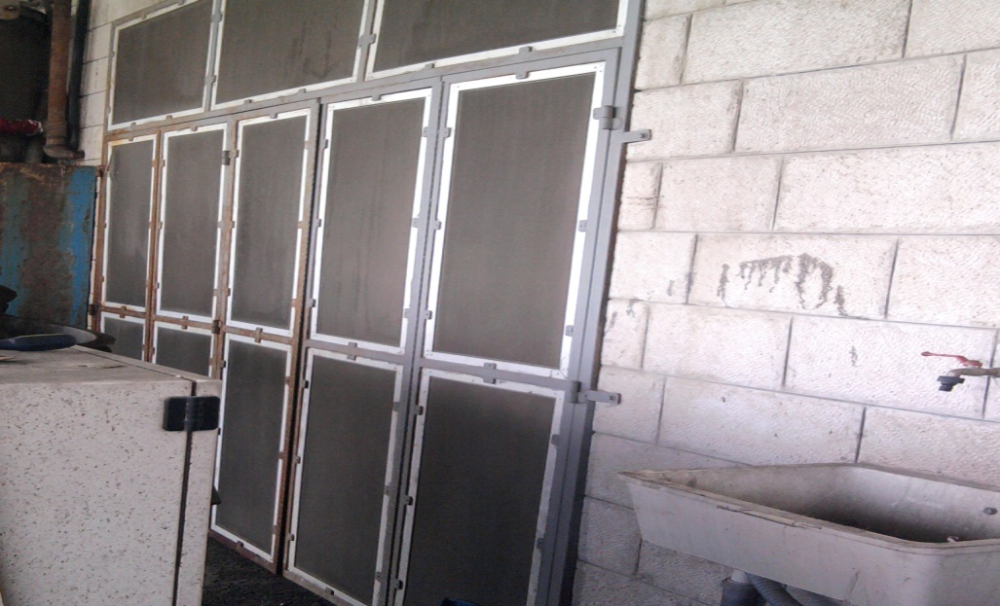
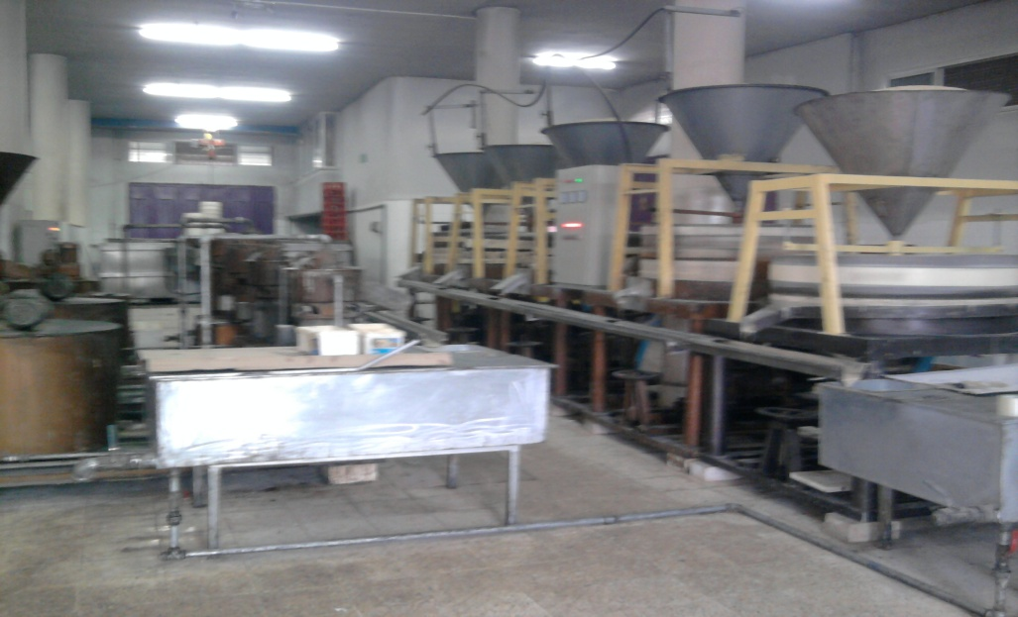
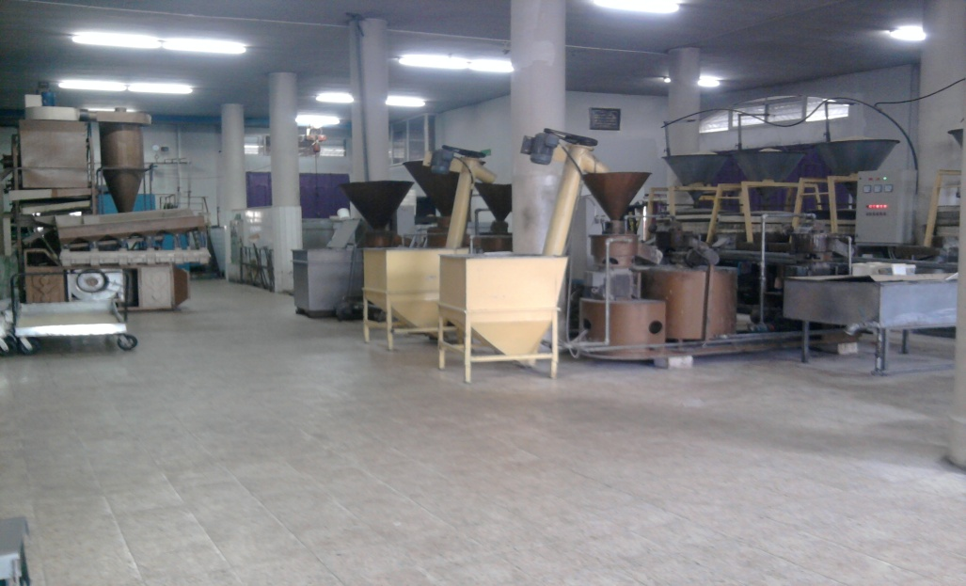
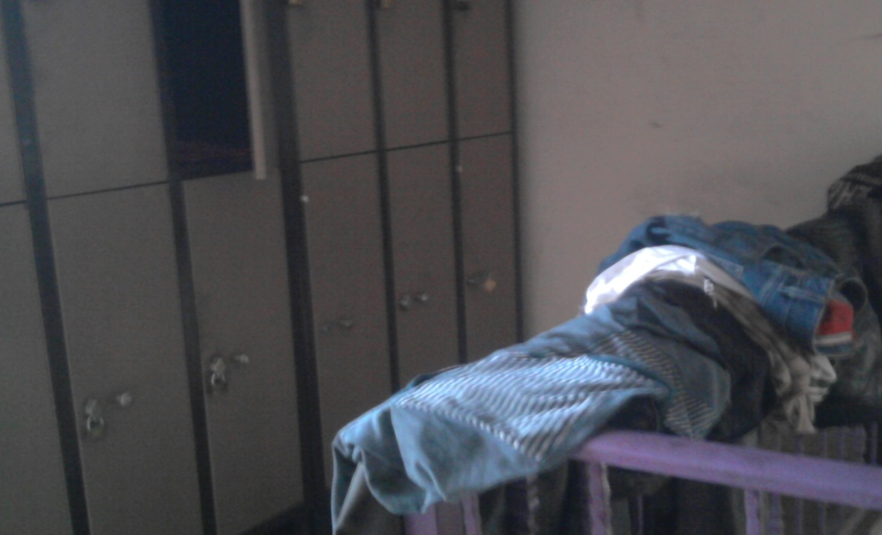

Slide 28
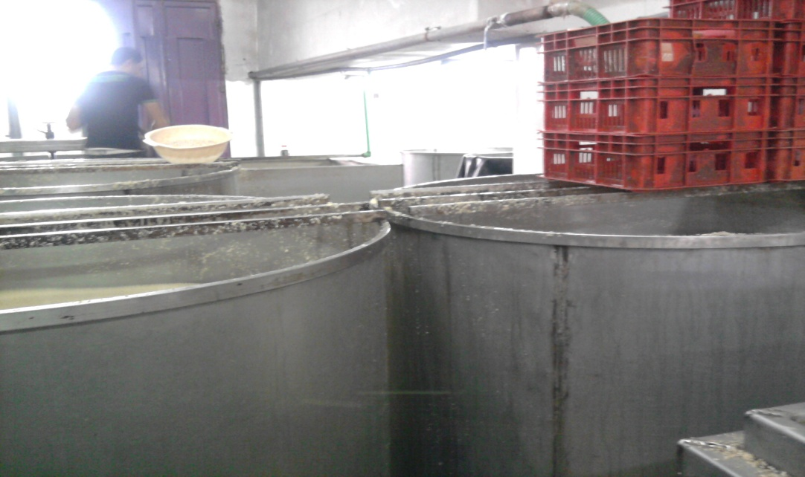
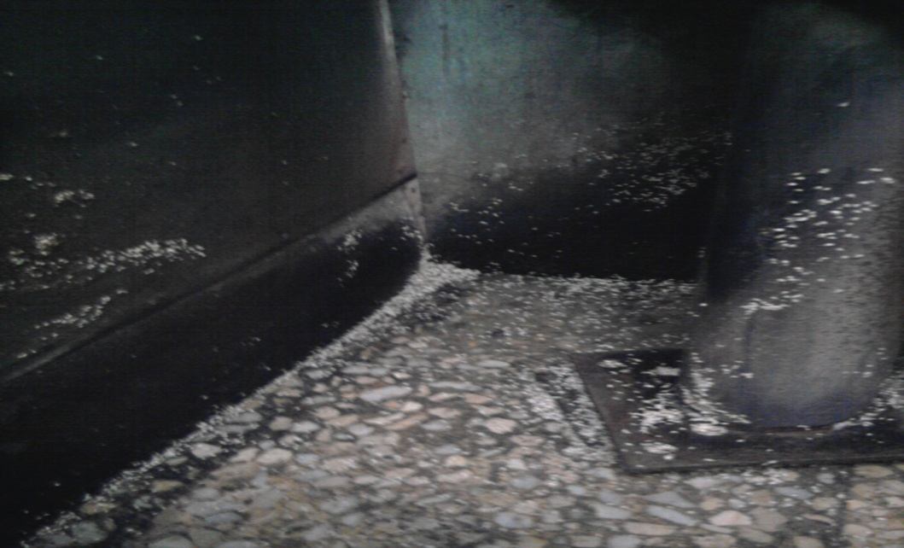
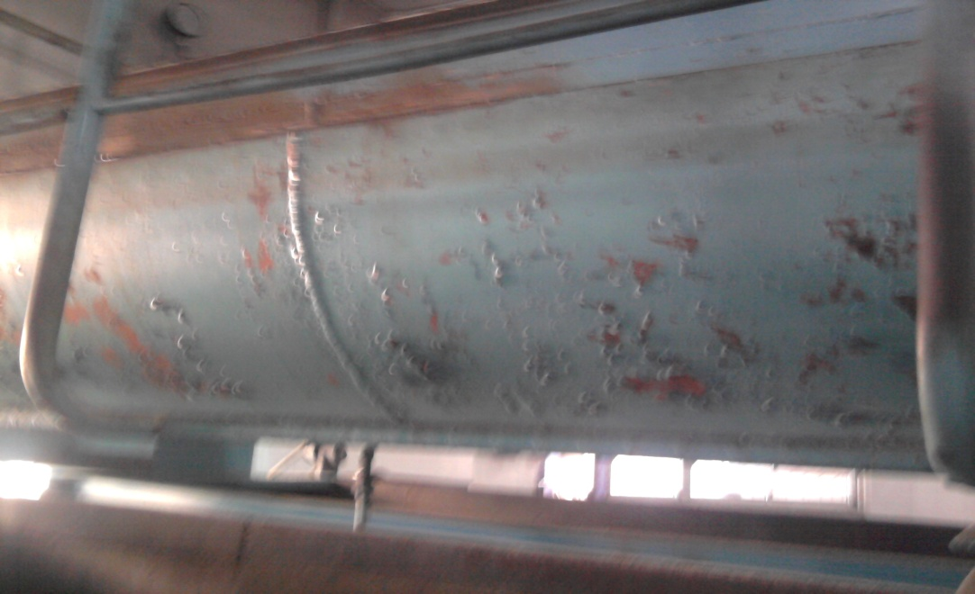
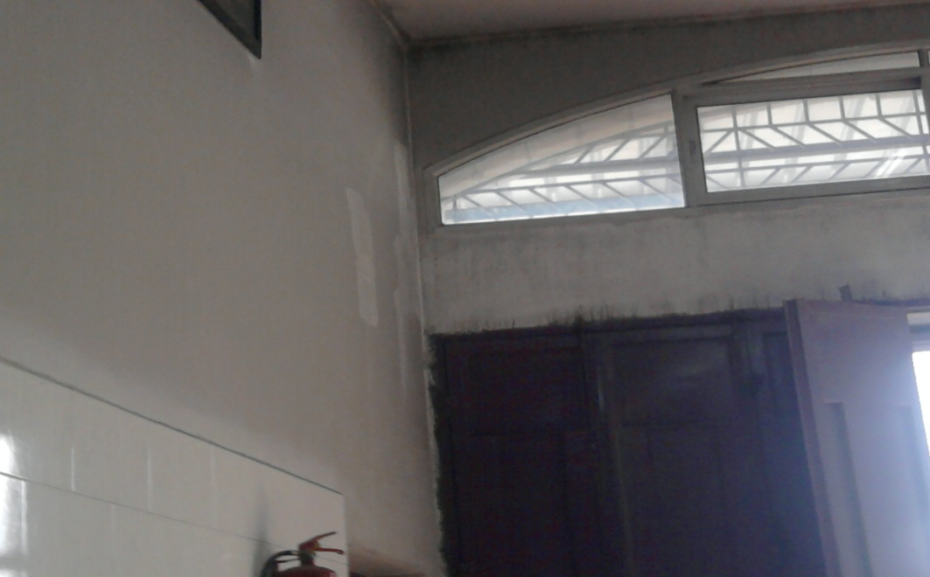

Slide 29
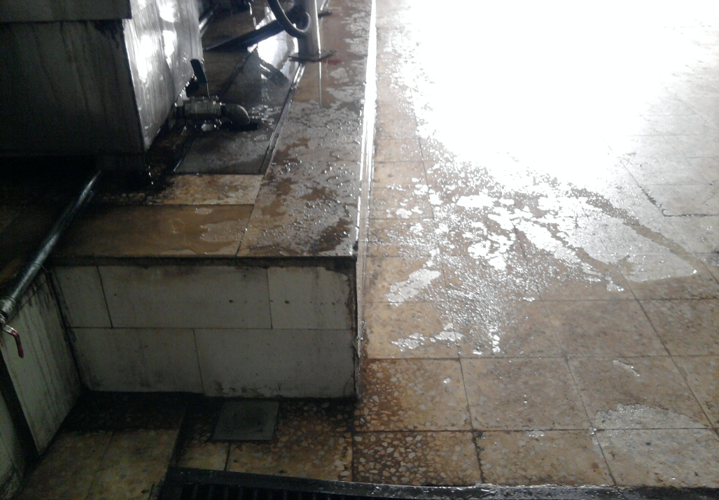
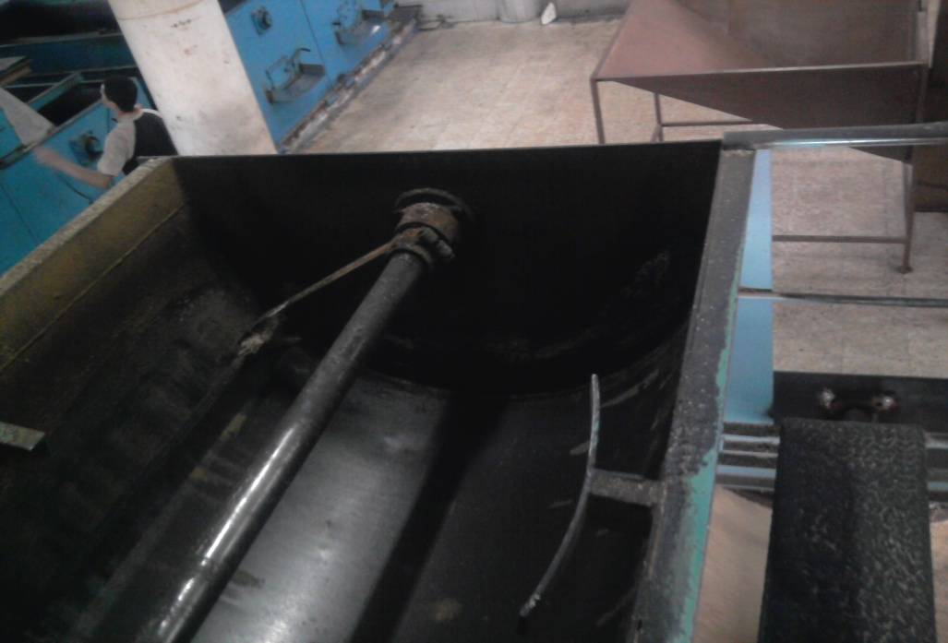
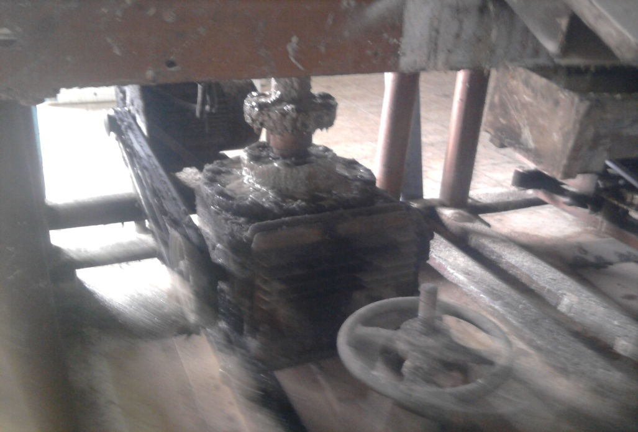
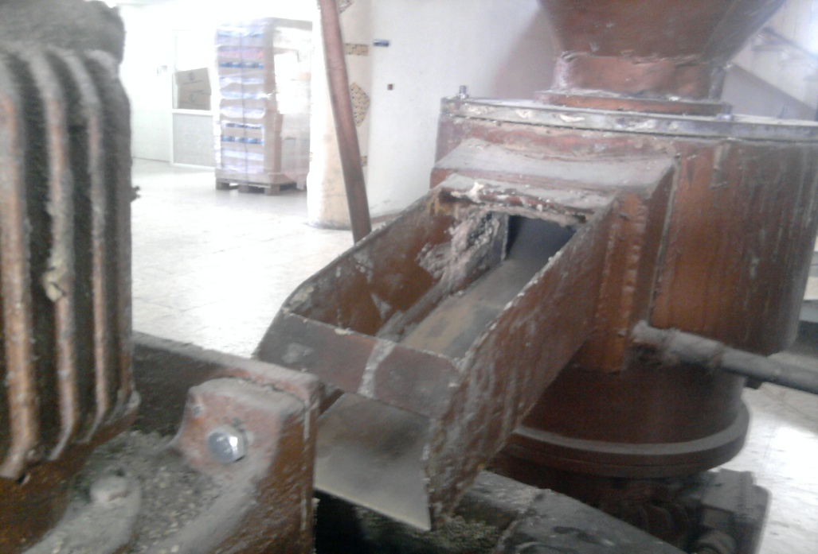

Slide 30
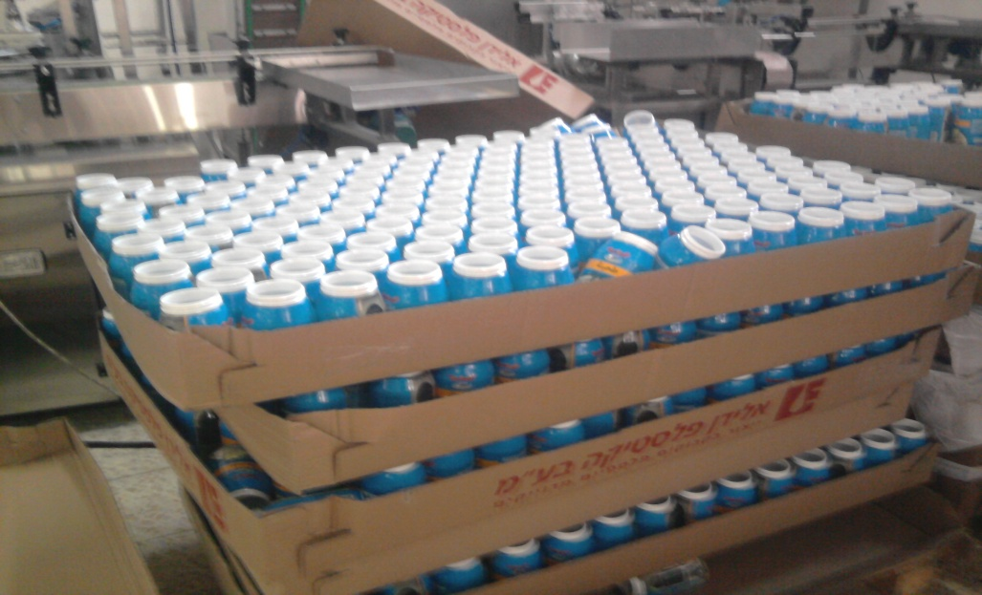
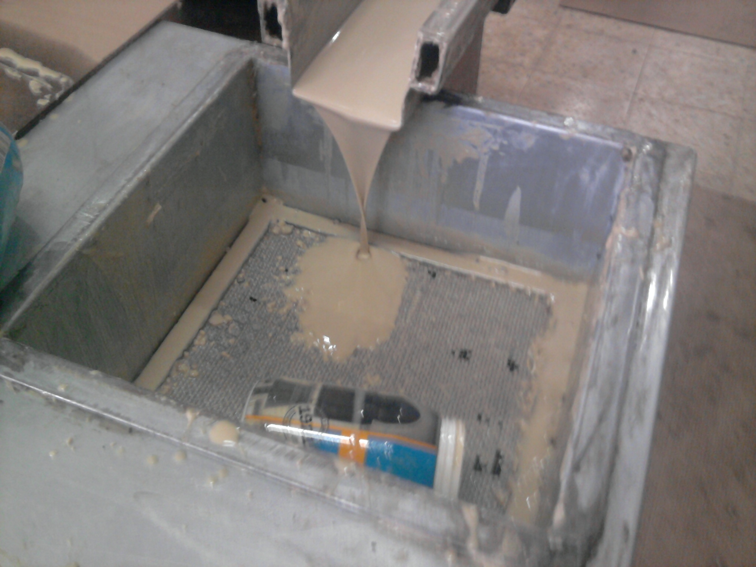
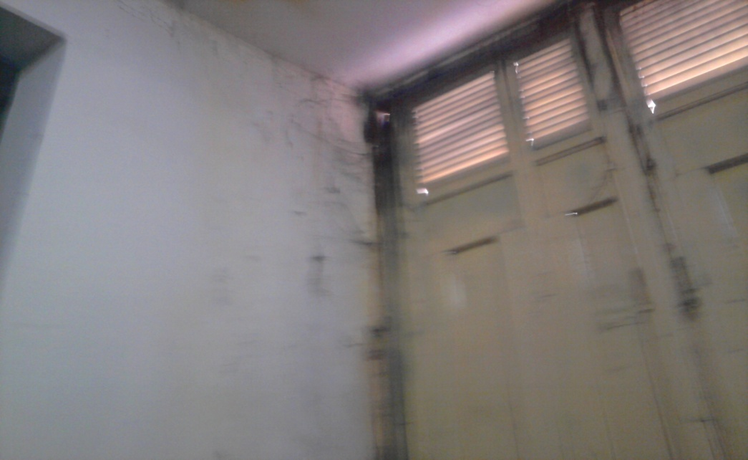
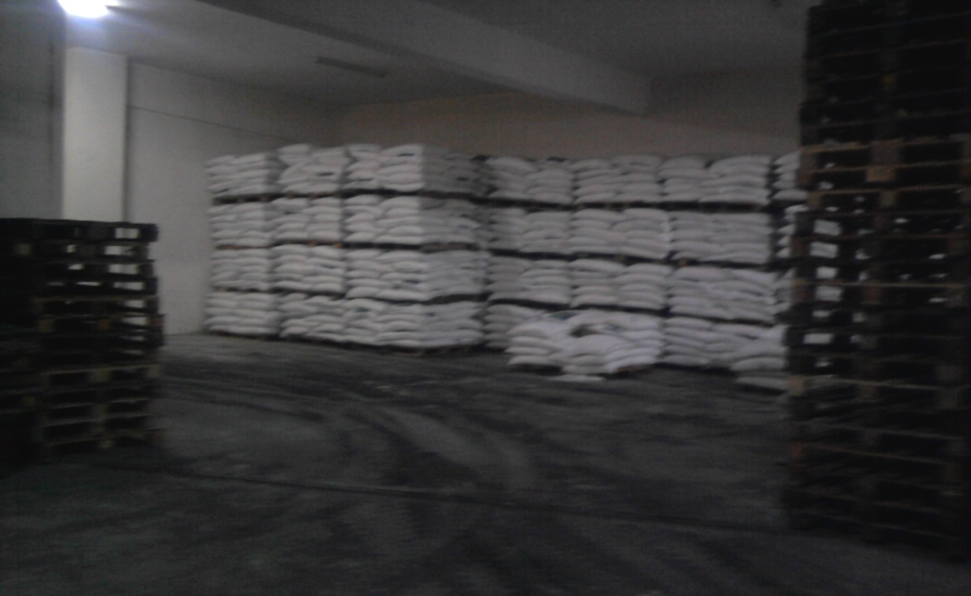

Slide 31
Recommendation For GMP & PRP’s
identify direction of individuals within the plant
sections must be isolated from each other
floor should be free of cracks and Resistant to chemicals
Walls must be fire resistance and the provision of the doors must be well to prevent the entry of insects.
The Factory should be careful to the machinery cleaning and prevent accumulation of food.

Slide 32
After applying the PRP’s and GMP’s that are not exist in the factory , the second step is applying the HACCP step
By applying the 12 steps
Management
system elements
HACCP Steps
GMP & PRP’s

Slide 33

1- Assemble the HACCP team
The top management should appoint the HACCP team leader, and then the team should be established.
Knowledge required:
HACCP principles and techniques.
Practical aspects of unit operations and process flow.
Technology and equipment used on the processing lines.

Slide 34
Team Tasks:
define the scope of the HACCP plan:
Limit the study to specific product or process
Define the part of the food chain to be studied
A time line and clear goals should be set for work.
Conduct a hazard analysis.
Identify potential hazards.
Identify hazards which must be controlled.
Recommend controls, critical limits, and procedures for monitoring and verification.
Recommend appropriate corrective actions when a deviation occurs.
Recommend research related to the HACCP if important information is not known.
Validate the HACCP plan.

Slide 35
2- Product description
Product Description
Tehina (Tahini, Tehineh, Tehena) | Product title
It's used in some food preparing | Purpose
It Contains of proteins, not harmful fats, calcium and iron. It can be used for gingivitis Treatment, Help digestion | Importance
consists of 100% Sesame without any additions like Preservatives | Components
In this product the input is Sesame as a raw material, It's often come from Africa. And the output product is Tehina | Inputs/Outputs
Tehina looks like a Viscous liquid | Presentation
The product must matches the requirements According to the Palestinian Standard Institute (PSI) for Sesame Tehina, about the general requirements, Compositional requirements, Category, Packaging, production label, Content, Test methods | Requirements
Plastic containers | Packaging
One year | Shelf life
Supermarkets | Sold in
Keep at room temperature and day conditions | Labeling instructions
This product produced by Karawan factory Nablus-Industrial zone The manager: Alaa tammam | Ownership

Slide 36
3- Identify intended use
Used in preparation of some traditional foods like hummus and some salads; a major ingredient of halawa.

Slide 37
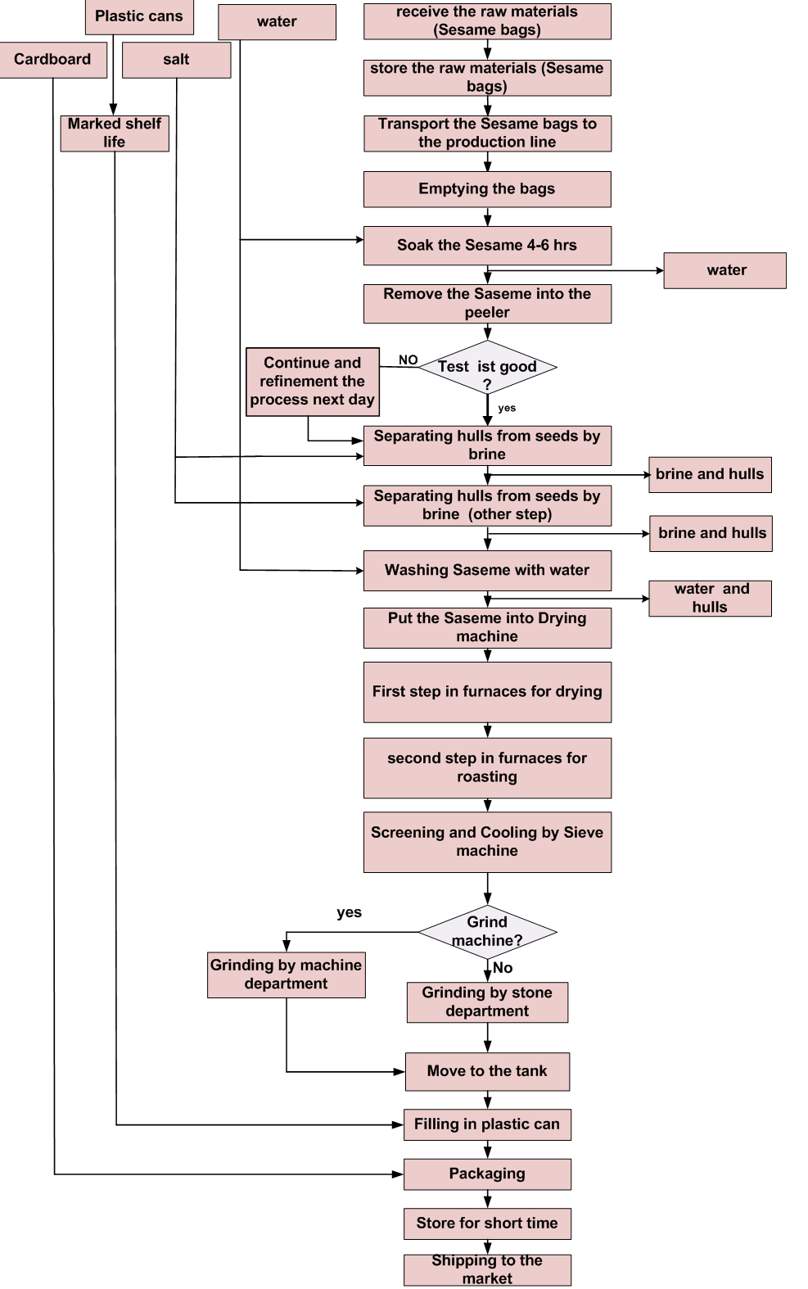
4- Construct Flow Diagram

Slide 38
5- On-site confirmation
we compared between the production line existing in the factory and the flow diagram that we draw, by visiting the production line through working hours and check if the flow diagram that we draw reflect and describe the real process, and record any difference.

Slide 39
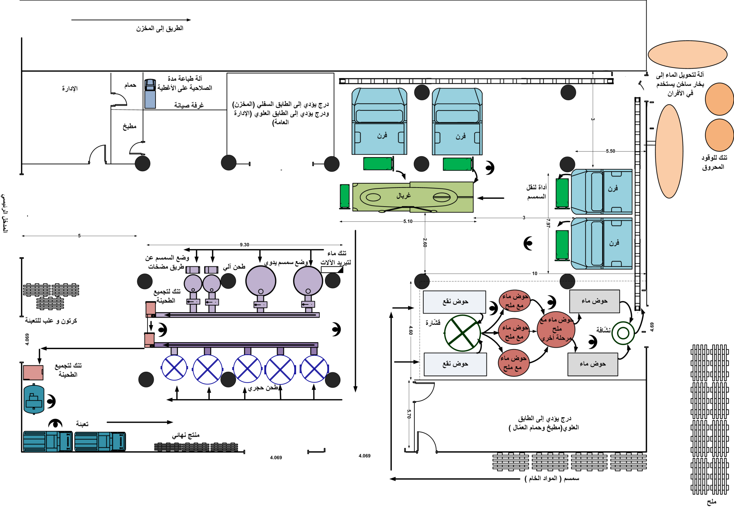
Current layout

Slide 40
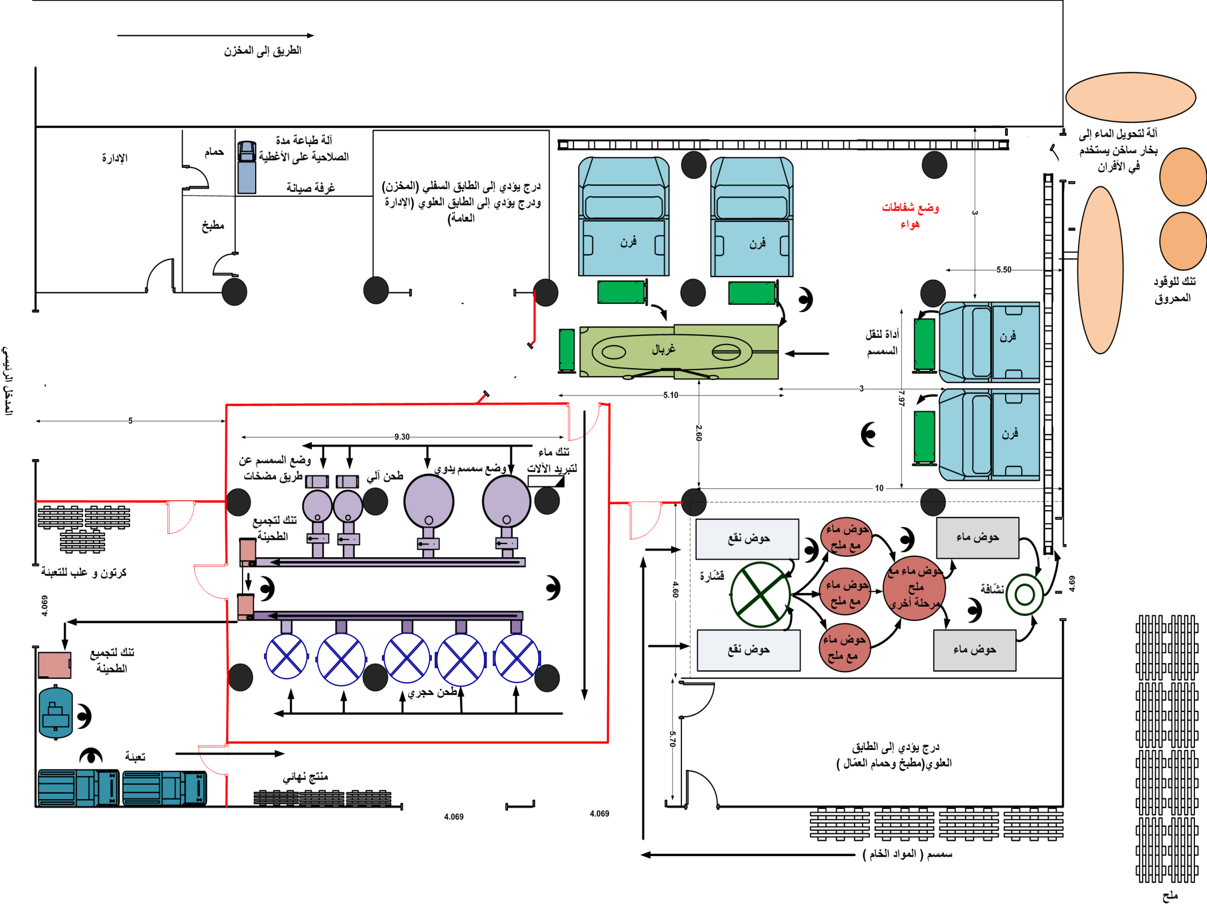
mOdify layout

Slide 41
6- Conduct Hazard Analysis
the hazard analysis is established for each potential
hazard in the process.
For example:
1. Roasting process
Prerequisite program / critical control points | Hazard evaluation | Probability | Severity level | Hazard description | Potential hazard | Raw material /Activates
Continuous and appropriate maintenance for the furnaces Make sure that the furnaces reach the suitable temperature | 6 | 2 | 3 | Causes medical conditions and Poisoning | B: the existence of microbes, because furnace do not reach to the proper temperature to kill these microbes | Roasting
Isolate and cover the tanks | 6 | 2 | 3 | Cause Wounds and pain if they enter the gastrointestinal tract | P: Log rust, paint and harmful substances into the exposed furnace

Slide 42
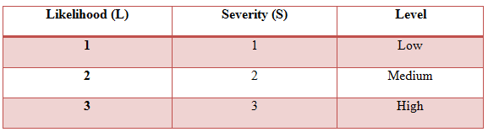
Potential Hazards:
  Biological hazards (B)
  Chemical hazards (C)
  Physical hazards (P)
Severity (S) and likelihood (L) (probability)

Slide 43
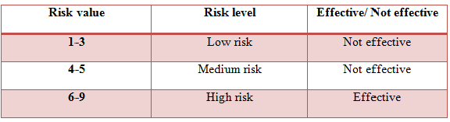
Hazard Evaluation
the risk ( R = L*S )

Slide 44
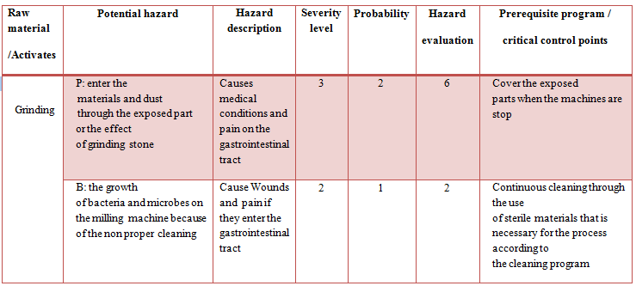
2. Grinding process

Slide 45
3. Packaging process
Prerequisite program / critical control points | Hazard Evaluation | Probability | Severity level | Hazard description | Potential hazard | Raw material /Activates
-Clean the packages by using air blowing machine. -The importance of personal clean by the workers -Isolate the filling and packaging department | 3 | 1 | 3 | Cause Wounds and pain if they enter the gastrointestinal tract | P: The presence of dust during the filling process or the presence of pollutants and dust within the covers and packages | packaging

Slide 46
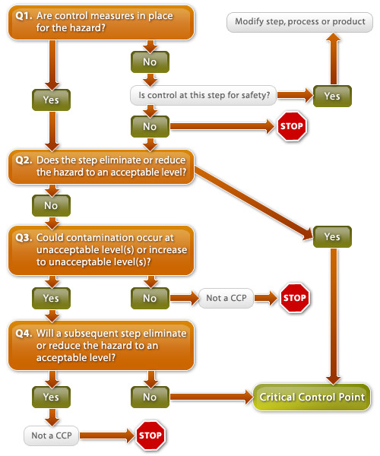
7- Determine Critical Control Point
By using CCP Decision Tree we determined the Critical Control Points in the production line

Slide 47
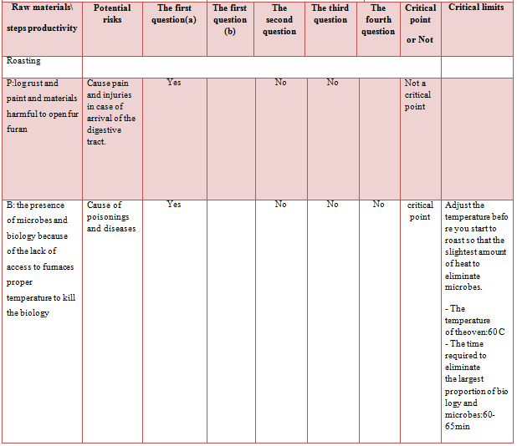

Slide 48
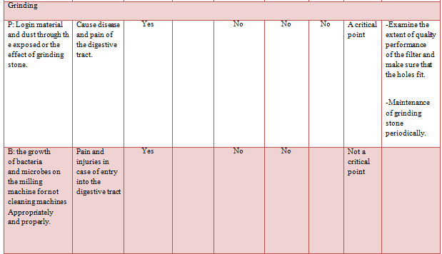

Slide 49
8-Establish critical limits for each CCP
Critical limits | Hazard Description | Potential hazard | Raw material /Activates
-Adjust the temperature before the roasting process start, and the temperature should be suitable to elimination the microbes. - The temperature of the furnace should be >105 - The time required eliminating the largest proportion of biology and microbes should be 2 - 2.5 hours. | Causes medical conditions and Poisoning | B:the existence of microbes, because furnace do not reach to the proper temperature to kill these microbes | Roasting
-The size of the filter holes should be small and suitable to prevent dust and harmful substances to enter in to the tank that is connecting with the packing process. -The absence of parts form grinding stone as a result of friction between parts of the stone | Causes medical conditions and pain on the gastrointestinal tract | P: enter the materials and dust through the exposed part or the effect of grinding stone | Grinding

Slide 50
9-Establishment of Monitoring
Procedure
Monitoring programs |  |  |  |  | Critical limits | Hazard description | Potential hazard | Raw material /Activates
Frequency | when | how | what | Who
Each meal | Before, after and during the process | -Monitor the filter by looking | Monitor the filter | Production line manager | -The size of the filter holes should be small and suitable to prevent dust and harmful substances to enter in to the tank that is connecting with the packing process -The absence of parts form grinding stone as a result of friction between parts of the stone | Causes medical conditions and pain on the gastrointestinal tract | P: enter the materials and dust through the exposed part or the effect of grinding stone | Grinding

Slide 51
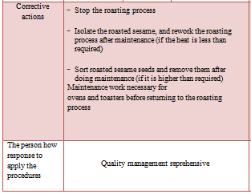
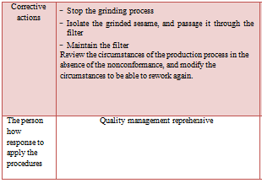
10-Establish Corrective Actions
1. Roasting process 2. Grinding process

Slide 52
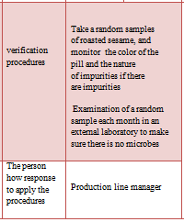
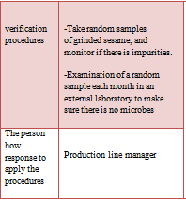
11-Establishment of the verification procedures
1. Roasting process 2. Grinding process

Slide 53
12-Establish documentation and records keeping
A documentations and records are established for the hazard analysis, Critical Control Points, Critical Limits and the corrective and verification procedure.

Slide 55
HACCP Plan
Monitoring programs |  |  |  |  | Critical limits | Hazard description | Potential hazard | Raw material /Activates
Frequency | when | how | what | Who
Each meal | Before, after and during the process | monitor the filter by looking | Monitor the filter | Production line manager | The size of the filter holes should be small and suitable to prevent dust and harmful substances to enter in to the tank that is connecting with the packing process The absence of parts form grinding stone as a result of friction between parts of the stone | Causes medical conditions and pain on the gastrointestinal tract | P: enter the materials and dust through the exposed part or the effect of grinding stone | Grinding
 | Control records | -Take random samples of grinded sesame, and monitor if there is impurities. -Examination of a random sample each month in an external laboratory to make sure there is no microbes |  | verification procedures | Stop the grinding process Isolate the grinded sesame, and passage it through the filter Maintain the filter Review the circumstances of the production process in the absence of the nonconformance, and modify the circumstances to be able to rework again. |  |  | Corrective actions
 |  | Production line manager |  | The person how response to apply the procedures | Quality management reprehensive |  |  | The person how response to apply the procedures

Slide 56
The final step is about procedures and documentation and that is related to ISO 9001
ISO 9001
Management
system elements
HACCP Steps
GMP & PRP’s

Slide 57
Procedures
A set of processes necessary to accomplish a specific job which highlights the importance of actions in the management of operational work for companies.
The procedures are based on the organizations policies; declare the recipe as to how things get done, Where policies provide the signposts or guidance, the procedures tell people how things will be done.
A procedure specifies what will be done, when, and what records are to be kept

Slide 58
The importance from Documenting working Procedures
Development of methods and organization as a standard work on the facility and it must be known to all employees.
Reduce the administrative efforts in the follow-up business, thus reducing the cost.
The ability to automate the process for any of the programs of Workflow and others.
In addition to ease of training new employees on how to work.
Easy identification of imbalances in the course of the administrative process.

Slide 59
Working Procedures at Al Karawan Factory
A set of documents and records Procedure.
Training Procedure and forms of Human Resources department.
Emergency Situations Procedure.
Measures Cases of Non-Conformity Procedure.
A Traceability Procedure
An Internal Audit Procedure.
An Administrative Review Procedure.
A Quality control Procedure
An Internal communication Procedure.
Sales Procedure.
A withdrawal of goods from the market Procedure

Slide 60
internal Audit & Checklist
After the implementation of ISO 22000 standard and It’s Items, procedures and all objects Related to it.
The Final Step is making Internal Audit which is one of the items in ISO22000 system , in order to make sure about realizing and application all the items according to The standard.
For clearifation there's Checklist on the Annex

Slide 61

Recommendation

Slide 62
The management should have the commitment that make the ISO 22000 system implementation easier
The factory should apply the PRP's and the GMP's to ensure the safety of its product
The labor should be committed by the procedures and uniform
The HACCP team should have the suitable training and skills that make hem able for implement the food safety system
A job description should be documented to identify each employee responsibilities

