Slide 1

An-Najah National University
Faculty of Engineering
Civil Engineering Department
Structural analysis and design of Tareq Al-Alool building - Nablus
Prepared By:
Yazan saif
Motaz othman
Mohammad masalha
Supervisor: : Dr. Riyad Abd Alkareem

Slide 2
Outline :
Background information
Analysis and design inputs
Conceptual design
ETABs modeling & checks.
Design.

Slide 3
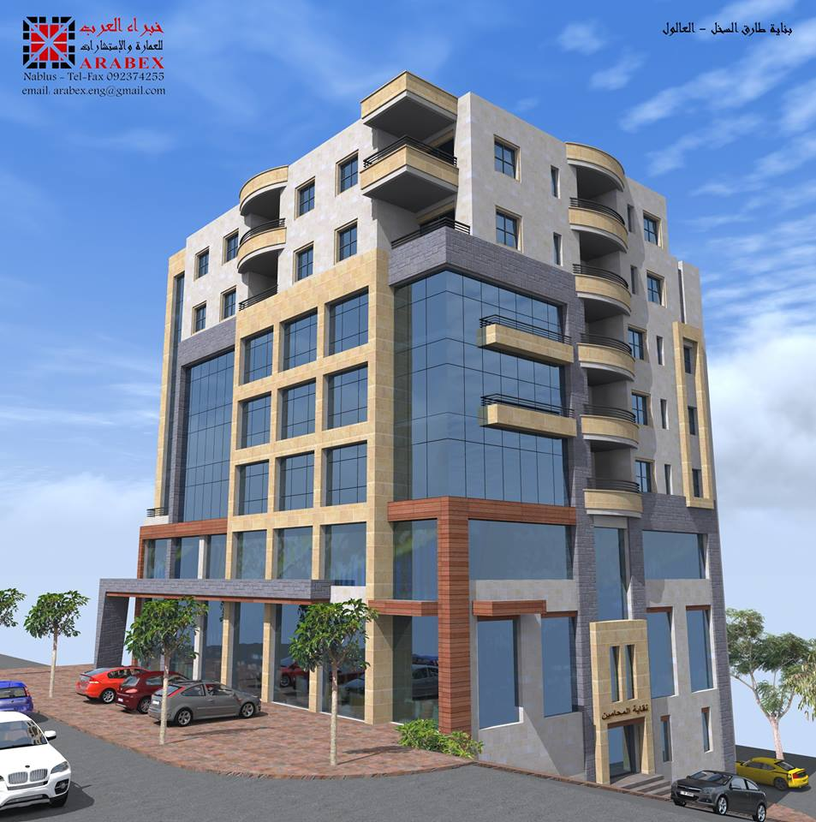

Slide 4
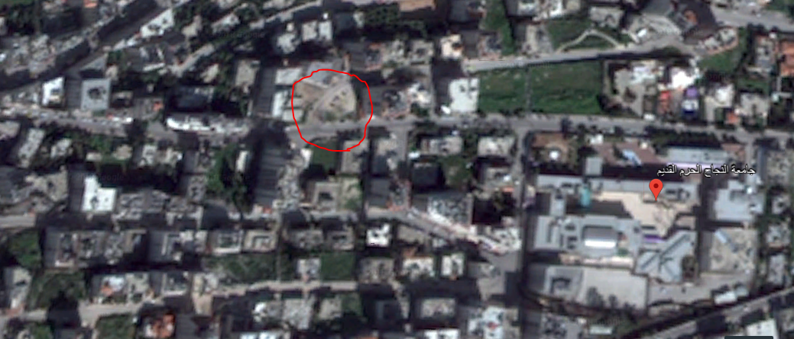
Location:
The project addresses is the analysis and design of Tareq Al-Alool building (5500 m²) located in Nablus.

Slide 5
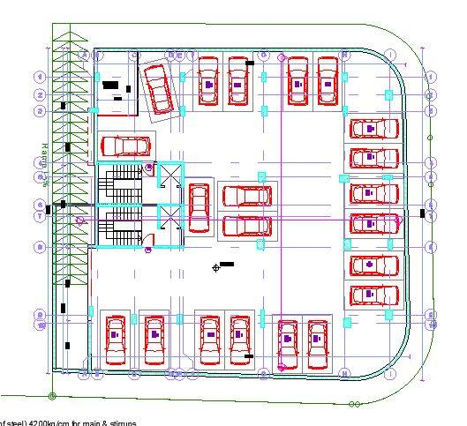
Basement floor

Slide 6
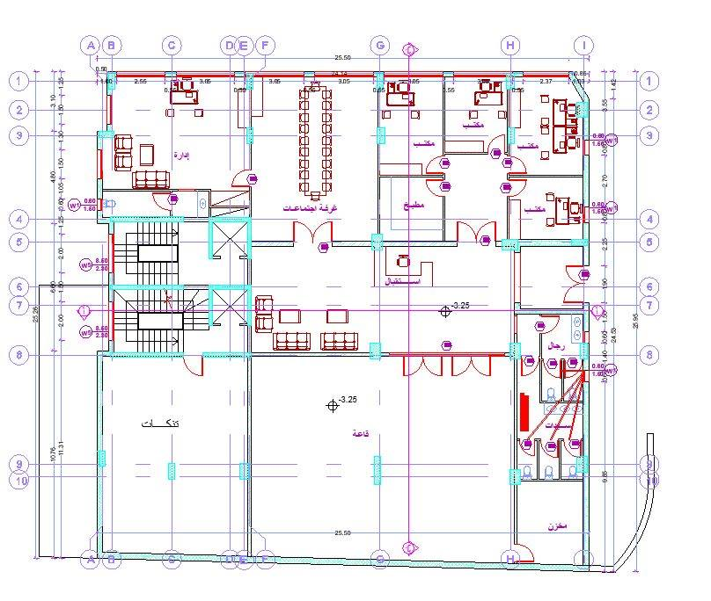
Ground floor

Slide 7
1st floor

Slide 8
Floors, functions areas and heights
Floor number | Function | Summation of Areas (m2) | Height of floors(m)
Basement (B3) | Parking, | 660 | 3.25
Basement(B2,B1) | Stores | 1115 | B2=3.25 B1=3.5
floors(GF,F1,F2,F3,F4) | Offices | 2240 | GF = 4.5 Floors=3
floors (F5,F6) | Apartments | 810 | 3
Sixth floor roof(F6) | Apartment | 55 | 3

Slide 9



What we do in GP 11?
Gravity Load
Dead
Superimposed
Live

Slide 10
    Concrete:
Unit weight of reinforced concrete = 25 kN/m³
Materials:
Structural element | Fc` (MPs) | Concrete type | Modulus of elasticity(MPs)
Beams, slabs , stairs | 24 | B300 | 23000
Mat, columns, shear walls | 28 | B350 | 24900
Reinforcement steel:
Yielding strength (Fy) = 420MPa.
Modulus of elasticity (Es) = 200GP

Slide 11
.
Soil properties:
Soil investigation indicated that the
bearing capacity of the soil is 250 KN/m2.

Slide 12
Loads :
Loads
Gravity
Lateral
Dead
Live
Earthquake

Slide 13
  Load:
13
Dead Load:
  Slab one way ribbed = 3.63 KN/ m2
  Slab two way ribbed =4.82 KN/m2
  Superimposed dead load= 4 KN/m2
Live load:
In this project, a live load of 2.5 kN/m² will be used for Garage and 5 kN/m² for corridors and floors according to IBC 2015

Slide 14
  Load combinations:
  According to the "ACI 318-2011 , the load factors that are used in the analysis and design are:
Load combinations:
U = 1.4D
U = 1.2D + 1.6L
U = 1.2D + 1.6L + 0.5(Lr or S or R)
U = 1.2D + 1.6(Lr or S or R) + (1.0L or 0.5W)
U = 1.2D + 1.0W + 1.0L + 0.5(Lr or S or R)
U = 1.2D + 1.0E + 1.0L + 0.2S
U = 0.9D + 1.0W
U = 0.9D + 1.0E

Slide 15
  Computer programs:
  1) ETABS 2016: is used to analyze and design the structural elements.
  2) Sap 2000 for design and checks some of structural elements .
  3) AutoCAD: is used for plans and draw structural detailing.
  4) Other programs such as Excel and word.

Slide 16
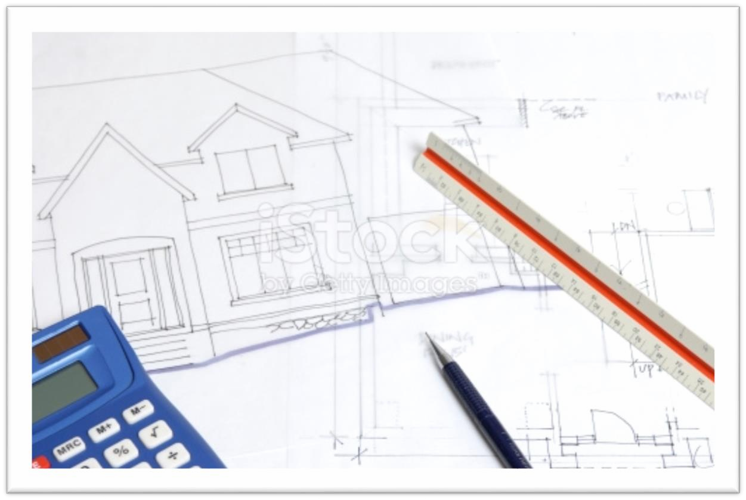
Preliminary design for building:

Slide 17
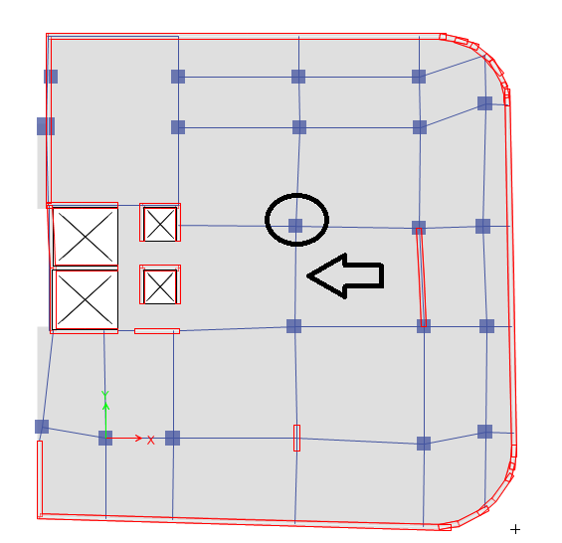
Slab :

Slide 18
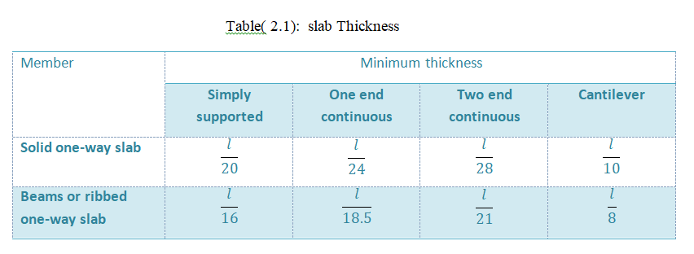
For two end continuous ribbed slab thickness of slab h=span length/21
Ribbed slab thickness = 6.75 m/21 = 32 cm

Slide 19
2. Beam Dimensions :
After making checks, the final beam dimensions are shown in this table:
Beam | Dimensions(mm2)
main beams B2 | 320×1000
secondary beams B1 | 320×350

Slide 20
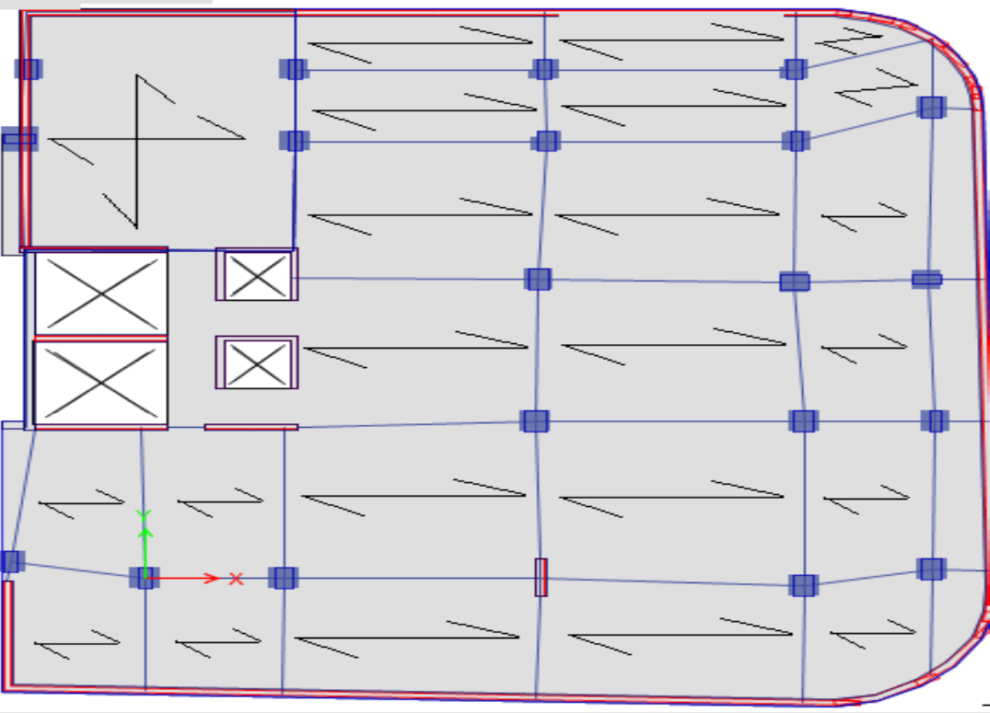

Slide 22
3. Column Dimensions :
Critical column is shown below in figure below:

Slide 23
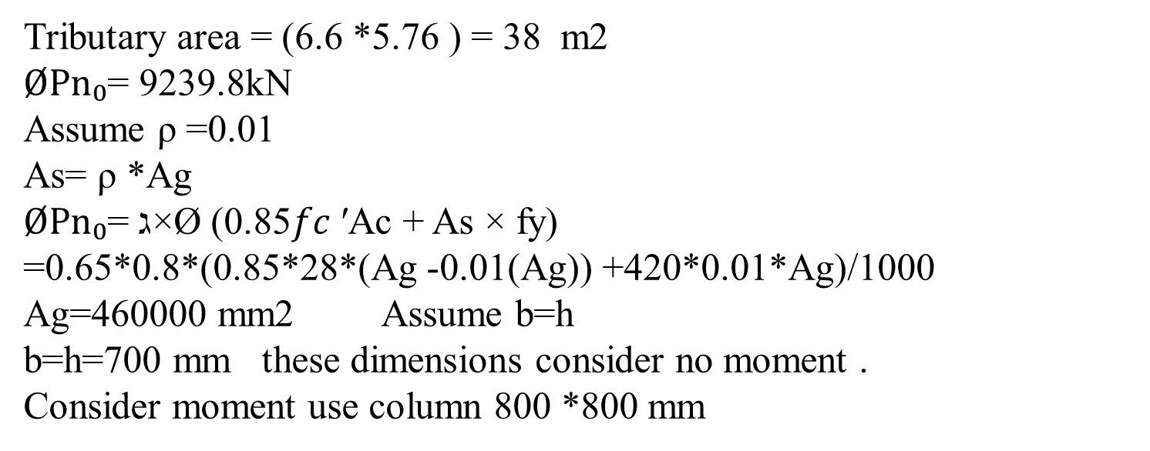
By using tributary area method,
Tributary area = (6.6 *5.76 ) = 38 m2
$ØPn₀$= 9239.8kN
Assume ρ =0.01
As= ρ *Ag
$ØPn₀$= ג×Ø (0.85𝑓𝑐 ′Ac + As × fy)
=0.65*0.8*(0.85*28*(Ag -0.01(Ag)) +420*0.01*Ag)/1000
Ag=460000 mm2 Assume b=h
b=h=700 mm these dimensions consider no moment .
Consider moment use column 800 *800 mm

Slide 24
Columns dimensions are shown in table:
 | Original dimensions (mm)
C1 | 800*800
C2 | 600*600
C3 | 1000*1000

Slide 25
Shear Wall
Wall | Thickness (mm)
Wall 1 | 200
Wall 2 | 250
Wall 3 | 300

Slide 26
Modifiers for area structural element
Modifiers/Section | Slab | Shear walls
Membrane f11 Direction | 1 | 1
Membrane f22 Direction | 1 | 1
Membrane f12 Direction | 1 | 1
Bending m11 Direction | 0.25 | 0.7
Bending m22 Direction | 0.25 | 0.7
Bending m12 Direction | 0.25 | 0.7
Shear v13 Direction | 1 | 1
Shear v23 Direction | 1 | 1
Mass | 1 | 1
Weight | 1 | 1

Slide 27
Modifiers for frame structural element
Modifiers/Section | beams | Columns
Cross Section(axial) Area | 1 | 1
Sheer Area in 2 direction | 1 | 1
Sheer Area in 3 direction | 1 | 1
Torsional Constant | 0.35 | 0.7
Moment of Inertia about 2 axis | 0.35 | 0.7
Moment of Inertia about 3 axis | 0.35 | 0.7
Mass | (Depth-200)/200 | 1
Weight | (Depth-200)/200 | 1
.

Slide 28
DYNAMIC ANALYSIS
  Response Spectrum Analysis
Modes and Period
Drift Check

Slide 29
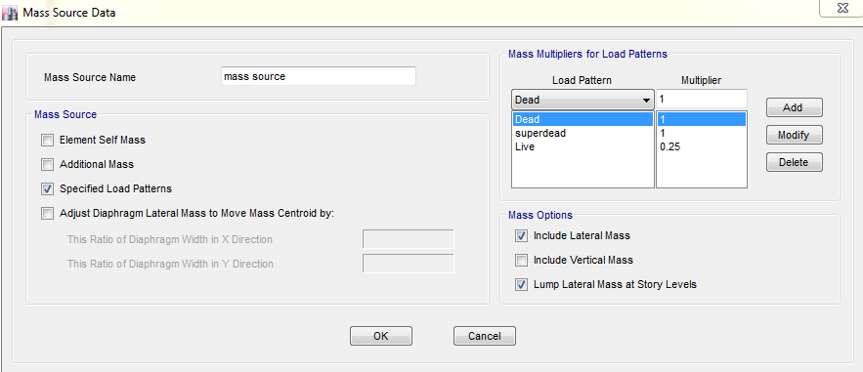
Definition of mass resource

Slide 30
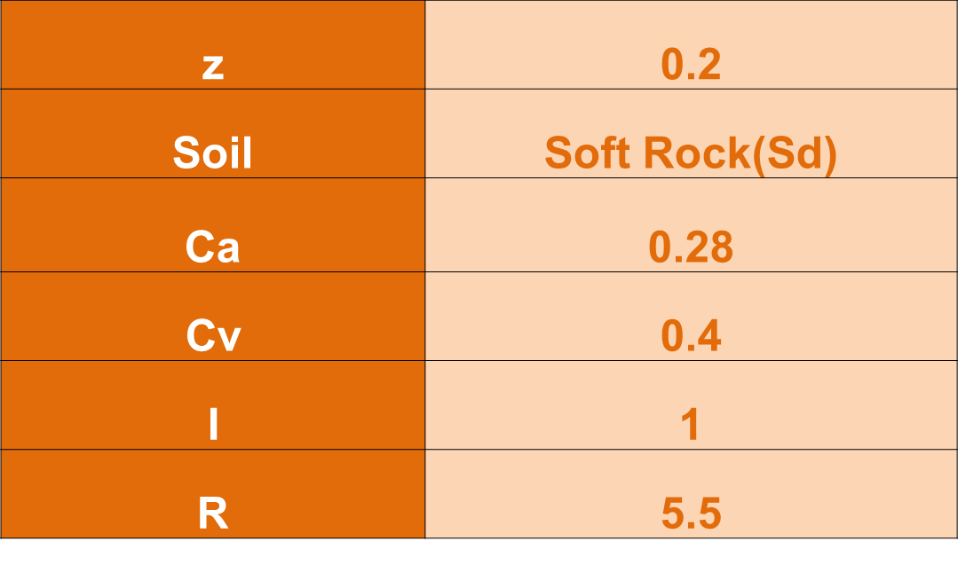
Seismic Parameters

Slide 31
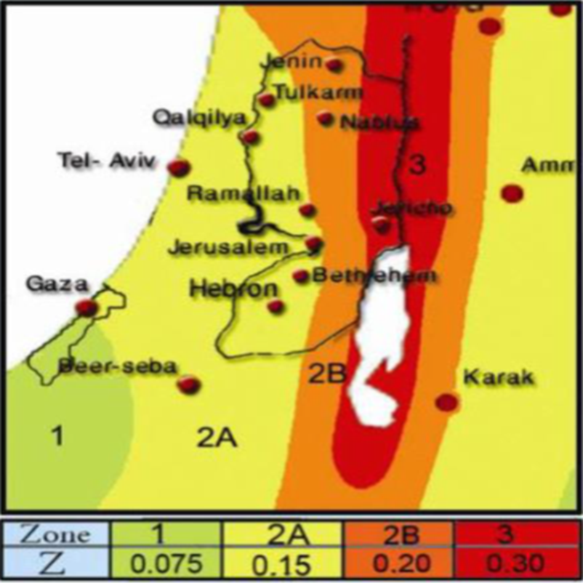
Seismic Zone Factor Z

Slide 32
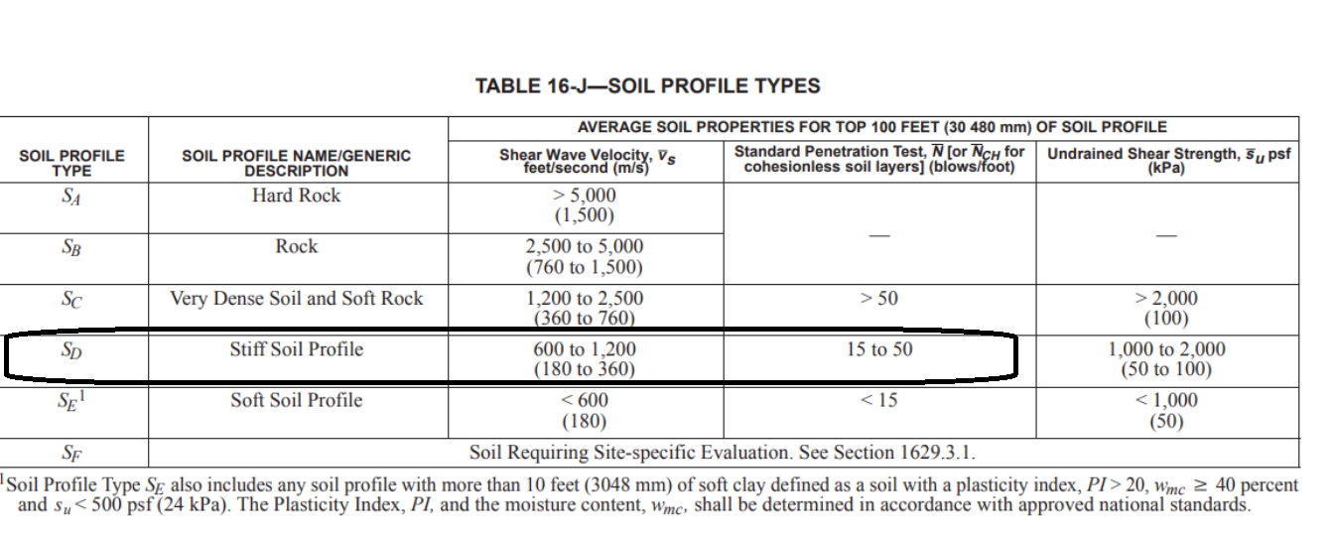
Site Classification Sd

Slide 33
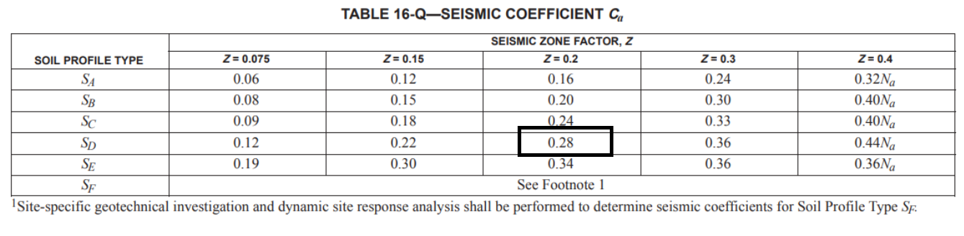
Seismic Coefficient Ca

Slide 34
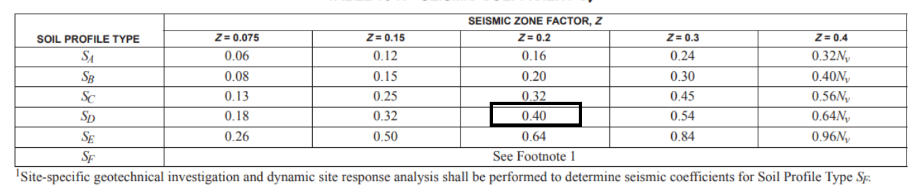
    Seismic Coefficient Cv

Slide 35
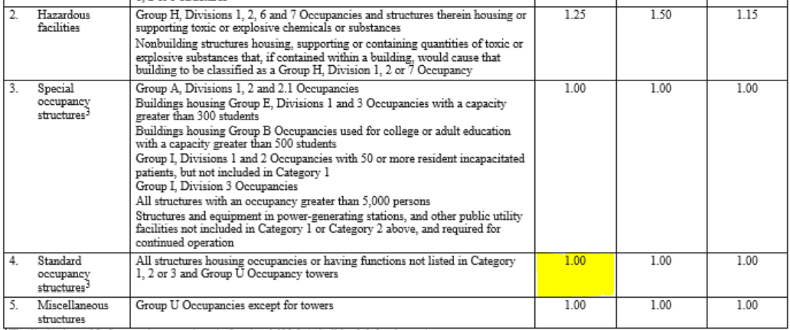
Seismic Importance Factor I

Slide 36
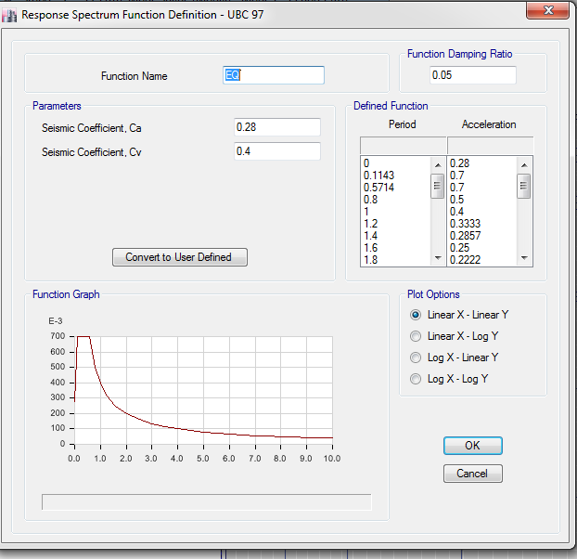
Define Of Response Spectrum Function

Slide 37
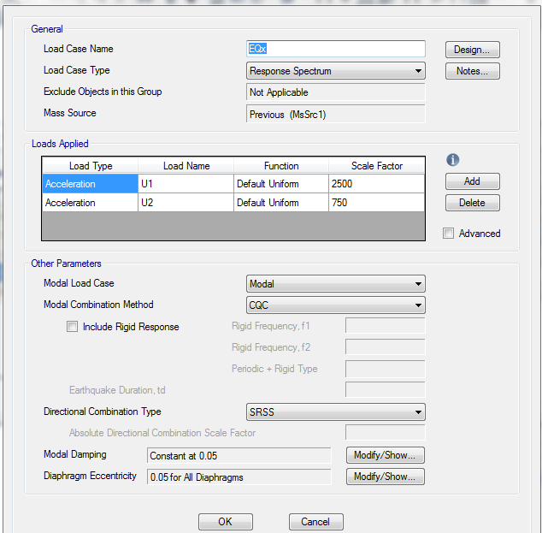
Response Spectrum In X-Direction

Slide 38
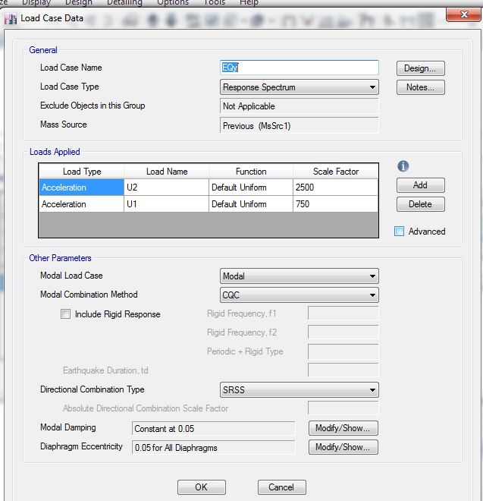
Response Spectrum In Y-Direction

Slide 39
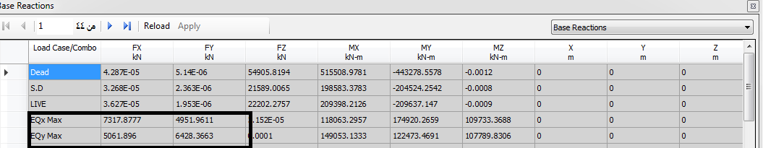
Check Base Shear

Slide 40
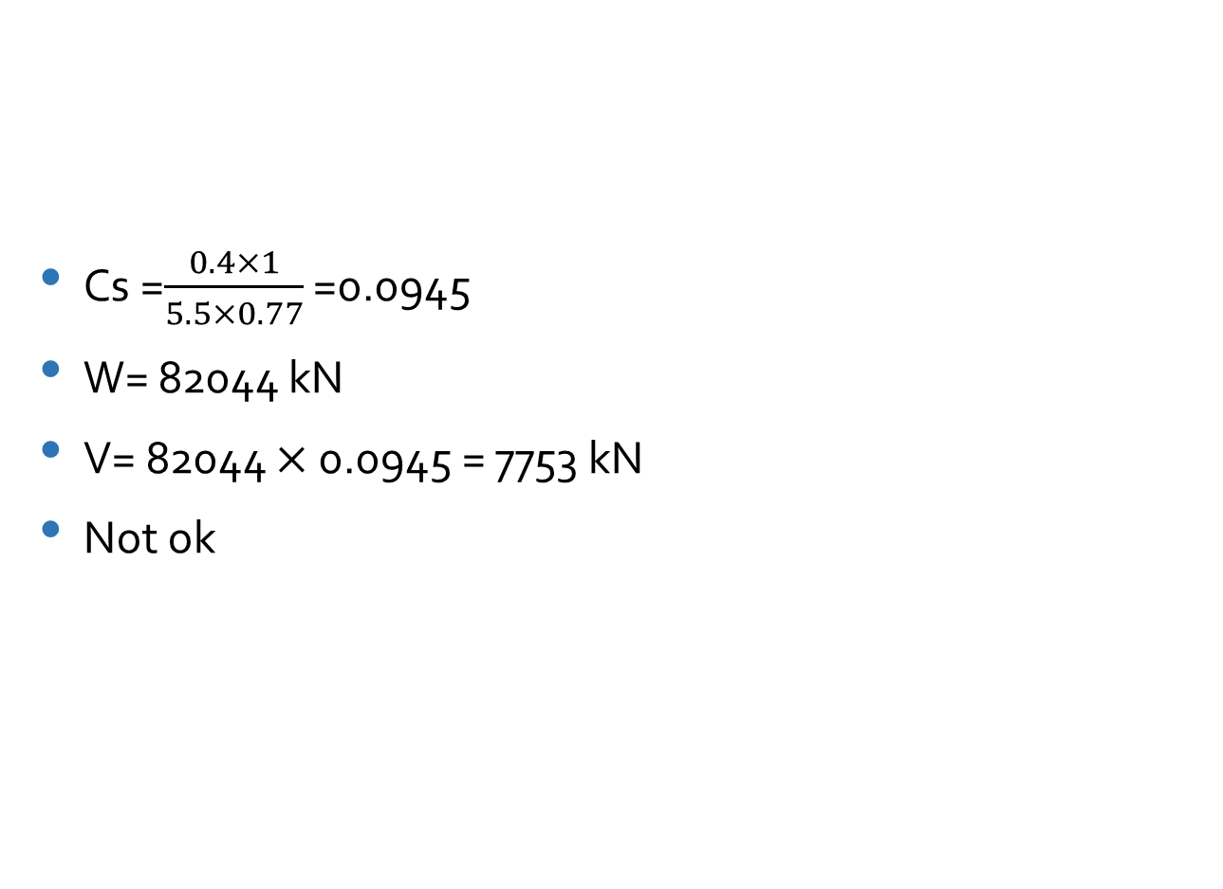
Cs =$\frac{0.4×1}{5.5×0.77}$ =0.0945
W= 82044 kN
V= 82044 $×$ 0.0945 = 7753 kN
Not ok

Slide 41
After increase scale factor the value become large than V

Slide 42
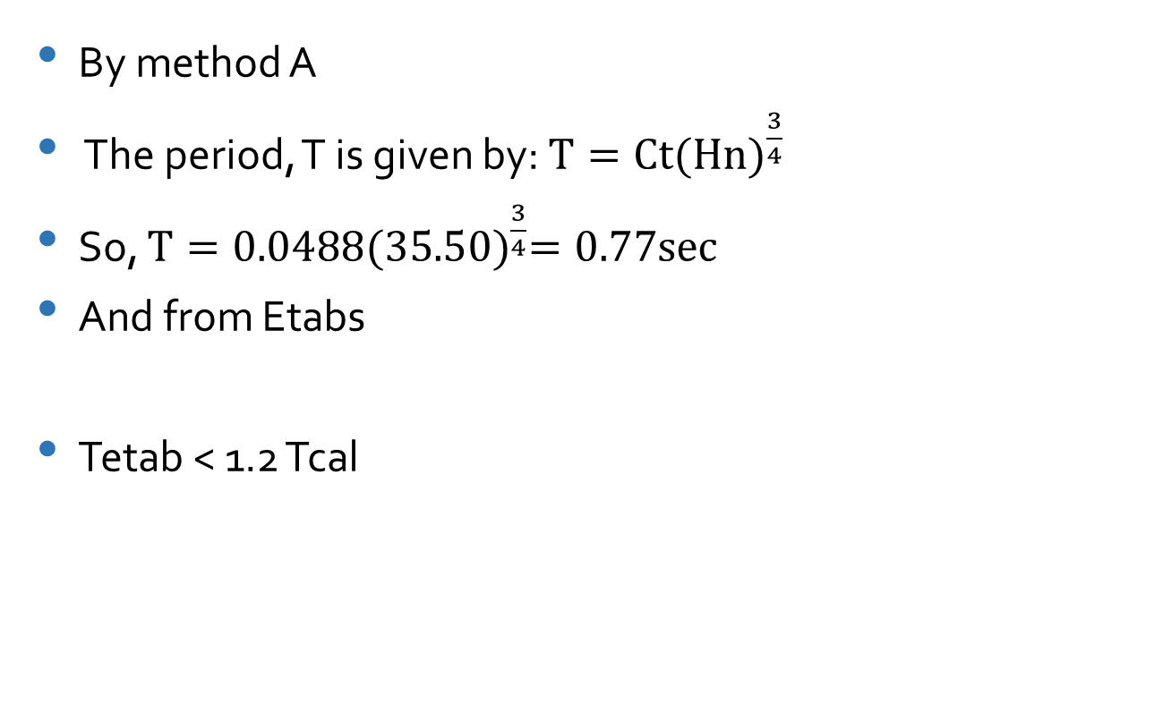
Check period
By method A
The period, T is given by: $T=Ct{(Hn)}^{\frac{3}{4}}$
So, $T=0.0488{(35.50)}^{\frac{3}{4}}=0.77sec$
And from Etabs
Tetab < 1.2 Tcal
Period in mode 1 → T= 0.74 sec.

Slide 43
Checks
Model check
Deflection check
Structural period T check
Stress strain check
Equilibrium check

Slide 44
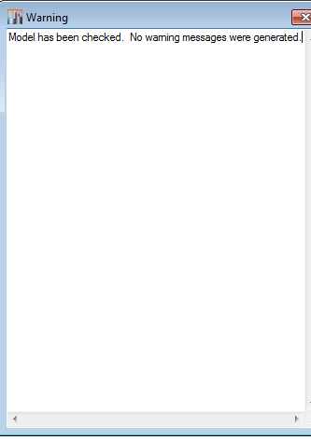
Model check

Slide 45
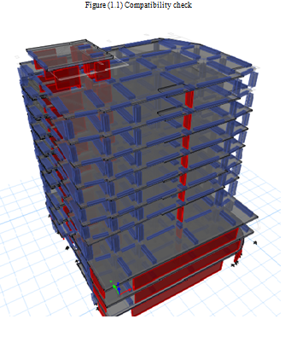
compatibility check

Slide 46
  Equilibrium check
Type | ETABS results (KN) | Hand calculation (KN) | Error%
Live | 22200 | 22182 | 0
Superimposed | 21588 | 21574 | 0
Dead | 55643 | 54811 | 0

Slide 47
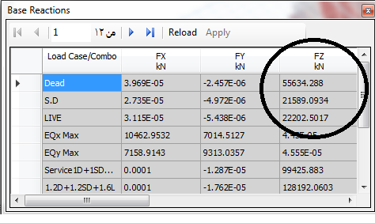

Slide 48
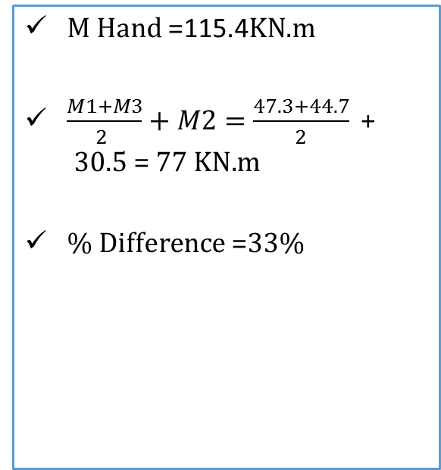
Stress strain check
We made the internal force check from live load for this beam as following in the figure:
M Hand =115.4KN.m
$\frac{M1+M3}{2 }+M2=\frac{47.3+44.7}{2}\text{ + }\text{30.5} \text{= }\text{77} \text{KN}\text{.}\text{m}$
% Difference =33%

Slide 49
Stress strain check
We made the internal force check from live load for this coulmn as following in the figure:
D= (-From hand:
D= (37.46*2.5*3)+(37.46*5*7)=1592KN
1564 KN
Error 0 < 10 % OK

Slide 50
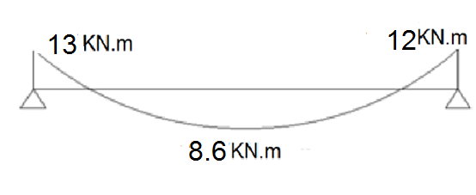
Stress strain check
We made the internal force check from SD load for slab as following in the figure:
-From hand:
SD =𝑊𝑢×𝑙2/8=(4×6.45^2)/8=20KN.𝑚
From Etab
-(M1 + M2)/ 2 + M3 =(13+12.2)/2 + 8.6= 21.5KN.m.
Error 5 % < 10 OK

Slide 51
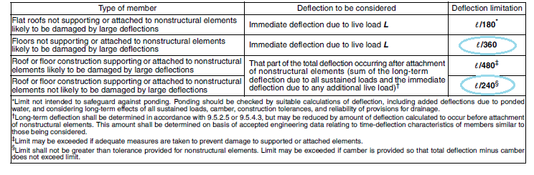
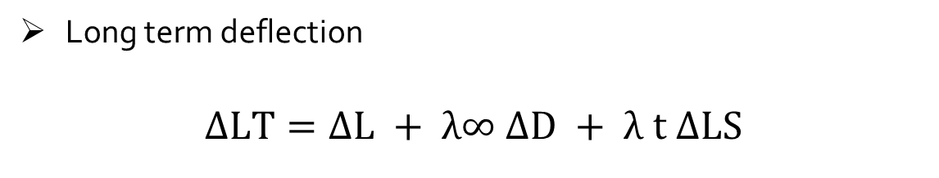
Deflection check
ACI code limitations on immediate and long term deflections
Long term deflection
$$ΔLT=ΔL + λ∞ ΔD + λ t ΔLS$$

Slide 52
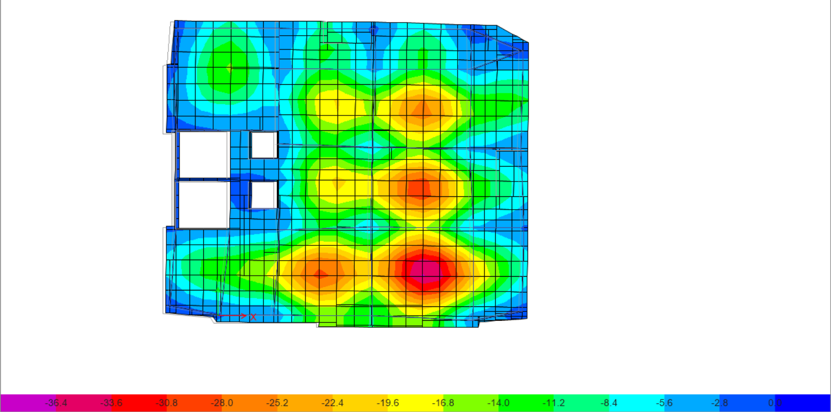
Deflection check
immediate term deflection for ribbed slab :
Maximum deflection (Uz) = 22.8-(AVG OF (2.5, 3.56,2.8, 3.9))
=19.61 mm
𝐴𝑙𝑙𝑜𝑤𝑎𝑏𝑙𝑒 𝑑𝑒𝑓𝑙𝑒𝑐𝑡𝑖𝑜𝑛 = 𝐿 /240
=(7.25∗ 1000)/ 240
= 30.2 𝑚𝑚.
19.61 mm < 30.2 → Ok

Slide 53
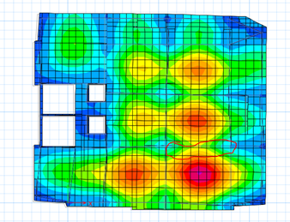
Deflection For Beam

Slide 54
For beam:
Allowable deflection=L / 240= (7.25 *1000)/240= 30.2 mm
Deflection from sap = 9.7- ((3.9+2.3)/2) = 6.6 mm

Slide 55
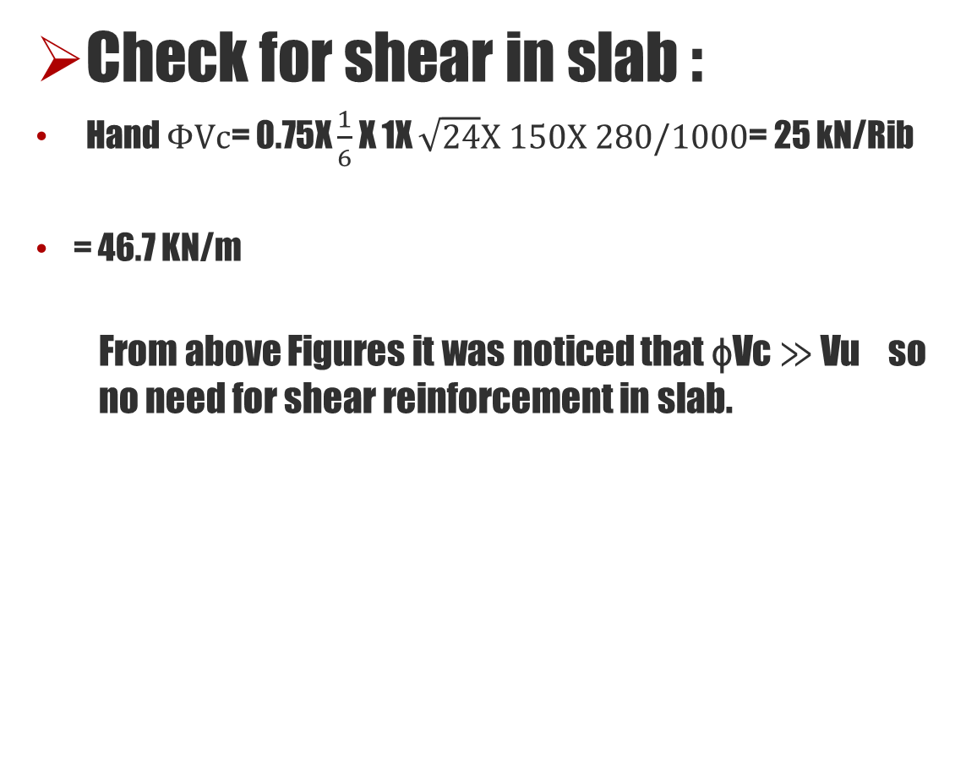
Check for shear in slab :
Hand $ΦVc$= 0.75X $\frac{1}{6}$ X 1X $\sqrt{24}X 150X 280/1000$= 25 kN/Rib
= 46.7 KN/m
  From above Figures it was noticed that ɸVc ≫ Vu so no need for shear reinforcement in slab.

Slide 56
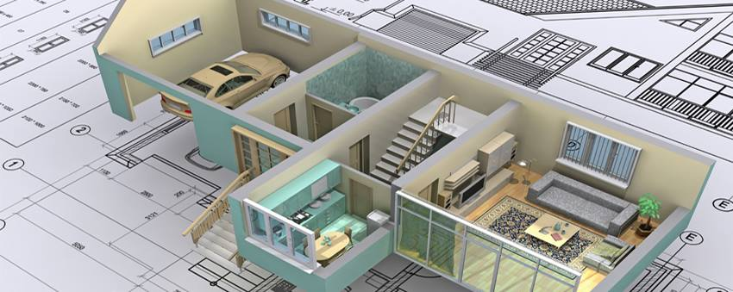
    DESIGN Design of element for flexure

Slide 57
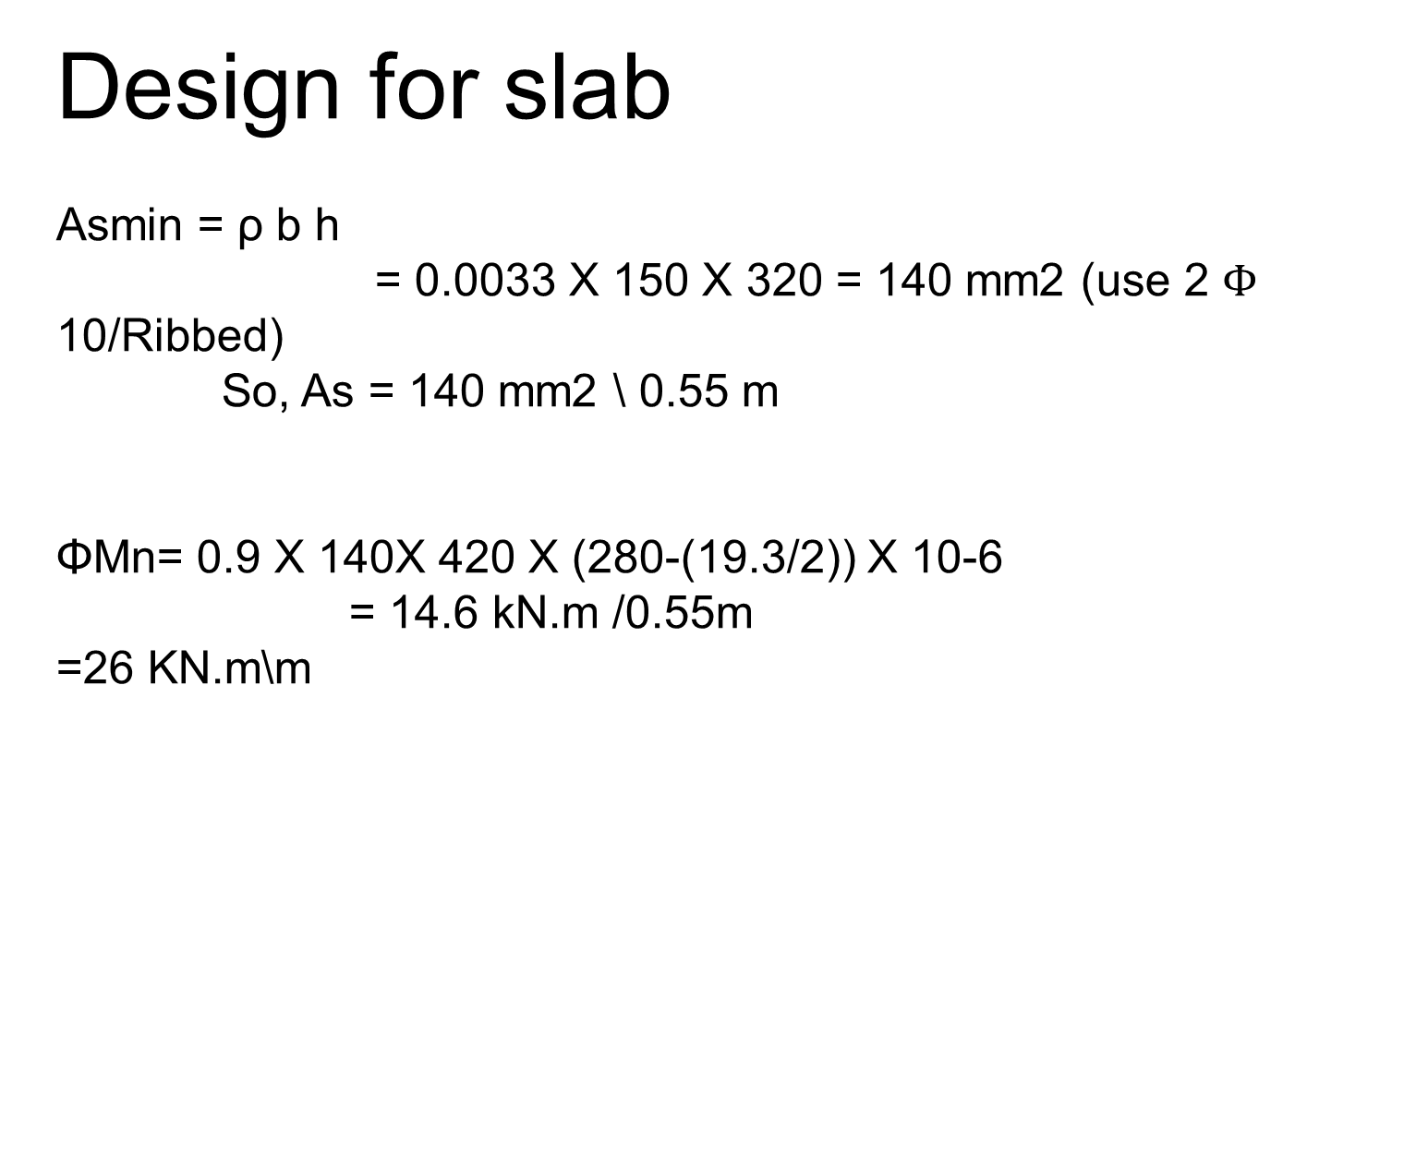
Design for slab
Asmin = ρ b h
= 0.0033 X 150 X 320 = 140 mm2 (use 2 $Φ$ 10/Ribbed)
So, As = 140 mm2 \ 0.55 m
ΦMn= 0.9 X 140X 420 X (280-(19.3/2)) X 10-6
= 14.6 kN.m /0.55m
=26 KN.m\m

Slide 58
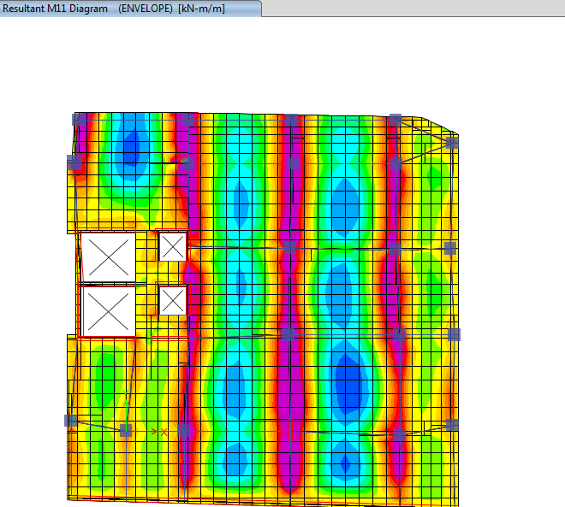
    Moment (11)→ bottom and top
    2φ10mm/ribbed mm for top steel

Slide 59
Design for coulmn
From ETABS we found:
The axial force in column =548 kN
M₁₁=113kN.m
M₂₂=195kN.m
At first we will check the slenderness effect (KL/r):

Slide 60
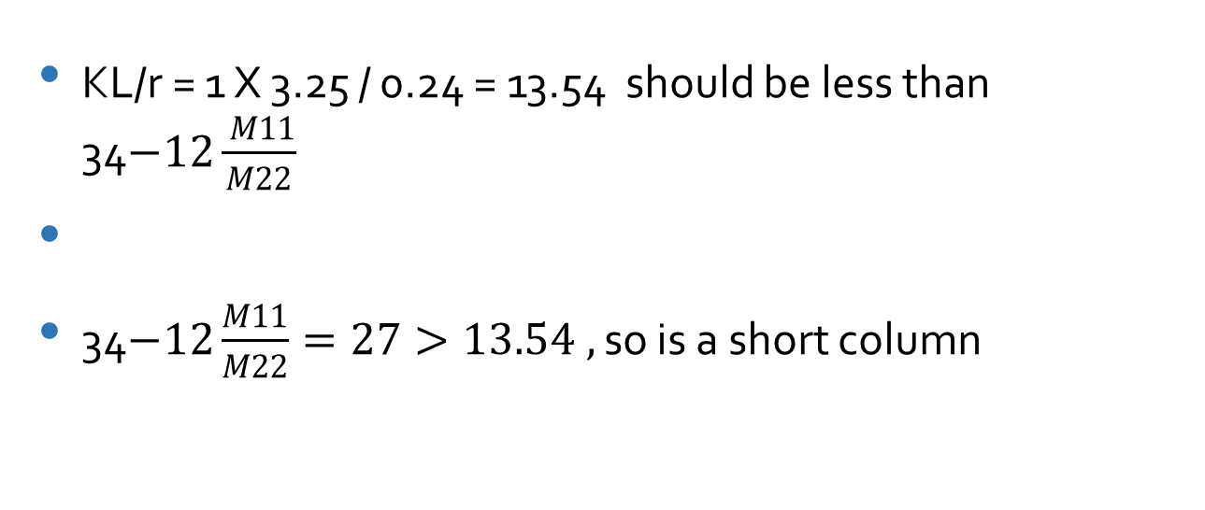
KL/r = 1 X 3.25 / 0.24 = 13.54 should be less than 34$−12\frac{ M11}{M22}$
34$−12\frac{M11}{M22}=27>13.54 ,$so is a short column

Slide 61
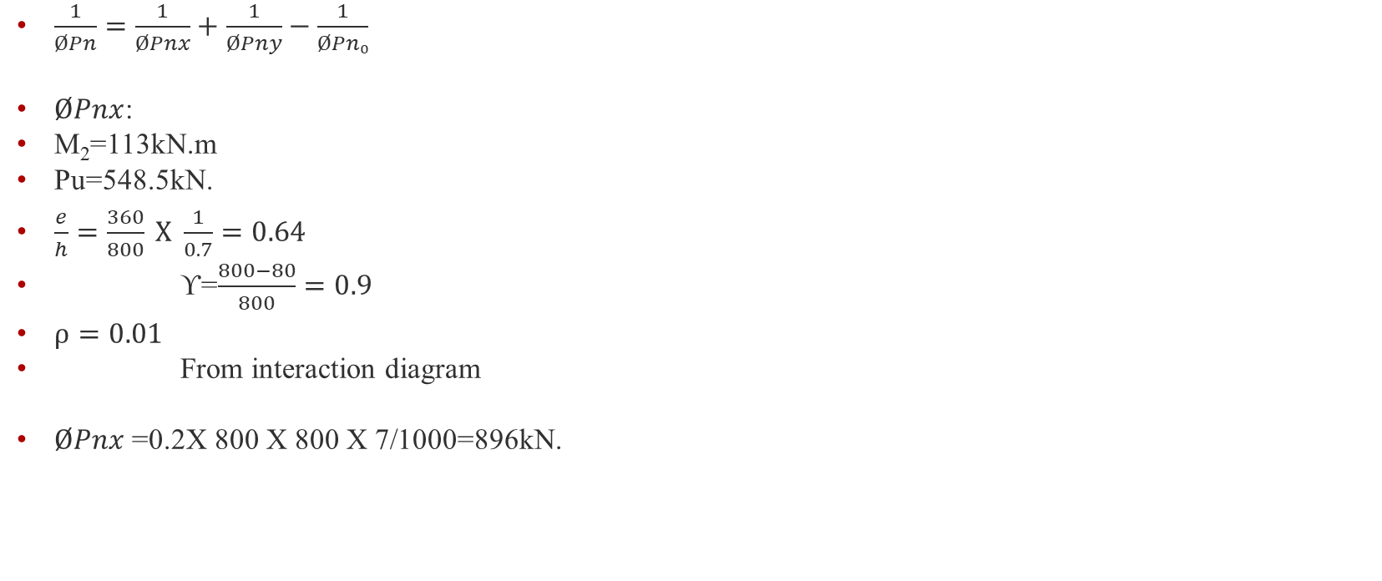
$\frac{1}{ØPn}=\frac{1}{ØPnx}+\frac{1}{ØPny}−\frac{1}{ØPn₀}$
$ØPnx$:
M₂=113kN.m
Pu=548.5kN.
$\frac{e}{h}=\frac{360}{800} X \frac{1}{0.7}=0.64$
ϒ=$\frac{800−80}{800}=0.9$
$ρ=0.01$
From interaction diagram
$ØPnx$=0.2X 800 X 800 X 7/1000=896kN.

Slide 62

$ØPny$:
=1254
Pn>Pu
As=0.01$×$800$×$800=6400mm²(17Ø22)

Slide 63
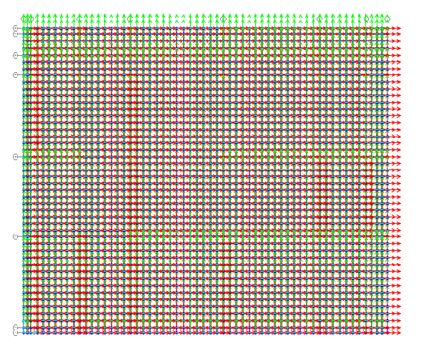
Design for matt foundation

Slide 64
Checks:
Bearing capacity of soil
maximum spring load = 40
Bearing capacity = 40/0.5*0.5 = 160 < 250 K.n/m2 ok

Slide 65

Shear capacity check(punching):
Vu = pu – q (critical section )
$V_{c}=\frac{1}{3}$ $\sqrt{f^{′}}c$ bd
Vu = 4954
Vc = 6773
VC>VU Check is ok

Slide 66
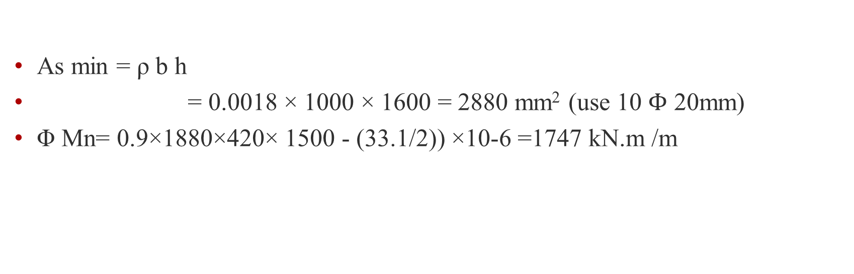
Slab Moment and Area of steel
As min = ρ b h
= 0.0018 × 1000 × 1600 = 2880 mm² (use 10 $Φ$ 20mm)
Φ Mn= 0.9×1880×420× 1500 - (33.1/2)) ×10-6 =1747 kN.m /m

Slide 67
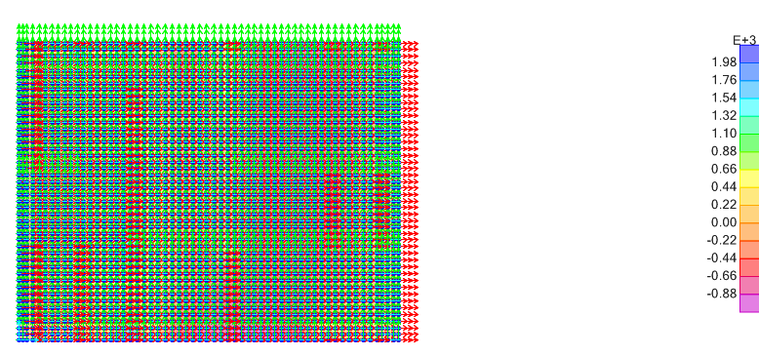

All value is less than 1747 K.n/m in both m11 & m22
The reinforcement is 10 $Φ$ 20mm/m

Slide 68
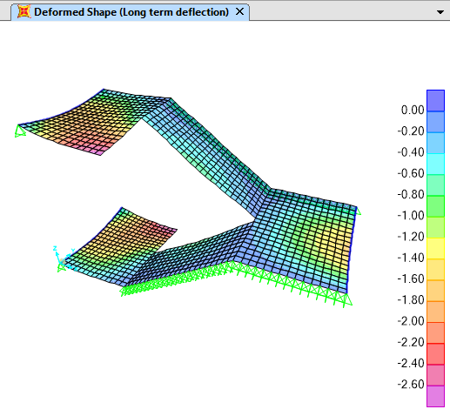
Design of stairs:

Slide 69
Deflection shape

Slide 70
Based on the long term deflection, max. immediate deflection from SAP2000, ∆ =2.7 mm
Deflection limitation:
𝑎𝑙𝑙𝑎𝑤𝑎𝑏𝑙𝑒 𝐿𝑜𝑛𝑔 𝑡𝑒𝑟𝑚, ∆𝐿 ≤ 𝑙 /240 = 2700/240= 11.25 mm
The long term deflection from SAP found approximately 2.7 mm, which means that is smaller than the allowable deflection → OK

Slide 71
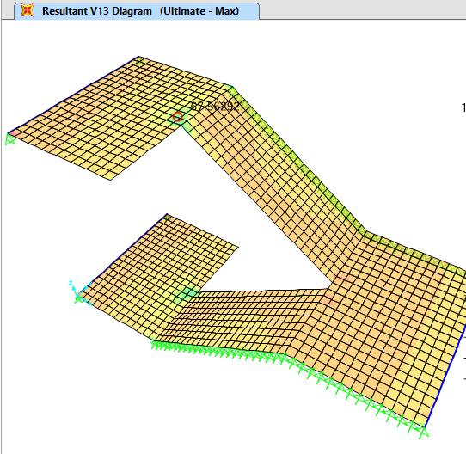
Check for shear:
Vu13 and Vu23 from SAP analysis = 67 kN and 62 kN respectively.

Slide 72
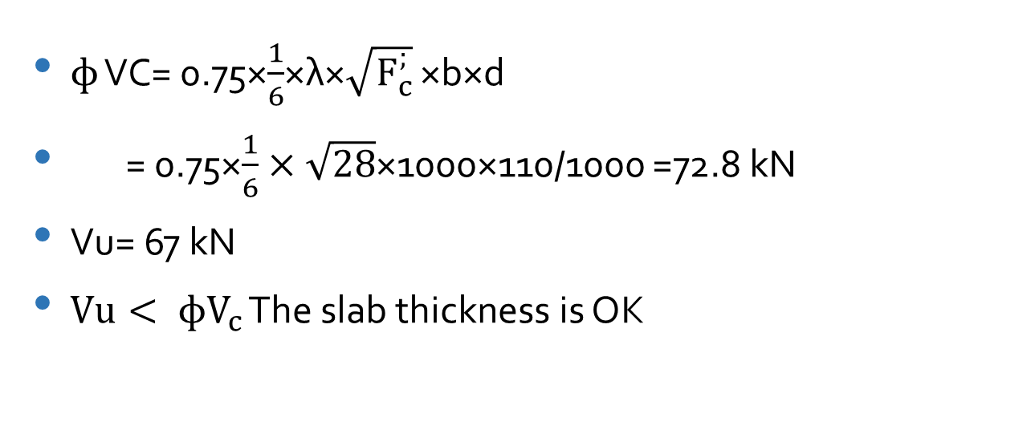
$ɸ$ VC= 0.75×$\frac{1}{6}$×λ×$\sqrt{F_{c}^{;}}$ ×b×d
= 0.75×$\frac{1}{6}×\sqrt{28}$×1000×110/1000 =72.8 kN
Vu= 67 kN
$Vu< ɸV_{c}$ The slab thickness is OK

Slide 73
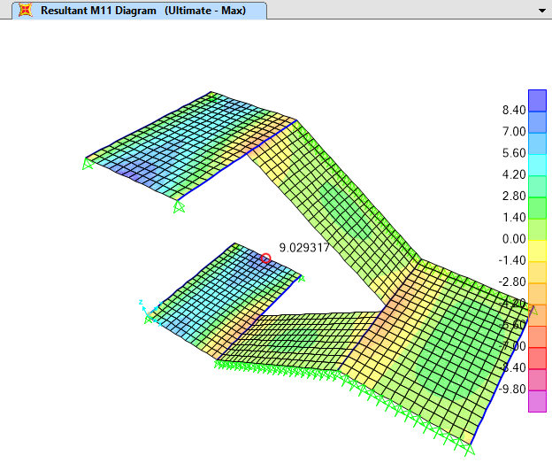

Design for flexural:
$M_{u11}$ and $M_{u22}$ from landing analysis by SAP2000 = 9 , 10.6 kN.m respectively.

Slide 74
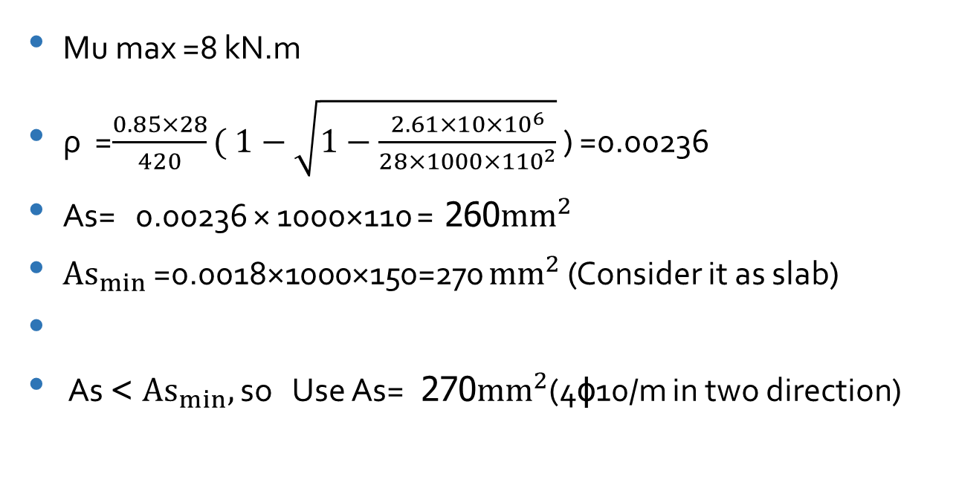
Mu max =8 kN.m
ρ =$\frac{0.85×28}{420}( 1−\sqrt{1−\frac{2.61×10×{10}^{6}}{28×1000×{110}^{2}}}$ ) =0.00236
As= 0.00236 × 1000×110 =260 ${mm}^{2}$
${As}_{min}$ =0.0018×1000×150=270 ${mm}^{2}$ (Consider it as slab)
As >${As}_{min},$ so Use As= 270 ${mm}^{2}$(4ɸ10/m in two direction)

Slide 75
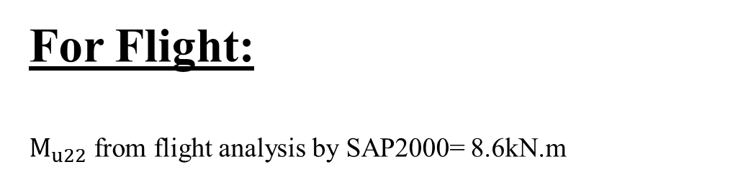
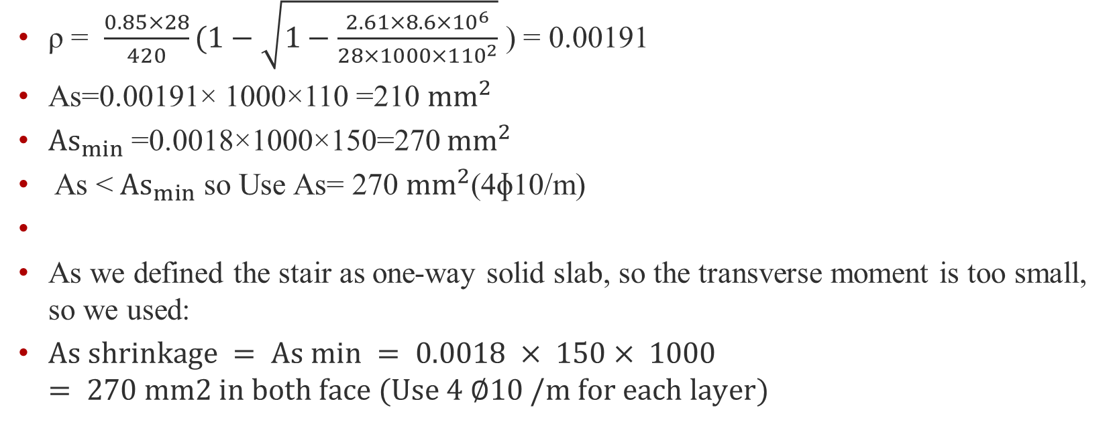
For Flight:
$M_{u22}$ from flight analysis by SAP2000=8.6 kN.m
ρ = $\frac{0.85×28}{420}(1−\sqrt{1−\frac{2.61×8.6×{10}^{6}}{28×1000×{110}^{2}}}$ ) = 0.00191
As=0.00191× 1000×110 =210 ${mm}^{2}$
${As}_{min}$ =0.0018×1000×150=270 ${mm}^{2}$
As <${As}_{min}$ so Use As= 270 ${mm}^{2}$(4ɸ10/m)
As we defined the stair as one-way solid slab, so the transverse moment is too small, so we used:
$As shrinkage = As min = 0.0018 × 150× 1000 = 270 mm2 in both face (Use 4 ∅10 /m for each layer)$

Slide 76


Design For Interior Panel (B12 ):
:
1-Parameters:
2-Steel Reinforcement:
Mu,max Positive = 120 kN.m >>> 6Ø16 mm.
Mu,max Nevative = 225 kN.m >>> 8Ø20 mm.
Vu = 242 kN >>> $2Φ10$ / 300 mm.
b (mm) | h (mm) | d (mm) | $fs$ (Mpa) | fy (Mpa)
1000 | 320 | 240 | 24 | 420

Slide 77

AutoCAD Details :

Slide 78

Design For Shear Wall (SW-3 ):

Slide 79
Notes:
5 internal ultimate forces can be computed; namely, P, Vx, Vy, Mx and My .
Design for V-y in a way similar to beams .
Design for M-y can be carried out by assuming there acts as Couple.
Design for P and Mx in a way similar to columns.
The stresses in the SW-3 are less than 0.1 F`c, there is no need for interaction diagram check.

Slide 80

Reinforcement For SW-3 :
A_{S min}=0.0025×b×h=0.0025*1000*300 >>> (1Ø12/200mm) on each side.
According to ACI315-04 section 2.10 these rules are following:
Transverse and Longitudinal rebar ratio shall be at least 0.0025
Spacing of reinforcement shall not exceed: $\left\{\begin{aligned}450 \\ 3h \\ \frac{lw}{5}\end{aligned}\right\}$mm.
h: the thickness of shear wall (300mm).
So the maximum spacing is 450 mm which is larger than 300 mm, so it is OK.

Slide 81
Reinforcement For SW-3 :
First : Add Two column to the shear wall , To minimize the moment on shear wall and make Minimum Reinforcement.
Second : Use General Reinforcement At Etabs Pier Design.

Slide 82
Shear Wall Results :
General Reinforcement:
Define General Reinforcement for Etabs using minimum Reinforcement ,But many Etabs alerts for moment and shear so we increase the Reinforcement.

Slide 83

Etabs Reinforcement Check Result :

Slide 84
Shear Wall Reinforcement Results :
 | Vertical reinforcement/m | As/2 | Reinforcement For wall | Horizontal reinforcement/m | Reinforcement For wall | Shear Reinforcement For wall | Vertical reinforcement For Column | Shear Reinforcement for Column
SW-3 | 1600 | 800 | 1φ12/130mm | 850 | 1φ18/200mm | 1φ12/200mm Use 1φ18/200mm | 1φ25/150mm | 2φ10/200mm

Slide 85

AutoCAD Details :

Slide 86
Thank you

