Slide 1



FLY CAR
Rent car & Order Taxi

Slide 2
Project Team
Rahaf Ahmad Rasheed Melhem
11821193
Seema Mohammed Abd-Alhameed Nassar
11820036
Supervisors:
Dr. Abdallah Rashed

Slide 3



Main Problem
Rent Car & Order Taxi
70%

Slide 4
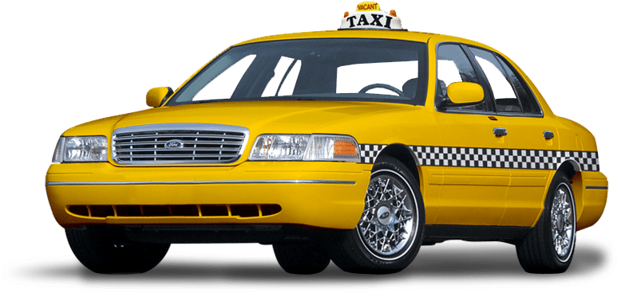
Project Objective:
The main goal is to facilitate people's lives by facilitating the transportation process and facilitating the process of renting cars at any time and from anywhere through our application
Hospital

Slide 5


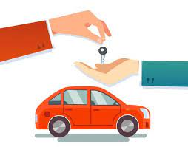



Who uses the Application?
Admin
User to order taxi
User to rent car

Slide 6
Human-centered design
01.Inspiration phase
02.Ideation phase
03.Implementation phase

Slide 7
01.Inspiration phase
Waiting for a long time for the taxi to arrive.
When visiting an area and not knowing the numbers of nearby taxi owners to communicate with them.
When a person comes from outside the country or moves to different governorates, he wants a rental company to rent a car from for specific days.

Slide 8


02.Ideation phase​
The most appropriate solution is an application that brings together a group of car rental companies available in more than one governorate, with the display of cars, their information, and the ability to rent them.
Showing the user's location and the location of taxis near him, with the driver's name and number available to communicate with him.

Slide 9




03.Implementation phase
1)Programming languages.
2)Testing the app.

Slide 10
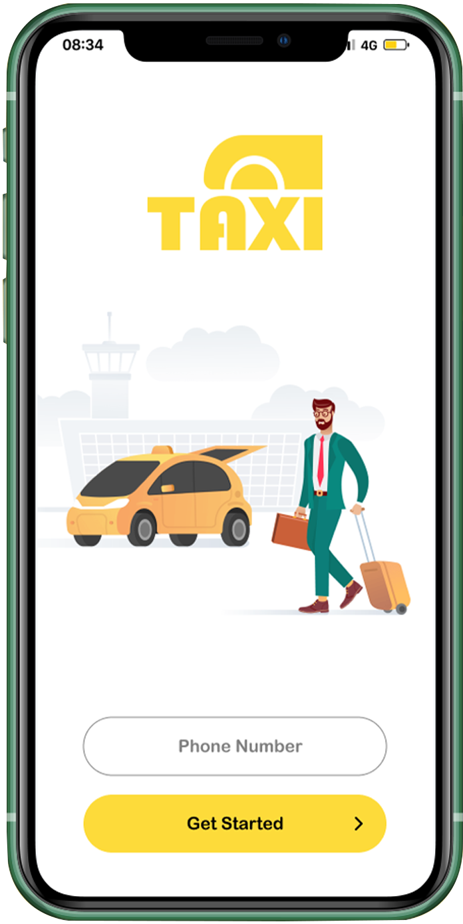

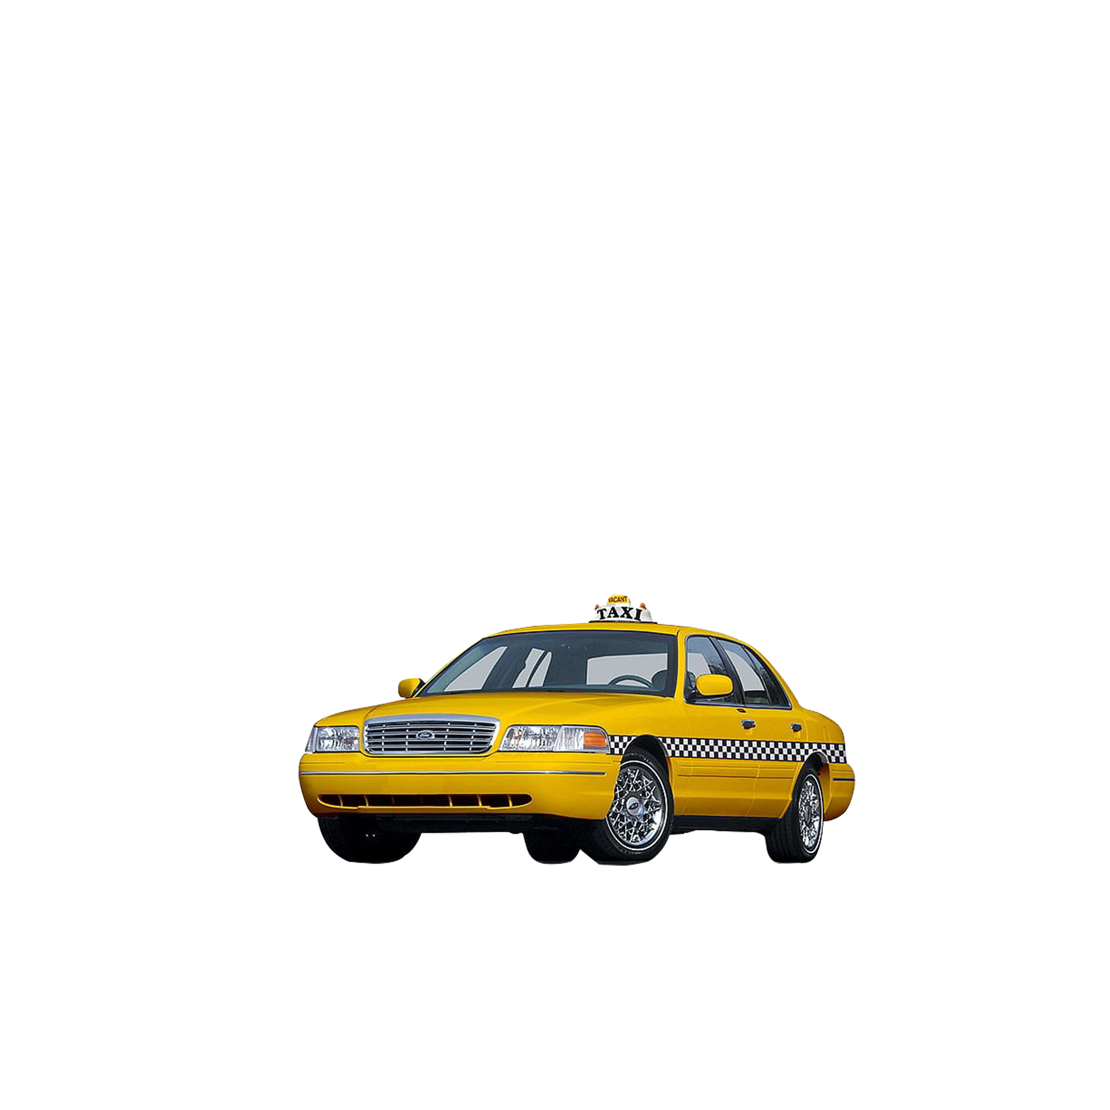
Arrow Timeline Features
01
04
Locating the user
Text message & Call
02
03
Add taxi locations on the map
See the nearest taxi through the K-nearest neighbour

Slide 11




Arrow Timeline Features
Car companies request to join the application and add or reject them.
Calendar to determine the number of reservation days.
The application filtered through the companies’ location, the name of the cars, the name of the companies, and the rental price per day.
Payment by credit card.

Slide 12
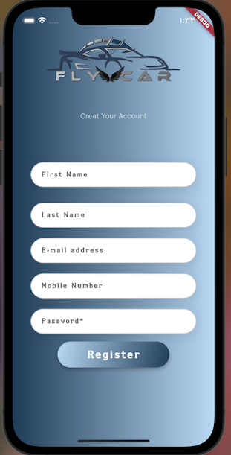
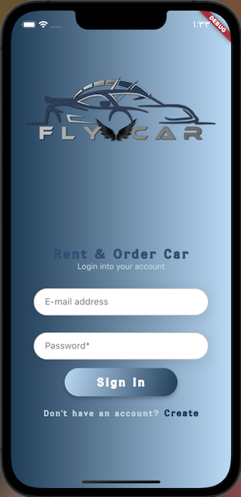
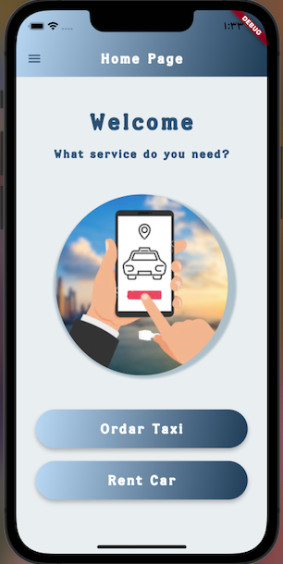
FLY CAR APPLICTION
Sign in
Home page
Order taxi
Register

Slide 13
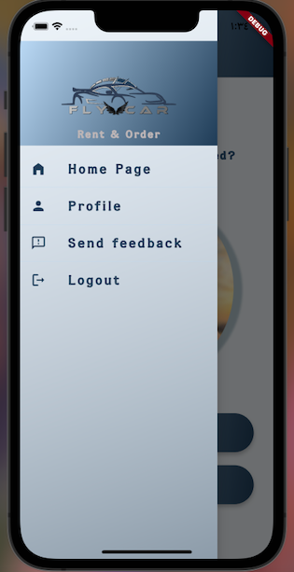
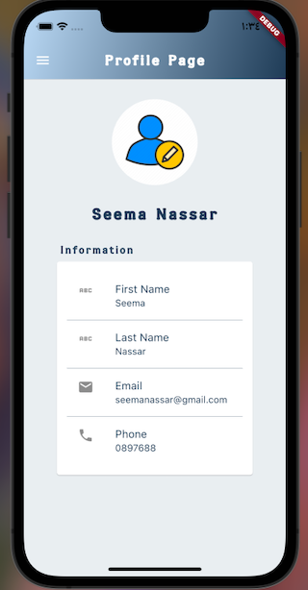
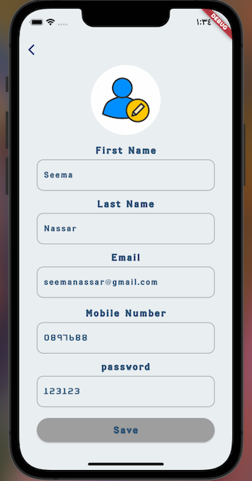
Profile page
Edit profile page

Slide 14
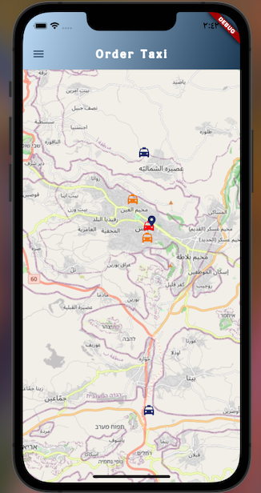
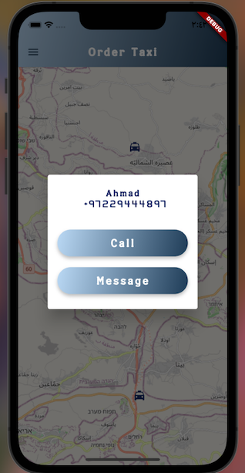
Taxi location & User location
Order taxi

Slide 15
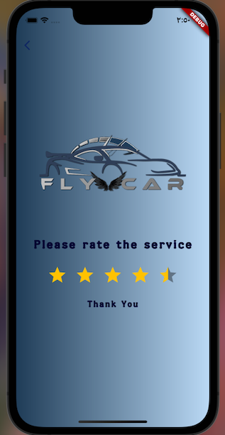
Rate the service
Home page rent car

Slide 16
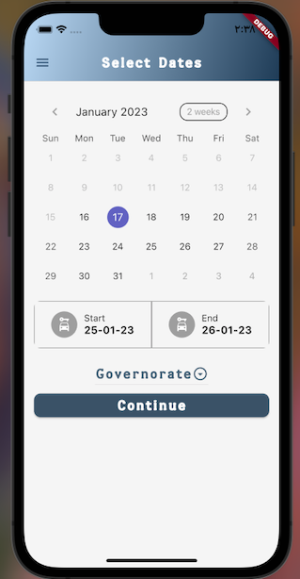
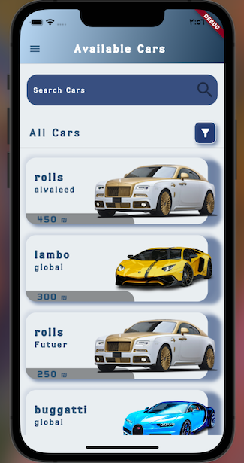
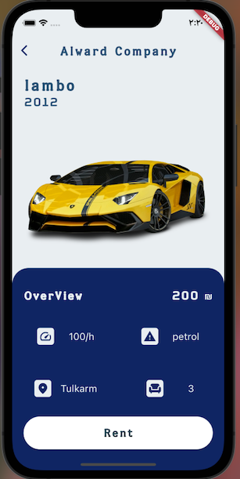
Calendar
All cars available at this time & search

Slide 17
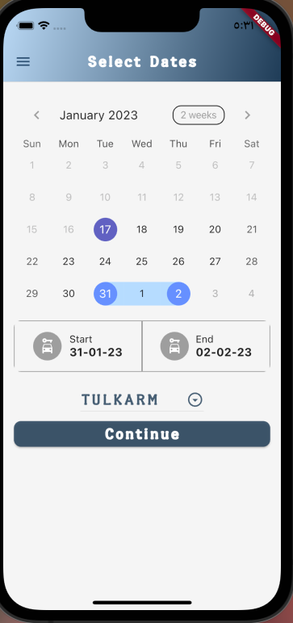
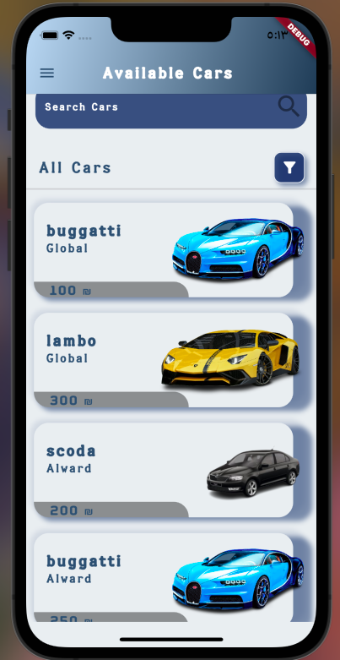
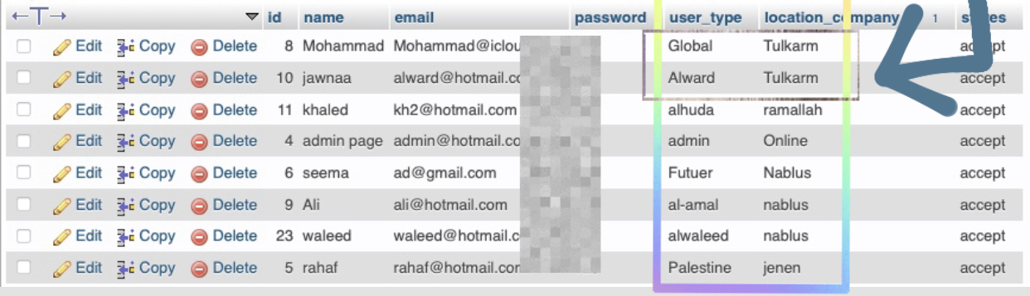
Date Test
Date Test Result1

Slide 18
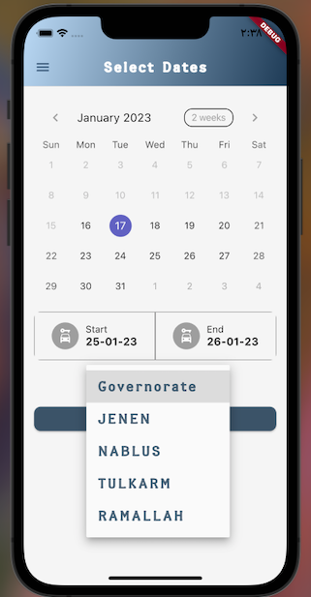
Filter by company location

Slide 19
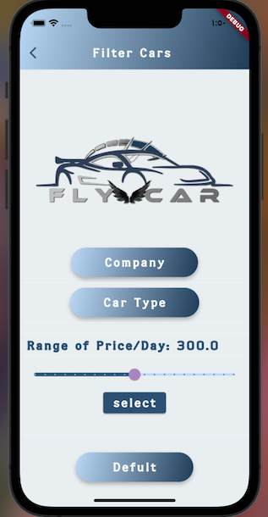
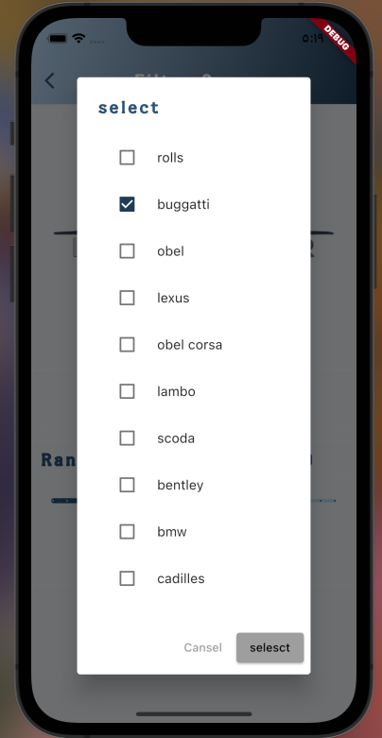
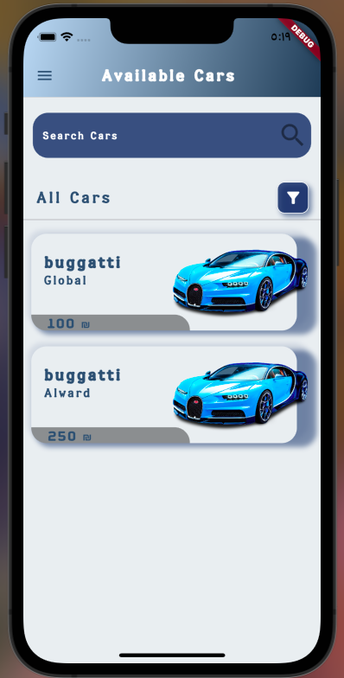
Filter by
Car name
Filter car Result

Slide 20
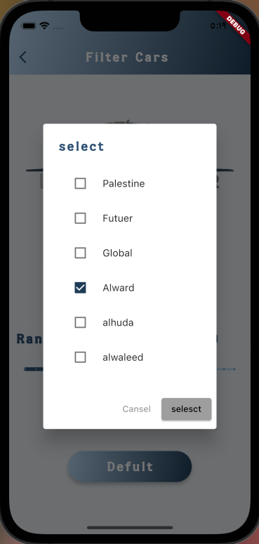
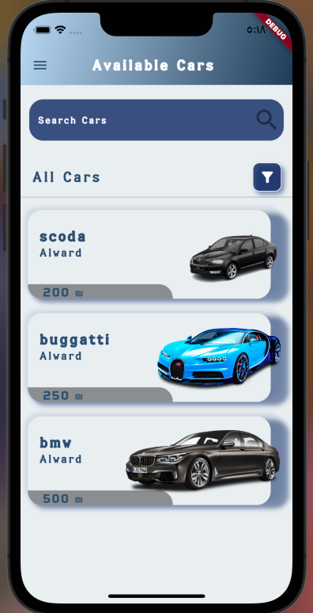
Filter car
Company Name
Filter Company Result

Slide 21
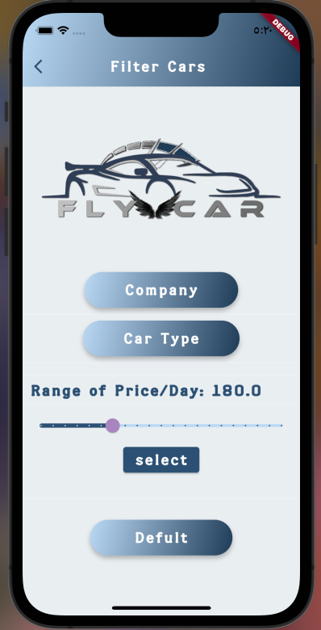
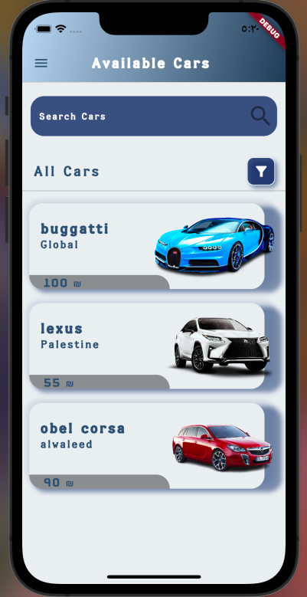
Filter by price/day
Filter Price Result

Slide 22
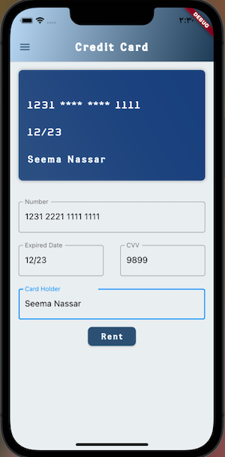
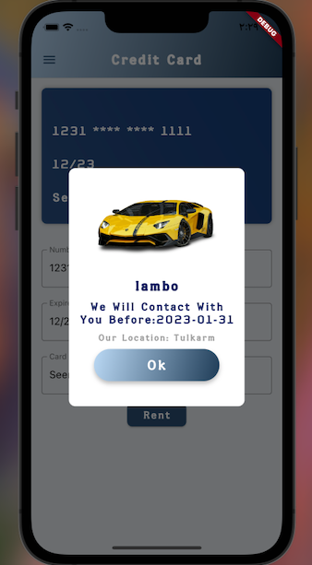
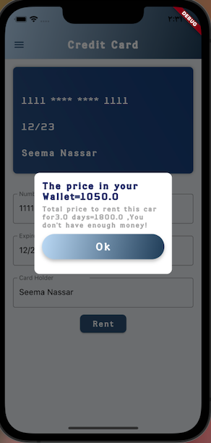
Payment by credit card
The rental has been completed
The rental has not been completed

Slide 23
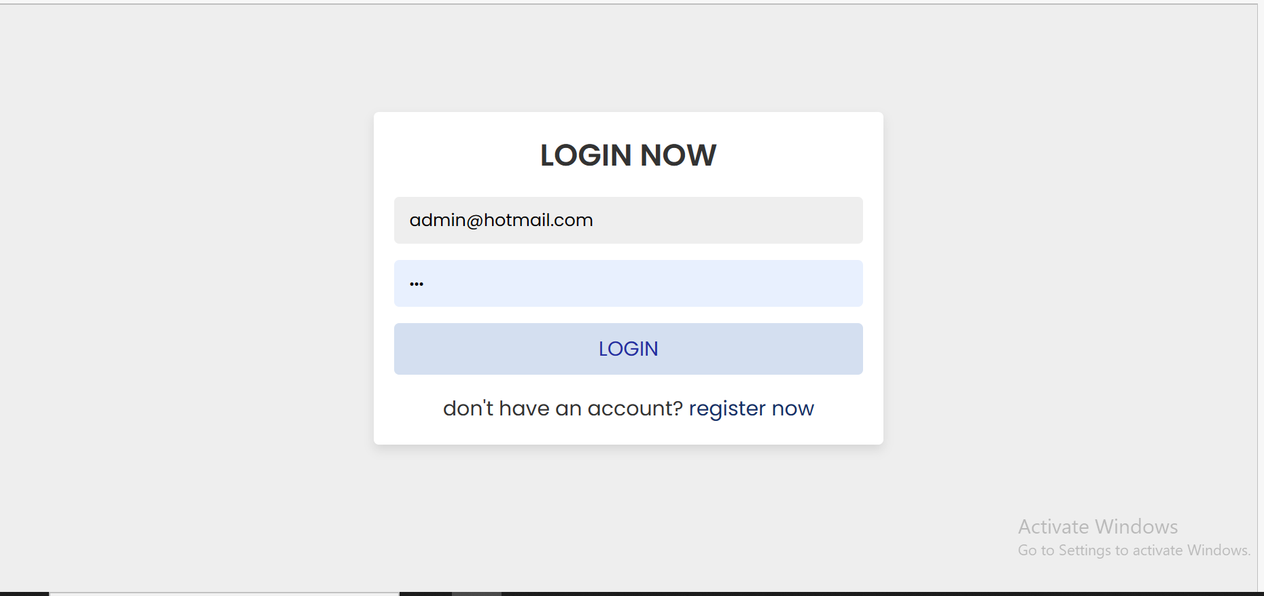
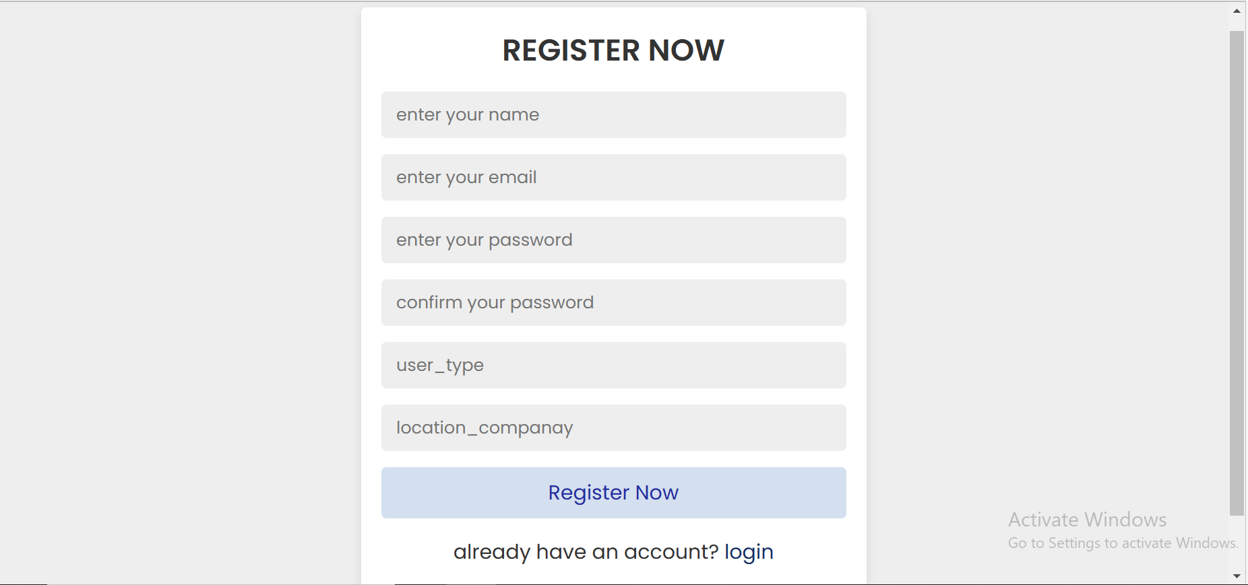
Admin feature
Login page admin
Signup page admin ​

Slide 24
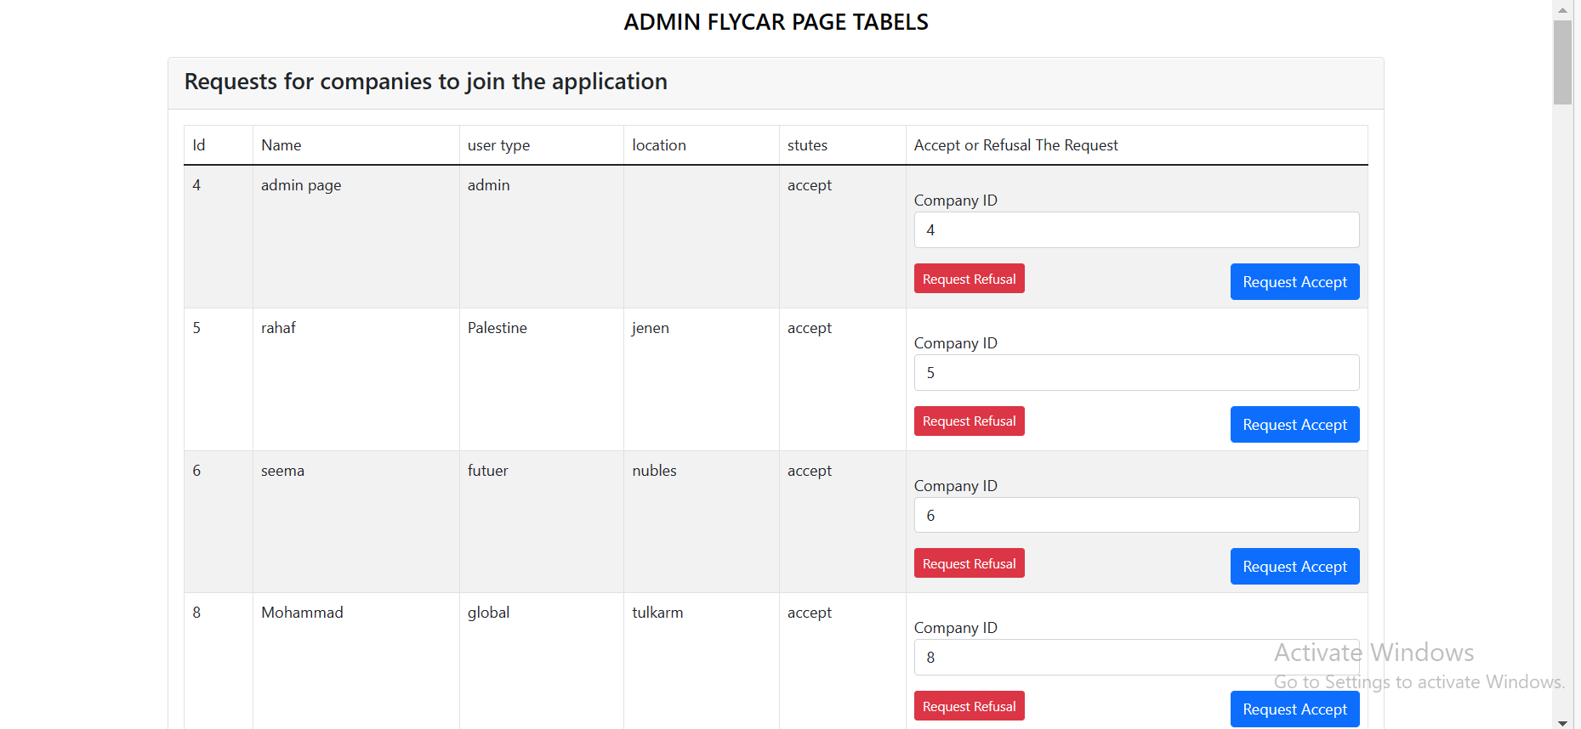
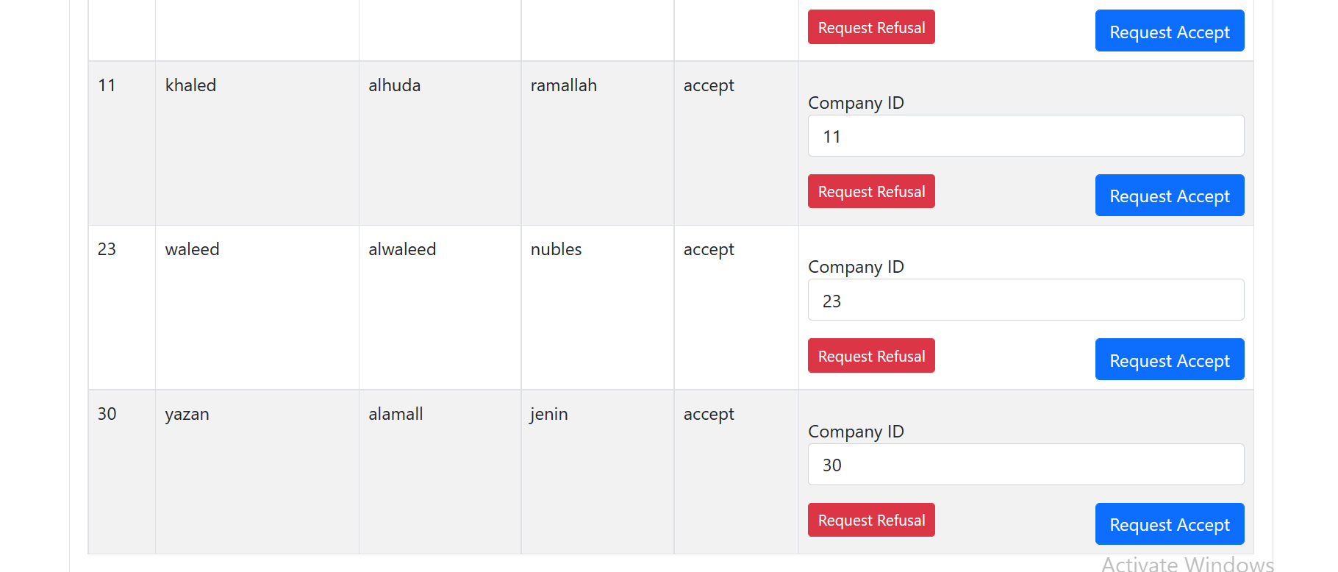
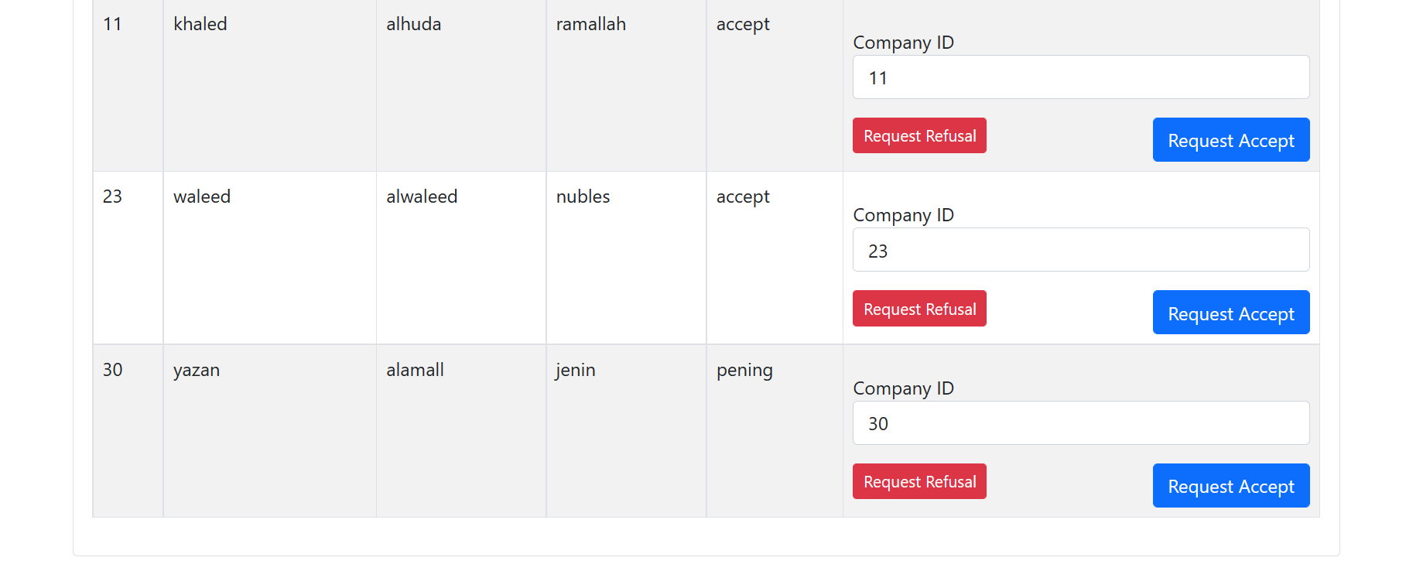
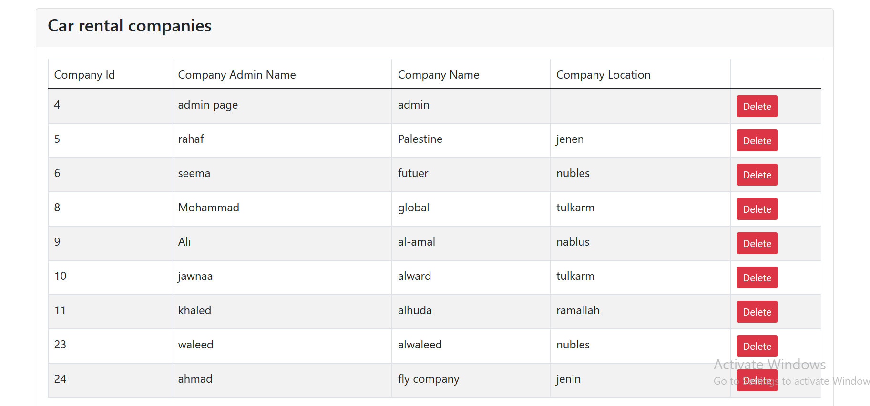
Company send request
Delete any company

Slide 25
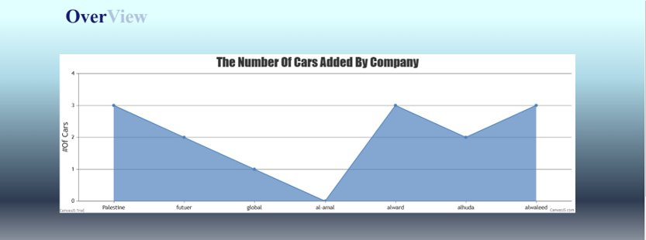
Over View

Slide 26
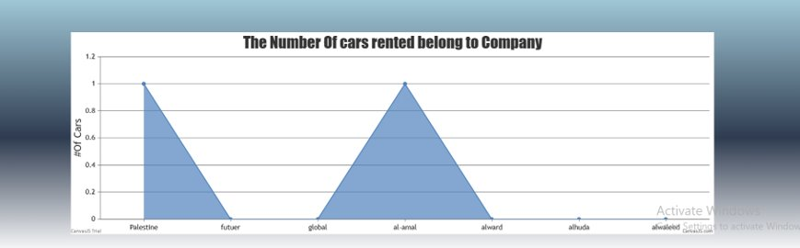
Over View

Slide 27
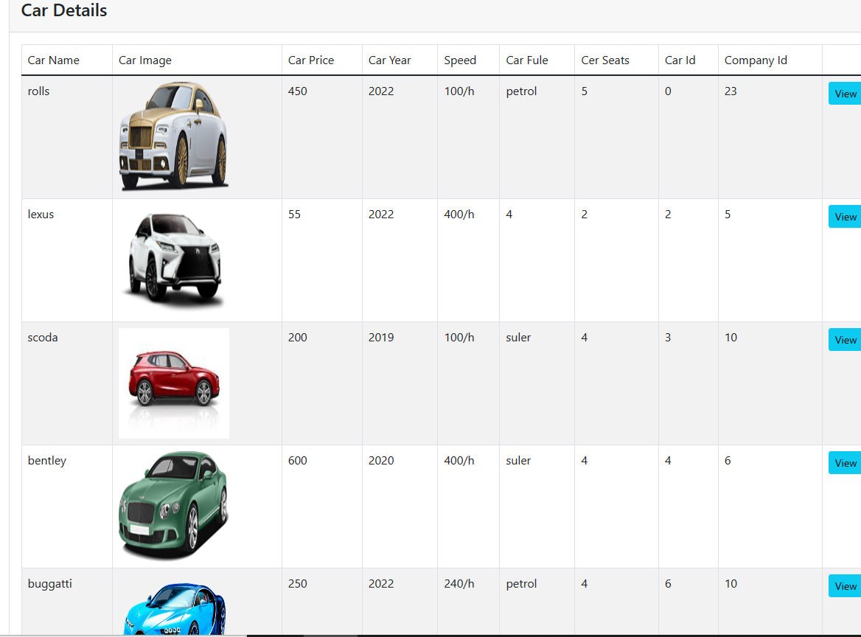
Car details

Slide 28
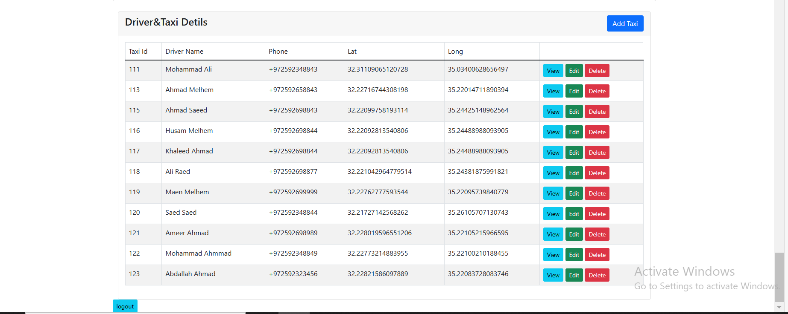
ADD TAXI

Slide 29
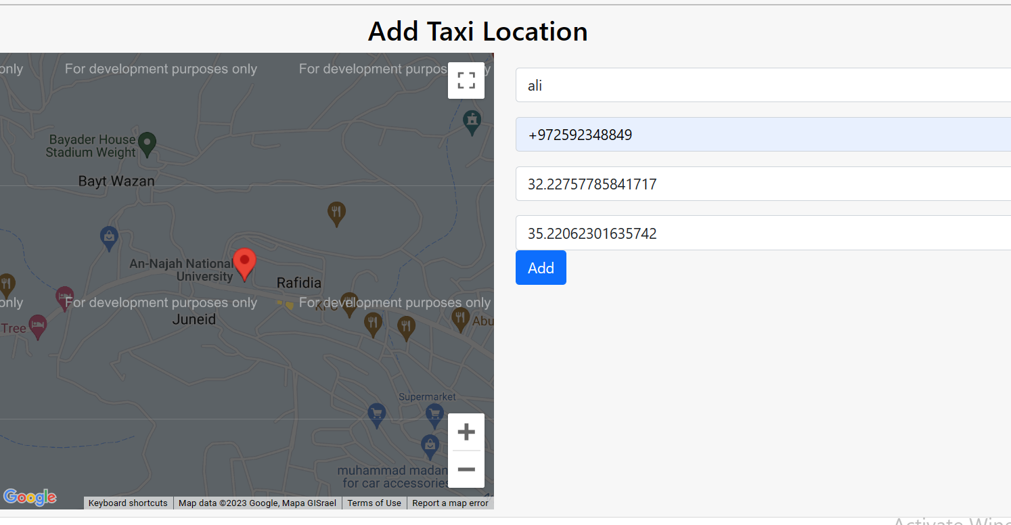

Slide 30
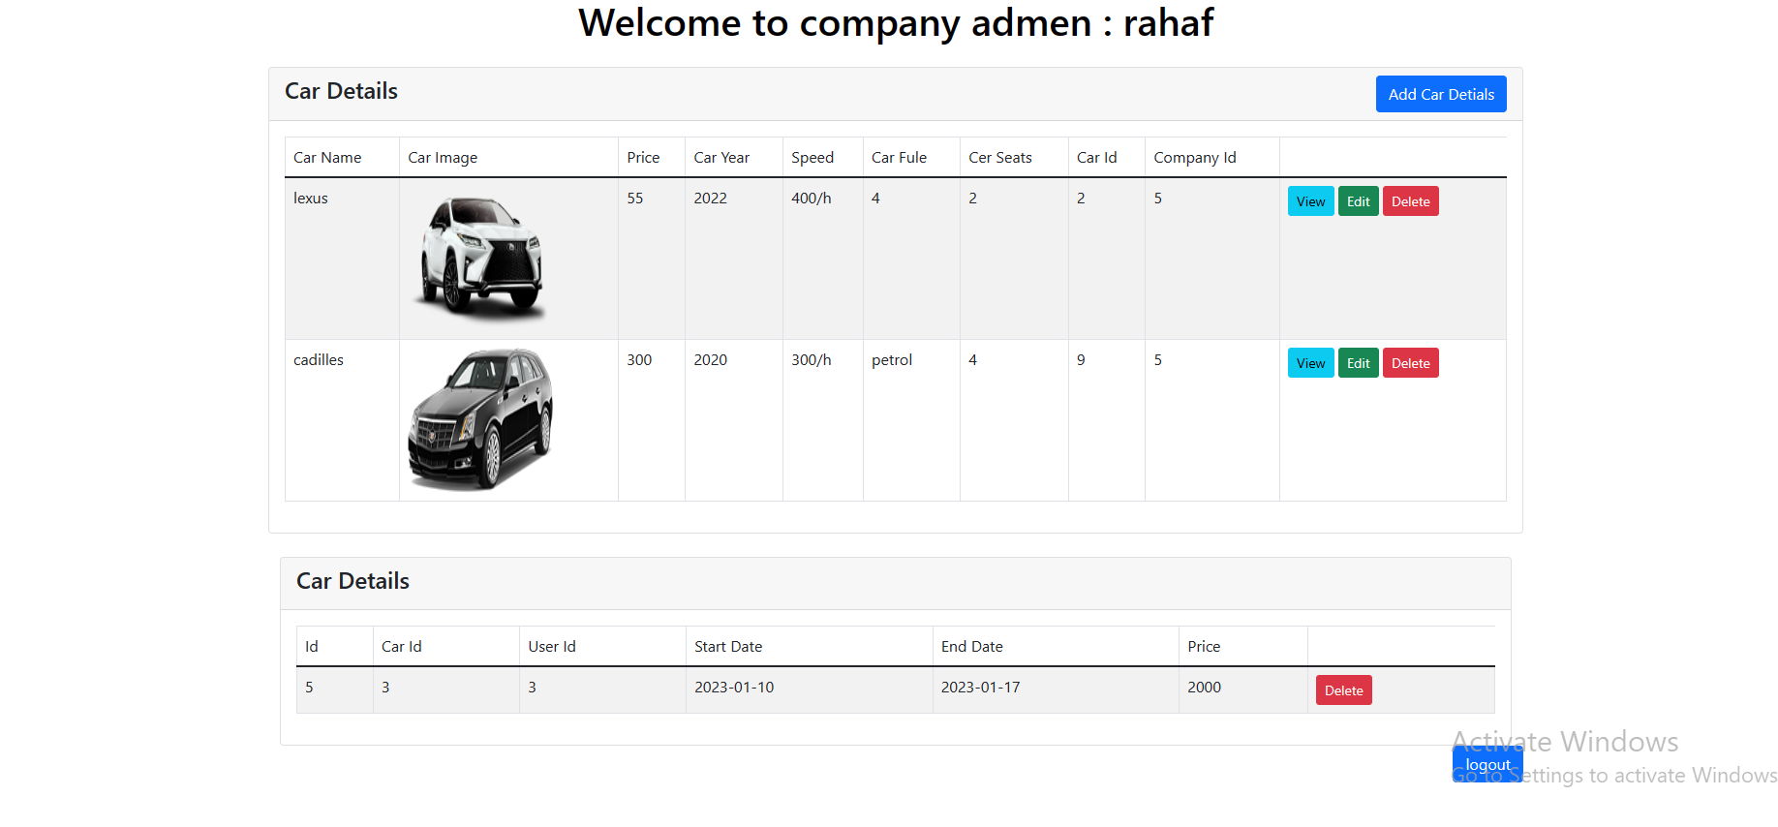
Admin company page example
admin

Slide 31

THANK YOU
FLY CAR

