Slide 1
Redesign of Gaza International Airport – Airside
Under the Supervision of Prof.
Sameer Abu - Eisheh
Proposed by :
Osama Demaidi
Waleed Shawahne
Leena Jarrar
Tasneem Ali

Slide 2
CONTENTS
1
Reviewing project 1
2
GEOMETRIC DESIGN OF THE AIRFIEL
3
DESIGN OF THE TERMINAL BUILDING AND APRONS AREA
4
AIRPORT MARKING, LIGHTING, AND SIGNAGE
5
DESIGN OF AIRPORT PAVEMENTS
6
RESULTS AND DISCUSSION

Slide 3
Background of the project
Study Area
Significance of the project
Objectives
Project Constrains
01
Introduction

Slide 4
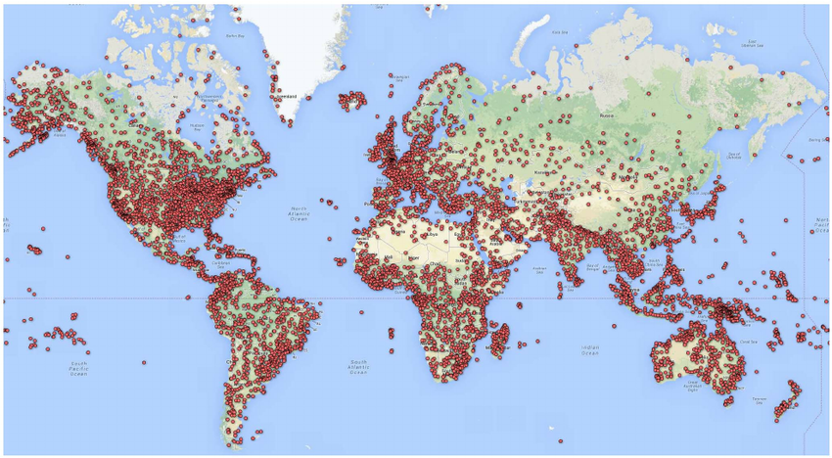
Background of the project
41,788 military and civil airports around the world.

Slide 5


Palestinian Airlines
The company was established on January 1, 1995, and began its operations in June 1997
with a series of flights to transport pilgrims to Jeddah. The flights were initially launched
from Gaza, but due to the Israeli ban, the company's business now takes place in Port Said
in northern Egypt.

Slide 6

Gaza International Airport
Gaza International Airport, located in the southeastern part of Gaza Strip, was operated in 1997. The airport gave the citizens of Gaza Strip better access to the world outside their narrow confines, but the long-awaited airport didn't last long though. It was destroyed by the Israeli occupation authorities in 2001.

Slide 7
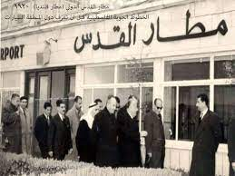
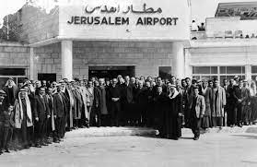
Jerusalem International Airport
is located on the lands of the Jerusalem Governorate, specifically in the town of Qalandia
The airport was established in 1920 under the management of the British Mandate, then in
the early 1950s, was placed under Jordanian administration after the West Bank joined the
Kingdom Hashemite. It fell into the hands of the Israeli forces in the 1967 war, which soon
changed its name to Atarout airport which was operated only on limited scale. Since
the Al-Aqsa intifada, the airport has been neglected, although it is under the control of the
Israeli army.

Slide 8
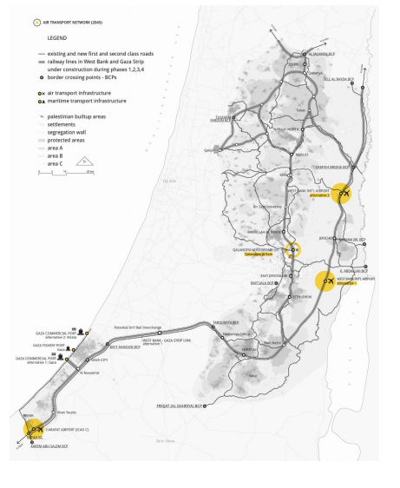
Study Area
The airport as proposed in Palestinian's Road and Transportation Master Plan.
Gaza Airport

Slide 9

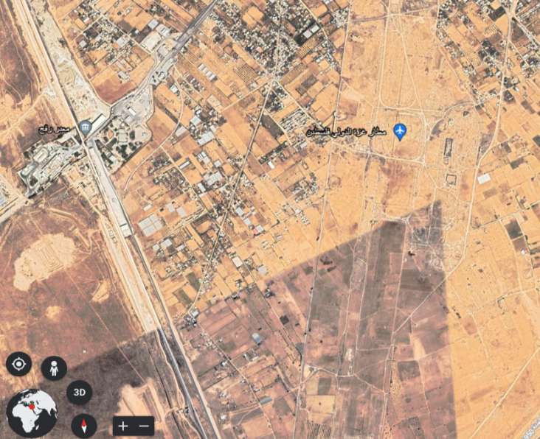
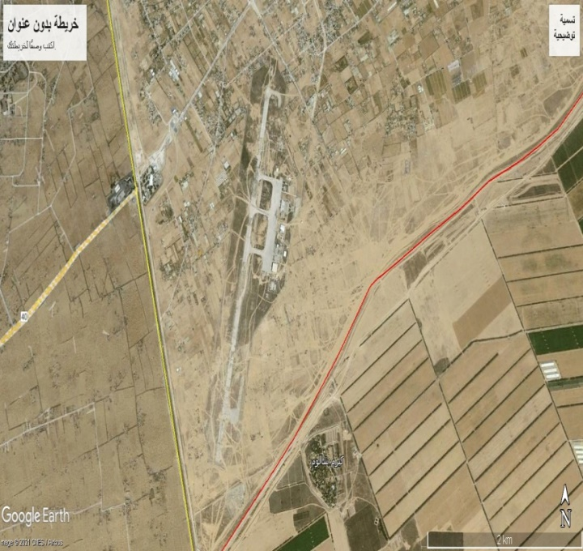
Study Area
The elevation of the airport above sea level 98m (320ft) It is away from the Palestinian capital (Jerusalem) at about 107 km to the southwest.
2021
2006

Slide 10
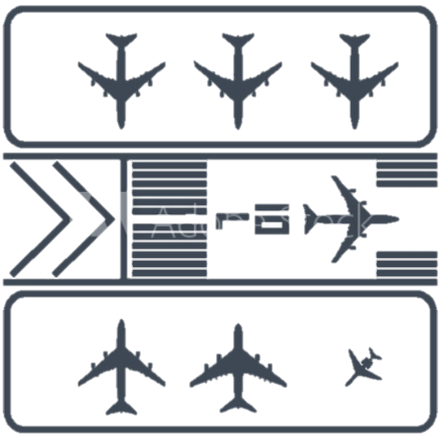


Objectives
The main objective of the project is to provide the recommended design of all airside infrastructure of Gaza International Airport. This includes:
The preparation of the airport master plan.
The design of the runways.
The design of the taxiways.
The design of the terminal aprons (aircraft gates).
The design of the terminal building.
The design of airfield ground lighting, marking, signage and navigational aids.

Slide 12

Methodology
Boeing 767-300ER
D-IV

Slide 13
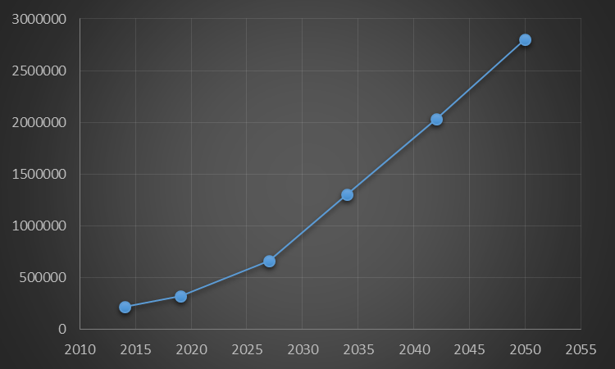
West Bank Citizens
Year | Population | %Total passengers of population | Total Passengers | %Air Passengers of total passengers | Air Passengers
2027 | 3,528,896 | 74% | 2,611,383 | 25.48 | 665,481
2034 | 4,078,696 | 81% | 3,303,743 | 39.48 | 1,304,446
2042 | 4,812,679 | 89% | 4,283,285 | 47.48 | 2,033,869
2050 | 5,678,748 | 89% | 5,054,085 | 55.48 | 2,804,202
Gaza Strip Citizens
Year | Population | %Total passengers of population | Total Passengers | %Air Passengers of total passengers | Air Passengers
2027 | 2,489,755 | 74% | 1,842,418 | 25.48 | 469,519
2034 | 3,026,881 | 81% | 2,451,774 | 39.48 | 968,055
2042 | 3,784,026 | 89% | 3,367,783 | 47.48 | 1,599,154
2050 | 4,730,562 | 89% | 4,210,201 | 55.48 | 2,335,982

Slide 14
5% of the West Bank
90% of the Gaza Strip
50% of foreign tourists
Year | Total Tourists | By Air (87.5%)
2027 | 2,967,020 | 2,596,143
2034 | 3,994,628 | 3,495,300
2042 | 5,611,552 | 4,910,108
2050 | 7,882,966 | 6,897,595
Year | West Bank Passenger By Air | Gaza Passenger By Air | Tourists Passenger By Air | West Passenger through Gaza Airport (5%) | Gaza Passenger through Gaza Airport (90%) | Tourists through Gaza Airport (50%) | Total
2027 | 665,481 | 469,519 | 2,596,143 | 33,274 | 422,567 | 1,298,072 | 1,753,913
2034 | 1,304,446 | 968,055 | 3,495,300 | 65,222 | 871,250 | 1,747,650 | 2,684,122
2042 | 2,033,869 | 1,599,154 | 4,910,108 | 101,693 | 1,439,239 | 2,455,054 | 3,995,986
2050 | 2,804,202 | 2,335,982 | 6,897,595 | 140,210 | 2,102,384 | 3,448,798 | 5,691,391

Slide 15
02
GEOMETRIC DESIGN OF THE AIRFIEL

Slide 16
Runway Design
Separation Requirements
Vertical Alignment
Runway Length
Runway dimension
Runway Transverse Slope

Slide 17
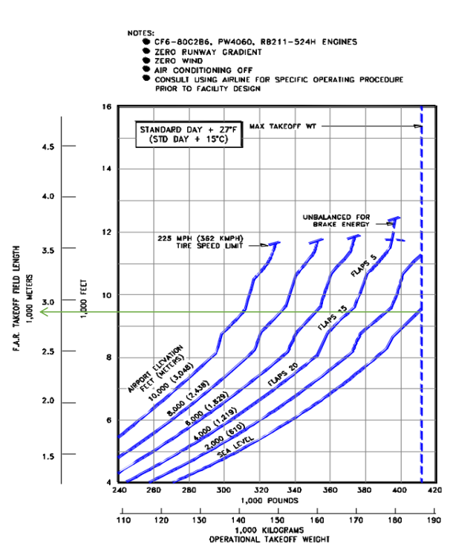
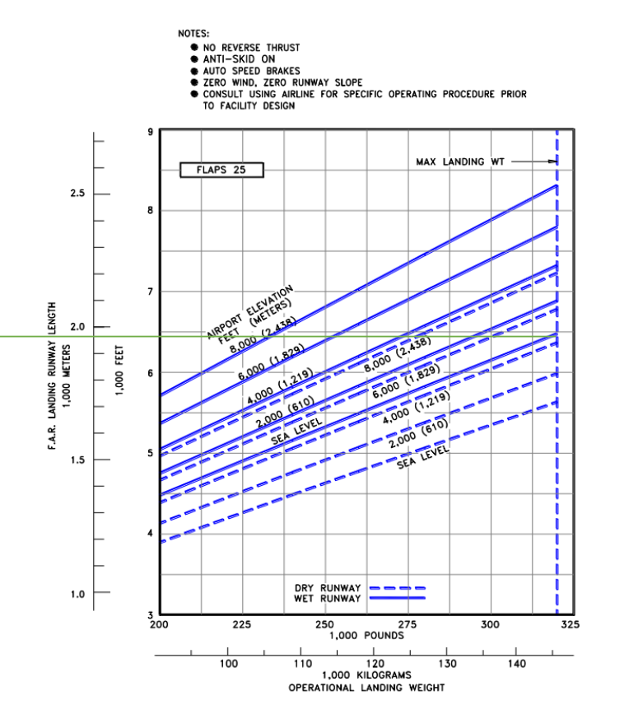
Runway Length
10080 feet (3072 m)

Slide 19
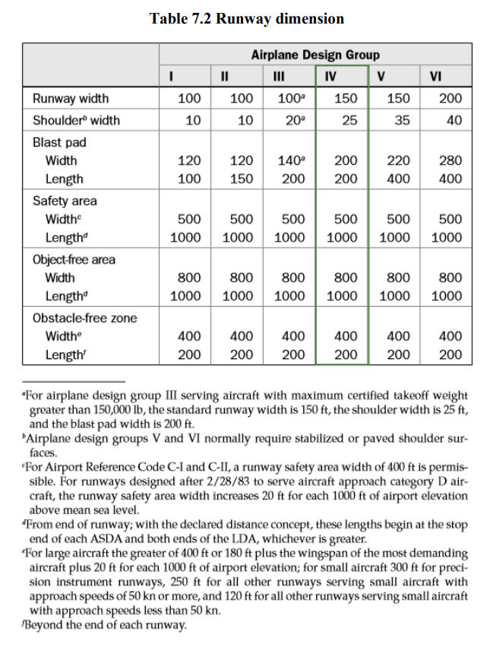
Runway Dimensions
Length, m (ft) | 3080 (10073)
Direction | 1/19
Runway width, m (ft) | 45.72 (150)
Shoulder Width, m (ft) | 25 (7.62)
Blast Pad Length, m (ft) | 60.96 (200)
Blast Pad Width, m (ft) | 60.96 (200)
RSA Length, m (ft) | 304.8 (1000)
RSA Width, m (ft) | 152.4 (500)
OFA Length, m (ft) | 304.8 (1000)
OFA Width, m (ft) | 243.84 (800)
Runway Surface (ft) | Flexible Asphalt

Slide 20
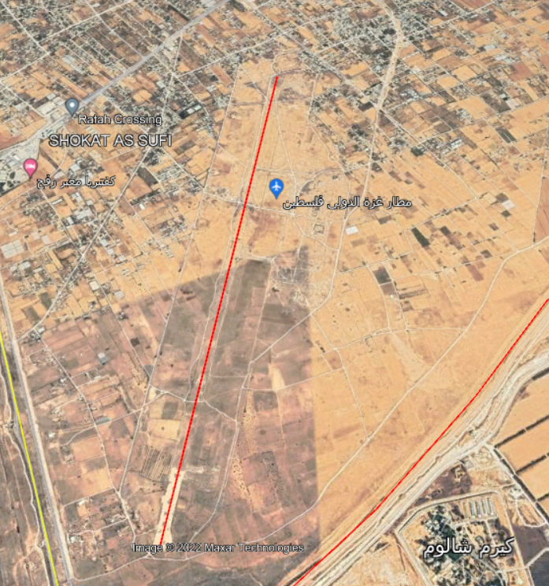
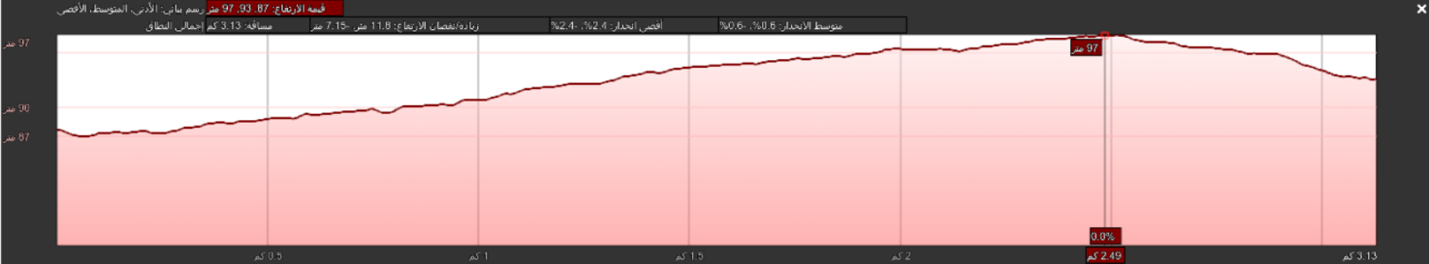

Slide 21
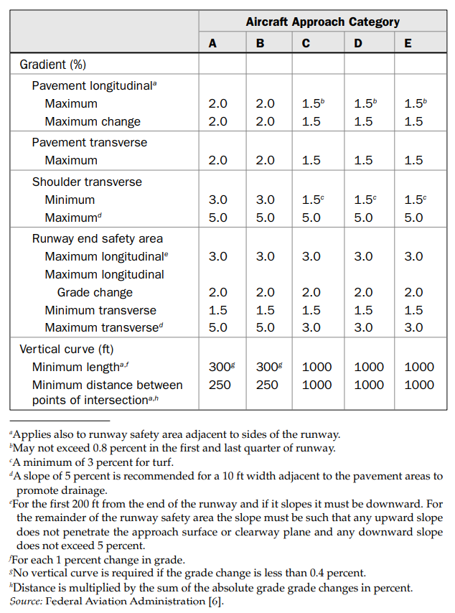
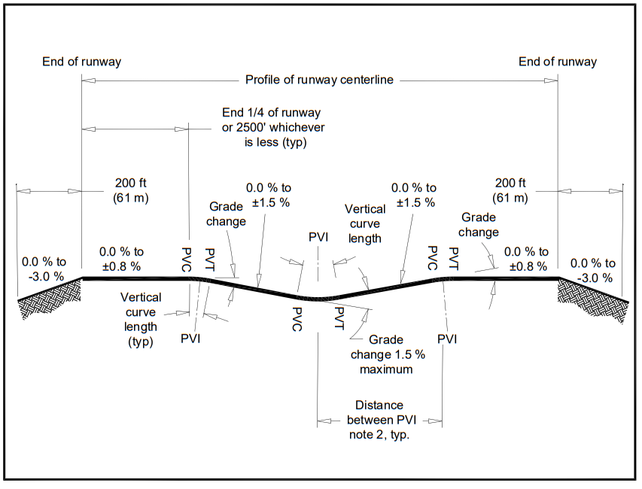
Design of the Vertical Alignment

Slide 22
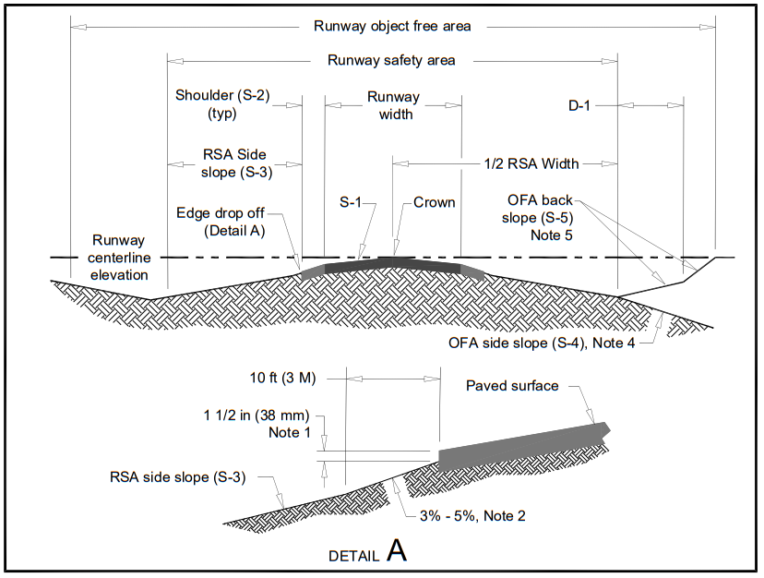
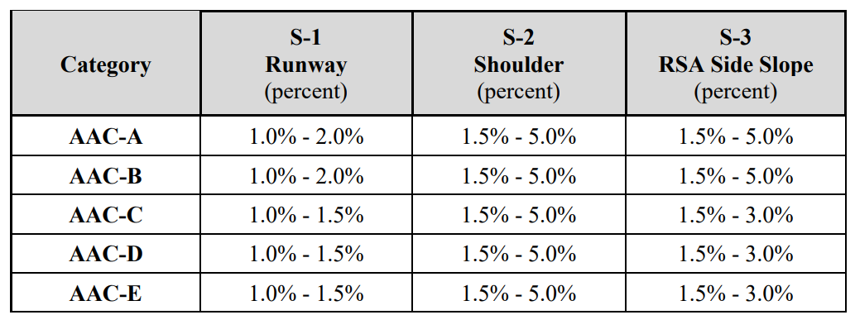
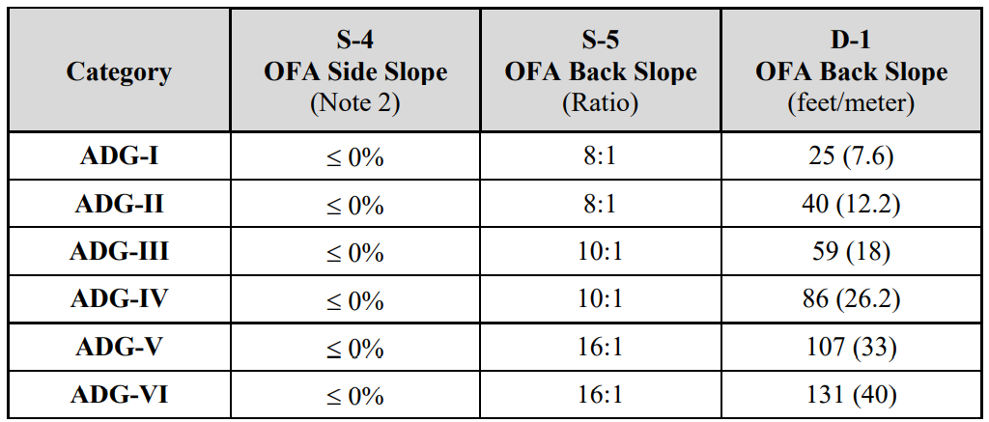
Runway Transverse Slope

Slide 23
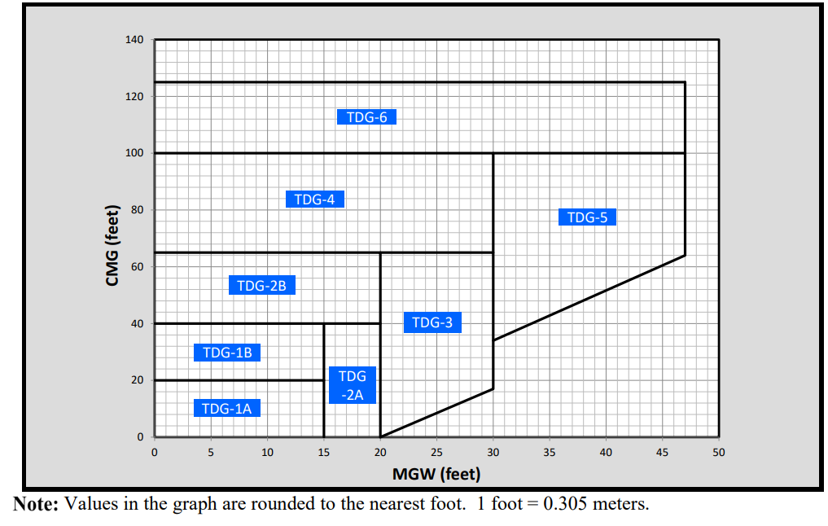
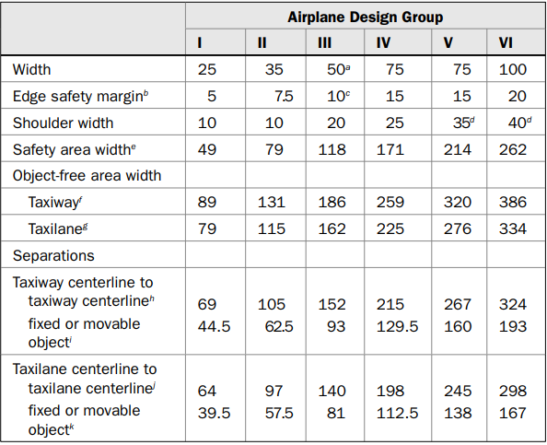
TDG for design aircraft is 5
For Gaza Airport, the width of the taxiway is 75 ft (22.86 m). and the shoulder is 20 ft (6.1 m).

Slide 24
Taxiway Gradient Standards

Slide 26
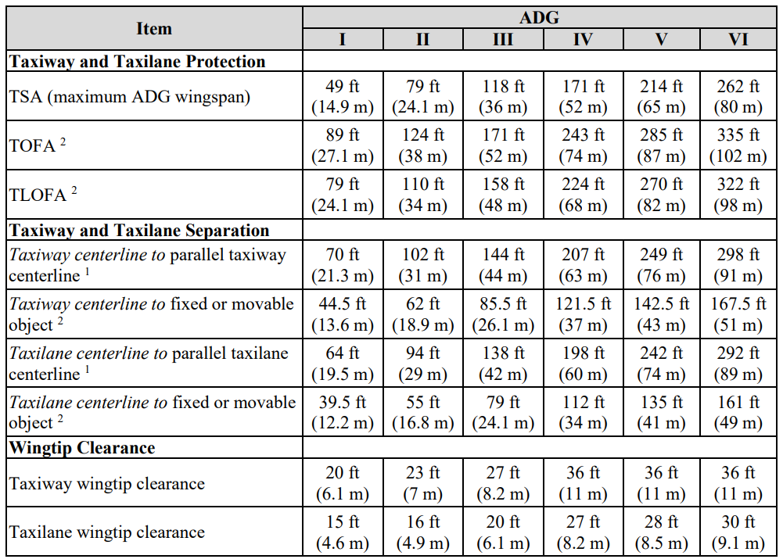
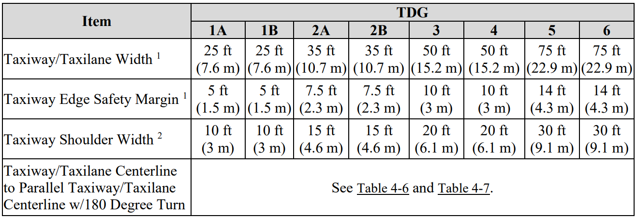
Design Standards Based on Airplane Design Group (ADG)

Slide 27
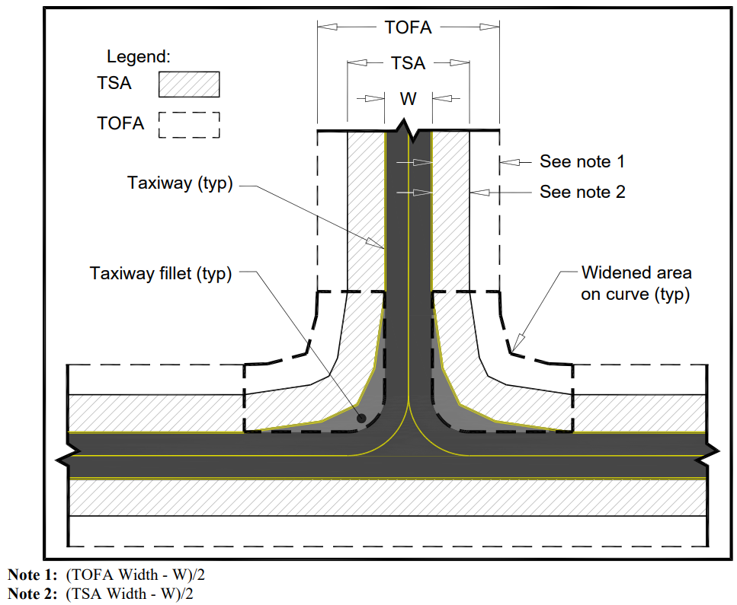

Slide 29
03
DESIGN OF THE TERMINAL BUILDING
AND APRONS AREA

Slide 30
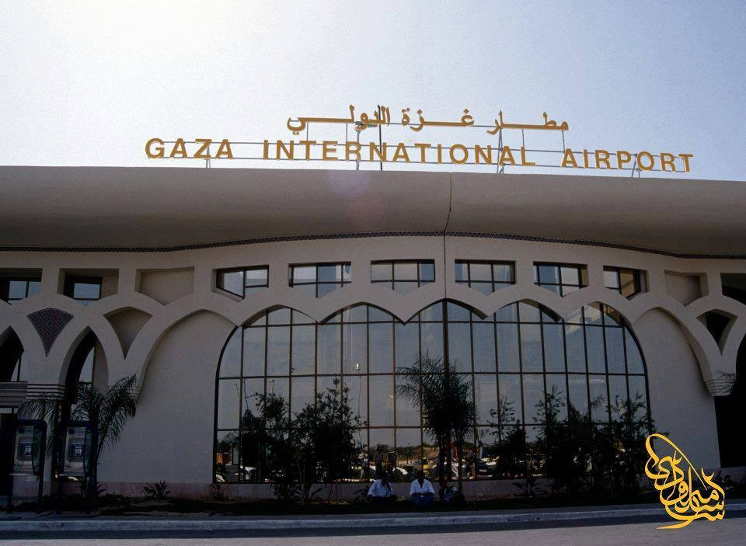
Phase | Year | Peak Hour passengers | Gross Terminal Building Area (m²)
2027-2034 | 2034 | 1,208 | 16,912
2034-2042 | 2042 | 1,665 | 16,310
2042-2050 | 2050 | 2,288 | 32,032

Slide 31
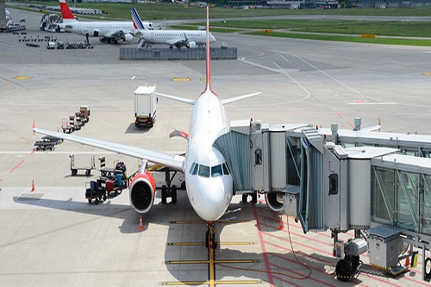
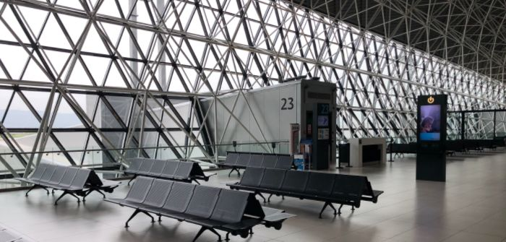
phase | year | Number of Gates | μ_{k} | E (T_{g}) | C_{g}
2027-2034 | 2034 | 10 | 0.8 | 56 | 9
2034-2042 | 2042 | 15 | 0.8 | 56 | 13
2042-2050 | 2050 | 20 | 0.8 | 56 | 17

Slide 32
Concept Development
Aircraft Parking Type
Piers or Finger concept
Nose-In Parking
Advantages
Disadvantages
Advantages
Disadvantages
Availability to
expand ,
Economical
long walking
distance, lack of
a direct
curb front
Requires the smallest
gate area, lower noise
levels,
Need for towing
equipment, nose is too
far from the building

Slide 33
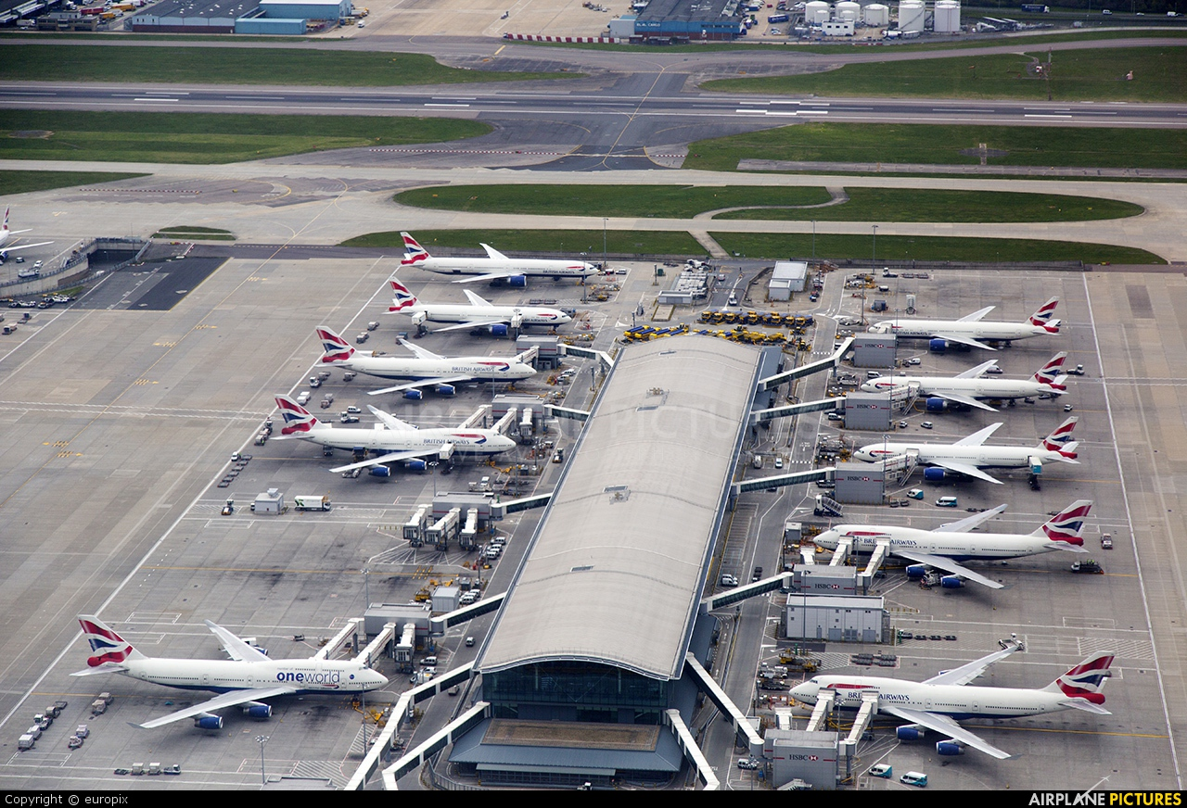

Slide 34
Gate number | Aircraft type | Category (FAA) | Length (ft) | Width (ft) | Clearance | Length of the parking | Width of the parking
1 | Cessna, 675 (C208) | B-II | 37 | 52 | 10 | 47 | 104.20
2 | Cessna, CITATION (C550) | B-II | 47.57 | 52.23 | 10 | 57.57 | 115.02
3 | ATR, ATR-72-200/210 (AT72) | B-III | 89 | 88 | 25 | 114 | 195.80
4 | Fokker (F-28-2000) | B-II | 97 | 77 | 25 | 122 | 191.70
5 | Fokker (F-28-3000) | C-III | 89 | 77 | 25 | 114 | 183.70
6 | Boeing, 737- 100 (B731) | C-III | 93 | 93 | 25 | 118 | 205.30
7 | Airbus, A318-100 (A318) | C-III | 103 | 111.9 | 25 | 128 | 236.09
8 | Boeing, 737- 300 (B733) | C-III | 109.58 | 94.75 | 25 | 134.58 | 223.81
9 | Airbus, A319 (A319) | C-III | 111.54 | 111.3 | 25 | 136.54 | 243.97
10 | Airbus, A320 (A320) | C-III | 123 | 111.3 | 25 | 148 | 255.43
11 | Airbus, A321 (A321) | C-III | 147.63 | 111.83 | 25 | 172.63 | 280.64
12 | Airbus, A300-600 (A306) | C-IV | 177.4 | 147.08 | 25 | 202.4 | 349.19
13 | Boeing, 767-300ER | D-IV | 156.08 | 180.25 | 25 | 181.08 | 364.36

Slide 35
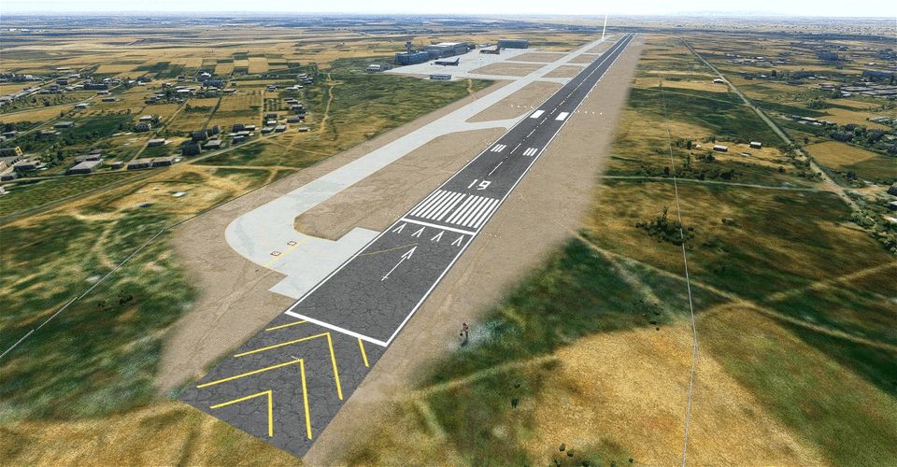

Slide 36
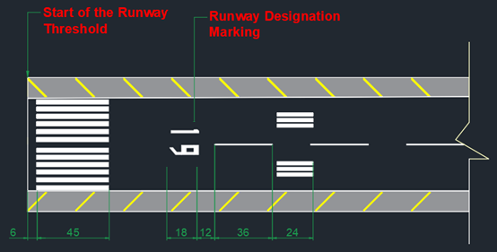
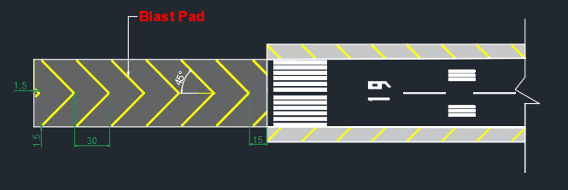

Slide 37
05
DESIGN OF AIRPORT PAVEMENTS

Slide 39
THANK YOU

