Slide 1

Time and Cost Management of Nablus City Mall
Prepared by:
Ghalib Al-Shaikh,
Mahmoud Awad,
Osama Kolayb,
Sa’ed Turkman,
Under Supervision of: Eng. Reema Nassar.

Slide 2
Outline
Part 1: Introduction,
Part 2: Objectives,
Part 3: Project Description,
Part 4: Quantities Surveying Using Revit Software,
Part 5: Project Human Resources Management,
Part 6: Resources Price,
Part 7: Project Scope Management,
Part 8: Time and Cost Management Using
Primavera Software,
Part 9: Cost and Price Estimate.

Slide 3
PART 1
Introduction
Estimating is an approximation that defines the Cost of construction Activity or activities prior to commencement of work V.S the cost of work during and after construction, which is the Actual cost.
Estimating is not exact science. It is group of skills and experience in knowledge of construction , knowledge of prices, Common sense, the judgment required
An estimate is the “Prediction” of future construction costs.

Slide 4
PART 2
Introduction
  Project Management: is the sum of all activities such as Planning, organising, implementing and controlling a project in order to meet the client’s expectation from start to finish within the planned period, budget and quality.

Slide 5
Objectives
We have two main objectives for this project:
Calculate the budgeted cost and price for foundation, structural elements, partitions, stone and plastering after estimated the quantities takeoff for it.
Calculate the optimal period needed to finish works by depending on productivity rate for resources (labors and equipment).

Slide 6
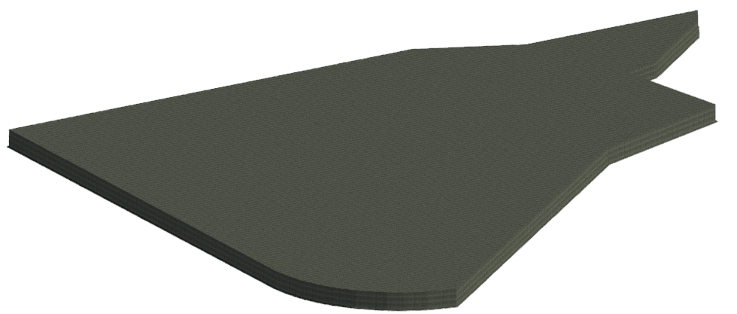
Project Description
PART 3
This report deals with time and cost management of Nablus City Mall in Nablus, which has a location of 32° 13’ 25˝ N, 35° 15’ 27˝ E, and about 600 m above mean sea level. The mall consists of fourteen floors with a total area of 35557 m².
The building is multifunctional structure and table 1.2.1 summarizes the functions, area and height of each story center to center.

Slide 7
Function | High (m) | Area (m²) | Floor Number
Garages | 3.35 | 3017.20 | B4
Shopping | 3.50 | 2723.40 | B3
Shopping | 4.00 | 2521.00 | B2
Shopping | 3.80 | 2422.00 | B1
Shopping | 3.95 | 2550.80 | Ground Floor
Shopping | 3.75 | 2550.80 | F1
Offices | 3.50 | 2565.00 | F2
Offices | 3.00 | 2544.80 | F3
Offices | 3.30 | 2530.50 | F4
Offices | 3.30 | 2530.50 | F5
Offices | 3.30 | 2530.50 | F6
Garages | 3.30 | 2530.50 | F7
Garages | 3.30 | 2276.00 | F8
Garages | 3.30 | 2176.30 | F9
- | 2.65 | 87.24 | Stair Floor

Slide 8
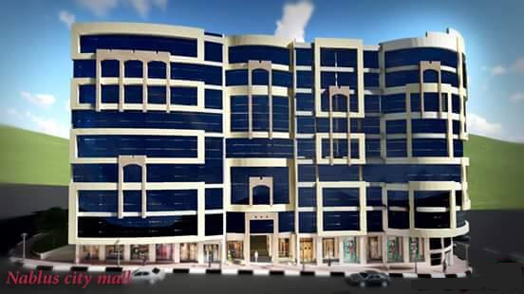

Slide 9
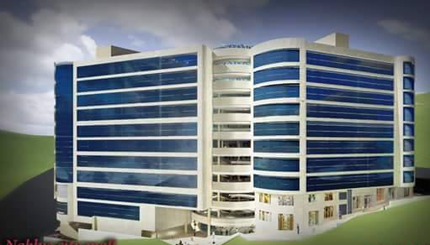

Slide 10
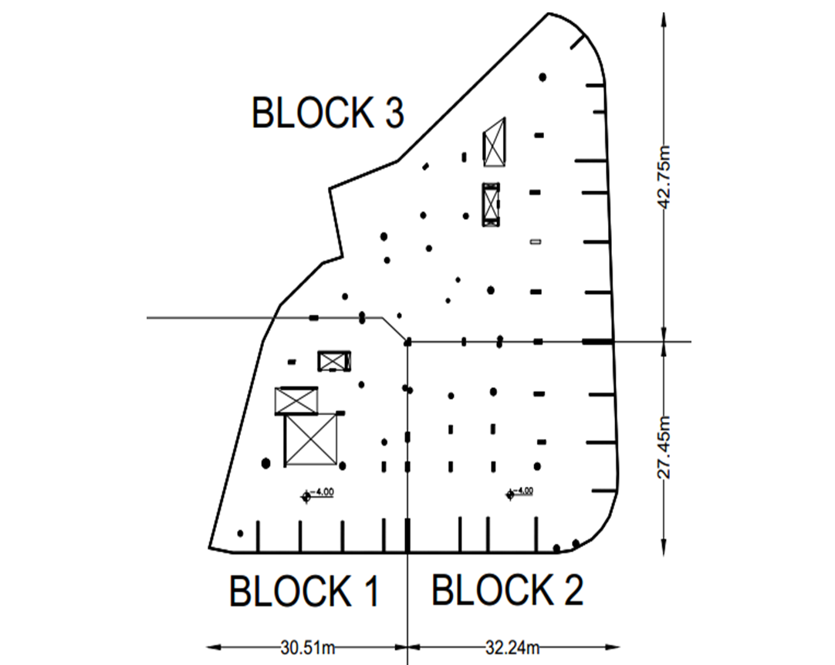

Slide 11

PART 4
Quantities Surveying Using
Revit Software

Slide 12
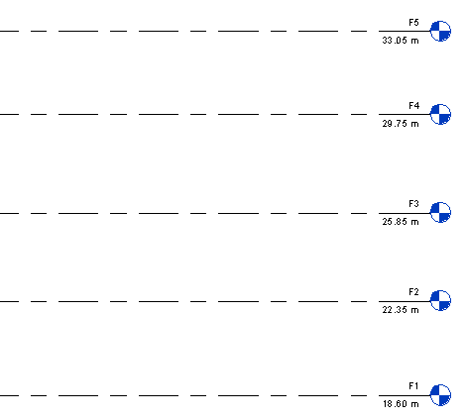
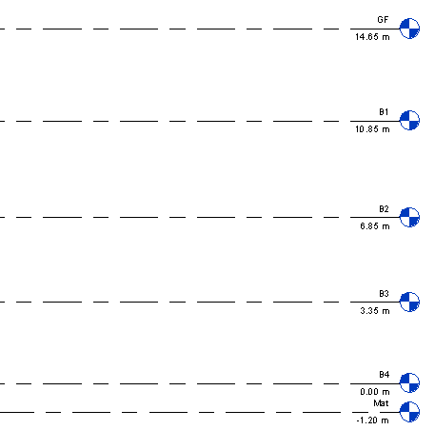
Quantities Surveying Using
Revit Software
Quantities Surveying Using
“Revit Software”
Levels Definition in Revit
Floor Number | High (m)
B4 | 3.35
B3 | 3.5
B2 | 4
B1 | 3.8
Ground Floor | 3.95
F1 | 3.75
F2 | 3.5
F3 | 3
F4 | 3.3
F5 | 3.3
F6 | 3.3
F7 | 3.3
F8 | 3.3
F9 | 3.3
Stair Floor | 2.65

Slide 13
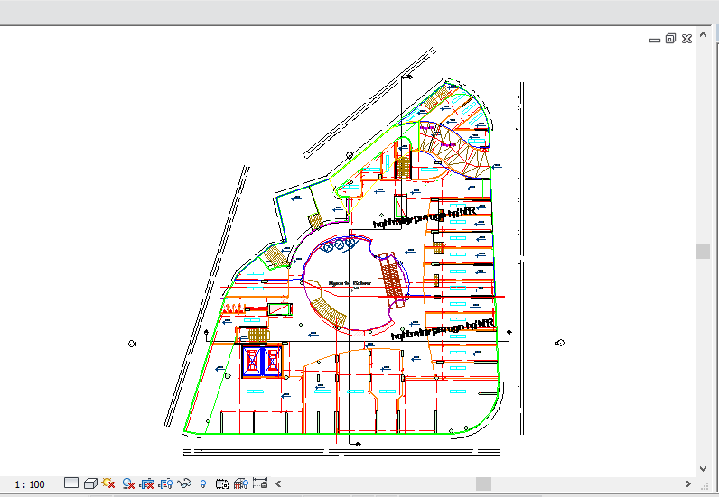
Link CAD Importing for Drawing

Slide 14
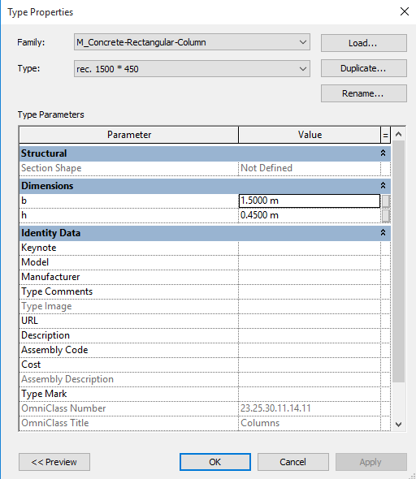
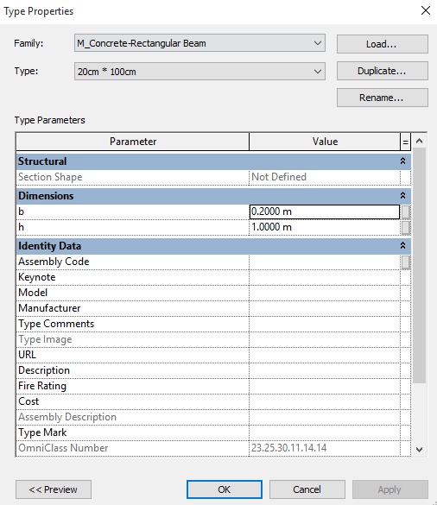
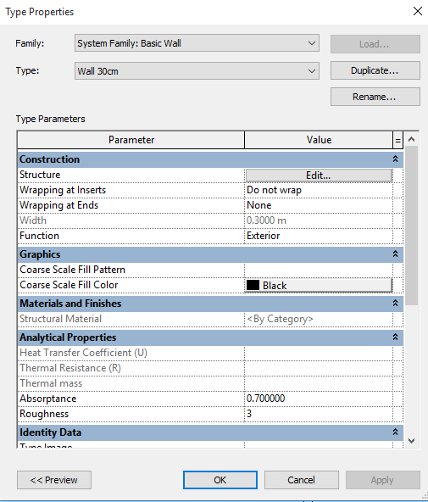
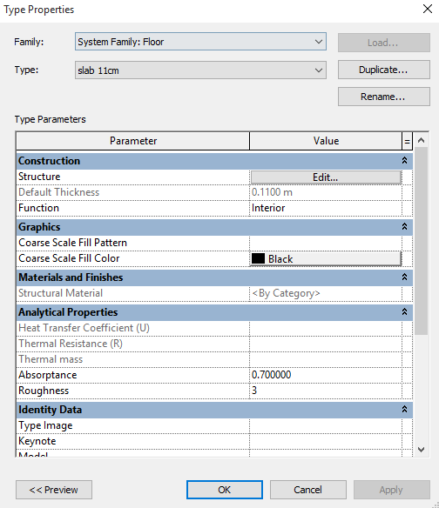
Sections Definition for the
Structural Elements
Sections Definition for the Structural Elements
Column Section Definition Example
Beam Section Definition Example
Shear Wall Section Definition Example
Floor Section Definition Example

Slide 15
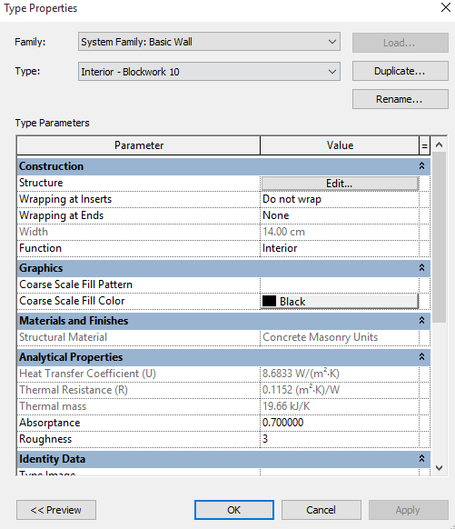
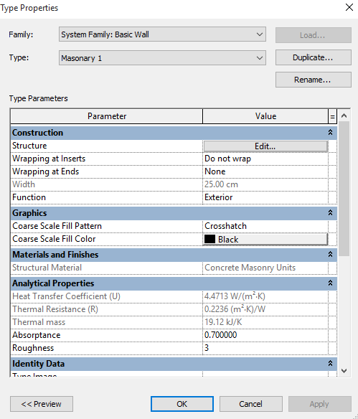
Sections Definition for non-Structural Elements
Sections Definition for non-Structural Elements
Partition Wall Definition Example
Stone Wall Definition Example

Slide 16
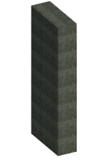
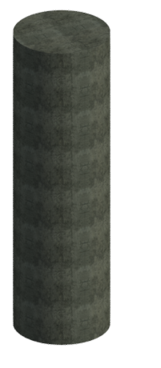
Drawing Stages
Raft Draw Example for Block 3
Rectangular Column Draw Example

Slide 17
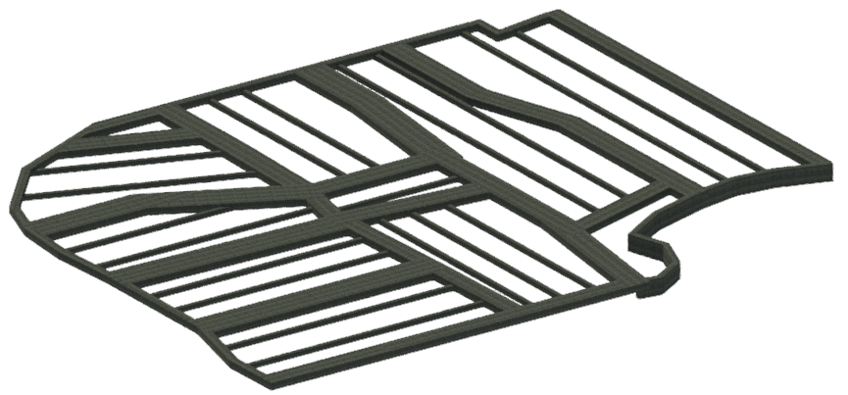
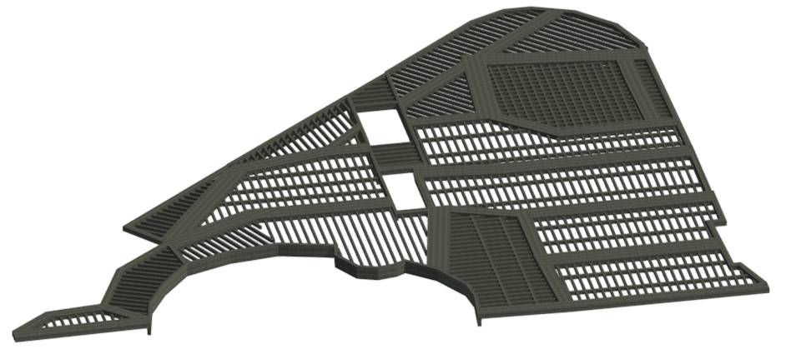
Beams Draw Example for Block 2
Ribs Draw Example for Block 3

Slide 18
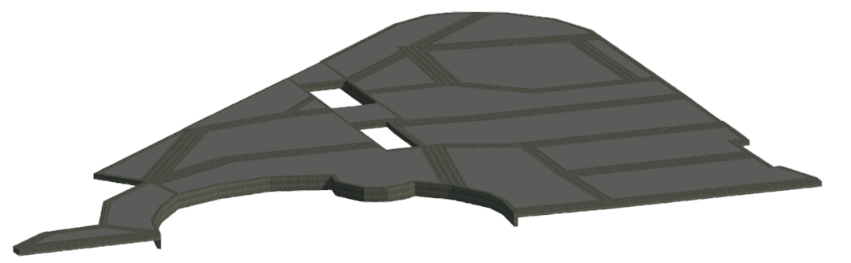
Cover Slab Draw Example for Block 3

Slide 19
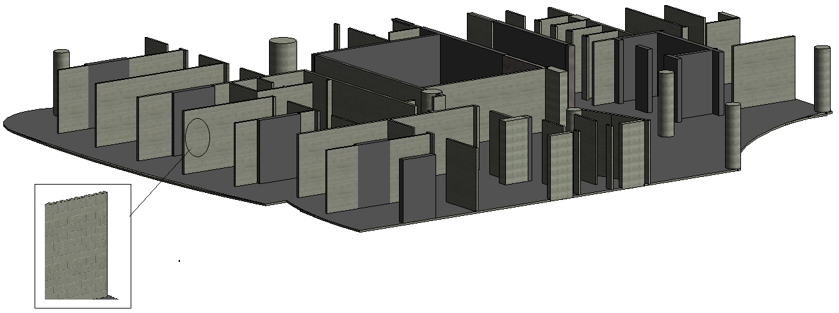
Partition walls Draw Example for Block 1

Slide 20
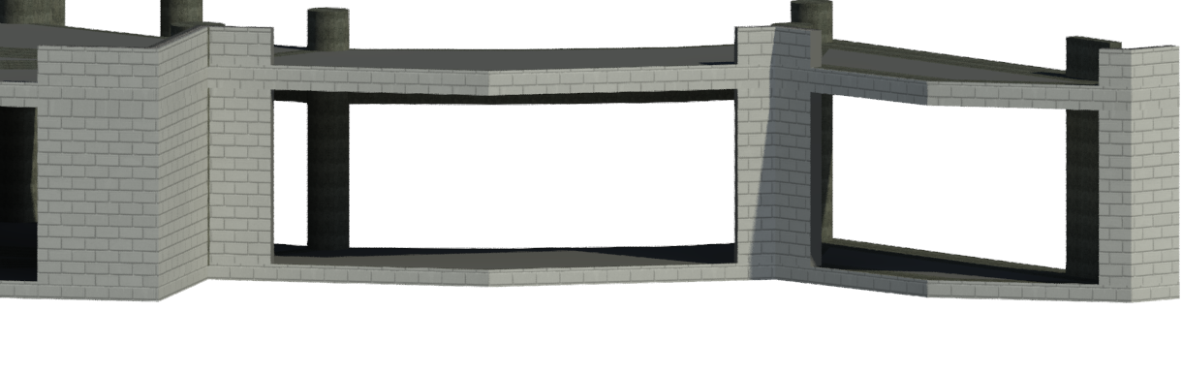
Stone Walls Draw Example for Block 3

Slide 21
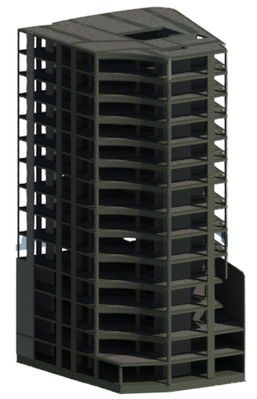
3-D View for Block 1

Slide 22
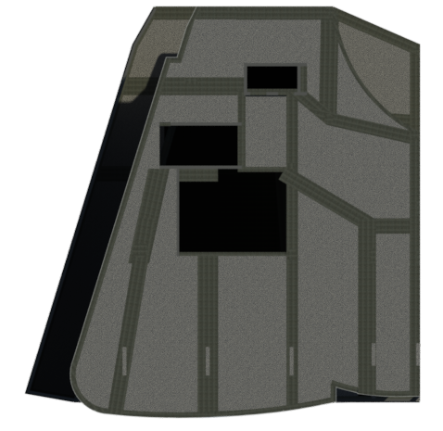
Top View for Block 1

Slide 23
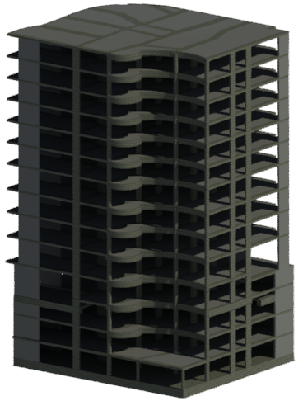
3-D View for Block 2

Slide 24
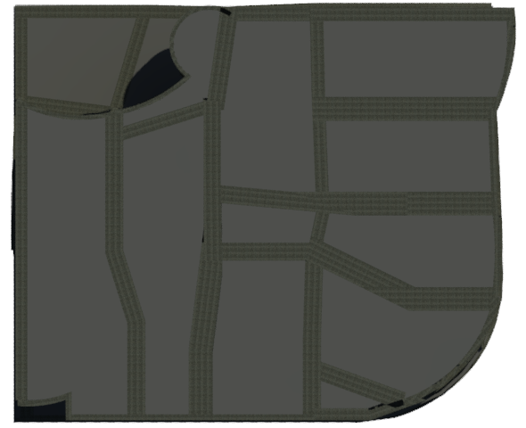
Top View for Block 2

Slide 25
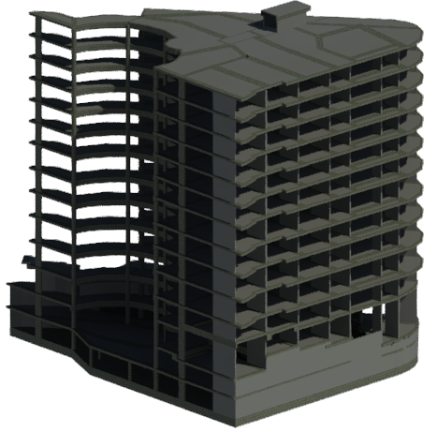
3-D View for Block 3

Slide 26
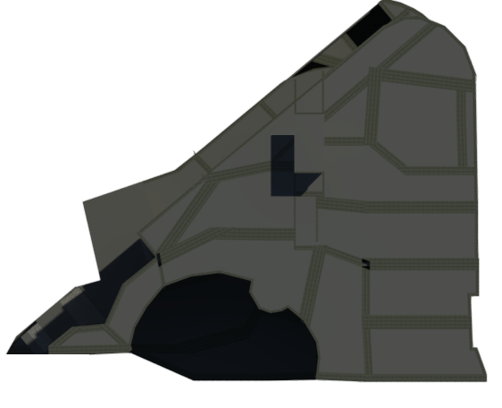
Top View for Block 3

Slide 27
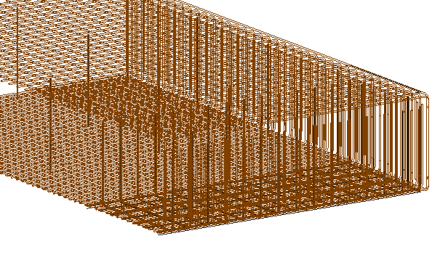
Drawing Reinforcement Using Revit
Steel Bars Distribution for the Raft in Revit

Slide 28
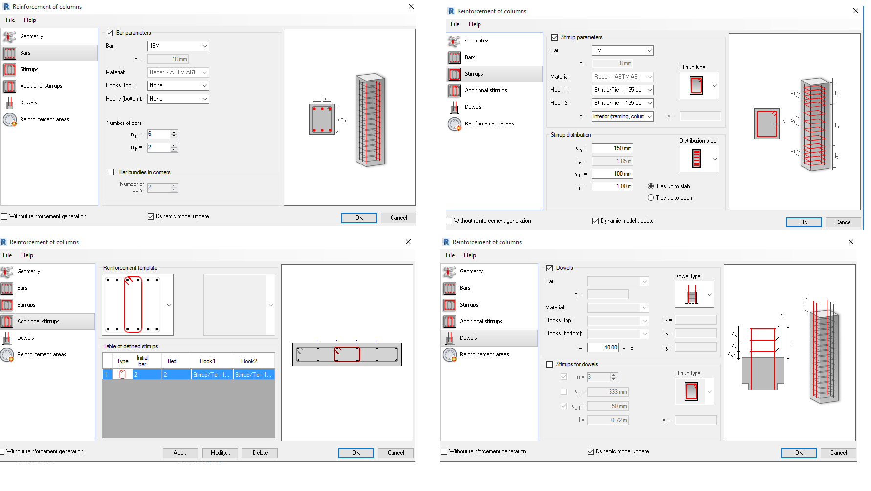
Slide Title
Rebar Extension for Columns

Slide 29
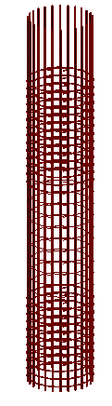
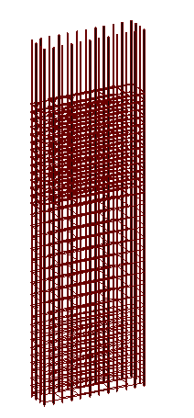
Columns Rebar in Revit
Bars distribution for rectangular and circular columns in Revit

Slide 30
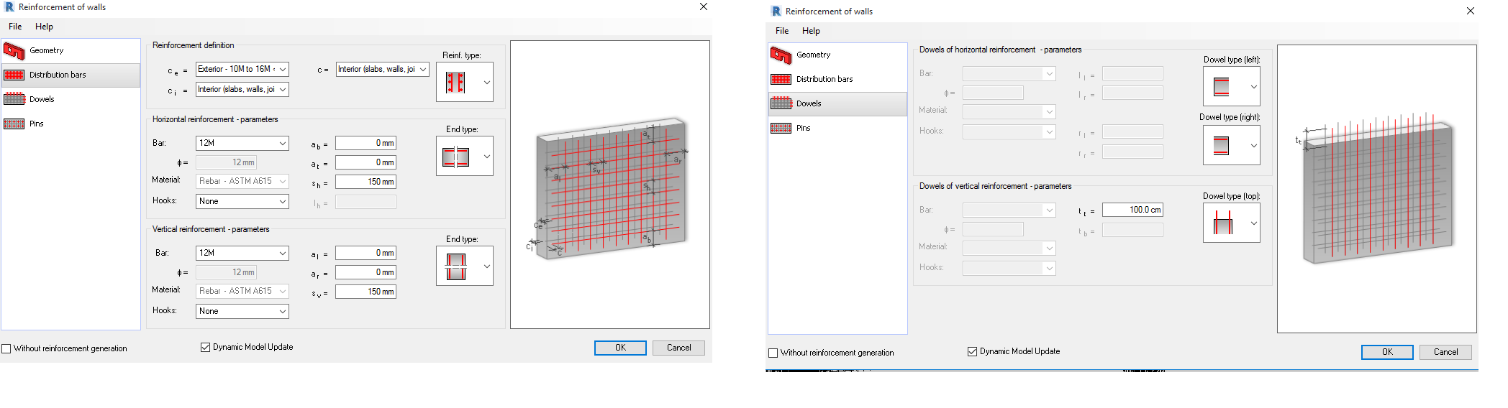
Slide Title
Rebar Extension for Shear Walls

Slide 31
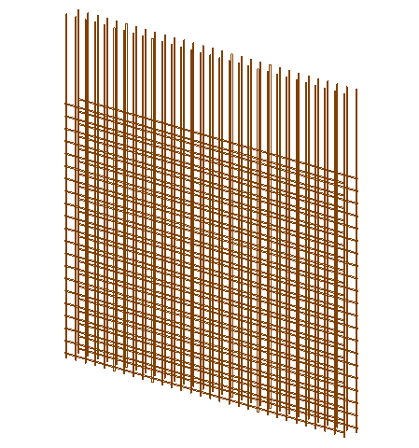
Shear Walls Rebar in Revit
Bars Distribution for Shear Walls in Revit

Slide 32
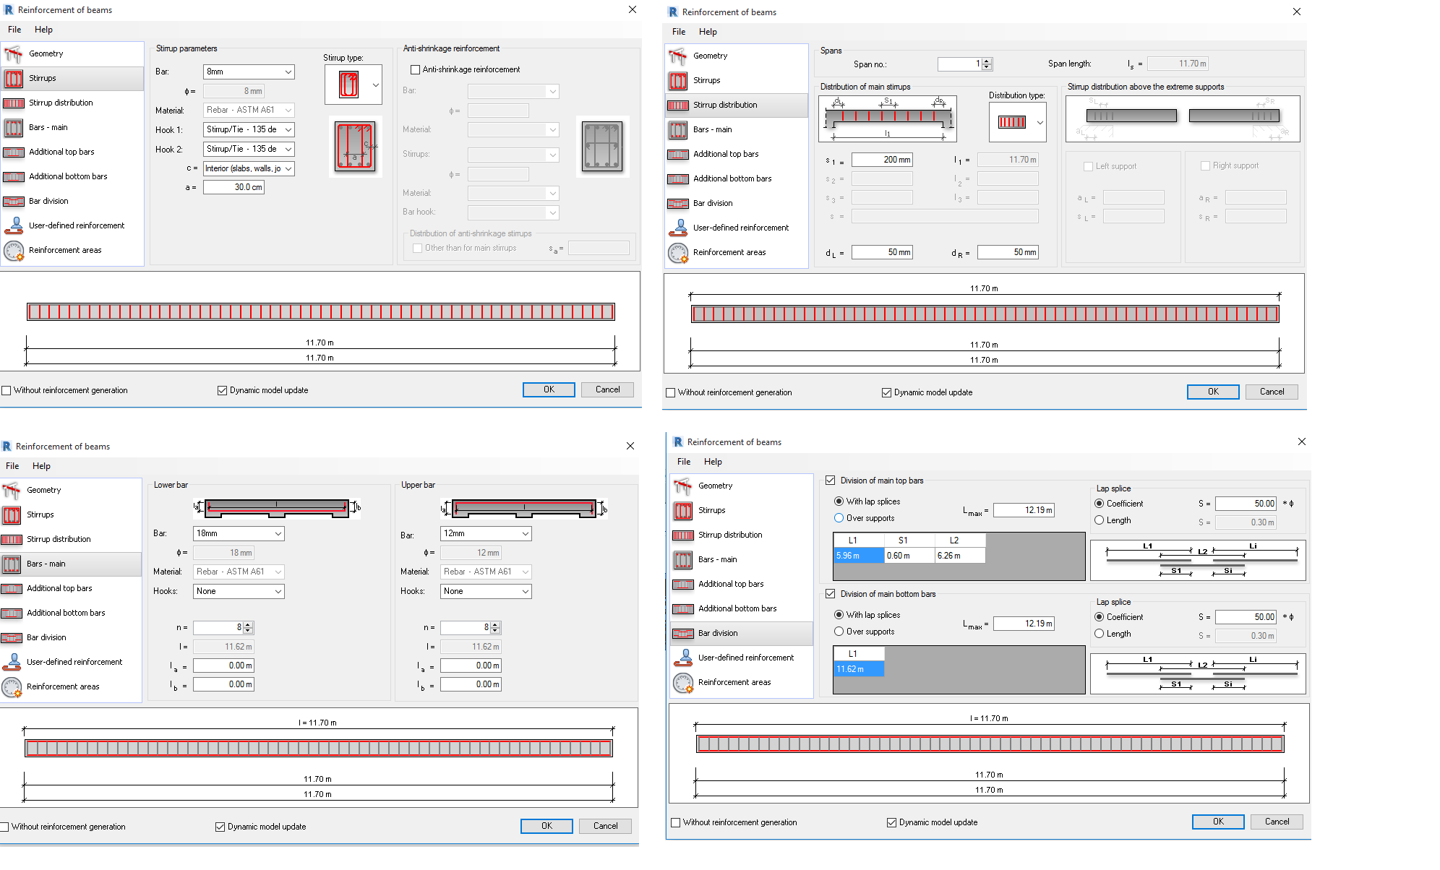
Slide Title
Rebar Extension for Beams

Slide 33
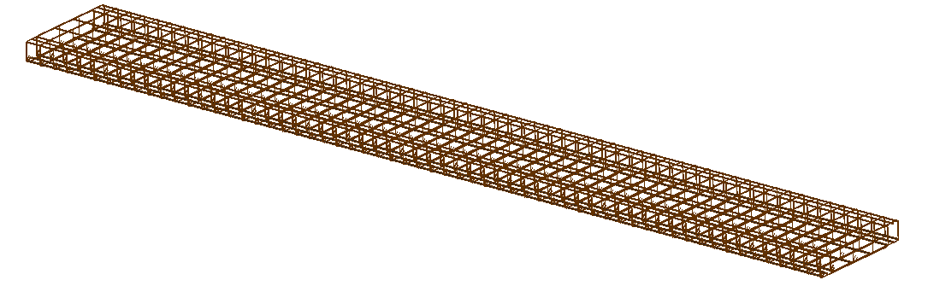
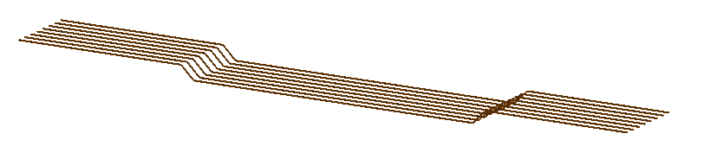
Beams Rebar in Revit
Bars and stirrups distribution for Beams in Revit
Bent Bars Distribution for Beams in Revit

Slide 34
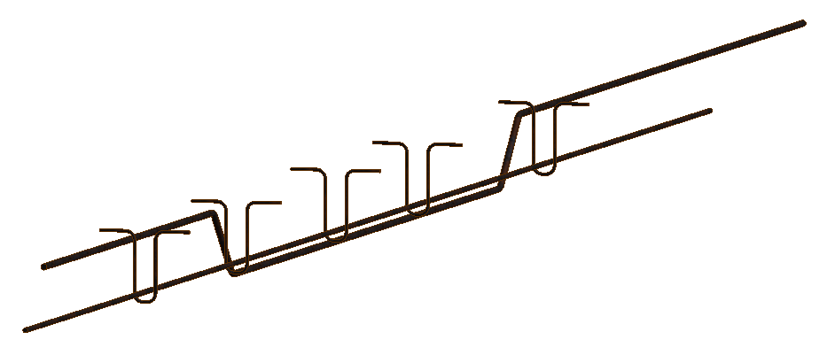
Slabs Rebar in Revit
Bars Distribution for Ribs in Revit

Slide 35
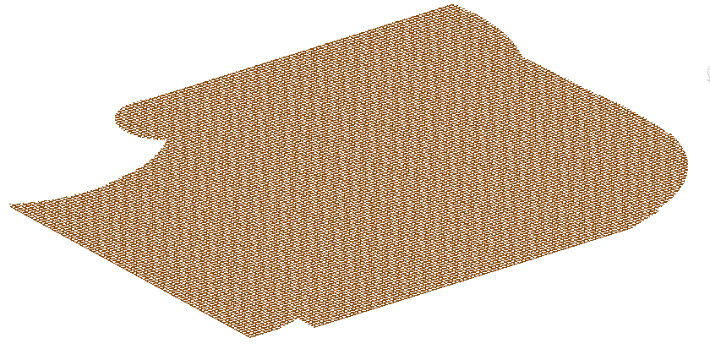
Bars Distribution for Shrinkage Steel Area in Revit

Slide 36

Slide Title

Slide 37
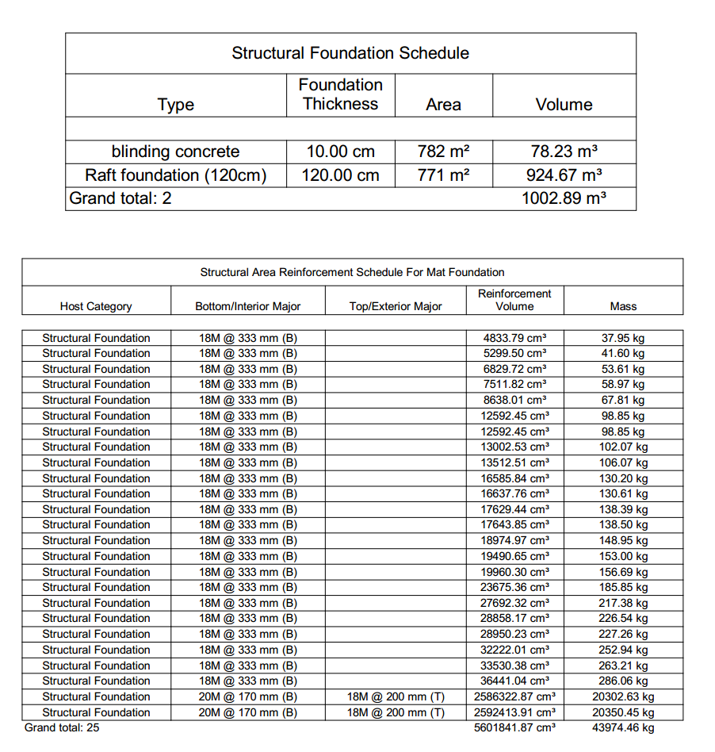

Slide 38
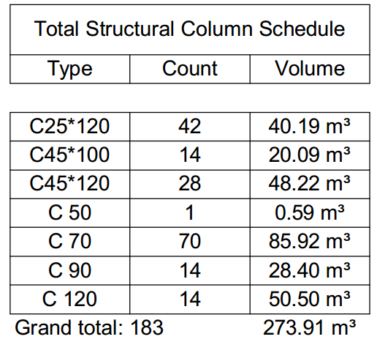
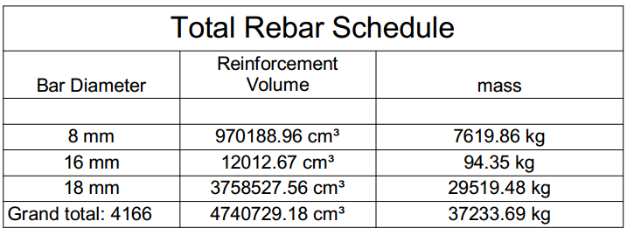
Columns Schedules Example

Slide 39
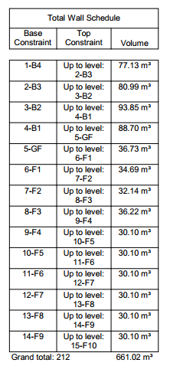
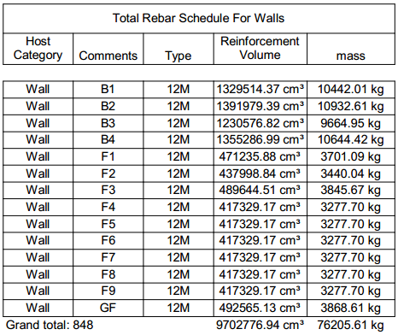
Slide Title
Shear Walls Schedules Example

Slide 40
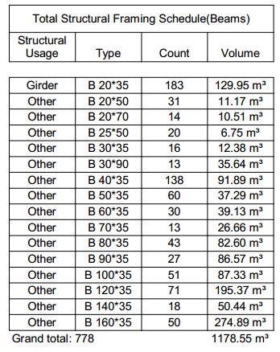
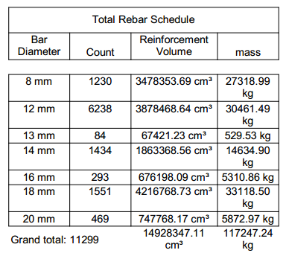
Beams Schedules Example

Slide 41
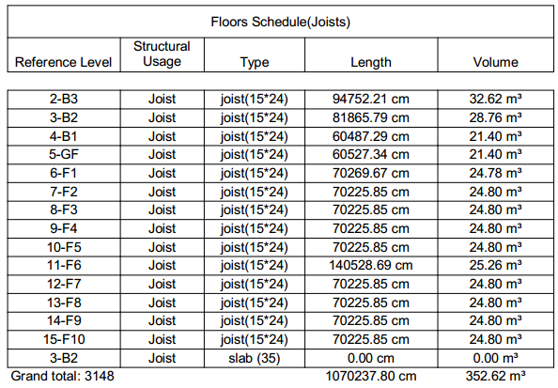
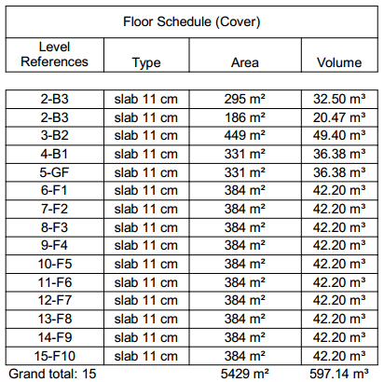
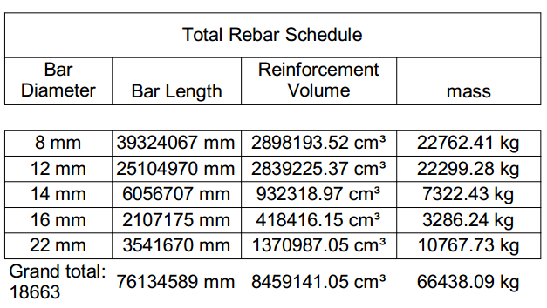
Floors Schedules Example

Slide 42
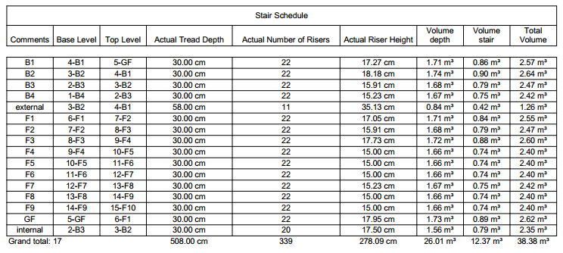
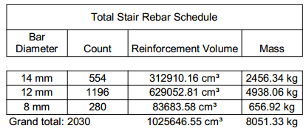
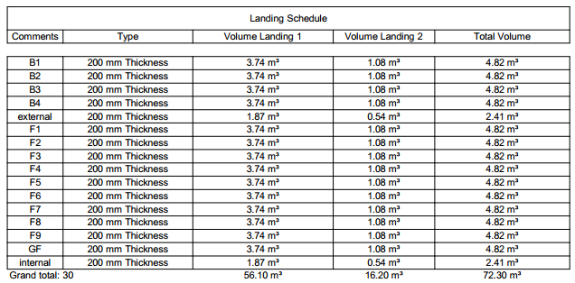
Stairs Schedules Example

Slide 43



Stones and Partitions Schedules Example

Slide 44

Formwork Schedules Example

Slide 45

PART 5
Project Human Resources
Management

Slide 46
Actual Resource Needed in the Project
Num. of persons | Work Type | Equivalent Crews Number
6 | Carpenter | 3
3 | HELPER (carpenter)
4 | steel fixer for column | 4
12 | steel fixer for raft | 12
8 | steel fixer for floor | 8
1 | Mason (stones) | 1
1 | HELPER (stones)
4 | Mason (partitions) | 4
4 | HELPER (partitions)
6 | Mason (plaster) | 6
6 | HELPER (plaster)

Slide 47



Slide 48
PART 6
Resources Price
Labor Resources Price
Resource Name | Price / Unit | Unit
Carpenter | 200 | Nis/d
Helper with Carpenter | 100 | Nis/d
Steel Fixer for Floors | 225 | Nis/d
Steel Fixer for Columns and Shear Walls | 225 | Nis/d
Mason for Stone Works | 560 | Nis/d
Helper for Stone Works | 200 | Nis/d
Mason for Partitions Works | 360 | Nis/d
Helper for Partitions Works | 85 | Nis/d
Mason for Plastering Works | 768 | Nis/d
Helper for Plastering Works | 85 | Nis/d

Slide 49
Resources Price
Materials Prices
Resource Name | Price / Unit | Unit
Concrete B300 | 320 | Nis/CM
Concrete B500 | 400 | Nis/CM
Steel 420 Mpa | 2600 | Nis/Ton
Stone | 130 | Nis/m²
Block 10 cm | 1.5 | Nis/Unit
Block 15 cm | 2 | Nis/Unit
Block 20 cm | 2.5 | Nis/Unit
Block 24 cm for Slabs | 2.8 | Nis/Unit
Mortar for Partition Works | 260 | Nis/CM
Plain Concrete | 270 | Nis/CM
Plastering Materials | 10 | Nis/m²

Slide 50

PART 7
Project Scope Management

Slide 51

Slide Title
Work Breakdown Structure(WBS)

Slide 52
Columns Works Duration and Materials needed for Block 1
Columns Works for Block 1
 |  | B4 | B3 | B2 | B1 | GF | F1 | F2 | F3 | F4 | F5 | F6 | F7 | F8 | F9
Formwork for columns | D | 1.75 | 1.75 | 2 | 2 | 2 | 2 | 1.75 | 2 | 1.75 | 1.75 | 1.75 | 1.75 | 1.75 | 1.75
 | M | 0 | 0 | 0 | 0 | 0 | 0 | 0 | 0 | 0 | 0 | 0 | 0 | 0 | 0
Steel fixing for columns | D | 1.25 | 1 | 1 | 1 | 1 | 1 | 1 | 1 | 1 | 1 | 1 | 1 | 1 | 1
 | M | 3520 | 2535 | 2870 | 2740 | 2830 | 2720 | 2560 | 2810 | 2450 | 2450 | 2450 | 2450 | 2450 | 2450
Casting concrete for columns | D | 0.25 | 0.25 | 0.25 | 0.25 | 0.25 | 0.25 | 0.25 | 0.25 | 0.25 | 0.25 | 0.25 | 0.25 | 0.25 | 0.25
 | M | 19 | 20 | 23 | 22 | 22 | 22 | 20 | 22 | 19 | 19 | 19 | 19 | 19 | 19
Deshuttering for columns | D | 0.5 | 0.5 | 0.5 | 0.5 | 0.5 | 0.5 | 0.5 | 0.5 | 0.5 | 0.5 | 0.5 | 0.5 | 0.5 | 0.5
 | M | 0 | 0 | 0 | 0 | 0 | 0 | 0 | 0 | 0 | 0 | 0 | 0 | 0 | 0
Curing for columns | D | 14 | 14 | 14 | 14 | 14 | 14 | 14 | 14 | 14 | 14 | 14 | 14 | 14 | 14
 | M | 0 | 0 | 0 | 0 | 0 | 0 | 0 | 0 | 0 | 0 | 0 | 0 | 0 | 0

Slide 53
Shear walls Works
Shear Walls works for Block 1
 |  | B4 | B3 | B2 | B1 | GF | F1 | F2 | F3 | F4 | F5 | F6 | F7 | F8 | F9
Formwork for walls | D | 4 | 4.25 | 5 | 4.75 | 1.75 | 1.75 | 1.5 | 1.75 | 1.5 | 1.5 | 1.5 | 1.5 | 1.5 | 1.5
 | M | 0 | 0 | 0 | 0 | 0 | 0 | 0 | 0 | 0 | 0 | 0 | 0 | 0 | 0
Steel fixing for walls | D | 2.75 | 2.5 | 2.75 | 2.75 | 1 | 1 | 1 | 1 | 1 | 1 | 1 | 1 | 1 | 1
 | M | 10650 | 9670 | 10940 | 10445 | 3870 | 3700 | 3440 | 3850 | 3280 | 3280 | 3280 | 3280 | 3280 | 3280
Casting concrete for walls | D | 0.75 | 0.75 | 0.75 | 0.75 | 0.5 | 0.5 | 0.5 | 0.5 | 0.5 | 0.5 | 0.5 | 0.5 | 0.5 | 0.5
 | M | 78 | 81 | 94 | 89 | 37 | 35 | 33 | 37 | 31 | 31 | 31 | 31 | 31 | 31
Deshuttering for walls | D | 1.5 | 1.5 | 1.75 | 1.75 | 0.75 | 0.75 | 0.5 | 0.75 | 0.5 | 0.5 | 0.5 | 0.5 | 0.5 | 0.5
 | M | 0 | 0 | 0 | 0 | 0 | 0 | 0 | 0 | 0 | 0 | 0 | 0 | 0 | 0
Curing for walls | D | 14 | 14 | 14 | 14 | 14 | 14 | 14 | 14 | 14 | 14 | 14 | 14 | 14 | 14
 | M | 0 | 0 | 0 | 0 | 0 | 0 | 0 | 0 | 0 | 0 | 0 | 0 | 0 | 0

Slide 54
Stone Works
Stone works for Block 1
 |  | B4 | B3 | B2 | B1 | GF | F1 | F2 | F3 | F4 | F5 | F6 | F7 | F8 | F9
Parameter Slab Stone installation | D | 0 | 0 | 0 | 0 | 0 | 3 | 3 | 3 | 3 | 3 | 3 | 3 | 3 | 3
 | M | 0 | 0 | 0 | 0 | 0 | 24 | 24 | 24 | 24 | 24 | 24 | 24 | 24 | 24
External walls stone installation | D | 0 | 0 | 0 | 0 | 4 | 3.75 | 3.5 | 4 | 3.25 | 3.25 | 3.25 | 3.25 | 3.25 | 3.25
 | M | 0 | 0 | 0 | 0 | 32 | 30 | 28 | 31 | 26 | 26 | 26 | 26 | 26 | 26

Slide 55
Floors Works for Block 1
 |  | B4 | B3 | B2 | B1 | GF | F1 | F2 | F3 | F4 | F5 | F6 | F7 | F8 | F9
Formwork for floors | D | 5.25 | 4.75 | 4.25 | 4.25 | 4.25 | 4.25 | 4.25 | 4.25 | 4.25 | 4.25 | 4.25 | 4.25 | 4.25 | 4.25
 | M | 0 | 0 | 0 | 0 | 0 | 0 | 0 | 0 | 0 | 0 | 0 | 0 | 0 | 0
Blocks distribution on the floors | D | 1.25 | 1 | 1 | 1 | 1 | 1 | 1 | 1 | 1 | 1 | 1 | 1 | 1 | 1
 | M | 4050 | 3640 | 3310 | 3310 | 3310 | 3310 | 3310 | 3310 | 3310 | 3310 | 3310 | 3310 | 3310 | 3310
Steel fixing for beams | D | 4.75 | 5 | 4.75 | 4.5 | 4.75 | 4.75 | 4.75 | 4.75 | 4.75 | 4.75 | 4.75 | 4.75 | 4.75 | 4.75
 | M | 8280 | 8650 | 8140 | 7950 | 8500 | 8430 | 8430 | 8430 | 8430 | 8430 | 8430 | 8430 | 8430 | 8340
Steel fixing for Ribs | D | 1.75 | 1.25 | 1 | 1 | 1 | 1 | 1 | 1 | 1 | 1 | 1 | 1 | 1 | 1
 | M | 4590 | 3260 | 2320 | 2320 | 3210 | 3210 | 3210 | 3210 | 3210 | 3210 | 3210 | 3210 | 3210 | 3210
Steel fixing for the shrinkage mesh | D | 0.75 | 0.75 | 0.5 | 0.5 | 0.5 | 0.5 | 0.5 | 0.5 | 0.5 | 0.5 | 0.5 | 0.5 | 0.5 | 0.5
 | M | 1880 | 1680 | 1530 | 1530 | 1530 | 1530 | 1530 | 1530 | 1530 | 1530 | 1530 | 1530 | 1530 | 1530
Casting concrete for the floors | D | 1 | 1 | 1 | 1 | 1 | 1 | 1 | 1 | 1 | 1 | 1 | 1 | 1 | 1
 | M | 155 | 142 | 154 | 142 | 145 | 150 | 150 | 150 | 150 | 150 | 150 | 150 | 150 | 150
Curing for floors | D | 28 | 28 | 28 | 28 | 28 | 28 | 28 | 28 | 28 | 28 | 28 | 28 | 28 | 28
 | M | 0 | 0 | 0 | 0 | 0 | 0 | 0 | 0 | 0 | 0 | 0 | 0 | 0 | 0
DE shuttering for floors | D | 1.25 | 1.25 | 1 | 1 | 1 | 1 | 1 | 1 | 1 | 1 | 1 | 1 | 1 | 1
 | M | 0 | 0 | 0 | 0 | 0 | 0 | 0 | 0 | 0 | 0 | 0 | 0 | 0 | 0

Slide 56
Partition Walls Works
Partition Walls Installation for Block 1
 |  | B4 | B3 | B2 | B1 | GF | F1 | F2 | F3 | F4 | F5 | F6 | F7 | F8 | F9
Partition walls of block 10 cm | Duration | 0 | 0.25 | 0.25 | 0 | 0 | 0.25 | 0.25 | 1 | 2.25 | 2.25 | 2.25 | 0 | 0 | 0
 | Area | 0 | 23 | 27 | 0 | 0 | 29 | 25 | 77 | 213 | 213 | 212 | 0 | 0 | 0
Partition walls of block 15 cm | Duration | 0.5 | 2.25 | 2.25 | 1.25 | 3 | 1.75 | 1.5 | 2 | 2 | 2 | 2 | 1 | 1 | 0.5
 | Area | 48 | 200 | 212 | 128 | 288 | 153 | 139 | 188 | 179 | 179 | 179 | 87 | 87 | 44
Partition walls of block 20 cm | Duration | 0 | 0.25 | 0.25 | 0.25 | 0.25 | 0.25 | 0.25 | 0.25 | 0.25 | 0.25 | 0.25 | 0 | 0 | 0
 | Area | 0 | 10 | 11 | 11 | 11 | 12 | 10 | 12 | 11 | 11 | 10 | 0 | 0 | 0

Slide 57
Plastering Walls Works
Plastering for Block 1
 | B4 | B3 | B2 | B1 | GF | F1 | F2 | F3 | F4 | F5 | F6 | F7 | F8 | F9
Shear Wall | 750 | 670 | 610 | 610 | 610 | 610 | 610 | 610 | 610 | 610 | 610 | 610 | 610 | 610
Floor | 674 | 708 | 821 | 776 | 289 | 273 | 253 | 285 | 237 | 237 | 237 | 237 | 237 | 237
Wall (10cm) | 0 | 46 | 54 | 0 | 0 | 58 | 50 | 154 | 426 | 426 | 426 | 0 | 0 | 0
Wall (15cm) | 96 | 400 | 424 | 256 | 576 | 306 | 278 | 376 | 358 | 358 | 358 | 174 | 174 | 88
Wall (20cm) | 0 | 20 | 22 | 22 | 22 | 24 | 20 | 24 | 22 | 22 | 20 | 0 | 0 | 0
Area | 1520 | 1844 | 1931 | 1664 | 1497 | 1271 | 1211 | 1449 | 1653 | 1653 | 1651 | 1021 | 1021 | 935
Duration | 4.00 | 5.00 | 5.00 | 4.50 | 4.00 | 3.50 | 3.25 | 3.75 | 4.50 | 4.50 | 4.50 | 2.75 | 2.75 | 2.50

Slide 58

PART 8
Time and Cost Management Using
Primavera Software

Slide 59

Project Definition In Primavera

Slide 60

Calendar Definition

Slide 61

Currency Definition

Slide 62

Work Breakdown Structure
(WBS) Assignment

Slide 63

Activities Definition

Slide 64

Activities Relationships Assignment

Slide 65


Resources Definition

Slide 66

Resources Assignment

Slide 67

Schedule (Run)

Slide 68
Results from Primavera for the Planning Phase
- Time schedule report .
- Budgeted total cost reports.
- Gantt chart found sheets.
- S-curve sheets.

Slide 69

Time Schedule Report

Slide 70

Budgeted Total Cost Reports

Slide 71


Slide 72

Gantt chart found sheets

Slide 73

S-Curve found sheets

Slide 74

S-Curve

Slide 75

PART 9
Cost and Price Estimate

Slide 76
Direct Cost
The direct cost calculated by Revit and primavera software and it was 13,530,715 NIS.

Slide 77

Materials Waste Factors
In-Direct
Cost
Job overhead cost = 10%
Operating overhead cost = 5%
Profit = 15%
Waste factor for materials = 5%
Waste of mortar in plastering = 13%

Slide 78
Blinding and Raft Foundation Cost and Price
1- Blinding direct cost = Budgeted Material cost + Budgeted Labor cost
= 97,600 + 2,625
= 100,225 NIS
2 – Raft Foundation direct cost = Budgeted Material cost + Budgeted Labor cost
= 1,672,000 + 77,625
= 1,749,625 NIS
Budgeted Total direct Cost of the Foundation = 1,849,850 Nis
Indirect cost = (0.1+0.05) ☓1,849,850
= 277,478 NIS
Waste of the materials = 0.05☓ (1,672,000 + 97,600)
= 88,480 NIS
Budgeted Total cost = 1,849,850 + 277,478 + 88480
= 2,215,808 NIS

Slide 79

Price of the foundation = 2,215,808 + (0.15☓2,215,808)
= 2,548,179 NIS
$Unit Price for the raft = \frac{Price }{Total Volume}$
= $\frac{\begin{aligned}2,548,179 \\ \end{aligned}}{3,982.97}$
= $640 NIS/mᶟ$

Slide 80

Columns and Shear Walls Cost and Price
Columns and Shear Walls direct cost = $budgeted Material cost + Budgeted Labor cost$
= $2,122,179.5+526,453.19$
= $2,648,632.69 NIS$
Indirect cost = 0.15☓2,648,632.69
= 397,294.9 NIS
Waste of the materials = 106,109 NIS
Budgeted Total cost = 2,648,632.69 + 397,294.9 +106,109
= 3,152,037 NIS

Slide 81

Price of the columns and shear wall = 3,152,037 + (0.15☓3,152,037)
= 3,624,843 NIS
$$Unit Price = \frac{Price }{Total Volume}$$
= $\frac{3,624,843 }{1,012.7}$
= 3,580 NIS/m³

Slide 82
Floors cost and price
Floors direct cost = Budgeted Material cost + Budgeted Labor cost
= 5,195,690 + 920,475
= 6,116,165 Nis
Indirect cost = 0.15☓6,116,165
= 917,424.75 Nis
Waste of the materials = 0.05☓5,195,690
= 259,785
Budgeted Total Cost = 6,116,165 + 917,424.75 + 259,785
= 7,293,385 Nis

Slide 83

Price of the floors = 7,293,385 + (0.15☓7,293,385)
= 8,387,393 NIS
$$Unit Price = \frac{Price }{Total Volume}$$
= $\frac{8,387,393 }{8,386}$
= 1000 NIS/m³

Slide 84
Partitions Cost and Price
Partitions direct cost = Budgeted Material cost + Budgeted Labor cost
= 334,195 + 249,200
= 583,395 NIS
Indirect cost = 0.15☓583,395
= 87,509.25 NIS
Waste of the materials = 0.05☓334,195
= 16,710 NIS
Budgeted Total cost = 583,395 + 87,509.25 + 16,710
= 687,614.25 NIS

Slide 85

Price of the partitions = 687,614.25 + (0.15☓687,614.25)
= 790,756.39 NIS
$$Unit Price = \frac{Price }{Total Area}$$
= $\frac{790,756.39}{12,960}$
= 61 NIS/m²

Slide 86

Stone Works Cost and Price
Stone Works direct cost = Budgeted Material cost + Budgeted Labor cost
= 322,136 + 213,750
= 535,886 NIS
Indirect cost = 0.15☓535,886
= 80,383 NIS
Budgeted Total cost = 535,886 +80,383
= 616,269 NIS
Price of the Stone works = 616,269 + (0.15☓616,269)
= 708,709 NIS
$$Unit Price = \frac{Price }{Total Area}$$
= $\frac{708,709 }{2225}$ = 319 NIS/m²

Slide 87
Plastering Cost and Price
Plastering direct cost = Budgeted Material cost + Budgeted Labor cost
= 762,950 + 1,033,836
= 1,796,786 Nis
Indirect cost = 0.15☓1,796,786
= 269,518 Nis
Waste of the materials = 0.13☓762,950
= 87,484 Nis
Budgeted total cost of the plastering = Budgeted Material cost + Budgeted Labor cost
= 1,796,786 + 269,518 + 87,484
= 2,153,788 Nis

Slide 88

Price of the plastering = 2,153,788 + (0.15☓2,153,788)
= 2,476,856 NIS
$$Unit Price = \frac{Price }{Total Area}$$
= $\frac{2,476,856}{77,143}$
= 32.1 NIS/m²

Slide 89
Bill of Quantity “B.O.Q.’’
B.O.Q.
Activity Name | Quantity |  | Unit Price |  | Total Price
 | Value | Unit | Value | Unit
Blinding and Raft Foundation | 3,982.97 | m³ | 640 | NIS/ m³ | 2,548,179
Columns and Shear Walls | 10,012.7 | m³ | 3,580 | NIS/ m³ | 3,624,843
Floors | 8,386 | m³ | 1000 | Nis/ m³ | 8,387,393
Partitions | 12,960 | m² | 61 | Nis/m² | 790,756
Stone Works | 2225 | m² | 319 | Nis/m² | 708,709
Plastering | 77,143 | m² | 32.1 | Nis/m² | 2,476,856
 |  |  |  | Total Price | 18,536,736 Nis

Slide 90
Results
The total project cost is 13,530,715 NIS.
The total project price is 18,536,736 NIS.
The project planning start at 1st Jan, 2018, and the planned finish date is 22th March 2020.
4. The duration for the project is 818 calendar days and 696 working days.
5. The cost Distribution and Percentages in the following table:

Slide 91
Cost Distribution and Percentage
Item | Total Cost | Total Price | Percent % of Total
Blinding and Raft Foundation | 2,215,808 | 2,548,179 | 14%
Columns and Shear Walls | 3,152,037 | 3,624,843 | 20%
Floors | 7,293,385 | 8,387,393 | 45%
Partitions | 687,614 | 790,756 | 4%
Stone Works | 535,886 | 708,709 | 4%
Plastering | 2,153,788 | 2,476,856 | 13
Summation ($) | 16,038,518 | 18,536,736 | 100%

