Slide 1


Reviving Nablus City CBD Area
An-Najah National University
Faculty of Engineering and Information Technology
Graduation Project 2
Supervised by
Prof. Samir Abu-Eisha
Murad Nabil Dmaidi and Hadi Wathek Abu-Yacoub

Slide 2
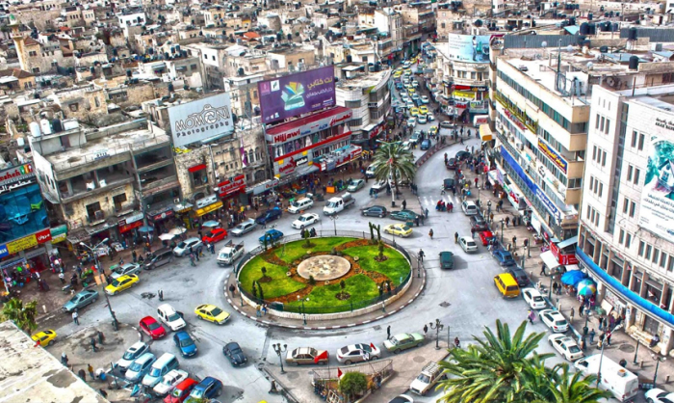

Slide 3
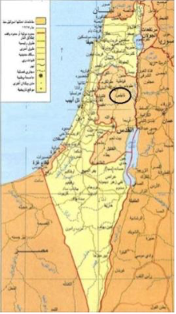
Nablus, Palestine

Slide 4
INTRODUCTION
Nablus is considered as a major economic center in West Bank/Palestine.
It is considered as a destination for vast number of people who travel to the city every day.
Large numbers of vehicles enter the city daily; this in turns causes increasing traffic congestion on the major corridors that convey traffic to the Central Business District (CBD) area of Nablus.

Slide 5
AIM
CBD Nablus Traffic Problems
Determination
Current
Future
Scenarios
&
Solutions
Stakeholder
appropriate decisions
Reviving CBD Area of Nablus City

Slide 6
METHODOLOGY
Parking
Traffic Volumes
(Vehicles & Pedestrians)
Analysis
Aerial Photographs
Scenarios & Testing
Structural Plans
Design & Cost
Solution

Slide 7
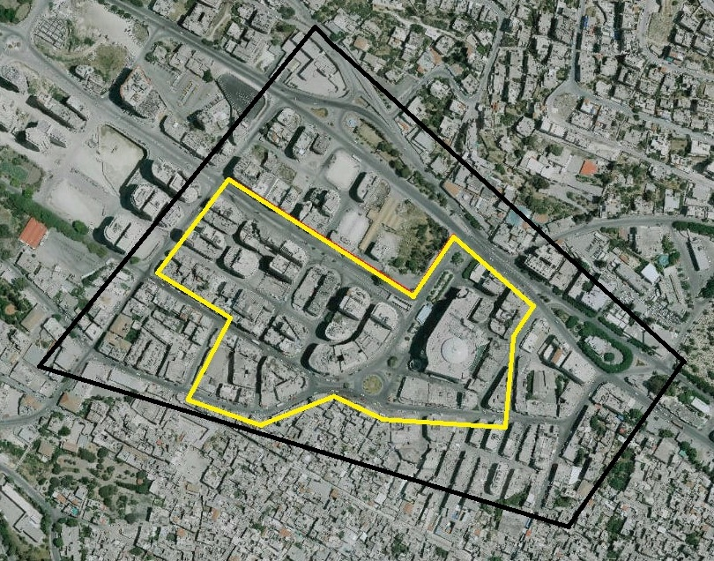
Sufyan
Bank
Haj- Nimer
Shuhada
Figure 1: Aerial photograph of the study area of Nablus CBD area.

Slide 8
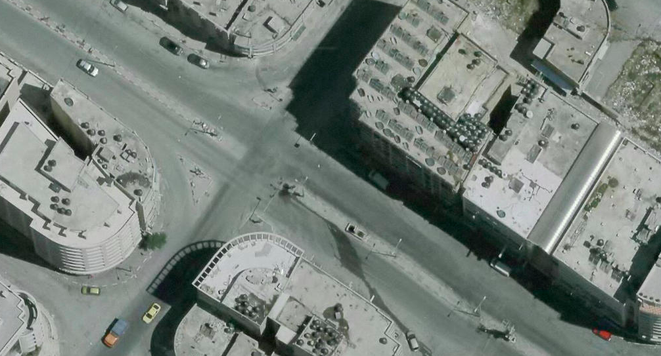
Sufyan Intersection

Slide 9
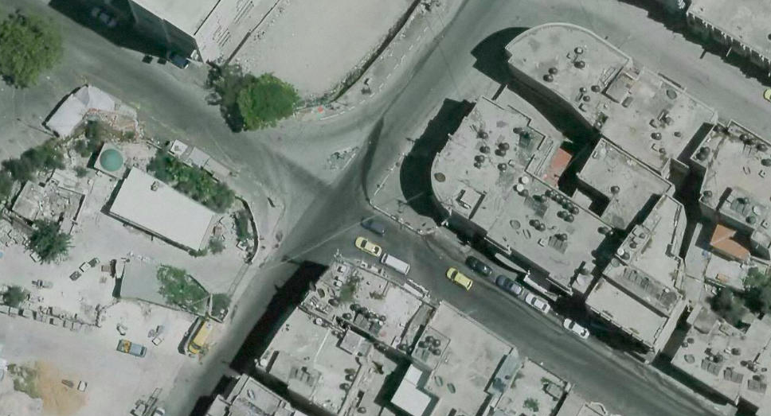
Bank of Palestine Intersection

Slide 10
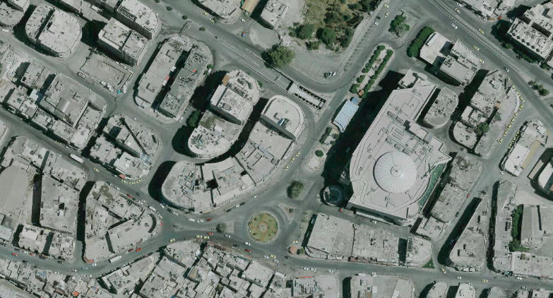
Shuhada Intersection

Slide 11
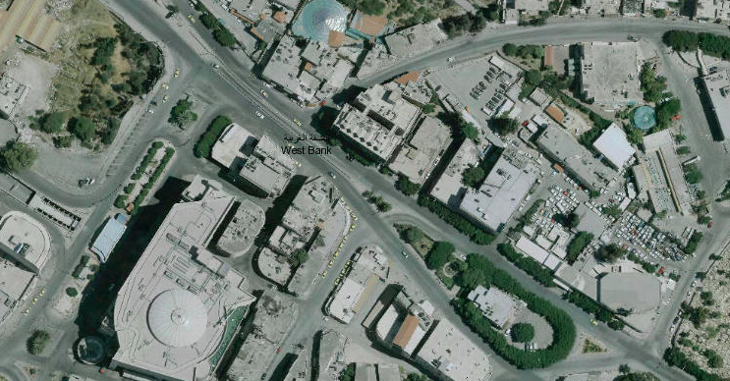
Haj-Nimer Intersection

Slide 12

Synchro Software
Simulated according to
HCM 2010
Scenario Testing

Slide 13
Do Nothing Scenario
Keep the status quo.
Determine network LOS for current and future conditions.

Slide 14
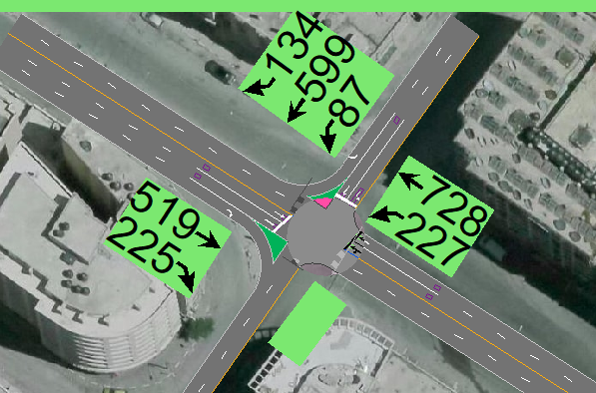
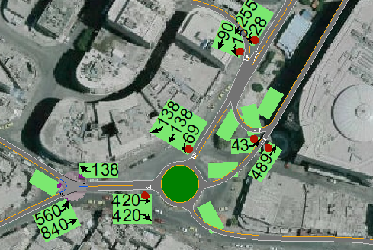
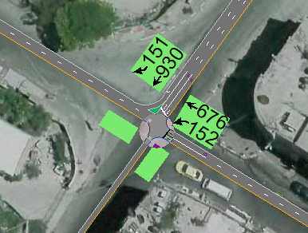
Present LOS
Current LOS
Sufyan
Shuhada
Bank
C
E
D

Slide 15
Vehicle Volume Growth Rate
Volume of Vehicles
Year
Figure: Vehicle volume growth of Watani intersection of Nablus CBD area.

Slide 16
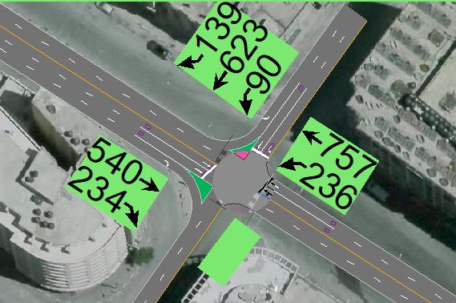
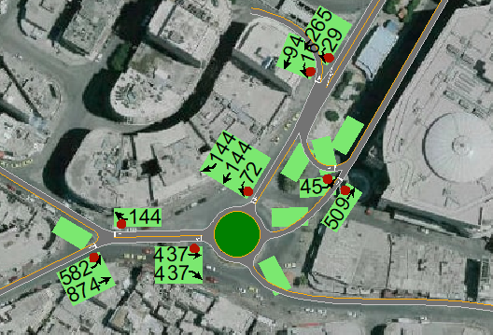
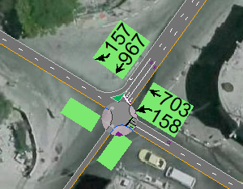
Future LOS
Future LOS
Sufyan
Shuhada
Bank
D
F
E

Slide 17
Parking Area, Designated Pedestrian Zone with Suitable Circulation Plan
Zone for pedestrians & public transportation.
New circulation plan (from 7am – 5pm).
Parking area with parking facilities.
Determine network LOS with these conditions.

Slide 18
Pedestrian Zone

Slide 19
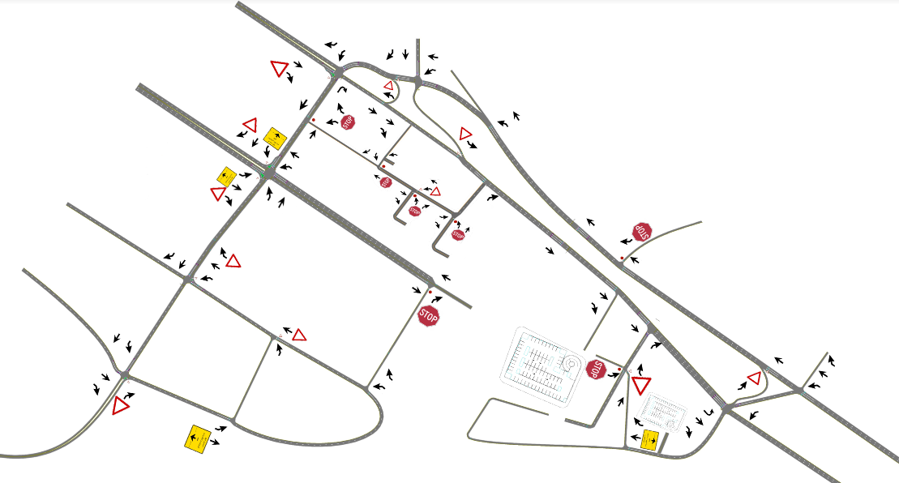
Circulation Plan

Slide 20
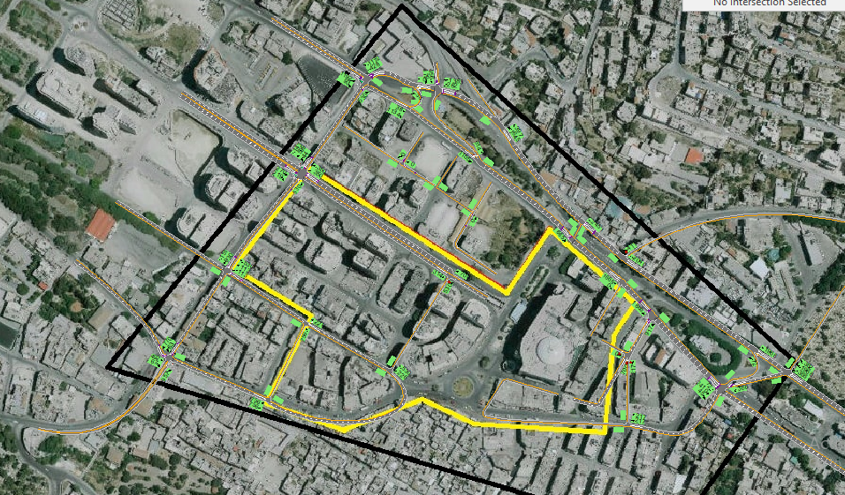
Modeling

Slide 21
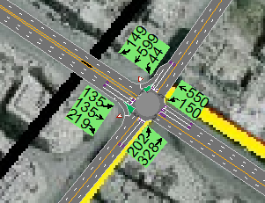
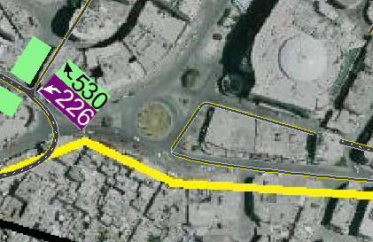
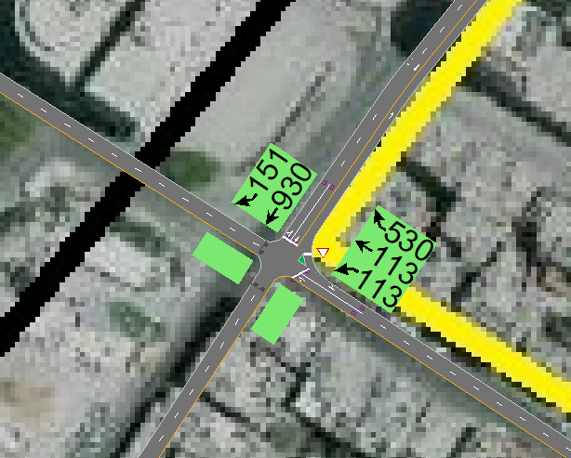
Present LOS
Resulting LOS
Sufyan
Shuhada
Bank
B
No Conflict
B

Slide 22
Allocating Public Transportation on The Boundaries of Nablus CBD Area
Public transportation will be moved to the boundaries of the CBD area.
Percentage = 𝑇𝑎𝑥𝑖𝑠/Total volume ∗ 100%
= 638/1158 ∗100% =55%
Assuming the percentage of taxis 50% and the percentage of shared taxis to the public transportation 60% it yields to 30% of all volume.
Determine network LOS with this reduction.

Slide 23
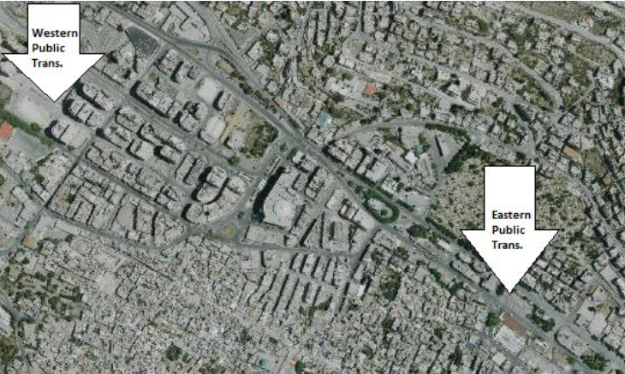

Slide 24
Present LOS
Shared Taxi Percentage
Total Vehicle Volume
Public Transportation
Private
%50
30% Shared Taxis

Slide 25
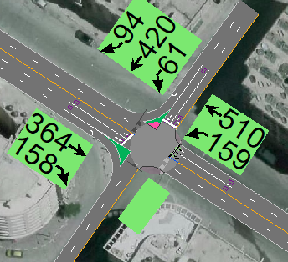
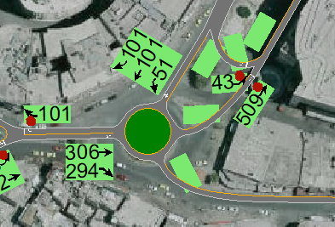
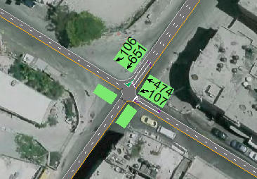
Present LOS
Resulting LOS
Sufyan
Shuhada
Bank
S
S
B

Slide 26
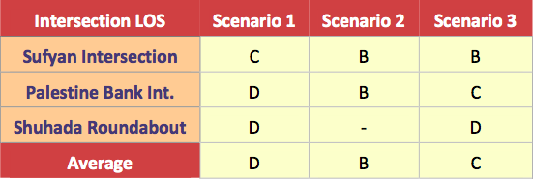
Scenario Selection
Comparing between the suggested scenarios based on LOS analysis the overall performance of each scenario.
Choosing the Reasonable Scenario.

Slide 27

Scenario 2

Slide 28
Design
Parking
Geometry
Controls
Demand &
Parking Area
Sufyan & Arz
Streets
Signs
Surface Lots
Bank
Intersection
Phasing &
Timings
Garages

Slide 29
Parking Demand & Supply
On-street parking supply lost in the zone equals 306 meters which is 612 space.
Supply =N*T*F= 612*10*0.9= 5508 space.hour
New Off-street parking demand = Supply = 5508 space.hour
Existing supply = 124*10*0.8= 992 space.hour
Total Demand = 4516 space.hour
Capacity of needed Parking Facilities:
  Main Garage = 3936/10*0.8= 492 (82 space * 6 floors)
  Surface Lots = 332/10*0.85= 39 ( 18 + 21 )

Slide 30
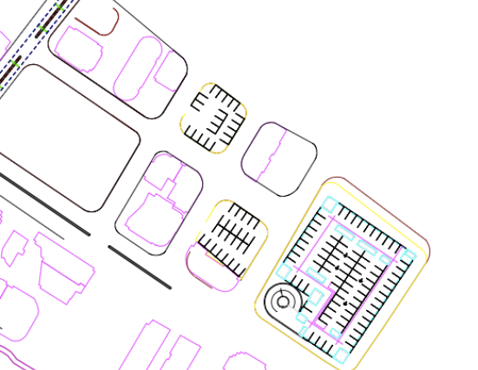
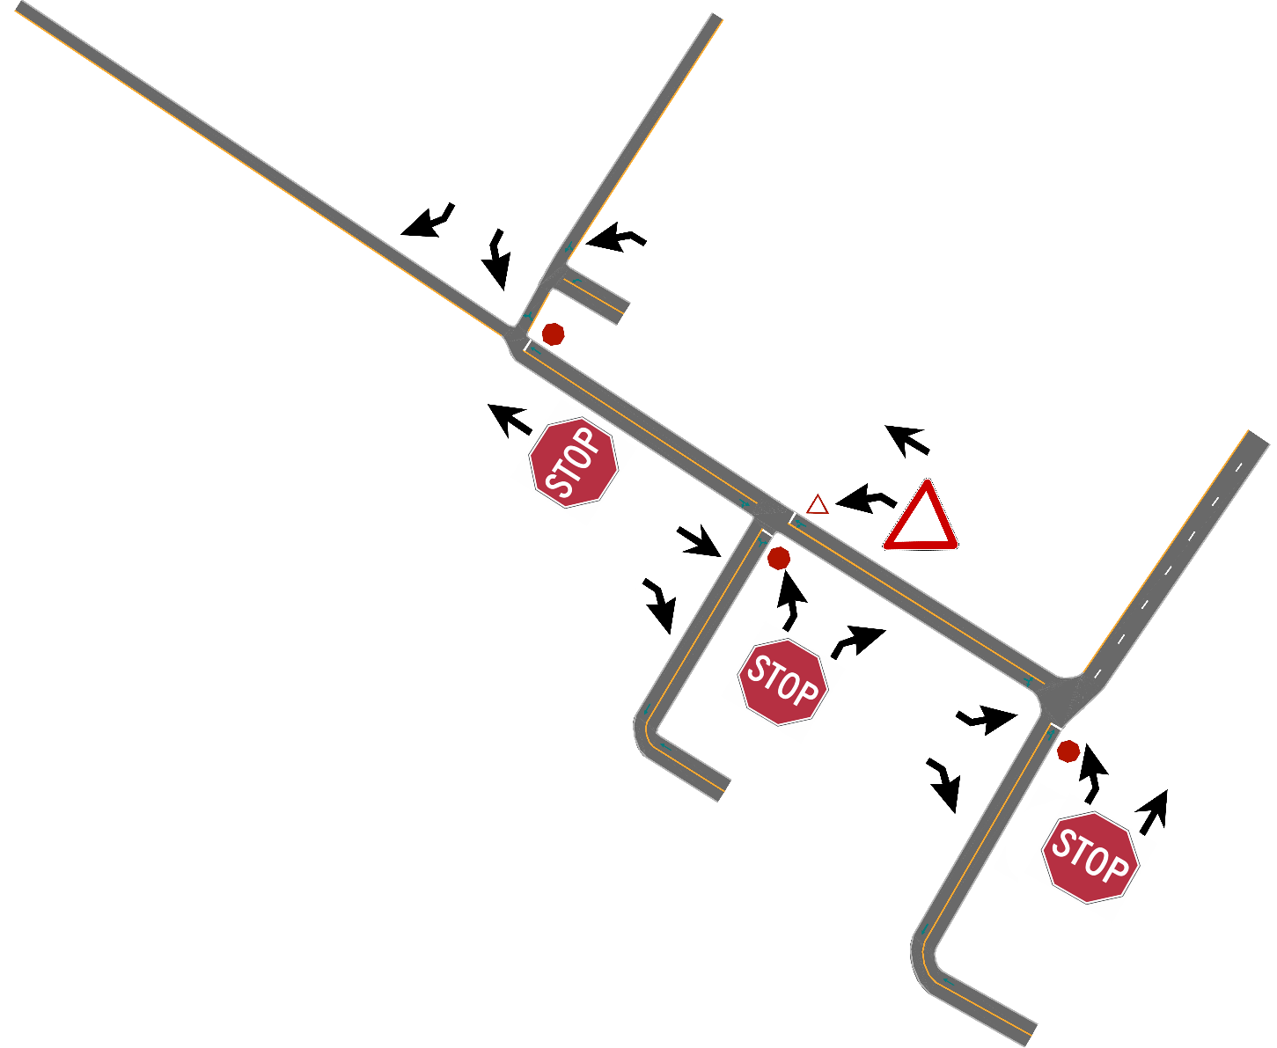
Parking Area
Parking Locations
Circulation Plan Within

Slide 31
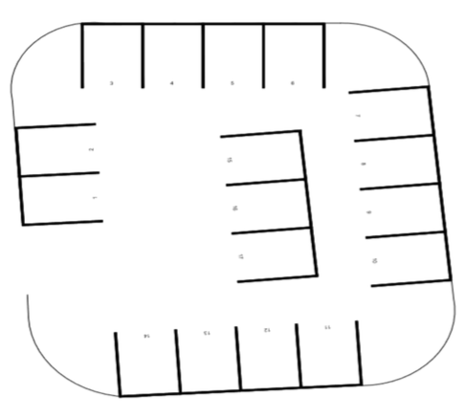
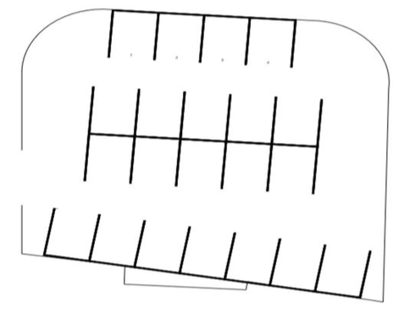
Surface Lots
Design
Spaces = 18
Spaces = 21

Slide 32
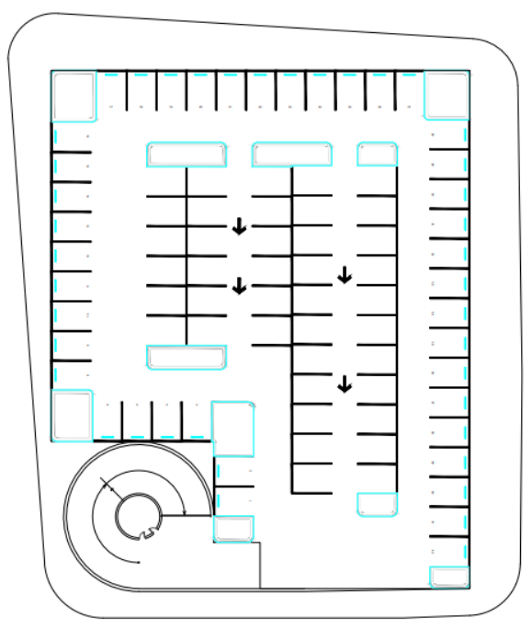
Main Garage
Design
Spaces = 82 space/floor * 6 floors = 492 space

Slide 33
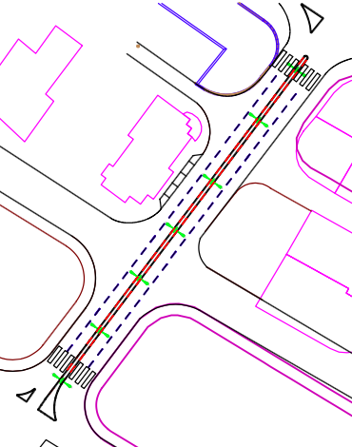
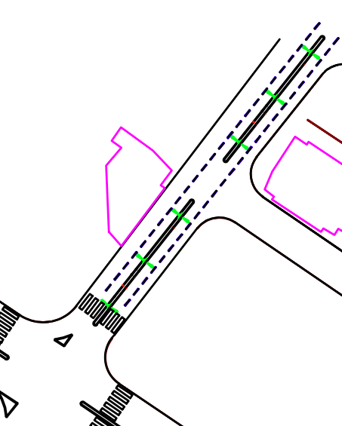
Geometry
Sufyan St.
Arz St.

Slide 34
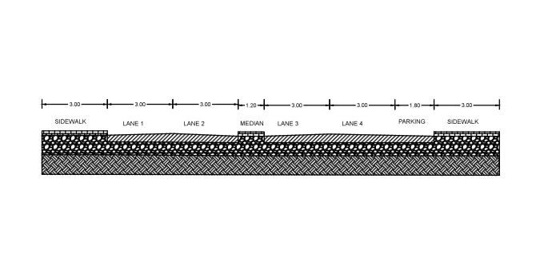
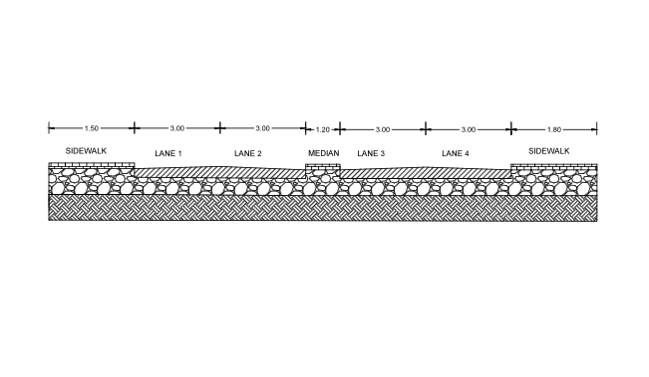
Geometry
Sufyan St.
Arz St.

Slide 35
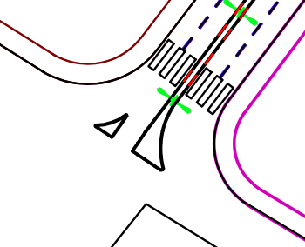
Geometry
Design
Bank Intersection.
Island designed according to AASHTO with a design vehicle SU.
Curve Radius = 40 ft
= 12 m
AutoCAD Sketch.

Slide 36
Controls Map
Design

Slide 37
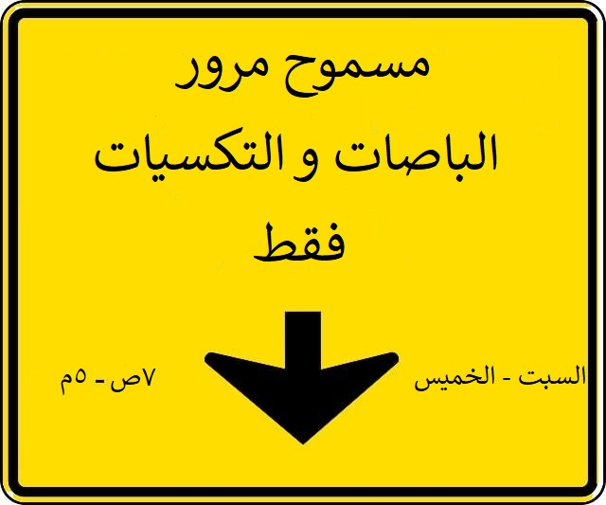
Zone Restricting Signs
Design
Zoning time 6 days a week from 7am - 5pm.
Put on 4 locations in the CBD (Entrances of the zone).

Slide 38
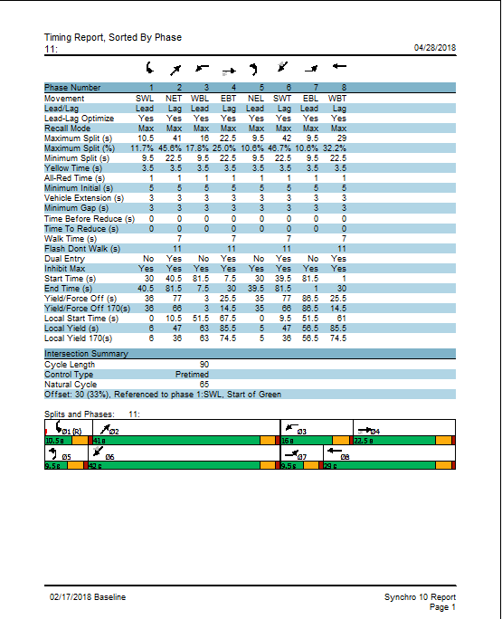
Phasing
8 Phases including Pedestrian walk time.
Cycle Length 90 s.

Slide 39
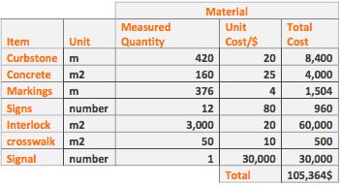
Cost Estimation
Control Elements

Slide 40
Cost Estimation
Main Garage
1,000,000$ per floor, 6 floors will be designed to meet the demand.
Total Cost:
6,000,000$ + 105,364$ = 6,105,364$

Slide 41
CONCLUSION
Pedestrians’ Effect
Vehicles
Relatively high volume
Nablus CBD Traffic Problems
Low Level of Service
Limited Capacity

Slide 42
RECOMMENDATIONS
Scenario 2
Parking Area
Pedestrian Zone
Circulation Plan
Reviving CBD Area of Nablus City

Slide 43


