Slide 1

Graduation Project 2
Structural Analysis and Design of the Dawabsheh Residential Building in Duma –Nablus – Palestine
Prepared By :
1) Abdallah Qasqas –
2) Huthaifa Abu-Nei’ma
3) Mohyee Aldeen Abu-Obaid
4) Shadi Halayqa
Under Supervision of:
Dr. Ibrahim Irman

Slide 2
Project Description
The Dawabsheh residential building is located in the Duma – Nablus. This project, which is currently under construction, consists of a warehouse floor, storage floor, top six floors , top sixth floor and has one entrance with a total area of 3576 m² and The total building height is 23m .

Slide 3
Structure Material
concrete
Reinforcing steel
Grade-60 steel is used to give the composite section the strength in tension side.
Yielding strength (fy) = 420MPa.
Modulus of elasticity (Es) = 200GPa.
Concrete with cylindrical compressive strength at 28 days (fc`) = 28 Mpa
The unit weight of the reinforced concrete is 25 KN/m3

Slide 4
  Design philosophy
1
2
3
A 3D model will be constructed and analyzed using SAP2000 program taking into consideration the effects of dynamic Loads.
Columns and Beams will be represented as line elements
Slabs and shear walls will be modeled as area elements.
4
5
The connections between the footings and the column necks will be represented as pin connections.
Ultimate design method will be used for analyzing the structure.

Slide 5
Loading
Dead load
Superimposed dead load
loads on the shear walls.
Live loads
Earth Quick loads

Slide 6
Dimensions of structural element were used in project :
Slab:
Tow way solid slab 20 cm
Beams:
B400*400 (Width * Depth)
B600*400 (Width * Depth)
Shear Wall:
S 25 cm ( Thickness)
Column:
C1 (600*400 ) (Width * Depth)
C2 (600*500 ) (Width * Depth)

Slide 7
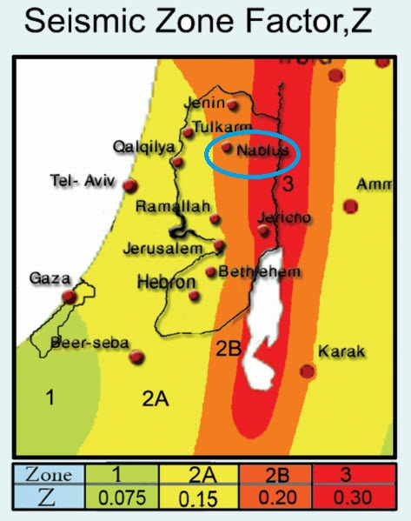
Lateral loads
According to the location of this project (Nablus), soil type (soft rock), and referring to IBC-2012 code the seismic parameters can be calculated as follows:
According to the Seismic Zone Factor (Z) map prepared by An-Najah National University for Palestine, Nablus ( bounded by blue circle in the map ) is located in zone (2B) and the seismic gravity acceleration factor for this zone = 0.2g

Slide 8
Lateral loads
Weight of structure:
The effective seismic weight:
W=Wdead+Wsd+0.25W live
Floor | W(KN)
GF (warehouse) | 0
Storage floor | 5749.89
First | 7410.4
Second | 7593.4
Third | 7593.5
Fourth | 7593.5
Fifth | 7593.4
Sixth | 7593.4
Seventh | 7263.005

Slide 9
Lateral loads
Design parameters of equivalent lateral force method (IBC 2012) :
According to the Seismic Zone Factor (Z) map for Palestine
S1= 1.25× Z = 1.25× 2 = 0.25 Israel standard SI 413 -202.1.2-2b
Ss = 2.5× Z = 2.5 × 0.2 = 0.5
Site classified as “C” according to ASCE ASCE Table 20.3-1
SMs = Fa × Ss IBC-2012
SM1= Fv × S1 IBC-2012
Fa = 1.2 ASCE Table 1613.3.3(1)
Fv = 1.55 ASCE Table 1613.3.3(2)
Then:
SMs = 0.6
SM1 = 0.3875
SDs = SMs
SD1 = SM1
SDs = 0.6
SD1 = 0.3875

Slide 10
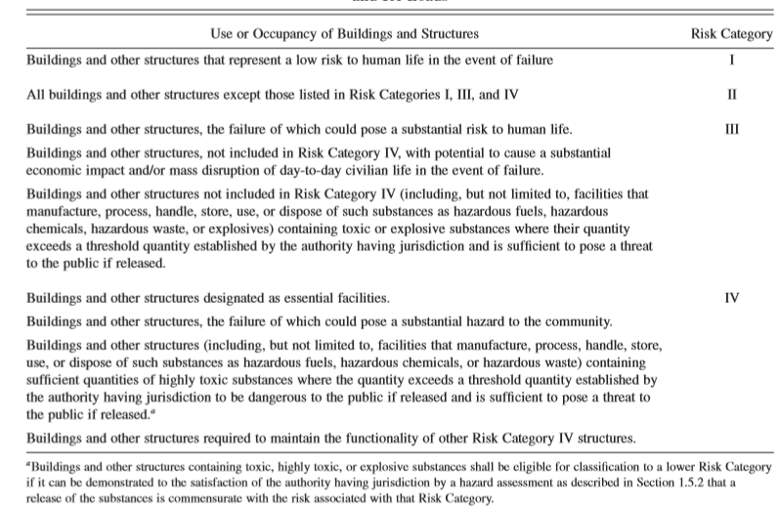
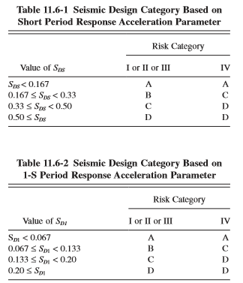
Lateral loads
Occupancy category of structure is II form ASCE-Table 1.5-1.
From Table 1613.3.5(1), the seismic design category is D.
From Table 1613.3.5(2), the seismic design category is D.
Therefore, the seismic design category is D.
According to Table 12.6-1in ASCE, equivalent lateral force method is permitted to use for all structures when the design category is D.

Slide 11

Lateral loads
Calculation for Base Shear:
V = Cs W (ASCE7-10 12.8.1)
Cs = min($\frac{SD1}{\left(\frac{R }{I}\right)Ta}$ , $\frac{SDS}{\left(\frac{R }{I}\right)}$)
Ta = C_{T} h_{n} ^{x}
From ASCE table 12.8-2
C_{T} =0.049
X = 0.75
Ta = 0.514 sec
Then
$\frac{SD1}{\left(\frac{R }{I}\right)Ta}$ = 0.15
$\frac{SDS}{\left(\frac{R }{I}\right)}$ = 0.12
So, Cs = 0.12
The value of base shear for all floors equal
V = Cs * W
V = 0.12 * 58351.064
V = 7002.1276 KN

Slide 12

Lateral loads
Horizontal Distribution of Base Shear on stories :
Fx = Cvx * V ASCE 07-10 section 12.8.3
Where:
Cvx = Vertical Distribution Factor
V = Base shear
Cvx = $\frac{Wx∗hx^K}{∑Wi∗hi^k}$
Where:
Wx = Weight at level x
h_{x} = elevation of level x above the base
k = exponent related to structure period, when T < 0.5sec, k =1, When T > 2.5sec, k =2,
and linearly interpolate when 0.5 < T < 2.5sec.
Since, T = 0.049 x 23^{0.75} = 0.514
So, K by interpolation equal 1.0073
K = 1.0073 ≈ 1

Slide 13
Lateral loads
The distribution of forces on the stories as shown on the below Table.
FLOOR | W (KN) | H^{K} (m) | W_{X} × H_{X}^{K} (KN/m) | C_{vx} | F_{X}
STORAGE FLOOR | 5749.89 | 2.65 | 17490.53 | 0.001588 | 111.206
FIRST | 7410.4 | 5 | 46528.1635 | 0.04226 | 295.82
SECOND | 7593.4 | 8 | 81529.26 | 0.074 | 518
THIRD | 7593.4 | 11 | 117269.7578 | 0.1065 | 745.5
FOURTH | 7593.4 | 14 | 154433.4703 | 0.14 | 980
FIFTH | 7593.4 | 17 | 192749.7048 | 0.175 | 1225
SIXTH | 7593.4 | 20 | 232039.5518 | 0.21 | 1470
SEVENTH | 7263.005 | 23 | 258922.542 | 0.235 | 1645

Slide 14
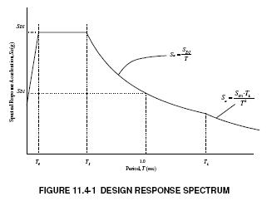
LATERAL LOADS
Response spectrum that is defined in IBC 2012
Response spectrum is an elastic response spectrum for 5 percent equivalent viscous damping used to represent the dynamic effects of the Design Basis Ground Motion for the design of structures.

Slide 15
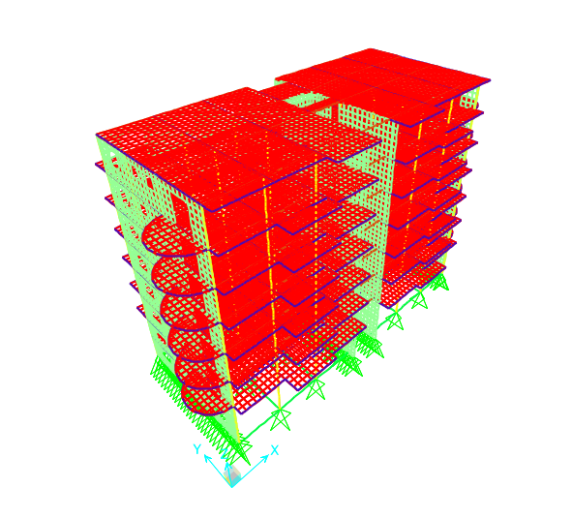
THREE DIMENSIONAL STRUCTURE ANALYSIS
The modeling starts with building block using SAP2000 by first defines: materials, sections as one-dimensional elements (columns and beams) and two-dimensional elements (slabs and shear walls), and loads (gravity and lateral loads), then draws each element relative to specific grid system on SAP2000.

Slide 16
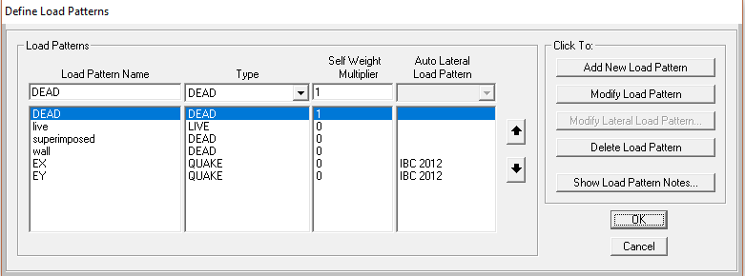
THREE DIMENSIONAL STRUCTURE ANALYSIS
Loads on SAP2000
Load pattern

Slide 17
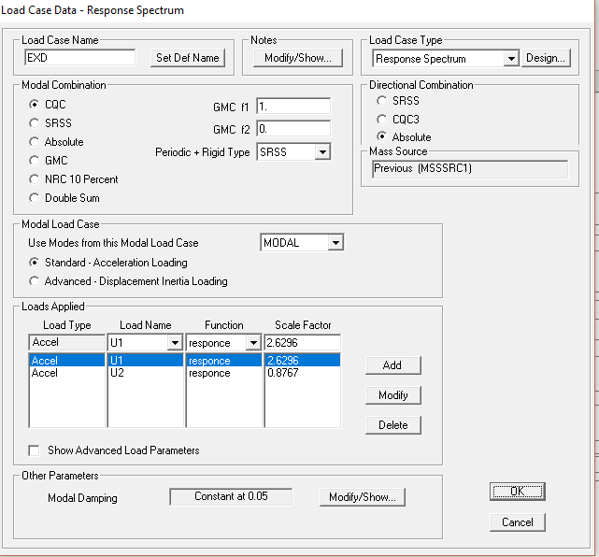
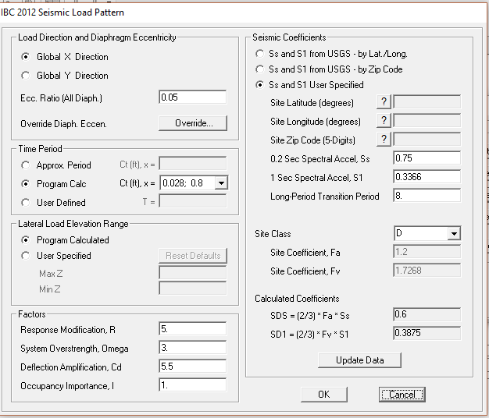
THREE DIMENSIONAL STRUCTURE ANALYSIS
Seismic load:
IBC code was used to define the load using equivalent static method and response spectrum and two figures shows the definition for IBC 2012.

Slide 18
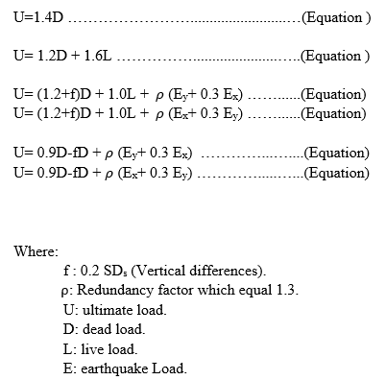
THREE DIMENSIONAL STRUCTURE ANALYSIS
Load Combinations:

Slide 19
Verifications of structural analysis
Strength check
Columns and beams should be checked for shear and torsion. In addition, for columns refer to ACI-318M-14 should be between 1% and 8%but for practical and economic consideration, for Beams ρ is recommended to be less than for singly.
After run and design of the structure, there were no red elements, so there were not any shear or torsion problems that would cause the elements to be over stressed.

Slide 20
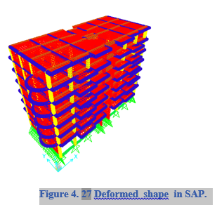
Verifications of structural analysis
Compatibility of structural model
By making start animation for the deformed shape of SAP2000 model, it can be noticed that the structural elements are compatible and all of them are moving together. Figure shows the deformed shape.

Slide 21
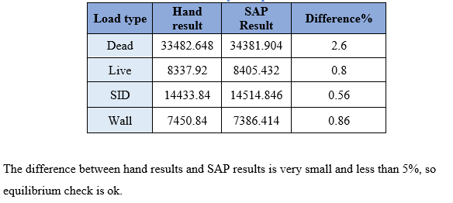
Verifications of structural analysis
Equilibrium

Slide 22
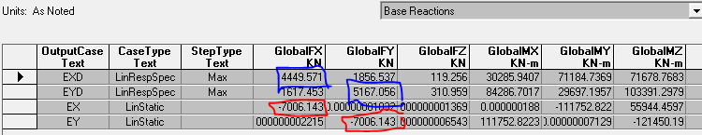
3D Model and Checks for First system: solid slab
Seismic load
Base shear for seismic load from sap from IBC-2012 is shown in Figure
Scaling of response spectrum results (IBC)
The scale factors must be modified according to IBC code in a way that the base shear from dynamic analysis is not less than 0.85 of the base shear from equivalent static method. Figure 4.22 shown base shear from equivalent static and response spectrum method

Slide 23
3D Model and Checks for First system: solid slab
Seismic load
Factors for modification
X = 4449.571/(0.85*7006.143)
X = 0.7471
Y = 5167.056/(0.85*7006.143)
Y = 0.86765
Therefore, multiply each scale factor in dynamic response in x-direction (EXD-IBC) by 0.7471, and multiply each scale factor in dynamic response in y-direction (EYD-IBC-) by 0.86765.
22

Slide 24
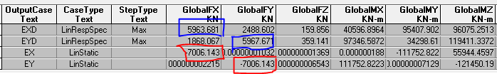
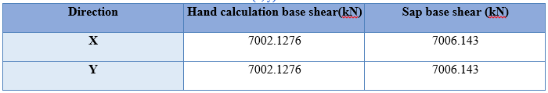
3D Model and Checks for First system: solid slab
Seismic load
After modifier scale factor:
The comparison between hand calculation and sap results for seismic loads (x, y) from IBC-2012 is shown in Tables
The values of base shear from hand calculation and equivalent static (SAP) are close to each other, so the check is okay.
23

Slide 25
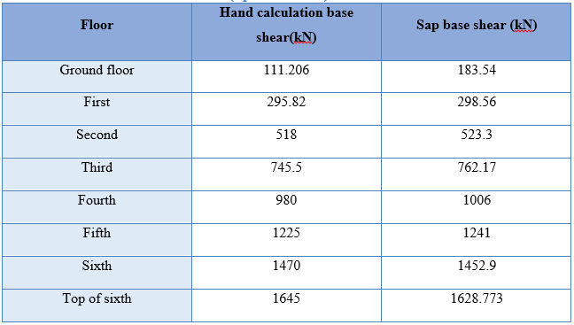
3D Model and Checks for First system: solid slab
comparison between the base shear at each floor from hand calculation and sap from IBC code.
24

Slide 26
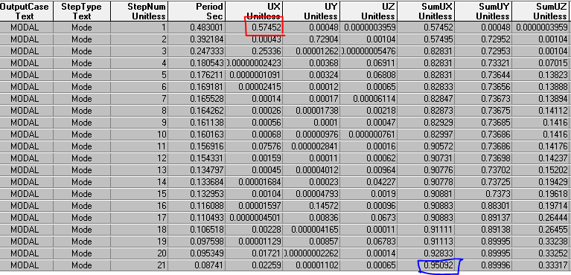
3D Model and Checks for First system: solid slab
Period and modal participation ratio :
Period and modal participation ratio for IBC code for modal X and Y are shown in Figures X and y respectively
25

Slide 27
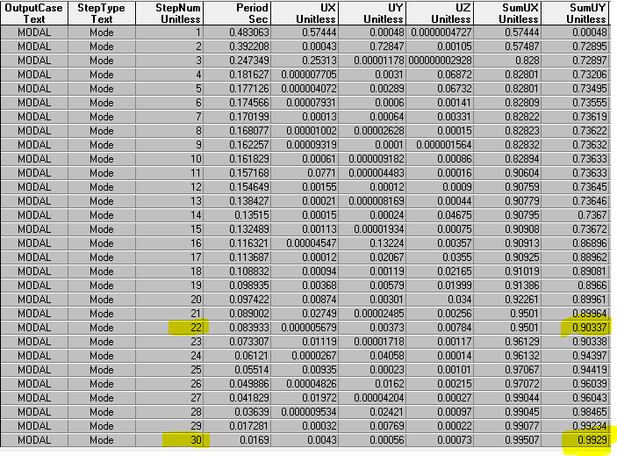
3D Model and Checks for First system: solid slab
The summation of modes in x and y for both codes is greater than 90% , where Ritz vectors approach is was used to get this percentage using 30 modes .
26

Slide 28
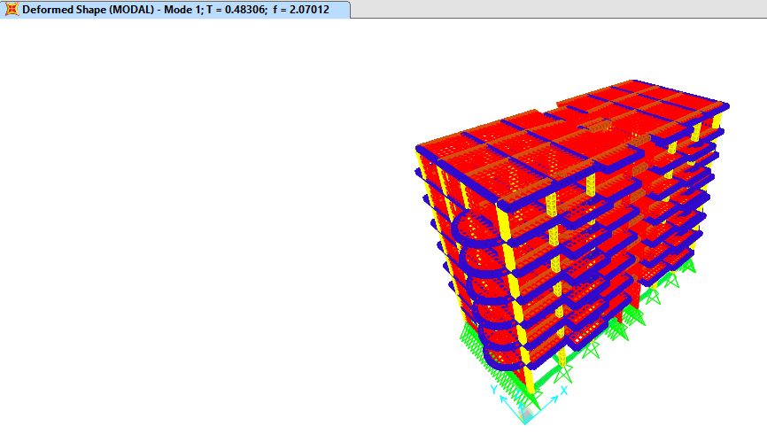

3D Model and Checks for First system: solid slab
By using Rayleigh’s formula to calculate T, Tn =2 π $\sqrt{\frac{\sum{Wi δ2}}{g\sum{Fi δi } }}$
T from SAP for the first mode equal = 0.483 sec.
The period should be less than C_{u} T_{a}
C_{u} = 1.4 (ASCE Table 12.8.1)
T ≤ C_{u} T_{a} = 1.4 x 0.049 x 23^{.75}
= 1.096 sec
that means 0.483 < 1.096Ok.
27

Slide 29
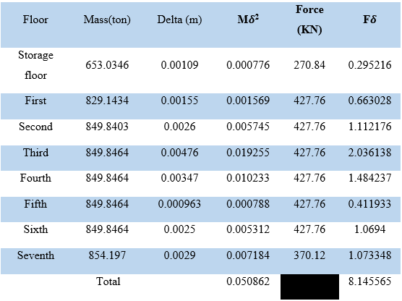

3D Model and Checks for First system: solid slab
Applying Rayleigh’s formula to calculate T manually:
Assuming a distributed area load having a value of 1 KN/m2 distributed at all stories.
T_{x} = 2π $\sqrt{\frac{0.050862}{8.145565 }}$
T_{x} = 0.4965 sec
Difference% =
$$\frac{0.4965−0.48306}{0.4965}100\%$$
= 0.69 % ➔ OK
28

Slide 30
Verifications of structural analysis
Stiffness irregularity – soft story In X:
1- Torsional Irregularity
  larger story drift more than 1.2 times average story drift
2- Extreme Torsional Irregularity
  larger story drift more than 1.4 times average story drift
3- Re-entrant Corners
(No re-entrant corners in this building)
4- Diaphragm Discontinuities
(Open areas are not greater than 50% of the gross enclosed diaphragm area refers to architectural drawings.)
5- Out-of-Plane Offsets
(No out-of-plan offsets in our building)
6- Nonparallel Systems
(All of lateral force-resisting element are parallel).
29

Slide 31
Verifications of structural analysis
Stiffness irregularity – soft story in Y:
1- Stiffness Irregularities:
1a - Soft Story
  the lateral stiffness is less than 70% of that in the story above or less than 80% of the average stiffness of the three stories above.
1b - Extreme Soft Story
  the lateral stiffness is less than 60% of that in the story above or less than 70% of the average stiffness of the three stories above.
(Not permitted in Design Categories E & F. No soft story in our building)
2- Weight (Mass) Irregularity
) There is no found mass of any story is more than 150% of the effective mass of an adjacent story).
3- Vertical Geometry Irregularity
(No vertical geometry irregularity in this building).

Slide 32
Verifications of structural analysis
Stiffness irregularity – soft story in Y:
4- In-Plane Discontinuity in Vertical Lateral Force Resisting Elements
(There is no discontinuity in Vertical Lateral Force Resisting Elements).
5-Discontinuity in Capacity - Soft Story
(There is no Discontinuity in Lateral Strength- Weak or Extreme Weak Story irregularity).
31

Slide 33
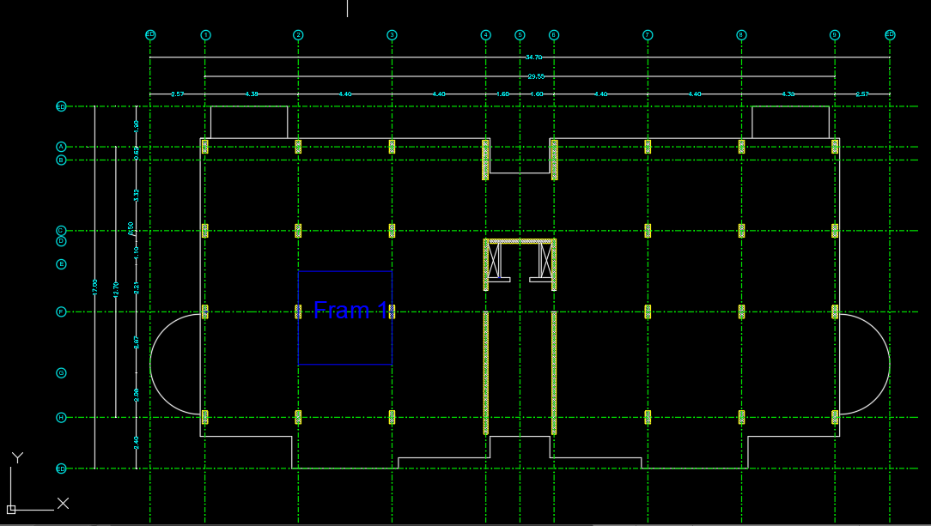
Verifications of structural analysis
Stress Strain relationship (internal equilibrium)
32

Slide 34
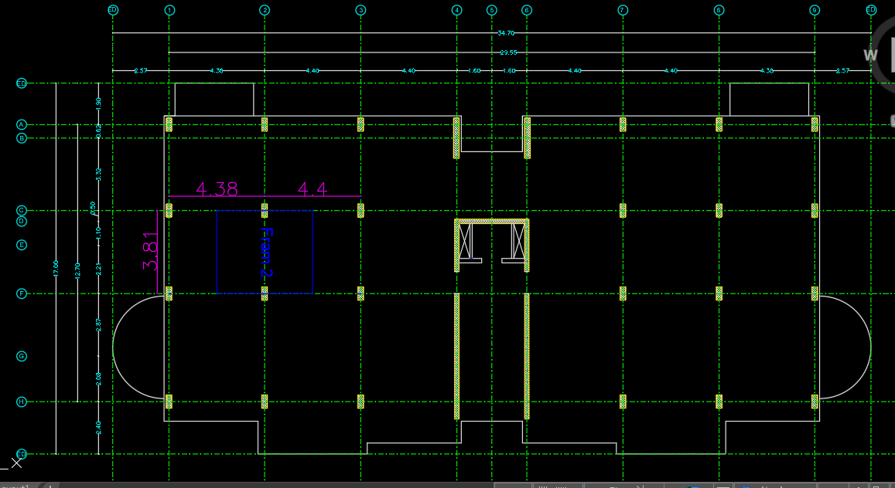
Verifications of structural analysis
Stress Strain relationship (internal equilibrium)
33

Slide 35
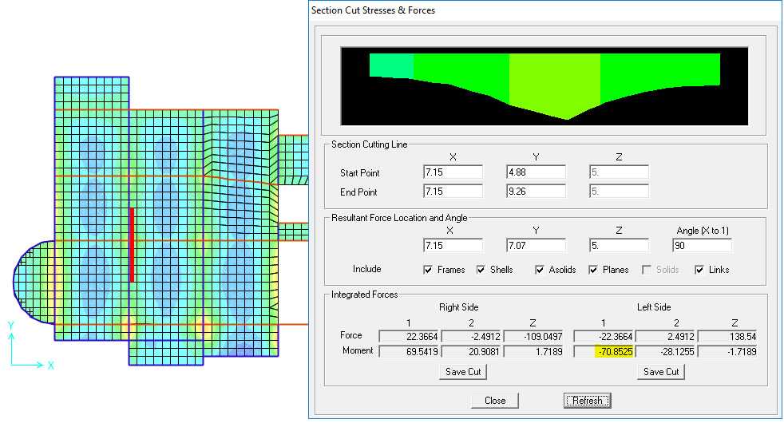


Verifications of structural analysis
Moment in frame1
$$moment\left(M11\right) in frame 1 from Sap=127.49KN.m$$
$$moment(M11) in frame 1 from calculatio=127.869KN.m$$
$$infram 2$$
$$Difference\%=\frac{84.53−82.55}{82.55}=2.4\%$$
$$Difference\%=\frac{127.869−127.49}{127.869}=0.29\%$$
34

Slide 36
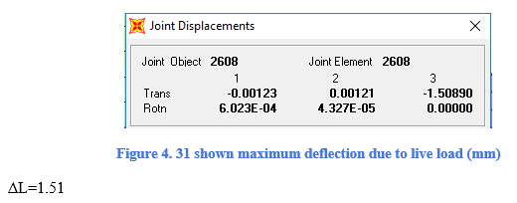
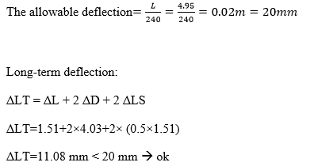
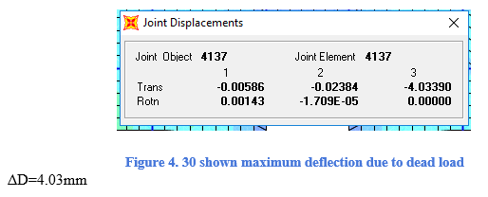

Verifications of structural analysis
Check slab for deflection :
35

Slide 37
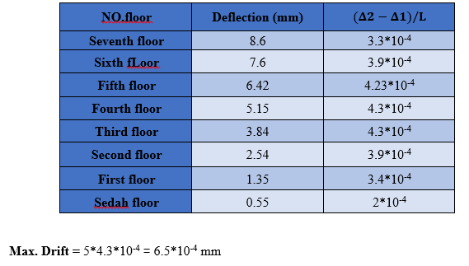
Verifications of structural analysis
Story drift:
Δ_{allowable} = 0.007
- All calculation stories drift are okay because they are less than 0.007 .
36

Slide 38
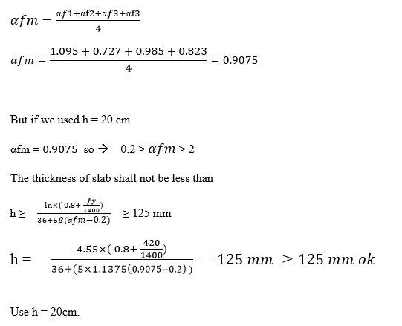
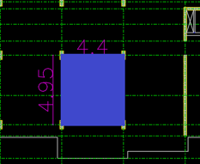
Design of Slab
Assume slab thickness equal 20 cm.
Assume beams of continues spans to be 400 and 600 mm width and to have thickness of 400 mm
37

Slide 39
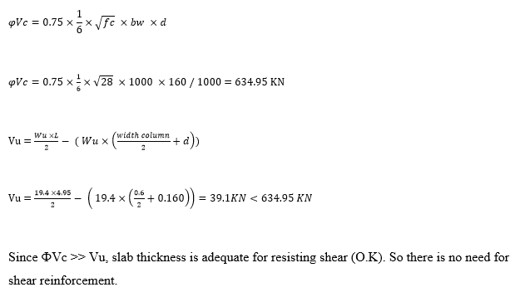
Design of Slab
Wide-beam shear check
38

Slide 40
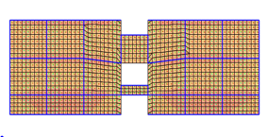

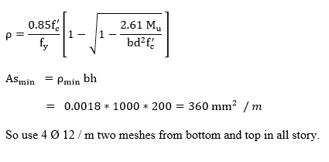


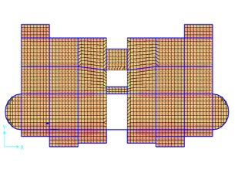

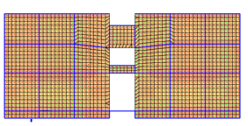
Design of Slab
Design the slab for flexure
39

Slide 41
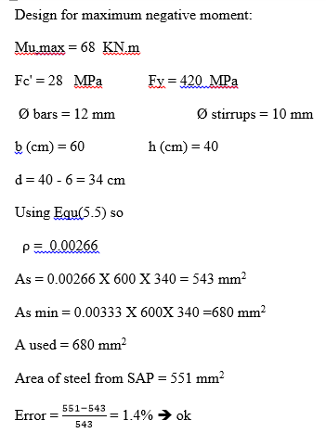
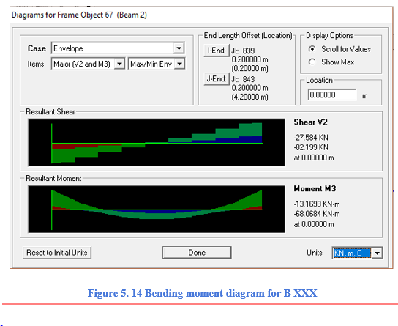
Design of Beams
Design of Beam for flexure
.
40

Slide 42
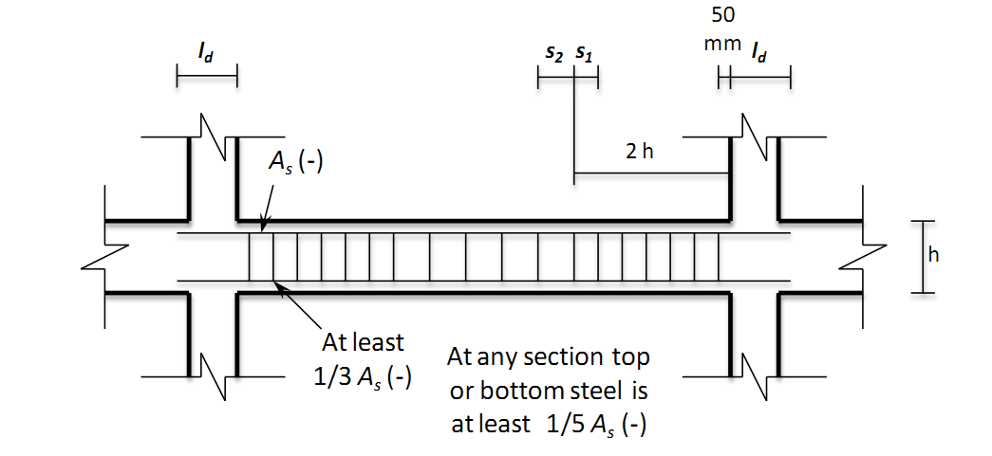
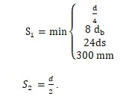
Design of Beams
These rules were followed in shear design of beams for intermediate resisting frames case.
.
41

Slide 43
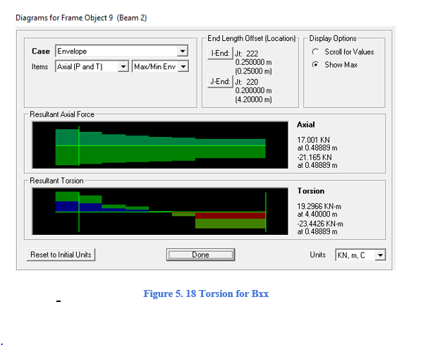
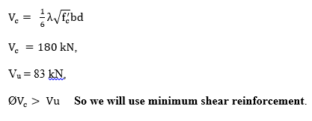
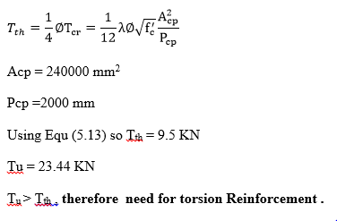
Design of Beams
Design of Beam for shear force
.
42

Slide 44
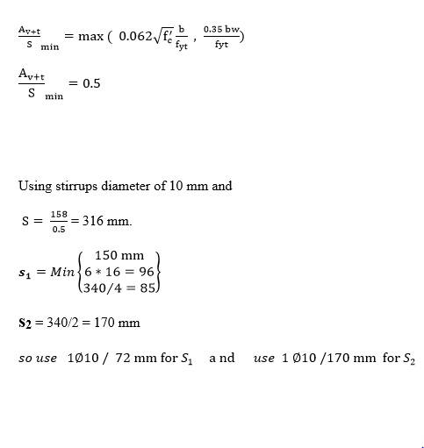
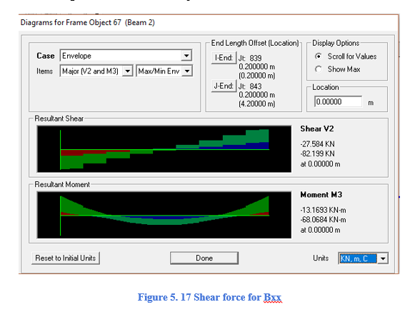
Design of Beams
Design of Beam for shear force
.
43

Slide 45
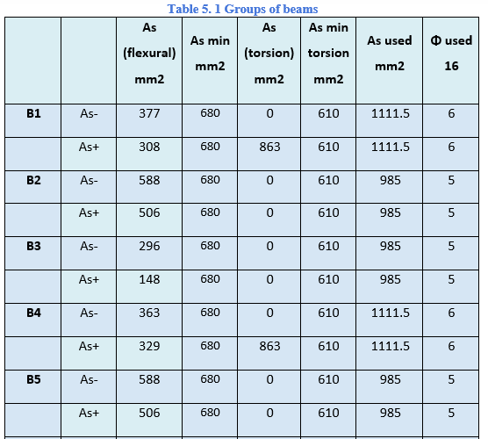
Design of Beams
Summary of beams group design
.
44

Slide 46
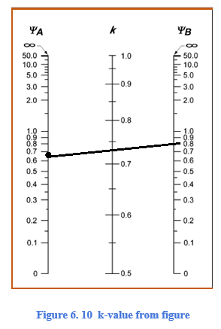
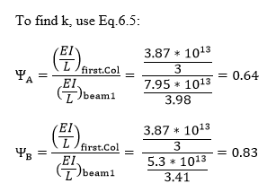
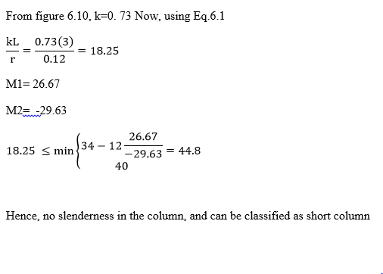
Design of Columns
Slenderness check for the columns
.
No slenderness in the column, and can be classified as short column
45

Slide 47
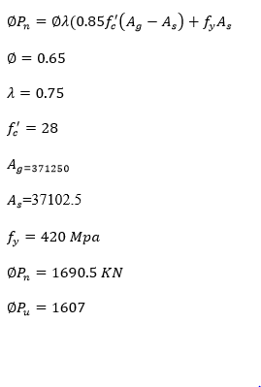
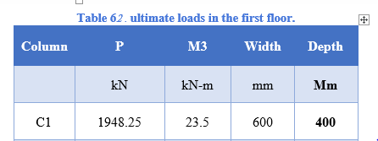
Design of Columns
.
46

Slide 48
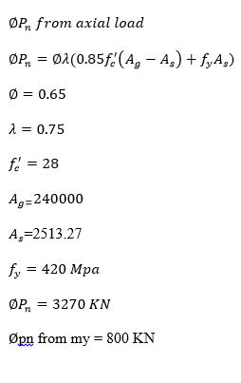
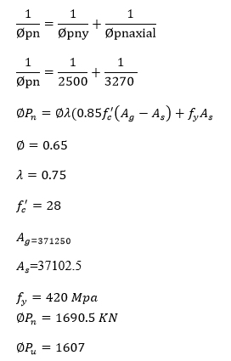

Design of Columns
.
47

Slide 49

Design of Columns
.
48

Slide 50



Design of Columns
The following rules are followed in shear design of columns for intermediate resisting frame case.
.
49

Slide 51



Design of Columns
.
50

Slide 52



    DESIGN OF SHEAR WALL
.
54

Slide 53



    DESIGN OF SHEAR WALL
.
Figure 6. 2 Axial secondary moment interaction diagram
Figure 6. 3 Axial main moment interaction diagram
54

Slide 54


    DESIGN OF SHEAR WALL
.
54

Slide 55



Design of Stairs
.
55

Slide 56

Design of Stairs
.
56

Slide 57


Design of Stairs
.
57

Slide 58


Design of Stairs
.
58

Slide 59


Design of Stairs
  Design for flexural:
.
59

Slide 60

Design of Stairs
  Design for flexural:
.
60

Slide 61
Foundation Design.
.
Expected value | Soil Property
350 KN/(m^2) | Bearing Capacity
18 KN/(m^3) | Specific weight (ɣ)
30 degree | Friction angle (Ø)
……. | Stiffness factor for soil (K)
61

Slide 62



Single Footing
.
61

Slide 63


    Design of wall footing
.
62

Slide 64


    Design of wall footing
.
63

Slide 65

.
64

