Slide 1
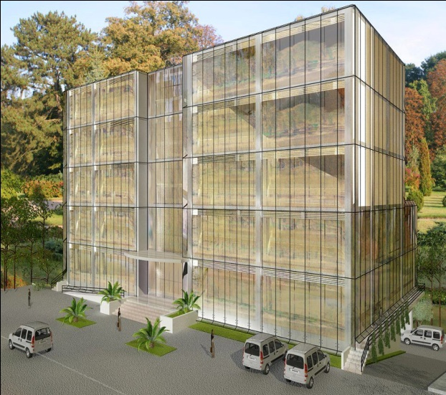
An Najah National University
Building Engineering Department
Potential Energy glazing Technologies
For Highly Glazed Buildings in Palestine
Prepared by :
Fuad Mutasim Baba
Murad Ribhi Bsharat
Wala' Hasan Omar
Supervised by:
Dr. Sameh Monna

Slide 2
Project Content
Why did we choose this project ?
What are the types of facade used?
What are the strategies for improving indoor environment in such buildings ?
What are the effects of each type of facade on Indoor Environment?
What are the Glass facade Construction and other elements?
What are the effects of each type of facade on the cost?
What is our Future work?

Slide 3
Why did we choose this project ?
Architects, designers, owner, and consultant tend to use large glazing area today more than ever before by using Single skin façade.
Without consider the impact of this type of facade on:

Slide 4

Environmental Impact

Slide 5
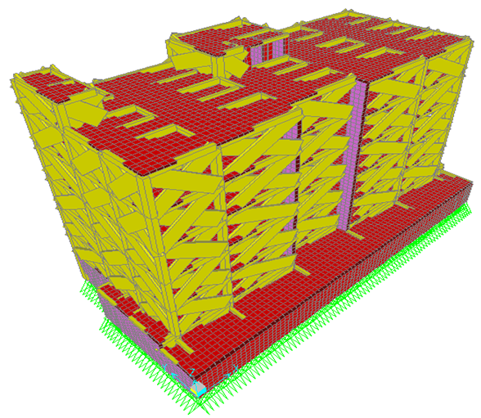
Structural System

Slide 6
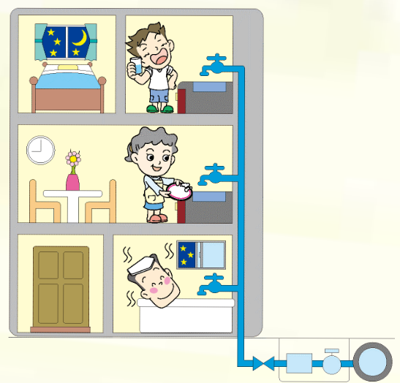
Mechanical and Electrical System

Slide 7

Project Cost

Slide 8
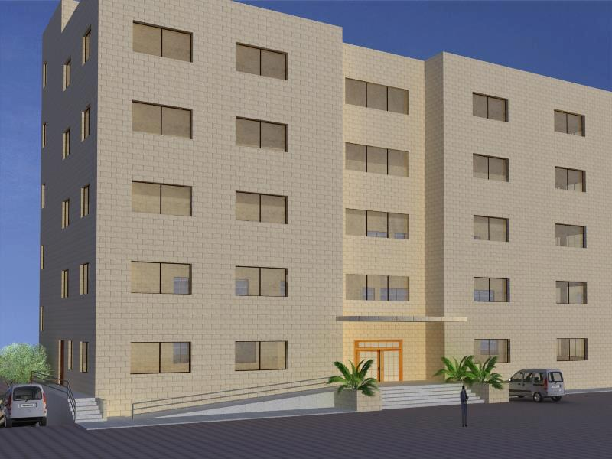
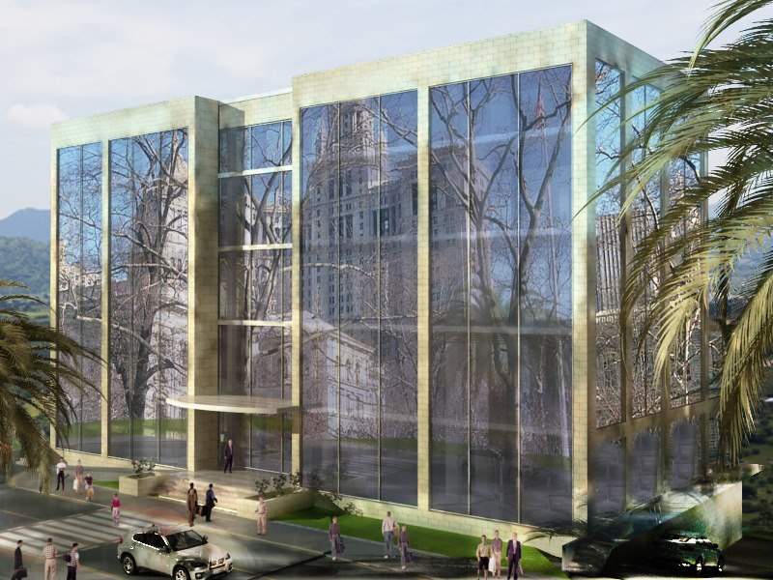

Architecture Design

Slide 9
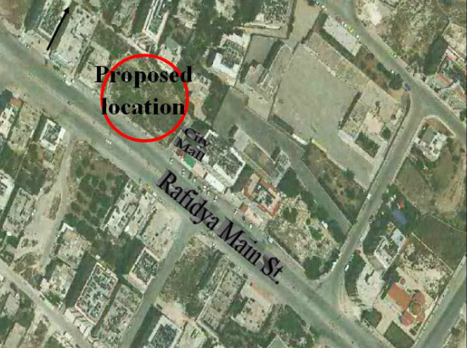
Project Location

Slide 10
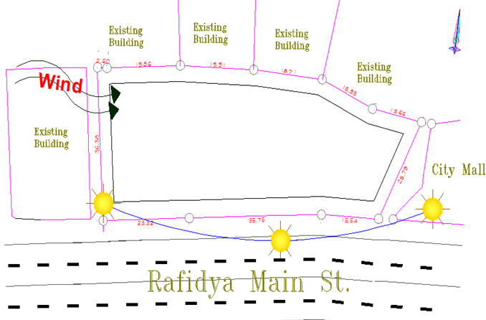
Location analysis

Slide 11
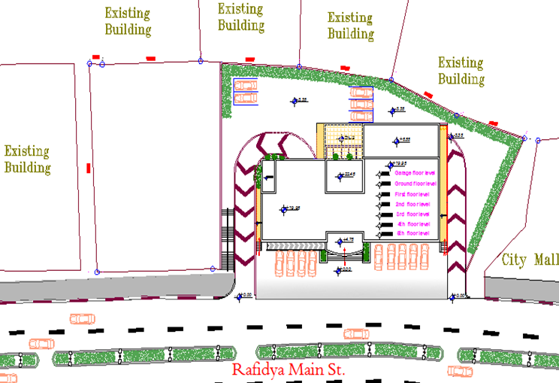
Site Plan

Slide 12

Traditional Facade

Slide 13
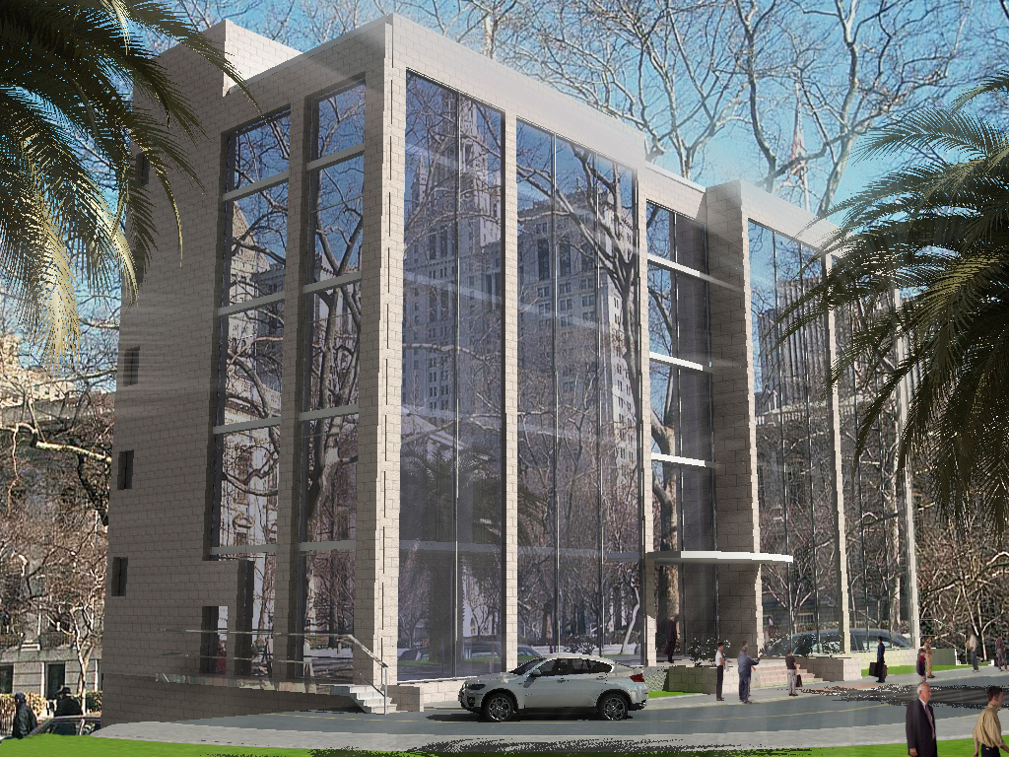
Single Skin Facade

Slide 14
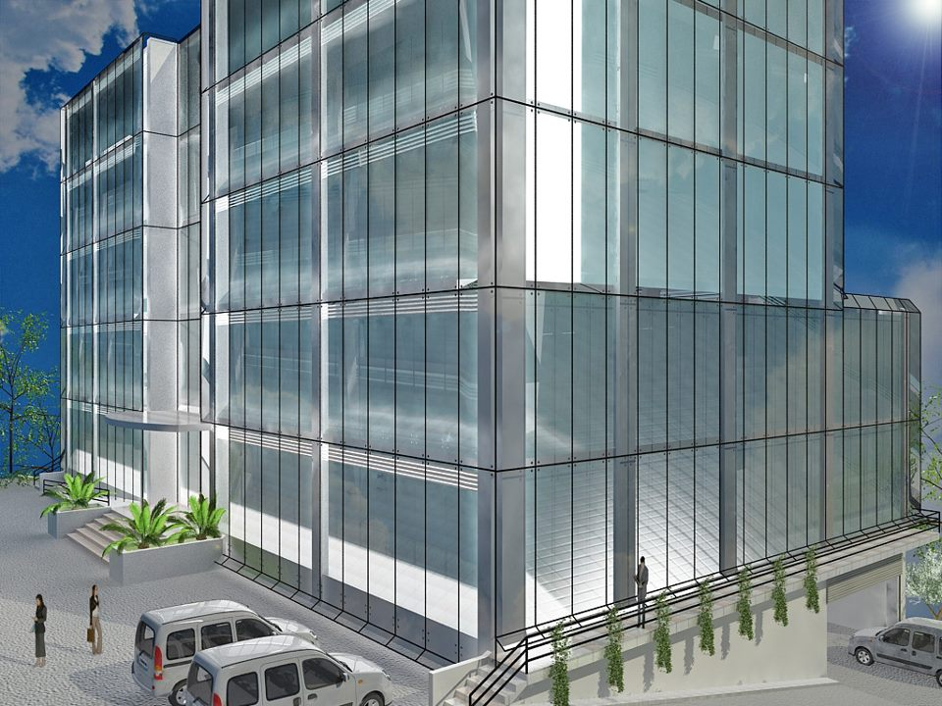
Double Skin Facade

Slide 15
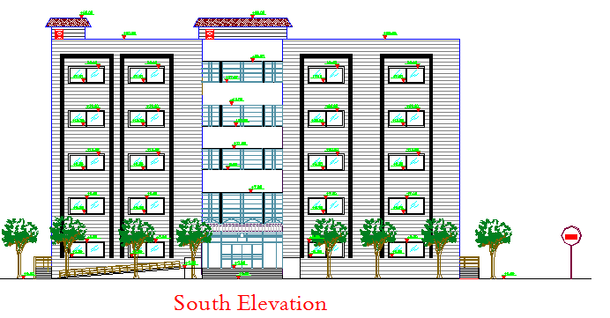
Elevations
Traditional Facade

Slide 16
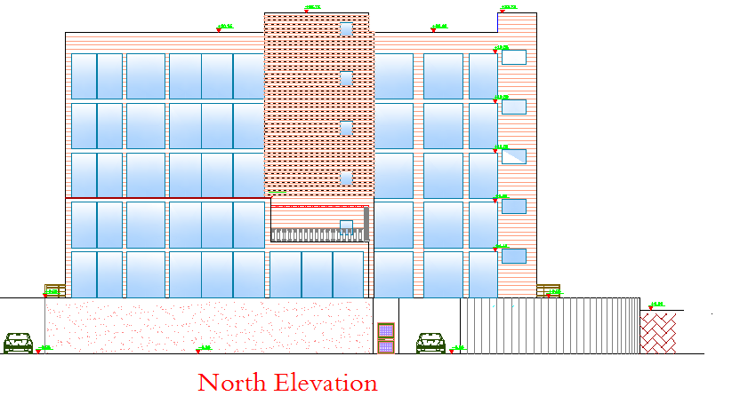
Elevations
Single Skin Facade

Slide 17
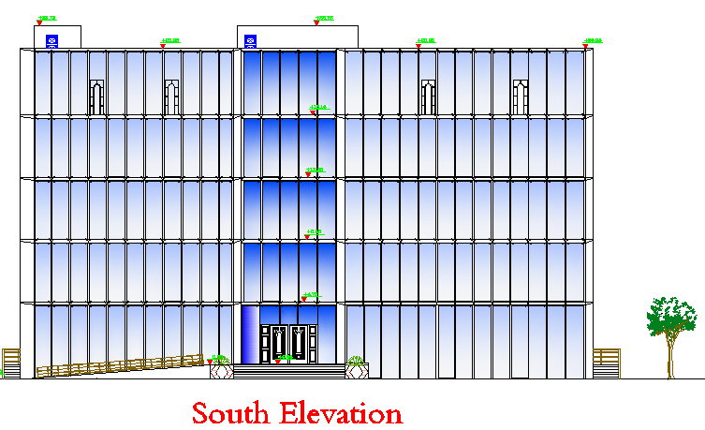
Elevations
Double Skin Facade

Slide 18
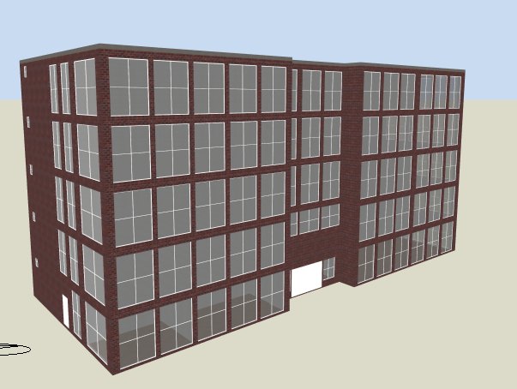
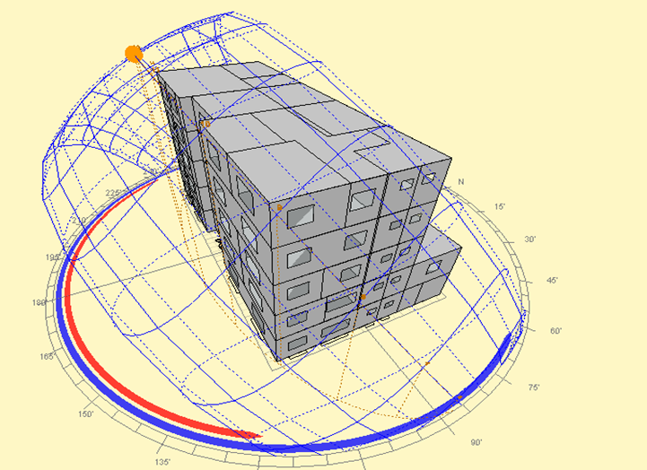
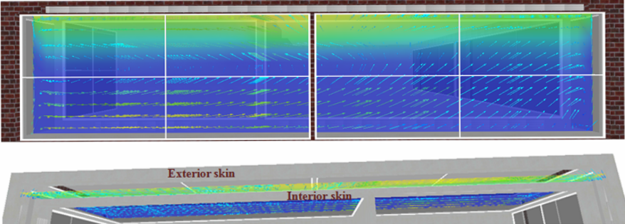
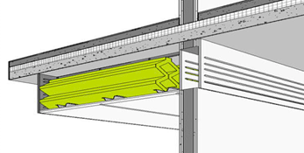
Environmental Analysis

Slide 19

Environmental Analysis
Heating and cooling loads
Natural Ventilation
Daylight
Acoustics

Slide 20

Heating and cooling loads
We used Design builder which is a simulation software for thermal analysis which is based on Energy Plus software.

Slide 21
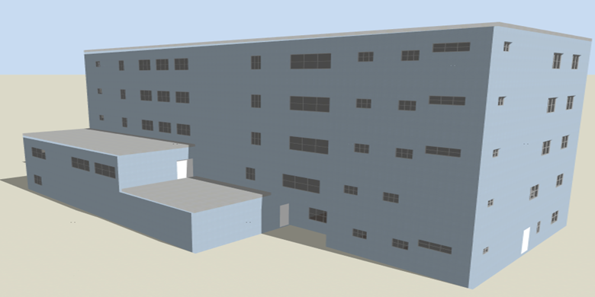
Heating and cooling loads
Traditional façade
There are two condition
in this case
* Un-insulated Building with double clear glass.
* Insulated building with Low emissive glass.

Slide 22
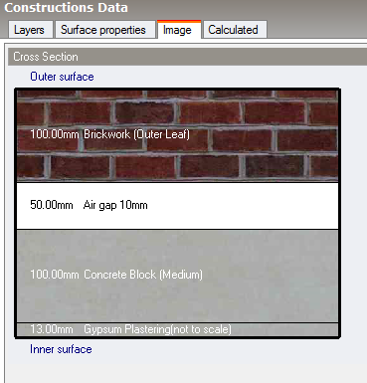
Thermal properties for Un- insulated building
The Heat transfer coefficient
U for wall=1.5 W/m².K
The layer of wall in Un-insulated building by Design builder Software

Slide 23
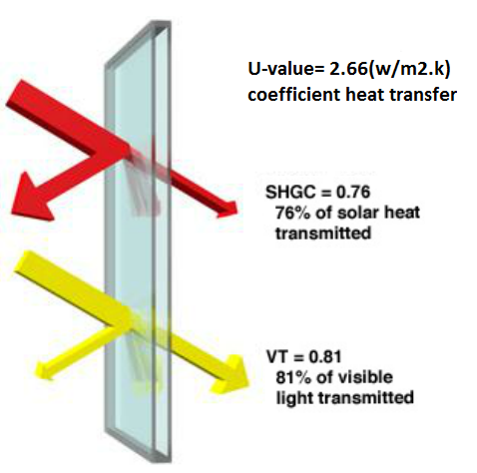
Thermal properties for Un- insulated building
The Heat transfer coefficient
U for wall=2.66 W/m².K
Double Clear Glass

Slide 24
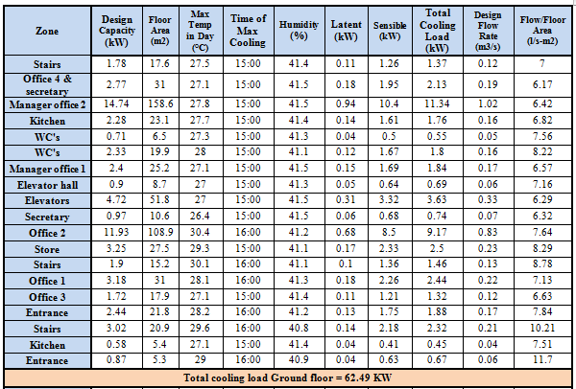
Cooling loads for
Un- insulated building

Slide 25
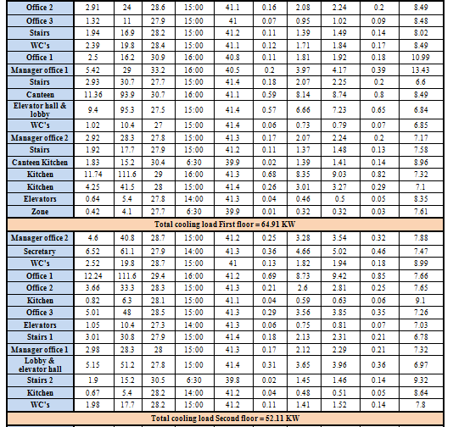
Cooling loads for
Un- insulated building

Slide 26
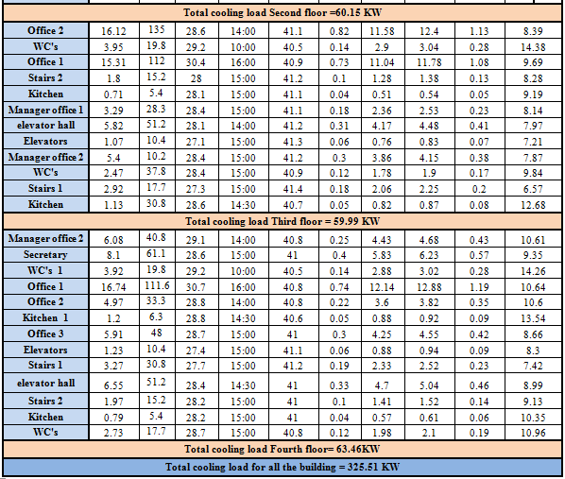
Cooling loads for
Un- insulated building

Slide 27
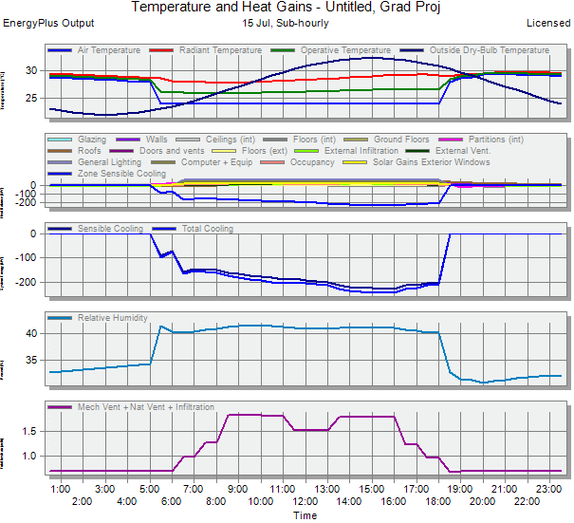
Cooling loads for
Un- insulated building

Slide 28
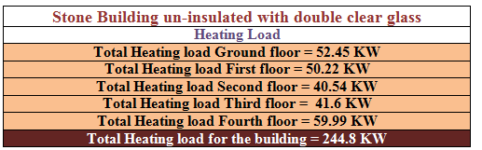
Heating loads for
Un- insulated building

Slide 29
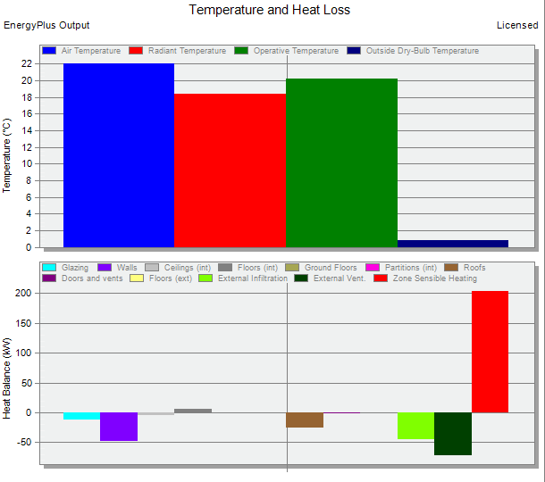
Heating loads for
Un- insulated building

Slide 30
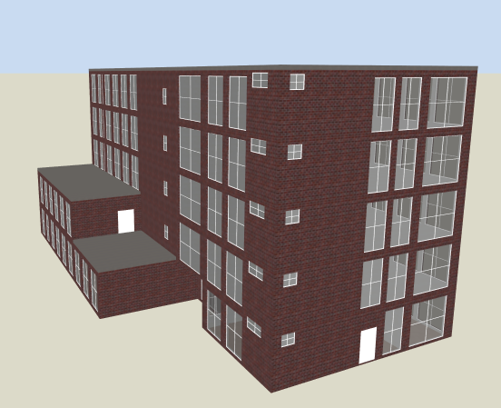
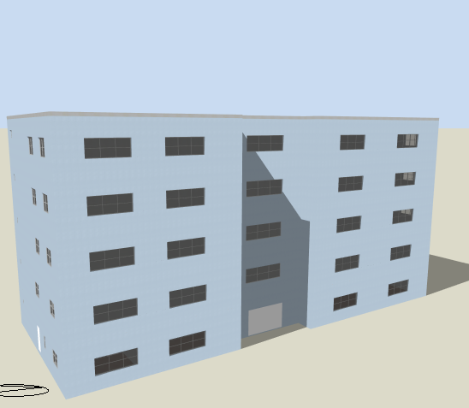
Insulated building (Traditional Façade)with Low emissive glass

Slide 31
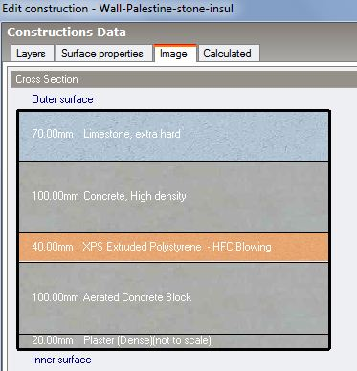
Thermal properties for Insulated building
The Heat transfer coefficient
U for wall=0.49 W/m².K
The layer of wall in Un-insulated building by Design builder Software

Slide 32
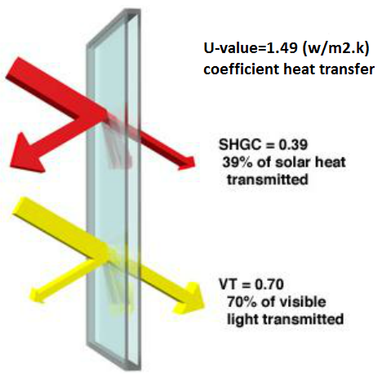
Thermal properties for Insulated building
The Heat transfer coefficient
U for wall=1.49 W/m².K
Low emissive glass

Slide 33
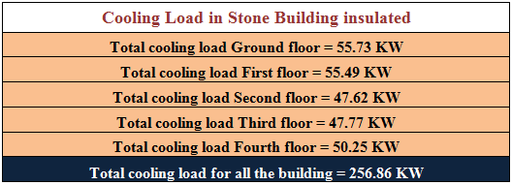
Cooling loads for insulated building

Slide 34
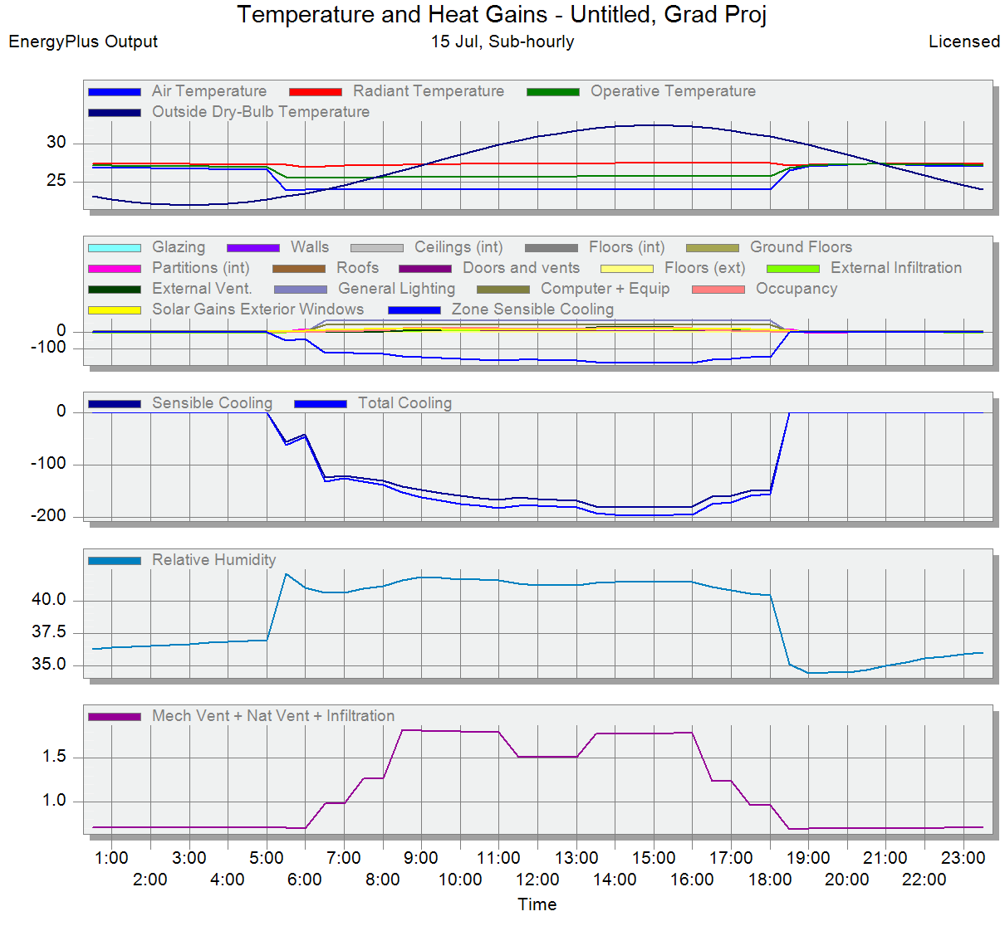
Cooling loads for insulated building

Slide 35
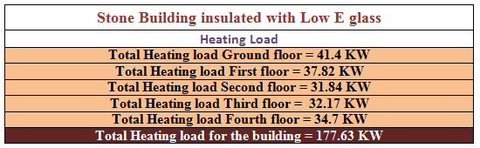
Heating loads for insulated building

Slide 36
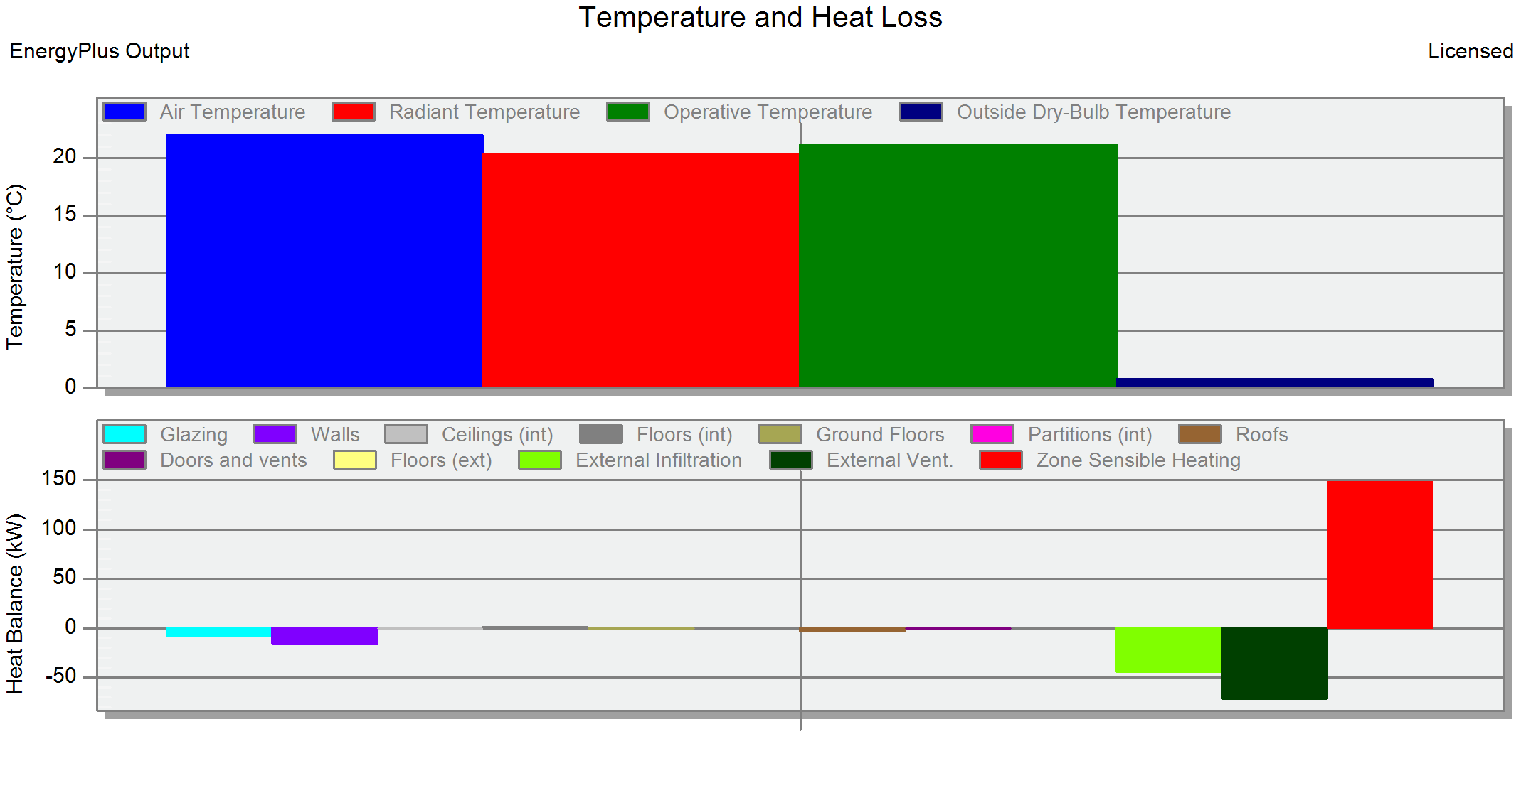
Heating loads for insulated building

Slide 37
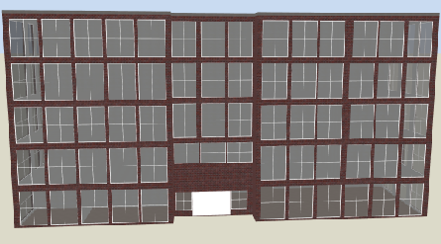
Heating and cooling loads
Single skin(glass) façade
There are two condition in this case
* Double clear glass
* Low emissive glass

Slide 38
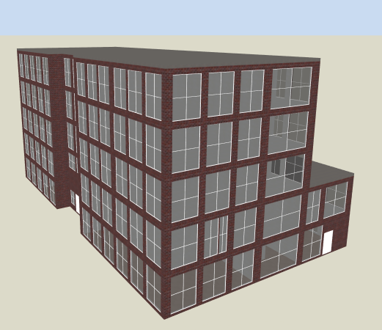
Single skin(glass) façade
Double clear glass

Slide 39
Thermal properties for Single Skin Façade
The Heat transfer coefficient
U for wall=2.66 W/m².K
Double Clear Glass

Slide 40
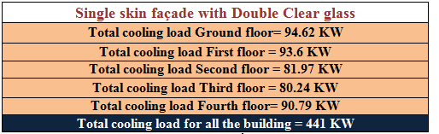
Cooling Load For Single Skin Façade
Double Clear Glass

Slide 41
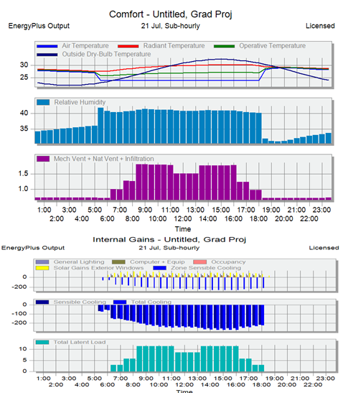
Cooling Load For Single Skin Façade
Double Clear Glass

Slide 42
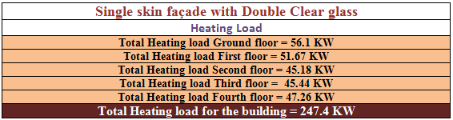
Heating Load For Single Skin Façade
Double Clear Glass

Slide 43
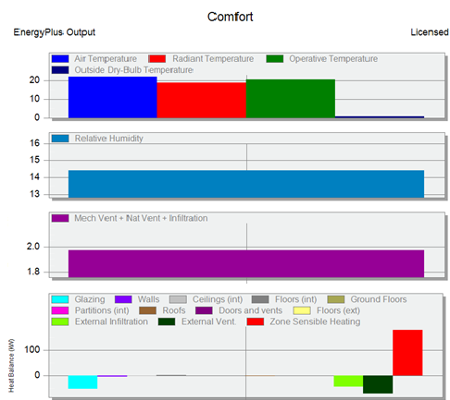
Heating Load For Single Skin Façade
Double Clear Glass

Slide 44
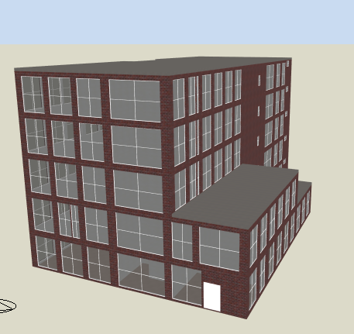
Single skin(glass) façade
Low Emissive Glass

Slide 45
Thermal properties for Single skin(glass) façade
The Heat transfer coefficient
U for wall=1.49 W/m².K
Low emissive glass

Slide 46
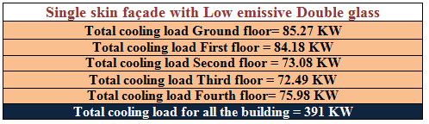
Cooling Load For Single Skin Façade
Low Emissive Glass

Slide 47
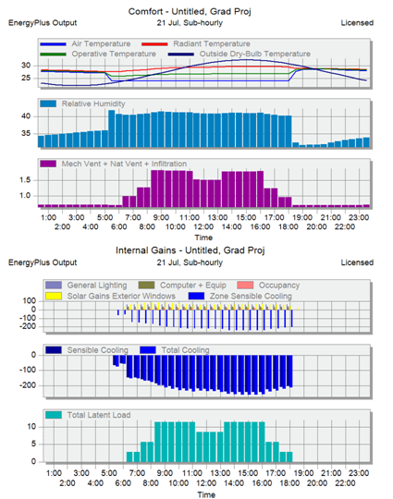
Cooling Load For Single Skin Façade
Low Emissive Glass

Slide 48
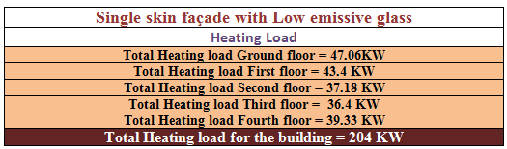
Heating Load For Single Skin Façade
Low Emissive Glass

Slide 49
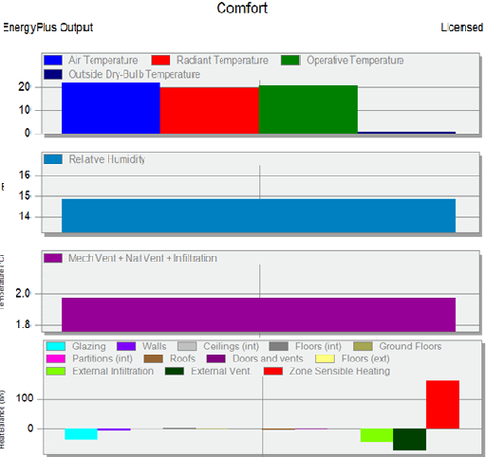
Heating Load For Single Skin Façade
Low Emissive Glass

Slide 50
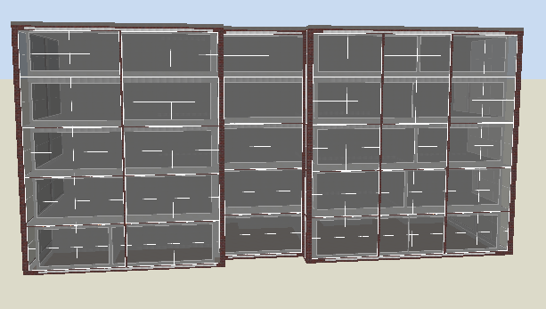
Heating and cooling loads
Double skin(glass) façade
There are four system for double skin façade,
Box Window Facade,
Shaft Box Façade,
Multi Storey Façade, and
Corridor Façade
(With cavity 60 cm)

Slide 51
Heating and cooling loads
Double skin(glass) façade
There are two condition in this case
* Double clear glass
* Low emissive glass

Slide 52
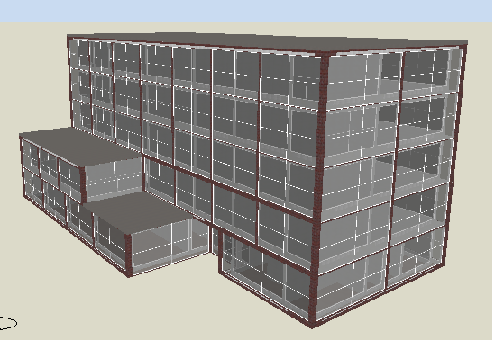
Double skin(glass) façade
Double Clear Glass

Slide 53
Thermal properties for Double Skin Façade
The Heat transfer coefficient
U for wall=2.66 W/m².K
Double Clear Glass in internal facade

Slide 54
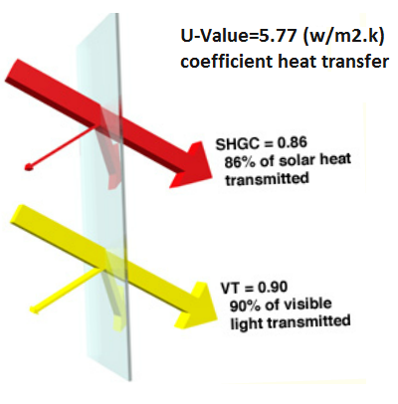
Thermal properties for Double Skin Façade
The Heat transfer coefficient
U for wall=5.77 W/m².K
Single Clear Glass in external facade

Slide 55
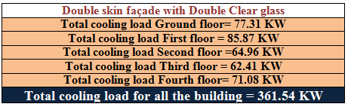
Cooling Load For Double Skin Façade
Double Clear Glass

Slide 56
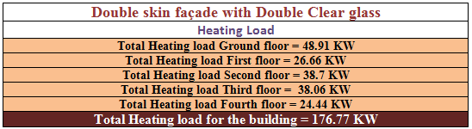
Heating Load For Double Skin Façade
Double Clear Glass

Slide 57

Double skin(glass) façade
Low Emissive Glass

Slide 58
Thermal properties for Double skin(glass) façade
The Heat transfer coefficient
U for wall=1.49 W/m².K
Low emissive glass

Slide 59

Thermal properties for Single skin(glass) façade
The Heat transfer coefficient
U for wall=5.77 W/m².K
Low emissive glass in External

Slide 60

Cooling Load For Double Skin Façade
Low Emissive Glass

Slide 61

Heating Load For Double Skin Façade
Low Emissive Glass

Slide 62


Slide 63


Slide 64
Natural Ventilation
The target of working double skin facade makes air flow and ventilation through the building.
To achieve that we distribute the vents as :

Slide 65


Vents distribution
To make air flow in the cavity between the double skin façade.

Slide 66


Vents distribution
To make air flow through each floor
Vents in the partition wall in floor

Slide 67
Natural Ventilation
The target of working double skin facade makes air flow and ventilation through the building.
To achieve that we distribute the vents as :

Slide 68
Vents distribution
To make air flow in the cavity between the double skin façade.

Slide 69
Vents distribution
To make air flow through each floor

Slide 70

CFD
Air flow through building

Slide 71
CFD
Air flow through building

Slide 72
Air flow makes :
Natural ventilation.
Air flow dynamics will create air movement in the room which will distribute comfort to all places in the building.
Air flow effect in cooling and heating load results.

Slide 73
Daylight Analysis

Slide 74
Daylight Analysis
The analysis is made on 3 cases for each type (Traditional , Single skin façade and Double skin façade.
Cases used in Daylight Analysis
First case |  | Second Case |  | Third case
Type of glass | Shading | Type of glass | Shading | Type of glass | Shading
Clr Dbl glazed (U = 0.49, SHGC = 0.76, VT =0.81) | No shading | Dbl glazed- low E glass (U =0.25, SHGC =0.39, VT = 0.7) | No shading | Dbl glazed- low E glass (U =0.25, SHGC =0.39, VT = 0.7) | Shutters 50 cm depth, distance between them 30 cm 60% reflection

Slide 75
Daylight Analysis
Every value of daylight factor will be represented by a specific color which expresses a certain situation.
The indicator and interpretation for each color for office building
Interpretation | Performance indicator
Unacceptable | +20%
Unacceptable | 18-20%
Unacceptable | 16-18%
Unacceptable | 14-16%
Unacceptable | 12-14%
Unacceptable | 10-12%
Unacceptable, it causes an uncomfortable reaction to the eyes. | 8-10%
Acceptable for conference room and drawing offices. | 6-8%
Preferable large potential for daylight utilization, and ideal for paper work. | 4-6%
Acceptable small potential for daylight utilization. | 2-4%
Unacceptably dark negligible potential for daylight utilization. | 0-2%

Slide 76
Daylight Analysis
Daylight factor for office 2
Third case | Second case | First case
3.43% | 5.08% | 5.72% | Traditional
8.1% | 9.29% | 10.57% | Single skin
7.05% | 8.54% | 12.02% | Double skin
Although the window wall ratio in Single skin (90.2%) which is less than Double skin (96%) but the daylight factor in double skin was better than Single skin.

Slide 77
Acoustics

Slide 78
Sources of noise
1- External noise that come from the main street.
2- Noise transmission between room through air vents.

Slide 79

External Noise
STC (sound transmission class) for double skin > 50 dB
STC for single skin $≈$ $43 dB$
Requires solution !
No problem

Slide 80
Internal Noise
Many solutions can be used to reduce the noise among them the use of barriers that prevent the transmission of sound for example:
Ventilated façade panel

Slide 81


Slide 82


Structural Design

Slide 83
Structural Design
This part contains:-
Glass Facade Construction
Traditional Building Elements Design

Slide 84
Glass Facade Construction
Design the components of building to limit deformation and make it suitable for the deflection capacity of the rubber.

Slide 85

Glass Facade Construction
Design the rubber around the frame to resist the maximum deformation in the building.

Slide 86

Glass Facade Construction
All glass that was used in this project contains laminated technology glass, which has outstanding safety properties.

Slide 87
Glass Facade Construction details

Slide 88



Glass Facade Construction details
Outgoing air opening at the top.
Horizontal partition with hole

Slide 89
Traditional Building Elements Design
Codes:
ACI -318-08: for reinforced concrete structural design.
UBC -97: for earthquake load computations.
ASCE for loads 07 (2005)

Slide 90
Data Input
f_{c} = 28 MPa For column, footings
f_{c} = 25 MPa For beams, slabs and shear
Fy = 420 MPa
Element | Dimensions/thickness
One way ribbed slab | 30 cm
Main beams | 30cm width x 60cm depth
Other main beams | 30cm width x 50cm depth / 20cm width x 60cm depth
Secondary beams | 30cm width x 30cm depth
All columns | 45cm x 45cm /45cm x 65cm /65cm x 65cm
Bracing (stone wall) | 150cm x 20cm
Shear wall | 30cm / 20cm
Dead load = 3 kN/m², Live load = 2.5 kN/m²

Slide 91
3D SAP model

Slide 92
Model Validation
1) Compatibility of structural elements.
2) Global Equilibrium.
3) Local Equilibrium (Internal forces).

Slide 93
Compatibility check

Slide 94

Equilibrium check

Slide 95
Internal force check
% difference | SAP | Manual | Location | Number
30.83 | 21.411 | 14.809 | 2nd Floor | 2nd Floor slab
29.5 | 18.215 | 12.841 | 3rd Floor | 3rd Floor slab
30.44 | 266.7 | 383.431 | 2nd floor | Beam 15
35.43 | 89.866 | 139.192 | 3rd floor | Beam 2
20.82 | 156.96 | 124.276 | GF | Column 27
6.87 | 973.78 | 906.874 | 2nd floor | Column 8
All % difference are less than 50%

Slide 96

Dynamic analysis
Response spectra method
The soil is soft lime stone “S_{c}”
C_{v}= 0.32
C_{a}= 0.24
R = 5.5
T(manual) = 0.4867 sec
T(SAP)= 0.536 sec
( with modal mass participation ratio =0.9)

Slide 97


Slab Design
Section in slab at support
Section in slab at middle

Slide 98


Beams Design
Longitudinal Section
Cross Section

Slide 99


Columns Design
Cross Section
Longitudinal Section

Slide 100

Footings Design

Slide 101

Tie beams Design

Slide 102


Shear wall & Wall footing Design
Shear wall details
Wall footing detail

Slide 103

Stairs Design

Slide 104
Mechanical Design

Slide 105
Mechanical Design
This part contains:-
Elevator Design
Water Supply Design
Sanitation Design
Fire protection design

Slide 106

Elevator Design
Design Conditions
The recommended interval for the elevators 30-39 s
The estimated population of the building
10 m²/person
Then the estimated population of the building 286.64 Person
The value of Handing Capacity (H.C) of elevator system=Pop*PHC= 37.26 per/5min PHC is = 0.13

Slide 107

Elevator Design
The best number for this building is 2 elevators (Motor driven elevator).
The Car Capacity is 2500 Ib with Minimum Car Speed is 350 feet per minute.
The elevator dimensions are
(2.2, 2.4 m) and with 2.5 m/sec

Slide 108

Water Supply Design
We have two water networks :
1. One for the cold water (Blue Line) comes from the tanks.
2. The other for hot water (Red line) comes from the Solar water heating

Slide 109

Water Supply Design
We have 4 water tanks of 2m³ (each) and 4 Solar water heaters each one consists of 2 collectors.

