Slide 1

Graduation Project II
Structural Analysis and Redesign of Qalqilya commercial center under static and dynamic loads
An-Najah National University
Faculty of Engineering
Civil Engineering Department
Supervisor: Dr. Munther Diyab.
Prepared by : Ihab Nazzal

Slide 2
Table of content
INTRODUCTION
PRELIMENERY DIMENTION
THREE-DIMENSIONAL ANALYSIS AND DESIGN

Slide 3
Project Description
The building consists of six floors with a total area of 5186 m². The building is multifunctional structure.
Floor name | Area (m^2) | Height (m)
Basement | 920.88 | 3.4
Ground floor | 804.33 | 6.9
F1 | 865.21 | 3.4
F2 | 865.21 | 3.4
F3 | 865.21 | 3.4
F4 | 865.21 | 3.4

Slide 4
Soil properties
The soil in the site is almost very dens soil and soft rocks where the allowable bearing capacity of the soil is 250 KN/m²

Slide 5
Materials
1) Structural materials
  Concrete: It is the main material resisting compression in sections of structural members. Where as its resistance for tension is low and inconsiderable. Materials including cement, water, sand and aggregates are mixed with standard ratios to prepare concrete. Classification of concrete is based mainly on its compressive strength f′c, which represents the value of stress needed to cause a standard concrete cylinder to fail at 28 days of curing in water.

Slide 6
Materials
Reinforcing Steel:
It is the main tension-resisting material in reinforced concrete sections. Although its compressive strength is high, it may not be used for compression resistance due to its high cost and properties changeability with temperature. Benefits including flexibility, ductility, and cracks' controlling can be acquired in sections, members and structures by virtue of steel. Yielding strength is the main factor used for steel classification. Such that this project uses ASTM A615Gr60 steel with 420 MPa yield strength and 620 MPa tensile strength

Slide 7
Materials
2) Non structural materials
Materials | Ɣ (kN/m³)
Mortar | 23
Tiles (porcelain) | 27
Masonry stone | 27
Bricks | 15
Aggregates (filling materials) | 18
Plastering | 23
Glass clear float | 25
Aluminum | 26.1

Slide 8
Load types
Dead Load: it is the self-weight of the structural elements. It is mainly affected by materials' unit weight and elements' dimensions. Mainly, the dead load of a certain structure is constant among its whole life
Live Load: It represents all movable loads that may vary with time. Weights of people, furniture and goods are parts of live load.
Superimposed dead load: it is the self-weight of the nonstructural elements including the different types of finishing like filling materials, plastering, false ceiling, mechanical instruments, tiles, partition and glass curtain walls.
Seismic Load: it represents forces resulting from earthquakes. It depends mainly on the building weight, location, height, and site conditions. Dead sea fault is the main cause of earthquakes in the west bank.

Slide 9
Load combination
Load combinations are called ultimate load combinations, buildings and other structure components will be designed so that their design strength equals or exceeds the effects of the factored loads in the following combinations: -
1.4D
1.2D + 1.6L

Slide 10
Philosophy of Analysis and Design
The structure will be designed as two way solid slab with drop beams and shear wall in some locations.
The superimposed and live loads are added as area loads on the slab and structure own weight will be computed automatically in the program.

Slide 11
PRELIMENERY DIMENTION
For slab
I take three types of slabs:
flat slab with no beams
Solid slab with drop beams
Voided slab
After comparison the three types I select solid slab because it has high section shear capacity, high section moment of inertia, and not containing brittle elements such as concrete blocks. Generally, solid slab is preferred in cases of earthquakes, high slab loads, and high desired serviceability and the lowest thickness of slabs

Slide 12
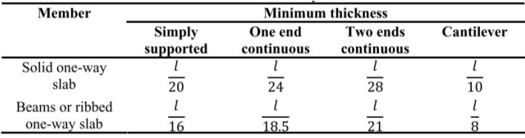
PRELIMENERY DIMENTION
For beams
Span length of the critical beam =8 m and its two end continue according to ACI Depth of beams in all floors = 𝐿 /21 = 0.38 m a thickness of 450 mm is used and a width of 500 mm, the dimensions of the beam are the same for all the beams in all floors

Slide 13
PRELIMENERY DIMENTION
For column
Dead load on the column=3346.2 +264+240=3850.2 KN (Table 2.6&2.7). After considering the column self-weight,
the total dead load= 1.1 ×3850.2= 4235.22 KN.
Whereas the total live load= 1003.8KN (Table 2.6).
Ultimate load equals the maximum of:
U1=1.4 D = 1.4×4235.22= 5929.3 KN.
U2=1.2D+1.6L = 1.2×4235.22 +1.6×1003.8= 6688.34 KN.
So, 𝑃𝑢= ∅𝑃𝑛 = ∅λ[0.85𝑓𝑐′(𝐴𝑔 − 𝐴𝑠𝑡) + 𝑓𝑦𝐴𝑠𝑡].
6688.34× 1000 = 0.65 × 0.80 × [0.85 × 28 × (𝐴𝑔 − 0.01 𝐴𝑔) + 420 × 0.01 𝐴𝑔].
Then, 𝐴𝑔= 688900 𝑚𝑚2. The dimensions that satisfy this area (850× 850) 𝑚𝑚2.

Slide 14
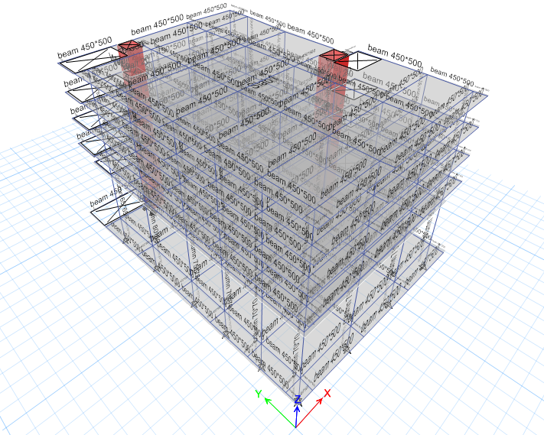
THREE-DIMENSIONAL ANALYSIS AND DESIGN
3D model

Slide 15
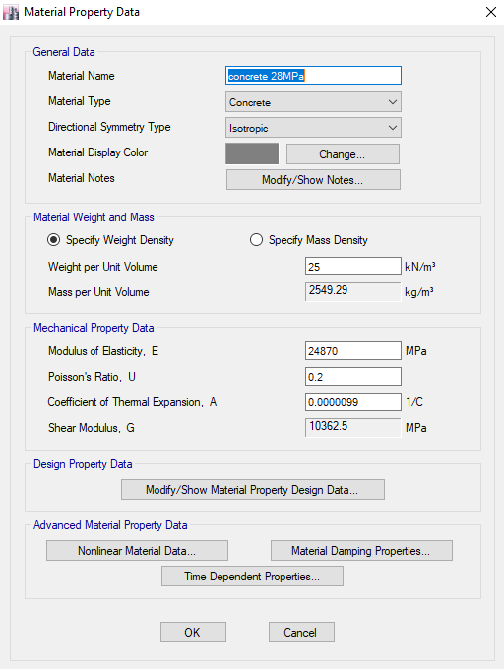
THREE-DIMENSIONAL ANALYSIS AND DESIGN
Material properties

Slide 16
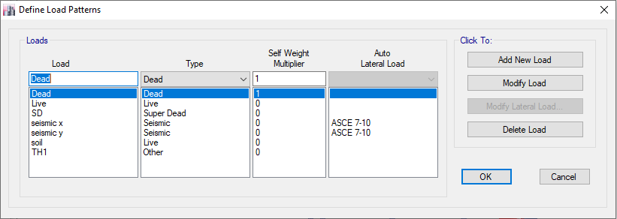
THREE-DIMENSIONAL ANALYSIS AND DESIGN
Load definition

Slide 17
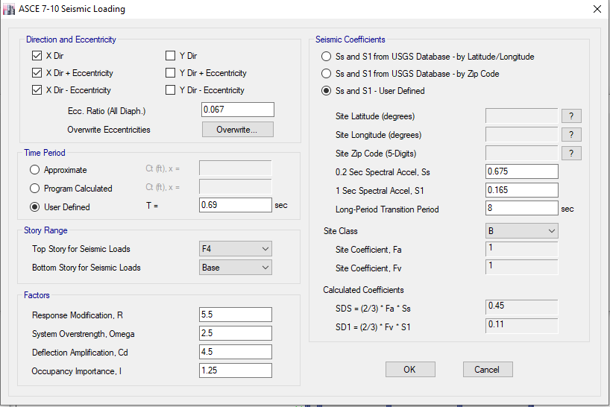
The parameters of seismic forces in x-direction

Slide 18

The parameters of seismic forces in y-direction

Slide 19
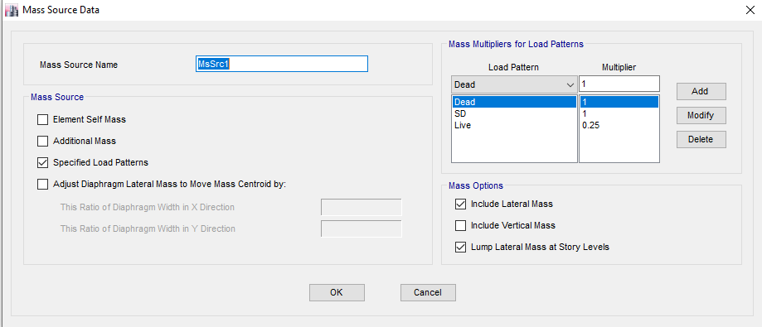
Mass source data

Slide 20
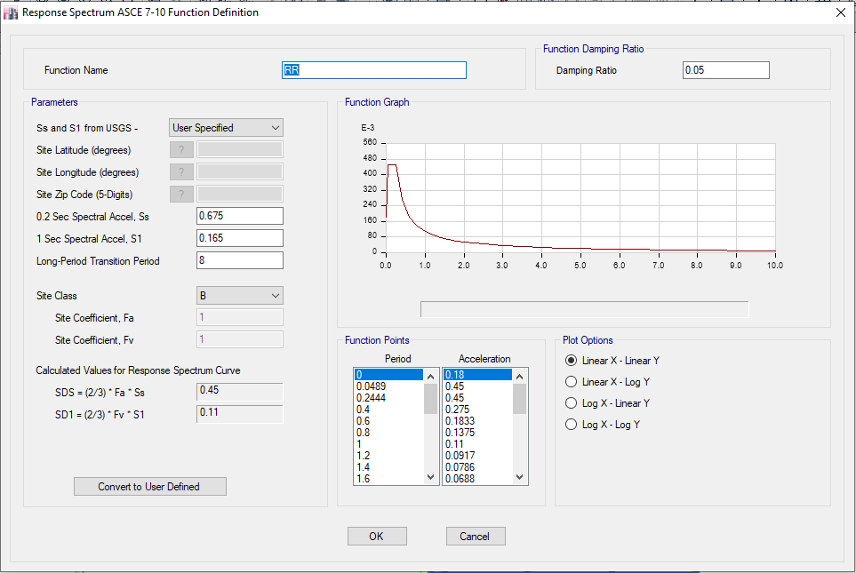
Functions
Response Spectrum:-
is a plot of maximum response of a single degree of freedom system subject to a specific input, such as step loading and triangular pulse versus period of vibration or another suitable quantity.

Slide 21
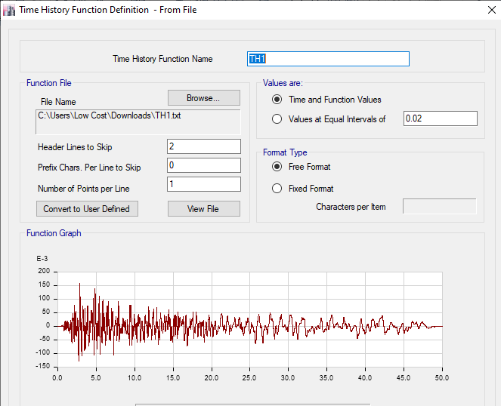
Time history
is a more detailed analysis involving the time instant. In time history analyses the structural response is computed at a number of subsequent time instants. In other words, time histories of the structural response to a given input are obtained ad a result.

Slide 22
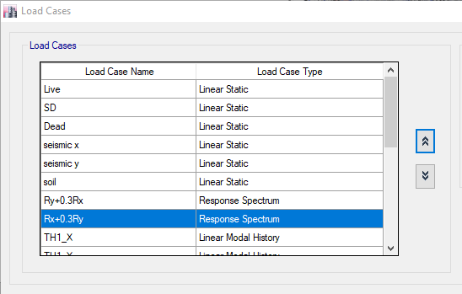
Load cases
I defind a load cases for seismic load and for response spectrum and for time history in x and y direction

Slide 23
THREE-DIMENSIONAL ANALYSIS AND DESIGN
Load combination
The two types of load combinations that mentioned in section 1.7 were defined in ETABS software.

Slide 24
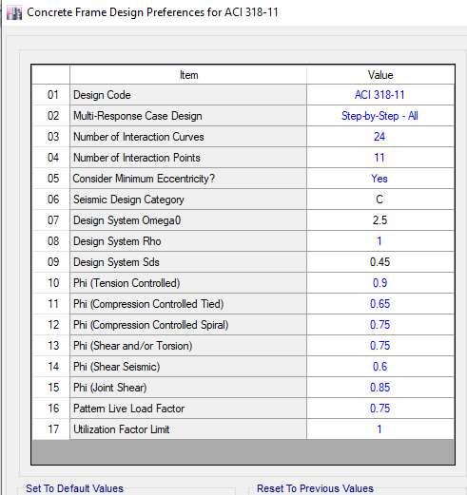
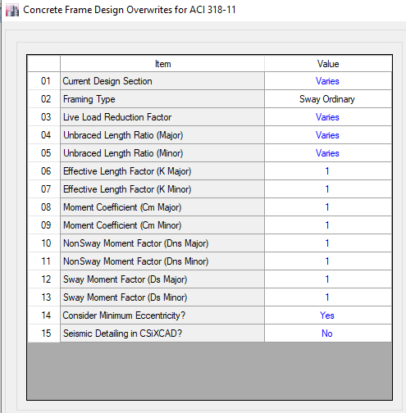
THREE-DIMENSIONAL ANALYSIS AND DESIGN
Design specification

Slide 25
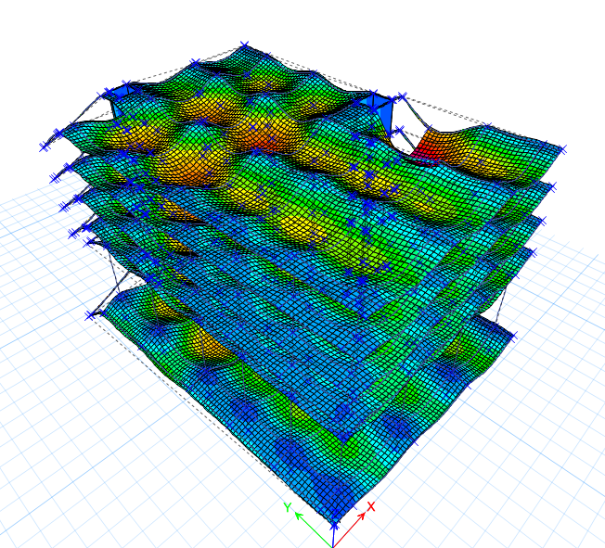
THREE-DIMENSIONAL ANALYSIS AND DESIGN
Verification of Structural Analysis
1) Compatibility check :

Slide 26
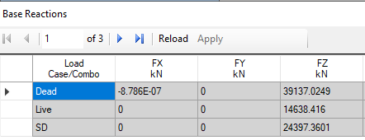
THREE-DIMENSIONAL ANALYSIS AND DESIGN
2) Equilibrium check
Manual calculation
From dead load = 39071.7 KN
From live load = 14668.71 KN.
From super imposed dead load = 24447.85 KN
From ETAPS

Slide 27
THREE-DIMENSIONAL ANALYSIS AND DESIGN
2) Equilibrium check
% Different in Dead load = 39071.7 −39137.0249 /39137.0249 = 0.17%
% Different in live load = = 14668.71−14638.416/14638.416= 0.2%
% Different in SD load = = 24447.85−24397.3601 /24397.3601 = 0.2%
All differences are less than 10%, So equilibrium is obtained.

Slide 28
THREE-DIMENSIONAL ANALYSIS AND DESIGN
3) Stress-strain check
Manually = (𝑊 × 𝐿𝑛^2 × 𝐿)/ 8
This equation gave maximum positive, considering no negative moment Frame PQ (basement )
w=3KN/m2 (live load).
L=7.4/2 + 5.4/ 2 =6.4 m
𝐿𝑛=7.6-0.8=6.8 m, (C 800*800)
Mmanually = 3 × 6.4×6.82 /8 = 110.976 KN.m

Slide 29
THREE-DIMENSIONAL ANALYSIS AND DESIGN
Mleft (-ve ) = 64.71 KN.m
Mmiddlet (+ve )= 50.96KN.m
Mright (-ve ) =60.85 KN.m
METABE=(𝑀𝑙𝑒𝑓𝑡(−)+𝑀𝑟𝑖𝑔ℎ𝑡 (−))/2+ Mmiddle
=(64.71 + 60.85)/2 + 50.96 = 113.74 KN.m
% difference = (110.976−113.74)/ 113.74 * 100%
= 2.4% < 5% is acceptable

Slide 30
THREE-DIMENSIONAL ANALYSIS AND DESIGN
4) Seismic Force
the Equivalent Static method was used to check that the values of the Response Spectrum were greater than or equal to 85% of the Equivalent Static values in the two directions based on the ASCE 7-10 code
 | Forces in x | Forces in Y
Response spectrum | 2410.7256 | 2411.5291
Equivalent static | 2411.5452 | 2411.5452
Response/equivalent | 99.96% | 99.99%

Slide 31
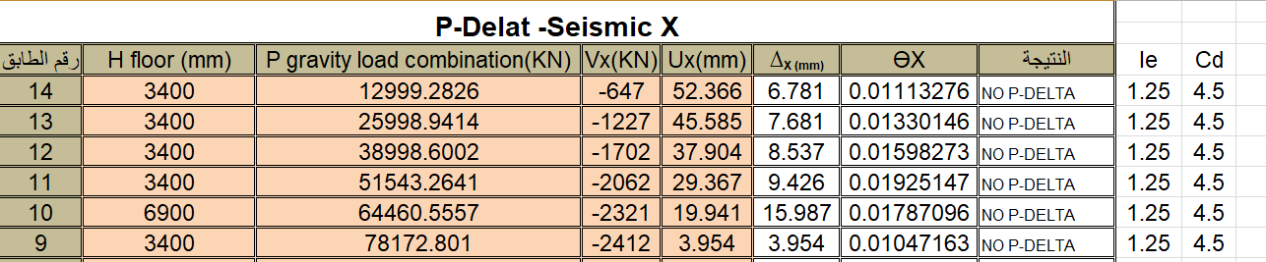
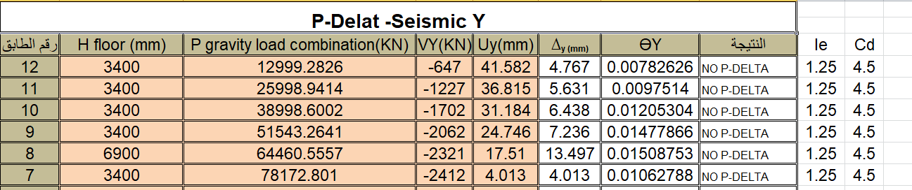
THREE-DIMENSIONAL ANALYSIS AND DESIGN
5)Effect of p-delta
According to both Tables, No story has a θ value exceeding 0.1 or 𝜃𝑚𝑎𝑥 (0.11). As a result, P-Δ effects are not considered.

Slide 32
THREE-DIMENSIONAL ANALYSIS AND DESIGN
6) long term deflection check
Manual calculation
Allowable deflection =L/240, L: longest span
=8/240=33.33mm take it 1.15*33.33=38.33mm
From ETAPS
For slab
For beam

Slide 33
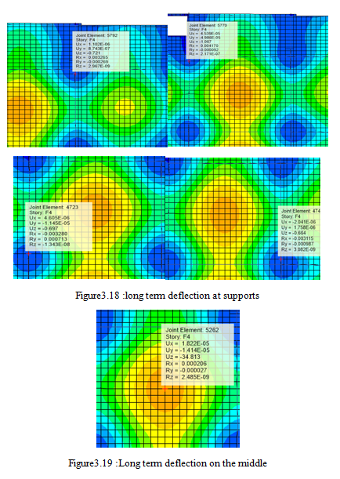
THREE-DIMENSIONAL ANALYSIS AND DESIGN
For slab
panel deflection = displacement at the middle of the panel - average support displacement
= 34.813-(0.721+1.067+0.697+0.664)/4=34.813 -0.78 =34.033mm< 38.33 mm, it's acceptable

Slide 34
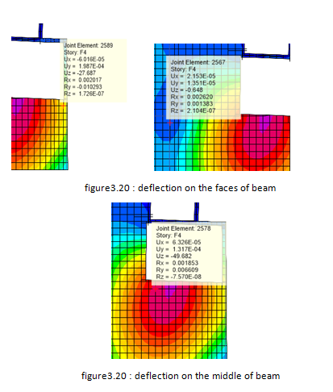
THREE-DIMENSIONAL ANALYSIS AND DESIGN
2) For beam
Deflection of beam = 49.682-(27.687 +0.648)/2=35.5mm < 38.33 mm ,it's acceptable

Slide 35
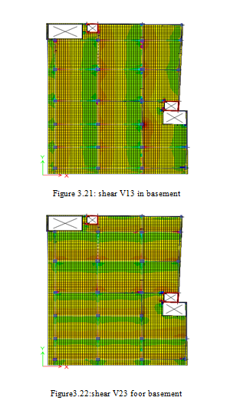
THREE-DIMENSIONAL ANALYSIS AND DESIGN
7) check wide beam shear
Manual calculation
∅𝑉𝑐= = 0.75 × (1 /6) (1) √28(1000) (170)/1000 =112.4KN
Form ETABS

Slide 36
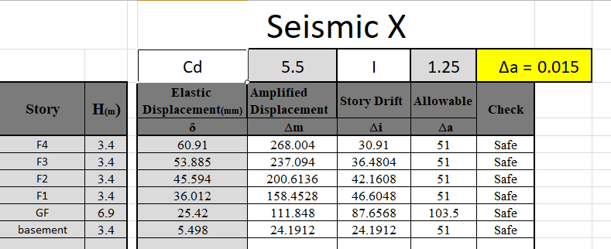
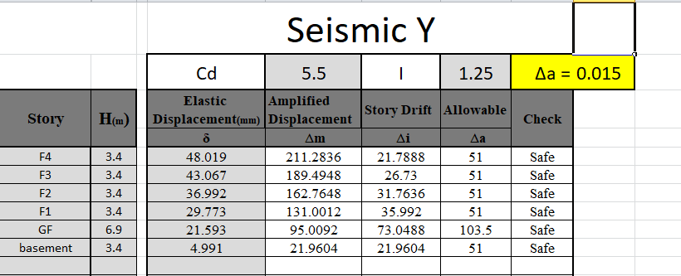
THREE-DIMENSIONAL ANALYSIS AND DESIGN
8) Drift Check
According to the Tables the maximum drift values in all stories is less than the allowable drift, so the check is correct.

Slide 37
THREE-DIMENSIONAL ANALYSIS AND DESIGN
Design :
1) slab design verification
Thickness of slab =200mm, cover of slab =30mm
Minimum steel for slab = 0.0018*b*h
Where: b is the width of the strip = 1000 mm
h is the slab depth = 170 mm
Minimum steel for slab =0.0018* 1000*200=360 mm² ∅12/250mm
Capacity of slab for moment:
∅Mn = ∅ × As× 𝐹y× (d-a/2) = 0.9×360×420× (170-6.35/2) *10⁻⁶=24.32KN.m
Asmin×Fy=0.85× 𝐹`𝑐×a×b
360×420=0.85×28×a×1000 a =6.35mm

Slide 38
THREE-DIMENSIONAL ANALYSIS AND DESIGN
Design of basement floor
Design of basement floor
Maximum +ve moment in X = 33.5 KN.m
ρ= (0.85∗fc′/ Fy) * [1-sqrt(1 − ( 2.61∗Mu /b∗d²∗fc′))]
ρ= (0.85∗28/ 420) * [1-sqrt(1 − ( 2.61∗33.5∗10^6/ 1000∗170²∗28))] =0.00315
A_{s}= ρ*b*d=0.00315*1000*170 =535 .5mm² >As min = 360 mm²
Use ∅14/200mm

Slide 39
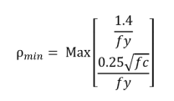
THREE-DIMENSIONAL ANALYSIS AND DESIGN
2) beam design verification:
Beam properties
A) flexure design:
ρ= (0.85∗fc′/ Fy) * [1-sqrt(1 − ( 2.61∗Mu /b∗d²∗fc′))]
ρ min = 1.4/ fy =0.0033
𝐴𝑠 min = 3.3*10⁻³ * 500*380= 1155 mm2
bw(mm) | H(mm) | D(mm) | f'c (Mpa)
500 | 450 | 380 | 28

Slide 40
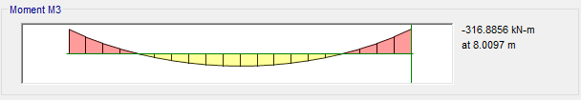
THREE-DIMENSIONAL ANALYSIS AND DESIGN
For negative moment
Mu = -316.886kN.m
ρ= (0.85∗28/ 420) * [1-sqrt(1 − ( 2.61∗316.886∗10^6/ 500∗380²∗28))]
=0.0131> ρ_{min}; use ρ
As for flexure = 2489 mm²

Slide 41
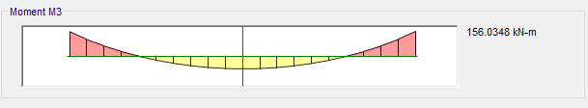
THREE-DIMENSIONAL ANALYSIS AND DESIGN
For positive moment
Mu = 156.035. KN.m
ρ= (0.85∗28/ 420) * [1-sqrt(1 − ( 2.61∗156.035∗10^6/ 500∗380²∗28))]
= 0.00603> ρ min; use ρ
As = 1145.7 mm²

Slide 42
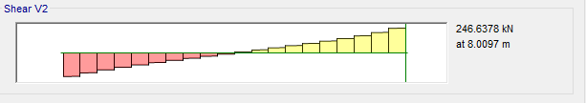
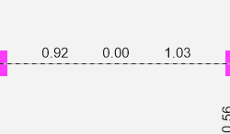
THREE-DIMENSIONAL ANALYSIS AND DESIGN
B) Shear design:
V_{c} = λ (1/ 6) √ fc′b_{w} d
V_{c} =1*1/ 6 *√28*500*380* 1/ 1000 =167.6 KN
v_{s} = 𝑣_{𝑢}/ ∅ − vc
VS= (246.6/ 0.75) -167.6=161.2 KN
Av/s = 𝑉𝑠 /𝑓𝑦𝑡∗ ,
161.2/420∗0.38 =1.01 mm2 /mm----1010 mm2 /m
From ETABS Av/s =1.03 mm2 /mm----1030 mm2 /m shown in fig
%error=1.98%

Slide 43
THREE-DIMENSIONAL ANALYSIS AND DESIGN
3)column design verification:
There are group of column with different reinforcement For column have steel ratio =1%
Column dimensions (mm*mm) | Steel ratio ρ (%) | Area of steel (mm^2) | Bars
900*400 | 1% | 3600 | 10Φ22
800*400 | 1% | 3200 | 10Φ22
650*650 | 1% | 4225 | 12Φ22
700*700 | 1% | 4900 | 10Φ25
750*750 | 1% | 5625 | 12Φ25
800*800 | 1% | 6400 | 14Φ25
850*850 | 1% | 7225 | 14Φ26

Slide 44
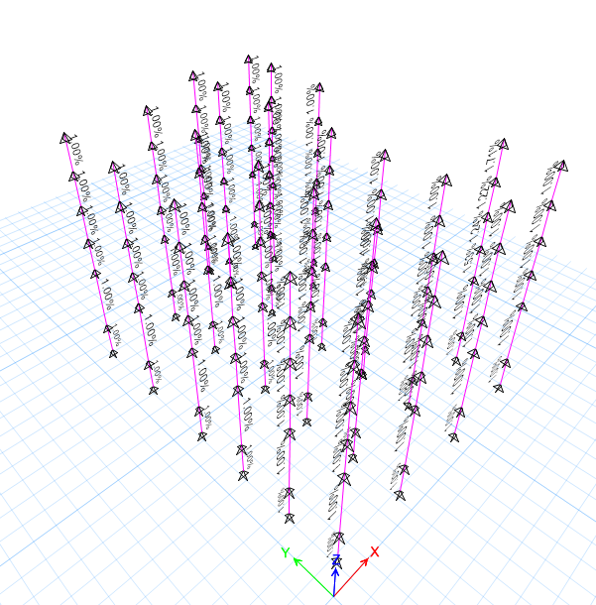
THREE-DIMENSIONAL ANALYSIS AND DESIGN

Slide 45
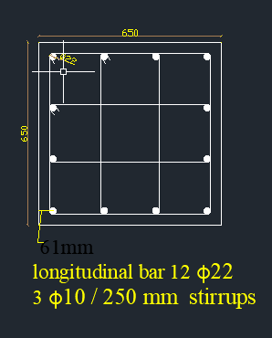
THREE-DIMENSIONAL ANALYSIS AND DESIGN
All columns has a Steel ratio ρ equal to 1% except four columns it has a Steel ratio ρ between ( 1%-2%) as shown in figure above so we neglect it
Sample of calculation:
C (650*650) → As = 4225mm^2 → 12Φ22
Spacing between bars = (650 – 2*(40+10+11))/4 = 132 mm ˂ 150 mm → OK.
Use 3 Φ 10/250 mm. as shown in figure

Slide 46
THREE-DIMENSIONAL ANALYSIS AND DESIGN
4) Footing Design verification:
Total footing area = 𝑙𝑜𝑎𝑑/𝑠𝑜𝑖𝑙 𝑏𝑒𝑎𝑟𝑖𝑛𝑔 𝑐𝑎𝑝𝑎𝑐𝑖𝑡𝑦= 121262/250= 485.048 m2
As 485.048/920.88 =0.53 > 0.5, this gives an indication that mat foundation should be used.
Area of mat = 1019.02 m2 extend out the area of building by 1 m
H =1 m, d=0.94m (cover 6 cm)
121262/1019.02 = 119 MPa < 250 MPa ok, area of mat sufficient
Soil is defined on ETABS as area springs. By considering a maximum allowable settlement of 10 mm, spring constant is calculated as follow
Spring constant = 1000*250 =250000 KN/m/m2

Slide 47
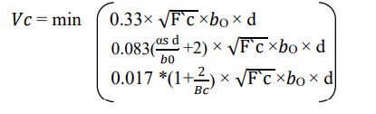
THREE-DIMENSIONAL ANALYSIS AND DESIGN
Punching shear check
Vu = 5606 KN, Column dimension =0.85X0.85 m ,d =0.94m ,𝛼𝑠=40
βc = 1 ,bo=7160mm
Critical eqn.
∅𝑉𝑐 = 0.75×0.33× √28× (4) × (940+850) ×940/1000= 8814.45>6550 KN
punching check from ETABS shows maximum value =0.072 <1 ok
Design for flexural
For top bars used minimum area of steel 1φ25/150 mm in both directionsAs
For bottoms used 1φ25/150 mm in both direction

