Slide 1

An-Najah National University
Facility of Engineering and Information Technology
Department of Building Engineering
Graduation Project 2
An integrated Redesign for a of Salah Al-Din Mosque in Oreef village.
Prepared by:
Abed Al-Rahman Harazne
Manar Shehada
Supervisor:
Eng. Haitham sawalha
Academic year: 2022-2023

Slide 2
Contents:
Introduction and site analysis
Architectural design
Environmental design
Structural design
Electrical design
Safty design
Quantity surveying
Mechanical design

Slide 3
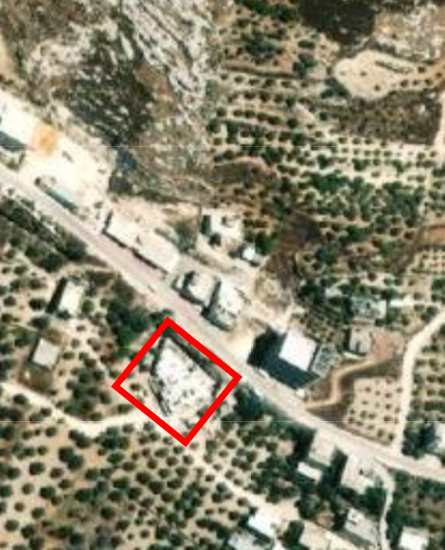
Introduction and site analysis
Our project Salah Al-Din Mosque in Oreef village in Nablus , and it is a forth floors building .
The Salah Al-Din Mosque includes four floors.
Total area of Mosque = 2180 m².

Slide 4
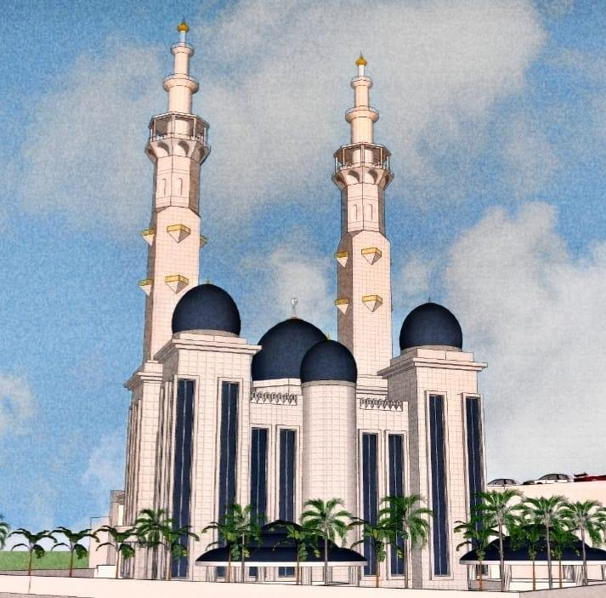
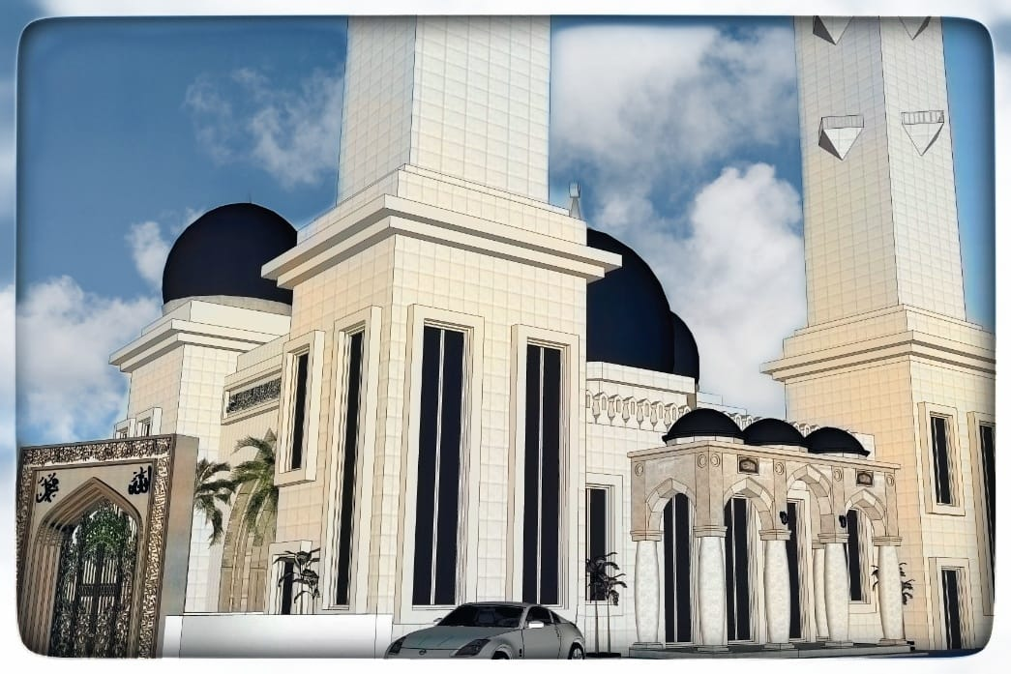
Architectural Design

Slide 5
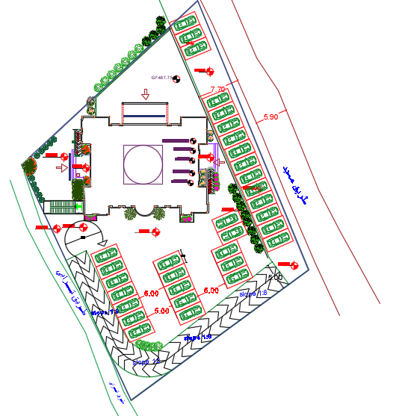
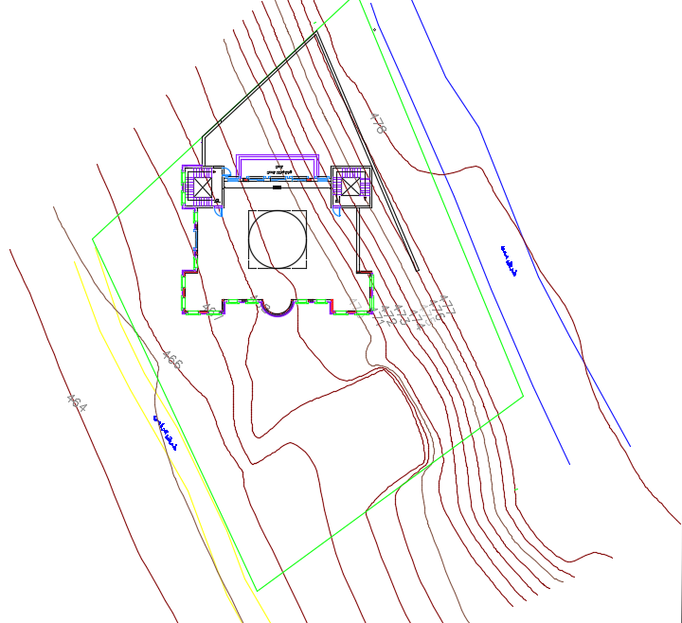
Site plan
Mosque has three entrances and exit which distributed on floors.
Mosque contains two staircases.
After modification
Before modification

Slide 6
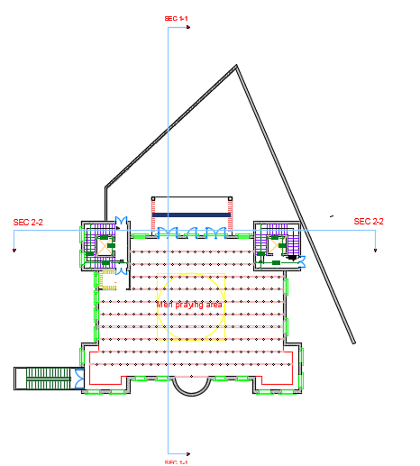
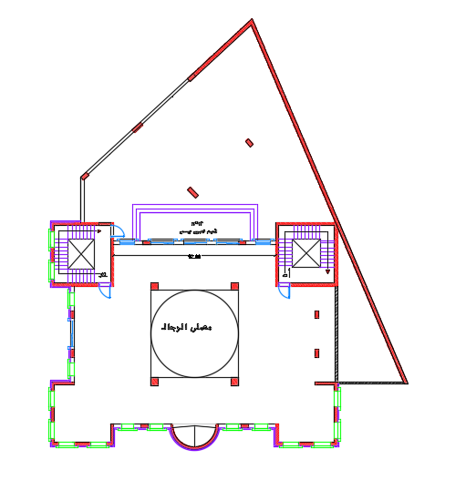
Ground floor
Area = 354.8 m²
Floor height = 6.00 m
m
After modification
Before modification

Slide 7
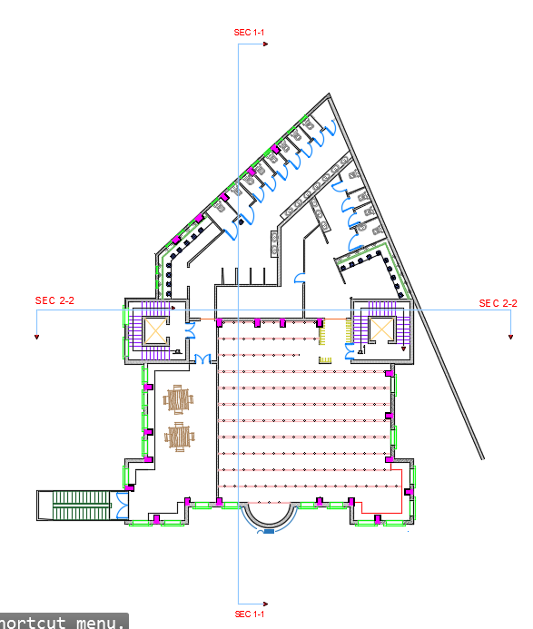
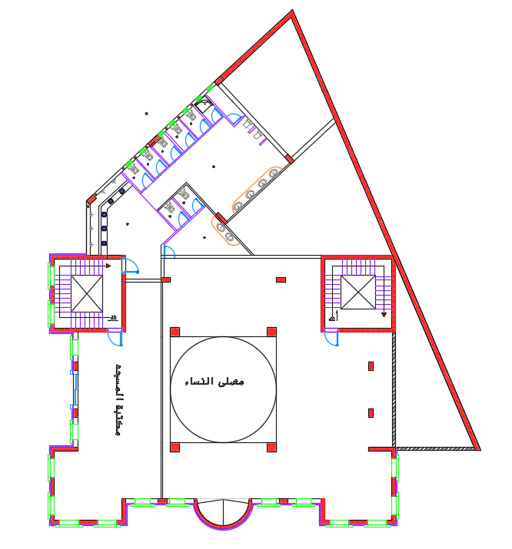
First basement floor
Area = 595.40 m²
Floor height = 4.60 m
After modification
Before modification

Slide 8
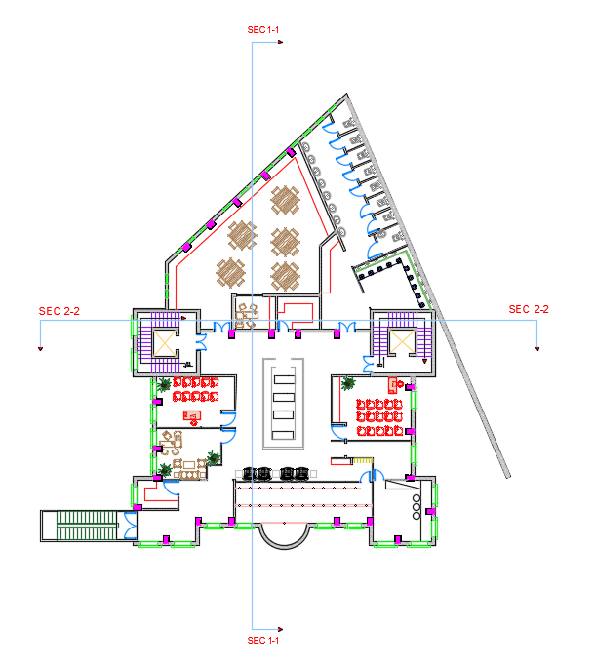
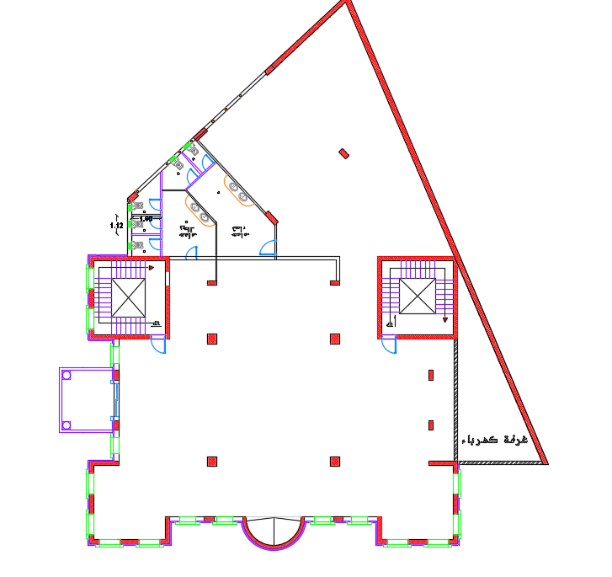
Second basement floor
Area = 595.40 m²
Floor height = 4.60 m
After modification
Before modification

Slide 9
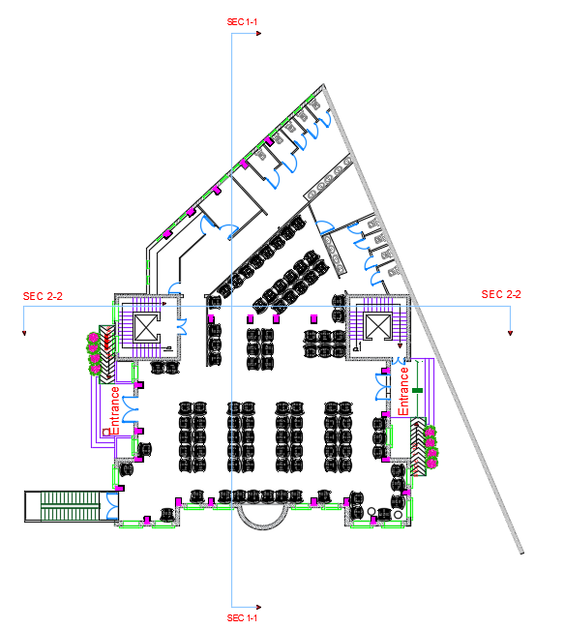
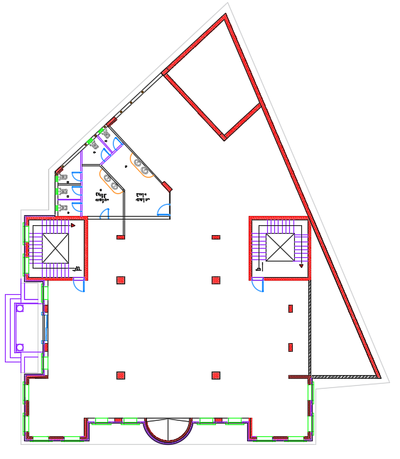
Third basement floor
Area = 595.40 m²
Floor height = 4.60 m
After modification
Before modification

Slide 10
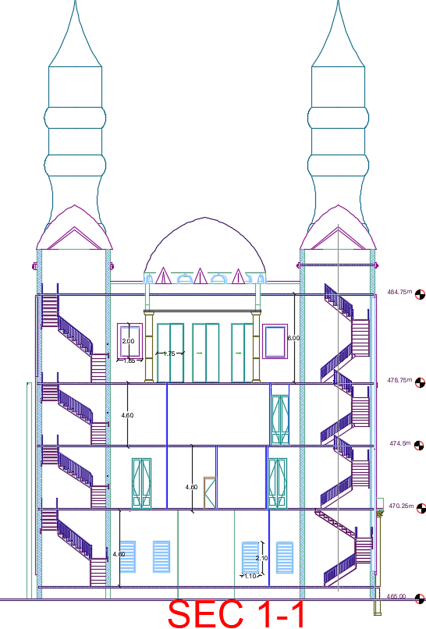
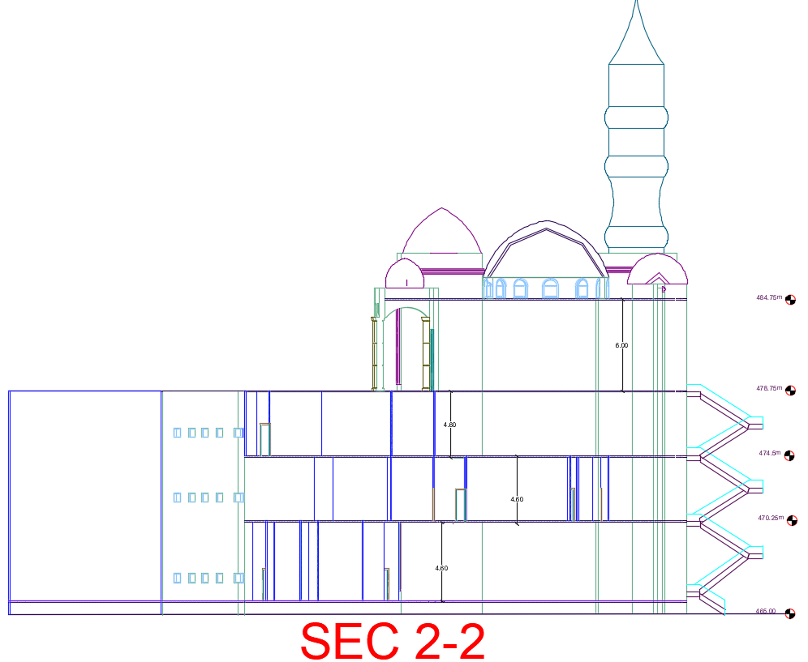
Sections

Slide 11
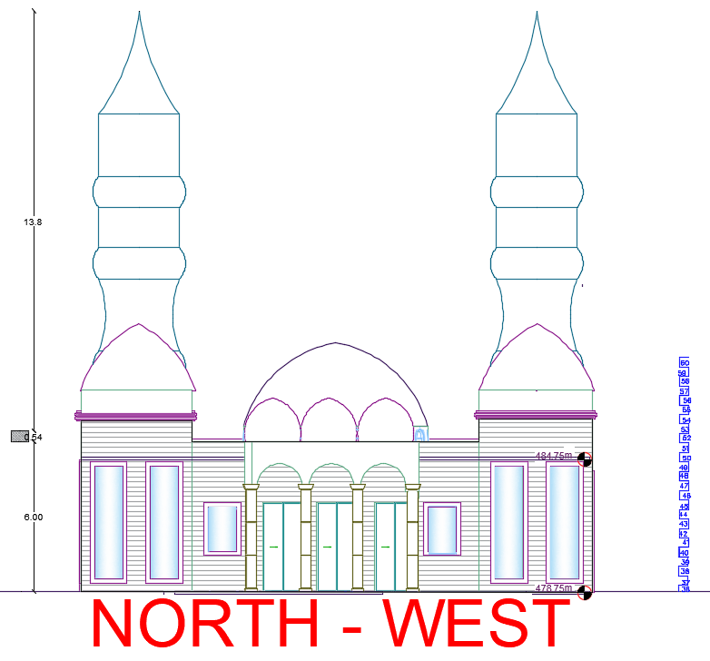
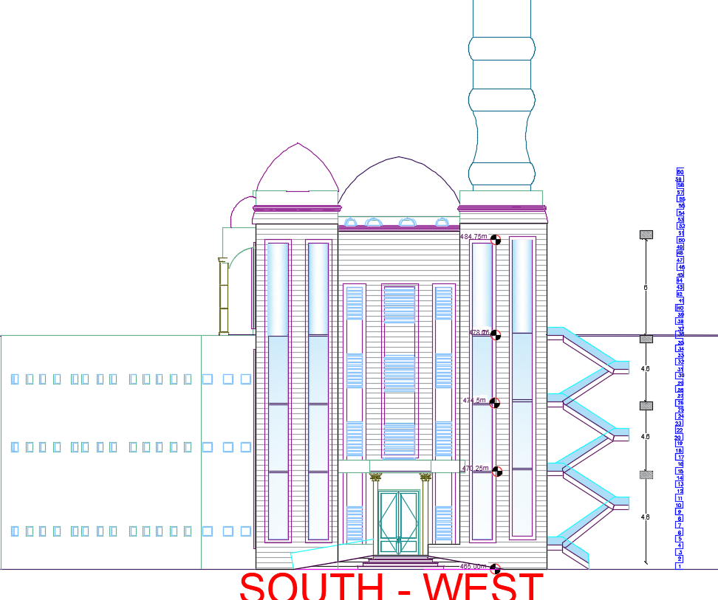
Elevations

Slide 12
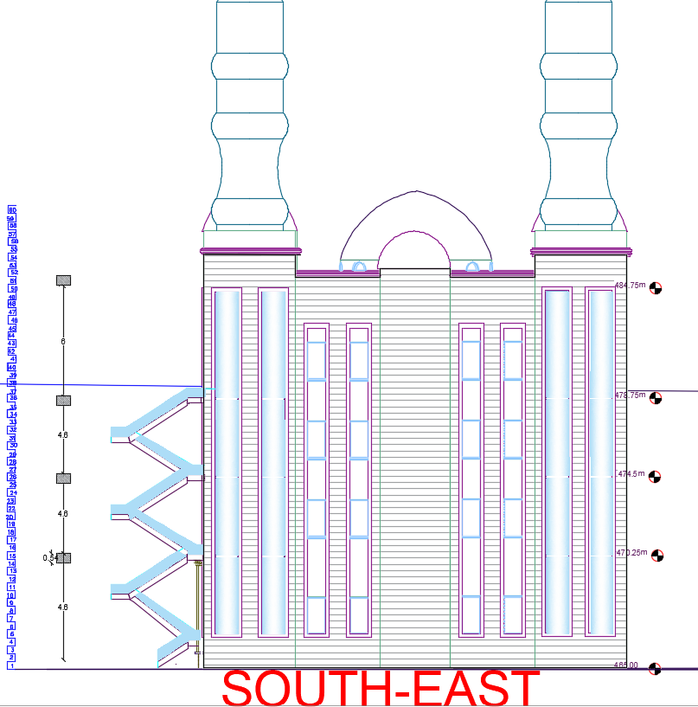
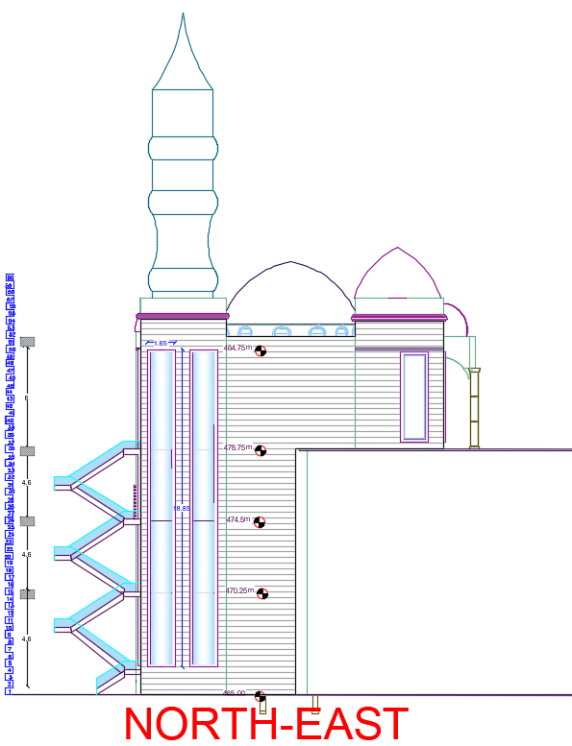

Slide 13
Environmental Aspects.
This part will deal with each daylight analysis, heating, and cooling load analysis, air movement analysis, shade analysis, thermal comfort analysis in the building, and solar gain analysis.

Slide 14
Environmental aspects:
Human comforts
Thermal comfort
visual comfort
Indoor air quality
Acoustical comfort

Slide 15
Environmental aspects:
Analysis
Daylight factor
Heating and cooling
Solar radiation
Shadowing and overshadowing

Slide 16
Daylight factor analysis:
DF% = (E internal/E external) *100%
the sky condition will be overcast with E ext. = 9000 lux and according to the recommendations, the values should range between 2—6 %.

Slide 17
Daylight factor analysis:
Daylight factor analysis before modifications
Daylight factor analysis after modifications

Slide 18
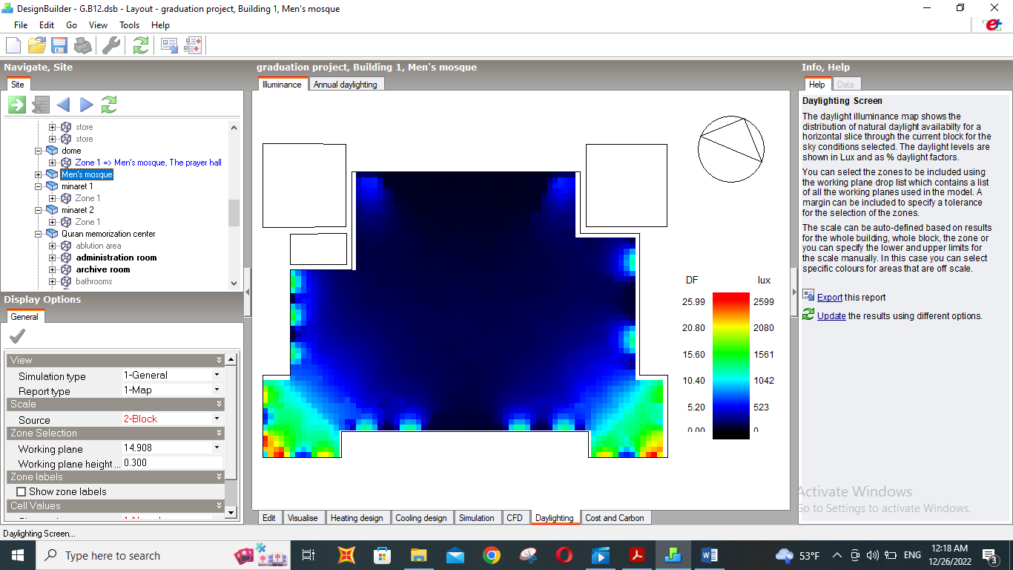
Daylight factor analysis before modifications
The floor contains three zones:
1: lower than standards ( need artificial lighting)
2: Within standards
3: higher than standards.( here the problem of glare is existed and need solutions)
Figure ‎2‑29: daylight factor analysis for men’s mosque.

Slide 19
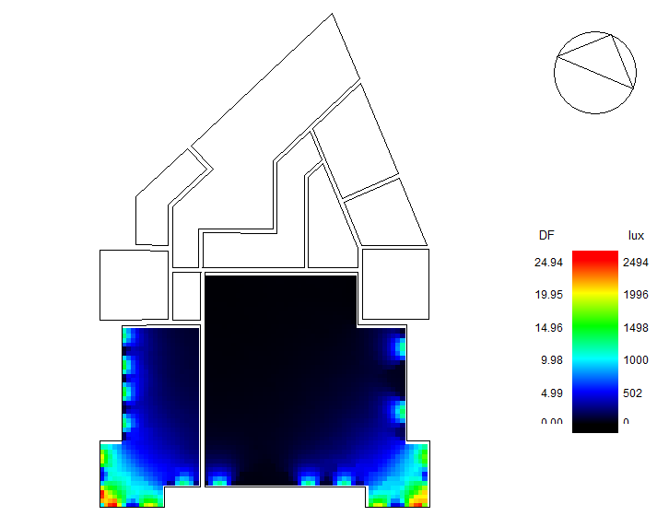
Figure ‎2‑30: daylight factor analysis for women’s mosque.

Slide 20
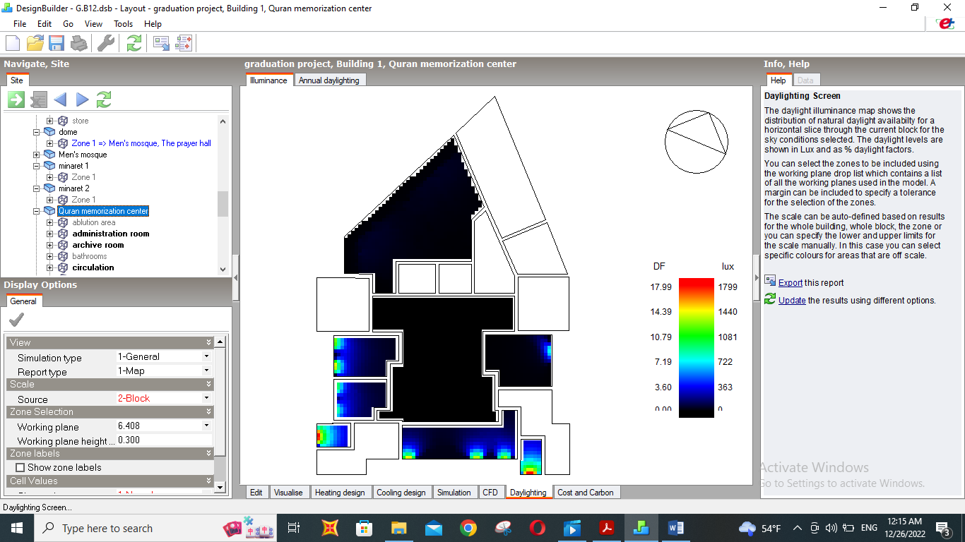
Figure ‎2‑31: daylight factor analysis for Quran memorization center.

Slide 21
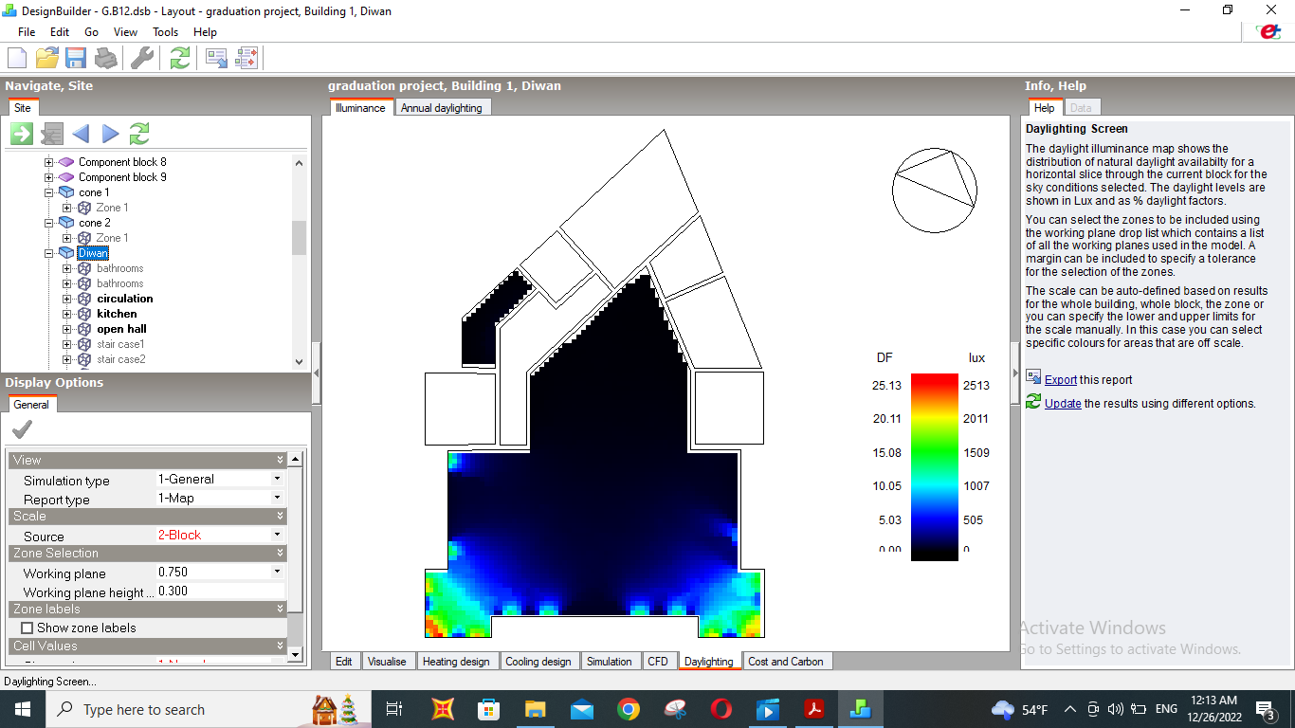
Figure ‎2‑32: daylight factor analysis for diwan.

Slide 22
The modifications that have been made:
Horizontal lovers were used
The type of glass has been changed

Slide 23
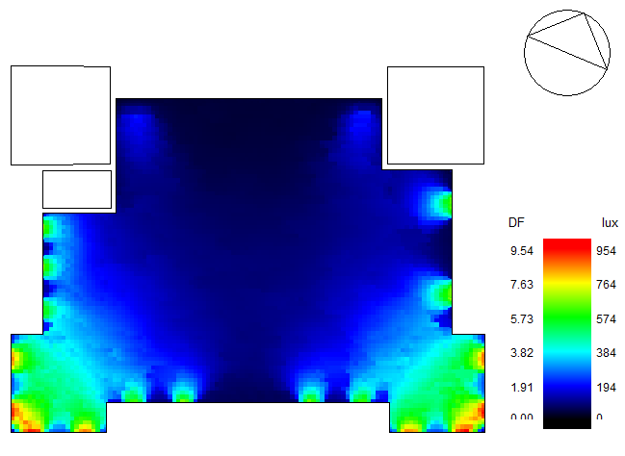
Daylight factor analysis after modifications
Figure ‎2‑33:daylight factor analysis for men’s mosque.

Slide 24
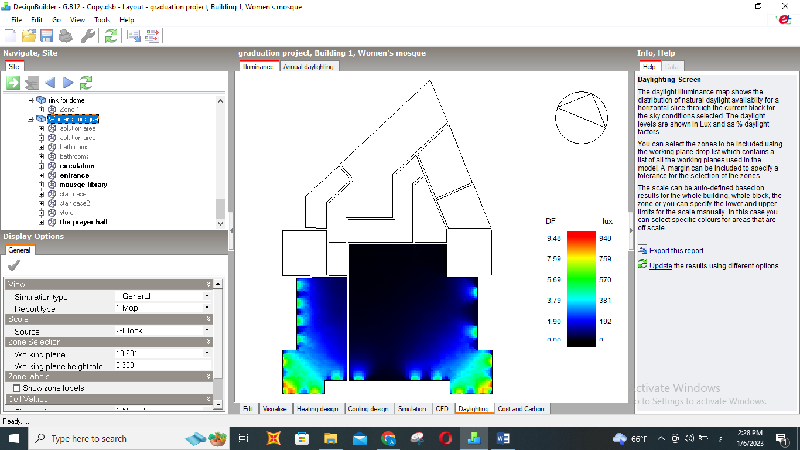
Figure ‎2‑34:daylight factor analysis for women’s mosque.

Slide 25
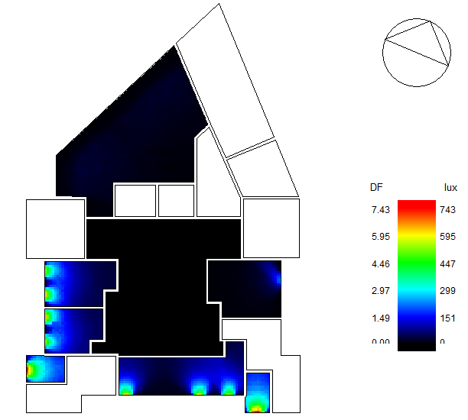
Figure ‎2‑35:daylight factor analysis for Quran memorization center.

Slide 26
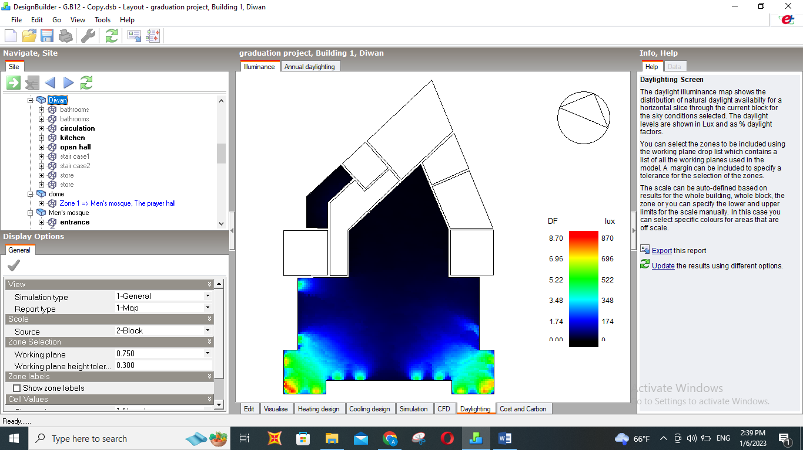
Figure ‎2‑36:daylight factor analysis for diwan.

Slide 27
Daylight factor analysis after modifications
Conclusion:
The values were clearly reduced, especially in the areas close to the windows, and thus the glare problem was eliminated.
Most of the regions have become within the standard.
There are areas where the values are less than the standard, and therefore they need artificial lighting.
There are very small areas where the values are still high, and these areas have been neglected because they are often unused areas, and the modification of these areas will negatively affect other areas and make them less than the standard.

Slide 28
Heating and cooling loads analysis:
Heating and cooling loads analysis before modifications:
Heating and cooling loads analysis after modifications:

Slide 29
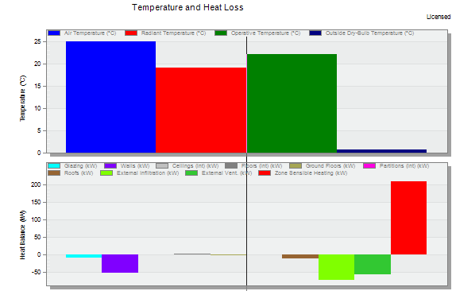
Heating and cooling loads analysis before modifications:
From this figure, we can notice that:
1- there is a big difference between air temp. and radiant temp.
2- there is a high contribution in heat loss by walls and roof
From this, we realize the importance of thermal insulation in the building.
Figure ‎2‑37: heating design before modification.

Slide 30
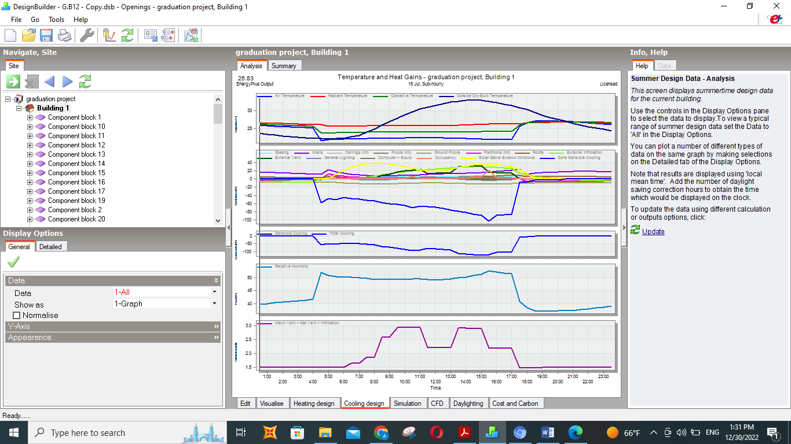
Heating and cooling loads analysis before modifications:
From this figure, we can notice that:
1- there is a big difference between air temp. and radiant temp.
2- there is a high contribution in heat gain by solar gain exterior windows.
From this, we realize the importance of making adjustments for windows.
Figure ‎2‑38: cooling design before modification.

Slide 31
The modifications that have been made:
Thermal insulation of the building
Horizontal lovers were used
The type of glass has been changed

Slide 32
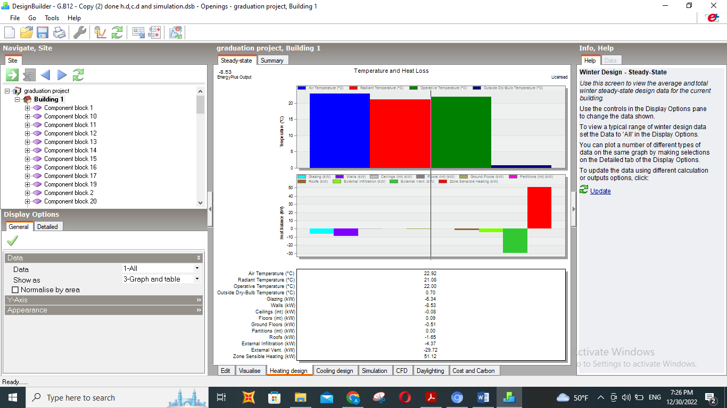
Heating and cooling loads analysis after modifications:
From this figure, we can notice that:
1- there is a small difference between air temp. and radiant temp. This provides a thermally comfortable environment
2- there is a small contribution to heat loss by walls and roof.
From this, we can note the positive effect of thermal insulation.
Thermal insulation leads to low heat loss
and thus the size of the heating system is less.
Figure ‎2‑45:heating design after modifications.

Slide 33
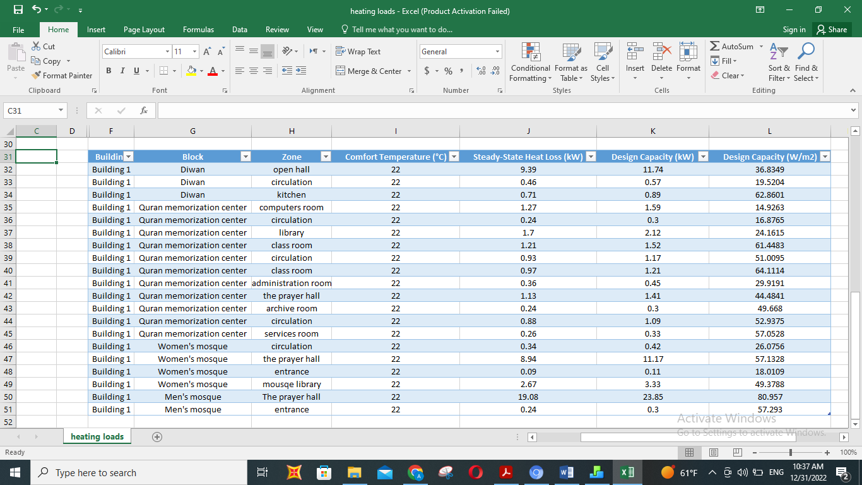
Table ‎2‑14:heating load for each space
Design capacity(w/m^2) in all spaces < 80 which means the building is considered energy efficient.

Slide 34
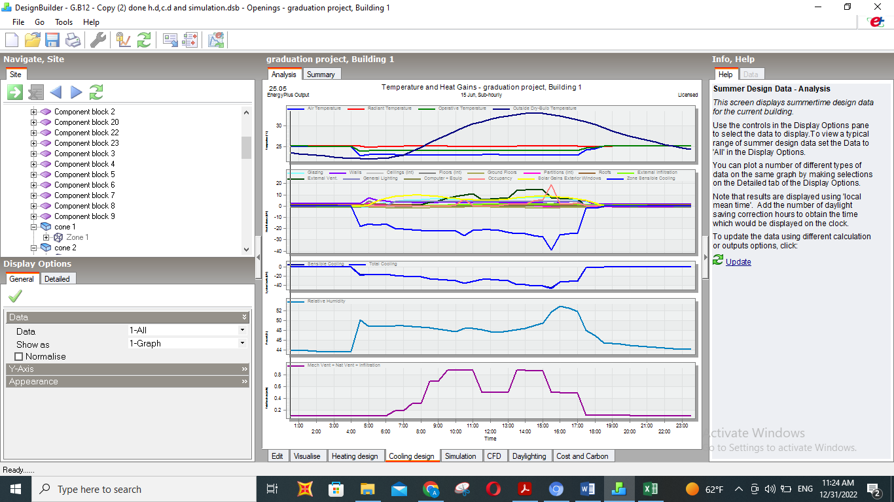
From this figure, we can notice that:
1- there is a small difference between air temp. and radiant temp.
2- there is a small contribution in heat gain by solar gain exterior windows.
From this, we realize that the modifications made to the windows were effective.
Figure ‎2‑46:cooling design after modifications.

Slide 35
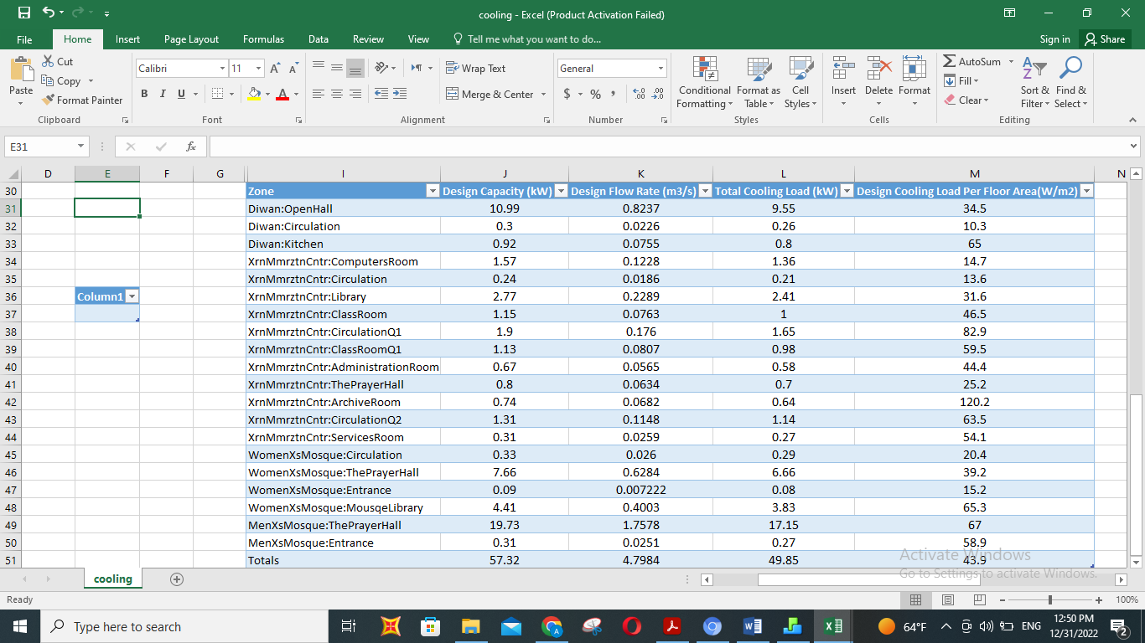
Table ‎2‑15:cooling load for each space
Design capacity(w/m^2) in all spaces < 80 which means the building is considered energy efficient.

Slide 36
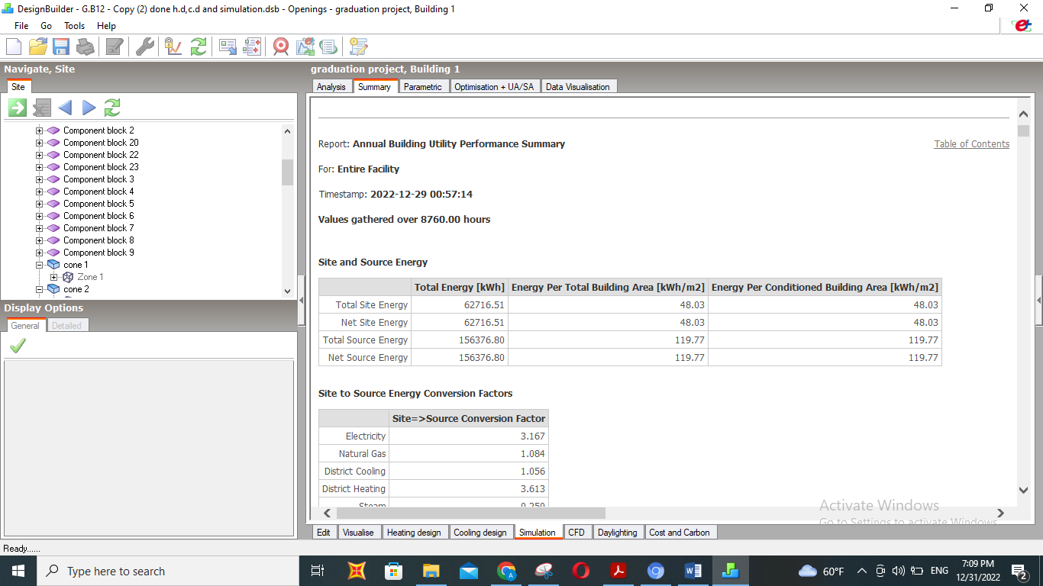
The site and source of energy:
Table ‎2‑16:site and source energy.
Based on the values given in Table ‎2‑16, the general condition can be assessed in general as acceptable, but a comparison must be made with another similar building to accurately assess and reach the best possible condition.

Slide 37
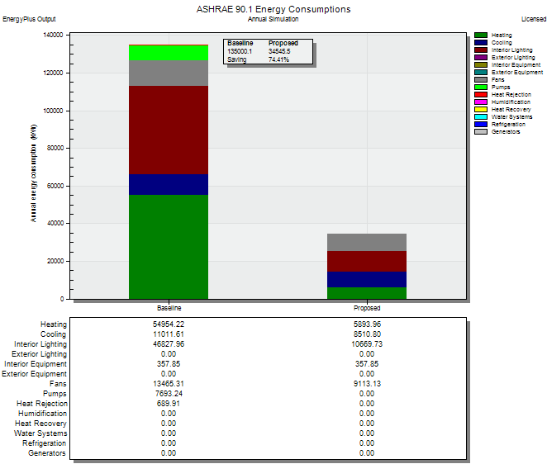
Comparison with baseline:
When the comparison was made with the baseline building, a percentage of savings in energy consumption was obtained = 74%
Figure ‎2‑47:comparison between the proposed and baseline building.

Slide 38
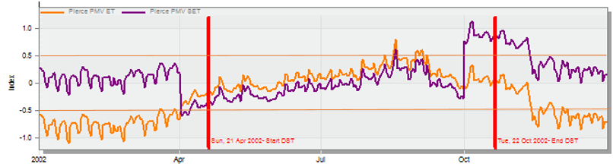
Thermal comfort:
Figure ‎2‑48: PMV index for users in building
From Figure ‎2‑48 we have noticed that the values were acceptable throughout the year, and this means that people feel thermal comfort well while they are inside the building, except for short periods, which are when there are high climatic fluctuations, which occur when switching from one season to another.

Slide 39
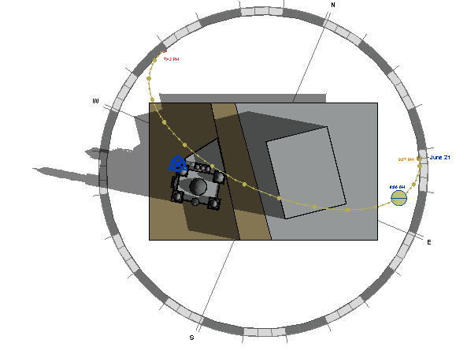
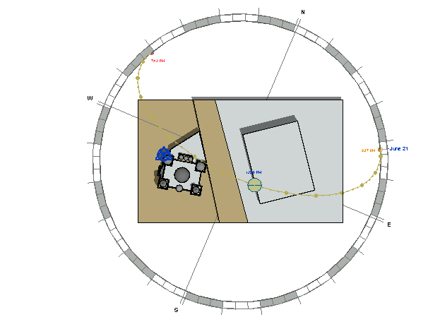
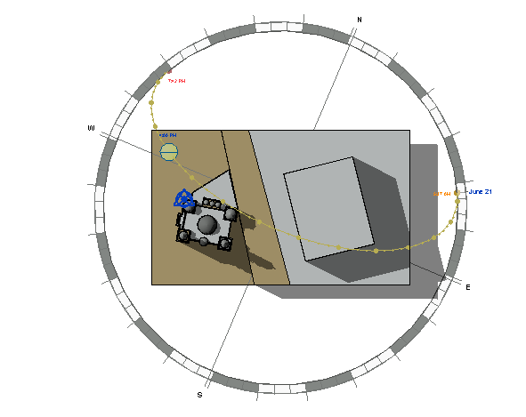
Shadowing and overshadowing analysis
In summer (21/06/2022):
at 8:00 am.
at 12:00 pm.
at 4:00 pm.

Slide 40
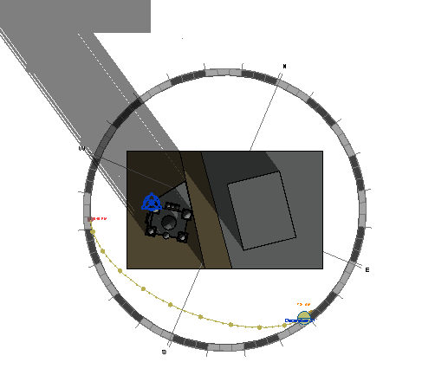
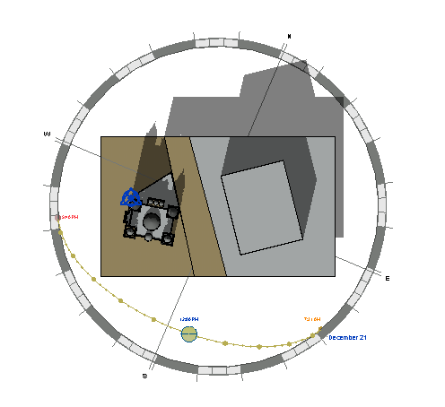
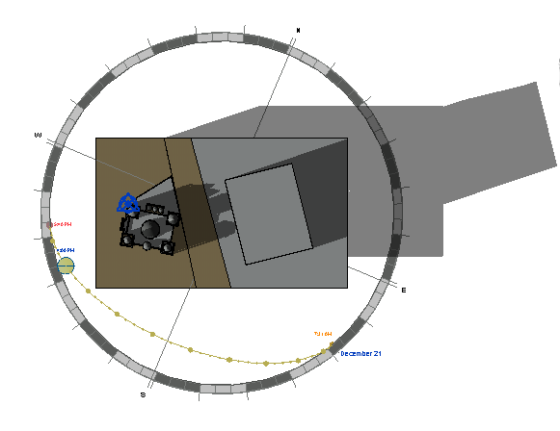
Shadowing and overshadowing analysis
In winter (21/12/2022):
at 8:00 am.
at 12:00 pm.
at 4:00 pm.

Slide 41
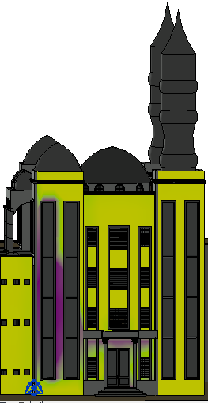
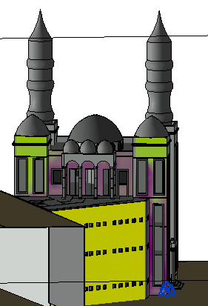
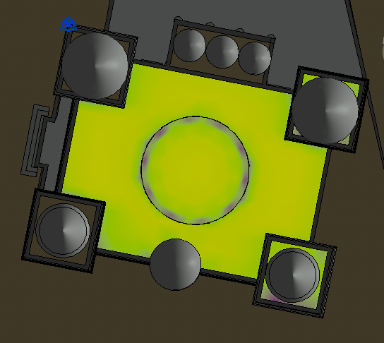
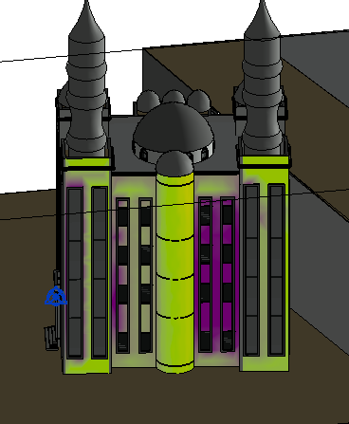
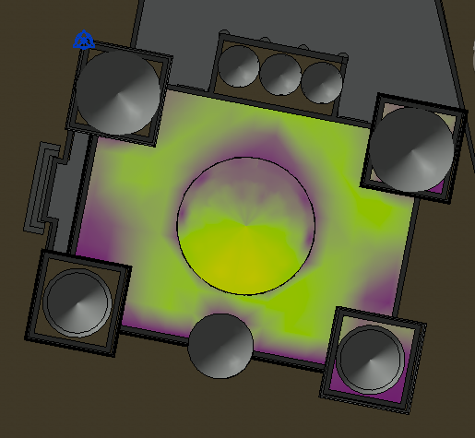
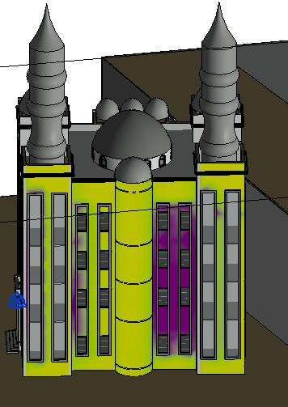
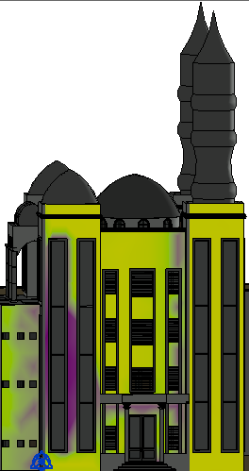
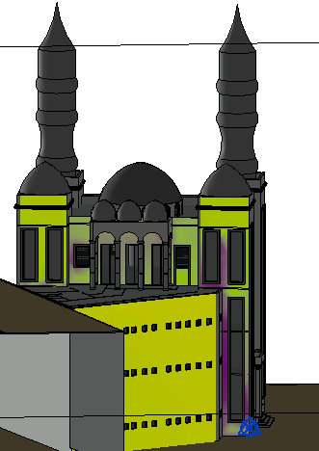
Solar radiation analysis:
In summer
In winter

Slide 42
Structural aspects.
In this chapter, all structural elements will be dealt with, as assumptions will be made, and based on them, we will start designing, as all the different elements will be designed with the necessary checks, and in the end, detailed drawings will be prepared.

Slide 43
Assumptions:
--Materials
Unit weight of concrete = 25 KN/m3.
B350 concrete will be used.
Yielding strength of steel (Fy) = 420MPa.
--Loads:
Live load = 5 Kn/m2(ASCE/SEI 7-10, 2010)
Superimposed dead load = 3.5 Kn/m2(ASCE/SEI 7-10, 2010)

Slide 44
Assumptions for design:
Slab system
After calculating the suitable thickness based on ACI 318 code, the system will use a flat plate voided slab.
Columns design
The assumed columns section is 400*600mm

Slide 45

ETABS model:
Figure ‎3‑1: Etabs Model.

Slide 46
checks:
Compatibility check: ok
Equilibrium check: ok
Deflection Check: ok
Slab shear check: ok
Punching shear check: ok
Stress-strain check: ok
Design Check: ok

Slide 47
Seismic checks:
Model participant mass ratio check: ok
Period check: ok
Drift check: ok
P-Delta check: ok

Slide 48

Column Centers

Slide 49


Detailing:
Detailing for slab:
Figure ‎3‑20:steel detailing for B1,B2and B3.
Figure ‎3‑19:flat plate voided slab for B1, B2, and B3.

Slide 50


Figure ‎3‑21:flat plate voided slab for G.F.
Figure ‎3‑22:steel detailing for G.F.

Slide 51

Column detailing :
Figure ‎3‑23:Column detailing.

Slide 52

Shear wall detailing:
Figure ‎3‑25:Shear wall detailing.

Slide 53


Footing detailing :
Figure ‎3‑27:Footing detailing.
Figure ‎3‑28:Footing detailing.

Slide 54

Stairs detailing :
Figure ‎3‑29:Stairs detailing.

Slide 55

Dome detailing:
Figure ‎3‑30:Dome detailing.

Slide 56

Figure ‎3‑31:Dome detailing.

Slide 57
Chapter 4: electro mechanical aspects.
This chapter will discuss various design aspects such as artificial lighting, HVAC, power, water supply, drainage, firefighting, acoustical, rainwater, and green stormwater harvesting.

Slide 58

Artificial lighting design:
Figure ‎4‑1: lighting quality features.

Slide 59
lighting design process and considerations:
space, function & users
specifications & recommendations
lighting types and strategies (techniques)
Luminaire selection and properties.
Evaluation & Sustainability

Slide 60


Prayer hall as a sample: types of luminaires were used

Slide 61

Figure ‎4‑17:3D modeling for the prayer hall.

Slide 62

Prayer hall as a sample
Figure ‎4‑16: lux level contour for the prayer hall

Slide 63


Electro-Mechanical design
Power Socket distribution GF :

Slide 64

Acoustical System
Acoustics is a science of high importance. So that the acoustic features in the interior spaces are no less important than the public places.
The absorption coefficient for finished material

Slide 65

Acoustical System
The reverberation time for Men praying area
$$Rt60=\frac{0.161×V}{S total ×∝avg}$$
is recommended to be (0.55- 0.8)sec It has been identified between two levels of speech and soft music, and this is what we need in the mosque , and its ok after treated

Slide 66




Acoustical System
Insul out put to external & internal walls:

Slide 67




Acoustical System
Loud speaker
loud speakers in the man & women praying area

Slide 68




HVAC system
System used is VRF
Out door unit
Indoor unit
Fan coil split unit diffuser

Slide 69
HVAC system
The cooling capacity was designed because the cooling capacity is greater than the heating capacity.
Heating load | 229.5 KW
cooling load | 306.8 KW

Slide 70


HVAC system

Slide 71
Water Supply System
Types of pipes:
Steel for Vertical pipes
PVC for horizontal and branch pipes

Slide 72



Pipes Diameters
 | B3 | B2 | B1
Main vertical | 1.5” | 1.5” | 1.5”
Main horizontal | 1” | 1” | 1”

Slide 73
Drainage System
2" diameter: The branch diameter connects the lavatory to the floor drain.
4" diameter: the main stacks line's.
4" diameter: water closet (WC) to the main stack.
6" diameter: between manholes.

Slide 74

Drainage System
Manholes plan

Slide 75

The diameters that would be used in the Mosque for vent, stack, drainage, and sewer are seen in the table below.

Slide 76



Total Fixture unit in floors:
Total dfu B1=121
Total dfu B2=78
Total dfu B3=65

Slide 77

B2 floor water drainage:

Slide 78
Safety Design

Slide 79



Fire protection system
The most common systems used in Mosque is:
Fire extinguisher
sprinkle
Hose

Slide 80


Fire Protection System in GF & B1 :

Slide 81

Egress Route
B3 Floor

Slide 82

Quantity surveying

Slide 83
Thank You

