Slide 1
Control and Design of PV-Battery Charger with Maximum Power Point Tracker (MPPT)
Graduation Project-II submitted to:
Department of Electrical Engineering
Faculty of Engineering and Information Technology
An–Najah National University
In partial fulfillment of the requirements for Bachelor degree in Electrical Engineering
Supervised by: Dr. Moien Omar

Slide 2
Outlines
Problem Statement
Objectives
Previous Work
Design Considerations
Buck converter Design
Voltage and Current sensors
Microcontroller Arrangement
Results & Recommendations

Slide 3
Problem Statement
Objectives
Project Work
The energy generated from the PV module is mainly dependent on the temperature and solar radiation.
Nowadays, the costs of small solar-power modular units and solar-power plants are economically feasible for large-scale production and use of solar energy.
MPPT is used to extract the maximum power from the PV panel in order to maximize the overall efficiency of the system, thereby reducing the overall system cost.
In this work, a battery charger form photovoltaic (PV) solar cell with maximum power point tracking is proposed.
The mathematical model was presented and simulated. Design, implementation and recommendation are done.
Recently, research and development of low cost solar panels, thin-film devices, concentrator systems, and many innovative concepts have increased.

Slide 4
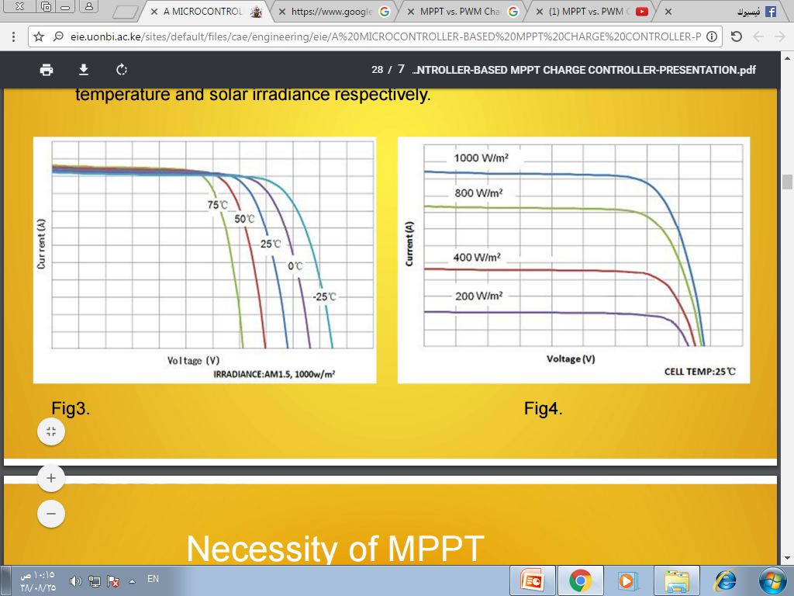
Previous Work
The voltage and open circuit voltage is not substantially affected due to changing levels of irradiance.
Power produced by the PV module varies greatly depending on its irradiance.
The current and short circuit current is not substantially affected due to changing levels of temperature.
MPP decreases with increase in temperature.

Slide 5
Assume a certain PV system with the following ratings:
Vmpp = 18 V
Impp = 6 A
Vb = 12 V
MPPT Charge controller:
P = [(Vmpp/Vb) * Impp] * Vb
P = Vmpp * Impp
P = [(18/12) * 6] * 12
P = 18 * 6
P = 108 W
PWM Charge controller:
P = Vb * Impp
P = 12 * 6
P = 72 W
PWM Charge controller | MPPT Charge controller
Smaller systems | Larger systems
Nominal voltage of array matches battery bank voltage | Mismatched nominal voltages
Cost of increasing PV panel less than extra cost of MPPT Charge controller | Cost of increasing PV panel more than extra cost of MPPT Charge controller
Less flexible and efficient | More flexible and efficient

Slide 6
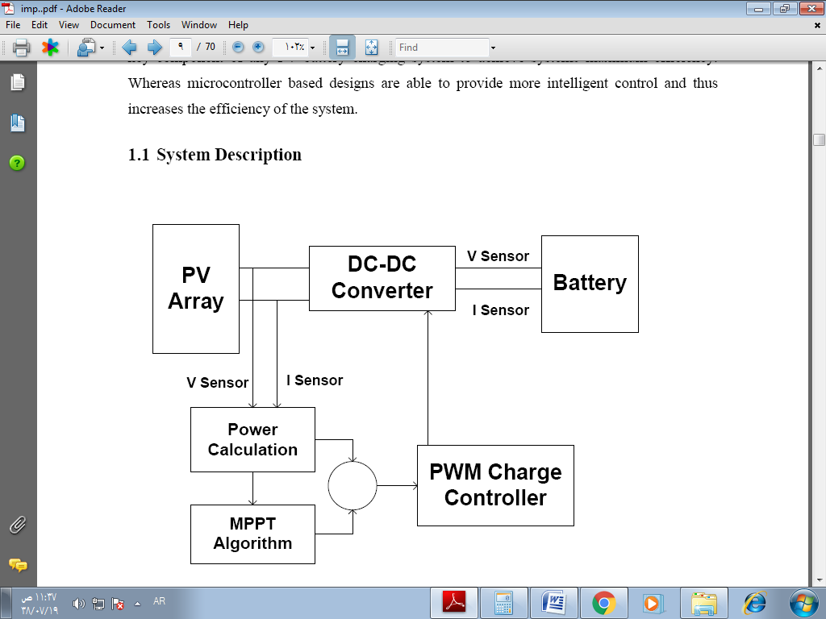
Design and Implementation
The microcontroller senses both the panel and battery voltages and takes decisions to activate different components of the circuit.
After taking the measurements of voltage and current, the tracking algorithm (Perturb and Observe) will control the operation and give orders to the controller.

Slide 7
Design Considerations:
Solar panel power is (50W).
Input voltage “equals the solar panel with open circuit voltage” is (22V).
Output rated voltage is (12V).
Maximum current is (5A).
The selected frequency is (50KHz).
An ideal switches (on-resistance, infinite off-resistance and zero switching time)
An ideal diodes.

Slide 8
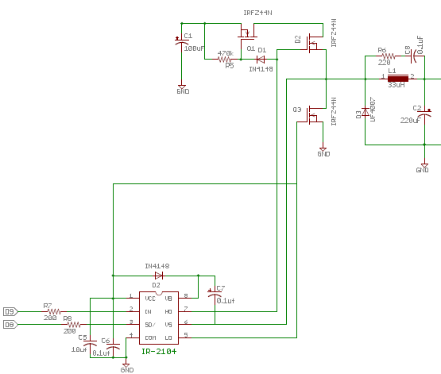
Buck converter Design

Slide 9
The snubber network : to filter the voltage across the inductor.
Output capacitance : to minimize the voltage overshoot and ripple present at the output of a buck converter.
The MOSFET will serve its purpose as a switch.
MOSFET driver allows a low current digital output signal from a microcontroller to drive the gate of a MOSFET.
We have to provide power to the gate driver. It is give on (V_{cc)} and its value is as per data sheet.
The high frequency PWM signal from Arduino goes to (IN), the shut-down control signal from the Arduino is connected on (SD).
The two output PWM signals are generated from (HI) and (LO) pins.

Slide 10
The inductor to smooth the switching current and the capacitor (C2) to smooth the output voltage.
The MOSFET (Q1) was added to allow the system to block the battery power from flowing back into the solar panels at night.
(Q1) turns on when (Q2) is on from voltage through diode (D1).
The diode (D3) is an ultra fast diode that will start conducting current before (Q3) turns on.
The diode (D2) and capacitor (C7) are part of circuit that generates the voltage (Q1) and (Q2).

Slide 11
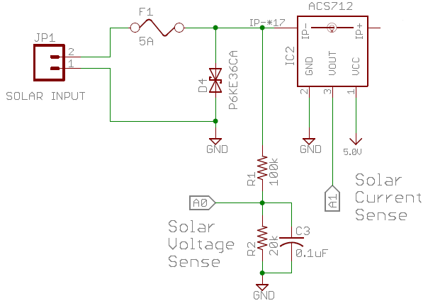
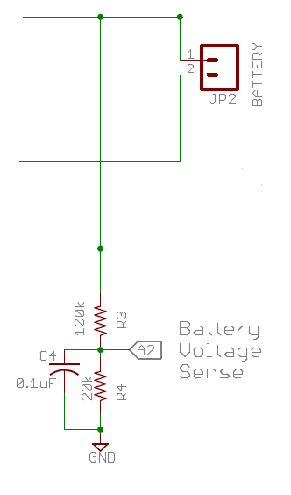
Voltage and Current sensors
Arduino’s analog inputs can be used to measure DC voltage between (0 and 5V) when using the standard (5V) analog reference voltage and this range can be decreased by using two resistors to create a voltage divider. The capacitors (C3) and (C4) are used to remove the high frequency .
We used a Hall Effect current sensor ACS712. The ACS712 sensor reads the current value and convert it into a relevant voltage value.

Slide 12
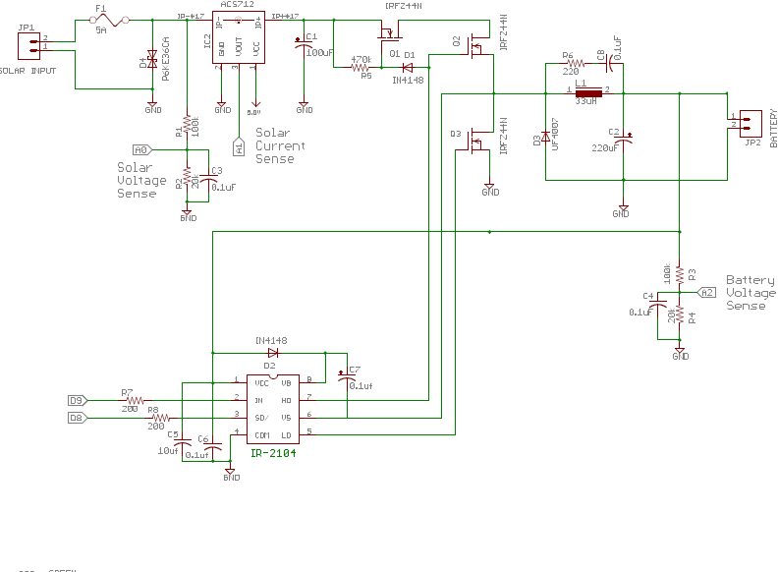
Microcontroller Arrangement

Slide 13
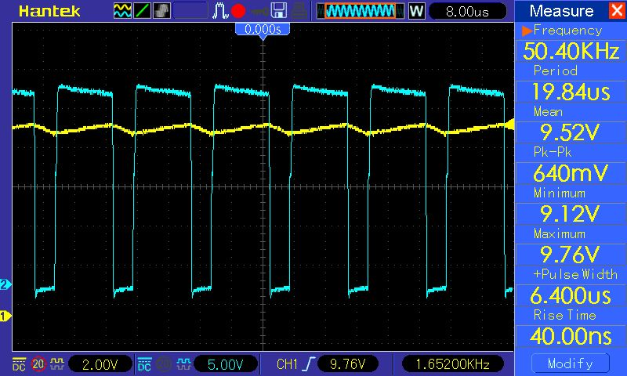
Results & Recommendations
In the test stage of the converter, the results were as the following figures:
output signal

Slide 14
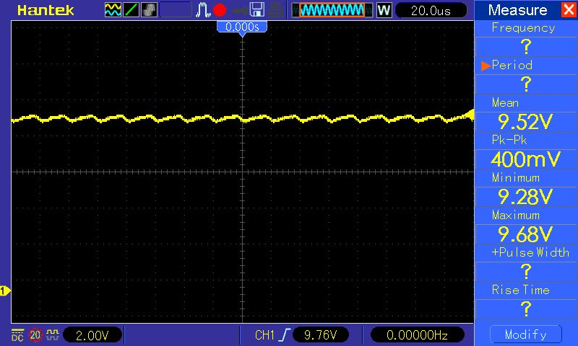
Output voltage ripple

Slide 15
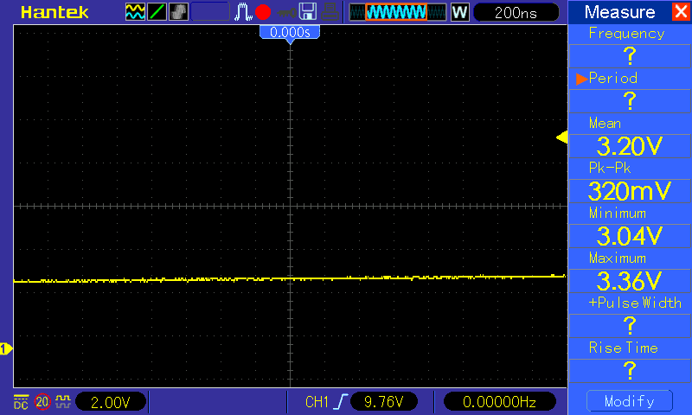
Output signal at 25% duty cycle

Slide 16
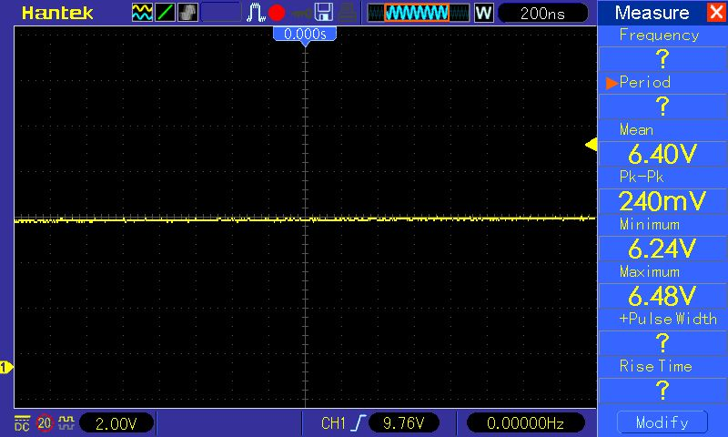
Output signal at 50% duty cycle

Slide 17
In the hardware stage we faced several problems, for example:
Making a good inductor is not a simple task. We recommend to buy a readymade inductor with appropriate rated current.
MOSFET (Q3) is burning repeatedly. We added a pull down resistors at (SD) pin and (IN) pin of MOSFET driver and we added a diode in place of low side MOSFET. Also, we tried to modify the existing software but we do not find any satisfactory results.
MOSFET (Q1) conducts even when there is no input.
Faulty components, shipping delays and difficulty when translating the designed schematics to the physical board.
Because of the burning of some electronic parts, the costs have increased and this project become beyond our financial capabilities as students.

Slide 18
The design portion of the major qualifying project was successfully completed. A design for a maximum peak power tracker has been successfully obtained, a functional working prototype was reached. However, our analysis of the algorithm and understanding of the different functions shows that by (ADC) of the voltages and current and (PWM) of the buck converter, we will be able to attain the MPP implement in the future with some modifications.
Eliminate the noise associated with the circuit. There was no significant work in minimizing the noise in the circuit while attempting to implement a working circuit both quickly and efficiently.
It would be helpful to perform tests using actual solar panels. It would be useful to perform tests both indoor and outdoor to observe both controlled and actual results for operation.

Slide 19


