Slide 1

{Quantity and cost surveying for Raesat Arafat school}
An-Najah National University
Faculty of Engineering and Information Technology
جامعة النجاح الوطنية
كلية الهندسة و تكنولوجيا المعلومات
BY:
Reham Salah Abughdaib
Noor Basem Abumuhsen
Under supervision of: Dr. Mohammad Abunemeh

Slide 2
Presentation outline:
Introduction.
Methodology.
Results.
Recommendation.

Slide 3

Introduction

Slide 4
Introduction :
At the current time, Palestine and all other countries are witnessing a rapid growth in construction, as there is a permanent need to establish facilities, whether residential, commercial or even industrial facilities.
It is noticeable that there are many tenders for the construction of facilities whatever their type. Where the awarding party for the bid, whether it is a private or governmental company offers the required bid. Some of contracting companies estimate the cost and time to implement the project, increase their profit, and then apply for the bid. Usually, the price is the main criterion in evaluating the bidders, as the least expensive is the one who takes the bid.

Slide 5
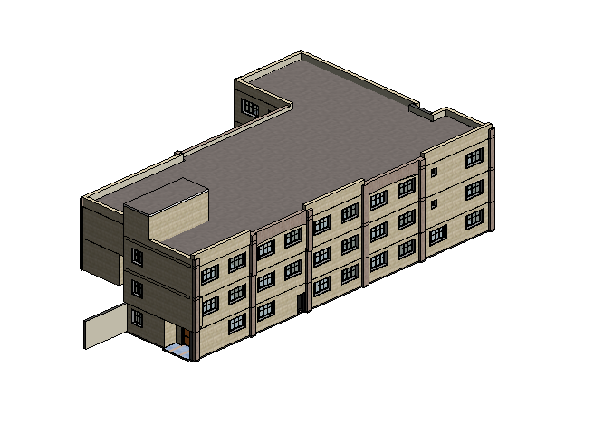
Project description :
This project is about estimating the price and time for a bid funded by Nablus municipality for the establishment of a school called Raesat Arafat.
The school is located in Nablus city, opposite to Al-Salahiya School and consists of three floors with a total area of 2170 square meters.

Slide 6

Objectives

Slide 7
Objectives :
Estimating the quantities of excavation in this project.
Calculating the quantities of each concrete, steel, stone, block and any other construction material in the project using software programs.
Estimating the time required to complete this bid, and then compare it with the time specified for project completion.
Estimating the cost of the project and compare it with the actual cost estimated by the bidder for the project.
Estimating the quantities, duration and cost for the whole finishing works for the project.

Slide 8

Significant of study:

Slide 9
Significant of study:
The completion of this project is of great importance in the scope of engineering projects, especially the construction ones where any engineering project cannot be completed without knowing the quantities and time necessary for its completion.
With the development of life, many different software programs have appeared that can be used in calculating the quantities of the construction elements and thus obtaining correct results that can be relied upon and benefiting from them. Thus, avoiding any error in the implementation of the project and its supervision.

Slide 10

Methodology :

Slide 11
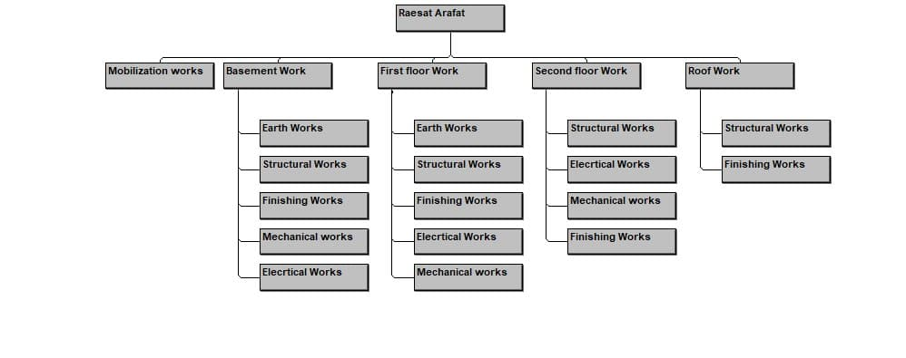
The work beak down WBS for the whole project will be performed as shown in the figure:

Slide 12
Methodology:
The quantity for each activity by building a 3D model on Revit.

Slide 13
Methodology:
The sequence of activities and the relationships between them must be defined.
To know the duration for each activity , the productivity rate must be known by asking the contractor.
By knowing each of quantity and productivity rate the duration for each activity can be known by divided the quantity on productivity rate.
Quantity
Productivity rate
Duration

Slide 14
Methodology :
The resources needed for each activity must be known.
The prices for each resources must be known by asking the contractor.
The resources and their prices for each activity will be entered to Primavera
So, the cost for each activity will be known.
Time
Price/time
Cost
Quantity
Price/unit
Cost

Slide 15
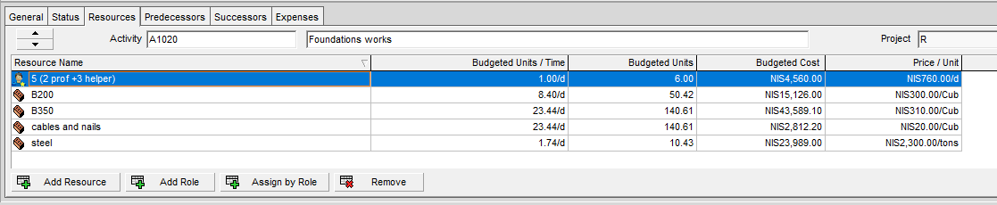
Methodology:
As an example, the resources for foundation work activity and their resources are shown in the figure below:

Slide 16

Results:

Slide 17
Results :
The results consists from three components which are :
Quantity.
Duration.
Cost.
Quantity
Price / unit
Cost
Price /time
Time
Productivity rate

Slide 18
Mobilization work

Slide 19
Mobilization work:
The quantities and duration for each activity listed under mobilization work are listed in the table below:
Activity name | Quantity | Productivity Rate | Duration (day)
Mobilization |  |  | 4
Surveying |  |  | 2
Excavation to reduce level | 1600 m³ | 300 m³/day | 5

Slide 20
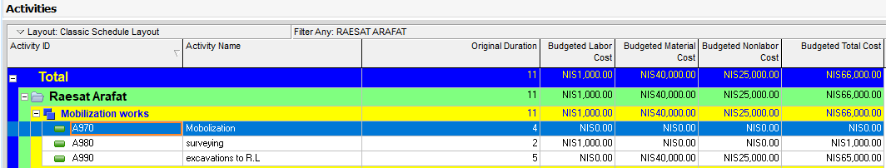
Mobilization work:
For mobilization work, the total cost is estimated to be 66,000 NIS as shown in the figure:

Slide 21
Basement work

Slide 22
The quantities and duration for each activity are listed in the table below:
Activity | Quantities | Productivity Rate | Duration (day)
Excavation for footing | 1034 cubs | 200 cub/day | 5
Backfilling | 836 m² | 200 m²/day | 4
Foundations works | 191 m³ | 30 m³/day | 6
Walls& necks under S.O. G | 45 necks | 10 necks/day | 5
Tie beams | 270 m | 50 m/day | 5
Electrical earthing works | 425 m² | 480 m² | 1
Sanitary earthing work |  |  | 1
Backfilling between tie beams | 358 m² | 200 m²/day | 2
Base course | 358 m² | 240 m²/day | 1
Slab on Grade works | 425 m² | 150 m²/day | 3
Columns & walls | 45 columns | 9 columns /day | 5
Sanitary works |  |  | 1
Isolation for walls | 227 m² | 55 m²/day | 4
Stairs work | 39 cubs | 20 cubs | 2
Stone works | 194 m² | 30 m²/day | 6
Formwork and steel works for GF Slab | 404 m² | 48 m²/day | 8
Electromechanical first fix for slab | 404 m² | 240 m²/day | 2
Casting GF slab |  |  | 1
Block works | 201 m² | 90 m²/day | 2
Electromechanical works First fix for walls | 566 m² | 240 m²/day | 3

Slide 23
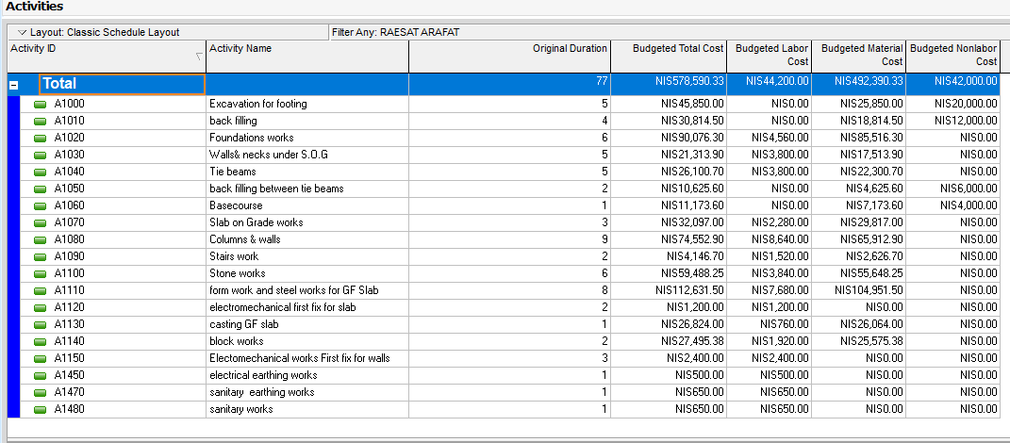
Basement work:
For the basement floor the total cost is estimated to be 578,590.33 NIS as shown in the figure below:

Slide 24
First floor work

Slide 25
The quantities and duration for each activity are listed in the table below:
Activity | Quantities | Productivity Rate | Duration (day)
Excavation for footing | 563 cubs | 200 cub/day | 3
Backfilling | 527 m² | 200 m²/day | 3
Foundations works | 113 m³ | 30 m³/day | 4
Walls& necks under S.O. G | 28 necks | 10 necks/day | 3
Tie beams | 322 m | 50 m/day | 6
Electrical earthing works |  |  | 2
Sanitary earthing work |  |  | 1
Backfilling between tie beams | 342 m² | 200 m²/day | 2
Base course | 342 m² | 240 m²/day | 1
Slab on Grade works | 417 m² | 150 m²/day | 3
Columns & walls | 71 columns | 9 columns/day | 8
Sanitary works |  |  | 1
Isolation for walls | 100 m² | 55 m²/day | 2
Stairs work | 78 m² | 20 m²/day | 4
Stone works | 546 m² | 30 m²/day | 18
Formwork and steel works for 1st Slab | 806 m² | 48 m²/day | 17
Electromechanical first fix for slab | 806 m² | 240 m²/day | 3
Casting 1st slab |  |  | 1
Block works | 530 m² | 90 m²/day | 6
Electromechanical works First fix for walls | 1138 m² | 240 m²/day | 5

Slide 26
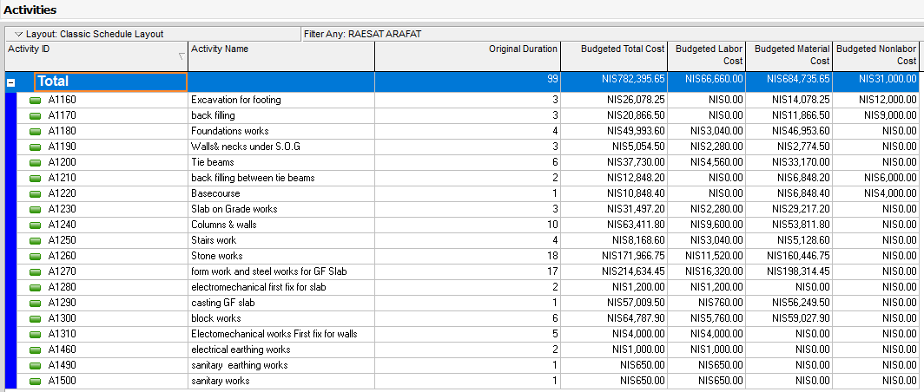
First floor work:
For the first floor the total cost is estimated to be 782,395.65 NIS as shown in the figure below:

Slide 27
Second floor work

Slide 28
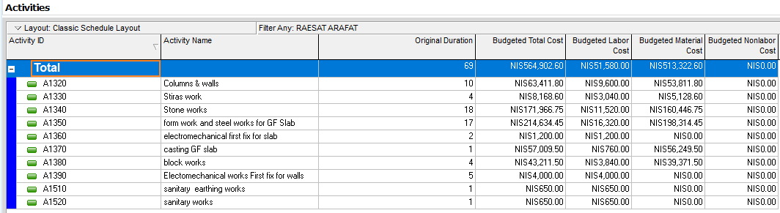
Second floor work:
The second floor is similar to the first floor except of block work which is different form it. So, the quantity ,cost and duration for all remaining activities are similar to the first floor.
For the second floor the total cost is estimated to be 564,902.60 NIS as shown in the figure below:

Slide 29
Roof work

Slide 30
The quantities and duration for each activity are listed in the table below:
Activity | Quantities | Productivity Rate | Duration (day)
Columns & walls | 9 columns | 9 column/day | 1
Isolation for walls | 61 m² | 55 m²/day | 1
Stone works | 246 m² | 30 m²/day | 8
Formwork and steel fixing for stair slab | 35 m² | 48 m²/day | 1
Casting stair slab |  |  | 1
Stone pointing | 1531 m² | 90 m²/day | 17

Slide 31
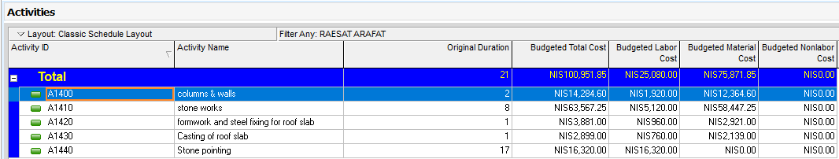
Roof work:
For roof floor the total cost is estimated to be 100,951.85 NIS as shown in the figure below:

Slide 32
The total cost of the whole project is estimated to be 2,092,840.42 NIS as shown in the figure below:
By taking 15% as a percent represents profit, risk and indirect cost, the total price for this bid is estimated to be 2,406,766.50 NIS.
Nablus municipality estimated the price for this bid to be approximately equal 2,343,722.00 NIS. So, the difference between the two prices is estimated to be 63,044.50 NIS.
Nablus municipality requires the project to be finished within 240days, the duration resulted for the project is estimated to be 233days which is less than the required time.

Slide 33
Finishing works

Slide 34
Windows
For windows the quantity, duration and cost for each type are listed in the table below:
Windows
Floor | Productivity rate (Window/day) | Duration (day) | Quantity (m²) | Type | Price (NIS/m²) | Cost (NIS)
Basement | 10 | 1 | 37.08 | Double glass | 450 | 16,686
 |  |  |  |  | Number of windows | 11
First |  | 3 | 77.19 |  | 450 | 34,735.5
 |  |  |  |  | Number of windows | 34
 |  | 3 | 84.97
Second |  |  |  |  | 450 | 38,237.4
 |  |  |  |  | Number of windows | 26
Total |  |  | 199.24 |  | Total | 89,658.9

Slide 35
Plastering
For plastering, the quantity, duration and cost for each floor are listed in the table below:
Plastering
Floor | Productivity rate (m²/day) | Duration (day) | Quantity (m²) | Price (NIS/m²) | Cost (NIS)
Basement | 40 | 26 | 1039 | 45 | 46,755
First |  | 45 | 1782.80 |  | 80,225.91
Second |  | 47 | 1886.75 |  | 84,903.66
Roof |  | 6 | 254.29 |  | 11,442.92
Total |  |  | 4,962.83 | Total | 223,327.49

Slide 36
Painting
For painting, the quantity, duration and cost for each floor are listed in the table below:
Painting
Floor | Productivity rate (m²/day) | Duration (day) | Quantity (m²) | Price (NIS/m²) | Cost (NIS)
Basement | 90 | 12 | 1039 | 15 | 15,585
First |  | 20 | 1782.80 |  | 26,741.97
Second |  | 21 | 1886.75 |  | 28,301.22
Roof |  | 3 | 254 |  | 3,814.305
Total |  |  | 4,962.83 | Total | 74,442.50

Slide 37
Doors
Floor | Productivity rate (door/day) | Duration (day) | Type | Material | Number | Price / unit | Cost (NIS)
Basement floor | 12 | 1 | D1 (hinged single leaf) | Wood | 3 | 1700 | 5100
 |  |  | D3 (hinged double leaf) | Wood | 1 | 3200 | 3200
First floor |  |  | D4 (hinged single leaf) | Steel | 2 | 900 | 1800
 |  |  | D5 (hinged single leaf) | Wood | 1 | 1200 | 1200
 |  |  | D6 (hinged single leaf) | Wood | 1 | 1200 | 1200
First floor |  |  | Number of doors | Wood | 8 | Total | 12,500
First floor |  | 3 | D1 (hinged single leaf) | Wood | 5 | 1700 | 8500
First floor |  | 3 | D2 (hinged double leaf) | Steel | 2 | 2000 | 4000
 |  |  | D3 (hinged double leaf) | Wood | 2 | 3200 | 6400
 |  |  | D4 (hinged single leaf) | Steel | 4 | 900 | 3600
 |  |  | D5 (hinged single leaf) | Wood | 23 | 1200 | 27600
 |  |  | D6 (hinged single leaf) | Wood | 3 | 1200 | 3600
 |  |  | Number of doors |  | 39 | Total | 53,700
Second floor |  | 1 | D1 (hinged single leaf) | Wood | 6 | 1700 | 10200
 |  |  | D2 (hinged double leaf) | Steel | 1 | 2000 | 2000
 |  |  | D3 (hinged double leaf) | Wood | 1 | 3200 | 3200
 |  |  | D5 (hinged single leaf) | Wood | 6 | 1200 | 7200
 |  |  | Number of doors |  | 14 | Total | 22,600
Total |  |  |  |  |  |  | 88,800

Slide 38
Tiles
Floor | Productivity rate (m²/day) | Duration (day) | Type | Quantity (m²) | Price (NIS/m²) | Cost (NIS)
Basement | 90 | 5 | Terrazzo | 380.88 | 100 | 37600
 |  |  | Tiles for sides | 34.002 | 80 | 2720.16
 |  |  | Marble | 41.12 | 200 | 8224
 |  |  | Total | 456.00 | Total | 48,544.16
First
 |  | 14 | Terrazzo | 734.342 | 100 | 73434.2
 |  |  | Tiles for sides | 468.842 | 80 | 37507.36
 |  |  | Marble | 82.24 | 200 | 16448
 |  |  | Total | 1285.42 | Total | 127,389.56
Second |  | 10 | Terrazzo | 729.522 | 100 | 72952.2
 |  |  | Tiles for sides | 82.343 | 80 | 6587.44
 |  |  | Marble | 41.12 | 140 | 5756.8
 |  |  | Total | 852.99 | Total | 85,296.44
Total |  |  |  | 2,594.41 | Total | 261,230.16

Slide 39

Recommendation

Slide 40
Recommendation :
There are many issues that can be recommended which are:
Preparing the equipment and agreeing on when to come to the site must be done before the specified time of each activity.
The request for materials must be performed in a previous specific time so that there is no delay in the completion of any activity.
The costs required for each activity must be paid on time to the contractor without any delay in their payment by the bidder.
Executing each activity at the time specified for it so that there is no delay in the delivery and completion of the project within the period agreed upon in the bid .
There must be a permanent follow-up of the implementation of the project within the required standards regarding time and cost for each activity in the project.

Slide 41
The end
Thanks for listening

