Slide 1
Analysis and redesign of water distribution network and waste water collection network for Tallouza Village
Prepared By :
Kamal Hamaydeh
Ahmad Odet-allah
Submitted to :
Eng.Hamees Tubieleh

Slide 2
Outline
Objectives and significance of the project
Study area
Methodology
Modeling , Analyzing and design
Results and conclusions

Slide 3
Objectives
This project will be utilized in evaluation the available water distribution network to detect the problems in the network .
After that designing criteria of water and wastewater distribution network to be able to meet the demand of water and enhance the quantity of water and create a healthy environmental for Tallouza village people.

Slide 4
Significance of work
The water network in Tallouza is an old network and it doesn’t satisfy the people requirements because of the increasing number of population in the last 10 years
The redesign of Tallouza water network to meet the needs of water and improve it’s efficiency as much as possible.
The people in Tallouza dispose their sewage using cesspits. Cesspits have many environmental problems. Accordingly, the design a wastewater collection network for Tallouza is required.

Slide 5
Study area
Tallouza Village is located 10 Km north of the city of Nablus
A total urban area of the village about 58,000 ​​donums
The mean source of water in Tallouza village is Al-Badan well .
Tallouza has a mountable terrain and its elevation ranging from 400 to 550 m above mean sea level.

Slide 6
Methodology
Data Collection
Designing
Data analysis
Selection of the study area
Giving recommendations

Slide 7
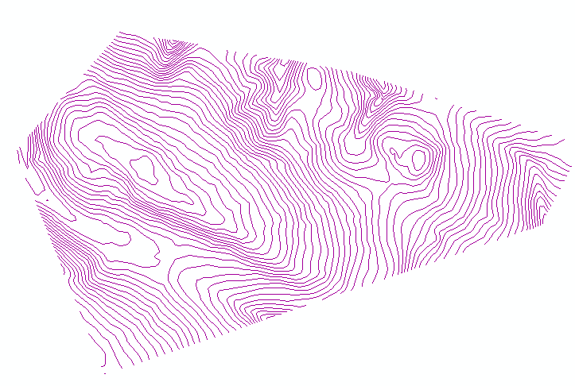
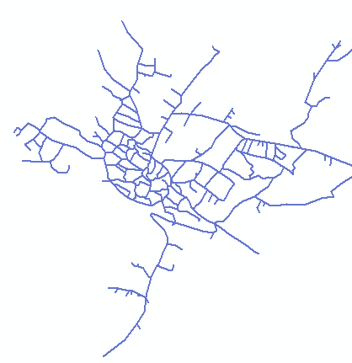
Data collection
Contour map
Road network
Structural plan (Houses distribution)
Boundary of study area (border of village)
Reservoir location
Population number and
the population growth rate

Slide 8
Water Distribution network
(Analyzing , Designing and modeling)

Slide 9
Data analyzing
The population of Tallouza village in 1997 is 2002 persons and in 2007 is 2375 persons; from these populations we calculated the annual growth rate(1.72%) and the population in 2016 by this equation:
Pn=P(1+r) n:
2375=2002(1+r)¹⁰, then the annual growth rate (r) is equal 1.72 %
Population at 2016 =2375(1+0.0172)9 =2770 persons
We take our design period as 30 years
P₂₀₄₆=P₂₀₁₆ (1+r)^{n}
Population at 2046 =2770(1+0.0172)³⁰ = 4619 person.

Slide 10
Data analyzing
Calculate the future average daily demand and enter it in Arc GIS
Qd = (Future population) * L/c-day * hourly factor
= 4619* 120 * 3
= 1662.84 m³/day.

Slide 11
Designing
Design considerations
Velocity : The minimum and maximum allowable velocities are 0.3 and 3.0 m/s
Pressure :The value of the pressure on each junction should be between “20 – 100” mH2O

Slide 12
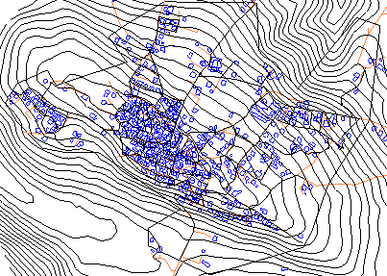
Modeling
Inserting the data to WaterCAD
Allocation of junctions and reservoir
Drawing pipes
Add contour file to determine the elevations of junctions and reservoir by TRex tool.

Slide 13
Modeling
Apply Thiessen polygon theory to determine the service area of each junction
Adding the total demand using load builder tool.
Run the model

Slide 14
In the case of low pressure (lower than 20 mH2O) we use a pump.
In the case of high pressure (higher than 100 mH2O) we use PRV (pressure reducing valve)
After running the model some velocities and pressure doesn’t meet the constraints.
The problem of low velocity that is less than 0.3m/s was solved by decreasing the pipe diameter.

Slide 15
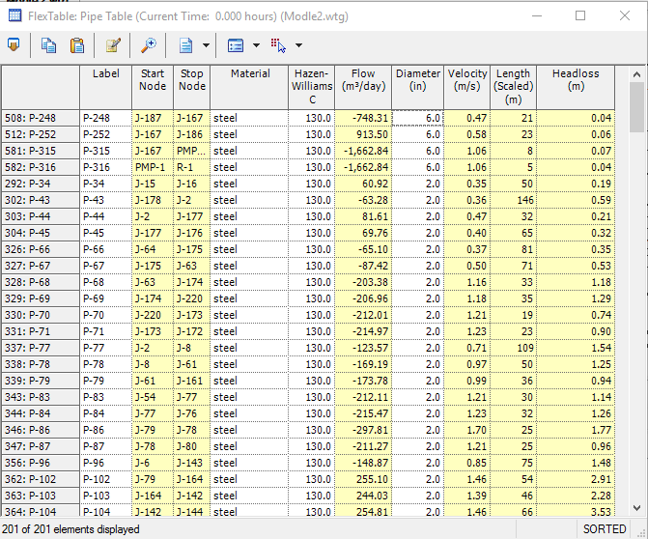
Results for pipes

Slide 16
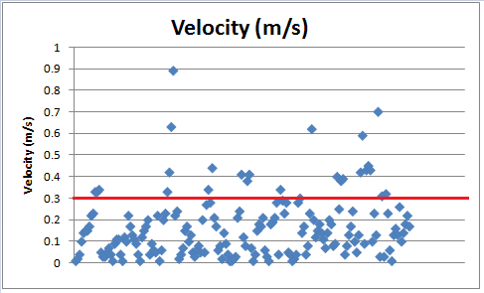
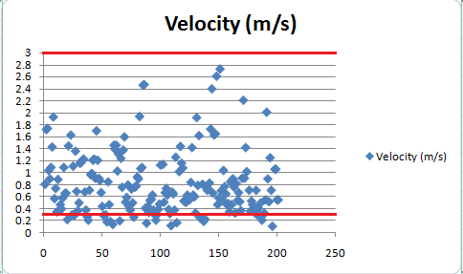
Comparison between velocities in existing and new designed network

Slide 17
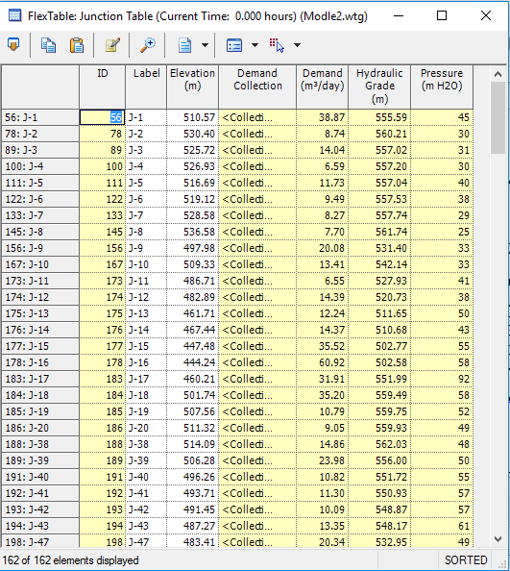
Results for junctions

Slide 18
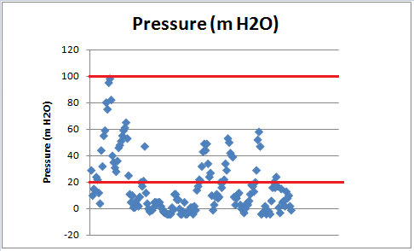
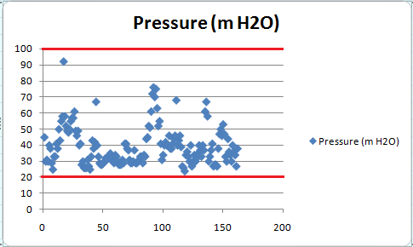
Comparison between pressure in junctions for existing and new designed network

Slide 19
Wastewater Collection network
(Analyzing , Designing and modeling)

Slide 20
Data analyzing
We take :
Wastewater generation rate is 80%.
Peak factor= 5*(pop.) ^ (1\6) = 5*(4.619) ^ (1\6) =3.9
Take peak factor=4
Infiltration rate is 20% from consumed water.

Slide 21
Designing
Design considerations
The least conduit diameter is 8 inch "203.2 mm".
used conduit is a circular PVC conduit.
partial flow with a percentage of 75%.
Sump depth is zero.

Slide 22
Average velocity
  minimum velocity is 0.6 m/s
  maximum velocity is 3 m/s
Slope
  minimum slope is1% .
  maximum slope is 15% .
Cover
  The minimum cover should at least be 1 m.
  The maximum cover should not exceed 5 m.

Slide 23
Modeling
Adding needed data to sewerCad
Allocation of manholes and outfalls.
Drawing Conduits.
Add contour file to determine the elevations of Manholes and outfall and length of Conduits using TRex tool.
Exporting these data as shapefile.
Using ArcHydro tool to determine the served area by each manhole.
Assigning design load on each manhole.
Run the model.

Slide 24
Manhole design load Calculation
To determine the design load on each manhole we need the following data :
Served area by each manhole (determined using ArcHydro).
Population density .

Slide 25
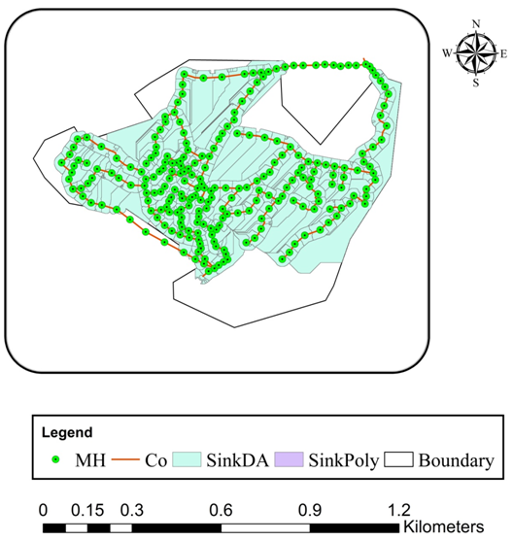
Manholes with there sub catchements

Slide 26
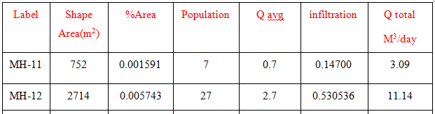
The total area of catchments in demand area= 72577m²
%Area= shape area\totalrea=2714\472577=0.005743%
The population= (%Area)*(pop) = (0.005743)*(4619) =27 capita.
Q avg= (pop.*100)/1000= (27*100)/1000)=2.7 m³\day
Q Infiltration=( 20%)*( Q avg)= 0.530536 m³\day
QTotal=( Q avg*4)+( Q Infiltration)=11.14 m³\day

Slide 27
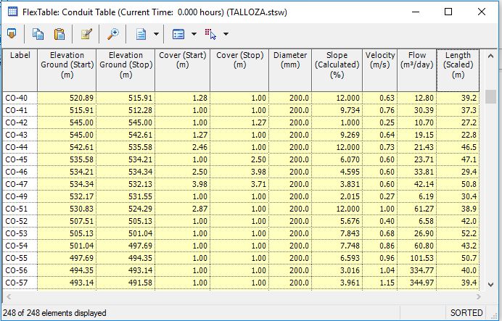
Results for conduits

Slide 28
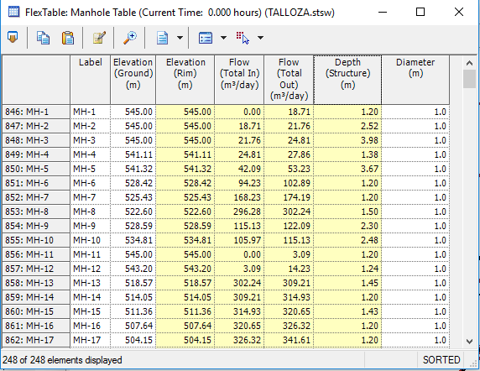
Results for manholes

Slide 29
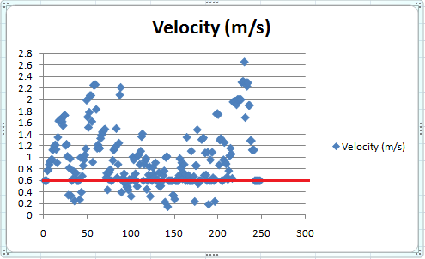
Results
Velocities

Slide 30
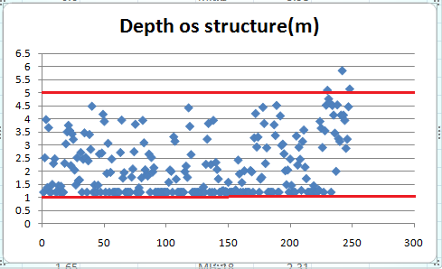
Results
Depth of Manholes

Slide 31
Conclusion and Recommendations
we recommend replacing the current water network and constructing a waste water collection network because of the great damage caused by cesspits on the environment and groundwater, In addition to seepage problems and expenses

Slide 32
Thank YOu

