Slide 1
IFC Model Checking Website
By: Hadeel H. Hamdan
Ikhlas Abu Shanab

Slide 2
Outline:
Introduction
Introduction about IFC files
IFC website idea
Demo
Framework and tools
Problems
Future work

Slide 3
Introduction
How we chosen the idea of our project ?
What is the main objectives ?

Slide 4
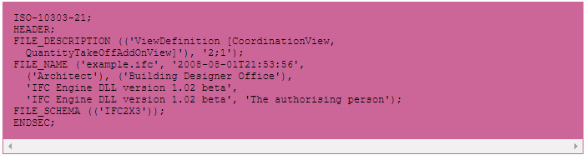
Introduction for IFC
Industry Foundation Classes
describe building and construction industry data
File Header Section

Slide 5
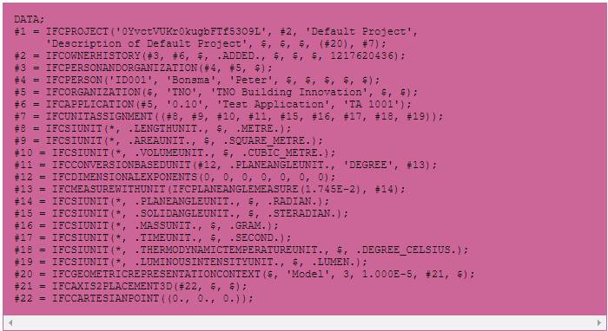
Introduction for IFC
File Data Section

Slide 6
IFC website idea
Our project is a website that allow users to understand, check and modify their IFC files, by converting these files to graph (nodes and links) and also 3D model for the uploaded file

Slide 7
DEMO

Slide 8
Framework & Tools
Tools
Languages
PHPStorm
Xampp
GoJs
IFCconvert
Obj2gltf
Xeogl
HTML
CSS
JavaScript
PHP

Slide 9
problems
Time
Learning about the Hierarchy of IFC files

Slide 10
Future work
Improve the editing part
Make it customize.

Slide 11
The End
Thank You

