Slide 1
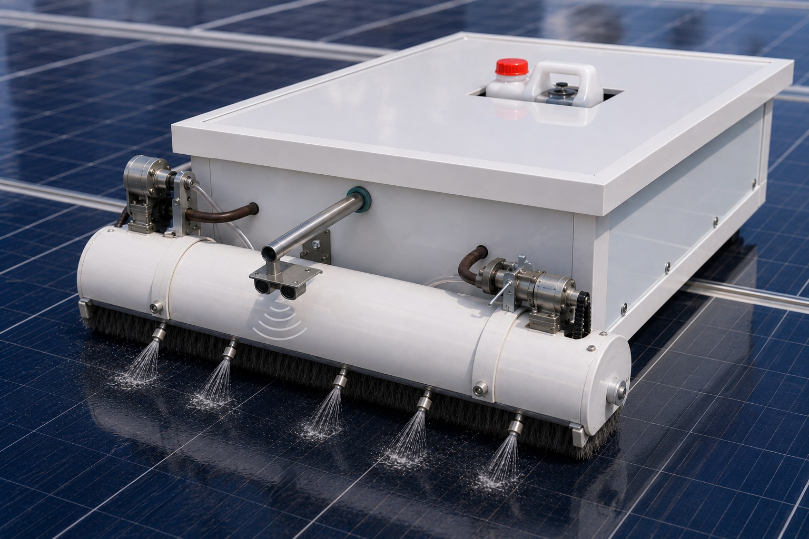
SolarX Robot
Intelligent Autonomous Solar Panel Cleaning System
Hala Maree · Wafa Namroti
Supervised by: Dr. Aladdin Masri
An-Najah National University · Computer Engineering · 2025/2026
Introduction
Technologies
Features
Constraints
Future Work
Conclusion
1

Slide 2
01
INTRODUCTION
The Problem
Solar Energy Dependency
Manual Cleaning Challenges
Solar panels are critical for clean energy generation in residential, commercial, and industrial sectors.
Traditional cleaning is time-consuming, costly, and dangerous — especially in large-scale solar farms.
Project Overview
SolarX Robot is an intelligent autonomous solar panel cleaning system developed at An-Najah National University. It integrates embedded systems, wireless communication, sensors, and a Flutter mobile app into one practical solution.
Dust Accumulation Problem
The Solution: SolarX Robot
Dust, sand, bird droppings and contaminants reduce sunlight reaching PV cells — causing significant efficiency loss.
An autonomous robot that automates the cleaning process using sensors, motors, and a mobile application.
2

Slide 3
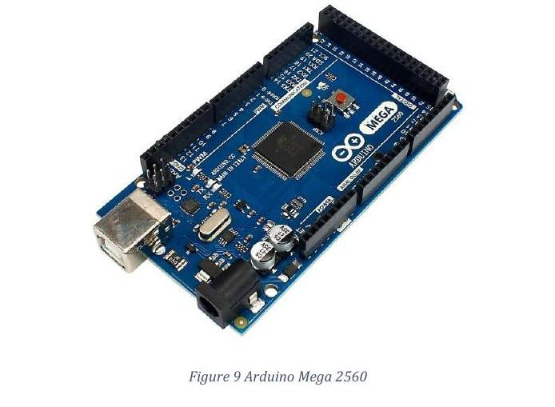
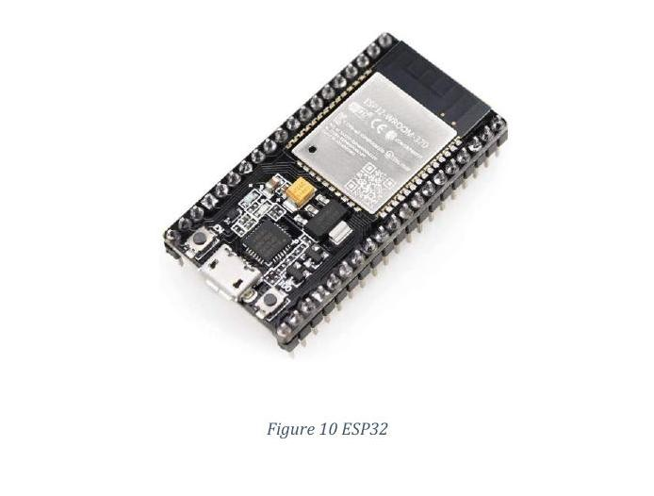
02
TECHNOLOGIES USED
Controllers & Communication
Arduino Mega 2560
ESP32 Module
Main Controller
• Reads all sensor data
• Controls motors & actuators
• Executes cleaning algorithms
• Manages Manual & Auto modes
• EEPROM state storage
Wireless Communication
• Connects robot to mobile app
• Bluetooth Low Energy (BLE)
• Real-time data exchange
• Remote monitoring & control
• UART link to Arduino
Key Sensors
IR Sensors ×4
Ultrasonic ×2
MPU6050
DS3231 RTC
Edge detection & panel boundary
Water level & panel detection
Orientation & 90° turns
Real-time scheduling
3

Slide 4
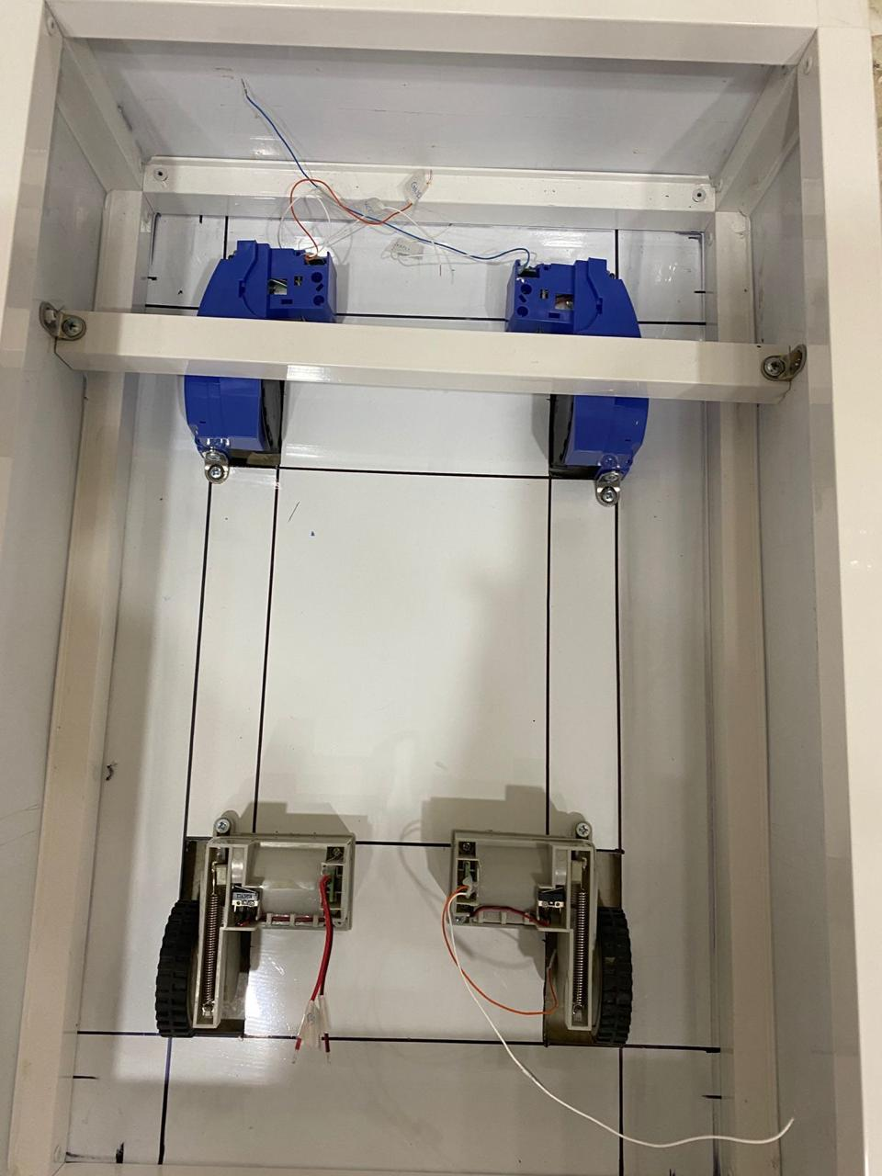
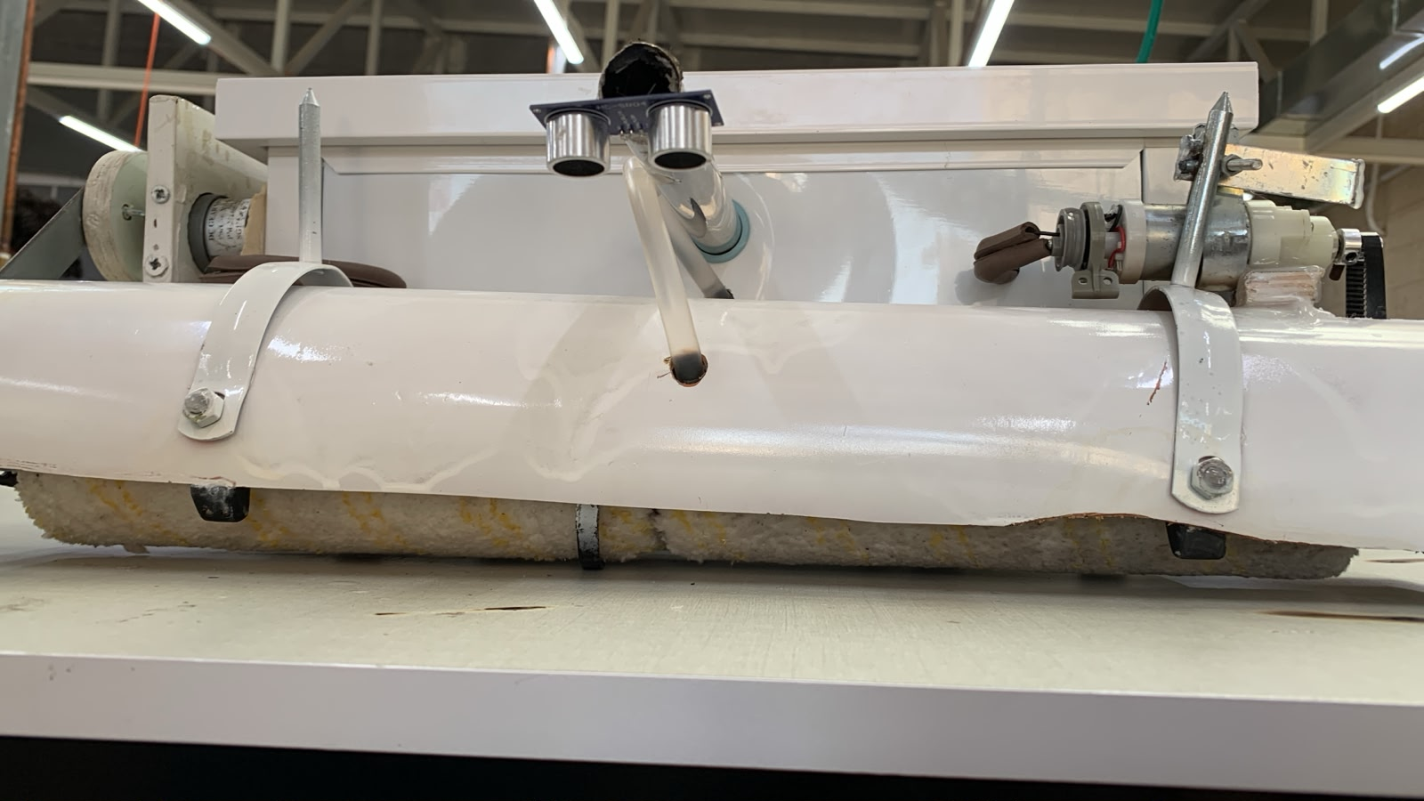
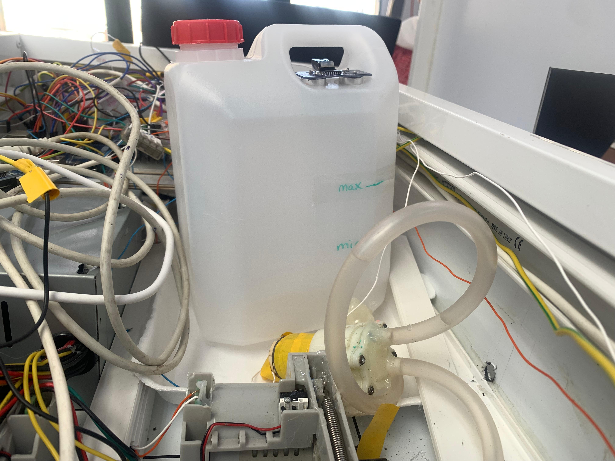
02
TECHNOLOGIES USED
Hardware Systems
Mobility System
Brush System
Water System
4 × DC Gear Motors + BTS7960 Drivers
2 × Paint Rollers + DC Motors
DC Pump + Nozzles + Tank
Four 12V DC gear motors with wheels
High-torque for inclined surfaces
BTS7960 for precise speed & direction
Two paint rollers as cleaning brushes
Rotation motor via pulley + timing belt
Lifting motor raises/lowers brush
Relay module for safe switching
H-Bridge for cleaning motors
Water pump draws from onboard tank
Car windshield nozzles distribute water
Relay-controlled pump operation
Diode protects from reverse current
4

Slide 5
03
FEATURES
Key Features
🕹
Manual Mode
⚡
Auto Mode
🕐
Scheduled Cleaning
Full directional control via Flutter app: Forward, Back, Left, Right, Stop commands over BLE.
Enter panel dimensions & count. Robot autonomously cleans row-by-row, tracking position in real time.
Set cleaning time via app. DS3231 RTC synced with phone triggers automatic cleaning at scheduled time.
📍
Edge Detection
💧
Water Level Monitor
🔋
EEPROM Save State
4 × IR sensors and ultrasonic sensors prevent the robot from falling off panel edges.
Ultrasonic sensor checks tank level before each session. Alerts user if water is insufficient.
Operational state is saved to EEPROM. User can pause, resume and stop robot when they want and continue from where it stoped.
5

Slide 6
Cleaning Algorithm
Row-by-row zigzag traversal with edge detection
1
2
3
4
5
6
7
8
Move Forward
Shift Row
▶
▶
▶
Start
Detect
Edge
▶
Turn 90°
▶
▶
▶
Turn 90°
Continue
Finish
Navigation Pattern — Zigzag Row-by-Row
Row 1
→
Robot
→
Row 2
←
←
Row 3
→

Slide 7
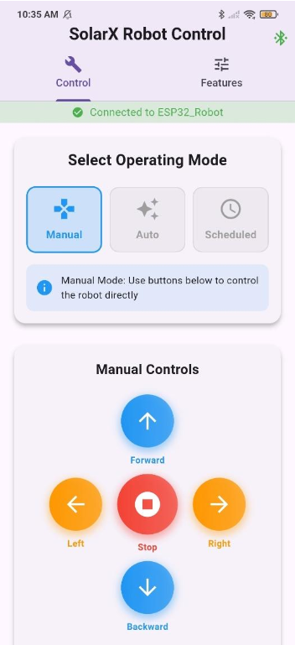
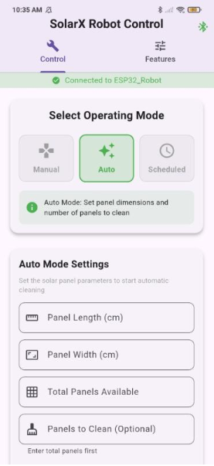
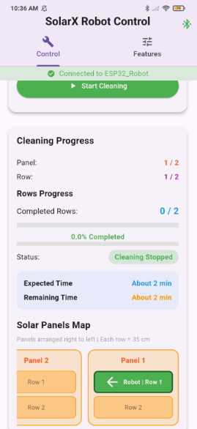
03
MOBILE APPLICATION
Flutter Mobile App
Built with Flutter · Communicates via Bluetooth Low Energy (BLE) · Controls & Monitors robot remotely
Manual Control
Directional buttons (F/B/L/R/Stop) send commands directly to the robot in real time.
Auto Mode
User inputs panel dimensions and count. App displays live position map and cleaning progress.
6

Slide 8
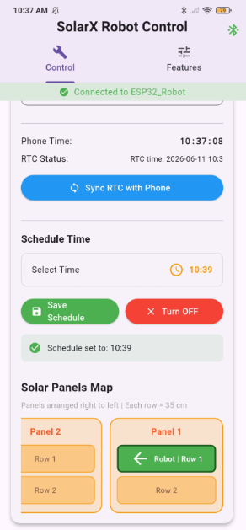
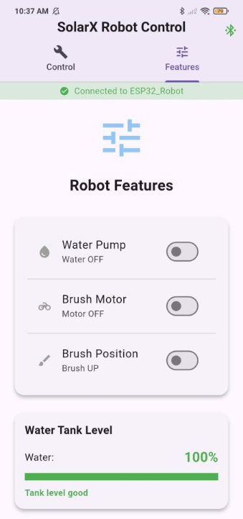
03
MOBILE APPLICATION
Scheduling & Features Control
Scheduled Mode
Syncs phone time with DS3231 RTC. User sets a time and the robot auto-starts cleaning.
Features Page
Toggle water pump, brush motor, and brush position individually. Displays water tank level.
7

Slide 9
04
CONSTRAINTS
Challenges & Limitations
01
IR Sensor Sensitivity to Sunlight
03
Limited Budget
Operating outdoors means sunlight intensity changes interfere with IR sensor readings. Multiple calibration rounds were required to achieve stable edge detection performance.
The project was developed with a constrained budget, requiring the use of locally-available, affordable components — which sometimes limited available options.
02
MPU6050 Hardware Issues
04
Weight Balance Challenge
Several MPU6050 sensor modules were damaged during testing and development. Replacing and re-integrating these sensors significantly increased debugging time.
The brushes increased front-side weight, causing imbalance. Two Metal Ball Caster Wheels were added to improve stability and maintain a fixed height.
✓ Despite these challenges, the final system was successfully implemented and demonstrated satisfactory performance during testing.
8

Slide 10
05
FUTURE WORK
Roadmap & Recommendations
Near-term
Near-term
🛰 GPS Navigation
🧠 AI-Powered Scheduling
Integrate GPS-based tracking and navigation for large-scale solar farm deployment.
Use artificial intelligence to optimize cleaning schedules based on weather data and dust accumulation patterns.
Mid-term
Long-term
☀ Solar Charging
🗺 Advanced Path Planning
Add onboard solar charging capabilities to extend operating time and make the robot fully energy-independent.
Develop smarter navigation algorithms for complex solar farm layouts with irregular panel arrangements.
9

Slide 11
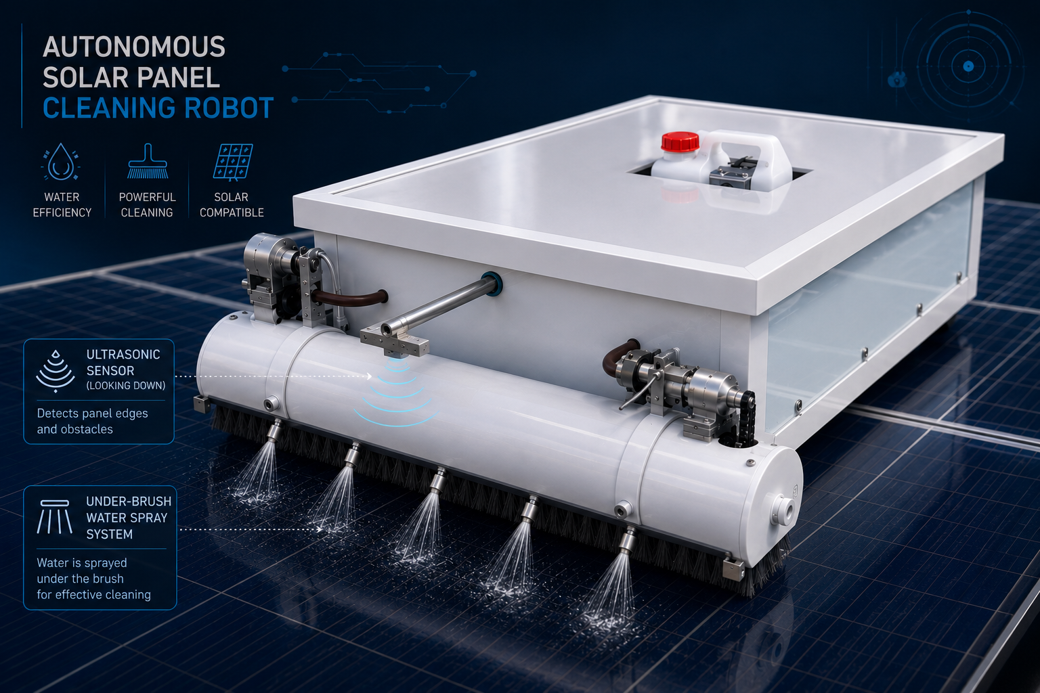
06
CONCLUSION
What We Achieved
✓ Autonomous cleaning in Manual & Auto modes
✓ Real-time position tracking & panel map
✓ Edge detection with IR sensors and ultrasonic
✓ Water level monitoring & wet cleaning
✓ Scheduled operations with DS3231 RTC
✓ BLE-based Flutter mobile application
🌟 SolarX Robot
A practical, low-cost, and efficient autonomous solution for solar panel maintenance. By combining embedded systems, sensor technologies, wireless communication, and a mobile application, SolarX Robot successfully reduces human effort and improves solar energy system efficiency — with a clear roadmap for scaling to commercial installations.
10

Slide 12


