Slide 1

PharmaStore 24/7
A pharmacy vending machine aimed at providing accessible and round-the-clock access to urgent pharmaceutical items.
Supervised by: Dr. Manar Qamhieh

Slide 2

Outline
1
3
5
7
Problems
Features
Constraints
Demo
Solution
Components
Future work
2
4
6

Slide 3

Unable to obtain essential items at night.
Unable to access urgent items when pharmacies are far away.
No feeding system for the machine.
Problems

Slide 4

Solution
A pharmacy vending machine with feeding system to access urgent items using a touchscreen or a barcode of a prescription.

Slide 5
 | Storage system |  | Retrieval system
 | This pharmacy vending machine has a storage system that also detect if any medicine box is empty and sends notification to the admin. |  | There are two modes of retrieving the medicine, using a barcode prescription or using the touchscreen.
 | Feeding system |  | Mobile app
 | The storage system will feed the medicine box which is under a certain limit and will not feed it if another box door is open to avoid any mistake. |  | The admin has a mobile application that can turn the machine on or off and get notifications if any mistakes occurs.
01
02
03
04

Slide 6
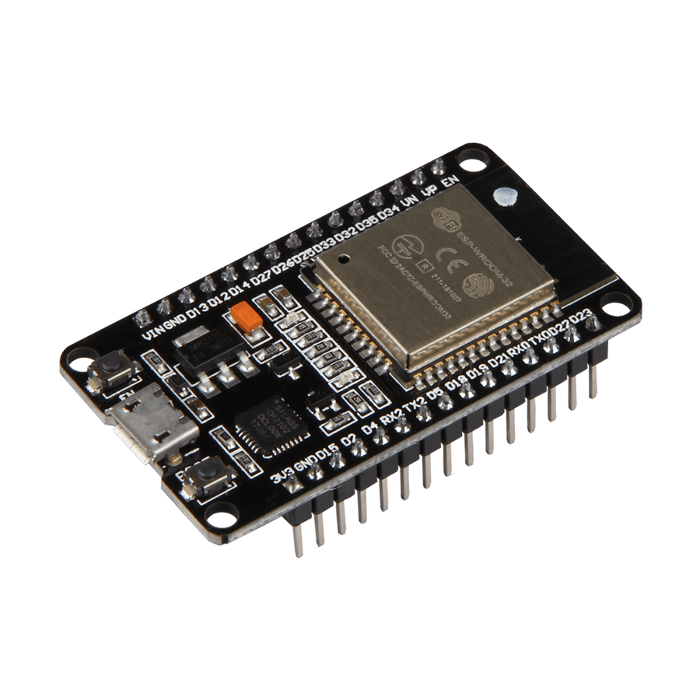
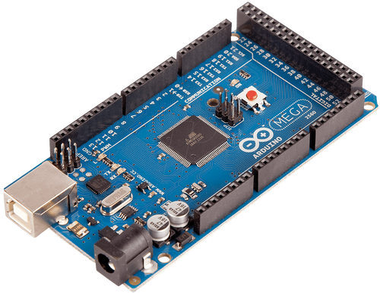
Microcontrollers

Slide 7
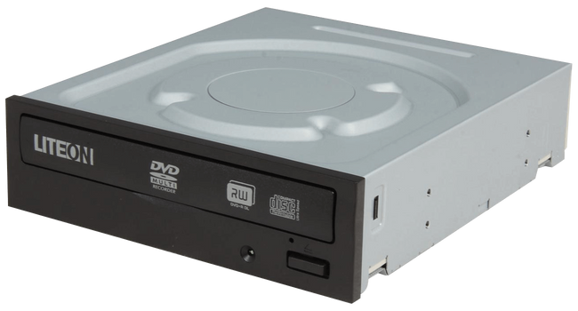
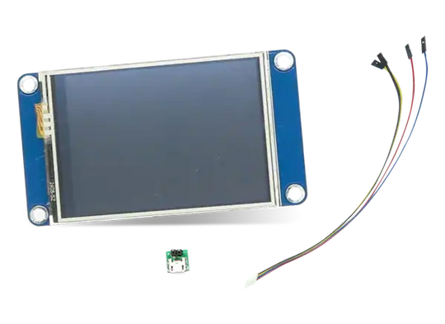
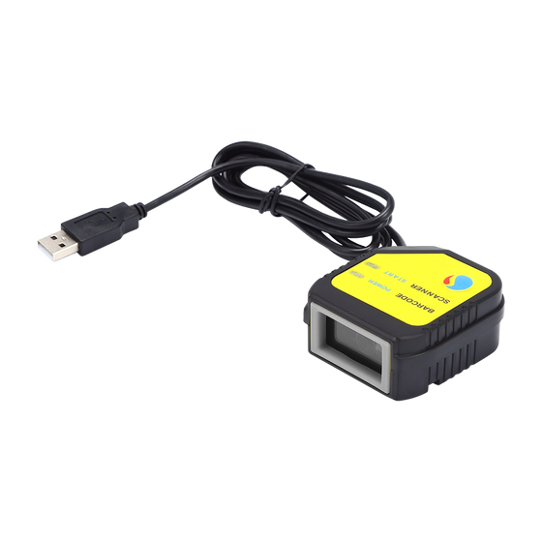
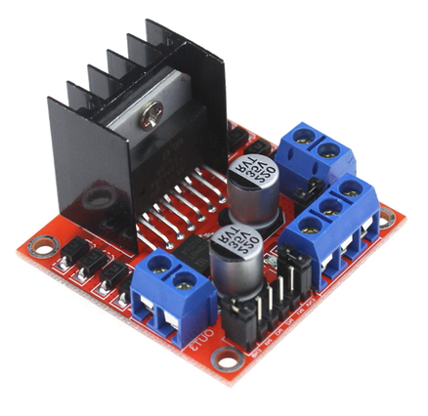
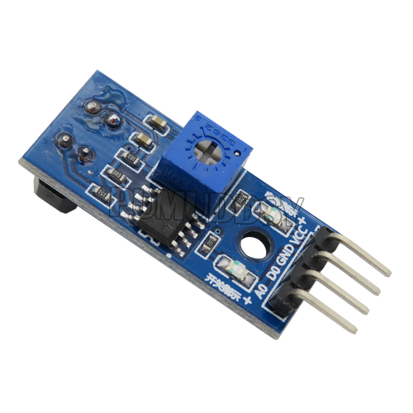
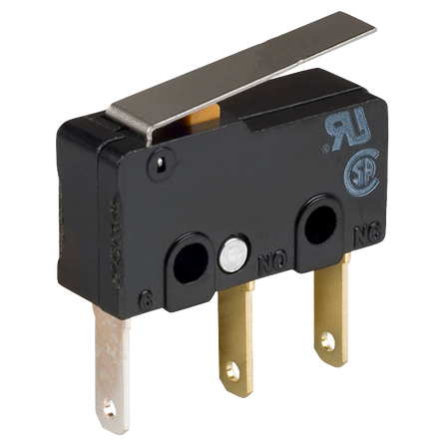
Sensors & components

Slide 8
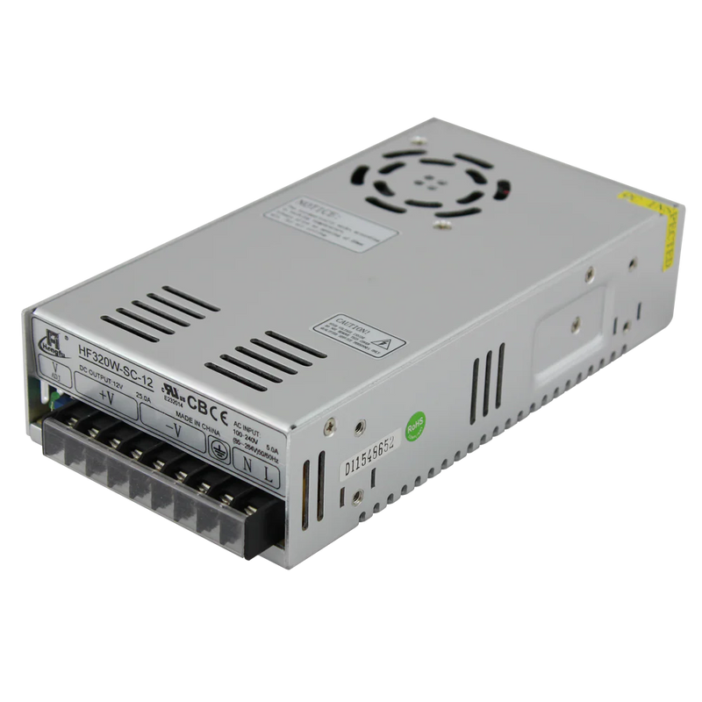
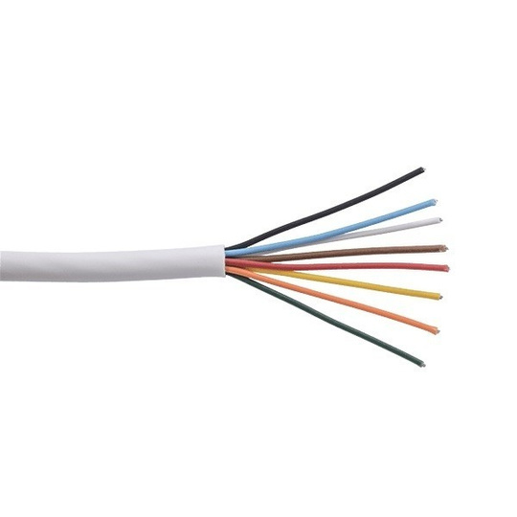
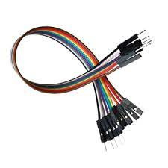
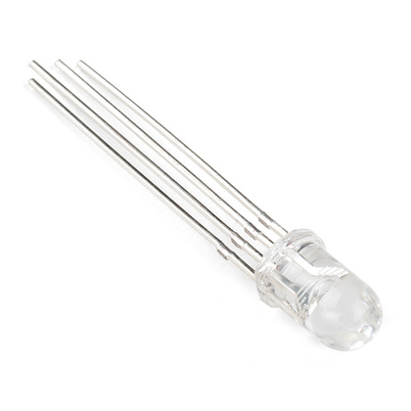
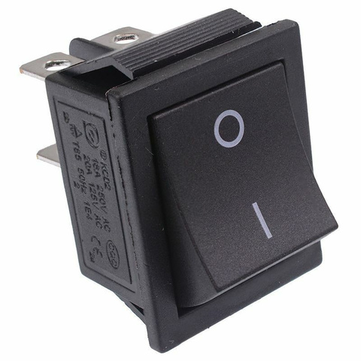
Other components

Slide 9
Constraints
These are some examples of the contraints we faced
1
2
3
Power distribution |  | Size and weight |  | Precision and accuracy

Slide 10

Future work
Expand the provided items.
Including baby needs and first aid kits..,
High level error detection system
detect if any mistakes occurs, doors not opening, closing, retrieval of wrong medicines etc.
Enhancement of the design and the mechanisms
Include more mechanisms and enhance the design for more accuracy when feeding the system.

Slide 11
Demo

Slide 12
THANK YOU
ANY QUESTIONS?

