Slide 1




GoFit Center
App
Supervisors: Dr.Raid Qadi
Dr.Samer Arandi
Ameera Shopaki & Samah Abdalrahman
1

Slide 2



TABLE OF CONTENT:
1
Intoduction
2
Features
3
Tools Used
2
4
Future Work
5
Question & Answer
2

Slide 3

Introduction
3

Slide 4
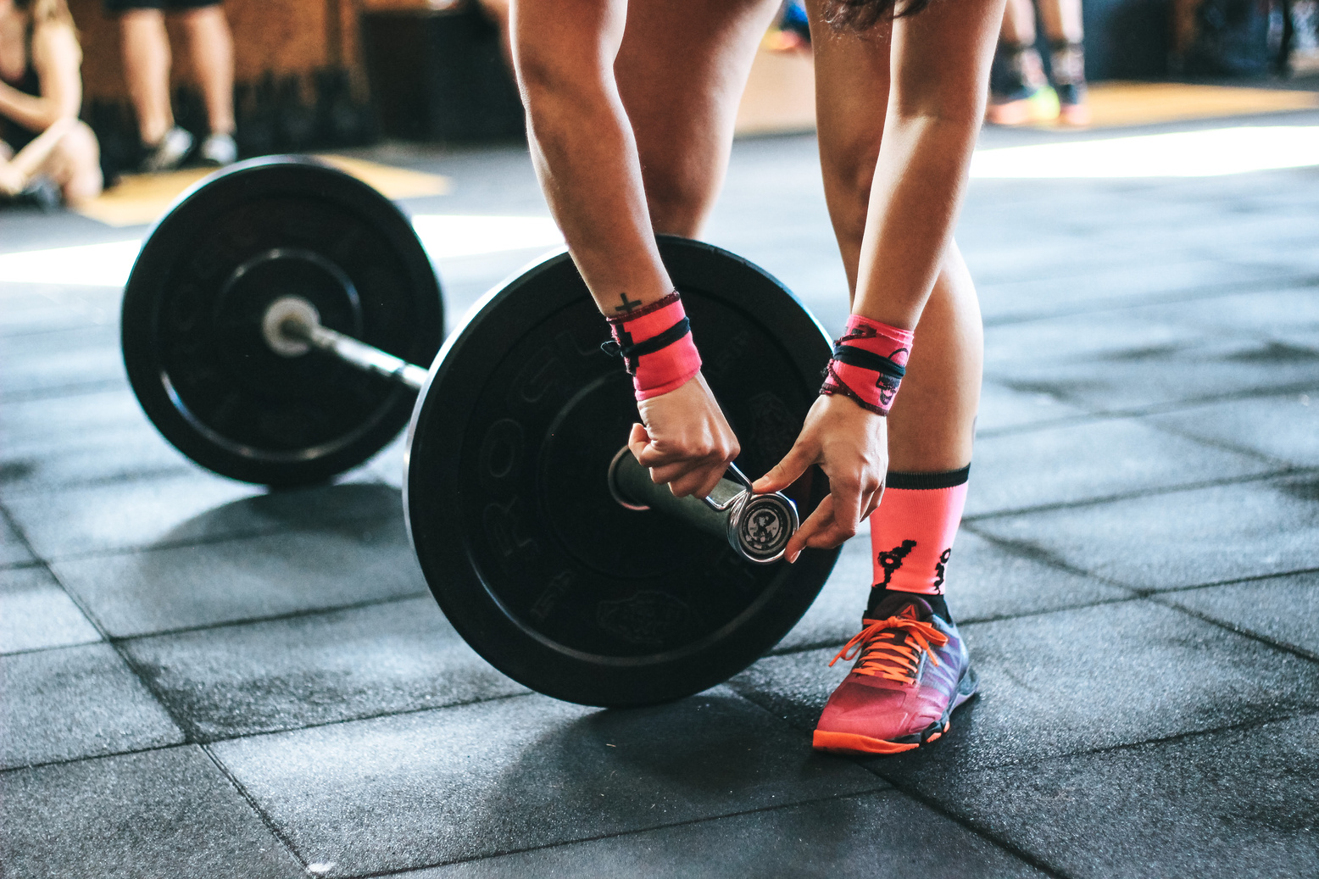

What&Why GoFit Center?
what?
  mobile application
  Website
Why?
  services for gym management
  services for subscribers
  services for employees
4

Slide 5
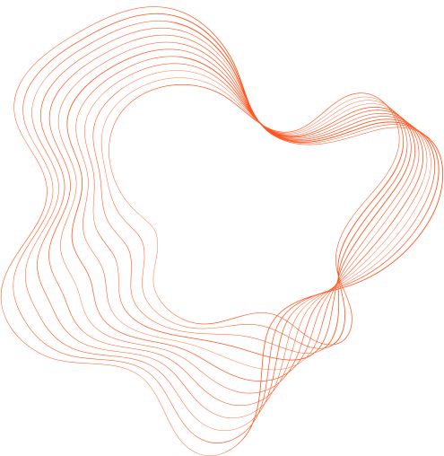


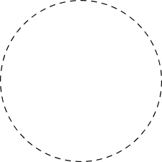


GOALS AND OBJECTIVES
Managing the gym
Services for Subscribers
Facilitating communication
  Profit Management
  Employees and Salaries
  Subscription Details
  Subscription Facilitation
  Online Payment
  Online Exercises
  Dietary Systems
  between users and employees
  employees and management
5

Slide 6
Features
Features
6
1

Slide 7
ROLES:
1
User
2
Sports coach
3
Nutritionist
ِ
2
4
Admin
Guest
5
7

Slide 8
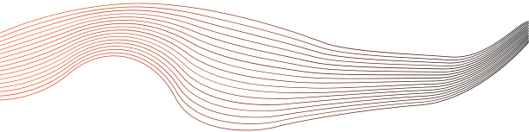
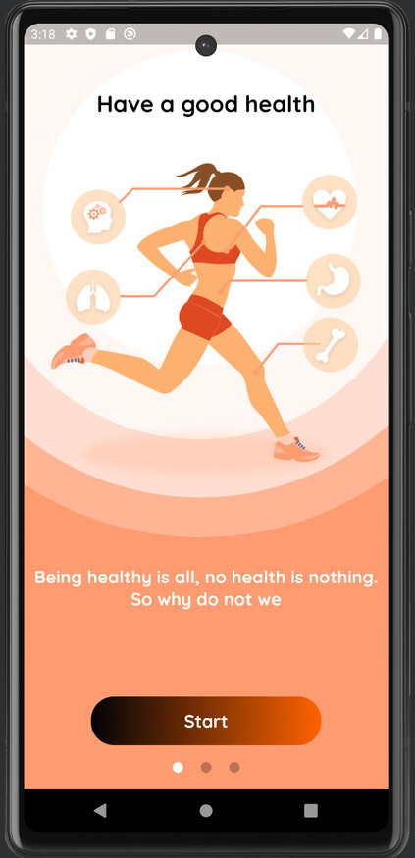
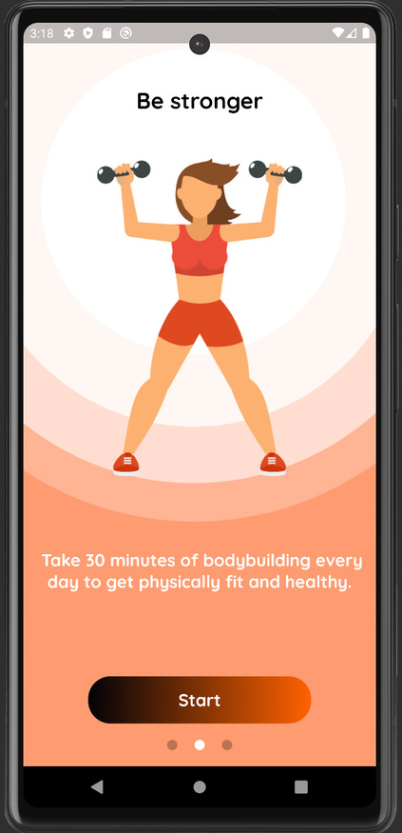
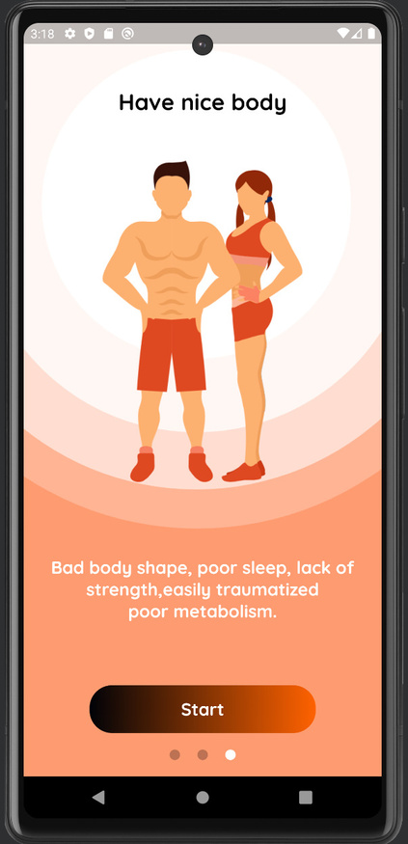
Onboarding Screen
8

Slide 9
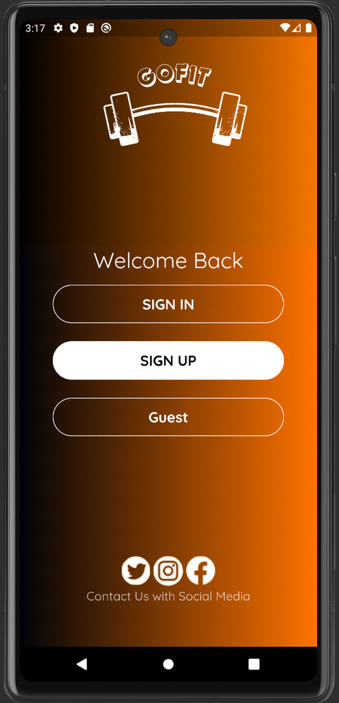
Welcome Screen
9

Slide 10
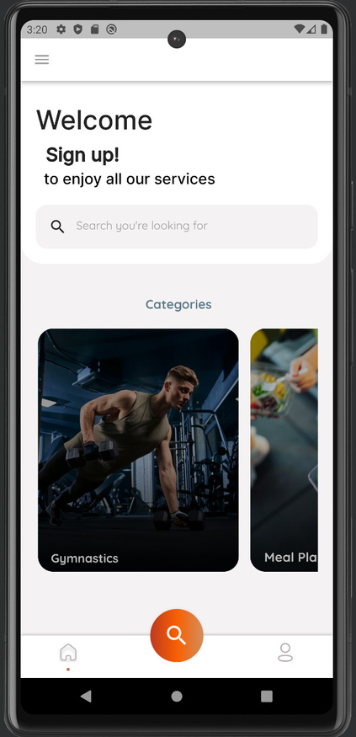
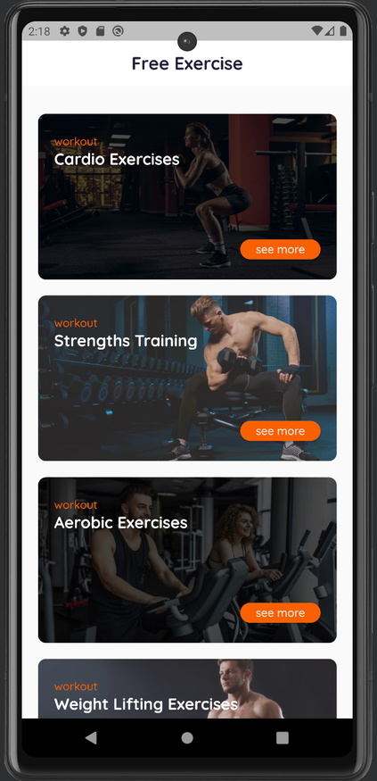
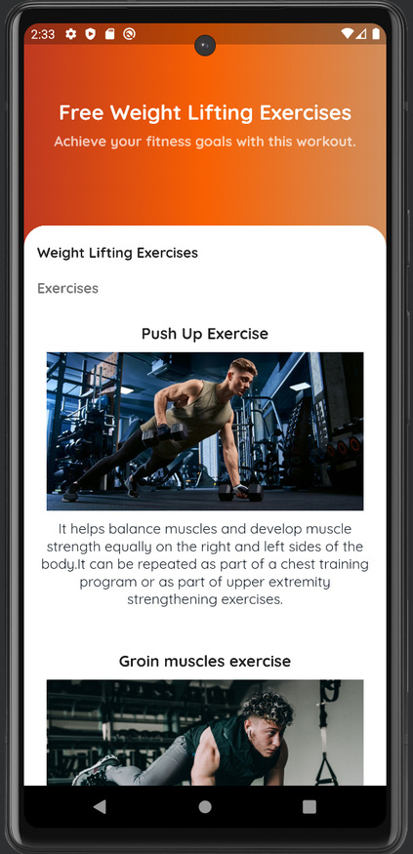
Guest Screen_Exercises
10

Slide 11
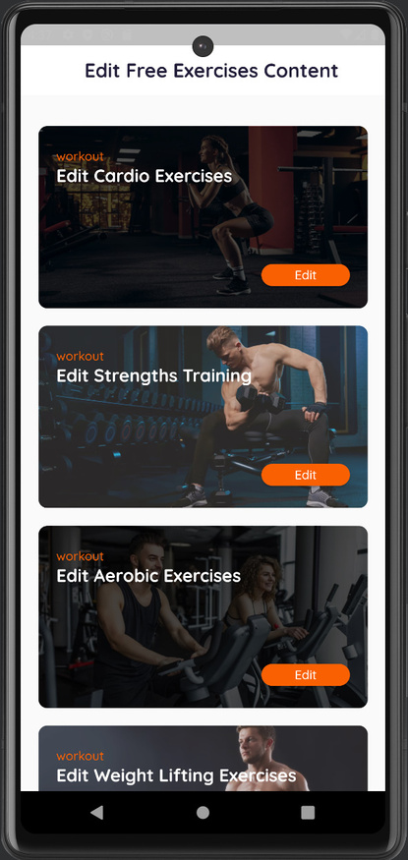
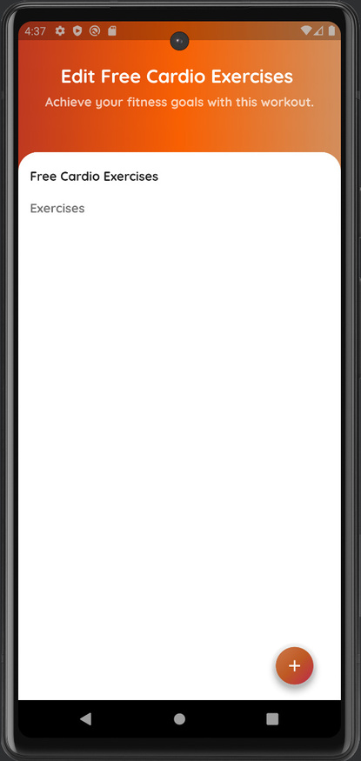
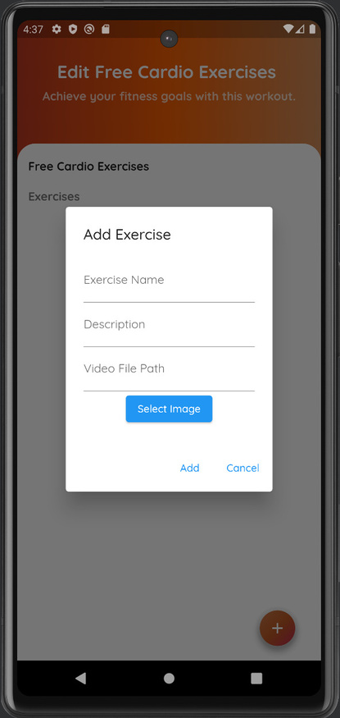
Edit Guest Exercise
Coach
11

Slide 12
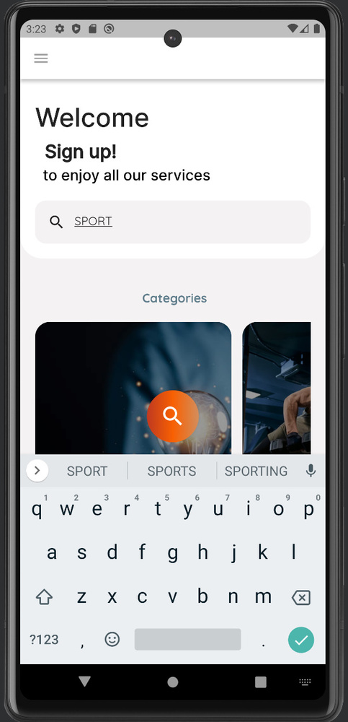
Guest Screen_Search
12

Slide 13
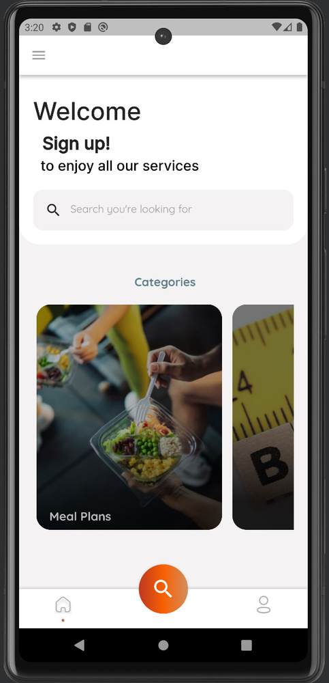
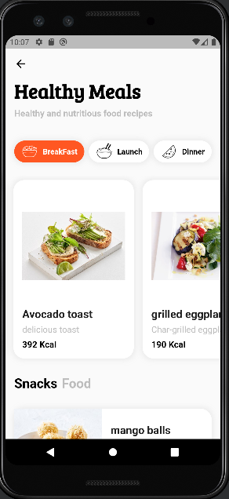
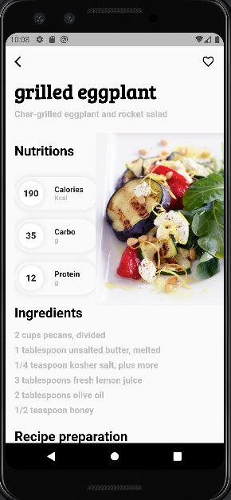
Guest Screen_Meals
Guest
13

Slide 14
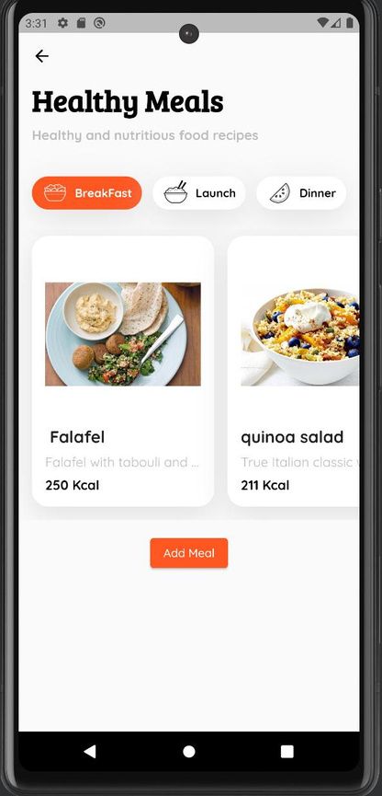
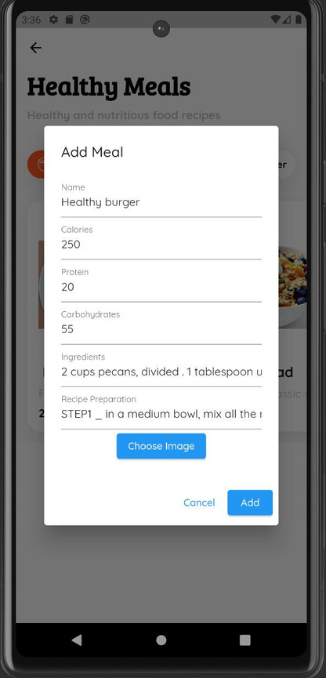
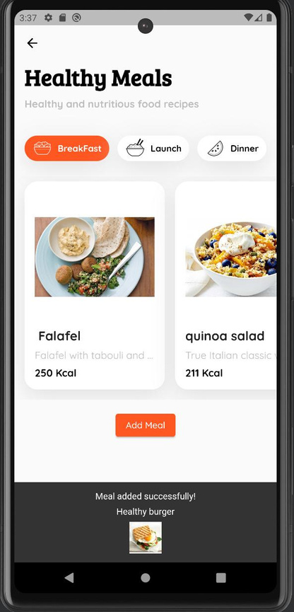
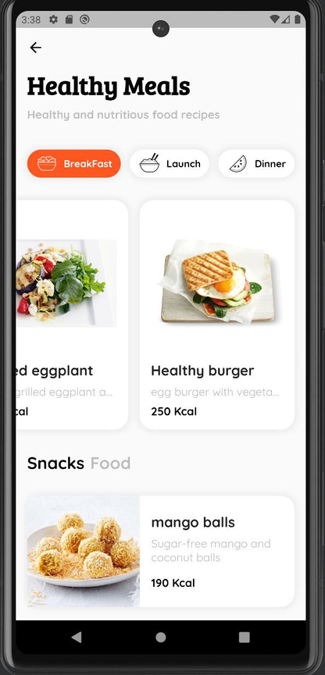
Edit Guest Meals
Nutritionist
14

Slide 15
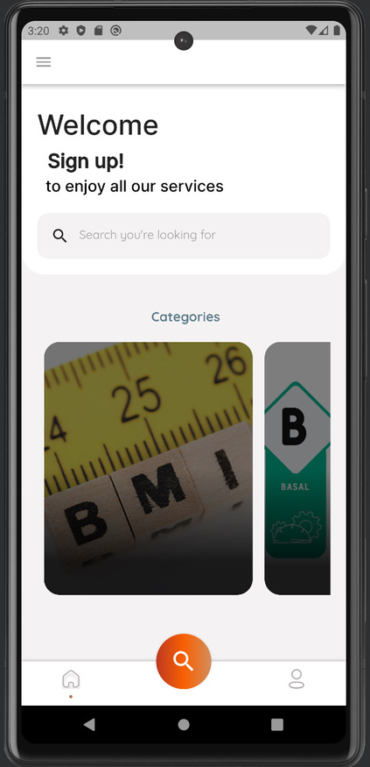
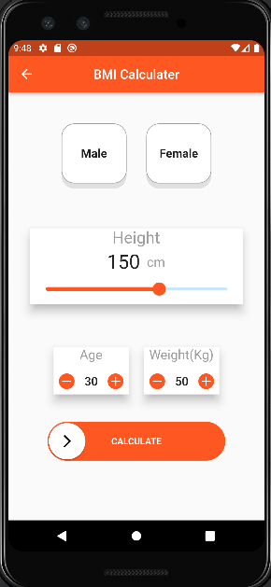
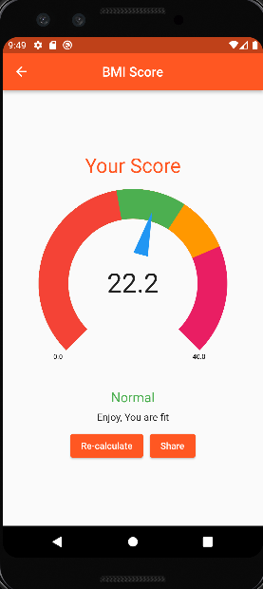
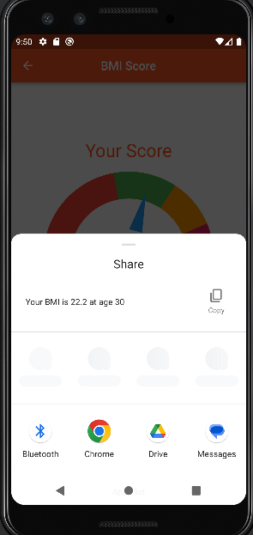
Guest Screen_BMI
15

Slide 16
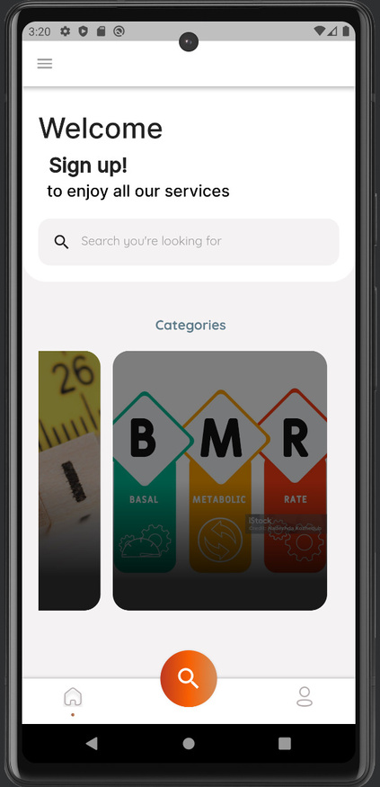
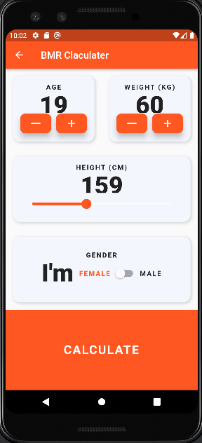
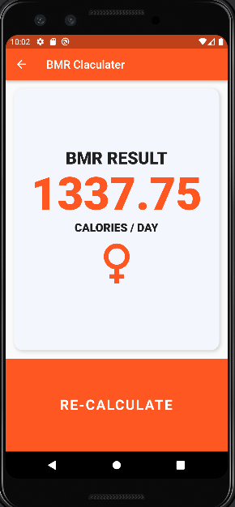
Guest Screen_BMR
16

Slide 17
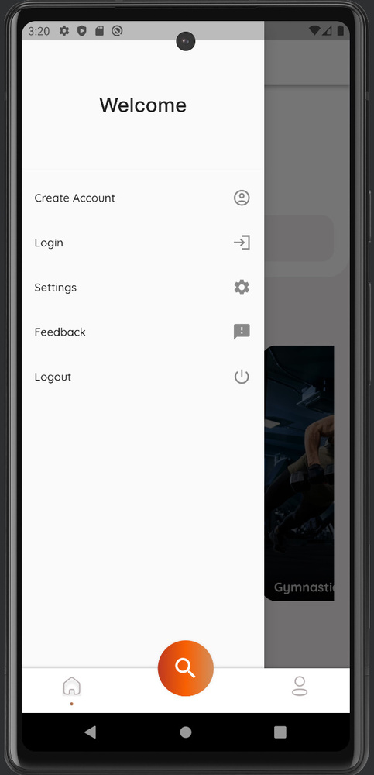
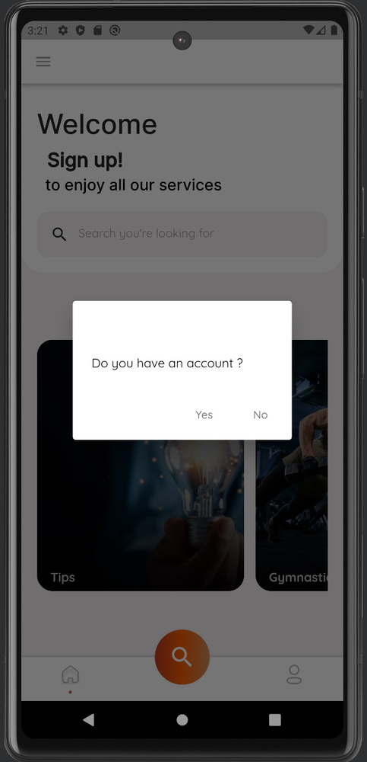

Guest Screen
17

Slide 18
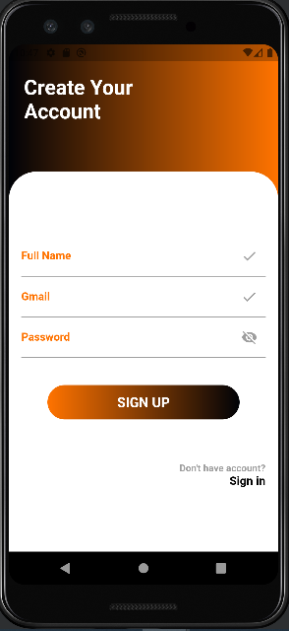
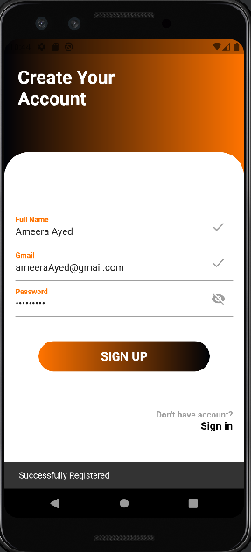
Sign up Screen
18

Slide 19
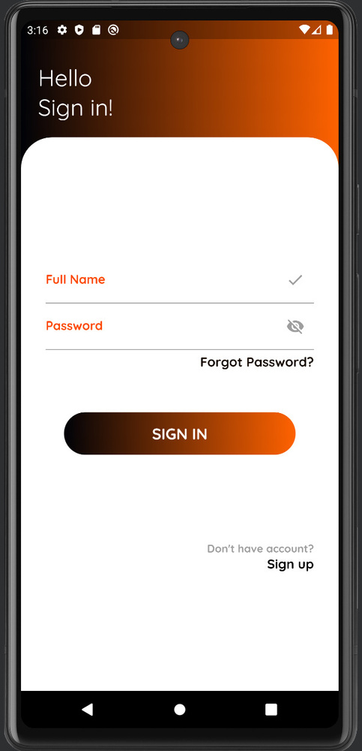
Sign in Screen
19

Slide 20
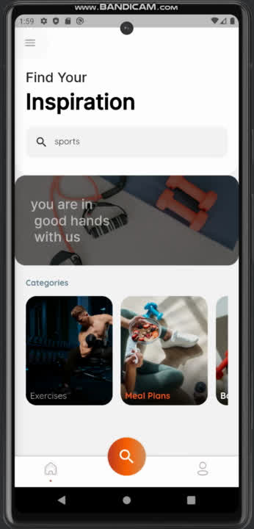
Sign in as User
user Home Page
20

Slide 21
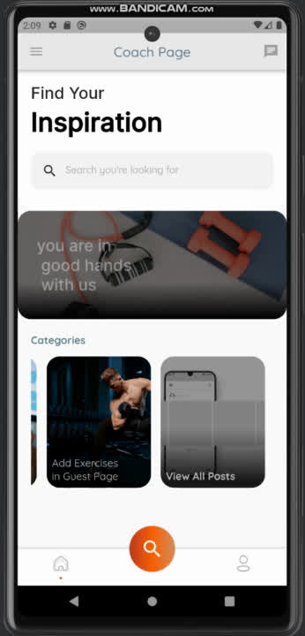
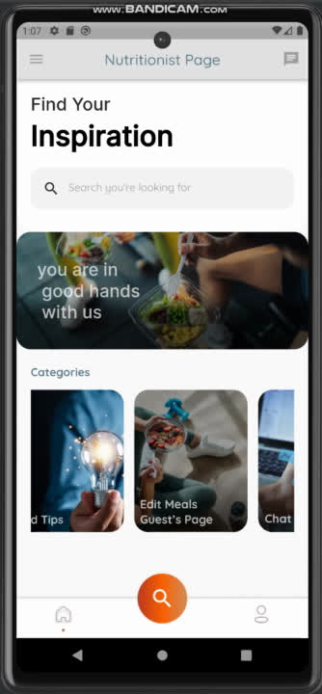
Sign in as Coach and Nutritionist
coach Home Page
Nutritionist Home Page
21

Slide 22
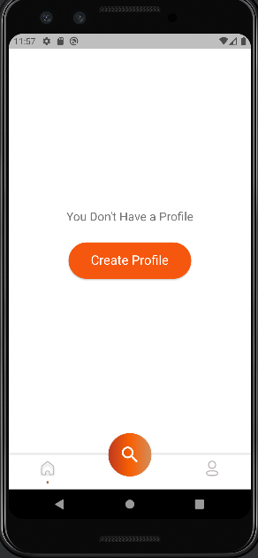
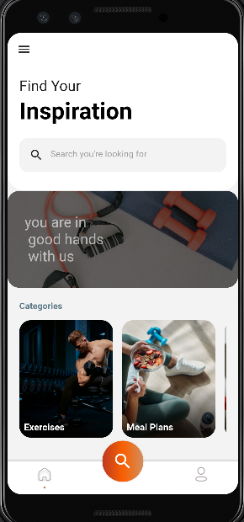
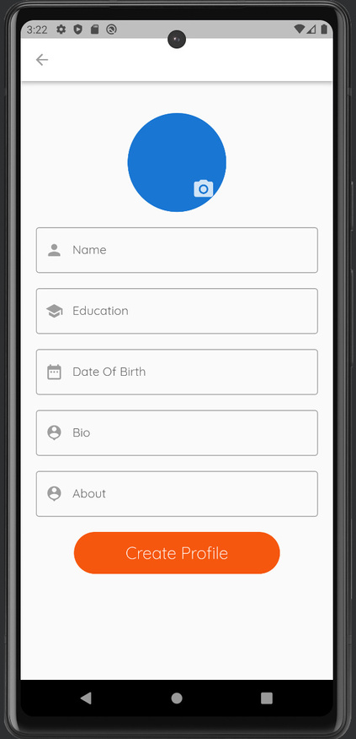
Creat Profile
22

Slide 23
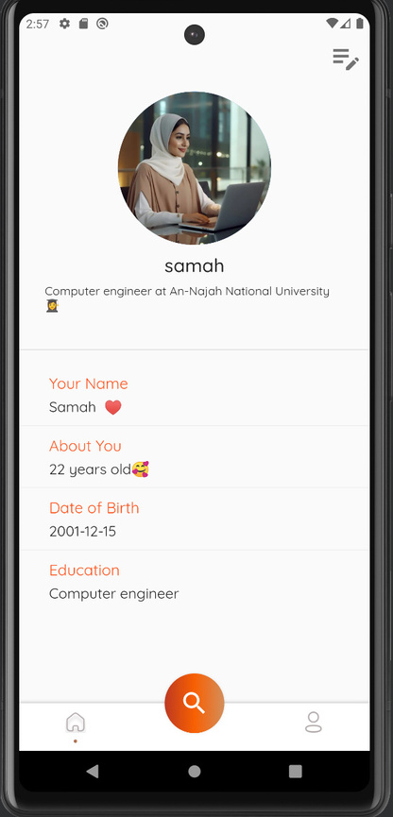
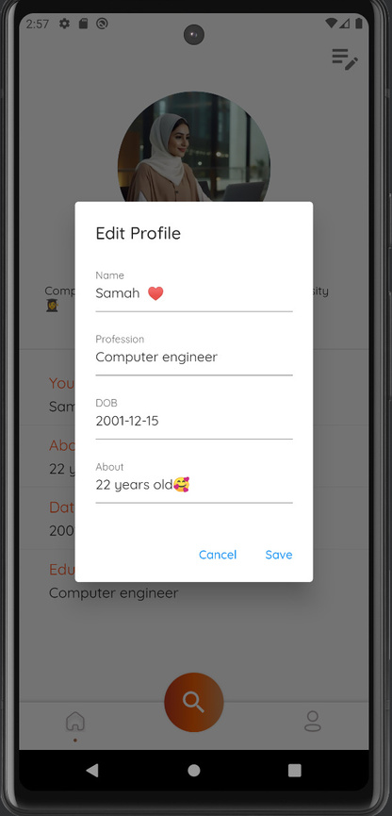
Profiles
23

Slide 24
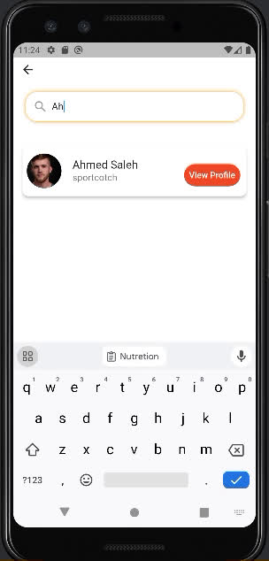
Search
24

Slide 25
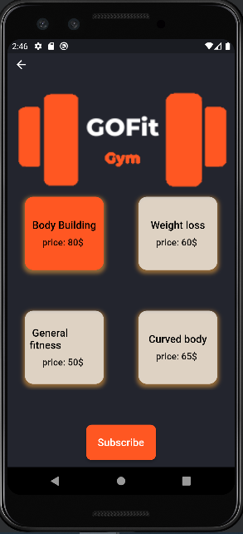
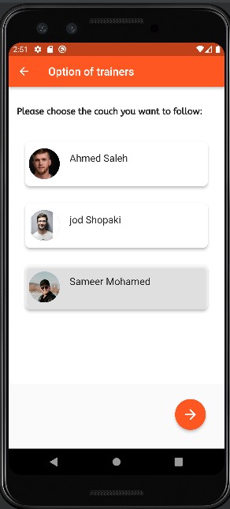
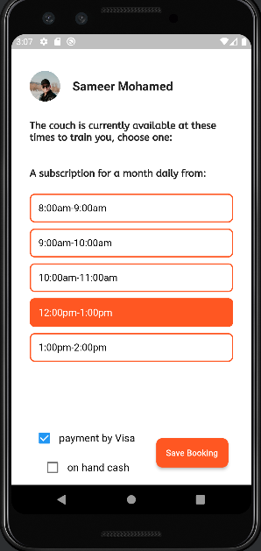
Gym Subscription
User
25

Slide 26
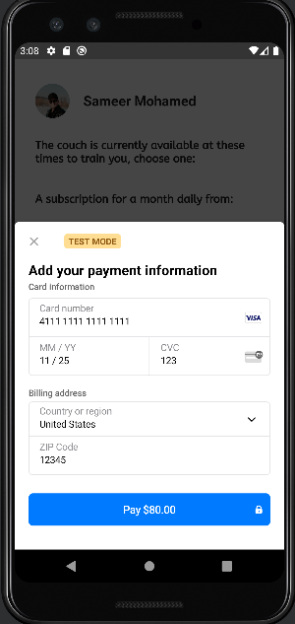
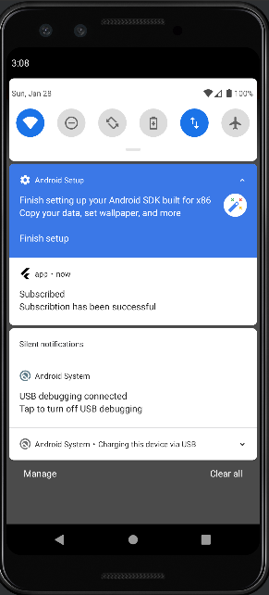
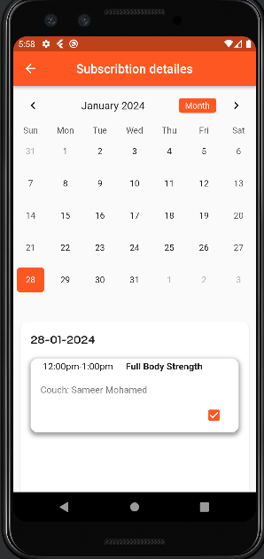
Gym Subscription
User
26

Slide 27
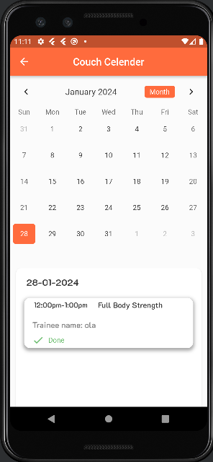

Couch Calender
Coach
27

Slide 28




Couch work time
Coach
28

Slide 29



Edit SubscriptionType
Coach
29

Slide 30




class Booking
User
30

Slide 31



Edit Classes
Coach
31

Slide 32




User Exercises
User
32

Slide 33







Edit User Exercises
Coach
33

Slide 34



User workout
User
34

Slide 35


meal plan
User
35

Slide 36




Posts
36

Slide 37



chat
37

Slide 38



chat
38

Slide 39



Admin
39

Slide 40


Admin
40

Slide 41
Web version
Features
41
1

Slide 42



42

Slide 43




43

Slide 44


44

Slide 45


45

Slide 46


46

Slide 47

47

Slide 48


48

Slide 49


49

Slide 50




50

Slide 51


51

Slide 52




52

Slide 53


53

Slide 54



54

Slide 55


55

Slide 56


56

Slide 57

57

Slide 58






TECHNOLOGY USED
Flutter
58

Slide 59


FUTURE WORK
The application can be integrated with other features such as a smart watch to monitor biometrics, which allows users to monitor heartbeat and blood pressure during exercise.
Artificial intelligence and machine language can be used to provide suggestions for accurate mathematical systems specific to each person according to their data
Periodic notifications can be added to remind you of appointments and encourage follow-up and continuity
59

Slide 60
Thank
you!
QUESTION&
ANSWER
60

