Slide 1





Oxyilator
Oxygen Ventilation System
Yousef Hanbali
Raoof Fares
Supervised by:
Dr.Raed Qadi

Slide 2


History of ventilators
Mechanical
PEEP Ventilation
Pressure Controlled Ventilation
Non-invasive Ventilation
1960
1980s
2000s
1971
1990s
Servo
Ventilatiors
Lung Protective
Ventilators

Slide 3
Problem Statement
"Problem is the lack of ventilation devices during the pandemic, and even though after the pandemic, the ventilation devices are too expensive and necessary for some patients that can’t get to the hospital."

Slide 4
COVID-19 Inspired
Fear
11%
According to PCBS, 4% of families in Palestine couldn't access medical care during COVID-19 Pandemic, which reasons were:
Other
27%
Can't Pay
23%
Can't Access
39%

Slide 5
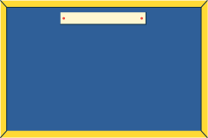

So now, what do we want?
Oxyilator
Easy to use
and
affordable
Can be used at
home
Reliable remote medical care

Slide 6
Our solution
"Oxylator is a system that integrates SpO2 with a mechanical ventilation system. It can be controlled through a touch screen or a mobile app for all new ventilation variables like BPM and Air Volume. With its user-friendly interface and IoT connectivity, it enables convenient and variable ventilation for patients in a home setting."

Slide 7



Oxyilator Main Features
Mechanical Ventilation System
Control
System
for users
Mobile
application
integration
Patient
Monitoring
System

Slide 8


Oxyilator vs Other Ventilators
 | Oxyilator | Mechanical (PEEP) | Modern (NIV)
Affordable
Cases Severity | Medium-Low | Low | High-medium-low
Technology | IoT, Automation | No technologies | Diagrams, Automation
Can be used at home?

Slide 9
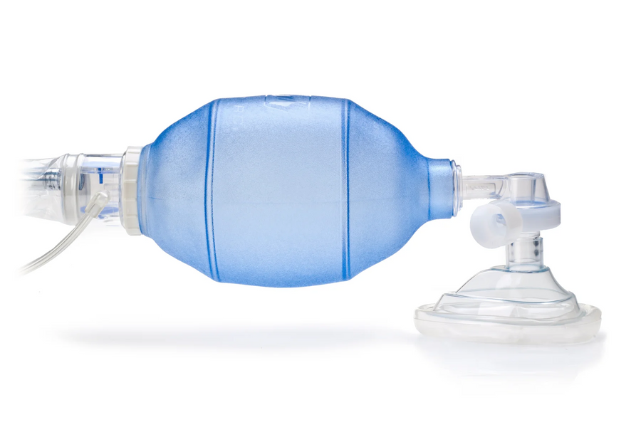
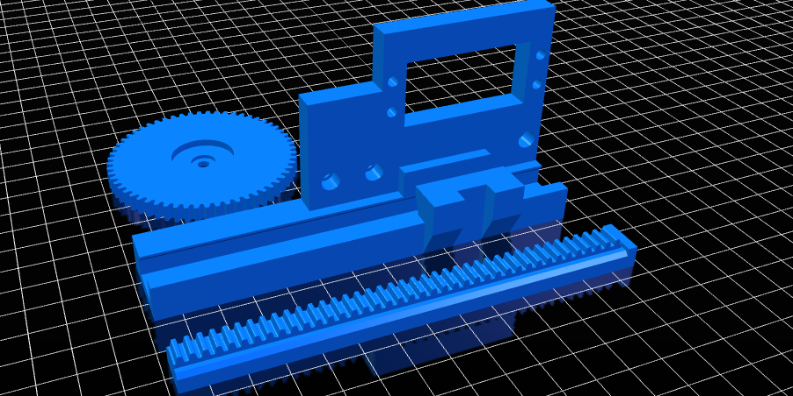
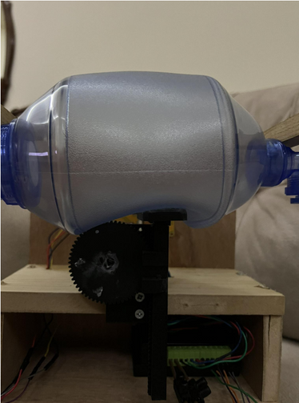
Oxyilator's bottom line

Slide 10
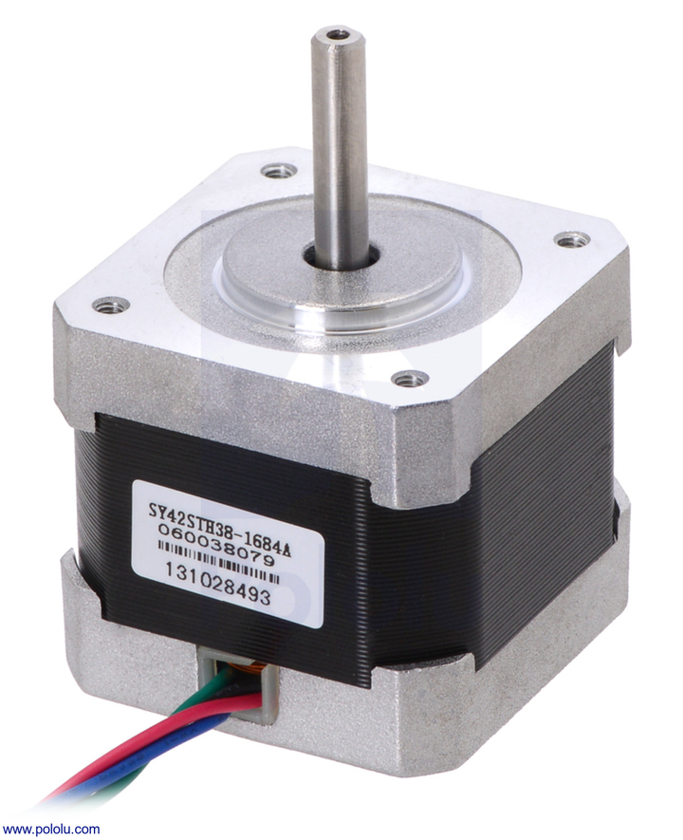
Oxyilator's bottom line
NEMA 17 Stepper motor

Slide 11
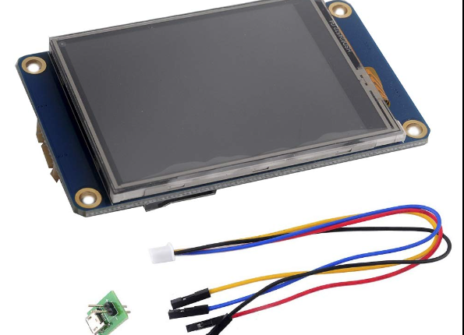
Oxyilator's bottom line
Nextion Resistive Screen

Slide 12
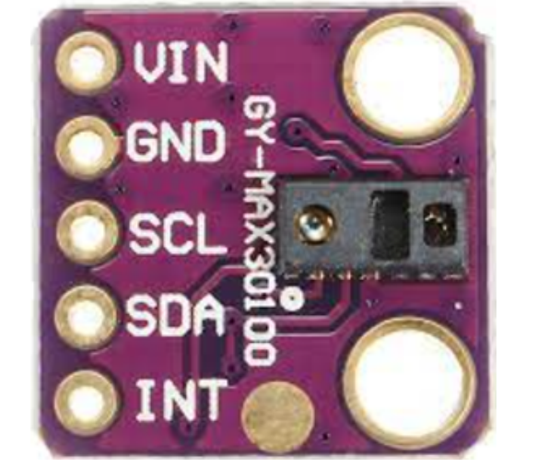
Oxyilator's bottom line
MAX30100 Oximeter

Slide 13
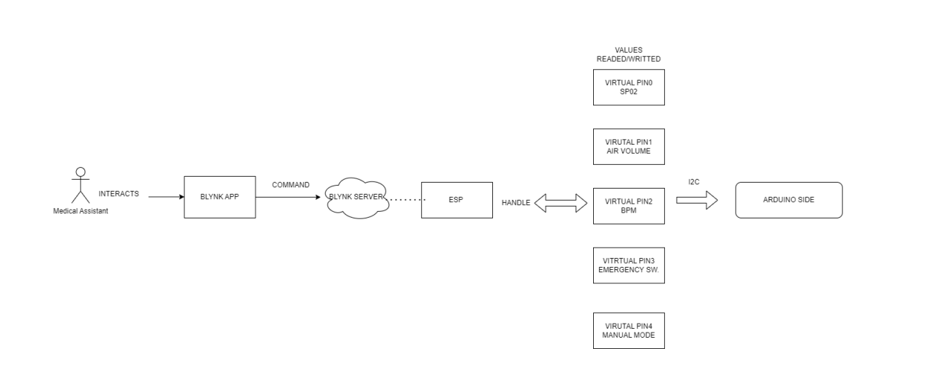
How Oxyilator work!

Slide 14
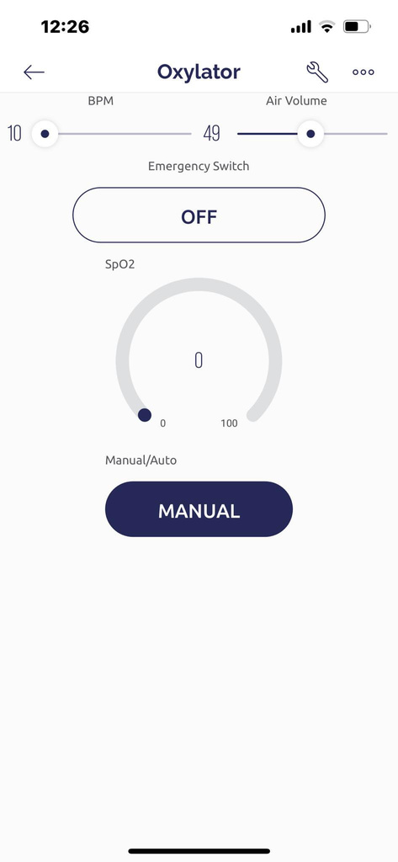
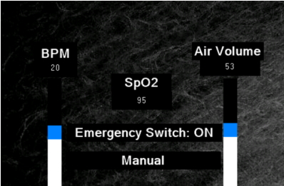
How Oxyilator work!

Slide 15
Oxyilator from the future
  Air Filteration & Moistening System
  Develop a stand-alone app, with stand-alone server
built on MQTT Protcol
  Add artificial intelligence with help from specalists to increase accuracy of auto mode.
  Adding recovery mode for patients, along with required sensors like ECG.

Slide 16
DEMO Time!

Slide 17
If you have any questions,
Don't ask me, ask China!
(Especially Wuhan)

