Slide 1

Graduation Project 2
Structural Analysis and Design of
Educational Research and Development Center in Birzeit
An-Najah National University
Nablus - Palestine
Faculty of Engineering
Civil Engineering Department
Prepared by:
Mahmoud Ibrahim Daraghmeh
Mustafa Nedal Eleyan
Qais Mofeed Daraghmeh
Qusai Mahmoud Mahmoud
Supervised by:
Eng. Ibrahim Arman
Spring 2020

Slide 2
Outline
Project Description
Codes and Standards
Materials
Site Investigation
Software
Load Types
Load Combinations
Preliminary Dimensions
Modeling
Irregularities
Checks
Design of structural elements

Slide 3
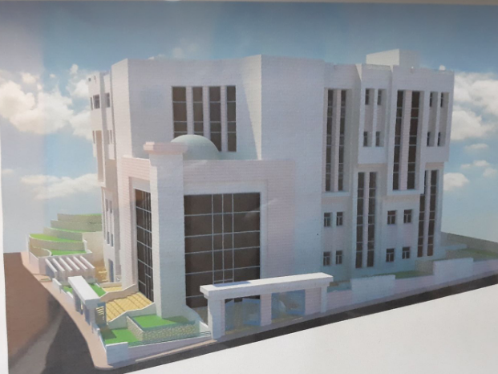

Slide 4
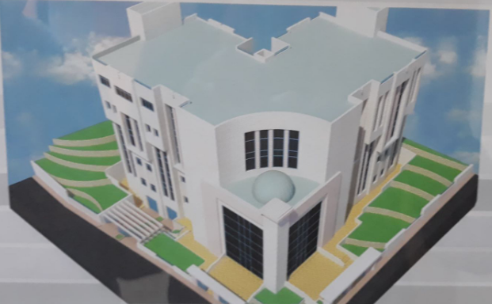

Slide 5
Project Description

Slide 6
The project includes a design of the educational research and development center building which located in Birzeit in Ramallah.
The building consists of six floors. Which are basement floor and five floors above the ground.
The height of each floor is 4.2 m except the basement floor which has a height of 3.5m.

Slide 7
Floor | Usage | Area (m²)
Basement | Garage, mechanical room and an electrical room. | 912
Ground | Conference hall and the department of education and research. | 792
First | Meeting rooms, administrative deputy unit and department of educational and policies. | 792
Second | Technical deputy unit, head of center and administrative department. | 875
Third | Technical deputy unit. | 819
Fourth | Cafeteria and bedrooms. | 853

Slide 8
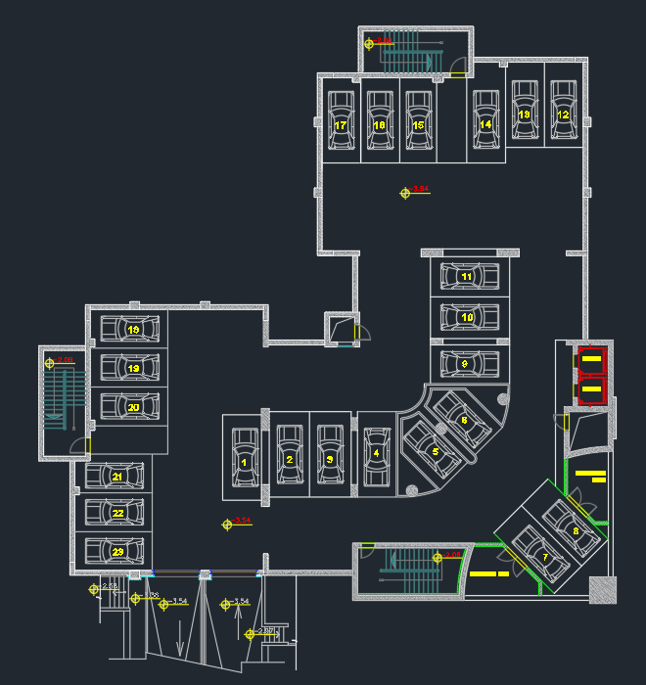
Plan for Basement

Slide 9
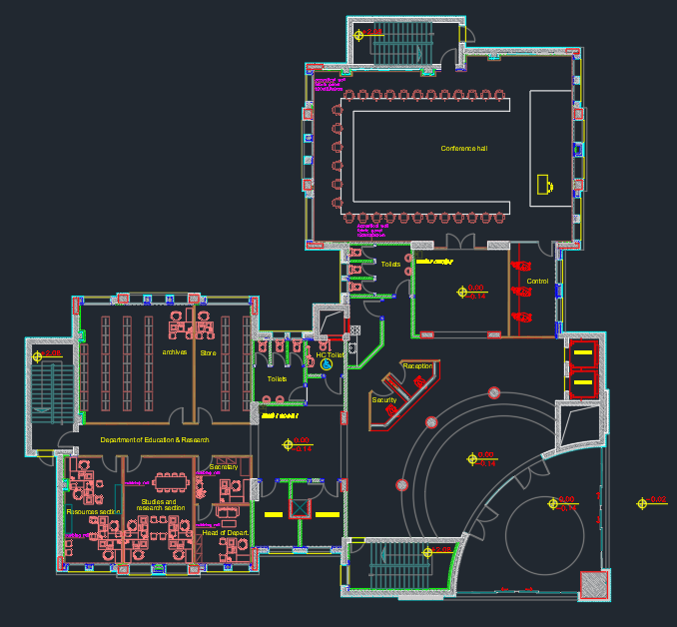
Plan for Ground Floor

Slide 10
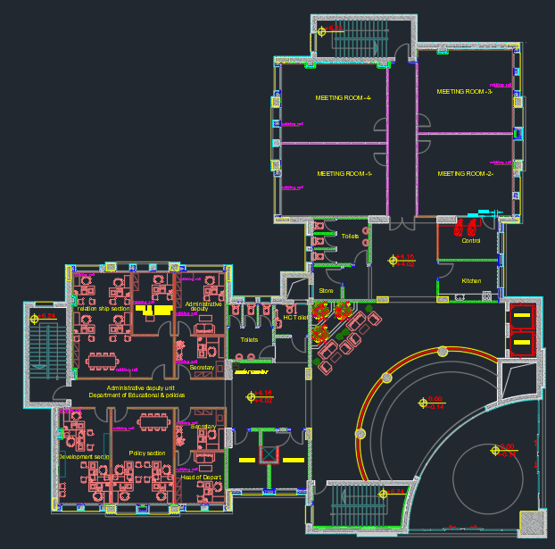
Plan for First Floor

Slide 11
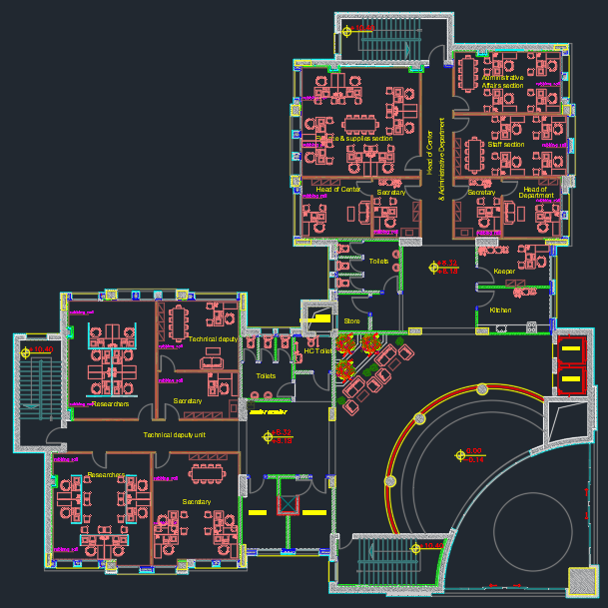
Plan for Second Floor

Slide 12
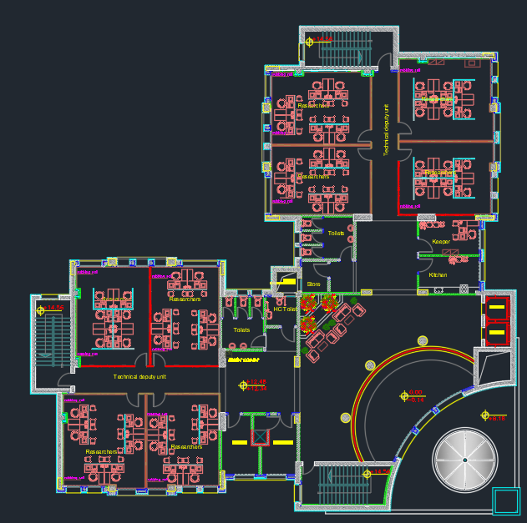
Plan for Third Floor

Slide 13
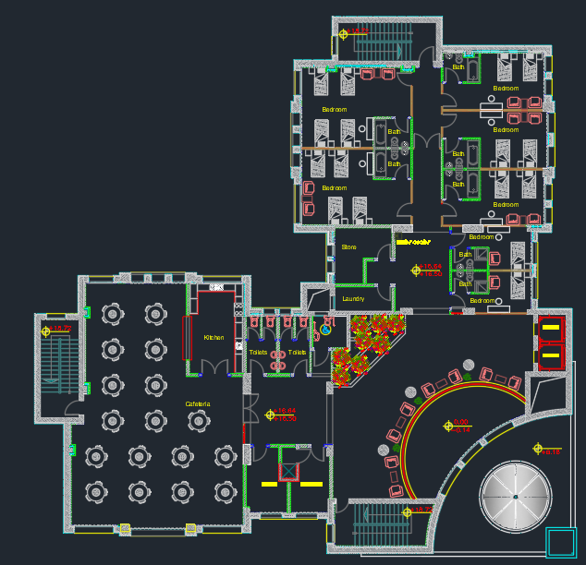
Plan for Fourth Floor

Slide 14
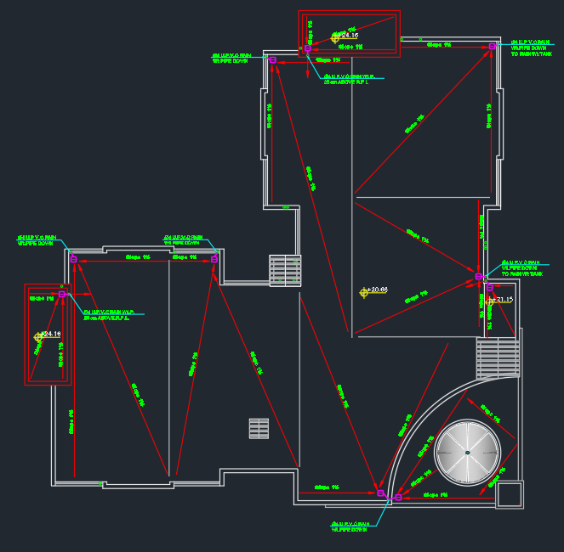
Plan for Roof

Slide 15
Materials
Materials for structural elements:
Concrete B350 (f’c = 28 MPa)
E = 24870.06 MPa, γ = 25 kN/m³
Reinforcing Steel (ASTM A615, Grade 60)
Fy = 420 MPa, Fu = 630 MPa Es = 200 GPa

Slide 16
Materials
Materials for non- structural elements:
Plain concrete (γ = 23kN/m³)
Concrete block (γ = 15kN/m³)
Sand (γ = 18kN/m³)
Tiles (γ = 27kN/m³)
Stone units (γ = 27kN/m³)
Spray foam
False ceiling

Slide 17
Soil Investigation
According to the types of material that are founded when making the boreholes, the recommended type of foundation is single footings using soil allowable bearing capacity,
q all=400 kN/m^2.

Slide 18
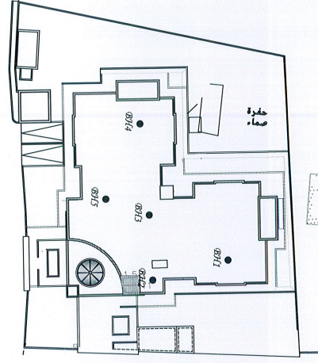
Soil Investigation
The locations of the boreholes in the site:

Slide 19
Codes
ACI 318-14: For sections design and detailing.
IBC–2012: For determining loads.
ASCE 7-10:For determining loads.
Jordanian Code for Loads – 2006.

Slide 20
Software
ETABS 18.1.1.
SAFE 16.0.0.
SAP2000 21.
AUTOCAD 2018.

Slide 21
Load Types
Dead Loads
It’s the own weight of the structural elements of the structure, which are slabs, beams, columns, walls, footings and dome.
Superimposed Dead Loads
It’s the weight of the non-structural elements, which is distributed on slabs, walls, dome and staircases.

Slide 22
Load Types
Live Loads
Live loads are produced from the occupancy and movable objects on the building, and their values were determined in consideration to ASCE 7-10.
A uniform live load on all floors, except roof, was taken as 5 kN/m².
And roof live load = 2 kN/m2.

Slide 23
Load Types
Snow Load
Snow load was determined in accordance with Jordanian Code 2006 using the following equation.
Sd = μi So, where:
So : Site snow load (kN/m2)
Sd : Snow load on roof (kN/m2)
μi : Snow load shape coefficient.
Sd = 1.125*0.8 = 0.9 kN/m2

Slide 24
Load Types
Wind Load
The structure was divided to two components with only one direction of wind; because all other cases will give the same results.

Slide 25
Load Types
Wind Load
P = q_{h} G C_{N}
p : wind pressure (N/m²)
q_{h} : velocity pressure (N/m²)
G : gust-effective factor
C_{N} : net pressure coefficient
Wind Speed (V) = 120 km/h
Exposure Category “D”
Topographic Factor (K_{zt}) = 1
Gust Factor (G) = 0.85

Slide 26
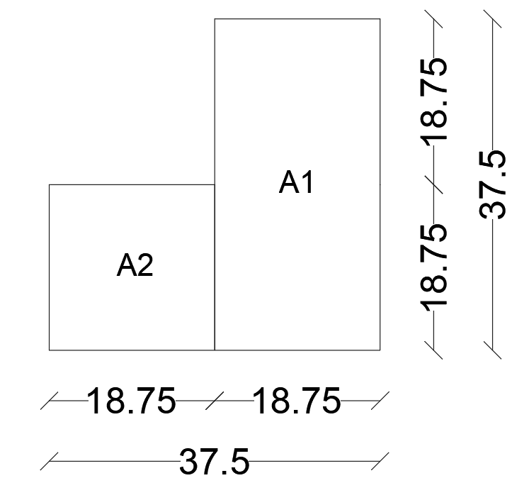
Load Types
Wind Load
Units of structure:

Slide 27
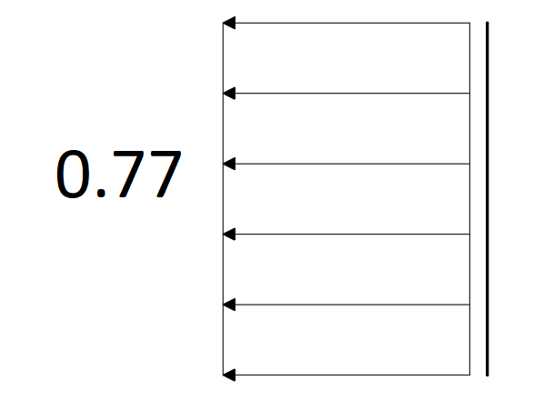
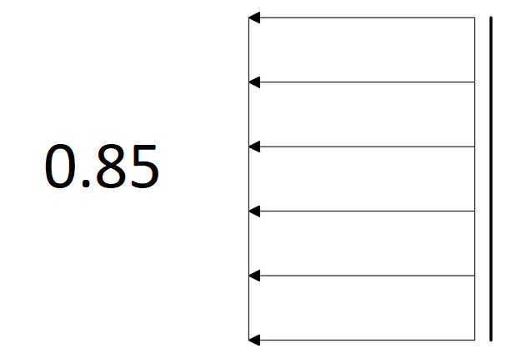
Load Types
Wind Load
Wind pressure on Leeward wall of unit 1:
Wind pressure on Leeward wall of unit 2:

Slide 28
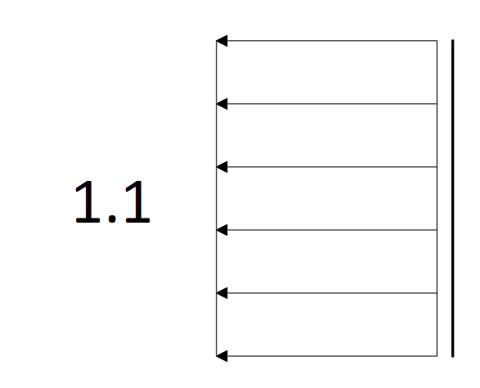
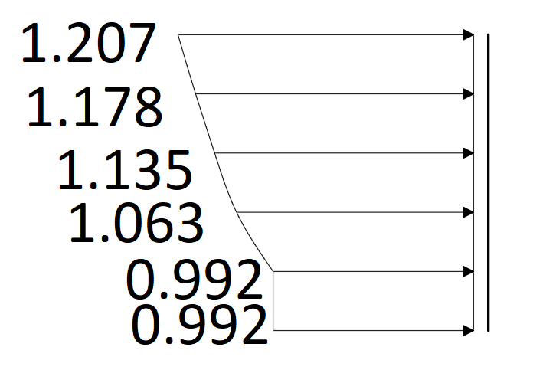
Load Types
Wind Load
Wind pressure on Side wall of unit 1 & 2:
Wind pressure on Windward wall of unit 1 & 2:

Slide 29
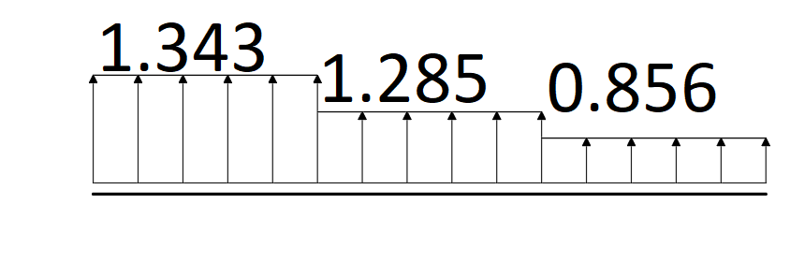
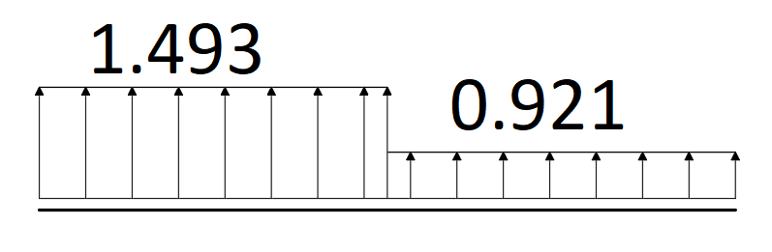
Load Types
Wind Load
Wind pressure on Roof of unit 1:
Wind pressure on Roof of unit 2:

Slide 30
Load Types
Earthquake Loads (EQ)
Risk Category (III)
Importance Factor (Ie) = 1.25
Site Class “B”
Acceleration Parameter at Short Period (Ss) = 0.44
Acceleration Parameter at 1-SEC Period (S₁) = 0.11
Fa = 1
Fv = 1
SDS = 0.44
SD1 = 0.11

Slide 31
Load Types
Earthquake Loads (EQ)
Seismic Design Category “C”
Modal Response Spectrum Analysis was used.
Redundancy Factor (ρ) = 1.0
E_{h} = ρ Q_{E} = 1.0 Q_{E}
E_{v} = 0.2*S_{DS}*D = 0.088 D

Slide 32
Load Types
Earthquake Loads (EQ)
Seismic force-resisting system is Bearing Wall System (Ordinary RC Shear Walls), as shear walls resist almost all lateral loads and more than 50% of gravity loads.
Direction | Total Base Shear (kN) | Shear Walls Portion (kN) | Percentage (%)
X | 9945 | 9789.8 | 98.4 %
Y | 10358 | 10264.5 | 99.1 %
Total Gravity Load (kN) | Shear Walls Portion (kN) | Percentage (%)
132534.3 | 91556 | 69 %

Slide 33
Load Types
Earthquake Loads (EQ)
Response Modification Factor (R) = 4
Overstrength Factor (Ω_{o}) = 2.5
Deflection Amplification Factor (C_{d}) = 4
Tn,x = 0.4 sec.
Tn,y = 0.38 sec.
Base Shear:
V,x = 10232.5 kN
V,y = 10585.4 kN

Slide 34
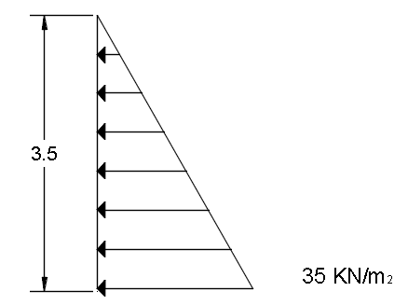
Load Types
Earth pressure
Pressure of the soil (P) = γ H k0
Ko =1-sin⁡∅
The horizontal component of the pressure of the soil

Slide 35
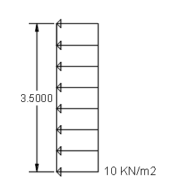
Load Types
Surcharge Pressure
The pressure on the basement from the surcharge load is constant and is calculated according to the following equation:
Psurcharge = Surcharge load * Ka = 2* 0.5= 1 KN/m2
Horizontal component of the surcharge load:

Slide 36
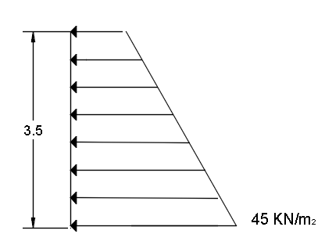
Load Types
The horizontal component of the pressure of the soil and the surcharge load:

Slide 37
Load Types
Soil Seismic Load
∆P = 0.4 Kh γt H rw.
Where,
∆P: additional earth pressure caused by seismic shaking, which is assumed to be uniform pressure.
Kh: horizontal seismic coefficient in the soil, which may be assumed equal to Sxs/2.5.
γt: Total unit weight of soil.
H rw: height of the retaining wall: and
Sxs: spectral response acceleration parameter (Sxs = Fa Ss).
Sxs = Fa Ss = 1.0*0.44 = 0.44.
Kh = Sxs/2.5 = 0.44/2.5 = 0.176.
∆P = 0.4 Kh γt H rw = 0.4*0.176*20*3.5 = 5 KN/m2.

Slide 38
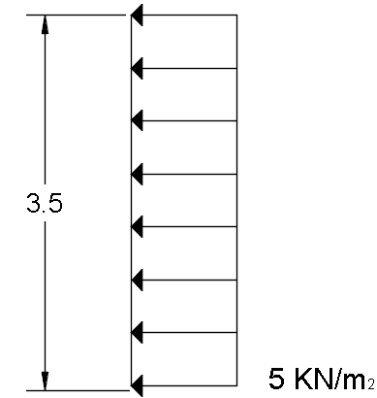
Load Types
Soil Seismic Load
The pressure caused by the seismic shaking

Slide 39
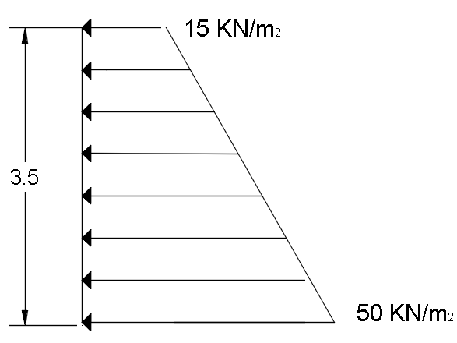
Load Types
Soil Seismic Load
The total earth pressure on the wall consists of the seismic earth pressure and the unfactored static active earth pressure.
The total earth pressure on the wall:

Slide 40
Load Combinations
There are two types of load combinations, strength (used for design) and service (used for serviceability checks).
D = dead load and super-imposed dead
H = load due to lateral earth pressure, ground water pressure, or pressure of bulk materials.
L = live load
E = earthquake load,
Where (E) consider Horizontal component Eh (both X & Y directions) and Vertical component Ev of seismic load, and directional effect (100% from seismic load acting on some direction and 30% from this load acting in other direction).
Ev = 0.2 SDS D = 0.2*0.44*D
Ev = 0.088 D

Slide 41
Load Combinations
Ultimate Load Combinations | Service Load Combinations
1.4 D + 1.6 H | D + H
1.2 D + 1.6 L + 1.6 H | D + L + H
1.2 D + Ev + Eh + L + 1.6 H | D + 0.7 Ev + 0.7 Eh + 1.0 H
0.9 D – Ev – Eh + 0.9 H | 1.0 D + 0.525 Ev + 0.525 Eh + 0.75 L + 1.0 H
 | 0.6 D – 0.7 Ev - 0.7 Eh + 0.6 H

Slide 42
Preliminary Dimensions

Slide 43
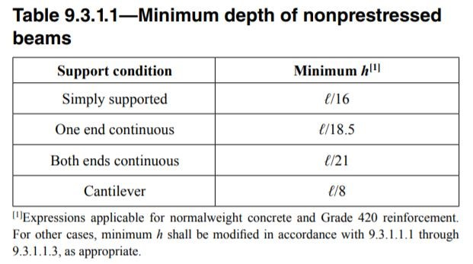
Preliminary Dimensions for Beams
Width of beams = Length of span / 20
Thickness of beams is according to the table:

Slide 44
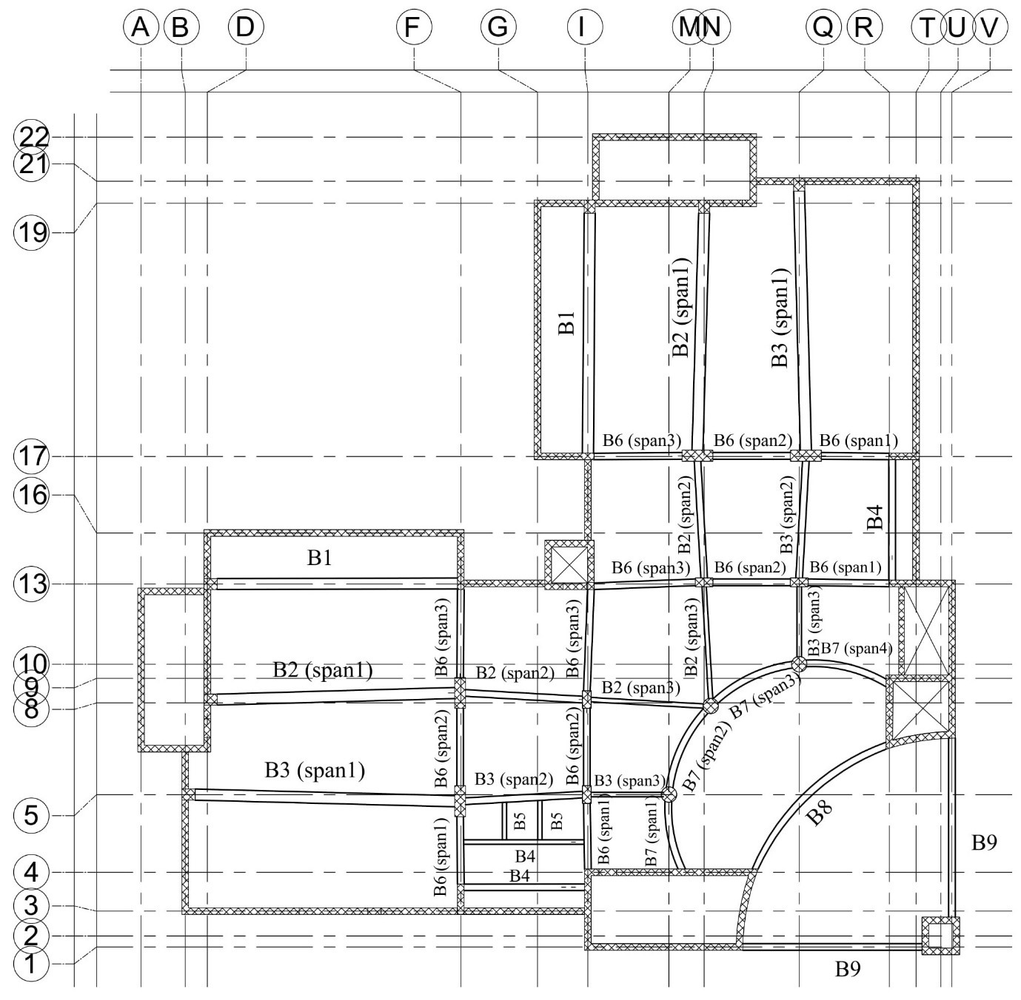

Slide 45
Preliminary Dimensions for Beams
Beam | Depth (mm) | Width (mm)
B1 | 700 | 550
B2 | 650 | 600
B3 | 700 | 650
B4 | 350 | 300
B5 | 200 | 200
B6 | 300 | 250
B7 | 250 | 250
B8 | 600 | 450
B9 | 600 | 450

Slide 46
Preliminary Dimensions for Slabs
Slab thickness for one way slabs are according to the table:
All one way slabs are taken as 200 mm thickness.
 | Cantilever | Simple | One-end continuous | Two-end continuous
Slab Thickness | L / 10 | L / 20 | L / 24 | L / 28

Slide 47
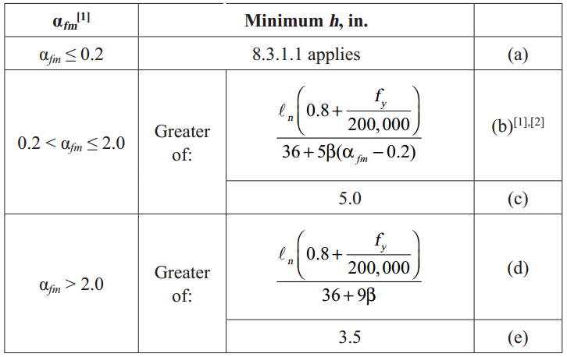
Preliminary Dimensions for Slabs
Slab thickness for two way slabs are according to the table:
All two way slabs are taken as 200 mm thickness.

Slide 48
Preliminary Dimensions for Shear walls
It is difficult to determine the thickness of the walls; because it is difficult to know the load that came on them.
All wall thicknesses are assumed to be 300 mm.

Slide 49
Preliminary Dimensions for Columns
The dimensions of the columns were determined from axial load on it, and it calculated from tributary area around columns, including its own weight.
P = (dead load + live load + super-imposed) * (tributary area) * 1.10
P = ϕPn = ϕ × λ × (0.85 f'c ×Ag × (1- ρ) + fy × ρ ×Ag)

Slide 50
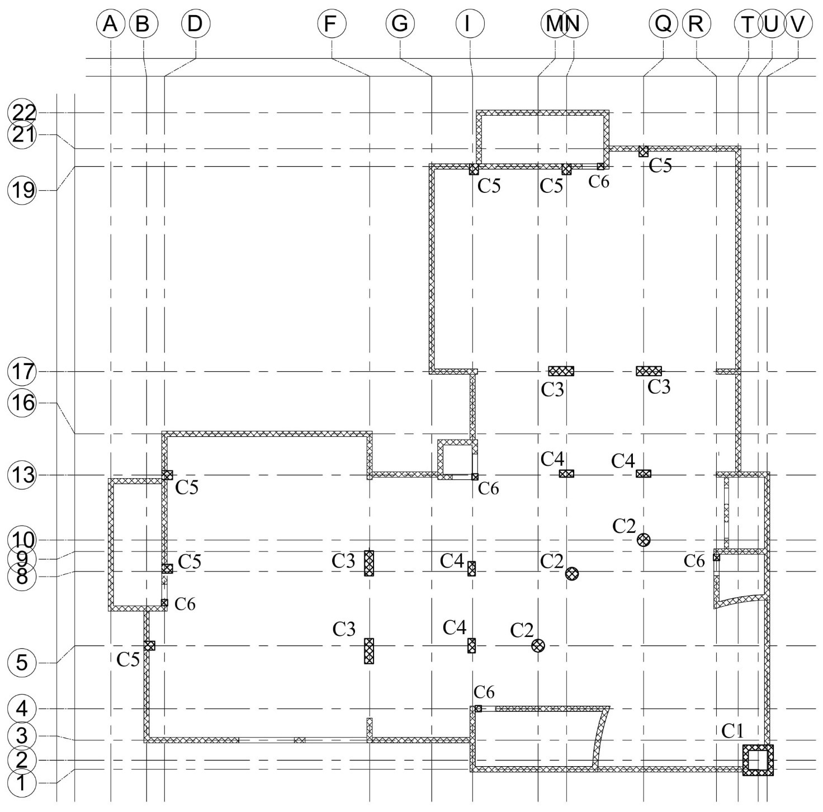

Slide 51
Preliminary Dimensions for Columns
Column | Dimensions (mm)
C1 | 1700 * 1700 * (300 thickness)
C2 | Diameter = 500
C3 | 1000 * 500
C4 | 600 * 300
C5 | 500 * 400
C6 | 350 * 350

Slide 52
Preliminary Dimensions for Footings
Type of footings is according to its type, in the meaning that the columns has single footings and wall has continuous footing.
Single and wall footings used because total area of footing needed to distribute load is less than 0.5 area of typical floor.
Area of footing are selected to distribute the load from structure to the soil and make pressure under footings less Bearing Capacity of the soil.
Thickness of footing are selected mainly to resist one way shear and punching shear

Slide 53
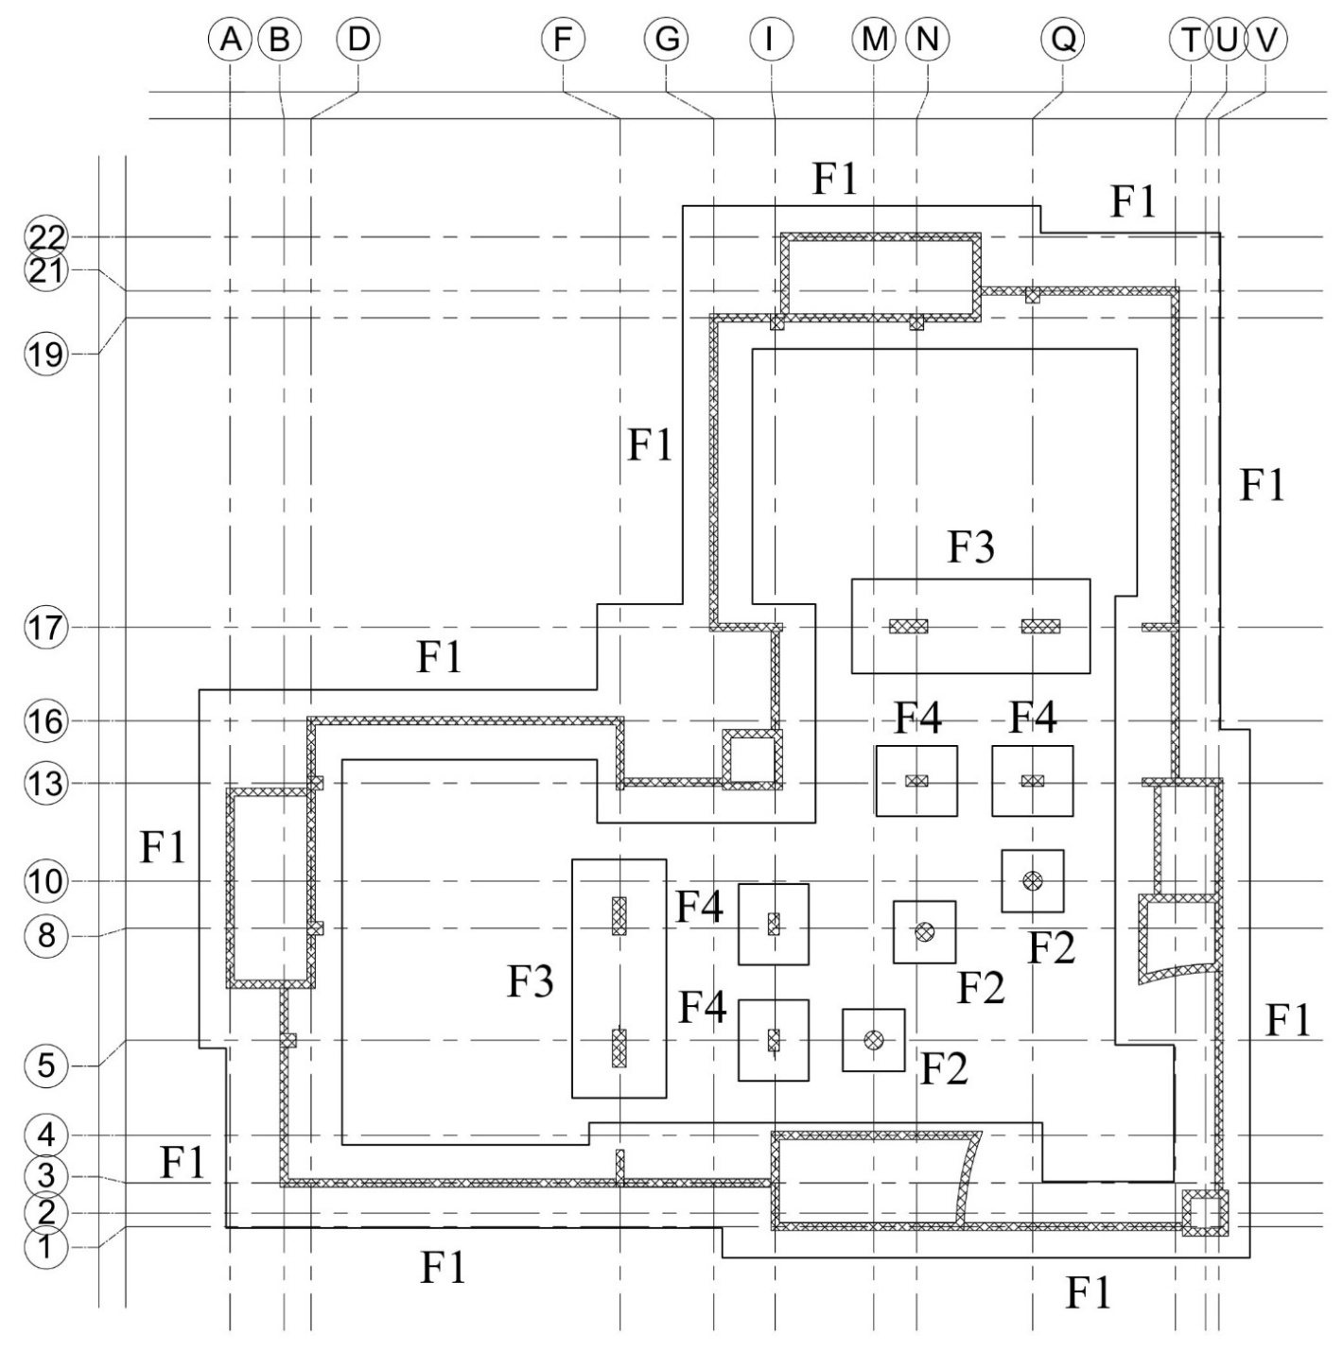

Slide 54
Preliminary Dimensions for Footings
Footing | Length (m) | Width (m) | Thickness (mm)
F1 | Variable | 4.0 | 1000
F2 | 2.3 | 2.3 | 500
F3 | 4.2 | 3.3 | 900
F4 | 3.0 | 2.6 | 700

Slide 55
Modeling

Slide 56
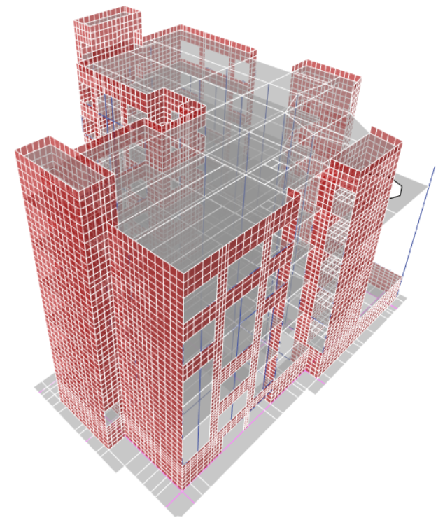

Slide 57
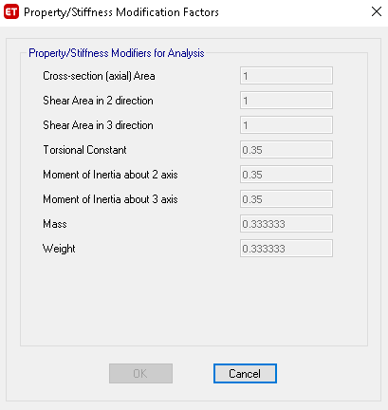
Modifiers
For beams
mass and weight
modifiers change
when depth of
beam change

Slide 58
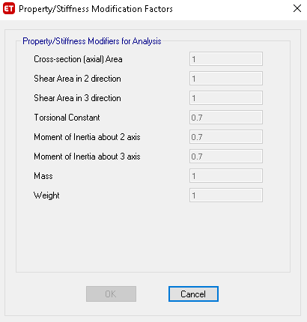
Modifiers
For columns

Slide 59
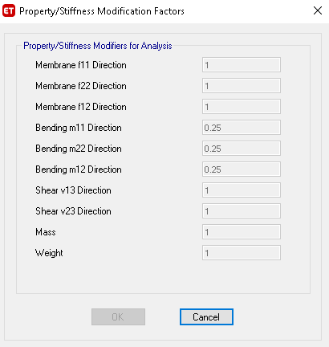
Modifiers
For slabs

Slide 60
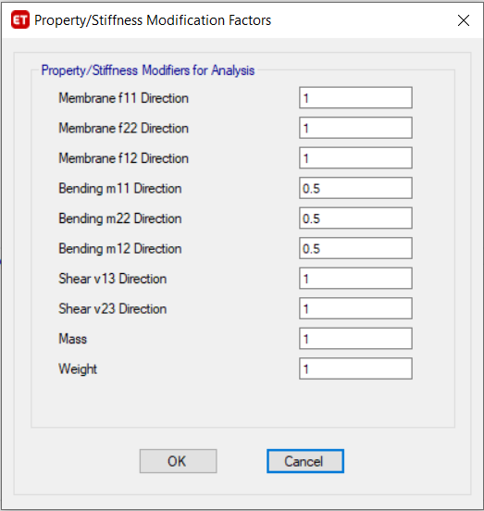
Modifiers
For footings

Slide 61
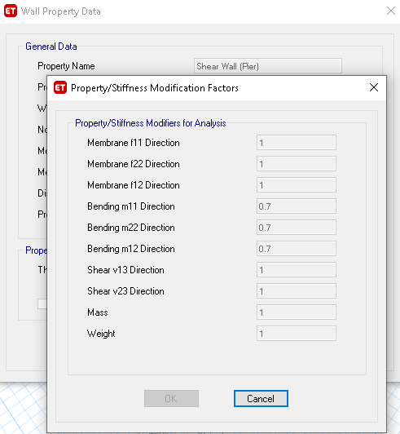
Modifiers
For piers

Slide 62
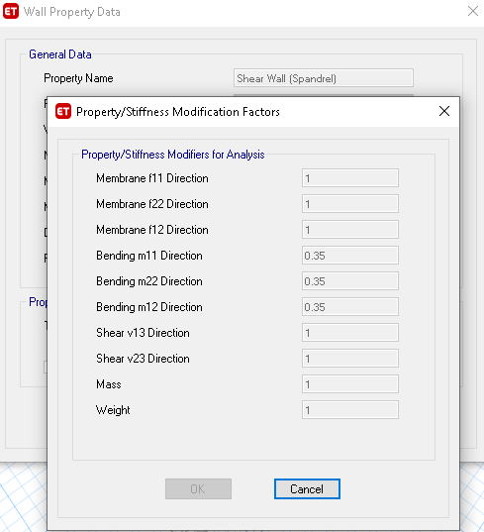
Modifiers
For spandrels

Slide 63
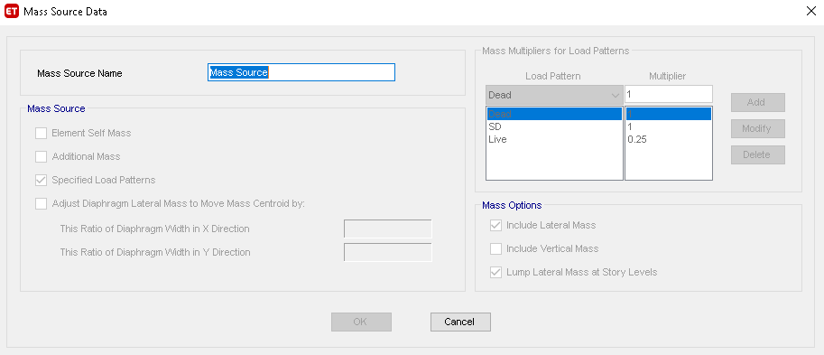
Mass source

Slide 64
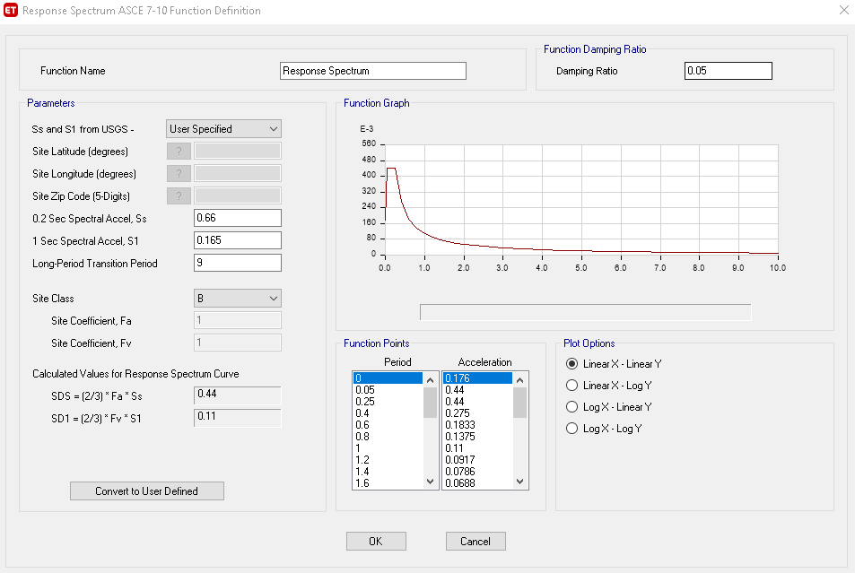
Function

Slide 65
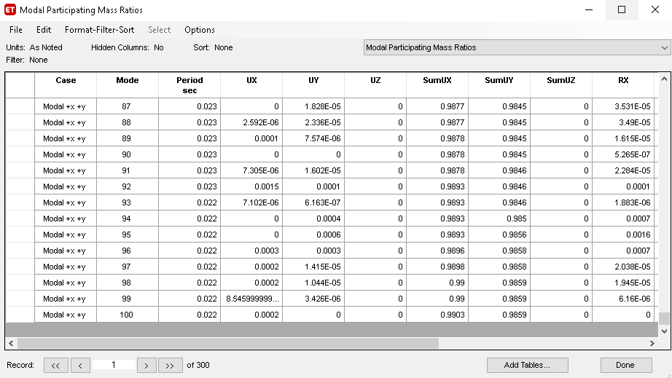
Number of modes

Slide 66
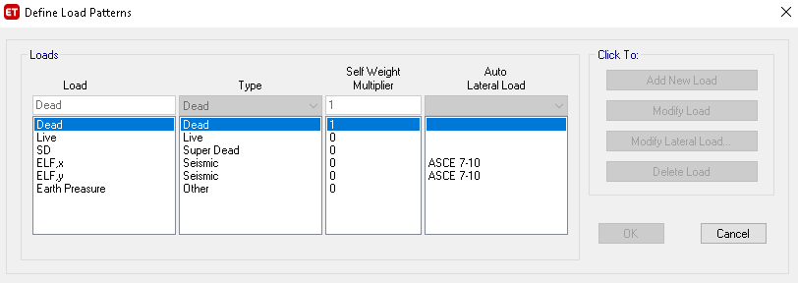
Load Patterns

Slide 67
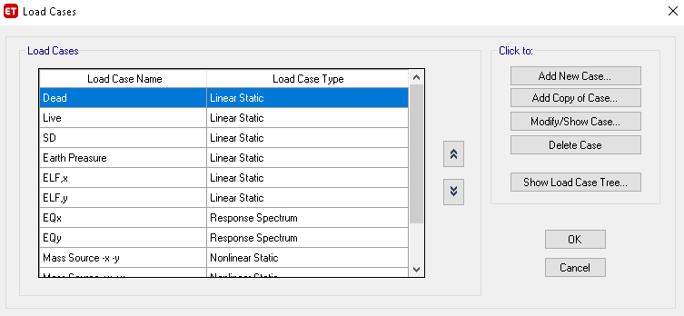
Load Cases

Slide 68
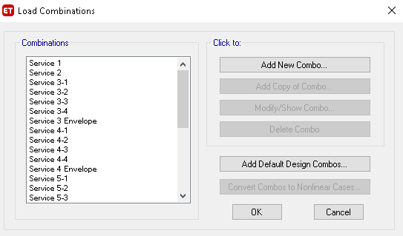
Load Combinations

Slide 69
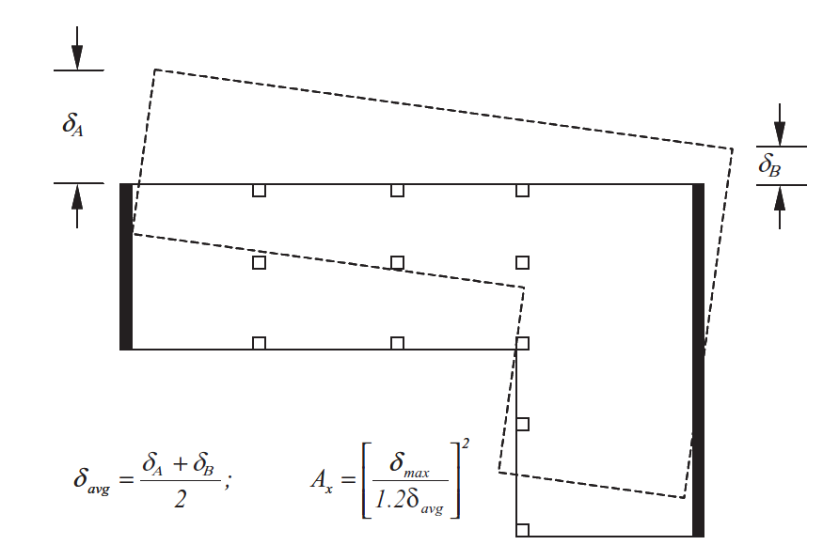
Irregularities
Torsional irregularity:
Torsional irregularity is defined
to exist where the maximum
story drift, computed including
accidental torsion with Ax = 1.0,
at one end of the structure
transverse to an axis is more
than 1.2 or 1.4 times the
average of the story drifts at
the two ends of the structure

Slide 70
Irregularities
Torsional irregularity:
The structure is irregular due to this type of irregularity, so the eccentricities
were modified to take the effect of torsional irregularity.
The Equivalent Lateral Force method was modified by changing eccentricities
directly.
Dynamic analysis was made to take the torsional irregularity effect on Response
Spectrum Analysis method according to the ASCE Code.

Slide 71
Irregularities
Reentrant corner irregularity:
Reentrant corner irregularity is defined to exist where both plan projections of
the structure beyond a reentrant corner are greater than 15% of the plan
dimension of the structure in the given direction.
This irregularity determine the type of analysis.
The structure is regular due to this type of irregularity.
Since Design category is (C), type of analysis will not affected by this irregularity,
and all types of analysis is valid.

Slide 72
Irregularities
Stiffness-soft story irregularity:
Stiffness-soft story irregularity is defined to exist where there is a story in which
the lateral stiffness is less than 70% or 60% of that in the story above or less than
80% or 70% of the average stiffness of the three stories above.
The structure is regular due to this type of irregularity.

Slide 73
Irregularities
Weight (mass) irregularity (weak story check):
Weight (mass) irregularity is defined to exist where the effective mass of any
story is more than 150% of the effective mass of an adjacent story. A roof that is
lighter than the floor below need not be considered.
The structure is regular due to this type of irregularity.

Slide 74
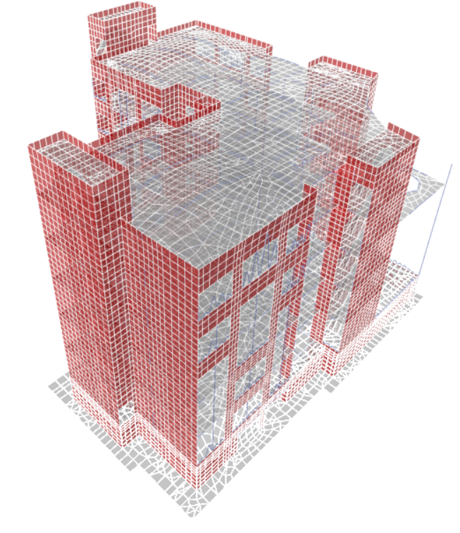
Checks
1- Compatibility Check:

Slide 75
Checks
2- Equilibrium Check
This check for ensure that loads added on model are correct
Dead Load:
Dead (Manual) = 68548 kN
Dead from program = 68498 kN
% error = 0.075 % < 5%
Live Load:
Live (Manual) = 20824.3 KN
Live from program = 21240 kN
% error = 2 % < 5%

Slide 76

Checks
3- Stress-Strain Check
It was done live loads for different elements.
Slab:
M11 = $\frac{WL∗L^{2}}{8}$ = $\frac{5∗{4.37}^{2}}{8}$ = 11.93 KN.m
Moments values from program :
M+ = 7.04 KN.m
M-₁ = 5.04 KN.m
M-₂ = 5.21 KN.m
(5.04+5.21)/2 + 7.04 = 12.17 KN.m
% error in moment = 2 % < 10 %

Slide 77

Checks
3- Stress-Strain Check
Beam:
M = $\frac{WL∗L^{2}}{8}$ = 19.05 KN.m
Moments values from program :
M+ = 115.97 KN.m
M-₁ = 164.8 KN.m
M-₂ = 185.54 KN.m
(164.8+185.54)/2 + 115.97 = 291.14 KN.m
% error in moment = 6.7 % < 10 %

Slide 78
Checks
3- Stress-Strain Check
Column:
Axial load (manual) = 292.6 kN
Axial load (ETABS) = 299.12 kN
% error in moment = 2.22 % < 10 %
Footing:
Moment (manual) = 228.63 kN.m
Moment (ETABS) = 253.7 kN.m
% error in moment = 9.8 % < 10 %

Slide 79

Checks
4- Deflection Check
Long-term deflection:
Deflection from self-weight = 4.69 mm
Deflection from the long-term load combination = 43.47 mm
Deflection = 43.47 – 4.69 = 38.78 mm
Δ_{all} = 47.5 mm
$∴$ Deflection < Allowable deflection, OK

Slide 80
Checks
5- Check stresses under footings
Allowable bearing capacity for the soil = 400 kN/m²
Maximum stress value under F1 = 348.9 kN/m² O.K.
Maximum stress value under F2 = 390.6 kN/m² O.K.
Maximum stress value under F3 = 382.4 kN/m² O.K.
Maximum stress value under F4 = 391.4 kN/m² O.K.
All minimum values are larger than zero.

Slide 81

Checks
6- Slenderness Check
Slenderness ratio =
Where:
k : effective length factor
Lu: unbraced length
r: radius of gyration
k = 1 , Lu,max = 3.95 m
For minimum section dimensions, r = 0.1
= 39.1 < 40
Then, all columns are short columns.

Slide 82
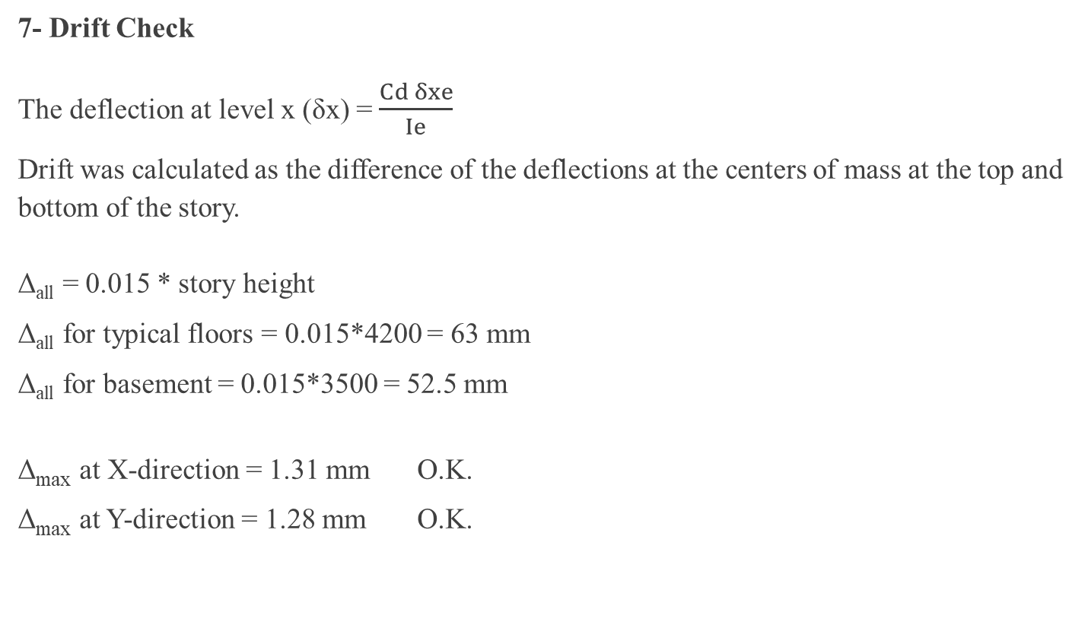
Checks
7- Drift Check
The deflection at level x (δx) = $\frac{Cd δxe}{Ie}$
Drift was calculated as the difference of the deflections at the centers of mass at the top and bottom of the story.
Δ_{all} = 0.015 * story height
Δ_{all} for typical floors = 0.015*4200 = 63 mm
Δ_{all} for basement = 0.015*3500 = 52.5 mm
Δ_{max} at X-direction = 1.31 mm O.K.
Δ_{max} at Y-direction = 1.28 mm O.K.

Slide 83

Checks
8- P-delta Check
θ = $\frac{Px Δ Ie}{Vx hsx Cd}$
When θ ≤ 0.1 , No Need for P-delta
θ_{max} = $\frac{0.5}{β∗Cd}$ ≤ 0.25
Where, $β$ is the of shear demand to shear capacity for the story. This ratio is permitted to be conservatively taken as 1.0.
So, θ_{max} = $\frac{0.5}{1∗4}$ = 0.125 < 0.25

Slide 84
Checks
8- P-delta Check
In X-direction:
In Y-direction:
Story | stability coefficient | Check
Roof | 0.0006 | No Need for P-Delta
Fourth Floor | 0.0007 | No Need for P-Delta
Third Floor | 0.0008 | No Need for P-Delta
Second Floor | 0.0009 | No Need for P-Delta
First Floor | 0.0008 | No Need for P-Delta
Ground Floor | 0.0004 | No Need for P-Delta
Story | stability coefficient | Check
Roof | 0.0006 | No Need for P-Delta
Fourth Floor | 0.0007 | No Need for P-Delta
Third Floor | 0.0008 | No Need for P-Delta
Second Floor | 0.0008 | No Need for P-Delta
First Floor | 0.0009 | No Need for P-Delta
Ground Floor | 0.0003 | No Need for P-Delta

Slide 85
Design of Structural Elements
Notes:
Design results of program was verified on all structural elements, so final design results were taken directly from the program.

Slide 86
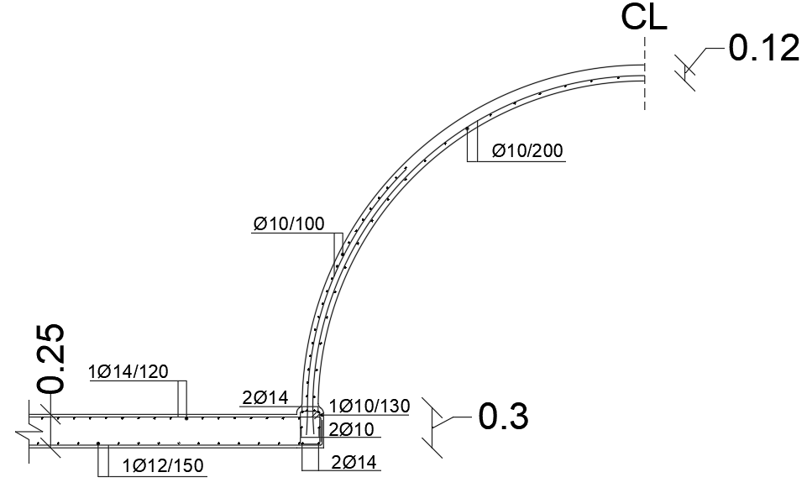
Design of Dome
Dome has a thickness of 12 cm.
Inner face reinforcement:
A net of 1 ∅ 10 / 200 mm in both directions.
Outer face reinforcement (at lower half of the height):
A net of 1 ∅ 10 / 100 mm in both directions.

Slide 87
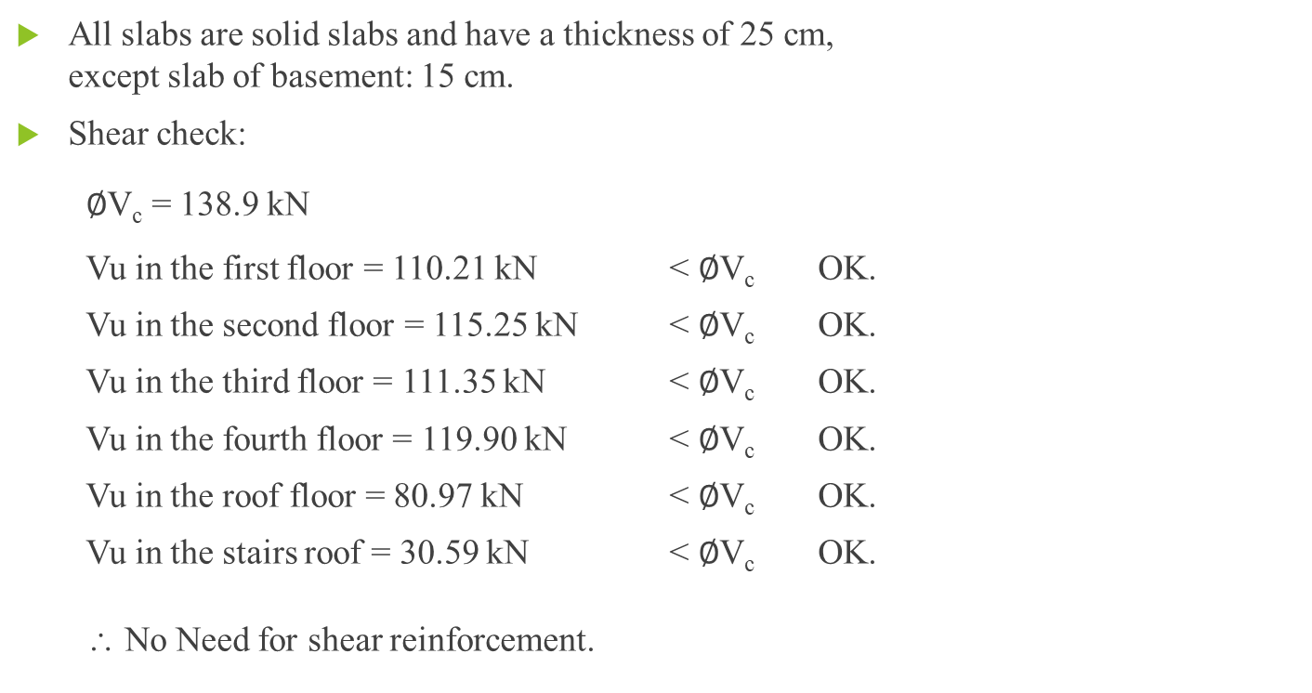
Design of Slabs
All slabs are solid slabs and have a thickness of 25 cm,
except slab of basement: 15 cm.
Shear check:
$∅$V_{c} = 138.9 kN
Vu in the first floor = 110.21 kN < $∅$V_{c} OK.
Vu in the second floor = 115.25 kN < $∅$V_{c} OK.
Vu in the third floor = 111.35 kN < $∅$V_{c} OK.
Vu in the fourth floor = 119.90 kN < $∅$V_{c} OK.
Vu in the roof floor = 80.97 kN < $∅$V_{c} OK.
Vu in the stairs roof = 30.59 kN < $∅$V_{c} OK.
∴ No Need for shear reinforcement.

Slide 88
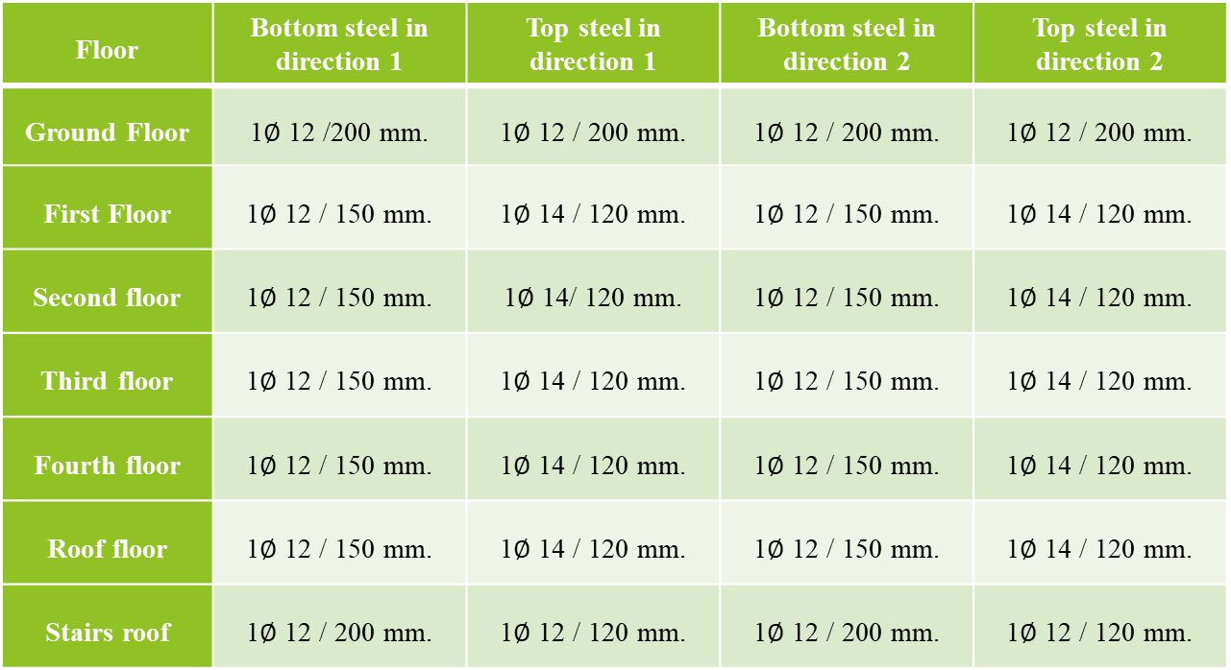
Design of Slabs
Floor | Bottom steel in direction 1 | Top steel in direction 1 | Bottom steel in direction 2 | Top steel in direction 2
Ground Floor | 1$∅$ 12 /200 mm. | 1$∅$ 12 / 200 mm. | 1$∅$ 12 / 200 mm. | 1$∅$ 12 / 200 mm.
First Floor | 1$∅$ 12 / 150 mm. | 1$∅$ 14 / 120 mm. | 1$∅$ 12 / 150 mm. | 1$∅$ 14 / 120 mm.
Second floor | 1$∅$ 12 / 150 mm. | 1$∅$ 14/ 120 mm. | 1$∅$ 12 / 150 mm. | 1$∅$ 14 / 120 mm.
Third floor | 1$∅$ 12 / 150 mm. | 1$∅$ 14 / 120 mm. | 1$∅$ 12 / 150 mm. | 1$∅$ 14 / 120 mm.
Fourth floor | 1$∅$ 12 / 150 mm. | 1$∅$ 14 / 120 mm. | 1$∅$ 12 / 150 mm. | 1$∅$ 14 / 120 mm.
Roof floor | 1$∅$ 12 / 150 mm. | 1$∅$ 14 / 120 mm. | 1$∅$ 12 / 150 mm. | 1$∅$ 14 / 120 mm.
Stairs roof | 1$∅$ 12 / 200 mm. | 1$∅$ 12 / 120 mm. | 1$∅$ 12 / 200 mm. | 1$∅$ 12 / 120 mm.

Slide 89

Design of Beams

Slide 90
Design of Beams
Beam | Span | Width (mm) | Depth (mm) | Stirrups | Top Steel at End-1 | Top Steel at End-2 | Middle Torsion Steel | Bottom Steel
B1 | ـــ | 500 | 750 | 1Ø12/90 | 4Ø32 | 4Ø32 | 4Ø16 | 5Ø25
B2 | span1 | 500 | 750 | 1Ø12/100 | 6Ø32 | 6Ø32 | 4Ø14 | 5Ø32
 | span2 | 300 | 500 | 1Ø10/150 | 2Ø32 | 4Ø18 | 2Ø14 | 4Ø18
 | span3 | 300 | 300 | 1Ø10/130 | 2Ø18 | 2Ø18 | 2Ø10 | 2Ø18
B3 | span1 | 500 | 750 | 1Ø12/100 | 5Ø32 | 6Ø32 | 4Ø14 | 4Ø32
 | span2 | 300 | 500 | 1Ø10/200 | 2Ø32 | 3Ø18 | 0 | 3Ø18
 | span3 | 200 | 300 | 1Ø10/130 | 3Ø18 | 2Ø14 | 2Ø10 | 2Ø14
B4 | ـــ | 300 | 500 | 1Ø10/100 | 3Ø25 | 4Ø25 | 2Ø14 | 3Ø25
B5 | span1 | 300 | 300 | 1Ø10/130 | 3Ø18 | 3Ø14 | 2Ø10 | 3Ø14
 | span2 | 300 | 300 | 1Ø10/130 | 3Ø14 | 3Ø14 | 0 | 2Ø14
 | span3 | 300 | 300 | 1Ø10/130 | 3Ø14 | 3Ø18 | 2Ø10 | 3Ø14
B6 | span1 | 300 | 500 | 1Ø10/150 | 3Ø20 | 3Ø18 | 2Ø14 | 3Ø18
 | span2 | 300 | 500 | 1Ø10/200 | 3Ø18 | 3Ø18 | 2Ø14 | 3Ø18
 | span3 | 300 | 500 | 1Ø10/200 | 3Ø18 | 5Ø20 | 2Ø14 | 3Ø20
B7 | span1 | 300 | 300 | 1Ø10/130 | 2Ø18 | 2Ø18 | 2Ø10 | 2Ø18
 | span2 | 400 | 500 | 1Ø10/100 | 4Ø18 | 3Ø20 | 2Ø14 | 3Ø20
 | span3 | 400 | 500 | 1Ø10/150 | 3Ø20 | 4Ø18 | 2Ø14 | 3Ø20
 | span4 | 300 | 300 | 1Ø10/130 | 2Ø18 | 2Ø18 | 2Ø10 | 2Ø18
B8 | ـــ | 200 | 300 | 1Ø10/130 | 2Ø14 | 2Ø14 | 2Ø10 | 2Ø14
B9 | ـــ | 200 | 300 | 1Ø10/130 | 2Ø14 | 2Ø14 | 2Ø10 | 2Ø14
B10 | ـــ | 300 | 1000 | 1Ø10/100 | 5Ø25 | 5Ø25 | 4Ø12 | 3Ø25
B11 | ـــ | 300 | 500 | 1Ø10/200 | 3Ø14 | 3Ø14 | 0 | 3Ø14
B12 | ـــ | 300 | 1000 | 1Ø10/100 | 4Ø25 | 3Ø25 | 4Ø12 | 3Ø25
B13 | ـــ | 200 | 300 | 1Ø10/130 | 2Ø14 | 2Ø14 | 2Ø10 | 2Ø14
B14 | ـــ | 300 | 500 | 1Ø10/150 | 3Ø18 | 3Ø18 | 2Ø14 | 3Ø18
B15 | ـــ | 400 | 500 | 1Ø10/100 | 3Ø20 | 3Ø20 | 2Ø16 | 3Ø20
B16 | ـــ | 300 | 300 | 1Ø10/130 | 3Ø14 | 3Ø14 | 2Ø10 | 3Ø14
B17 | ـــ | 200 | 300 | 1Ø10/130 | 2Ø14 | 2Ø14 | 2Ø10 | 2Ø14
TB-1 | ـــ | 300 | 400 | 1Ø10/150 | 3Ø16 | 3Ø16 | 0 | 2Ø18
TB-2 | ـــ | 300 | 400 | 1Ø12/90 | 2Ø16 | 2Ø16 | 0 | 3Ø25
TB-3 | All Spans | 300 | 400 | 1Ø10/150 | 4Ø18 | 4Ø18 | 2Ø12 | 2Ø25

Slide 91
Design of Beams
Beams Detailing:
According to ACI318-14 code, at least two longitudinal bars should be extended along the top and bottom faces of the beam.
Splicing Ls = 1.3 Ldt.
Development length:
Ldt = (0.48 fy)/√(f'c) db , when db < 20 mm.
Ldt = (0.59 fy)/√(f'c) db , when db ≥ 20 mm.
where db is the bar diameter.
Development lengths should be increased by 30% for top steel bars when d ≥ 300 mm.

Slide 92


Design of Beams
Beam B1:

Slide 93


Design of Beams
Beam B1:
Section 1-1 Section 2-2

Slide 94

Design of Columns

Slide 95



Design of Columns
Check for design was done using interaction diagrams and Bresler’s Reciprocal load method:
$$\frac{1}{∅Pn}= \frac{1}{∅Pn,3}+ \frac{1}{∅Pn,2}− \frac{1}{∅Pn,o}$$
$∅Pn$ >> Pu

Slide 96

Design of Columns
Column Label | Dimensions (mm, mm) | Longitudinal Reinforcement | L _{Splice} (mm) | Stirrups
C1 | 1700*1700 | 84$∅$16 | 800 | 2 $∅$ 12 / 150 mm.
C2 | Diameter = 700 | 14$∅$20 | 1000 | 1$∅$ 12 / 180 mm.
C3 | 1400*500 | 24$∅$20 | 1000 | 4$∅$ 12 / 320 mm.
C4 | 800*400 | 16$∅$16 | 800 | 3 $∅$ 12 / 250 mm.
C5 | 600*500 | 16$∅$20 | 1000 | 3 $∅$ 12 / 320 mm.
C6 | 350*350 | 8$∅$14 | 700 | 3$∅$ 12 / 220 mm.

Slide 97

Design of Columns

Slide 98

Design of Columns
Column C4 cross section:

Slide 99

Design of Walls
All shear walls have a thickness
of 30 cm.
All shear walls are ordinary reinforced
shear walls with uniform reinforcing.

Slide 100
Design of Walls
Pier Group | Piers' Labels
P-G1 | P1, P4, P12, P15, P16, P17, P19, P24, P28, P29, P30, P32, P43, P44, P45, P46, P57, P58, P60, P61, P62, P63, P66, P67, P70, P71, P72, P79, P85, P88
P-G2 | P2, P3, P7, P27, P34, P47, P48, P83, P86
P-G3 | P22, P80
P-G4 | P10, P13, P20, P74, P77
P-G5 | P11, P14, P35, P38, P40, P52, P54
P-G6 | P8, P25, P31, P33, P51, P64, P68, P69, P81
Pier Group | Vertical Reinforcement | Horizontal Reinforcement
P-G1 | 1 ∅ 14 / 200 mm | 1 ∅ 10 / 200 mm
P-G2 | 1 ∅ 14 / 125 mm | 1 ∅ 10 / 200 mm
P-G3 | 1 ∅ 18 / 200 mm | 1 ∅ 12 / 200 mm
P-G4 | 1 ∅ 22 / 100 mm | 1 ∅ 12 / 150 mm
P-G5 | 1 ∅ 22 / 150 mm | 1 ∅ 10 / 200 mm
P-G6 | 1 ∅ 22 / 200 mm | 1 ∅ 10 / 200 mm

Slide 101

Design of Walls
Pier P1 longitudinal section:

Slide 102
Design of Walls
Spandrel Group | Spandrels' Labels
S-G1 | S1, S41, S47, S75, S76, S89, S126
S-G2 | S2, S3, S4, S5, S16, S113, S127, S128, S129, S130
S-G3 | S6, S8, S9, S10, S11, S17, S18, S19, S42, S43, S44, S45, S46, S48, S49, S50, S51, S52, S53, S54, S58, S60, S62, S65, S67, S70, S72, S77, S79, S81, S84, S86, S90, S91, S92, S93, S94, S114, S115, S116, S121, S122, S123, S124, S131
S-G4 | S23, S24, S25, S28, S29, S30, S32, S33, S34, S35, S36, S97, S98, S99, S100, S102, S103, S104, S105
S-G5 | S12, S13, S20, S26, S31, S37, S38, S57, S64, S69, S74, S83, S88, S96, S101, S106, S112, S117, S118, S125, S132
S-G6 | S21, S22, S27
Spandrel Group | Top Steel Bars | Bottom Steel Bars | Vertical Reinforcement | Horizontal Reinforcement
S-G1 | 3 ∅ 25 | 3 ∅ 25 | 1 ∅ 12 / 150 | 1 ∅ 10 / 200
S-G2 | 4 ∅ 25 | 4 ∅ 25 | 1 ∅ 12 / 125 | 1 ∅ 10 / 200
S-G3 | 4 ∅ 25 | 4 ∅ 25 | 1 ∅ 10 / 200 | 1 ∅ 10 / 200
S-G4 | 4 ∅ 32 | 4 ∅ 32 | 1 ∅ 10 / 200 | 1 ∅ 10 / 200
S-G5 | 5 ∅ 25 | 5 ∅ 25 | 1 ∅ 10 / 200 | 1 ∅ 10 / 200
S-G6 | 5 ∅ 32 | 5 ∅ 32 | 1 ∅ 10 / 150 | 1 ∅ 10 / 200

Slide 103

Design of Walls
Spandrels S57, S64, S69:

Slide 104


Design of Walls
Spandrels S57, S64, S69:

Slide 105

Design of Footings
$∅Vc$ > Vu
$∅Vc$ for punching > Vu, punching

Slide 106
Design of Footings
Footing | Length (m) | Width (m) | Depth (mm) | Steel along length – top (Length in m) | Steel along length – bottom (Length in m) | Steel along width – top (Length in m) | Steel along width – bottom (Length in m)
F1 | Shown in drawing | Shown in drawing | 800 | Shown in drawing | Shown in drawing | Shown in drawing | Shown in drawing
F2 | 2.3 | 2.3 | 800 | ∅ 18 / 150 (2.8) | ∅ 18 / 150 (2.8) | ∅ 18 / 150 (2.8) | ∅ 18 / 150 (2.8)
F3 | 8.3 | 3.5 | 1000 | ∅ 20 / 150 (8.9) | ∅ 25 / 125 (9.0) | ∅ 20 / 150 (4.1) | ∅ 22 / 150 (4.2)
F4 | 3.0 | 2.6 | 900 | ∅ 18 / 150 (3.5) | ∅ 22 / 150 (3.7) | ∅ 18 / 150 (3.1) | ∅ 20 / 150 (3.2)

Slide 107

Design of Footings
Section in Footing F2:

Slide 108

Design of Stairs

Slide 109
THANK YOU

