Slide 1

CNC Drawing Machine
SUPERVISOR : DR. HANAL ABUZANT
PARTICIPANTS : RA’ED KHWAYREH & MURAD FARHAT

Slide 2
TABLE OF CONTENTS
Introduction
Components
Constraints
Working
Principle
Results
Summary

Slide 3
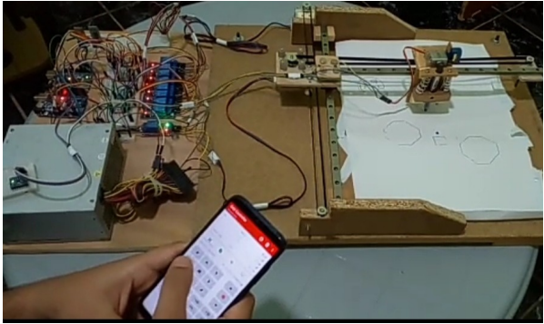
INTRODUCTION
Our project is a CNC 2D drawing machine, that allows the user to draw in a different ways, as it contains an automatic drawing mode, in addition to drawing manually by controlling via the phone remotely or by drawing using a gyroscope sensor by tracking the movement of the hand.
Features:
  Automatic Mode
  Manual Mode:
    Bluetooth
    Gyroscope sensor

Slide 4
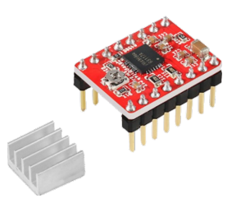
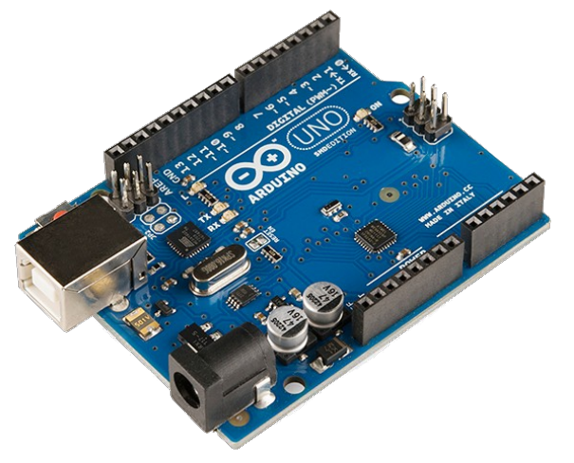
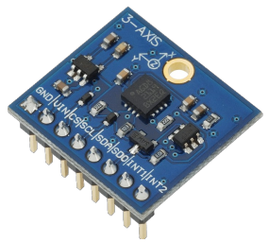
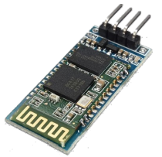
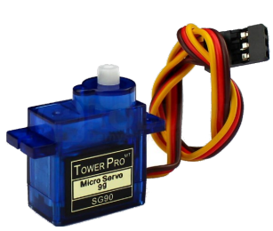
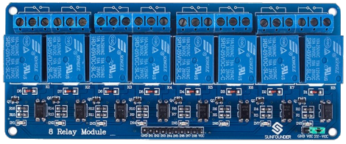
COMPONENTS

Slide 5
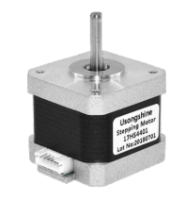
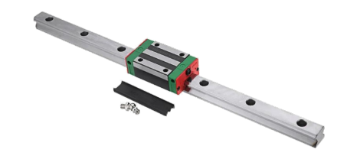
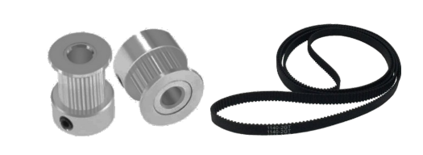
COMPONENTS

Slide 6
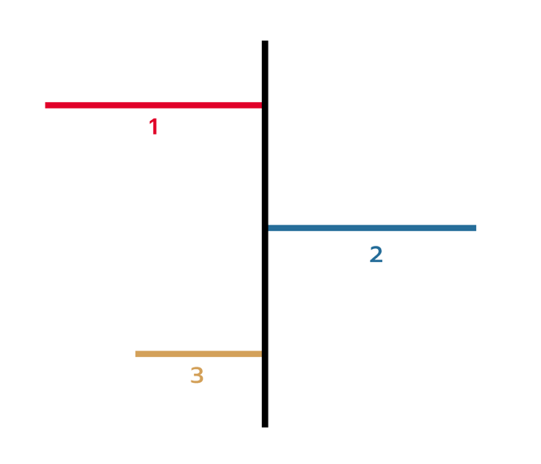

CONSTRAINTS
Appropriate equipment
and components
Build structure
Switch between
two Modes

Slide 7
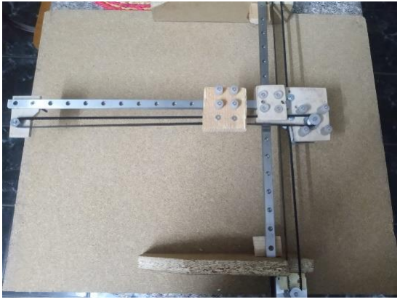
WORKING PRINCIPLE
  We planned the project on paper using engineering tools, and determined the dimensions required for the project
  We searched for the appropriate pieces for the project based on the plan that was drawn, and we prepared them, and then we built the external structure of the project from wood, and then installed the mechanical parts on it based on the plan

Slide 8
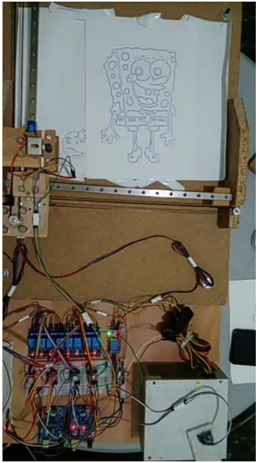
CONT.
After completing the construction of the external structure, we installed the electronic parts necessary to program the project and operate it after identifying and providing the electronic parts based on the characteristics of the project to be done.
While working on programming electronic parts, we encountered the problem of switching between the automatic mode and the manual mode. We came up with several solutions. We recommended them to find the best solution, which is
  Using Enables drivers
  Using 8 channel relay modules
The best solution was to use 8 channel relay modules.

Slide 9
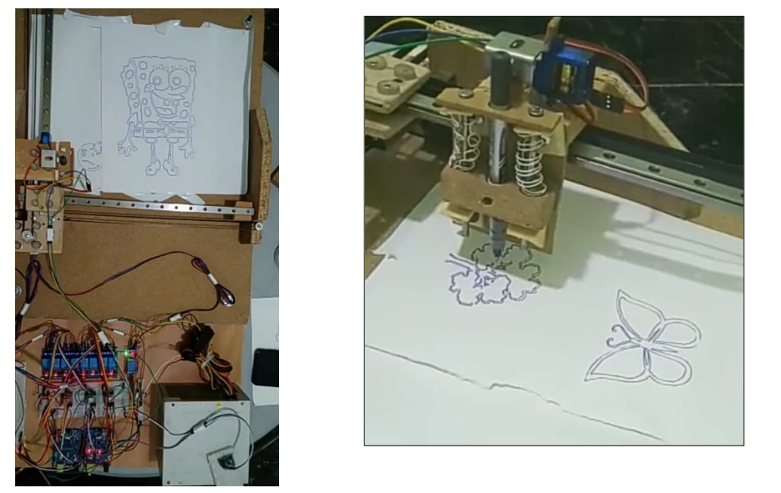
RESULTS
  Automatic Mode

Slide 10
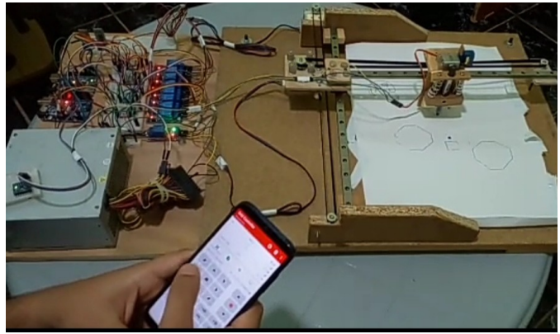
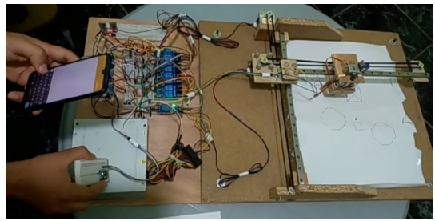
CONT.
  Manual Mode
    Bluetooth Gyroscope Sensor

Slide 11
SUMMARY
In summary, this project has provided a valuable solution for users seeking an automated drawing system that offers flexibility in both automatic and manual modes. The findings and conclusions drawn from this work open up new possibilities for future research and development in this field.

Slide 12

THANK YOU

