Slide 1
Automatic Car Parking System

Slide 2
Why Automatic Car Parking System?

Slide 3

Traditional Parking

Slide 4
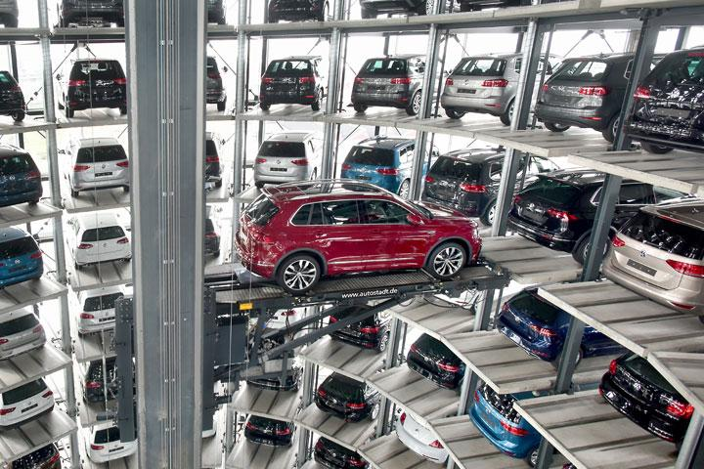
Automatic Car Parking

Slide 5
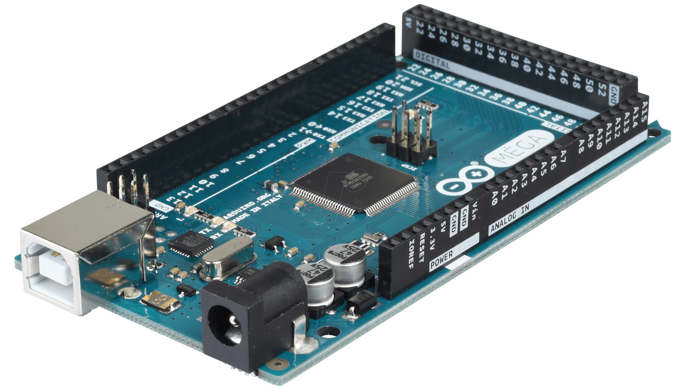
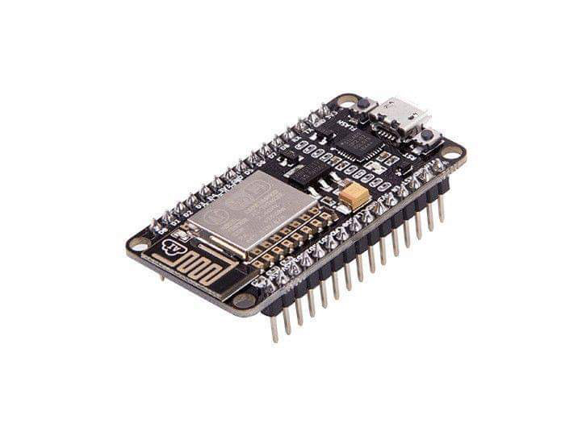
Main Components
Arduino Mega
NodeMCU

Slide 6
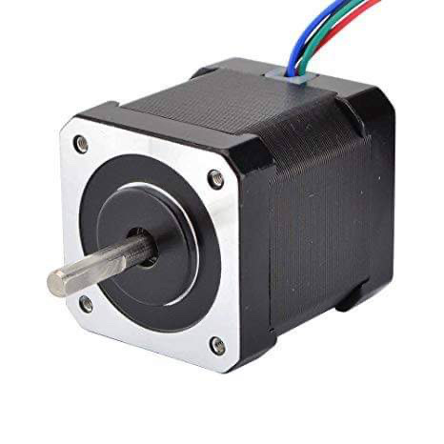
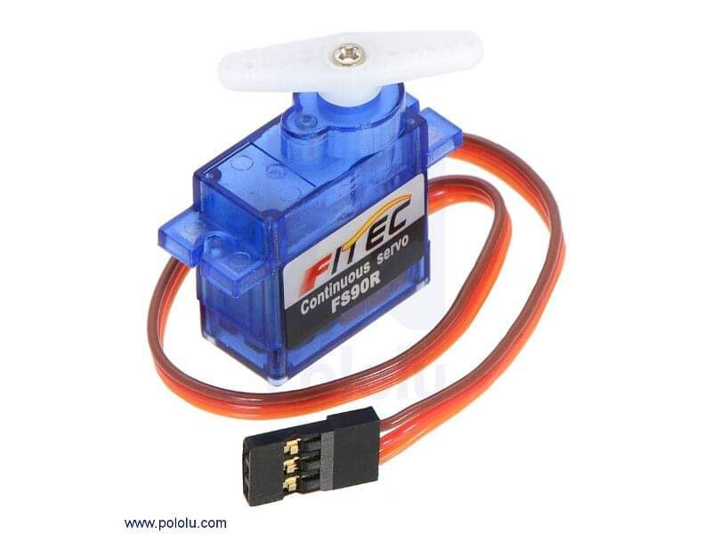
Main Components
Stepper Motor
Servo Motor

Slide 7
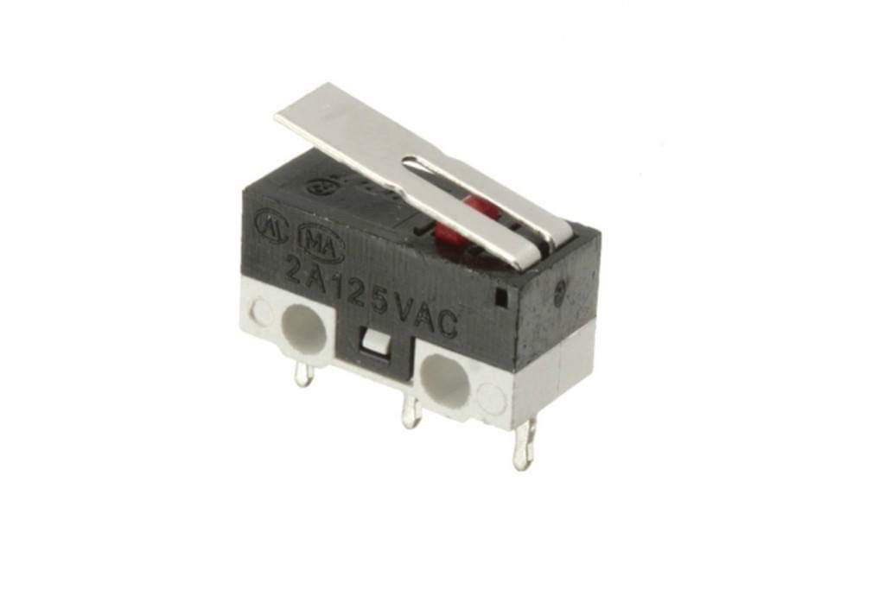
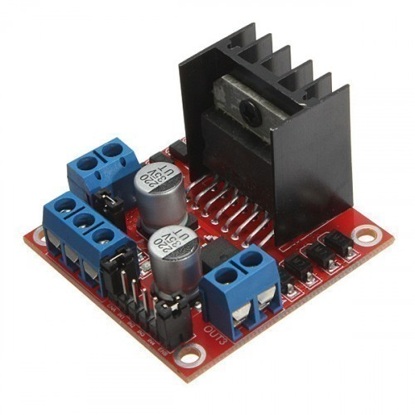
Main Components
Limit Switch
Stepper Motor Driver

Slide 8

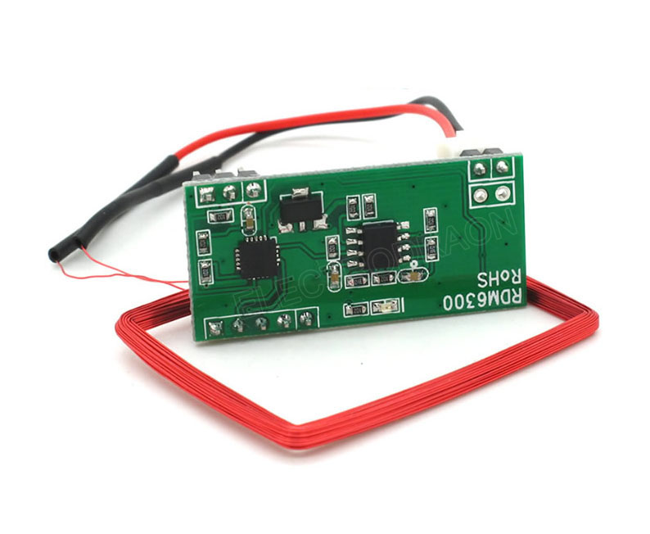
Main Components
RFID Reader
RFID Card

Slide 9




Softwares used

Slide 10

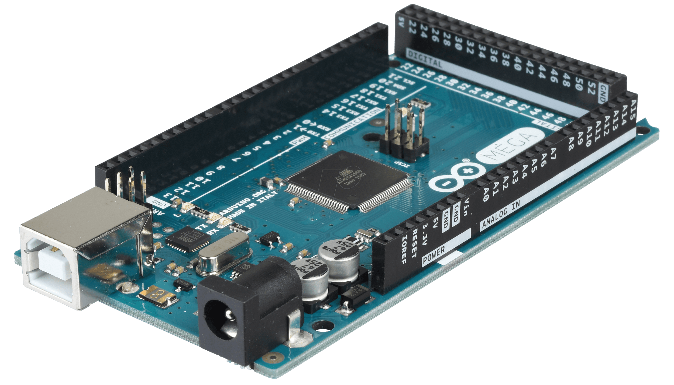
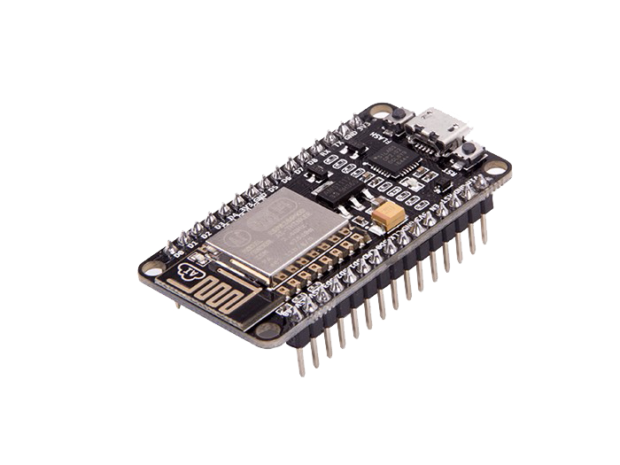
How does it Work?
Serial COM
Serial COM
POST Request
Arduino Mega
NodeMCU
XAMPP
RFID Reader
SQL Statements

Slide 11
Future Work
Change the stepper motor driver to an a micro stepper driver
Put feedback sensors on each slot
Connect our system to a mobile app, to easily recharge balance, and to know the parking availability
Increase the parking capacity

