Slide 1
DEVELOPMENT OF A SOLAR AID BOX FOR UNDERSERVED COMMUNITES IN THE RURAL AREA In the west bank of PALESTINE
Prepared by:
Ammar Sha’ar
Farah Mahmoud
Hiba Dweikat
Supervisor:
Dr. Tamer Khatib
Dr. Mohammed Othman

Slide 2
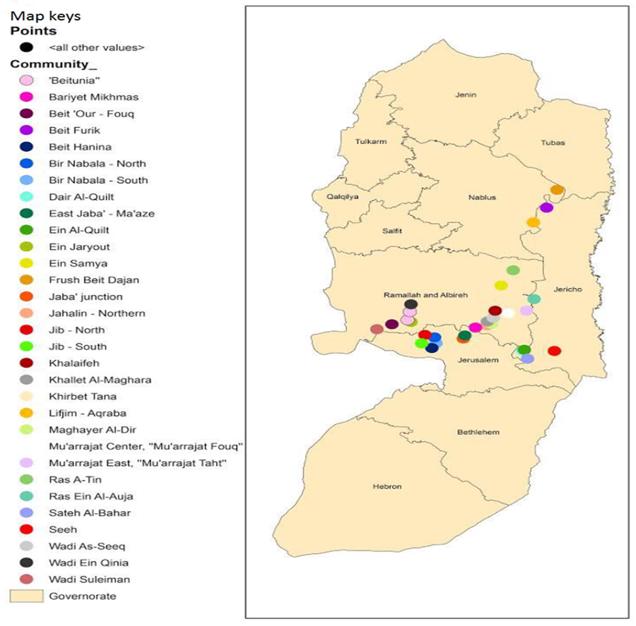
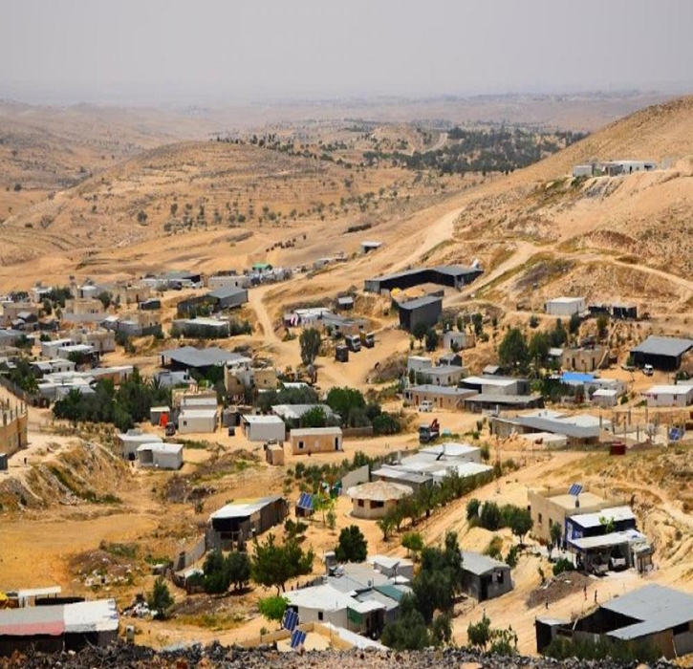
Problem Statement
About 1.1 billion people around the world have no access to electricity.
In Palestine there are about 600 families live in vulnerable herding remote areas that are not connected to the grid.
Lack of electricity services implies laborious work in many domestic tasks to secure basic needs.
The existing solutions and alternatives

Slide 3
Small, lightweight, decentralized and autonomous generation.
SolenX
Combination of appliances; LED lamps, Mini Insulin Refrigerator, Mosquito Shocker, Battery Charger and USB ports.

Slide 4
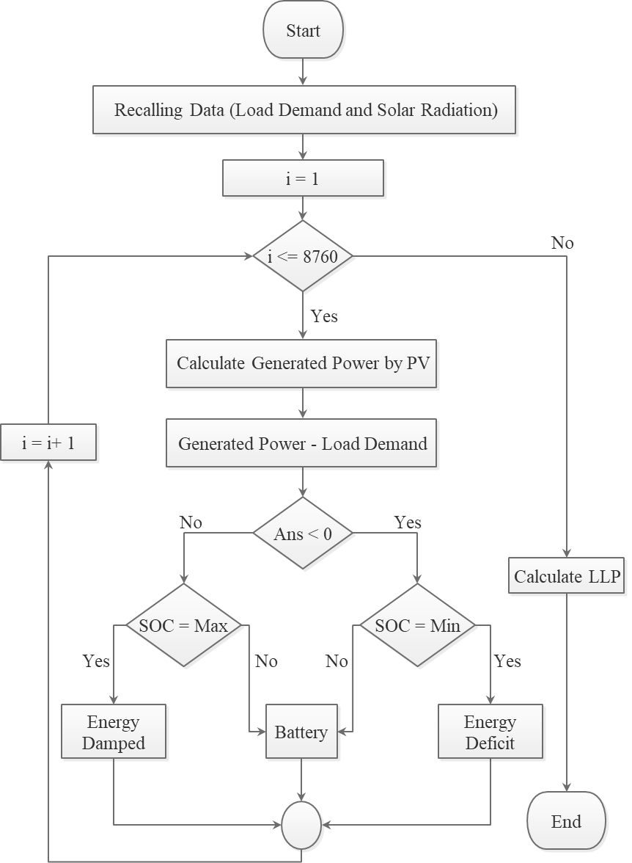
System’s consumption and sizing
Loads | Total Daily Usage (h) | Power (W) | Energy (Wh)
LED lamps (2) | 6 | 14 | 84
Mosquito shocker | 8 | 5 | 40
Mini Refrigerator | 10 | 5 | 50
Ref. Battery | 9 | 3 | 27
Battery Charger | 1 (monthly) | 5 | 5
USB Ports (2) | 3 | 10 | 30
Total |  |  | 236

Slide 5
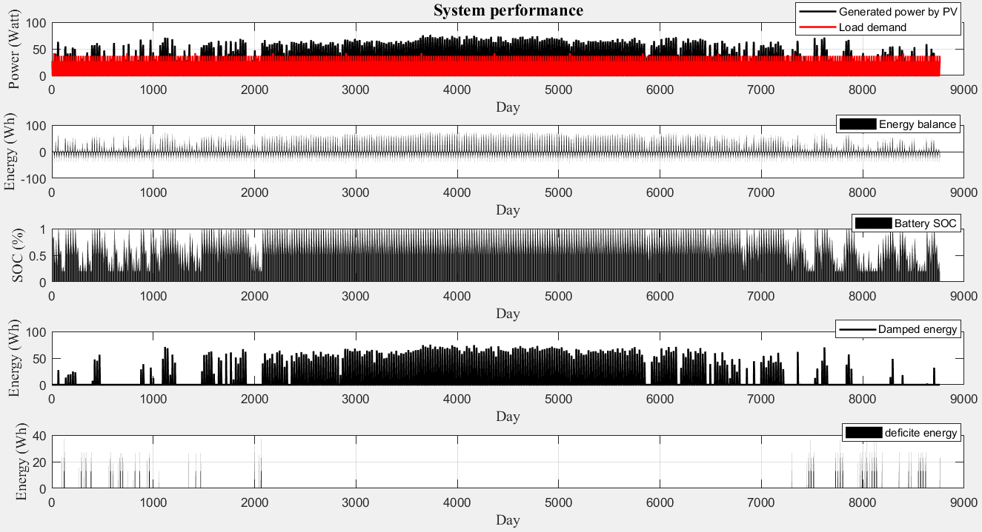
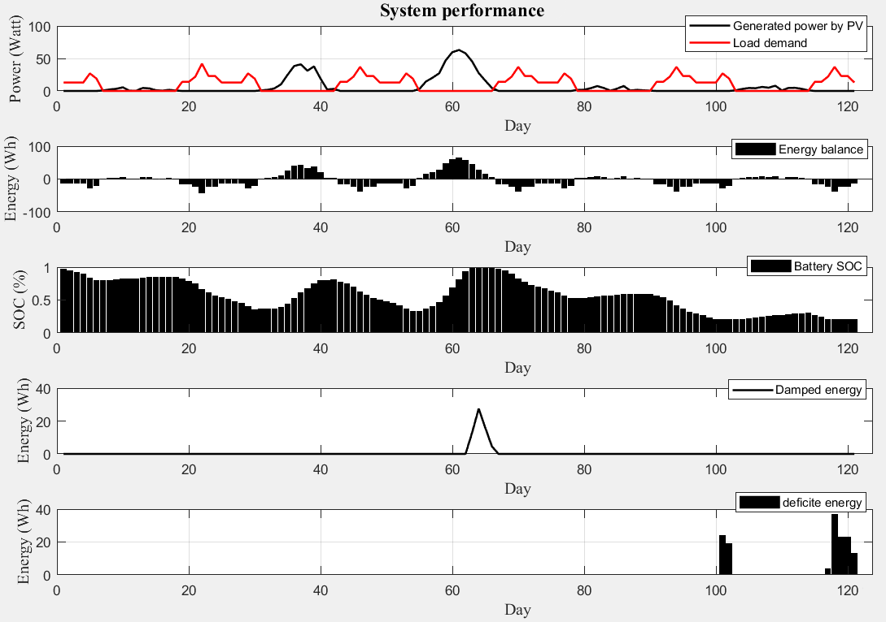
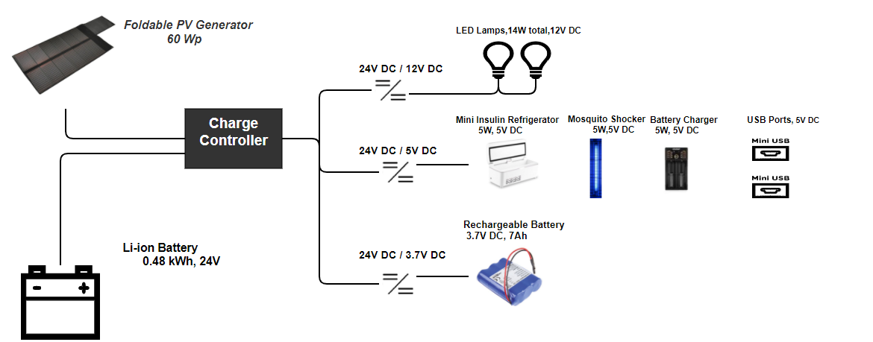
Simulation Results

Slide 6
Throwback of previous work
Concept Screening
 |  | Solar Panel Concept Selection Matrix
 |  | Concepts
Criteria |  | Panel connected Externelly (datum) | Foldable bag attached to shape | Built-in drawer shape | On top Built-in Panel
Ease of use |  | 0 | + | - | +
Durability |  | 0 | + | + | 0
Portability |  | 0 | + | + | +
System Size |  | 0 | + | + | -
Cost |  | 0 | - | - | 0
Elegance |  | 0 | + | 0 | +
Flexible Position |  | 0 | 0 | - | 0
Sum of 0's |  | / | 1 | 1 | 3
Sum of -'s |  | / | 1 | 3 | 1
Sum of +'s |  | / | 5 | 3 | 3
Net Score |  | / | 4 | 0 | 2
Decision |  | / | Yes | No | Revise
 |  | Shape Design Concept Selection Matrix
 |  | Concepts
Criteria |  | Flat | Vehicle | Cylindrical | Box | Triangular | Curved
Ease of use |  | 0 | 0 | - | - | + | +
Portability |  | - | - | - | 0 | + | +
Size |  | - | 0 | - | 0 | 0 | 0
Weight |  | - | 0 | 0 | + | 0 | 0
Cost |  | + | - | + | - | 0 | -
Elegance |  | 0 | 0 | - | 0 | 0 | +
Functionality |  | + | + | + | + | + | +
Sum of 0's |  | 2 | 4 | 1 | 3 | 4 | 2
Sum of -'s |  | 3 | 2 | 4 | 2 | 0 | 1
Sum of +'s |  | 2 | 1 | 2 | 2 | 3 | 4
Net Score |  | -1 | -1 | -1 | 0 | 3 | 3
Decision |  | No | No | No | Revise | Yes | Yes

Slide 7
Throwback of previous work
Concept Scoring
Concept #1 |  | sketch 1 |  | sketch 2
Selection criteria | Weight | Rating | Weighted score | Rating | Weighted score
Aesthetically pleasing | 7% | 3 | 0.21 | 3 | 0.21
Reasonably sized | 7% | 3 | 0.21 | 3 | 0.21
Cost efficient | 25% | 3 | 0.75 | 3 | 0.75
Durable | 8% | 3 | 0.24 | 3 | 0.24
Light weight | 3% | 3 | 0.09 | 4 | 0.12
Easy to use | 15% | 3 | 0.15 | 3 | 0.15
Ease of manufacture | 20% | 2 | 0.06 | 2 | 0.06
 |  | Total score | 2.89 | Total score | 3.23
 |  | Rank | 2 | Rank | 1

Slide 8
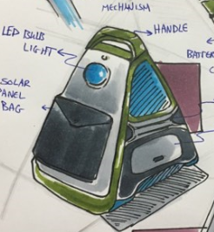
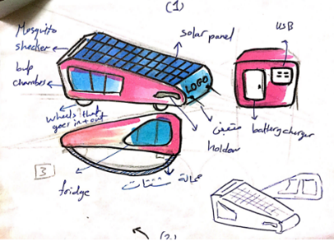
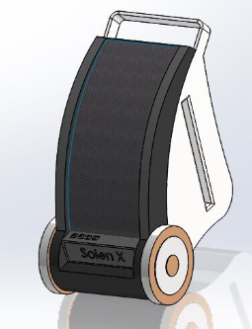
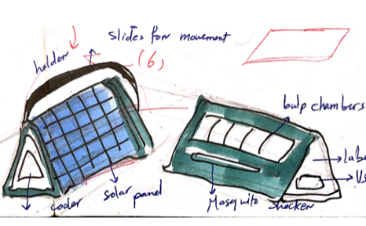
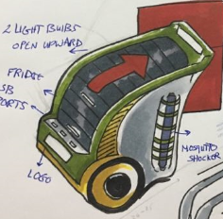
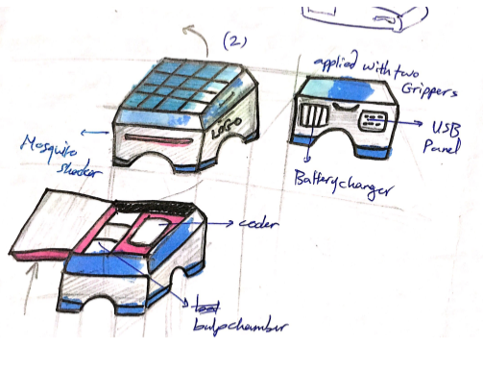
Product Design and Development
CAD design Solidworks

Slide 9
Quality Function Deployment

Slide 10
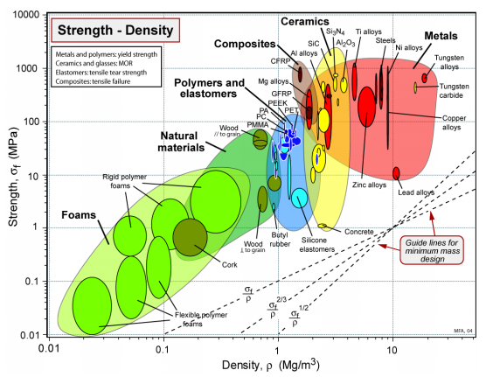
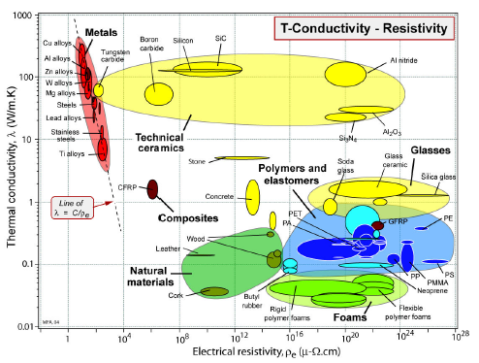
Material Selection
Class1 | Property | Symbol and units
General | Price | Cm | ($/kg)
 | Density |  | (kg/m³ or Mg/m³)
Thermal | Melting Temp | Tm | (C or K)
 | Thermal conductivity |  | (W/m.K)
Electrical | Electrical resistivity | e | (Ω.m or µΩ.cm)
Environmental | Oxidation rates | Very low, low, average,
resistance | Corrosion rates | high, very high
 | Wear rate constant | KA | Mpa-1
Mechanical | Yield strength | y | (MPa)

Slide 11
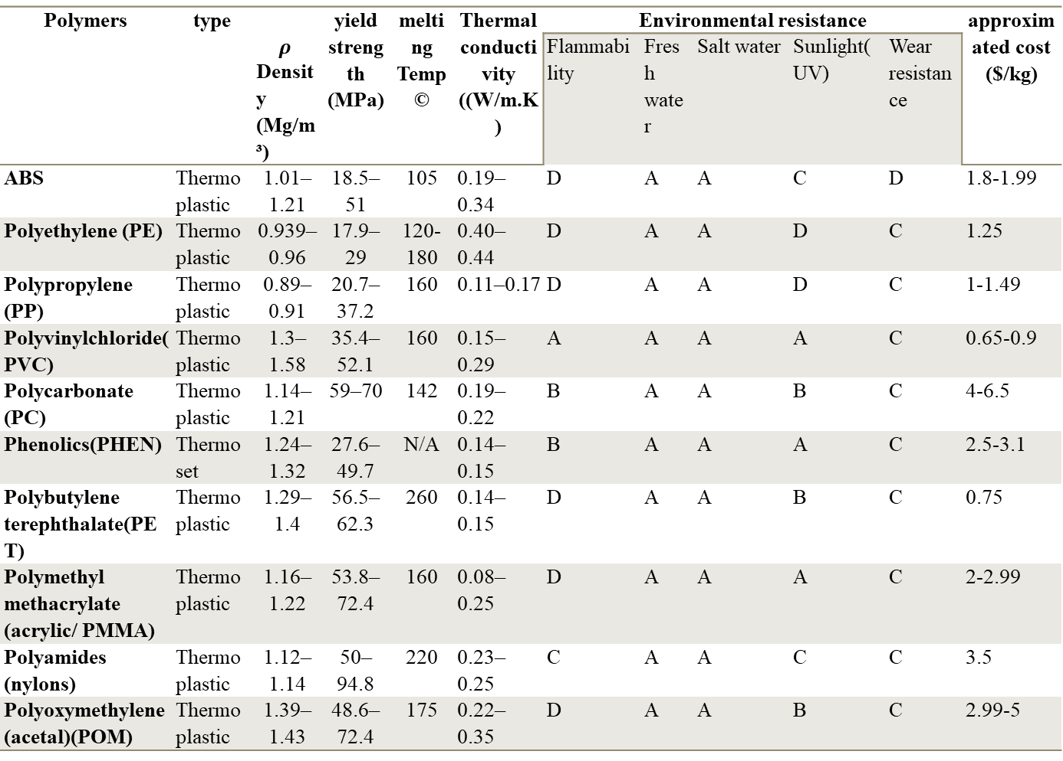
Polymers | type | $$ρ$$ Density (Mg/m³) | yield strength (MPa) | melting Temp © | Thermal conductivity ((W/m.K) | Environmental resistance |  |  |  |  | approximated cost ($/kg)
 |  |  |  |  |  | Flammability | Fresh water | Salt water | Sunlight(UV) | Wear resistance
ABS | Thermoplastic | 1.01–1.21 | 18.5–51 | 105 | 0.19–0.34 | D | A | A | C | D | 1.8-1.99
Polyethylene (PE) | Thermoplastic | 0.939–0.96 | 17.9–29 | 120-180 | 0.40–0.44 | D | A | A | D | C | 1.25
Polypropylene (PP) | Thermoplastic | 0.89–0.91 | 20.7–37.2 | 160 | 0.11–0.17 | D | A | A | D | C | 1-1.49
Polyvinylchloride(PVC) | Thermoplastic | 1.3–1.58 | 35.4–52.1 | 160 | 0.15–0.29 | A | A | A | A | C | 0.65-0.9
Polycarbonate (PC) | Thermoplastic | 1.14–1.21 | 59–70 | 142 | 0.19–0.22 | B | A | A | B | C | 4-6.5
Phenolics(PHEN) | Thermoset | 1.24–1.32 | 27.6–49.7 | N/A | 0.14–0.15 | B | A | A | A | C | 2.5-3.1
Polybutylene terephthalate(PET) | Thermoplastic | 1.29–1.4 | 56.5–62.3 | 260 | 0.14–0.15 | D | A | A | B | C | 0.75
Polymethyl methacrylate (acrylic/ PMMA) | Thermoplastic | 1.16–1.22 | 53.8–72.4 | 160 | 0.08–0.25 | D | A | A | A | C | 2-2.99
Polyamides (nylons) | Thermoplastic | 1.12–1.14 | 50–94.8 | 220 | 0.23–0.25 | C | A | A | C | C | 3.5
Polyoxymethylene (acetal)(POM) | Thermoplastic | 1.39–1.43 | 48.6–72.4 | 175 | 0.22–0.35 | D | A | A | B | C | 2.99-5

Slide 12
Business Model
Key Partners - Investors - OEM - NGOs - Governmental bodies (e.g Ministry of Energy) - Shipping Companies | Key Activities - R&D - Supply Chain Streamlining - Marketing - Selling | Value Propositions - Affordable price - Ease of use - Portability - Light weight - High safety measures - Environment friendly |  | Customer Relationships - Promotion Material - Customer support; Maintenance, sales - Awareness workshops -Website | Customer Segment - Off-grid Palestinian families - Palestinian and close by vulnerable communities in the Middle East with limited access to electricity
 | Key Resources - Patent - Supply Chain - R&D Personnel - Logistics |  |  | Channels - NGOs - Salesmen - Local community events - Website
Cost Structure - R&D - Capital Investment - Manufacturing cost - Operating cost - International and local logistics |  |  | Revenue Streams - Product Sales - Local and international NGO - Government - Endowments, donations and grants

Slide 13
Financial Model
 | Material Type | Required Parts/unit | Number of Parts | Cost
Outer Body Sides | ABS | 2 | 4000 | $19.98
Outer body back + bottom | ABS | 1 | 2000 | $30.90
Cylindrical front | Nylon 6 | 1 | 2000 | $20.27
Transparent cover | Nylon 6 | 1 | 2000 | $31.43
Protective side | Polycarbonate | 2 | 4000 | $12.73
 |  |  | total cost= | $115.31
Per unit | overall cost/unit
Estimated standard part cost | $ 115.31
Estimated custom part cost | $ 236.62
Assembly cost | $ 10.00
Overhead charging | $ 14.50
International bulk shipping | $ 40.00
Overall cost | $ 416.43
(10% ) profit margin | $ 458.07
Estimated Standard Parts | Required Parts/unit | Number of parts | Cost/part
LED lamp | 2 | 4000 | $6.88
Insulin refrigerator | 1 | 2000 | $80.00
Mosquito shocker | 1 | 2000 | $17.00
Battery charger | 1 | 2000 | $13.91
Main battery | 1 | 2000 | $50.00
Solar Panel | 1 | 2000 | $48.00
USB ports | 2 | 4000 | $10.00
grip handle | 1 | 2000 | $5.45
Caster wheels | 2 | 4000 | $5.38
 |  | total cost/part = | $236.62

Slide 14
Dimensions
Object | dimensions(cm)
battery | 15.5x14.5x7 cm
fridge | 18x8x7 cm
battery charger | 11.2 x 6 x 3 cm
mosquito shocker | 28 cm length x 2 cm diameter
solar panel (70 Watt) | folded :29 x 16 x 6.5 cm
 | unfloded:92 cm x 57 cm
LED lamp | 8.3 x15.74 x 4.5 cm
Led flexible arm dimension | D:1.77x 20 cm
approx exterior shell dimension | 26x 32 x 42 cm
2 wheels | 9.5 cm Diameter x 4.5 cm width
wall thickness of exterior form | approx 1.016 - 4 mm

Slide 15
Future and Present work
R&D
Prototyping
Fully detailed financial, marketing and production plan.
Preparing RFQ

