Slide 1
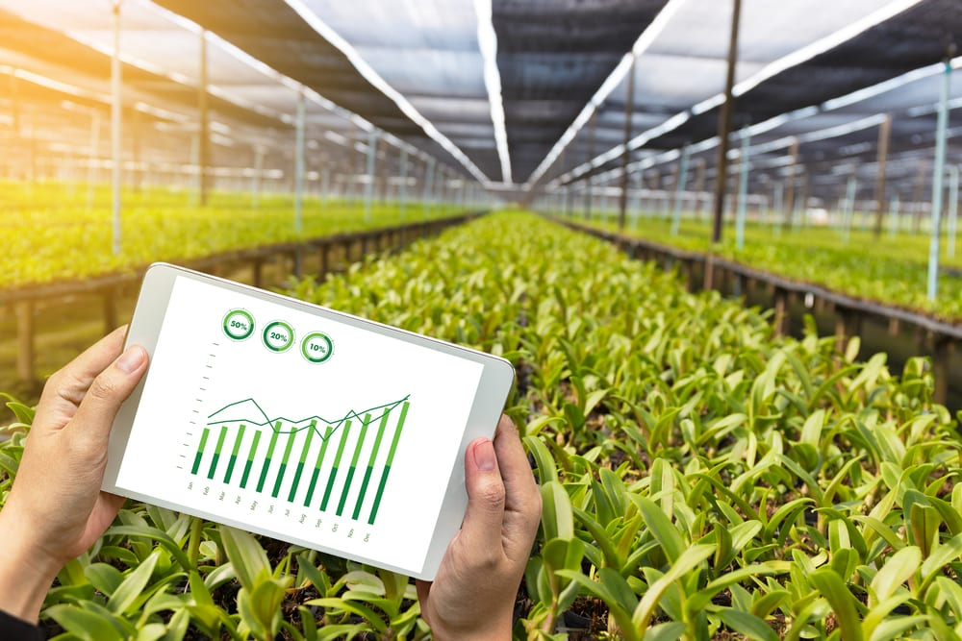
Smart Greenhouse Environmental and Monitoring Control using IoT
An-Najah National University
Telecommunications and Electrical Engineering Department
Submitted by: Supervisor:
Shahrazad Jamous Dr Saed Tarapiah
Duha abu ghalyoun

Slide 2
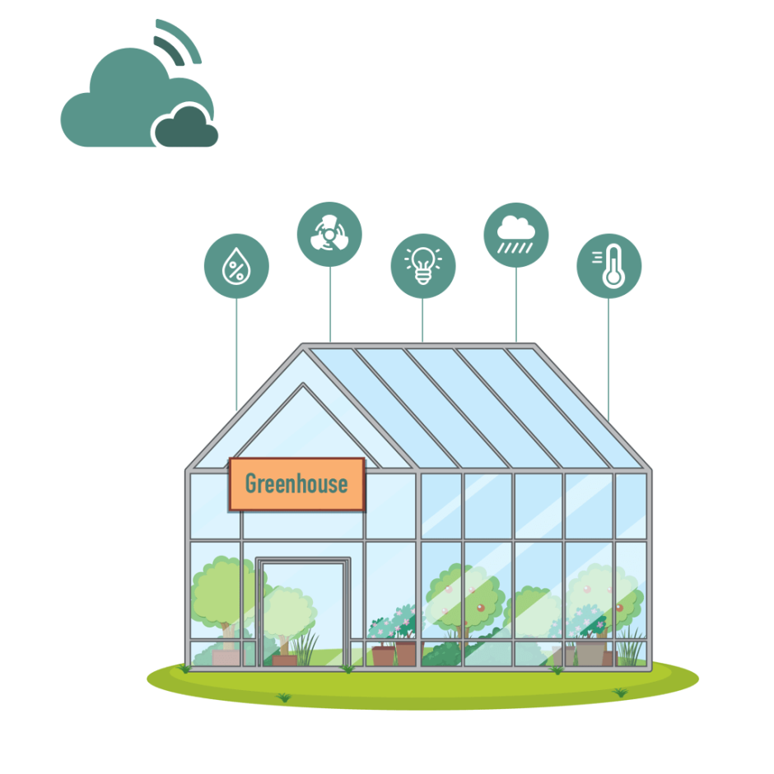
Content:
What is Smart Greenhouse Environmental and Monitoring Control using IoT?
Motivation for the idea
Working principle
Components
Results and Discussion
challenges
Future Improvements

Slide 3
What is Smart Greenhouse Environmental and Monitoring Control using IoT?
Today, the world is witnessing a current revolution in the field of technology, and with the increasing challenges facing the agricultural sector, this project comes as an innovative and smart solution to improve agricultural production and the effectiveness of the use of natural resources.
It deals with the integration of Internet of Things (IoT) technologies into the agricultural environment. Smart sensors, monitoring systems are used, and requirements are developed. This smart connection allows the application of environmental factors affecting plants, such as temperature and humidity, in addition to effective control of these conditions.

Slide 4
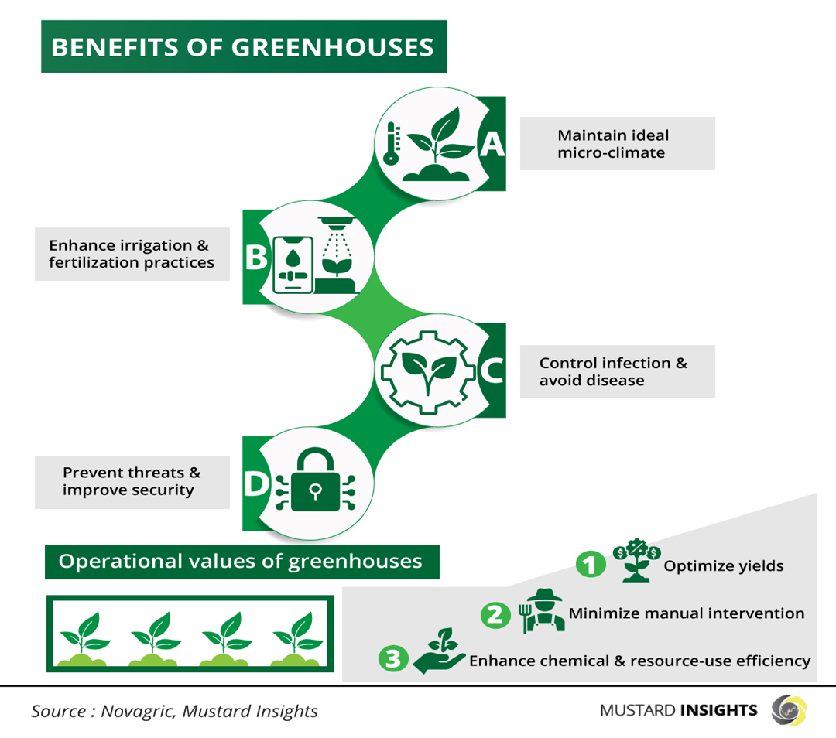
Motivation for the idea
Low Crop Yields or Poor Crop Quality
Water Scarcity or High Water Bills
Rising Energy Costs
Overwhelmed by Manual Labor
Environmental Impact of Current Practices

Slide 5
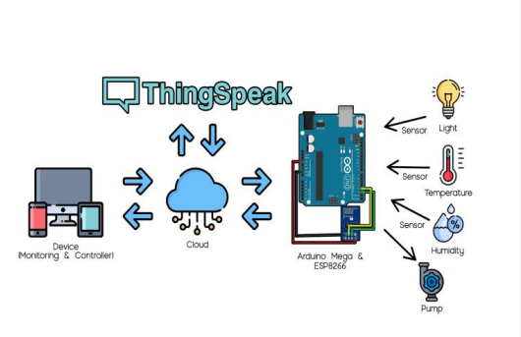
Working principle

Slide 6
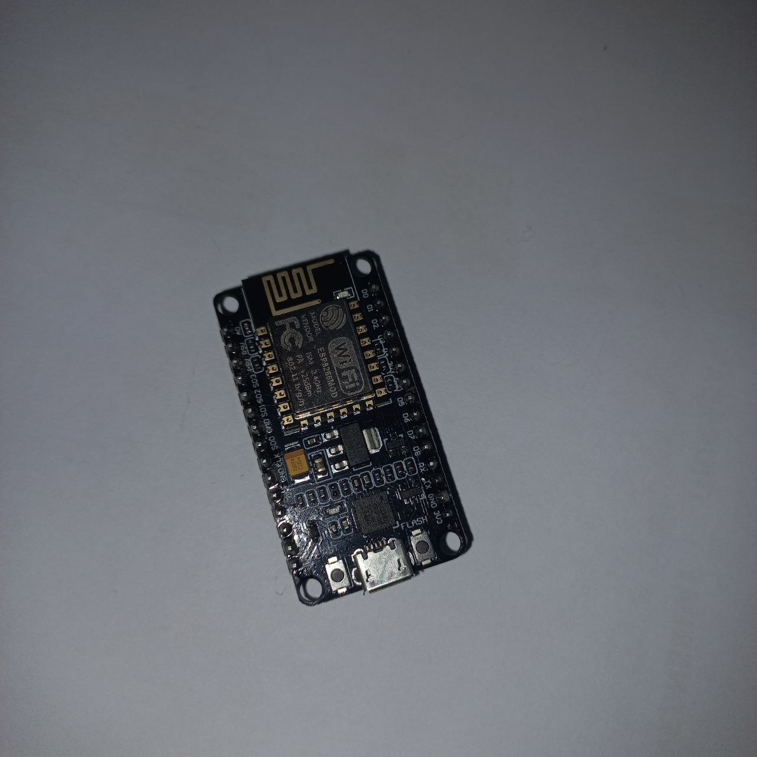

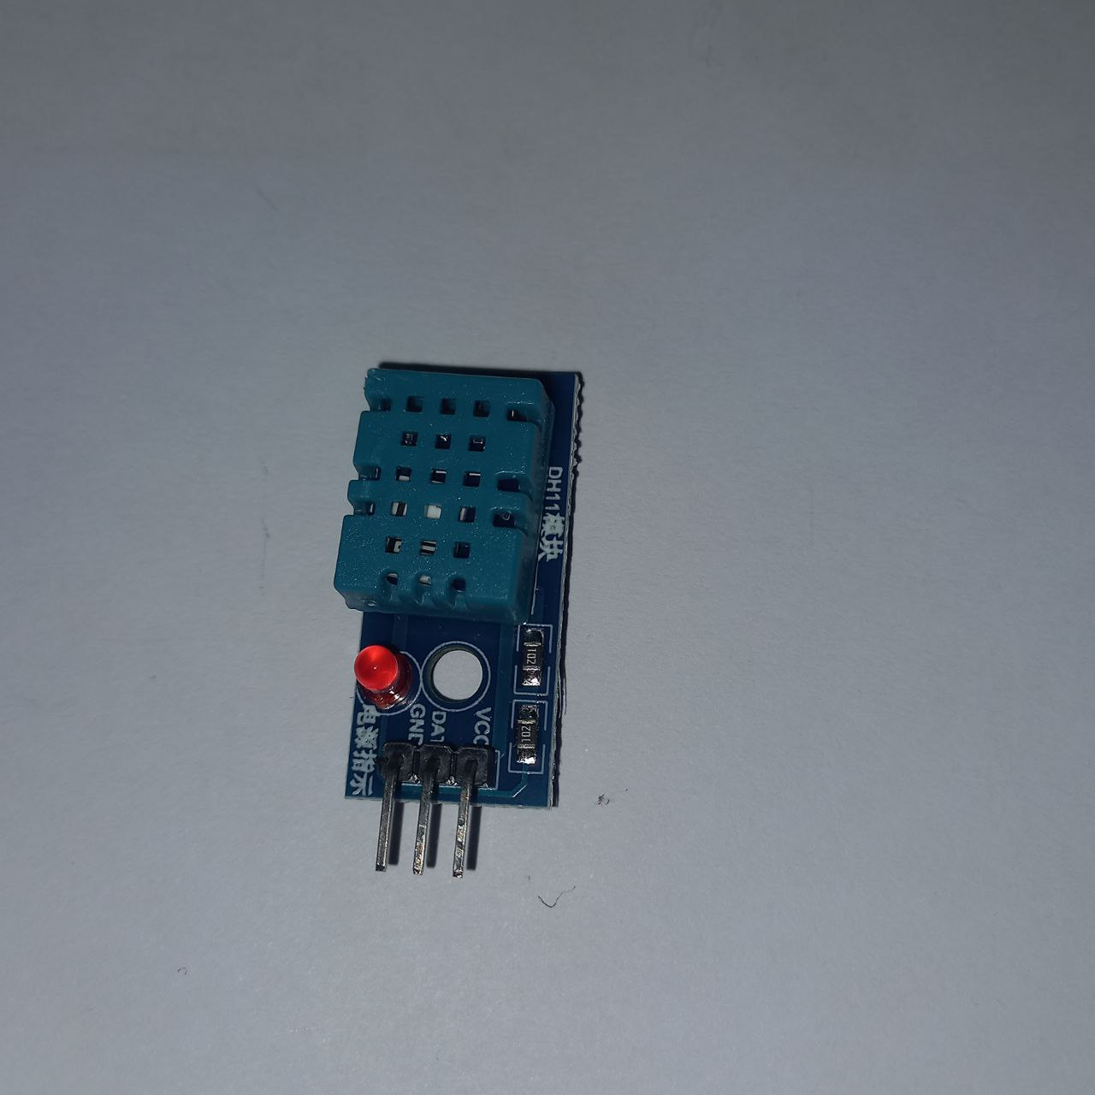
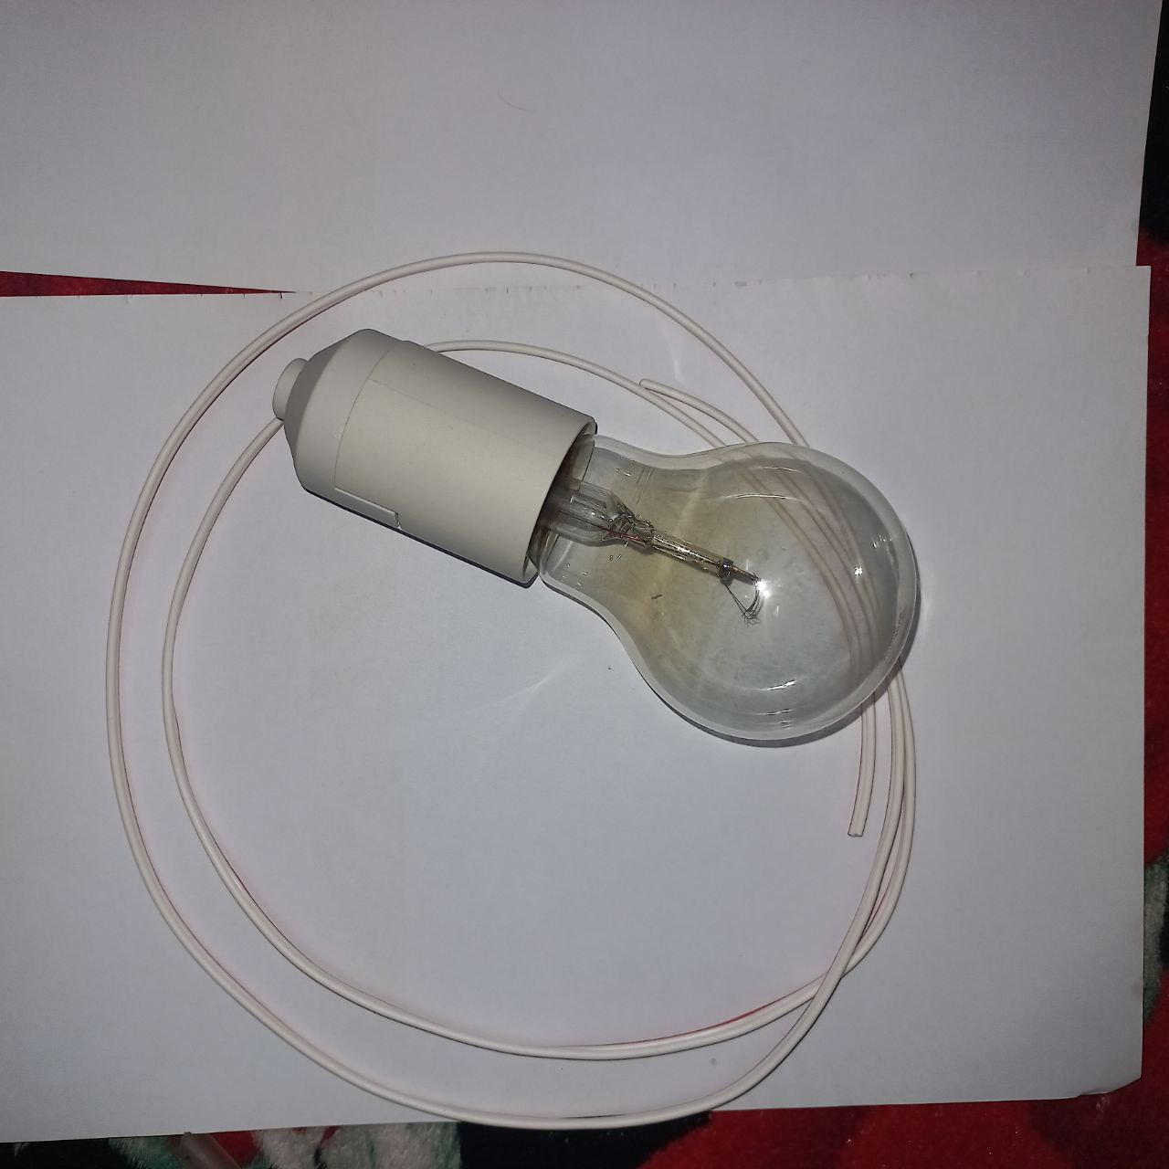
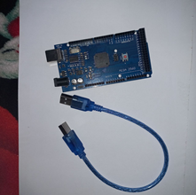
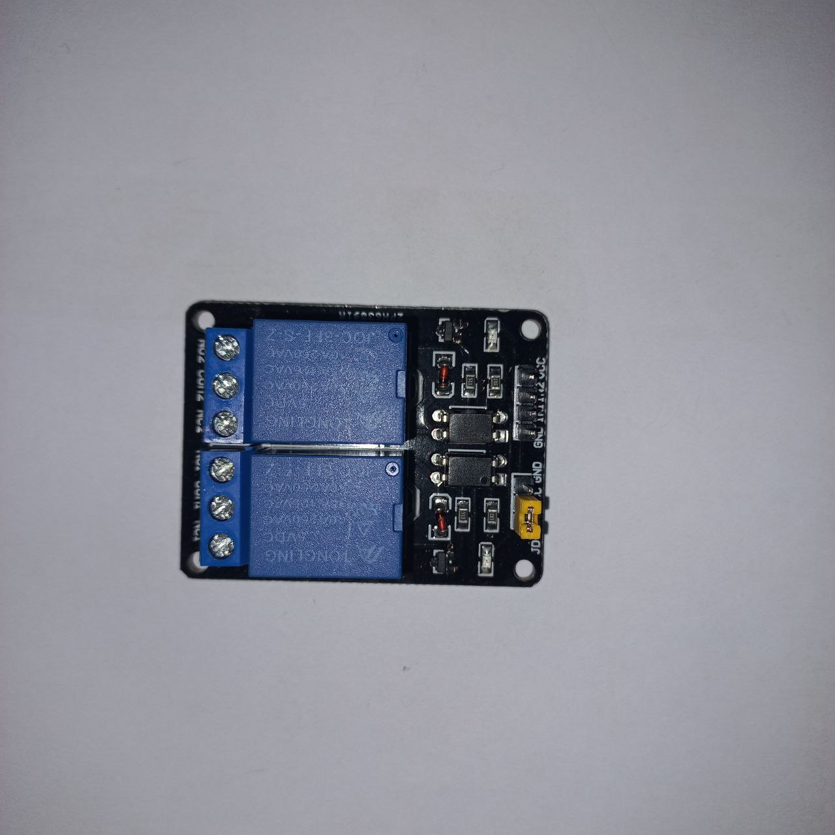
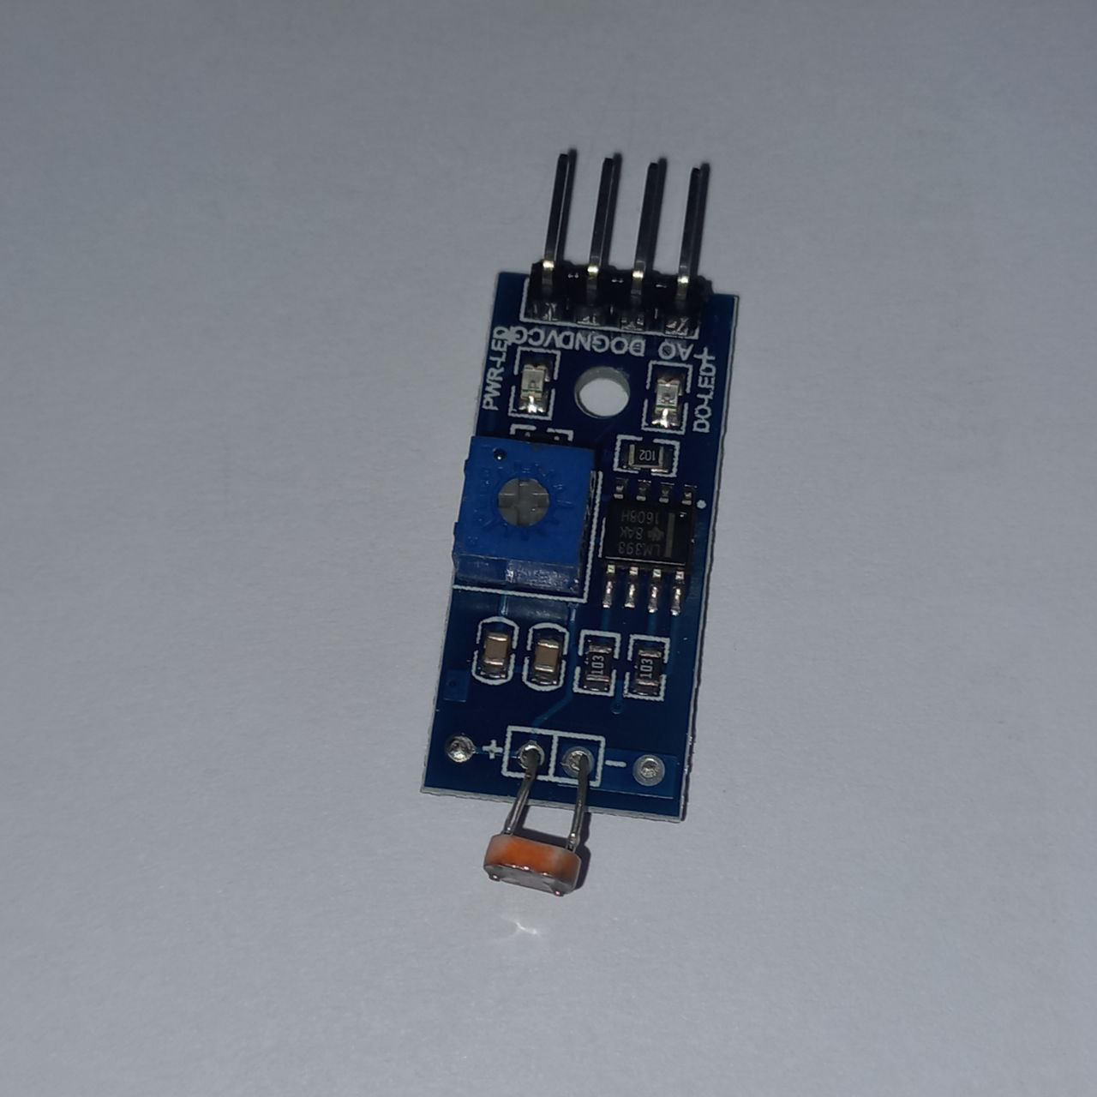
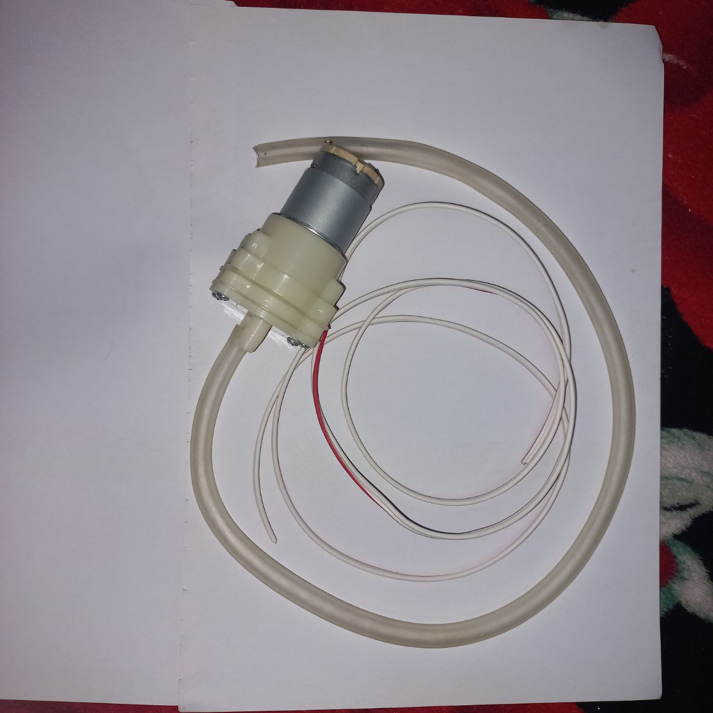
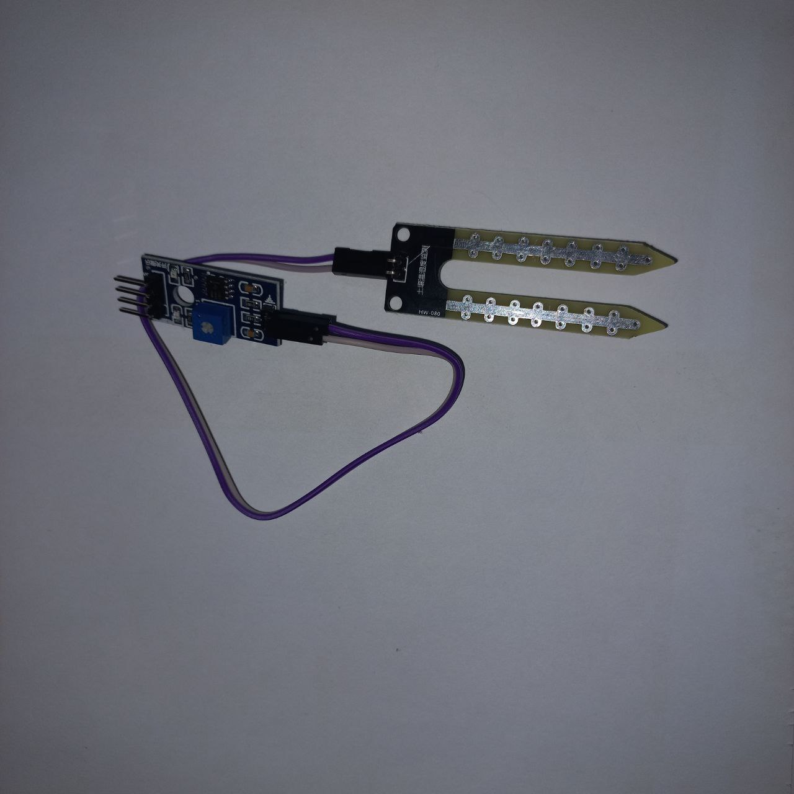
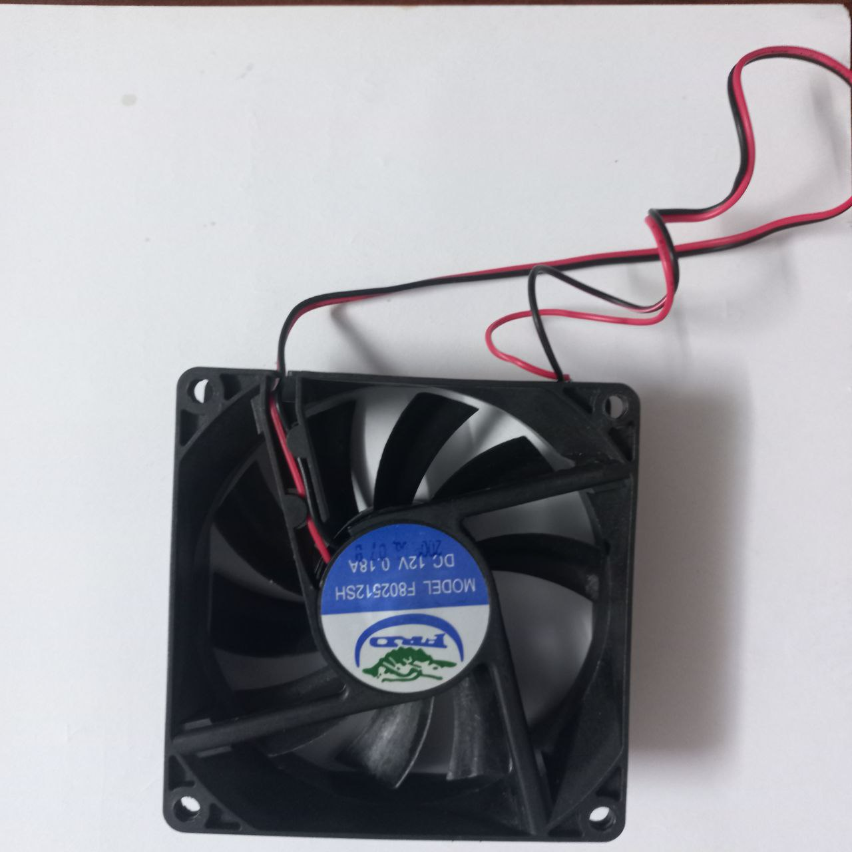
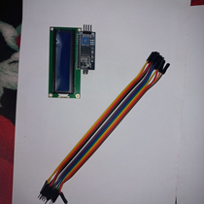
Componentes
Thingspeak
ESP8266 (Node MCU)
DHT11 sensor
Lamp
2 channel relay
Arduino mega 2560
Water pump
LDR sensor
Soil moisture sensor
DC Fan
LCD Display

Slide 7
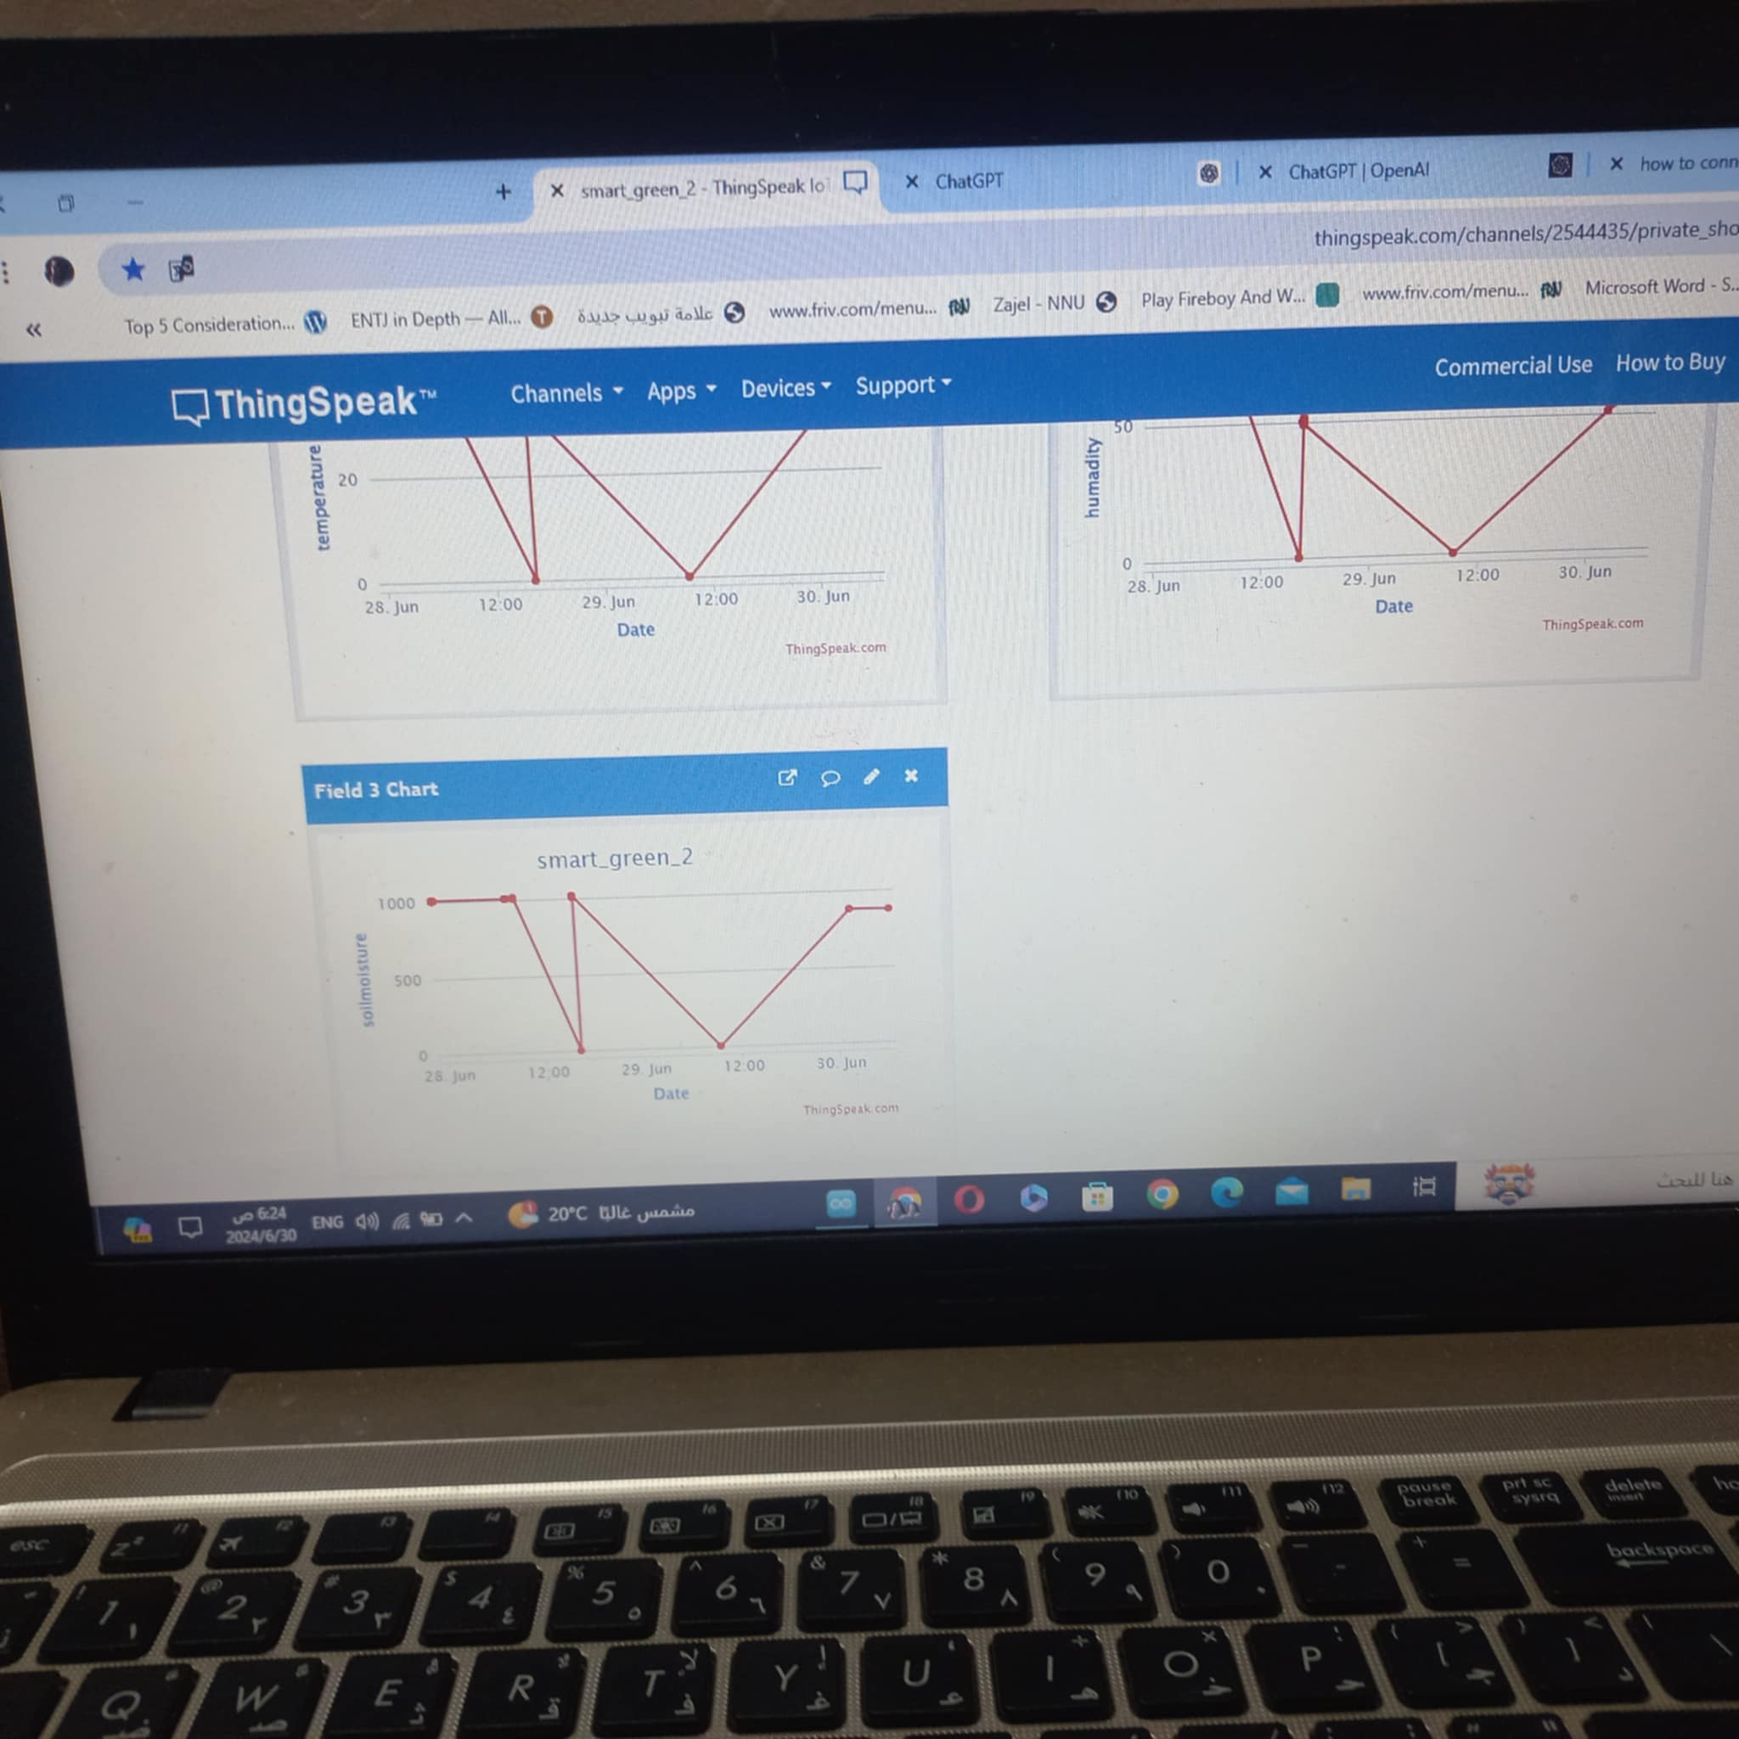
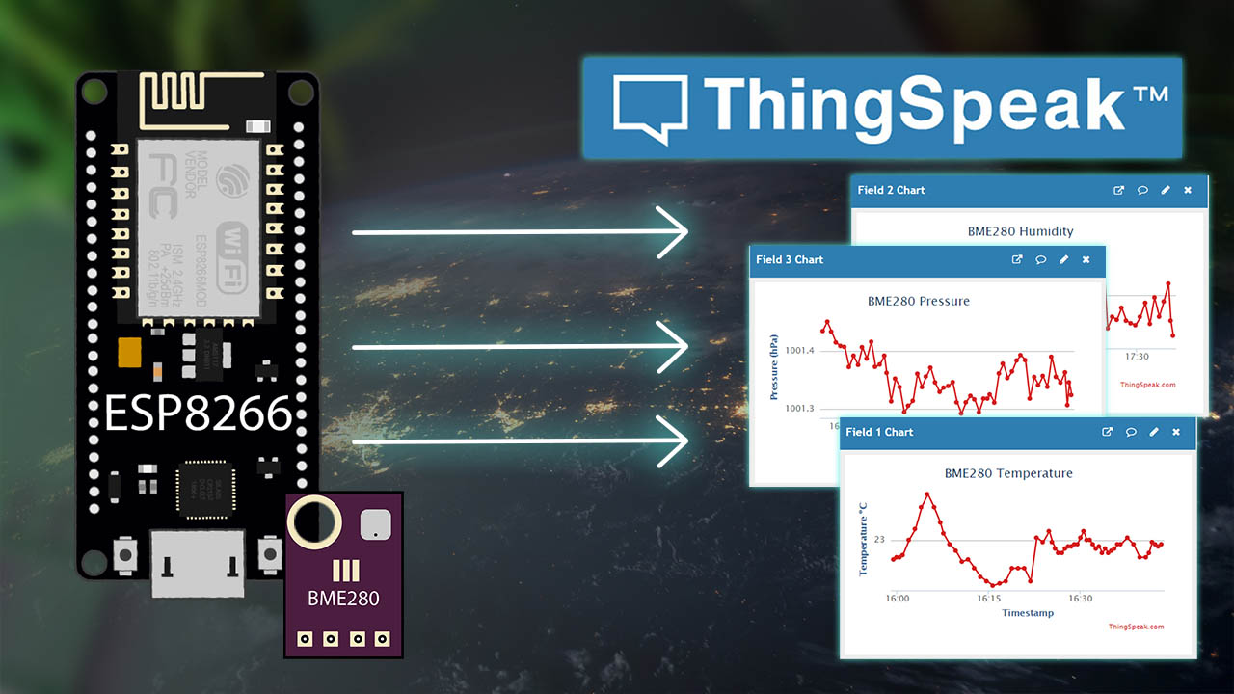
Thingspeak
ThingSpeak is an IoT analytics platform that allows users to collect, visualize and analyze live data streams in the cloud. It allows collecting and analyzing data from different IoT devices without the need to develop web software or set up servers. It can be used for a variety of applications, including environmental monitoring, health monitoring, industrial control, and home automation.

Slide 8
challenges
Operational Challenges: Develop a comprehensive operation and maintenance guide to facilitate operation and maintenance procedures.
Internet Connectivity: Use local data storage units or implement offline functionality in case of internet connection loss.
Environmental Challenges: Challenges may arise in dealing with external environmental changes such as adverse weather conditions or sudden temperature fluctuations) Integrate heating and cooling systems to regulate the temperature inside the greenhouse. These systems can be automated to activate based on preset thresholds, ensuring that the plants are kept within optimal temperature ranges(

Slide 9
Results and Discussion
In this project, we present the results obtained from the implementation of our Smart Greenhouse project. The project involved the integration of various components, including Arduino Mega, ESP8266 for Wi-Fi connectivity, Various sensors, water pump, fan, and lamp. The complete project is shown in the picture below.The data collected from the environmental sensors were analyzed using ThingSpeak platform, allowing real-time monitoring and logging. The system demonstrated efficient control over the greenhouse environment, ensuring optimal conditions for plant growth

Slide 10
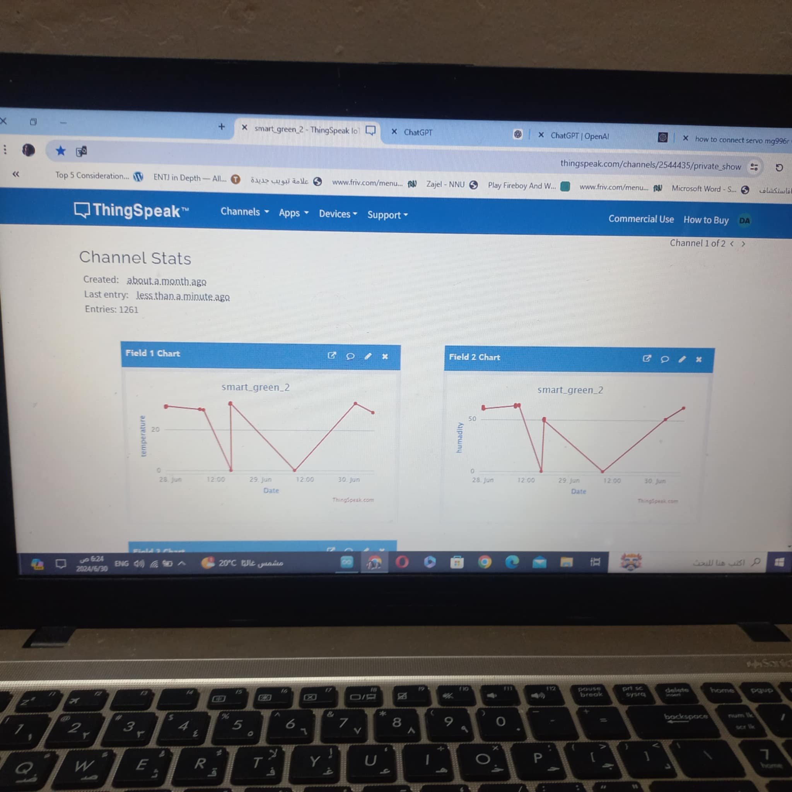
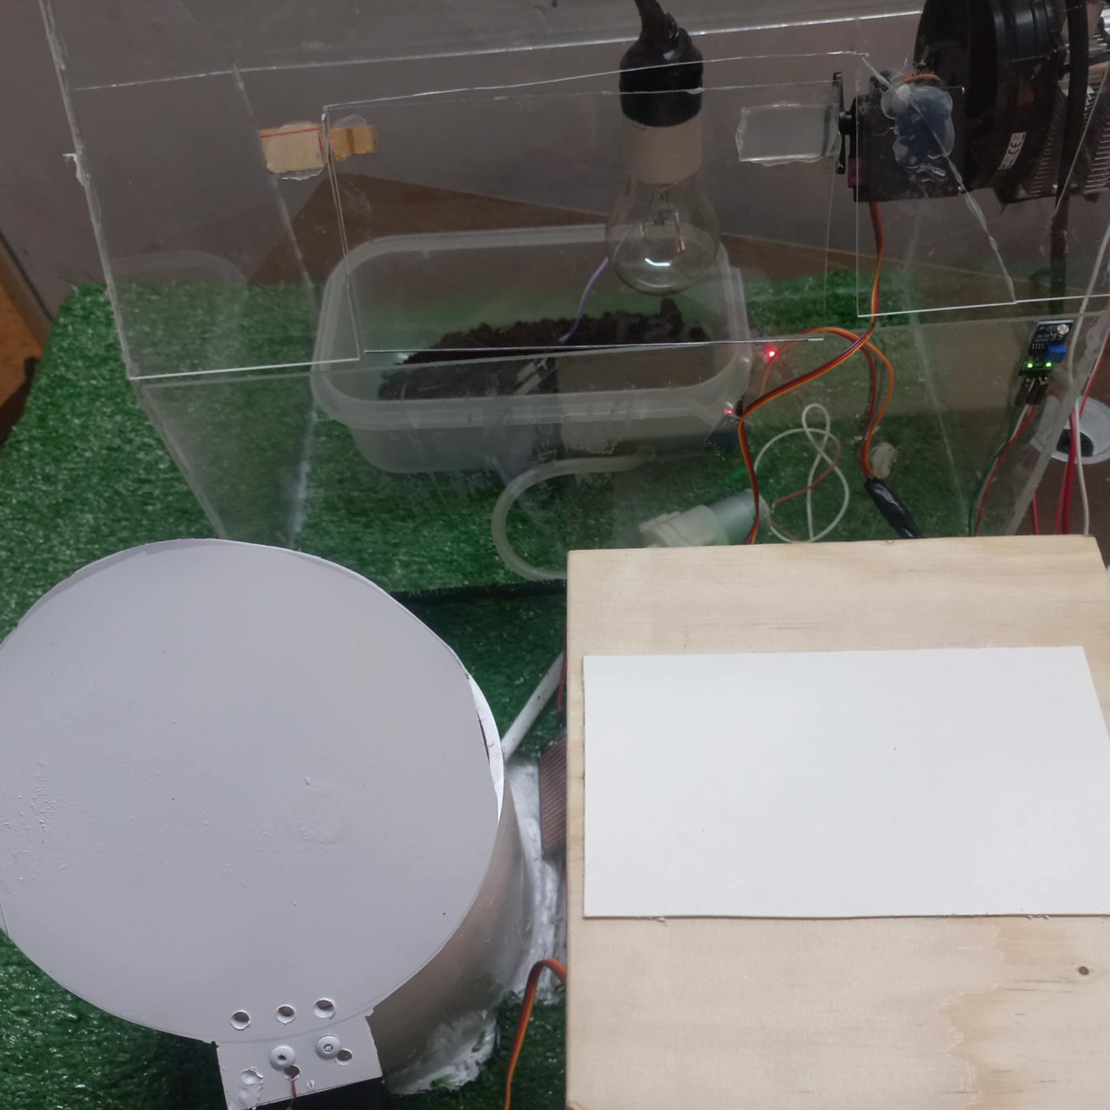
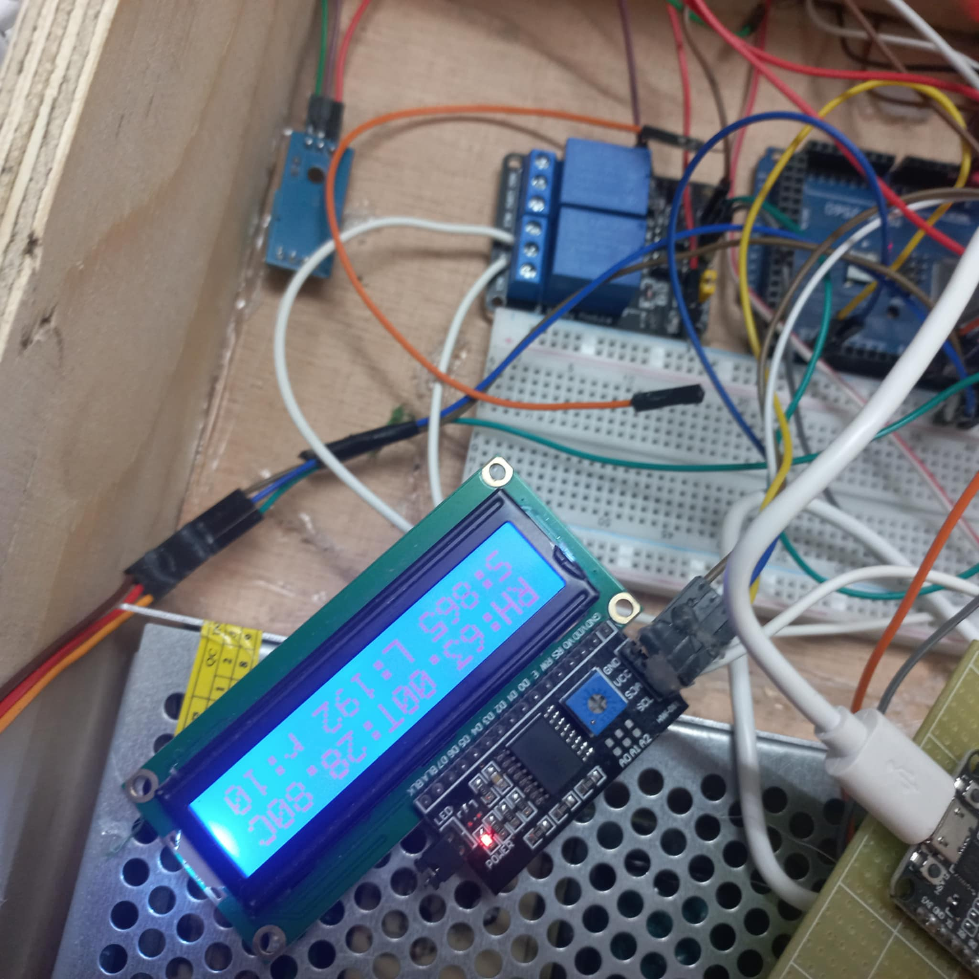
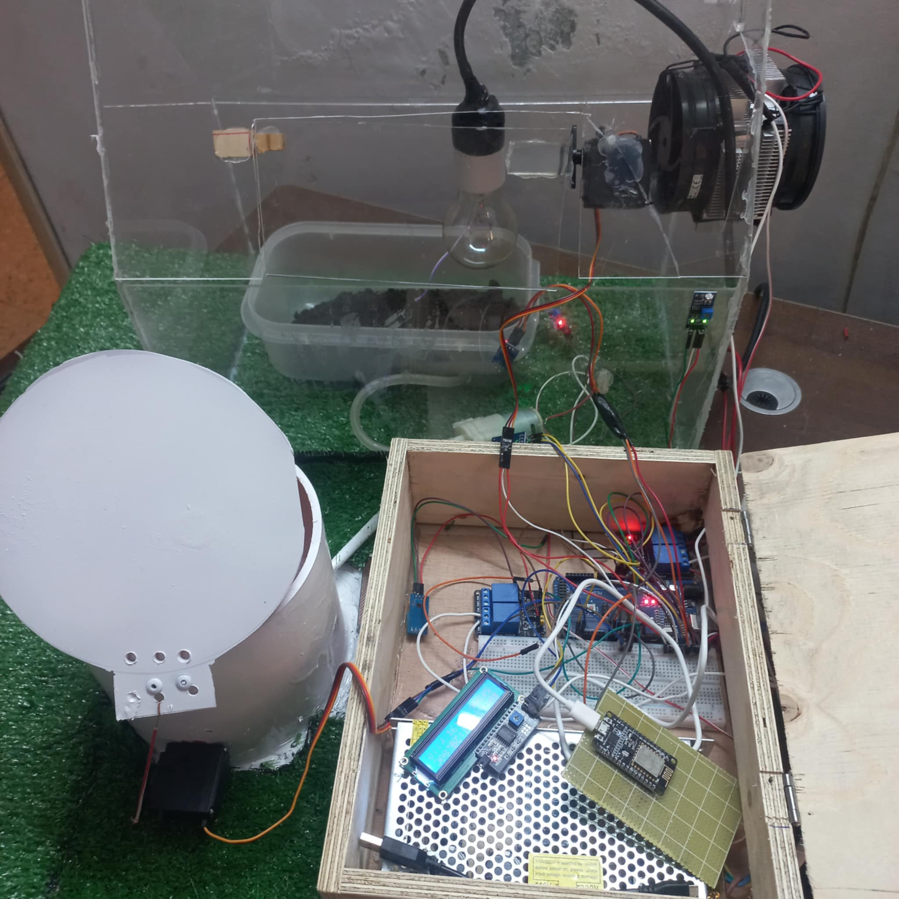
Result and Analysis

Slide 11
Thank you for accepting our invitation and for participating in our special day

