Slide 1

Al -Najah National University
Faculty of Engineering and Information Technology
Review of Developments in Iron (III) Ion Sensing by Carbon Nanodots Probes
By:
ASEEL YASeen
marah daraghmah
Tamara hanani
Under supervision of:
Dr. shadi sawalha

Slide 2
Presentation outline
Project objective
Introduction.
Sensing of Iron Ion
Comparison Between General methods and CDs
Major Factors Affecting the Properties of CDs
Ion Imprinted polymer
Methodology
Results
Conclusion

Slide 3
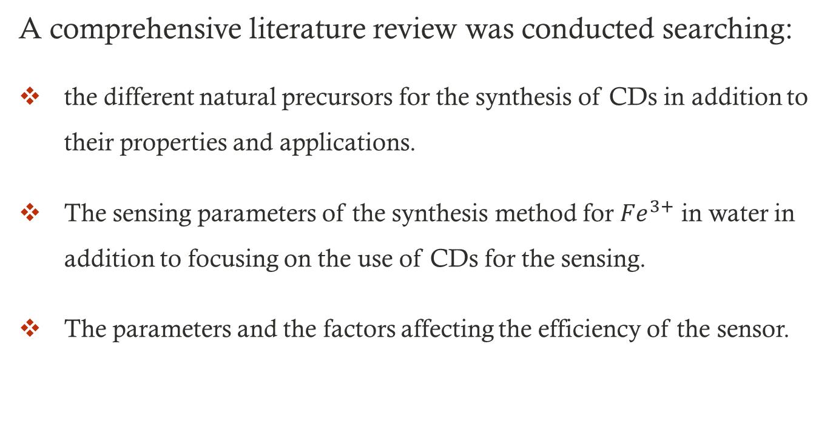
Project objective
A comprehensive literature review was conducted searching:
the different natural precursors for the synthesis of CDs in addition to their properties and applications.
The sensing parameters of the synthesis method for ${Fe}^{3+}$ in water in addition to focusing on the use of CDs for the sensing.
The parameters and the factors affecting the efficiency of the sensor.

Slide 4
Introduction
Carbon nanodots (CDs) are a new category of carbon nanomaterials with sizes under 10 nm.
several methods have been reported to prepare CDs, which can be roughly categorized into two methods Top-down and Bottom-up.
CDs have been synthesized from a large variety of precursors, including man-made and natural resources.
CDs have many applications in many fields, including bio-imaging, sensing, optronics and photocatalyis.
118 natural sources to synthesis of carbon nanodots were found.

Slide 5
Introduction
We found there was nearly 21 natural resources we can synthesis CDs for sensing iron ions Fe³⁺, that has a great importance in monitoring iron levels in the water, whose excess may cause many diseases.
The most important of sensor performance parameters are the sensing range (linear range), sensitivity , and limit of detection (LOD).
The detection of iron in water can be done using general methods However, these methods are expensive and time-consuming, so developing a sensor based on CDs derived from natural resources is a requirement and a point of interest for researchers.

Slide 6
Sensing of Iron Ion
Iron in water can be determined by :
General Method :
Automated methods
Automated methods are the best and most accurate to estimate iron and other heavy ions, For example:
Atomic Absorption Spectrophotometer (AAS)
Ion Coupled Plasma (ICP)
Spectral methods
Most test substances in water are colourless and undetectable to the human eye. To test for their presence, we must find a way to "see" them, For Example:
Colorimeter
Visible-Spectrophotometer

Slide 7
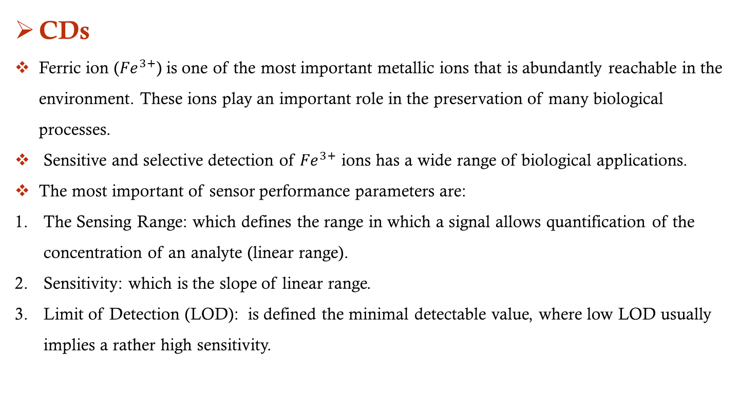
Sensing of Iron Ion
CDs
Ferric ion (${Fe}^{3+}$) is one of the most important metallic ions that is abundantly reachable in the environment. These ions play an important role in the preservation of many biological processes.
Sensitive and selective detection of ${Fe}^{3+}$ ions has a wide range of biological applications.
The most important of sensor performance parameters are:
The Sensing Range: which defines the range in which a signal allows quantification of the concentration of an analyte (linear range).
Sensitivity: which is the slope of linear range.
Limit of Detection (LOD): is defined the minimal detectable value, where low LOD usually implies a rather high sensitivity.

Slide 8
Comparison Between General methods and CDs
CDs | General Methods
Easy Manipulating Instruments | Sophisticated Instrumentations
Low Cost | Expensive Instrumentations
Simple Sample Preparation Techniques | Complicated Sample Preparation Techniques
Photo Stability Issues | Limiting The Applications For The Routine Fe3+ Analysis In Aqueous Samples
Excellent Biocompatibility | Bad Biocompatibility
Further Surface Passivation | No Need Surface Passivation
Low Toxicity | High Toxicity
Environmental Friendly | Harmful to the Environment
Water Soluble | -
Less Controllable | High Controllable

Slide 9
Major Factors Affecting the Properties of CDs
The four major factors governing the fluorescence properties of CDs are:
quantum size effects
surface defect states
bandgap transition
surface passivation
Since improving the synthesis conditions is the most common way to regulate the properties of CDs the effect of some of the major synthesis conditions on the properties of CDs are:
Raw Materials
Synthesis Temperature
Reaction Time
pH Value
Heteroatom Doping
Surface Passivation

Slide 10
Ion Imprinted Polymer
Ion imprinting technology is one of the most promising tools in separation and purification sciences because of its high selectivity, good stability, simplicity, and low cost.
IIP components:
1. Ligand: The template in IIPs is an ion.
2. Monomers: The use of a monovinylated monomer, such as 4-VP.
3. Initiator: Is homolytically cleaved by thermal decomposition.
4. Porogen: An organic solvent is introduced during the IIPs synthesis.
Types of IIP:
1. bulk polymerization.
2. precipitation polymerization.
3. suspension polymerization.
4. emulsion polymerization.

Slide 11
Ion Imprinted Polymer
Different approaches of IIP elaboration:
1. Chemical immobilization.
2. Trapping.
3. From linear chains.
4. Surface imprinting.
Applications of IIP:
1. Bio medical.
2. Removal of toxic metals from contaminated water and aqueous solutions.
3. Preconcentration of valuable metal ions for subsequent use.
4. Sensing of metal ions.

Slide 12
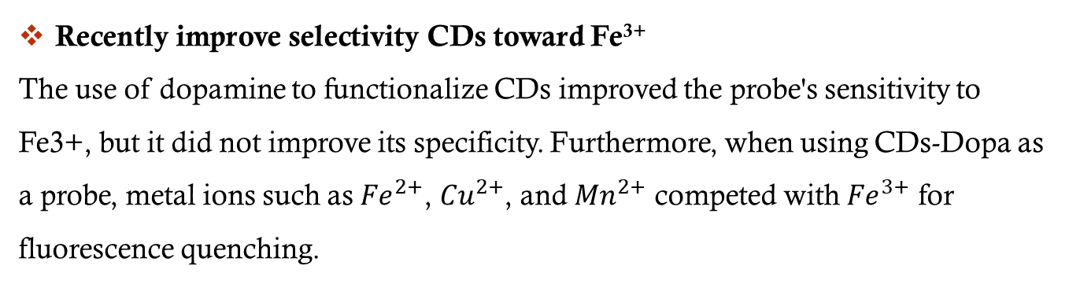
Ion Imprinted Polymer
Recently improve selectivity CDs toward Fe³⁺
The use of dopamine to functionalize CDs improved the probe's sensitivity to Fe3+, but it did not improve its specificity. Furthermore, when using CDs-Dopa as a probe, metal ions such as ${Fe}^{2+}$, ${Cu}^{2+}$, and ${Mn}^{2+}$ competed with ${Fe}^{3+}$ for fluorescence quenching.

Slide 13
Methodology
Comprehensive review of CDs synthesized from natural resources and their applications.
Classifying of CDs synthesized from natural resources and used as Fe³⁺ probes.
Study the sensing parameters of CDs which are the sensing range which defines the range in which a signal allows quantification of the concentration of an analyte (linear range), sensitivity which is the slope of linear range and limit of detection (LOD) is defined the minimal detectable value. in addition to a brief comparison with other detection method.
Investigate the effect of some synthesis or modification factors of CDs on the sensing parameter for detection of Fe³⁺.
Analyze the development of ion imprinted polymer for iron sensing and its effect on selectivity.

Slide 14
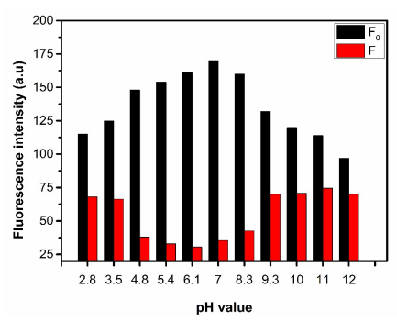
Results
The pH-dependence of the CD PL was investigated as shown in Figure 1.
From the figure:
at pH 2.8 the efficiency is 40.4%,
at pH 7 it is 80.9% and at pH 12 it is 25%.
The highest value of the efficiency is at pH 7.
Fig.1: Fluorescence response of CDs in the absence (black) and presence (red) of 100 μM Fe³⁺ at different pH values.

Slide 15
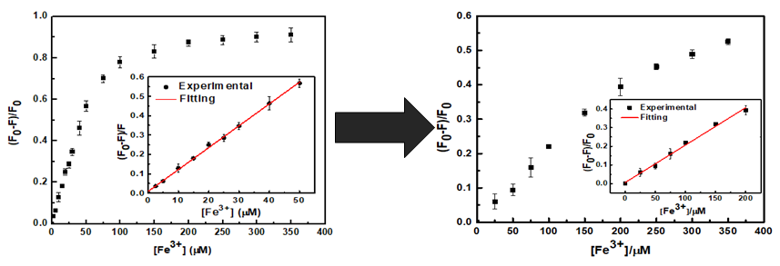
Results
The study of quenching efficiency for CDs and CDs-EDA and their sensing parameters which can be clarified as follows is shown in Figure 2.
From the figure
The sensing efficiency of CDs at concentration 100 µM was 79% which is higher than 24.5% of CDs-EDA .
The affinity of CDs will be reduced because of the decreasing of oxidized groups and the increase of amino acid groups.
Fig.2: Comparison between CDs and CDs-EDA quenching efficiencies.

Slide 16
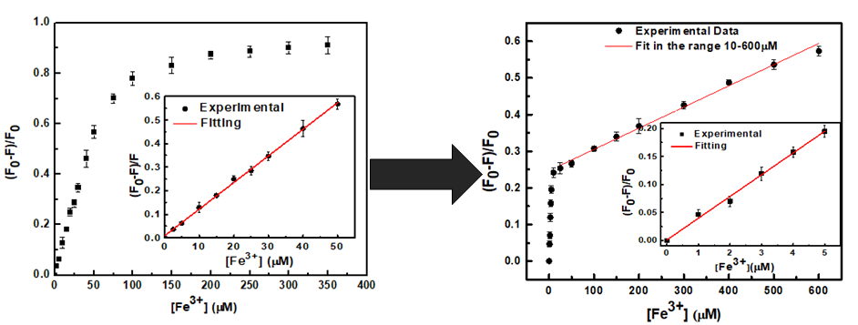
Results
The study of quenching efficiency for CDs and CDs-Dopa and their sensing parameters which can be clarified as follows is shown in Figure 3.
From the figure:
The introduction of dopamine groups on the surface of the CDs was the reason for the high sensitivity in the 0-5 µM range (0.0388 µM⁻¹ ), ), which is among the highest reported for CD-based probes and reduction of the LOD to 0.32 µM.
Fig.3: Comparison between CDs and CDs-DOPA quenching efficiencies

Slide 17
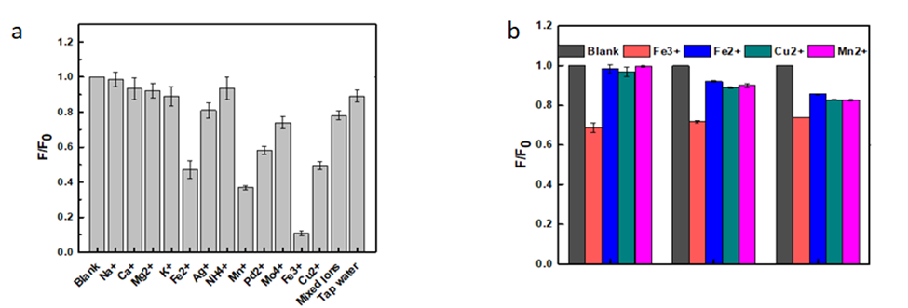
Results
The fluorescence quenching of the CDs in the presence of different cations is shown in figure 4.a, the result of the formation of the IIP around the CDs is shown in figure 4.b.
From the figure:
Fe³⁺ be the most efficient quencher for our CDs.
CDs-IIP microspheres show a complete selectivity for Fe³⁺ at 25 µM concentration.
The presence of the same concentration of other cations does not induce a quenching of the fluorescence.
It can be concluded that the cavities imprinted in the polymer allow the exclusive recombination with Fe³⁺ .
Fig.4 a) Ion sensing with CDs selectivity to different cations. b) on sensing with CD-IIP selectivity for different cations.

Slide 18
Conclusion
Most recent researches on CDs have focused on their fluorescence characteristics and photocatalytic properties.
This review reports the primary synthesis method, properties, application, and Fe³⁺ sensing.
We came up with 118 natural resources to extract CDs for different applications. 21 resources of them are for Fe³⁺ detection.
The most commonly used in the synthesis of CDs is hydrothermal methods.
The sensing parameters of the CDs probe toward Fe³⁺ are affected by different factors such as surface passivation, pH, doping elements, raw materials, temperature, and reaction time.
The highest value of the efficiency is at pH 7.

Slide 19
Conclusion
The sensing properties of the produced CDs can be modulated toward the detection of Fe³⁺ by modulating the surface chemistry of the CDs.
In both processes, CD-Dopa and CDs-EDA, a decrease in fluorescence intensity is noticed while increasing the Fe³⁺ concentrations.
The fluorescence emission intensity of the synthesized CDs is significantly high in the absence of metal ions and upon spiking with the cations, variations in the fluorescence intensities are observed. So Fe³⁺ be the most efficient quencher for our CDs.
A strong improvement in the selectivity is recorded when the formation of the IIP around the CDs.
The same concentration of other cations does not induce a quenching of the fluorescence.
the cavities imprinted in the polymer allow the exclusive recombination with Fe³⁺ .

Slide 20
Thank you

