Slide 1

AN-NAJAH NATIONAL UNIVERSITY
FACULTY OF ENGINEERING
DEPARTMENT OF MECHATRONICS ENGINEERING
STAIR CLIMBING WHEELCHAIR
Prepared by: supervisor:
Dua’a Dmadi Dr.Nidal Farahat
Rawan Massad
Maram Al hassan
Muna Al athma

Slide 2
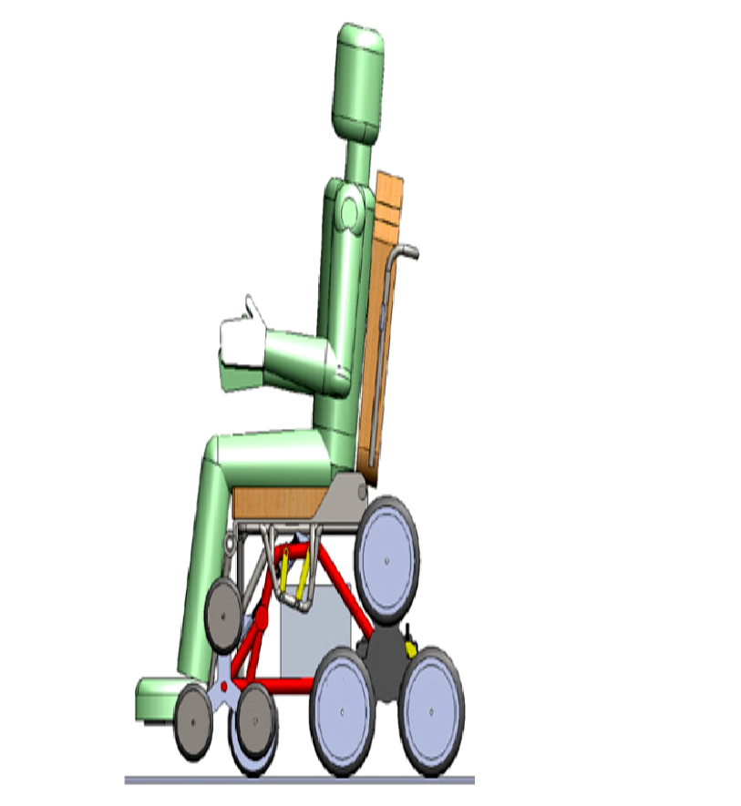
Stair climbing wheelchair

Slide 3
Main problem :
The main problem is to find the tools and equipment needed to manufacturing chair which climb the stairs without any assistance.
The principle of our design :
Tri wheel mechanisms.

Slide 4
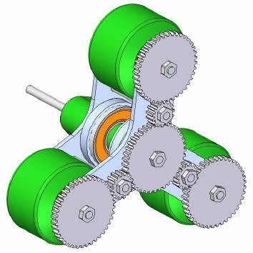
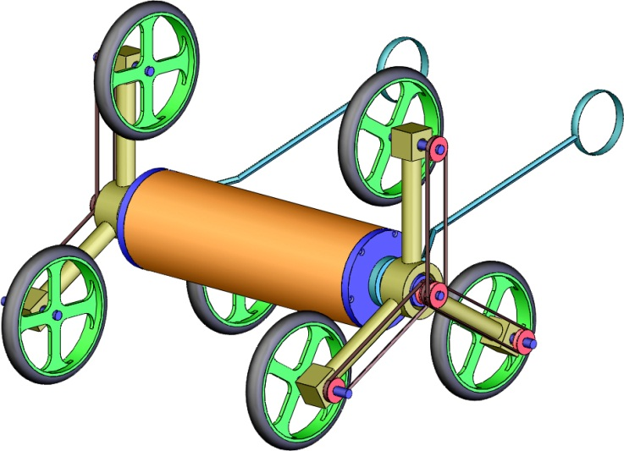
Tri-wheel mechanism
We change the design which consist of planetary gears to pulleys.

Slide 5
Because :
The gears are more expensive.
More complex and sometimes cannot be performed easily.

Slide 6

Main components
belt
pulley
Star frame
shaft
wheel
bearing

Slide 7
Main components :
In our mechanism we have the central pulley which combined with three pulley which transfer the motion from the central pulley to the follower pulleys.
follower pulleys is connected to the wheel.
When the follower pulleys rotate the wheels rotate.

Slide 8
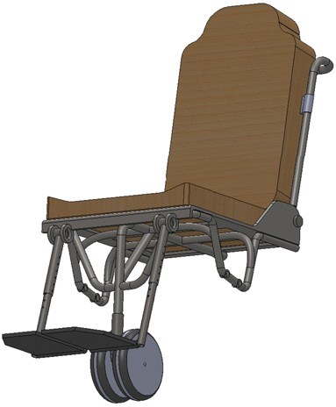
castor wheel
It used to rotate left or right

Slide 9
Mechanism for balance the seat with respect to wheels motion:
The main idea of this mechanism is to keep the person in the horizontal situation. To achieve this we use power screw
The angle of the stair

Slide 10
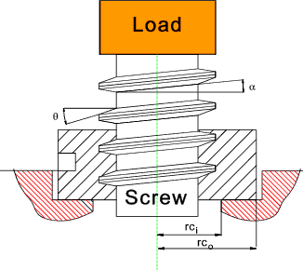
Power screw principle :
It used to convert rotational motion to linear motion .

Slide 11
Electrical Part
Electric DC motor :
Electric motors is a machine that converts electrical energy into mechanical energy and movement.
It is working on a DC currant.

Slide 12
Torque and Speed of a DC. Motor
Movement of the wheelchair :
1. On the flat surface the torque move the chair front and back.
2. when there is an obstacle, as stair the torque is transfer from the wheels to the star frame and causes the rotation of the star frame then go up.

Slide 13
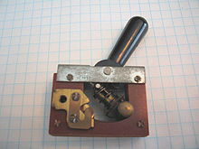
Toggle switch
A toggle switch is a type of electrical switches that are used manually by moving the switch to one of the trends available for movement.

Slide 14
why we choose it ?
This kind of switches gives multiple choices of movement. The choices are go front, back and stop.

Slide 15
Model
The model designed to show the project in the real world, because the real design very expensive and heavy.

Slide 16
Main frames: (the body)
The main frame is nearly square shape it has size of 35X30 cm², this size is to give enough space for the motors and enough distance between wheels . and the bearing is put in its suitable place.

Slide 17
Tri-wheel size: (star frame)
Star frame size 6cm for each rod, this size is according to the size of wheel which is 5cm diameter.

Slide 18
The pulleys:
The pulleys have diameter of [4cm as experimental size] in order to have suitable friction.
The pulleys were made from tephelon material which is light, cheep, available in market. Turning was used to manufacturing the pulleys, 16 pieces were used for project, 4 pieces for each star frame. The chain was used to connect between motor and star frame and prevent sliding .

Slide 19
The Belts:
The belts were made from rupper which increase the friction, and the size was suitable for the size of star frame. The rubber has (12cm) for each piece.

Slide 20
DC Motor and Control :
Glass car cleaner motor was used because it available and has properties for easy use in small model.
It has fairly small size and suitable velocity of 30 rpm and needs to 12v to work correctly, to achieve this, the 12 v battery was chosen to use. But it is not available so we use transformer.
Two motors were used in this model to give motion for each side (right and left) according to switches.

Slide 21
Dynamic analysis :
The free body diagram of the wheel

Slide 22
Free body diagram for central pulley :
w/4
F_{B}
fs
T
N
Free body diagram of the pulley :
fp
fp
FRp

Slide 23
Free body diagram for the wheel
Fp1
F_{MR}
T_{M}
Fp2

Slide 24
The diameter of actual pulley = 4 cm
The motor torque should be more than the torque of other forces.
F_{MR} * R_{FMR} ≥ (W/4 (R_{W}) +F_{PR} (R_{FPR)})
Now we can find the exact size of the pulley by this equation :
F_{MR} * R_{FMR =} (W/4 (R_{W}) +F_{PR} (R_{F(PR)})

Slide 25
By substitution in the previous equation
R_{F(PR) =} 9.976 cm
Which is the diameter of the pulley that achieve the equation.
The explanation of the results :
The size of pulleys doesn't available in the market, the pulleys were designed in suitable size by lathe machine.
The design of the model selected by the available size of the wheel in the market.
The motor didn’t give enough power.
The size of the pulley should more than 4 cm in order to increase the area an increase the distance and this leads to increase the torque and rotate the star.

Slide 26
Stair climbing wheel chair simulates the easiest and cheapest mechanism, where The person concerned can easily get. Where the chair facilitates his movement and reach to any place he wants. We searched for treatment of this problem at least equipment, efforts and costs. And we hope that this project can be implemented on the ground successfully. To provide humanitarian service, for special needs people.
Conclusion and recommendation

Slide 27
Thank you for listening

