Slide 1
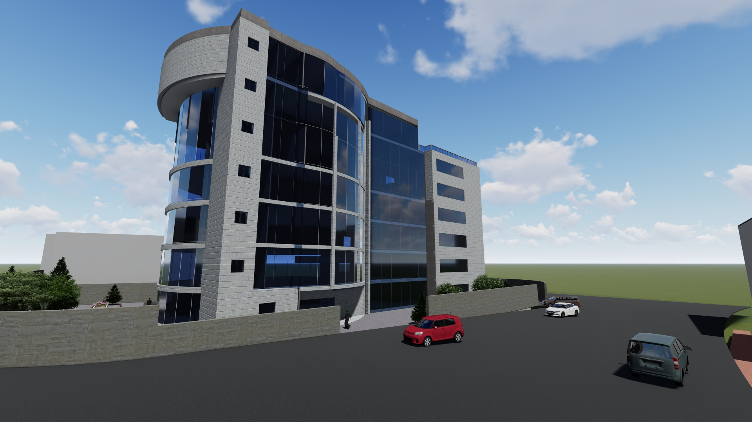
Nablus Municipality
Prepared by :
Ameen Hamed
Jaser Jamil Qaq
Mohammad Sholi
Supervisor :
Eng. Alaa Shaheen
An-Najah National university
Building Engineering Department

Slide 2


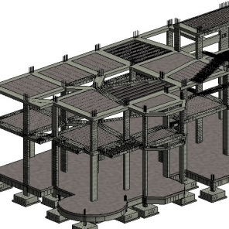



The Outlines
Architectural design
Environmental Design
Structural Design
Electro mechanical Design
Cost & Quantity
Conclusion

Slide 3
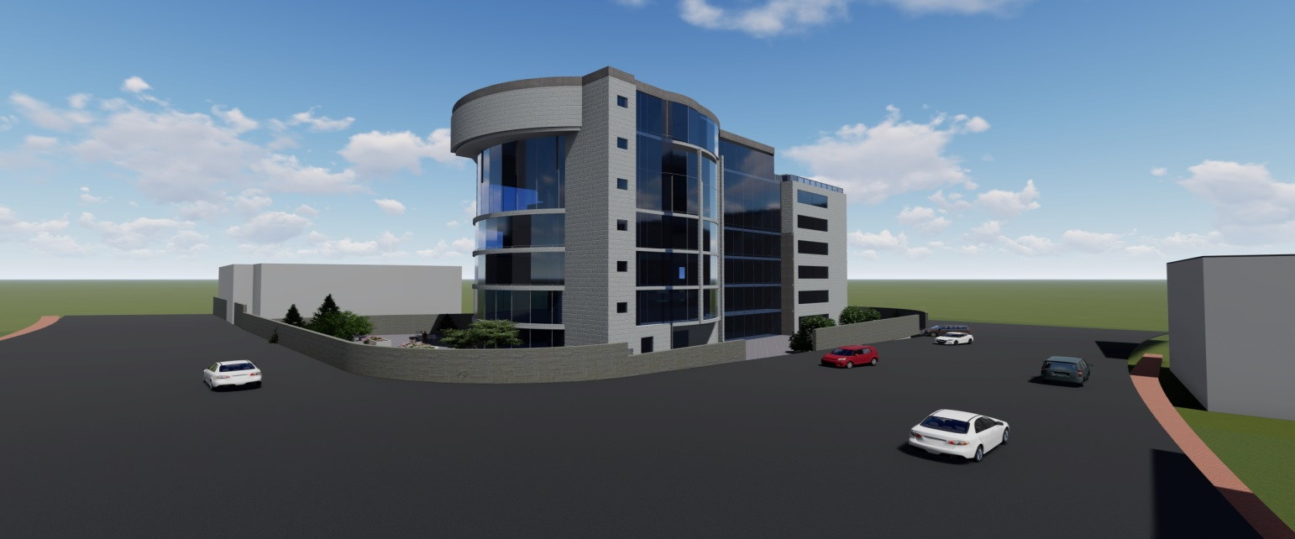
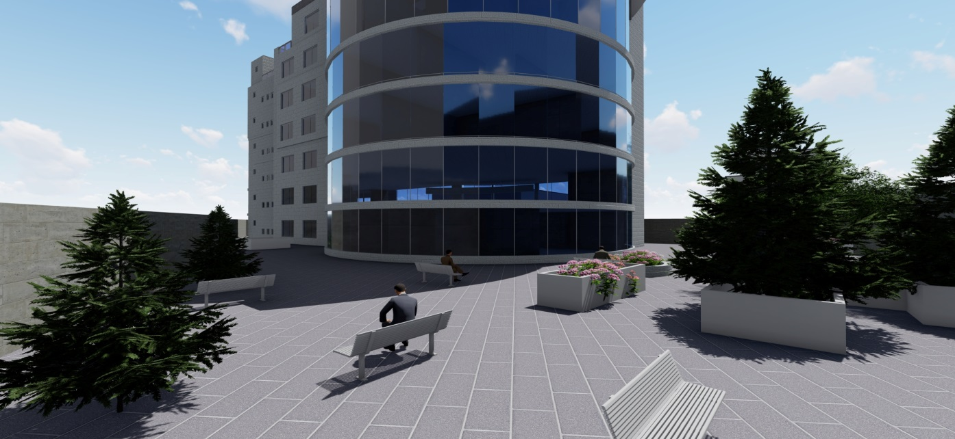
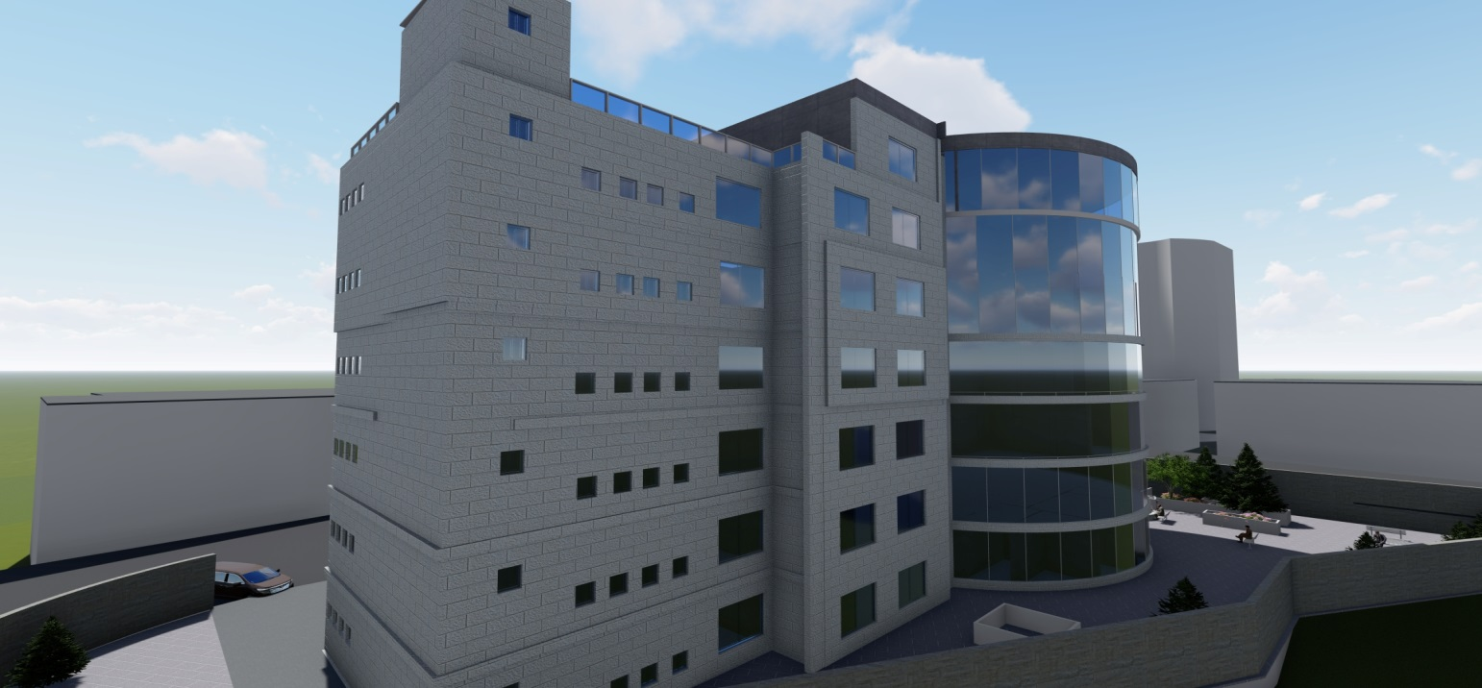
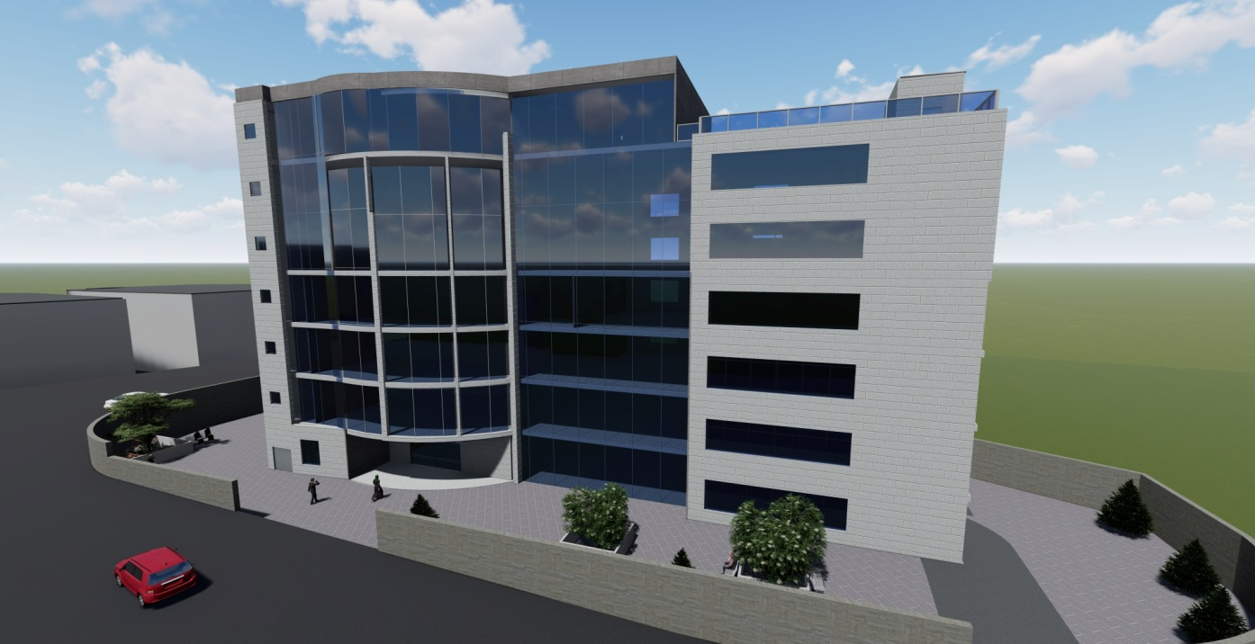
Architectural Design

Slide 4
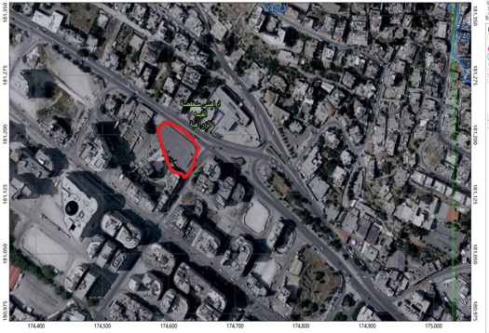
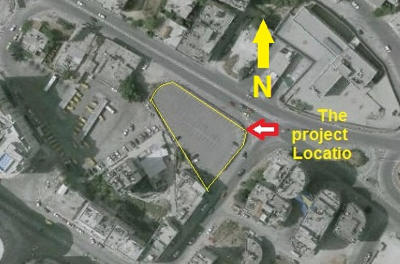
Location and Site Plan
The project is located in Nablus - on Tulkarm Street – opposite to the Tamimi fuel station

Slide 5
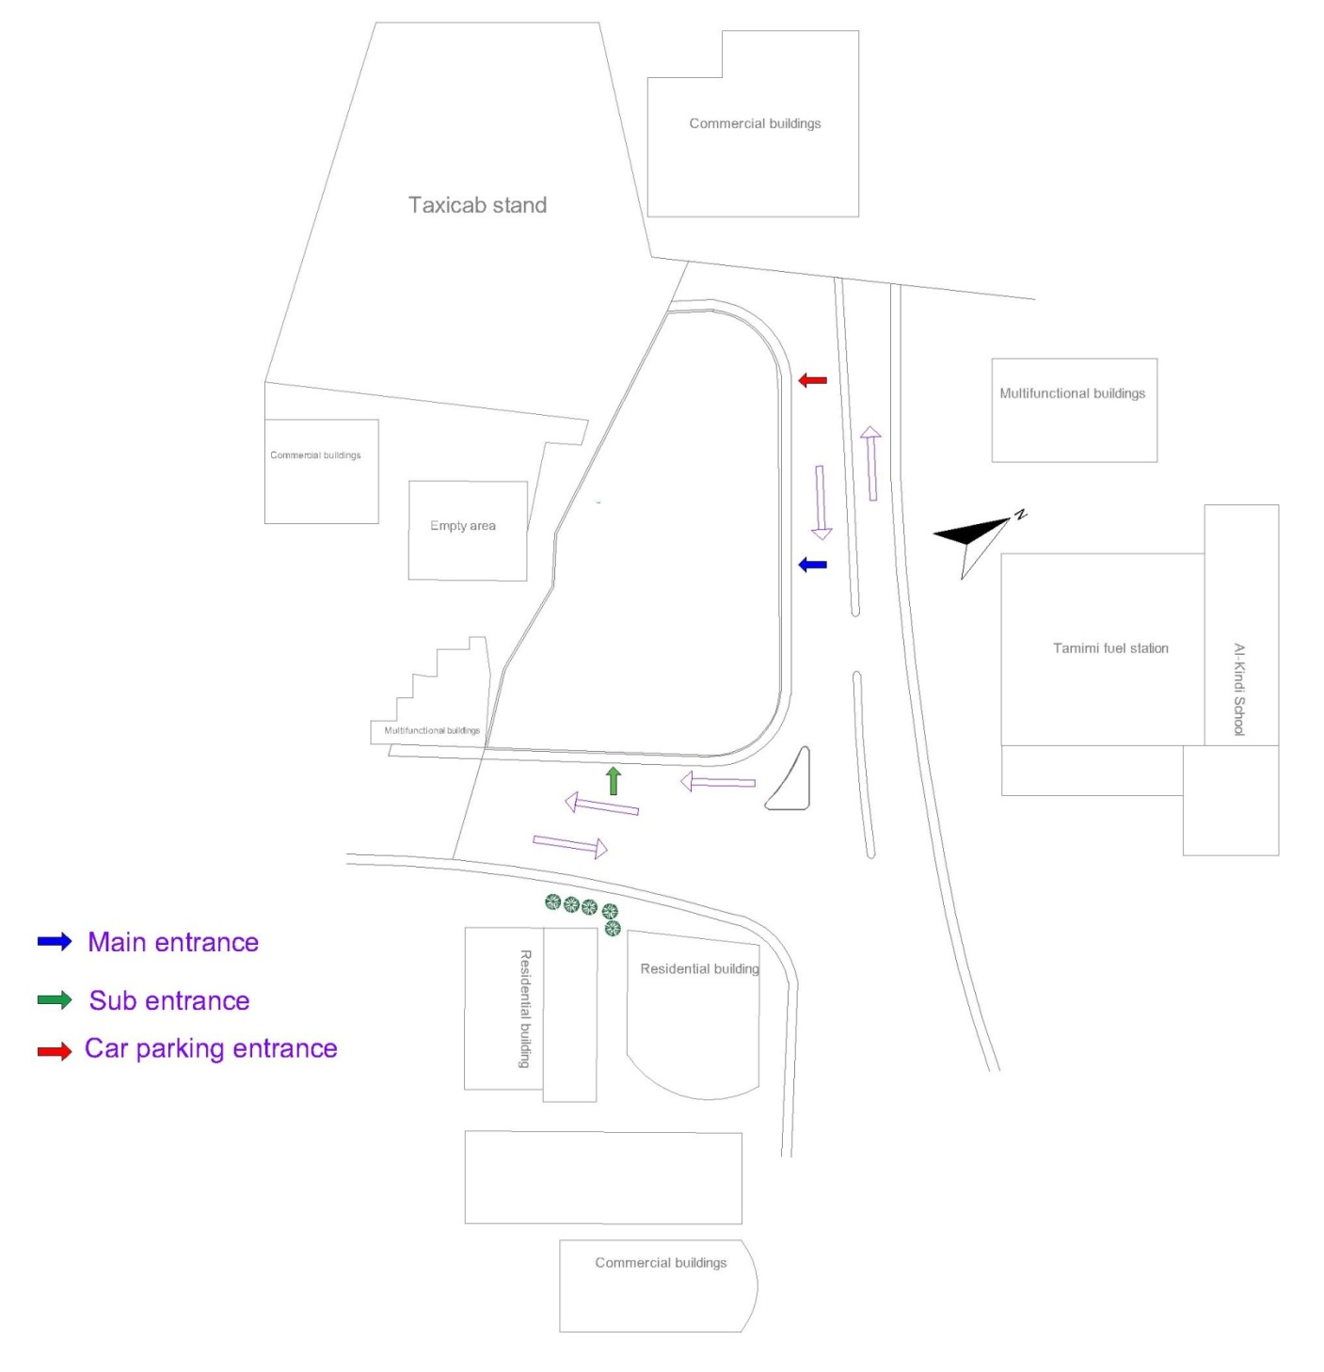
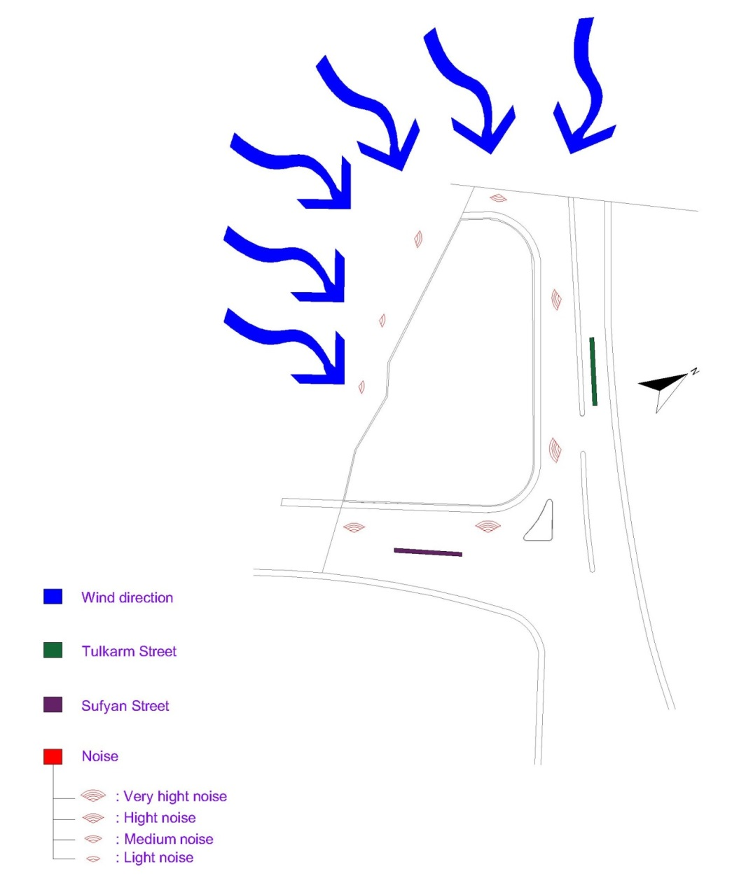
Site Analysis
Wind movement & Streets & Noise
Surrounding buildings & Entrances

Slide 6
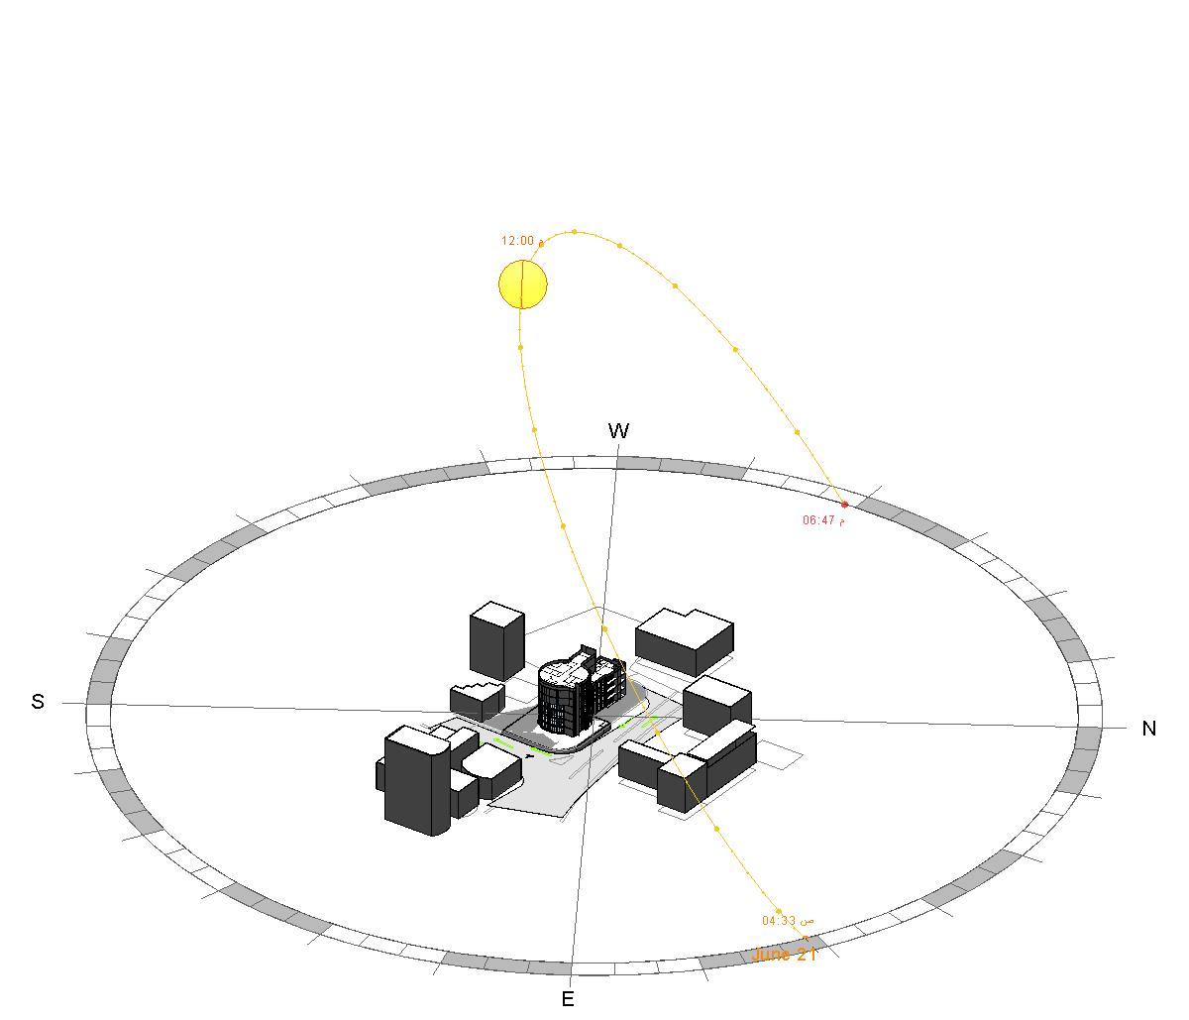
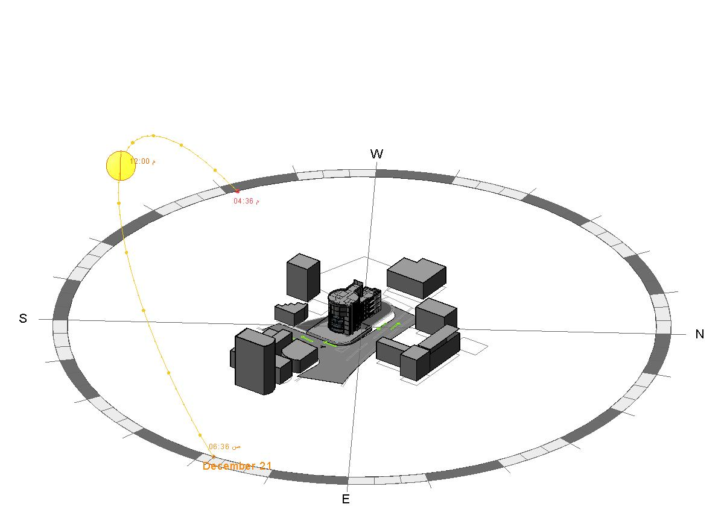
Site Analysis
Sun Path in Summer
Sun Path in Winter

Slide 7
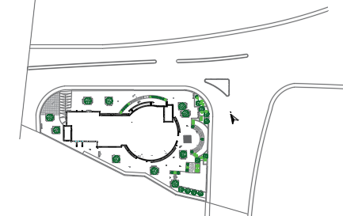
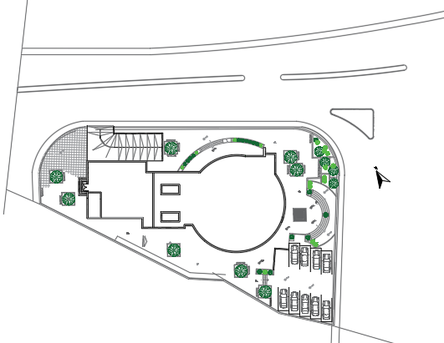
Architectural Plans
Site Plan with Analysis:
Site Plan Before
Site Plan After

Slide 8
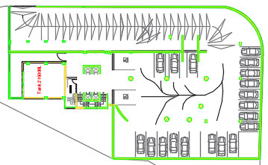
Basement floor after

Slide 9
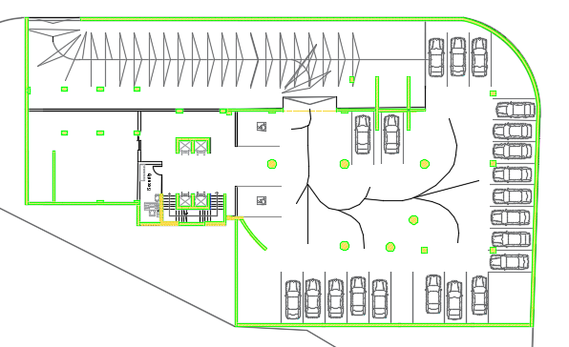
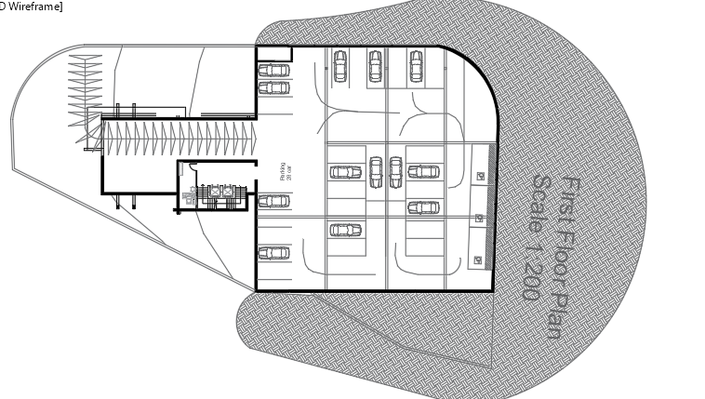
Basement floor before
Basement floor after

Slide 10
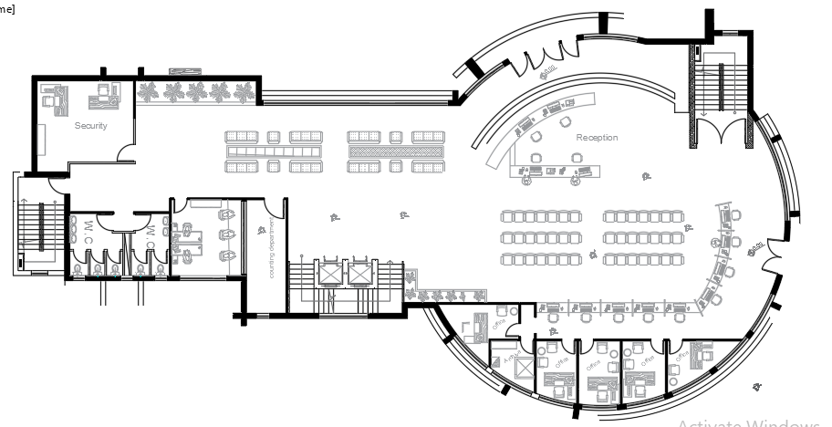
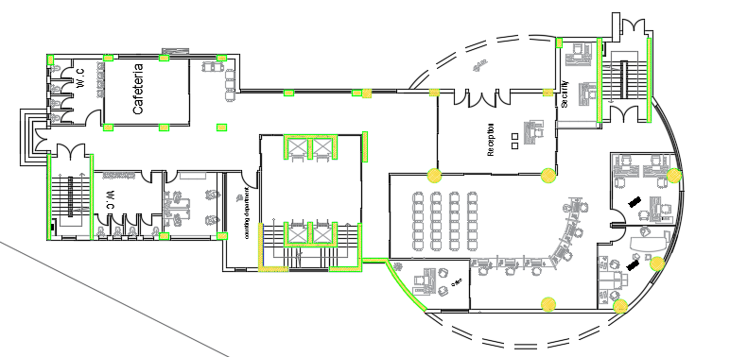
Ground Floor Before
Ground Floor After

Slide 11
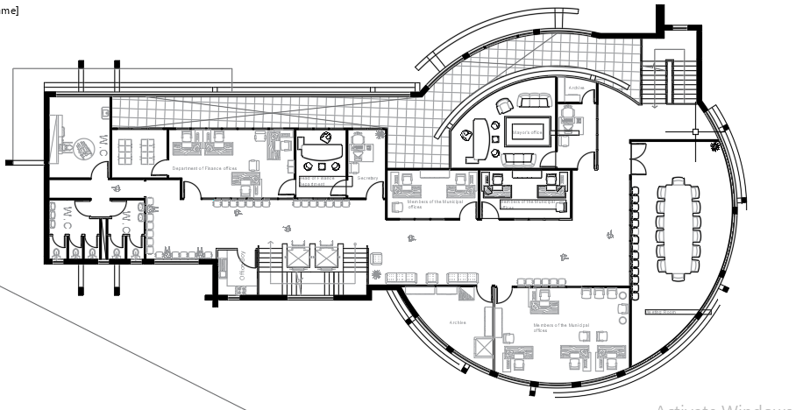
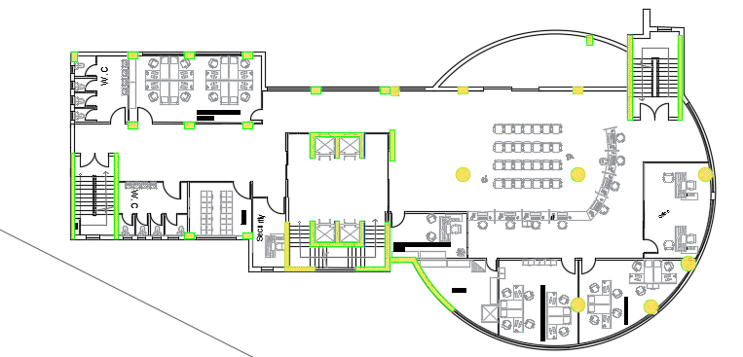
First Floor Before
First Floor after

Slide 12
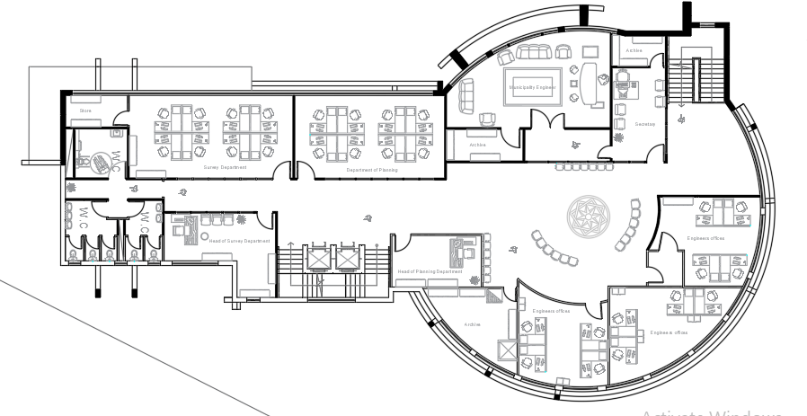
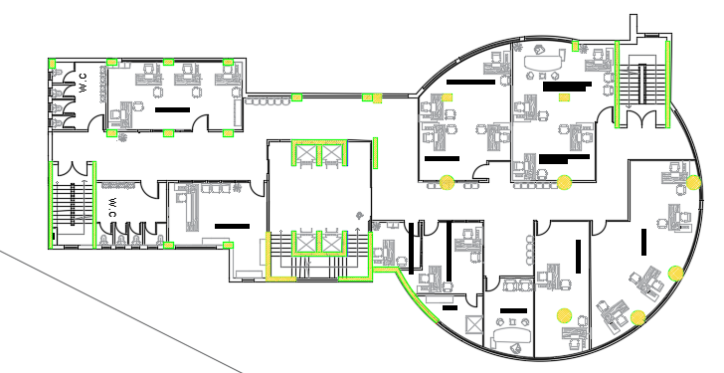
Second Floor Before
Second Floor after

Slide 13
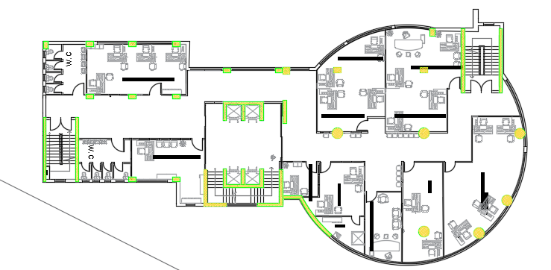
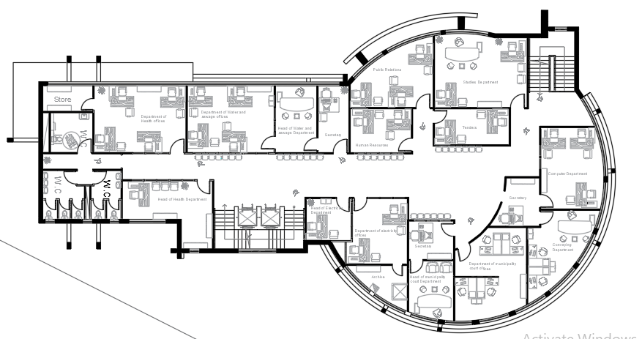
Third Floor Before
Third Floor after

Slide 14
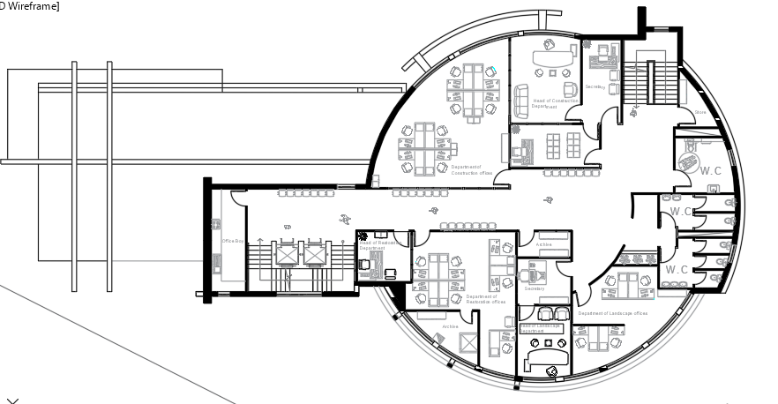
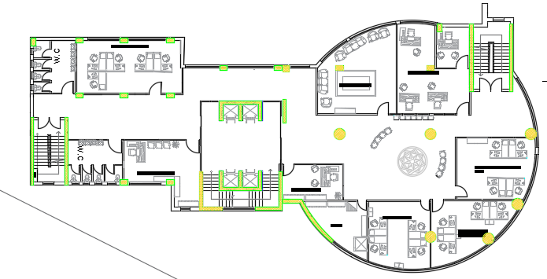
Fourth Floor Before
Fourth Floor after

Slide 15
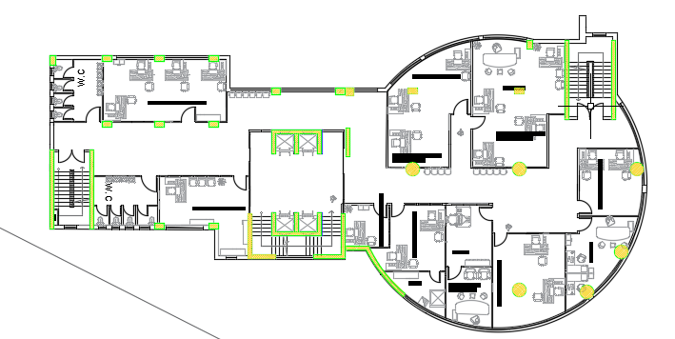
fifth Floor after

Slide 16
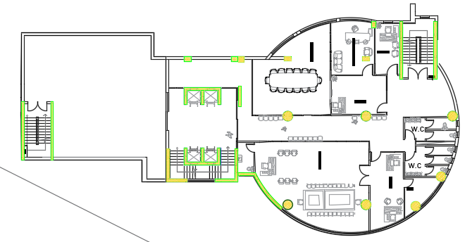
sixth Floor after

Slide 17

Environmental Aspects
Over Shadowing
Solar Radiation
Thermal Comfort

Slide 18
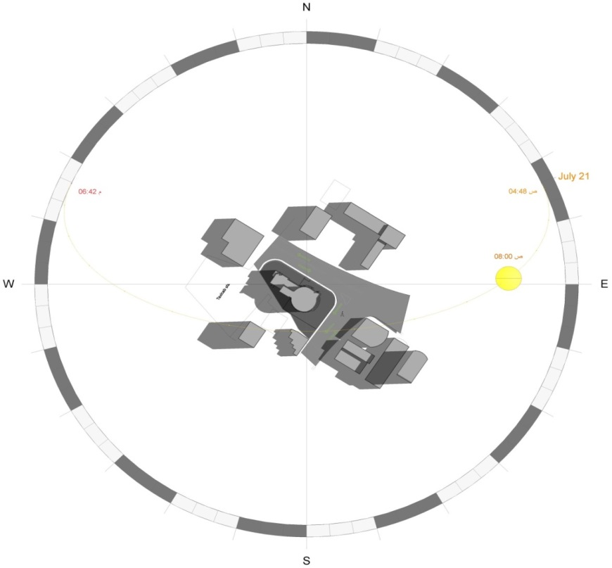
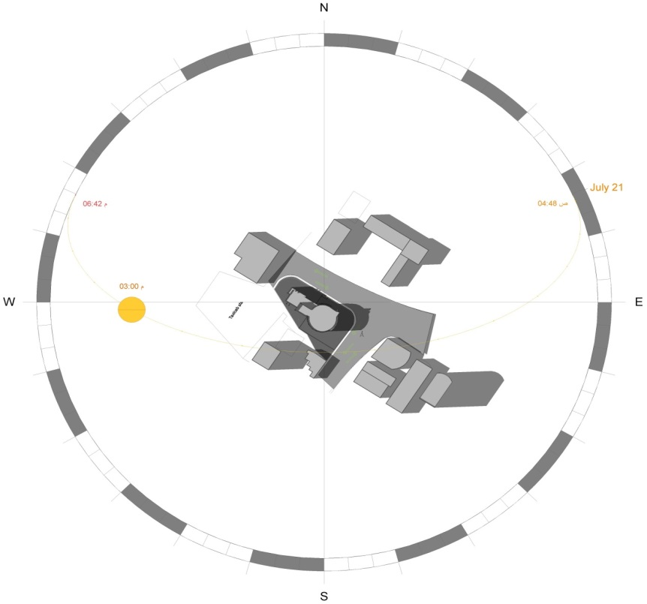
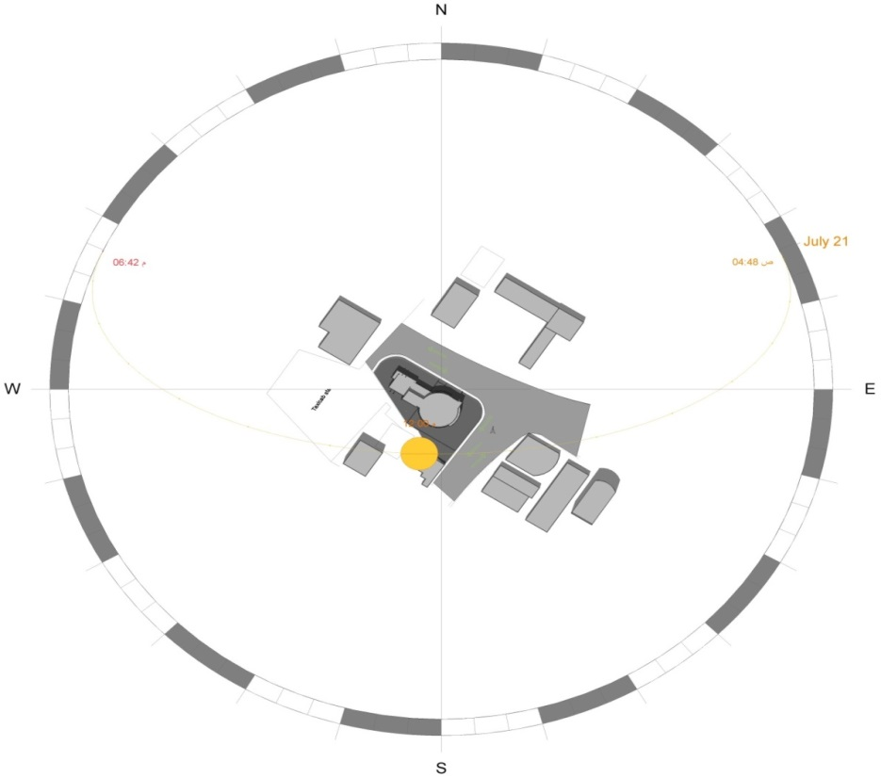
Overshadowing:
In Summer (21/Jan)
8 am
3 pm
12 pm

Slide 19
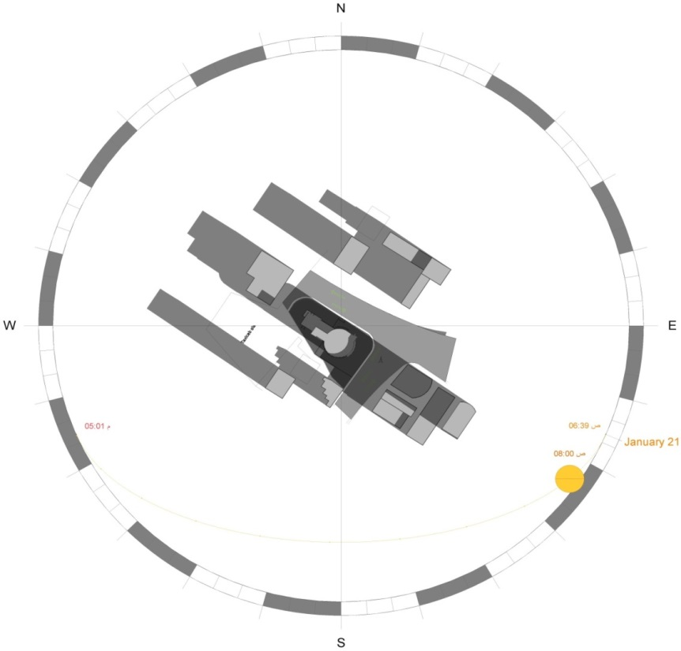
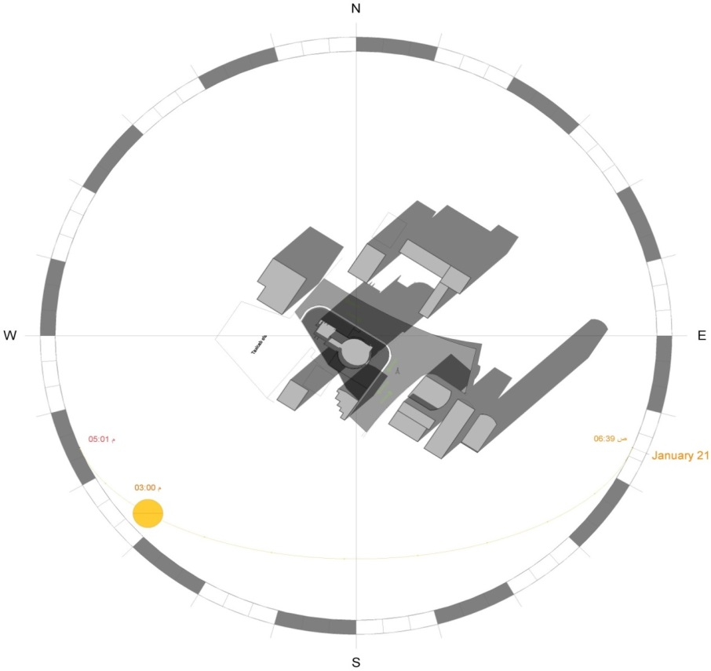
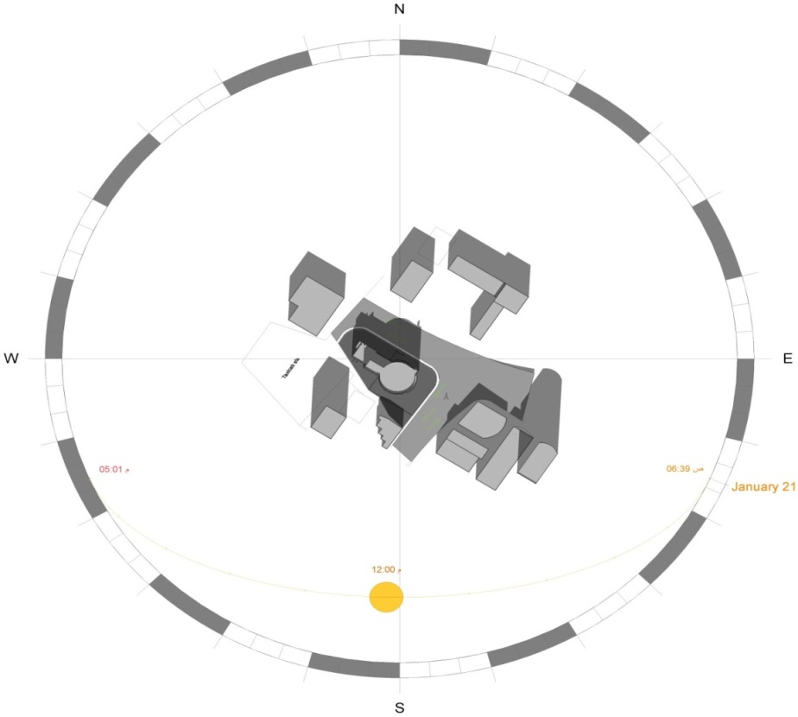
Overshadowing:
In Winter (21/Jan)
8 am
3 pm
12 pm

Slide 20
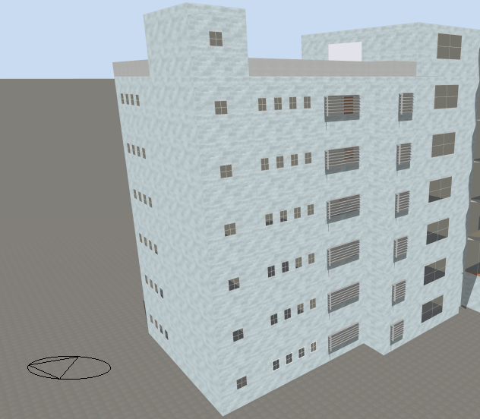
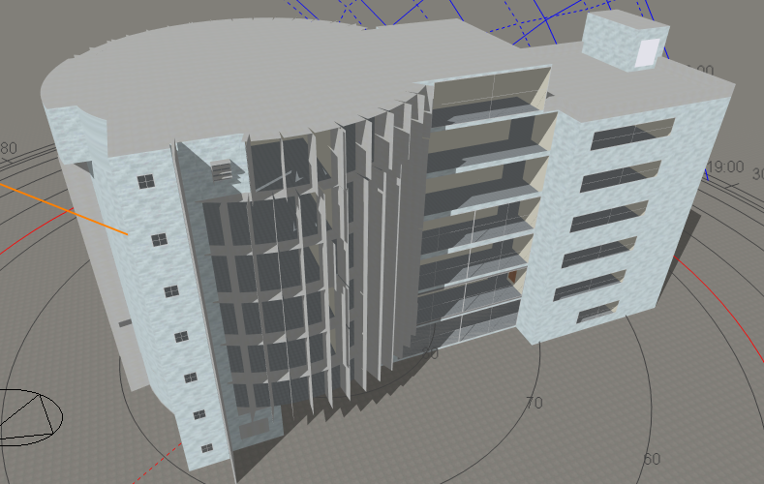
Shading System
SW
NE

Slide 21
Solar Radiation:
We made annual solar radiation for the roof, and we made solar radiation for each elevations before and after modification at the different time of the day, By Revit software.
Summary for the solar radiation in Summer after modification
Summary for the solar radiation in Winter after modification
Elevation | At 8 am (Wh/m2) | At 12 pm (Wh/m2) | At 3 pm (Wh/m2)
South | 40 | 210 | 338
North | 300 | 50 | 80
East | 480 | 380 | 100
west | 80 | 200 | 340
Elevation | At 8 am (Wh/m2) | At 12 pm (Wh/m2) | At 3 pm (Wh/m2)
south | 13 | 560 | 600
North | 15 | 60 | 70
west | 10 | 50 | 150
East | 25 | 306 | 20

Slide 22
Thermal Comfort
(U-value) W/m2.K for our building | Highest thermal transmissivity value (U-value) W/m2.K | Structural elements in the outer shell of the building
0.249 | 0.5 | External wall
0.611 | - | Celling
0.251 | 0.39 | Roof
0.395 | 0.46 | Ground Floor
1.493 | 2.46 | Exterior windows
1.492 | 6 | Exterior doors exposed
Energy status | Design Capacity(W/m²)
Highly energy efficient | 20 - 25
Good energy efficient | 26 - 40
Energy efficient | 41 - 60
Accepted | 61 - 80
Fails (consumes high amount of energy) | > 80

Slide 23
Heating & Cooling loads (With insulation)
Thermal Comfort
Floors | Zone | Cooling Design Capacity (kW) | Design Cooling Load Per Floor Area(W/m²) | Heating Design Capacity (kW) | Design Heating Load Per Floor Area(W/m2)
Ground floor | corridor | 3.34 | 23.9 | 4.78 | 34.1918
 | Cafeteria | 2.32 | 70.5 | 1.37 | 41.7579
 | counting department | 1.76 | 41.8 | 2.77 | 65.9995
 | Office 3 | 0.93 | 37.5 | 1.18 | 47.8655
 | crowd service | 4.39 | 27.7 | 5.62 | 35.4271
 | Office 1 | 1.92 | 69 | 1.63 | 58.5155
 | Office 2 | 1.98 | 72.1 | 1.55 | 56.3079
 | Security | 0.91 | 44.7 | 0.76 | 37.5584
First floor | crowd service & corridor | 12.8 | 42.2 | 7.78 | 25.6455
 | Office of Elections and Statistics | 2.69 | 53.8 | 3.05 | 60.9291
 | Security | 0.81 | 53.7 | 0.5 | 33.2706
 | Regulatory Office and General Police | 0.77 | 39.9 | 0.69 | 35.5523
 | Disputes and Legal Affairs Office | 2.1 | 56.8 | 2.11 | 56.9539
 | civil status office | 2.52 | 64 | 2.78 | 70.6917
 | Office | 1.99 | 57.7 | 1.99 | 57.5264
Second floor | corridor | 10.33 | 61.3 | 5.38 | 31.9161
 | Restoration office | 2.61 | 52.1 | 2.17 | 43.3347
 | Restoration office 2 | 1.55 | 38.5 | 1.35 | 33.542
 | Building Exploitation Office | 0.55 | 43.6 | 0.45 | 35.3679
 | Maintenance department office | 2.38 | 62.7 | 2.25 | 59.3524
 | Projects Follow-up Office | 3.58 | 62.1 | 2.8 | 48.6815
 | Media interest | 1.91 | 55.3 | 1.54 | 44.7619
 | Warehouse office | 2.17 | 55.5 | 1.73 | 44.1249
 | Office of the Building and Construction Authority | 4.08 | 60 | 3.45 | 50.8228
 | Materiel office | 4.22 | 55.3 | 4.51 | 59.0113

Slide 24
Thermal Comfort
Heating & Cooling loads (With insulation)
Floors | Zone | Cooling Design Capacity (kW) | Design Cooling Load Per Floor Area(W/m²) | Heating Design Capacity (kW) | Design Heating Load Per Floor Area(W/m2)
Third floor | corridor | 6.49 | 38.5 | 5.26 | 31.1844
 | Department of Electrical Engineering | 2.57 | 51.2 | 2.17 | 43.2417
 | Office of the director of engineers | 1.56 | 38.7 | 1.63 | 40.3447
 | Engineering File Manager | 0.55 | 43.1 | 0.45 | 35.2347
 | Audit engineers & Archive | 2.43 | 64.1 | 2.24 | 59.0708
 | Department of Civil Engineering | 3.56 | 61.8 | 3.17 | 55.0006
 | Department of Energy Engineering | 1.94 | 56.3 | 1.29 | 37.3276
 | Warehouse office | 2.18 | 55.8 | 1.74 | 44.4435
 | Department of Industrial & Building Engineering | 4.1 | 60.3 | 3.06 | 45.0842
 | Department of Mechatronics Engineering & IT | 4.21 | 55.1 | 4.11 | 53.8051
Fourth floor | corridor | 12 | 51.2 | 7.07 | 30.1805
 | Agricultural Affairs Office | 2.82 | 55.6 | 2.17 | 42.8942
 | Agricultural Affairs Office 2 | 1.45 | 40.4 | 1.2 | 33.2989
 | Social Affairs Office 2 | 0.78 | 40.1 | 0.68 | 34.5707
 | Cultural Affairs Office2 | 2.75 | 53.6 | 3.25 | 63.3839
 | Social Affairs Office | 1.96 | 53 | 2.14 | 57.9216
 | Cultural Affairs Office | 3.5 | 62.7 | 2.6 | 46.671
 | Office of Prevention and Public Health 2 | 2.36 | 59.1 | 2.94 | 73.5028
 | Office of Prevention and Public Health | 2.88 | 68.4 | 2.1 | 49.8085

Slide 25
Thermal Comfort
Heating & Cooling loads (With insulation)
Floors | Zone | Cooling Design Capacity (kW) | Design Cooling Load Per Floor Area(W/m²) | Heating Design Capacity (kW) | Design Heating Load Per Floor Area(W/m2)
Fifth floor | corridor | 13.14 | 65.4 | 6.52 | 32.4521
 | Office of Movement and Statistics | 3.48 | 69.6 | 2.49 | 49.66
 | Personnel Management Office 1 | 1.69 | 47.6 | 1.44 | 40.5927
 | Personnel Management Office | 0.48 | 38.5 | 0.44 | 35.7586
 | Office of General Inventory & Archive | 2.35 | 63.8 | 1.93 | 52.4599
 | Financial Operations Office, Processing Branch | 3.32 | 65.7 | 2.56 | 50.7056
 | Secretary | 0.81 | 43.8 | 0.63 | 34.0659
 | Office of General Inventory | 2.67 | 63.4 | 1.73 | 41.0339
 | Financial Operations Office, Management Branch | 4.12 | 60.8 | 3.58 | 52.7841
 | Deals office | 1.89 | 62.8 | 2.51 | 83.1936
 | Property Management Office | 1.53 | 56.1 | 1.52 | 55.3853
 | Municipal Property | 1.06 | 60.9 | 1.07 | 61.4125
Sixth floor | Corridor | 8.53 | 72.2 | 4.7 | 39.7975
 | Mayor's Office | 5.67 | 54.6 | 5.73 | 55.1849
 | Secretary 1 | 2.37 | 53.7 | 2.15 | 48.7545
 | Security | 1.09 | 72 | 0.54 | 35.5303
 | Secretary 2 | 1.34 | 52.6 | 1 | 39.3025
 | Deputy Mayor's Office | 1.54 | 54.3 | 1.66 | 58.6627
Total |  | 191.76 |  | 155.66

Slide 26
Thermal Comfort
Heating & Cooling loads Design Capacity :
 | Cooling Design Capacity (kW) | Heating Design Capacity (kW)
Without insulation | 289.91 | 359.66
With insulation | 191.76 | 155.66
We get the annual energy consumption rate of the building by using Design builder software and it was about 37 KWh/m².

Slide 27
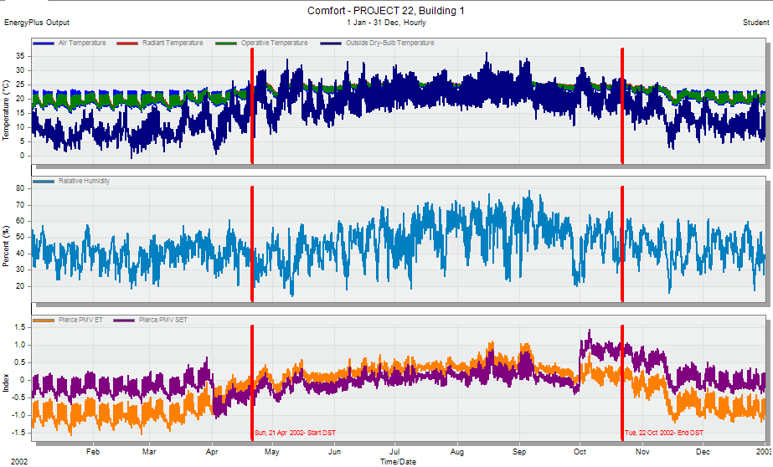
Thermal Comfort
PMV of the building

Slide 28
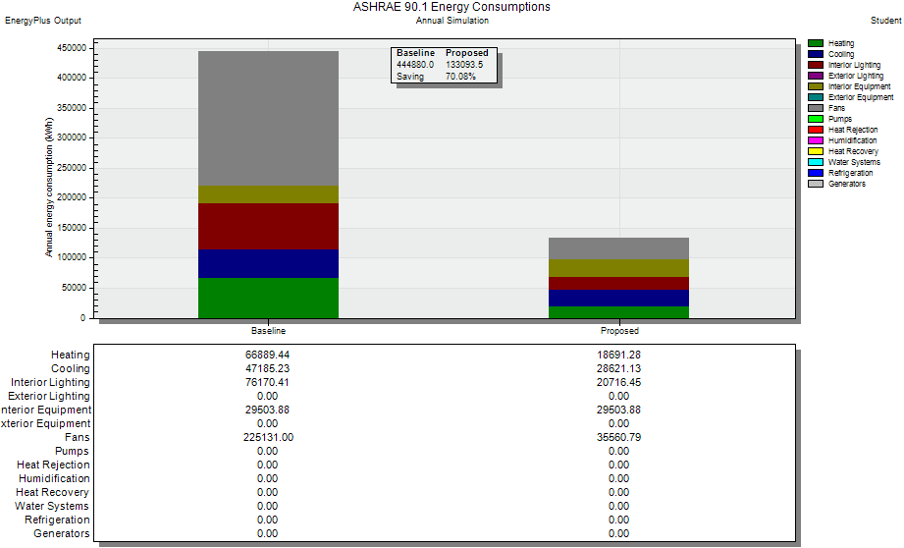
Baseline
 | Saving
Heating load | 72%
Cooling load | 40%
Interior lighting | 73%

Slide 29


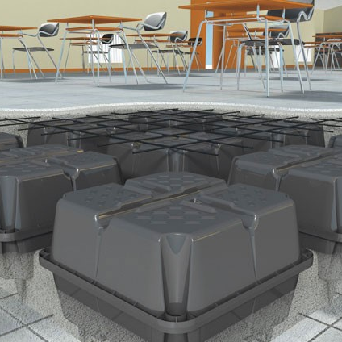
Structural Aspects
Cheeks & Design
Detailing

Slide 30
Codes:
ACI-318-14 for reinforcement concert design.
UBC-97 for earthquake design.

Slide 31
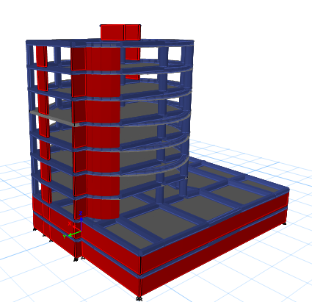
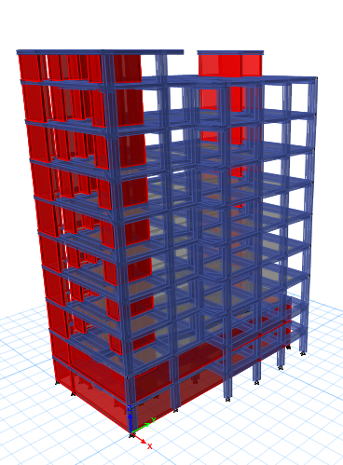
Blocks.
The building divided to two blocks.
Block No1.
Block No2.

Slide 32
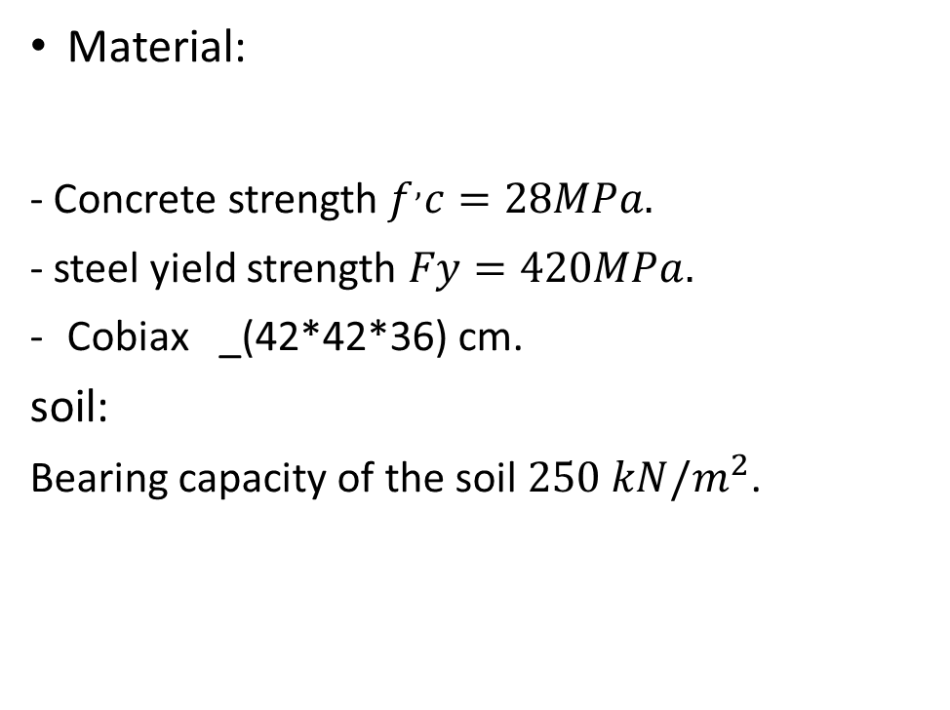
Design data:
Material:
- Concrete strength$f^{,}c=28MPa.$
- steel yield strength $Fy=420MPa.$
Cobiax _(42*42*36) cm.
soil:
Bearing capacity of the soil $250 kN/m^{2}$.
Loads.
Loads
block No. | Floor | Live load (KN/SM) | SID (KN/SM)
Block1 | basemnt floorS | 6 | 4
 | GF-6th floor | 5 | 4
 | Stair case | 1 | 2
Block2 | basemnt floorS | 6 | 4
 | GF-6th floor | 5 | 4
 | roof | 2 | 2
 | Stair case | 1 | 2

Slide 33
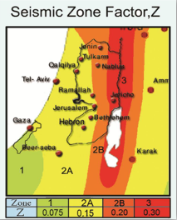
Design data:
Seismic factor:
Seismic factor
The location of the building in Nablus city.
Seismic zone factor | Z | 0.2
Soil profile |  | SC
Acceleration seismic coefficient | (Ca) | 0.24
Velocity seismic coefficient | (Cv) | .32
Seismic importance coefficient | (Ι) | 1
Structure design type |  | Building frame system -shear wall-concret
Over strength factor | (R) | 5.5
Seismic zone factor UBS-97

Slide 34
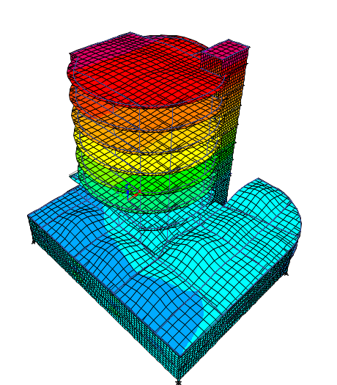
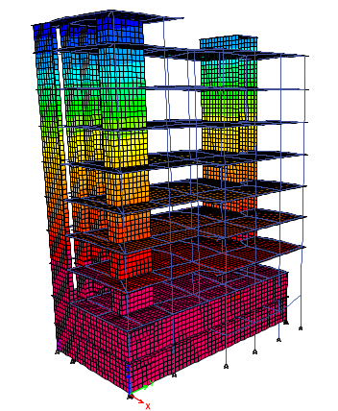
Verification check:
Compatibility check:
Block No1.
Block No2.

Slide 35
Verification check:
Equilibrium check:
The % of error in equilibrium check must be less than 5%.
Stress-Strain check:
The %of the error in stress strain check must be less than:
10% of column.
30% for beam and slab in two-way system.
10% for beam and slab in one-way system
Equilibrium check
blocks | Value of load (kN) |  | error
Block 1 | Etabs (V16) | manual calculated | % of error
Dead load | 65824.39 | 65058.22 | 1.16
Live load | 22388.91 | 23055.28 | 2.98
SID laad | 26721.91 | 26354.88 | 1.37
Block 2 | Etabs (V16) | manual calculated | % of error
Dead load | 34928.72 | 34212.69 | 2.05
Live load | 12479.32 | 12448.91 | 0.24
SID laad | 11689.6 | 11930.08 | 2.06

Slide 36
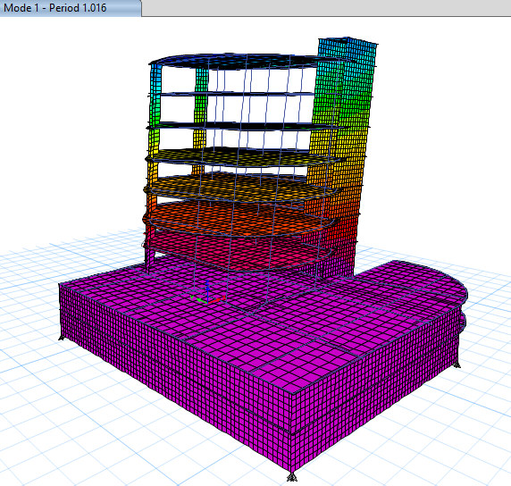
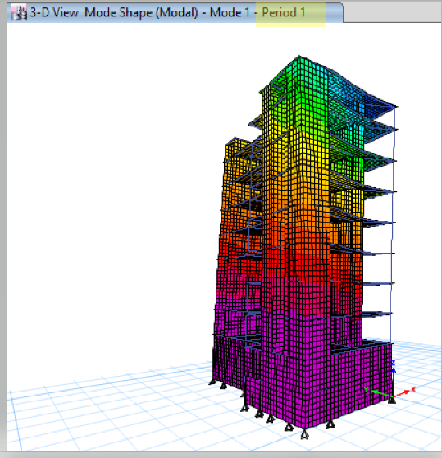
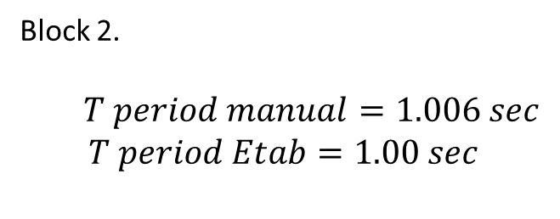
  Seismic check:
  Period check:
  Block 1.
𝑇 𝑝𝑒𝑟𝑖𝑜𝑑 𝑚𝑎𝑛𝑢𝑎𝑙=1.006 𝑠𝑒𝑐
𝑇 𝑝𝑒𝑟𝑖𝑜𝑑 𝐸𝑡𝑎𝑏=1.016 𝑠𝑒𝑐
Block 2.
  $$T period manual=1.006 sec$$
  $$T period Etab=1.00 sec$$

Slide 37
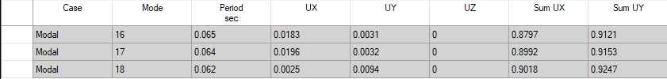
Seismic check:
  Mass partition check:
  The summation of Ux and Uy must bee reach 90%.
  Block 1.
  Need a 18 mode.

Slide 38

  Block 2.
  Need a 63 mode

Slide 39


  Drift check:
The displacement from Etabs for the two directions must be less than the limit displacement
  Block 1.
  The manual displacement less than the limit.
  Block 2.
  The manual displacement less than the limit.

Slide 40


Seismic check:
  Base shear check:
  The % of errors in base shear check must be less than 5%.
Block No1.
Block No2.
Manual calculated of base shear=5208.21 kN
Manual calculated of base shear=2643 kN
Etabs result
Etabs result

Slide 41
Deflection check:
  Deflection limit = Ln/240.
  After we checks all of the panel in the building, we made sure that there no values ​​from Etabs exceeding the limit.

Slide 42
Design and detailing of the structure elements:
1.Footings:
We are used one type of footings in this building.
mat footing.

Slide 43


Mat footing (Block1).
mat footing with thickness 90cm.
Bottom reinforcement.
Bottom reinforcement x-axis:
Bottom reinforcement y-axis:

Slide 44

Mat footing (Block1).
Top reinforcement.
Top reinforcement x-axis:

Slide 45

2. columns:
We are used three type of columns shape this building, rectangular ,square and circular shape with one dimension of each shape.

Slide 46



Slide 47
3. Slabs:
We used different systems of slab in this building.
Voided slab with thickness 50cm.
Two way solid slab with thickness 30cm.
One way ribbed slab with thickness 32cm.
One way solid slab with thickness 15cm for stair case.

Slide 48


Voided slab with thickness 50cm (Block1):
Basement floor layout.
Section in slab.

Slide 49

Voided slab with thickness 50cm (Block1):
Bottom reinforcement bars x-axis .
Bottom reinforcement bars y-axis .

Slide 50

top reinforcement bars x-axis .
top reinforcement bars y-axis .

Slide 51


4. Beams: we designed many different dimensions in this building.
Block No1.
Block No2.

Slide 52

Detailing of beam B1 in block 1.

Slide 53

Detailing of beam B9 in block 2.

Slide 54


5. Shear wall:
We used thickness 30cm for shear wall.
Block No1.
Block No2.

Slide 55





Electromechanical Aspects
HVAV
Design
Artificial lighting & Electrical
Acoustical
Design
Water Supply &
Drainage

Slide 56
HVAC system

Slide 57
HVAC Design
VRF (Variable Refrigerant Flow) system has been used.
Fan coil unit VRF system has been used.
Equipment from different companies (TOSHIBA, METALAIRE) has been used.
floor name | total clloing load kw
fgroung floor | 12.5
first floor | 19.3
second floor | 25.3
third floor | 31.52
fourth floor | 23.9
fifth floor | `17.5
sixth floor | 16.23

Slide 58

Outdoor units:
Out door VRF unit system

Slide 59


Indoor units:
Fan coil unit
Fresh air in take unit

Slide 60



Indoor units:

Slide 61

The distribution of the HVAC systems in the Basement floor

Slide 62
Artificial lighting Design

Slide 63



Lighting design for the manger room:
Luminaires selected
Lighting disruption swatch for head manger room
space | standard lux | lux desgion | ugr standerd | ugr desgion | uniform standerd | uniform desgion
head manager | 300 | 480 | <19 | <10 | 0.6 | 0.63
Simulation result

Slide 64


3D views for the manger room.

Slide 65


3D views for the lope room

Slide 66

Lighting design for lope:
Luminaires selected:
Lighting lope disruption
and swatch
space | standard lux | lux desgion | ugr standerd | ugr desgion | uniform standerd | uniform desgion
loope | 300 | 400 | <19 | <10 | 0.6 | 0.63
Simulation result

Slide 67
Lighting design for all room :
space name | stnderd lux | Lux design | UGR standard | UGR design | Uniformity standard | Uniformity design
Barcking | 75 | 92 | _ | _ | 0.4 | 0.36
Service office | 300 | 352 | _ | _ | 0.6 | 0.63
Lobby for theatr | 150 | 200 | <19 | <10 | 0.6 | 0.63
Cafeteria | 300 | 480 | _ | _ | 0.6 | 0.6
main head room | 300 | 480 | <19 | <10 | 0.6 | 0.63
WC | 100 | 115 | _ | _ | 0.4 | 0.33
Since all floors have the same spaces,
this table expresses all values ​​for all floors

Slide 68
Electrical Design

Slide 69



Slide 70

Electric board for light and socket

Slide 71
Load distribution and cable area
load | load (w) | total power (w) | I (load) w | IC. B Amp | I cable Amp | C.B Amp | Cable(ice)
light load | 2200 | 2200 | 10 | 11.5 | 13.2 | 16 | 2.5mm^2
socket load | 250 | 6250 | 28.4 | 32.6 | 37.5 | 40 | 8mm^2
main distrubuation for hvac | power (w) | I load (Amp) | IC.B (Amp) | I caple (Amp) | C.B (Amp) | Cable(Amp) | phase
ground floor | 15300 | 23.5 | 27 | 31.05 | 46 | 46Amp 10mm^2 | 3
first floor | 19000 | 29.3 | 29.7 | 34.155 | 46 | 46Amp 10mm^2 | 3
second floor | 29000 | 40.6 | 46.7 | 53.705 | 61 | 61Amp 10mm^2 | 3
third floor | 25600 | 39.4 | 45.3 | 52.095 | 61 | 61Amp 10mm^2 | 3
fourth floor | 26200 | 40.3 | 46.4 | 53.36 | 61 | 61Amp 10mm^2 | 3
fifth floor | 31600 | 48.6 | 55.9 | 64.285 | 61 | 61Amp 10mm^2 | 3
sixth floor | 17800 | 27.4 | 31.5 | 36.225 | 46 | 46Amp 10mm^2 | 3
Electrical load for first floor
main distribution for elevator | power (w) | I load (Amp) | IC. B (Amp) | I Caple (Amp) | C.B (Amp) | Cable (Amp) | phase
four elevators | 2800 | 44.8 | 50.6 | 57.5 | 60 | 61Amp (16mm^2) | 3
The electrical load of elevator
The electrical load of Hvac

Slide 72
Acoustical Design

Slide 73
Reverberation Time (RT60):
The spaces that were designed acoustically in the building :
Manger room in sixth floor
The absorption coefficient for the finished material were used.
finishing material | Absorption coefficient at every frequency (HZ)
 | 125 | 250 | 500 | 1000 | 2000 | 400 | 8000
plaster | 0.04 | 0.05 | 0.07 | 0.08 | 0.04 | 0.06 | 0.05
wooden floor | 0.07 | 0.2 | 0.41 | 0.49 | 0.51 | 0.54 | 0.53
glass | 0.1 | 0.06 | 0.04 | 0.03 | 0.03 | 0.03 | 0.04
door (hollow) | 0.14 | 0.35 | 0.25 | 0.2 | 0.03 | .03. | 0.04
calling | 0.15 | 0.2 | 0.15 | 0.1 | 0.15 | 0.1 | 0.15
ceramic | 0.01 | 0.01 | 0.04 | 0.04 | 0.04 | 0.07 | 0.07

Slide 74

Classroom RT60 according to Millington
 | FULL | 50% | EMPTY
freq (hz) | RT(60) | RT(60) | RT(60)
125 | 1.56 | 1.59 | 1.65
250 | 1.19 | 1.2 | 1.23
500 | 1.11 | 1.13 | 1.16
1 KHZ | 1.01 | 1.04 | 1.08
2KHZ | 0.88 | 0.89 | 0.9
4KHZ | 0.78 | 0.78 | 0.79

Slide 75


STC and IIC
External walls:
Internal wall
hz | 63 | 125 | 250 | 500 | 1k | 2k | 4k
db | 24 | 31 | 40 | 45 | 51 | 52 | 70
hz | 63 | 125 | 250 | 500 | 1k | 2k | 4k
db | 55 | 65 | 75 | 85 | 86 | 91 | 101
10 cm light block + 2mm plaster in both side +50 mm fiber class
Wall 1*71.2mm European l f5/G +1*100mm concrete +100 mm poliestere(10kg/m^3)+1*100 holly block

Slide 76


STC and IIC
Impact insulation class (IIC)
Ceiling
hz | 63 | 125 | 250 | 500 | 1k | 2k | 4k
db | 50 | 54 | 55 | 52 | 44 | 33 | 20
hz | 63 | 125 | 250 | 500 | 1k | 2k
db | 42 | 48 | 61 | 69 | 74 | 85
Sand bead under ceramic tile (40mm) +1*50rock wall T1 150+1*330mm concrete + 1*170mm rib slab +1*12.25gypsemna regular
1*50rock wall T1 150+1*60mm concrete+ 1*330mm concrete +1*70mm concrete savr-60
+Z purlin(700*70)mm empty cavity

Slide 77

Loud speaker
The type of speaker was used in the meeting room:
two speakers from Yamaha club Company were used on the walls and the max SPL value for this type is 88 dB

Slide 78
Fire fighting system

Slide 79




firefighting plan of the ground floor
The symbols of the fire fighting and evacuation systems in the building

Slide 80






Contests of fire fitting system
Smoke detector
Heat detector
Sprinkler
Fire hose
Dry stand pipe
Emergency sign

Slide 81


space name | fire fitting way
office | drw boder extinguisher
computer room | drw boder extinguisher
barcking | water sprinker
lope | water sprinker
caffteria | water sprinker
manger room | dry sprinkler

Slide 82
Water Supply System

Slide 83


Water supply system
Water Tanks Used

Slide 84
Water consumption
Consumption for drinking and domestic Consumption
Firefighting consumption
number of person | person cosume /day(L) | total consume/day(L)
160 | 8 | 1280
tupe of consumption | cosumption (m^3)
fire fitting | 170
Tank volume 4000L to provide the budling water in case of cutoff water

Slide 85

Water pipe dustrpution

Slide 86
Drainage System

Slide 87


Pipes used
The total number of fixture units is 210 fu the main diameter for the main stack is ${4 }^{̎}$
The diameters for the pipes as follows
Horizontal pipe for the water closet is ${4 }^{̎}$ with slope 1%
Horizontal pipe for the lavatory is ${2 }^{̎}$ with slope 2%
The pipe between the manholes is ${6 }^{̎}$ with slope1%
The rain water main vertical stack ${4 }^{̎}$
show fu for each floor and for horizontal and vertical pipe

Slide 88

Bath Room Drainage

Slide 89
Quantity Surveying and Cost Estimation

Slide 90

The total cost of the building is 19041028 NIS and the total area of the building is 9700m² which means that the total unit cost per m² is1866.518NIS/m², nearly 600 $/m²
Earth work = 1687770 NIS
Foundation = 838615NIS
Building (construction) = 1549217NIS
Finishing = 6113730NIS
Electrical = 378590NIS
Mechanical =1549217 NIS

Slide 91
Thank you
Prepared by :
Ameen Hamed
Jaser Jamil Qaq
Mohammad Sholi
Supervisor :
Eng. Alaa Shaheen

