Slide 1


An-Najah National University
Faculty of Engineering
Civil Engineering Department
جامعة النجاح الوطنية
كلية الهندسة ونكنولوجيا المعلومات
Graduation Project I
Structural Design of Nazareth Gate in Nazareth-City Palestine
1

Slide 2
Prepared by:
Marah Mosleh
Shimaa Ali
Tala Jamous
Under supervision: Dr.Ibrahim Arman
2

Slide 3
Outline:
1. General Description
2. Preliminary Design
3. 3-D Modeling and Analysis
4-Verification of structural design
5- Structural design
3

Slide 4
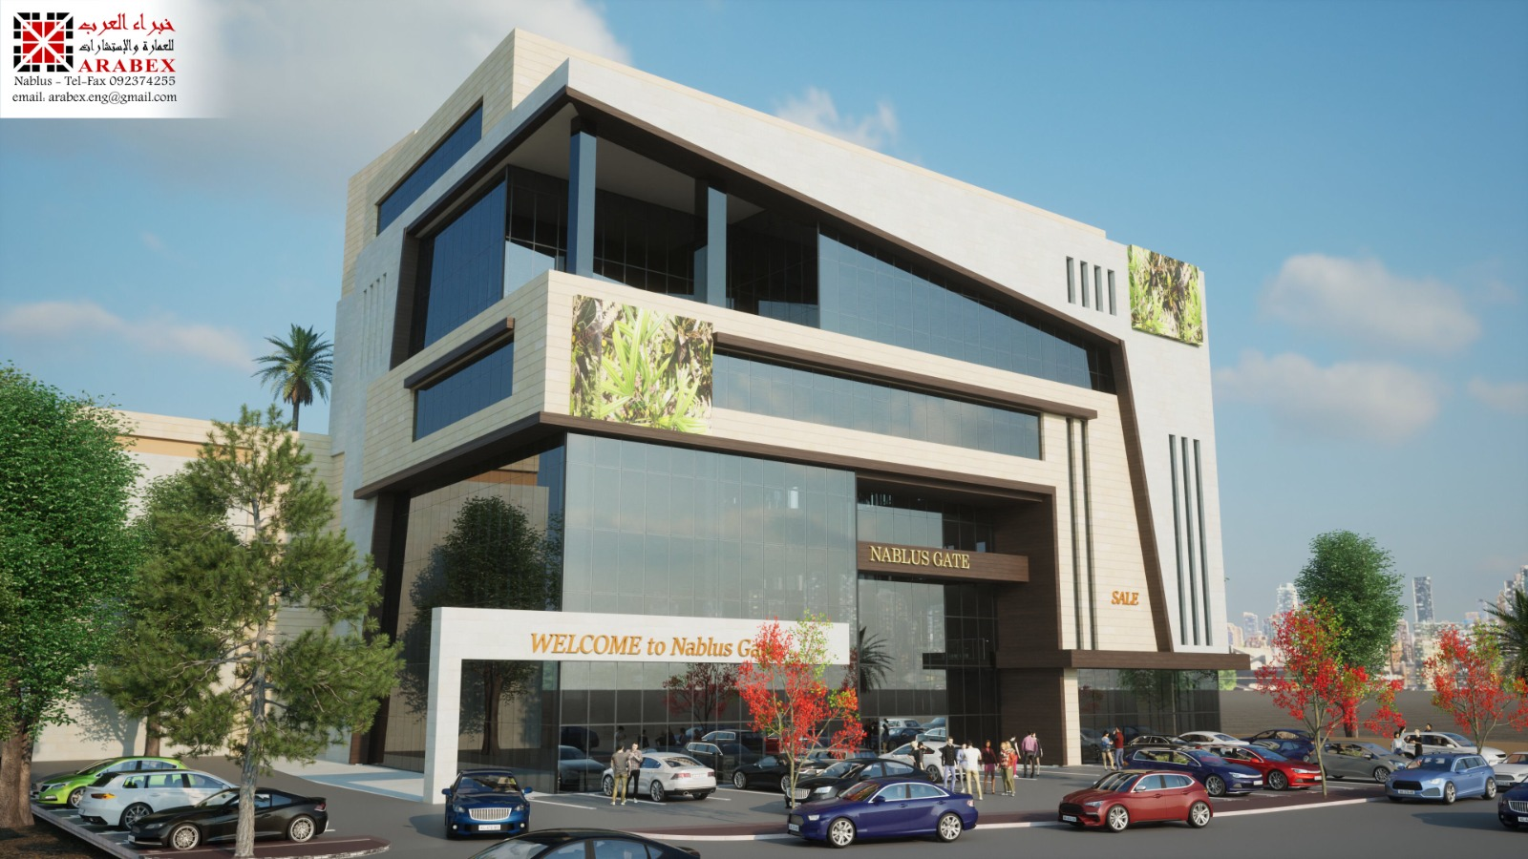
Member
4

Slide 5
General Description
5

Slide 6
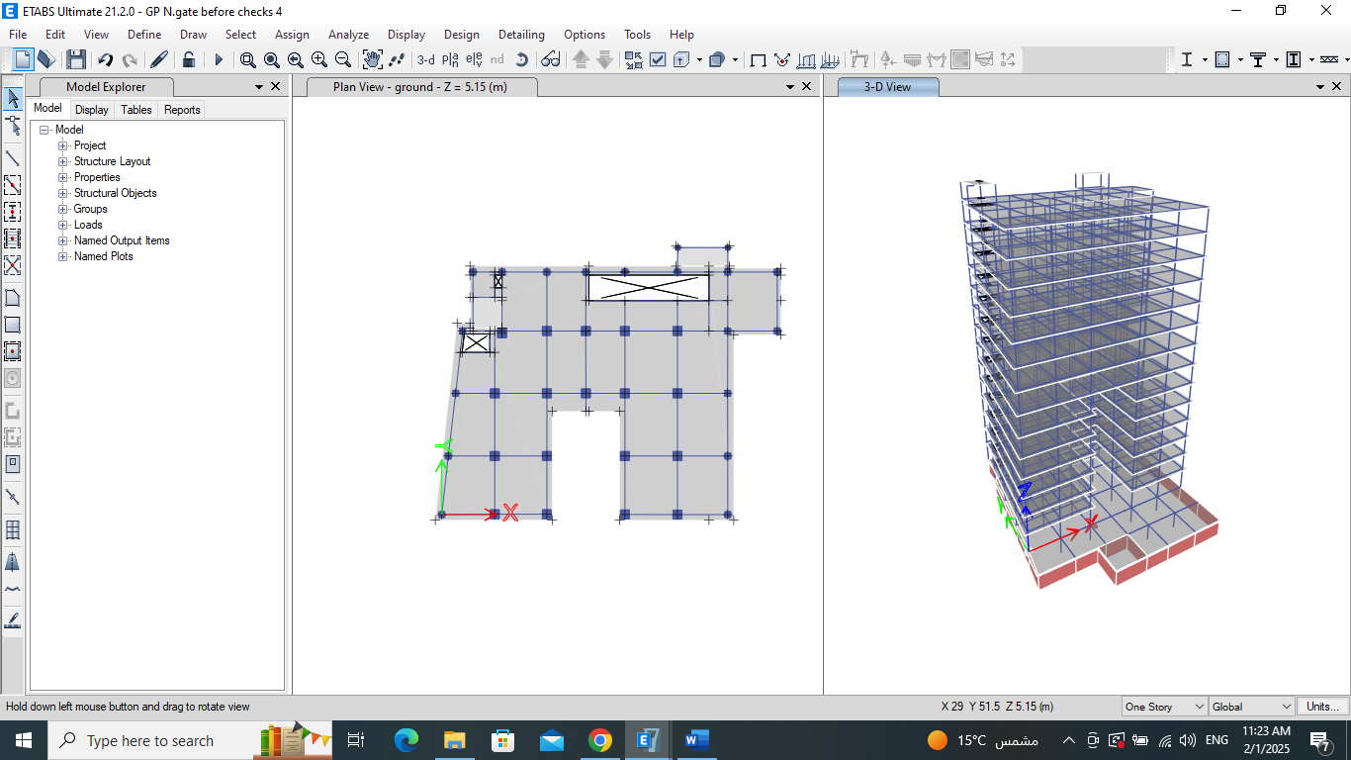
General Description
  Complex include:
parking lots, and offices.
serving as a multifunctional building.
Project Description:
  Location:
Near Galilee Street,
in Nazareth City,
Palestine.
  Area:
Around 17,600 m2.
  Floors:
  Level and Height:
15 floor : Basement, Ground floor and 13 story
> on 412 meters above the sea level.
> Total height = 63 m.
  Bearing capacity and Soil Classification:
  Site coordinate:
> Bearing Capacity =
450 kN/m2
> Soil Classification: class B
lines of longitude and latitude 35°18'39"E 32°42'25"N .
6

Slide 7
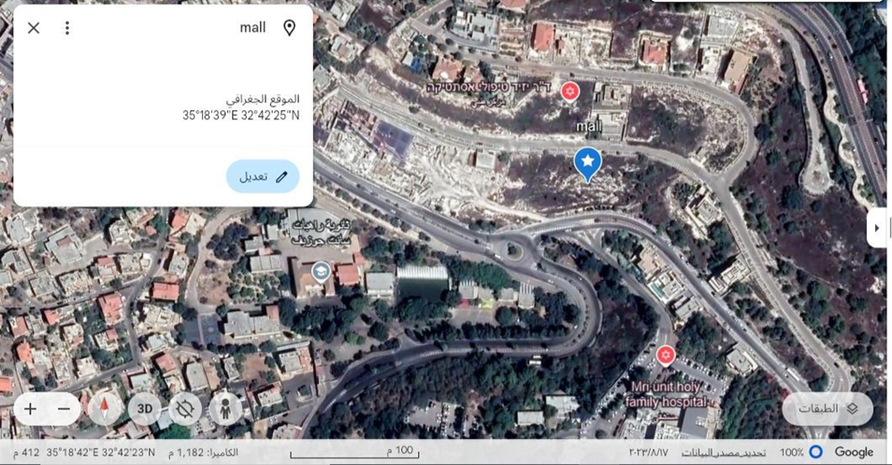
Location and elevation of proposed Nazareth Gate building.
7

Slide 8
Floor No. | Height (m) | Usage
Basement | 4 | Parking and water tanks
Ground floor | 5.15 | Supermarket
1st | 4.35 | Supermarket
2nd | 4.35 | Children’s toys exhibition
3rd | 4.35 | Sports equipment exhibition
4th | 4.35 | Housewares exhibition
5th | 4.35 | Electrical appliances exhibition
6th - 13 th | 4.35 | Offices
General Description
Floors Information:
8

Slide 9
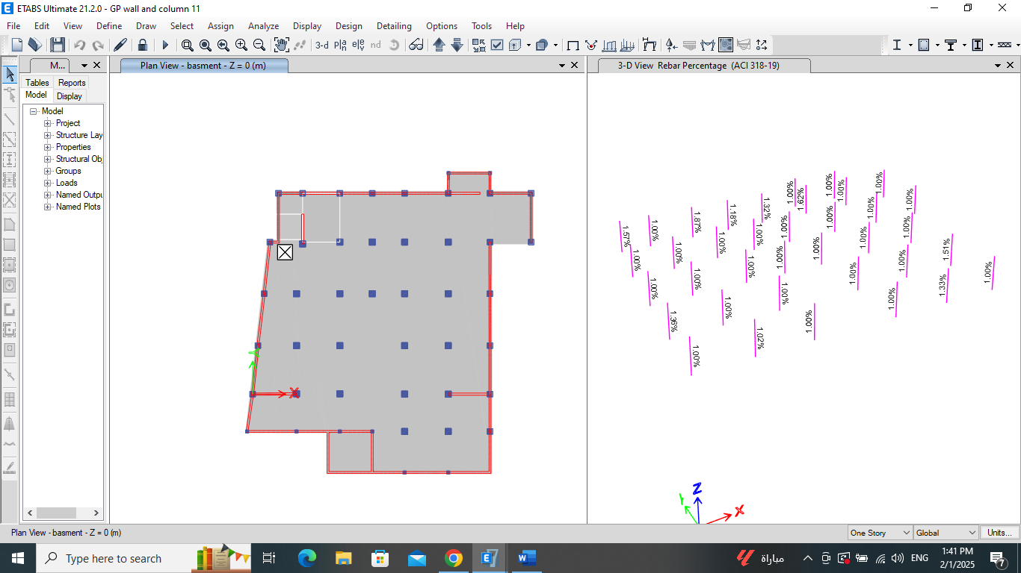
Basement
9

Slide 10
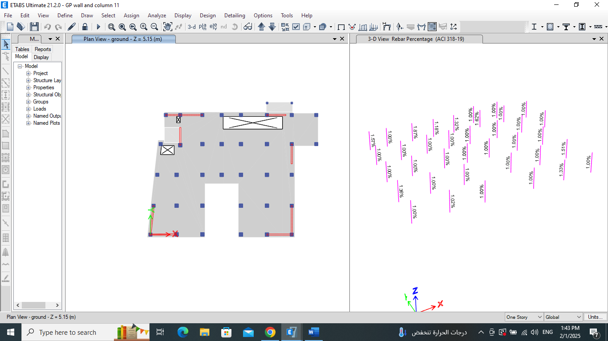
Ground floor
10

Slide 11

1st floor - 5th floor
11

Slide 12
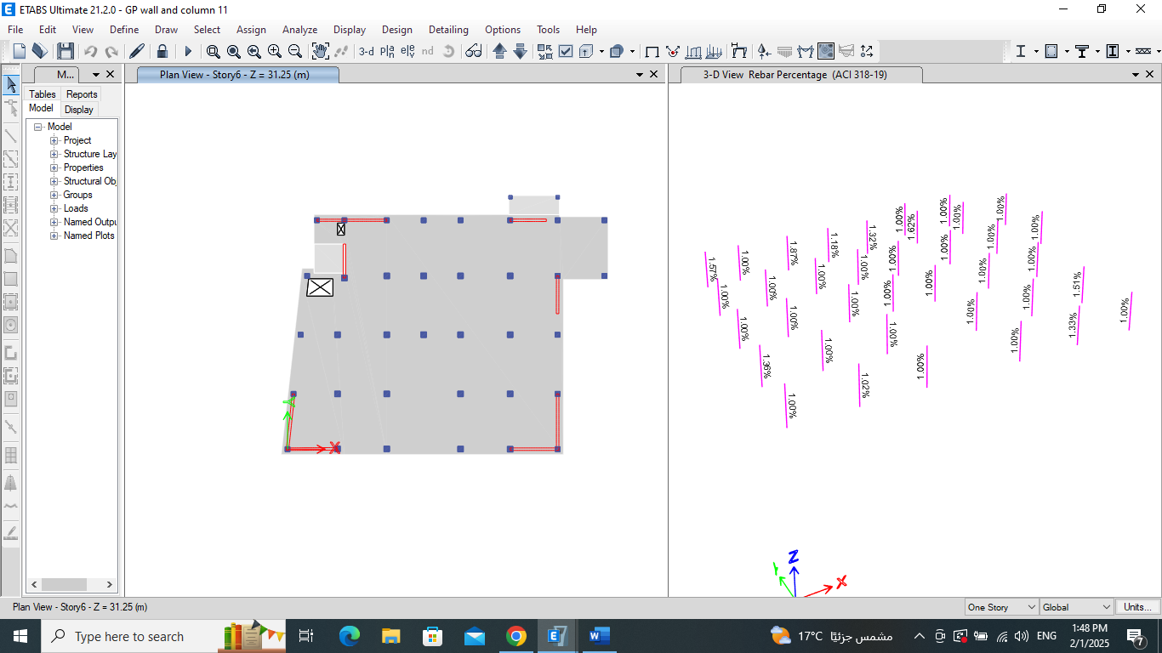
6th floor - 13th floor
12

Slide 13
General Description
Structural Materials:
Compressive strength (fc’) for slab | 36 MPa
Compressive strength (fc’) for columns and foundation | 36 MPa
Reinforcing Steel Grade | 60 (A572)
13

Slide 14
General Description
Loads:
Gravity Loads:
Lateral Loads:
Dead loads
Superimposed dead loads
Live loads
Snow loads
Seismic loads
Soil loads
14

Slide 15
General Description
Gravity Loads:
  Live Load:
  Snow Load:
0.20 kN/m2
Floor No. | Usage | Live load (kN/m2)
Basement | Parking | 3.5
Ground floor to 5th | Supermarket and stores | 5
6th - 13th | Office rooms | 3
15

Slide 16
General Description
Gravity Loads:
  Superimposed Dead Load
Line load at building perimeter
Floor No. | Floor height (m) | Line load (kN/m)
Ground | 5.15 | 2.83
1st - 13th | 4.35 | 2.4
Non-Structural elementts | Weight per unit area (kN/m2)
Tiles | 3.11
False ceiling | 0.25
Exterior walls (glass) | 0.55
16

Slide 17
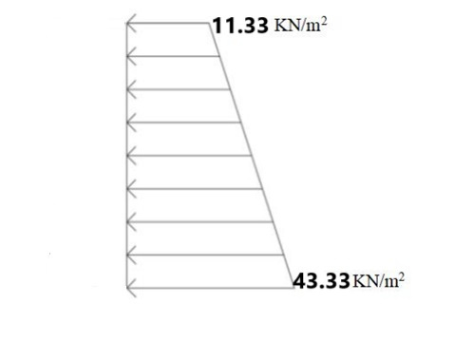
General Description
Lateral Load:
• Soil Load:
- Earth pressure:
p =k × γs × z =0.5 × 16 × 4=32 kN/m2
- Seismic earth pressure:
∆p = 0.4 × kh × γs ×z=0.4 × 0.252 × 16 × 4 = 6.45 kN/m2
-Surcharge load:
∆p = k × γs × heq=∆p = 0.5 × 16 × 0.61 = 4.88 kN/m2
17

Slide 18
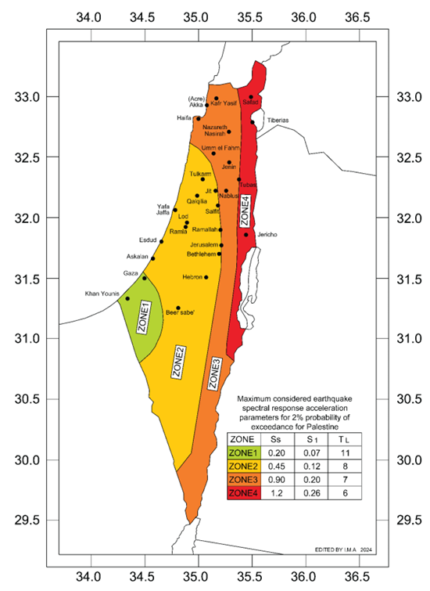
General Description
Lateral Load:
• Seismic Load:
Mapped acceleration parameters | Ss | 0.7
Mapped acceleration parameters | S1 | 0.14
Mapped acceleration parameters | T | 7
Site coefficient | Fa | 0.9
Site coefficient | Fv | 0.8
Design spectral acceleration | SDS | 0.42
Design spectral acceleration | SD1 | 0.074
Risk categoryof the building | III | III
18

Slide 19
General Description
Lateral Load:
• Seismic Load:
Importance factor | Ie | 1.25
Seismic design category | C | C
Lateral forces resisting system: | Dual system with intermediate moment frame | Dual system with intermediate moment frame
Response modification factor | R | 5.5
Overstrength factor | Ωo | 2.5
Deflection amplification factor | Cd | 4.5
Structural Period | 1.87 | 1.87
19

Slide 20


General Description
Computer Programs:
20

Slide 21
Structural Preliminary Dimension
21

Slide 22
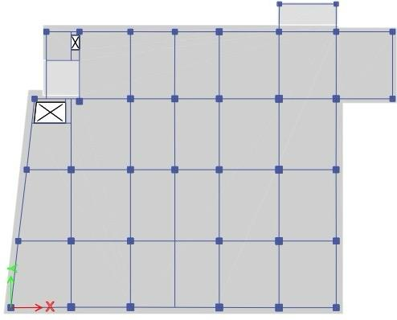
Preliminary Design:
Slab Layout:
Using two-way solid slab
slab thickness (h) = 200 mm.
22

Slide 23
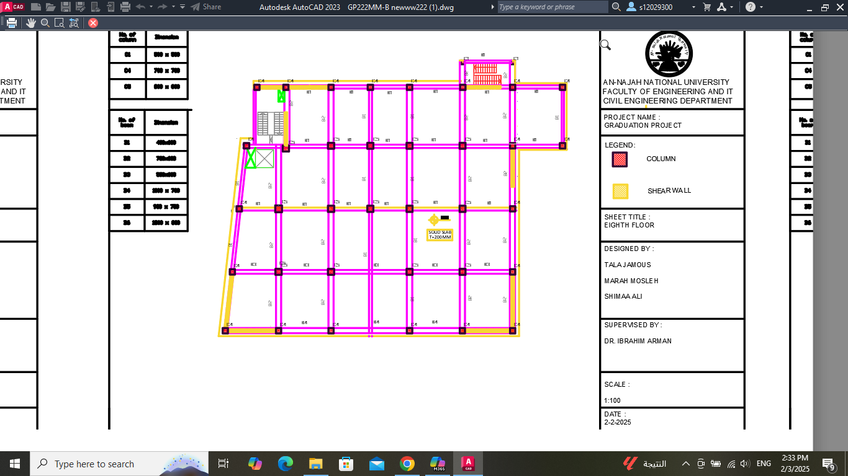
Preliminary Design:
Beam and column Layout:
Beams | Thickness | Width
B1 | 600 | 400
B2 | 600 | 500
B3 | 1000 | 700
23

Slide 24
Preliminary Design:
Group No. | Columns' Dimensions (mm) | Columns' Dimensions (mm)
Group 1 (Basement - 1st) floor | center | 1200 x 1200
Group 1 (Basement - 1st) floor | edge | 800 x 800
Group 2 (2nd - 4th) floor | center | 1050 x 1050
Group 2 (2nd - 4th) floor | edge | 700 x 700
Group 3 (5th - 7th) floor | center | 900 x 900
Group 3 (5th - 7th) floor | edge | 600 x 600
Group 4 (8th - 10th) floor | center | 750 x 750
Group 4 (8th - 10th) floor | edge | 500 x 500
Group 5 (11th - 13th) floor | center | 600 x 600
Group 5 (11th - 13th) floor | edge | 400 x 400
Preliminary Dimensions of Columns:
24

Slide 25
3-D Modeling and Analysis
25

Slide 26
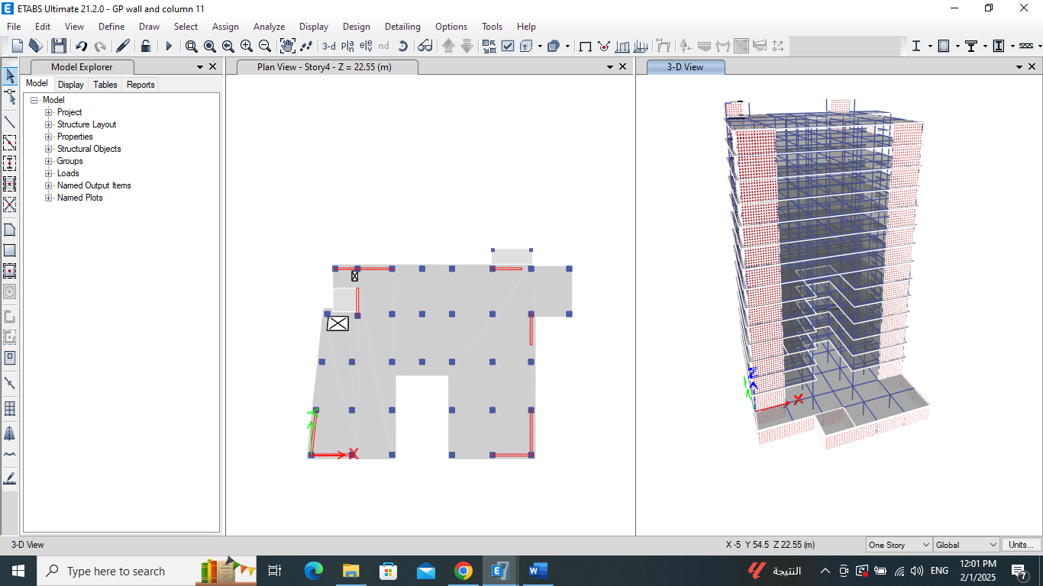
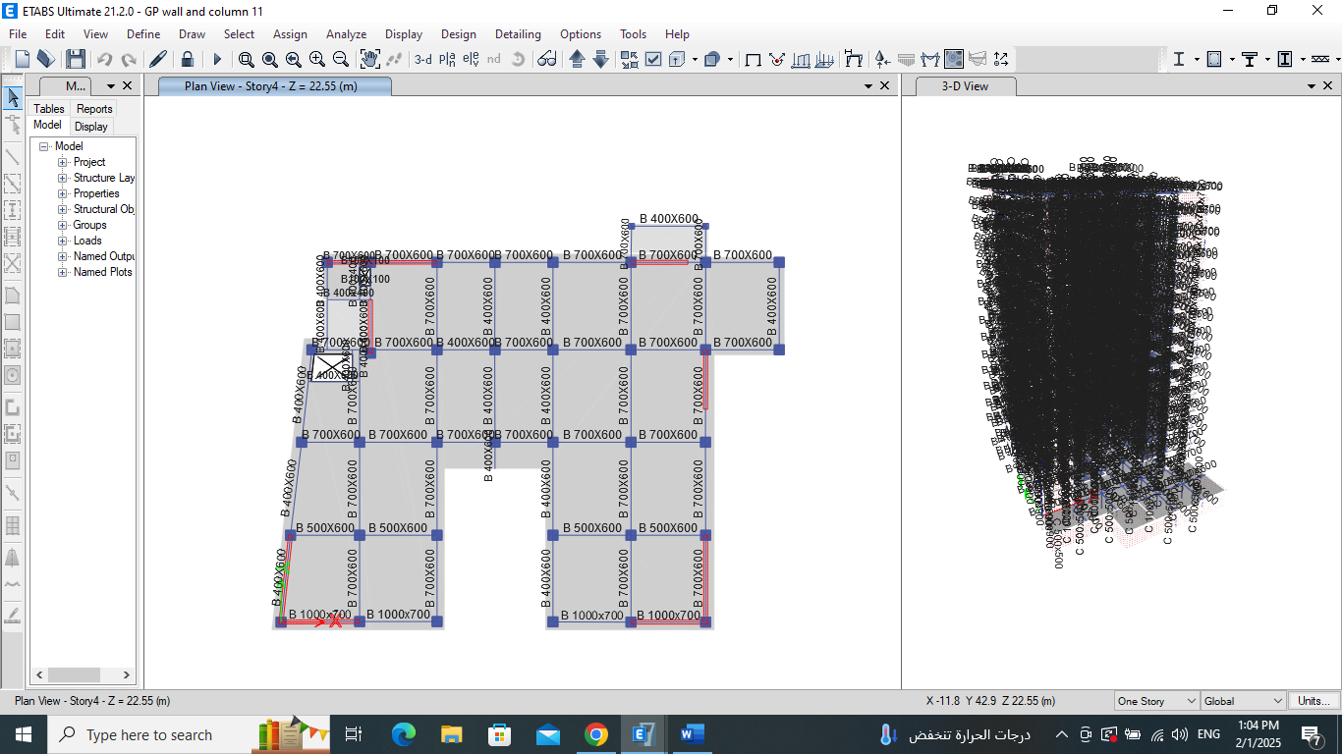
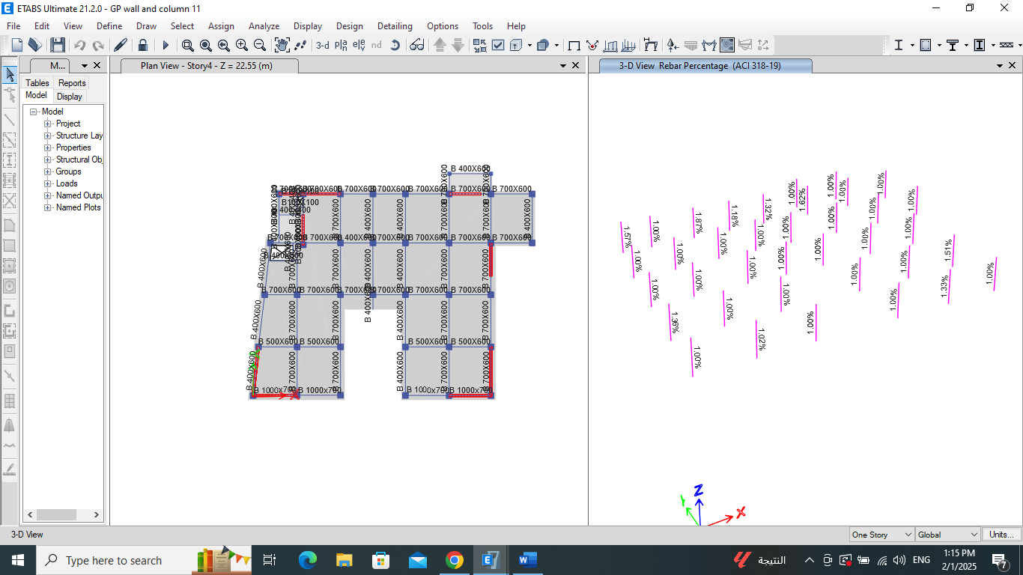
Evaluation of the Preliminary Design:
Walls
Beams
Columns
26

Slide 27
Beams | New Beams' Dimensions (mm)
B1 | 400 x 700
B2 | 700 x 600
B3 | 500 x 600
B4 | 1000 x 700
B5 | 900 x 700
B6 | 1300 x 800
27

Slide 28
Group No. | Old Columns' Dimensions (mm) | Old Columns' Dimensions (mm) | New Columns' Dimensions (mm) | New Columns' Dimensions (mm)
Group 1 (Basement - 1st) floor | center | 1200 x 1200 | center | 1000 x 1000
Group 1 (Basement - 1st) floor | edge | 800 x 800 | edge | 900 x 900
Group 2 (2nd - 4th) floor | center | 1050 x 1050 | center | 900 x 900
Group 2 (2nd - 4th) floor | edge | 700 x 700 | edge | 900 x 900
Group 3 (5th - 7th) floor | center | 900 x 900 | center | 800 x 800
Group 3 (5th - 7th) floor | edge | 600 x 600 | edge | 700 x 700
Group 4 (8th - 10th) floor | center | 750 x 750 | center | 800 x 800
Group 4 (8th - 10th) floor | edge | 500 x 500 | edge | 700 x 700
Group 5 (11th - 13th) floor | center | 600 x 600 | center | 800 x 800
Group 5 (11th - 13th) floor | edge | 400 x 400 | edge | 700 x 700
28

Slide 29
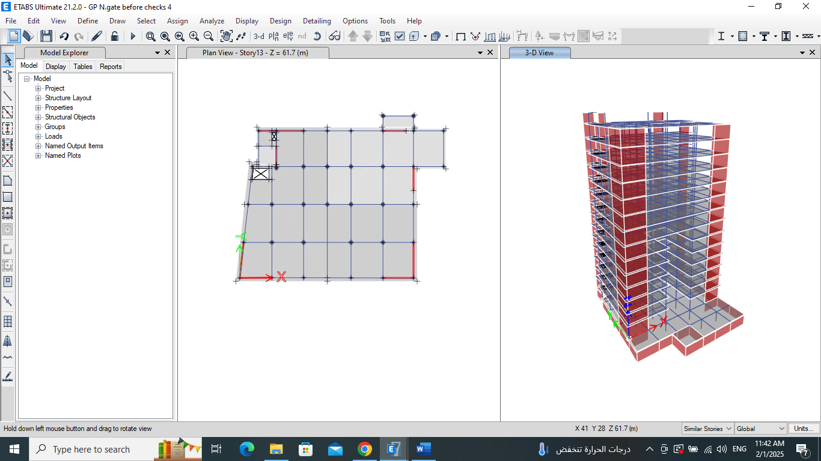
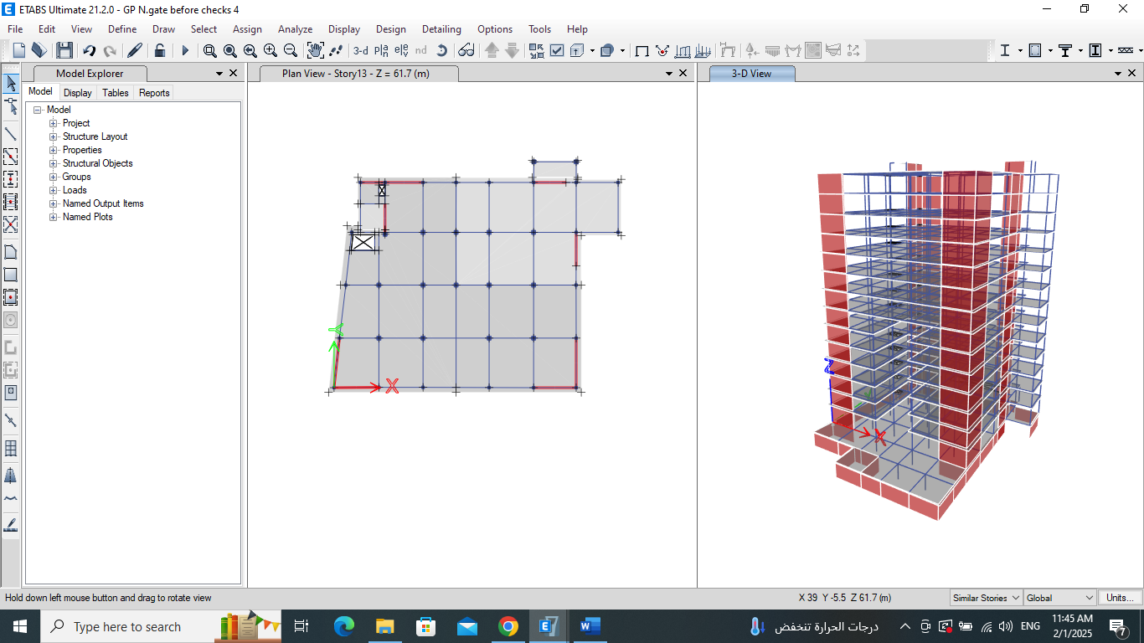
29

Slide 30
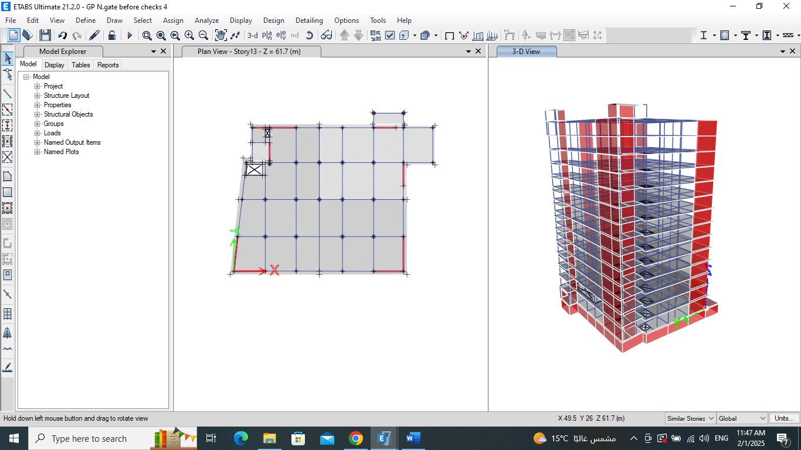
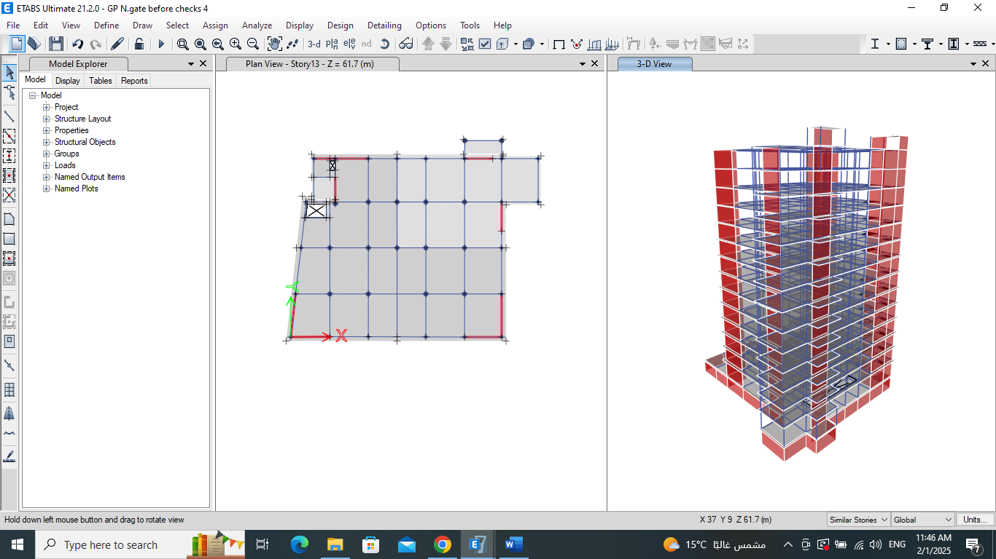
30

Slide 31
Verification of Structural Analysis
31

Slide 32
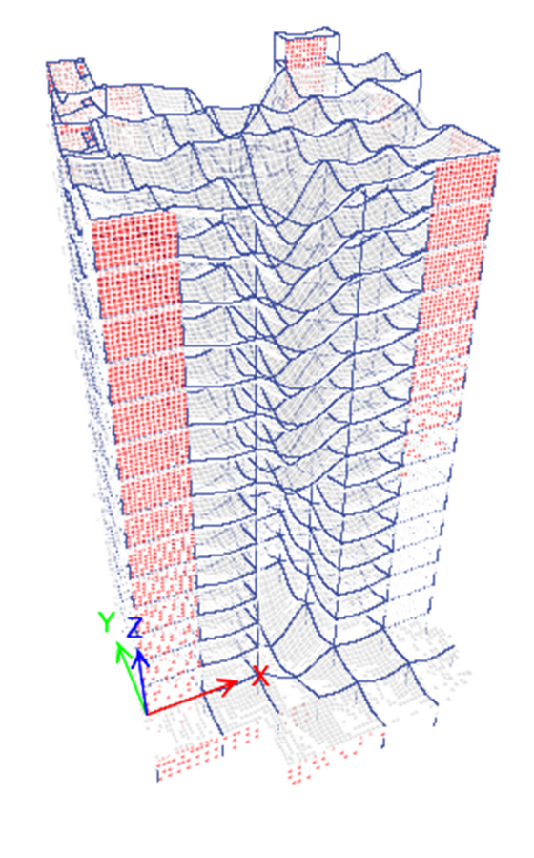
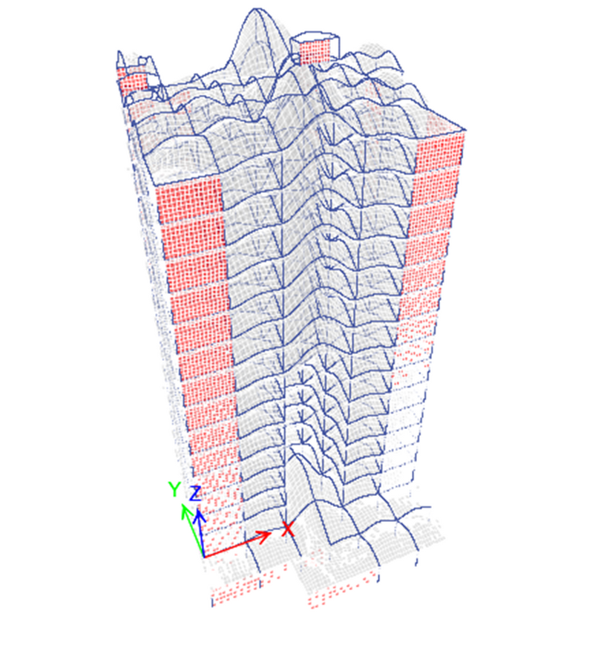
Verification of Structural Analysis:
Check of compatibility

Slide 33
Verification of Structural Analysis:
Check equilibrium:
 | Calculated Total weight KN | ETAPS KN | Difference %
Check equilibrium for self-weight load | 15035.65 | 14840.67 | 1.3%
Check equilibrium for superimposed dead loads (SD) | 89660.706 | 90161.9983 | 0.56%
Check equilibrium for live loads | 85616.16 | 85669.7112 | 0.06%
33

Slide 34
Verification of Structural Analysis:
Check of internal forces:
 | Calculated Value | ETAPS | Difference %
Internal check for slab and beam (Mo) | 1034.15 kN.m | 955.75 kN.m | 8.2%
Internal check for column (axil load) | 126 kN | 128.77 kN | 2.15%
34

Slide 35
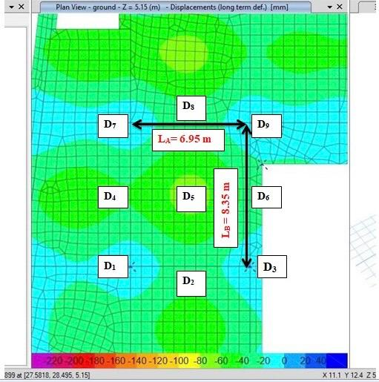

Verification of Structural Analysis:
Deflection computation:
Long term deflections for slab systems:
Selected panel of ground floor deflection.

Slide 36
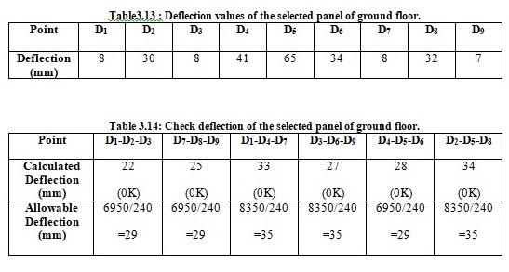
Verification of Structural Analysis:

Slide 37
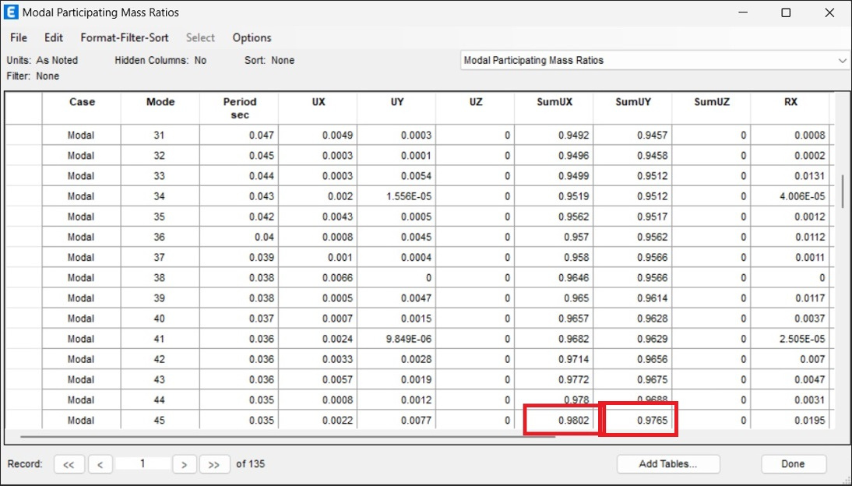
Verification of Structural Analysis:
Seismic Check:
1-Check mass participation ratio:
the value in X and Y -direction is 98% which is good.
37

Slide 38

Verification of Structural Analysis:
Seismic Check:
2-Check equilibrium of base shear:
Manual calculation of base shear in x-direction and y-direction:
V = Cs×W=7796 KN
From ETABS
the value equal to 7702.6172 kN
Diffrence (%) =(7796-7702.6)/7796 x100%=1.15% <10% (OK)
38

Slide 39

Verification of Structural Analysis:
Seismic Check:
3-Check time period by Rayleigh method:
in X-direction
in Y-direction
Manual calculation:
Manual calculation:
The value from ETABS =2.5
The value from ETABS =2.7
Difference (%)=(2.5-2.5)/2.5*100% = 0%
Difference (%)=(2.7-2.7)/2.7*100% = 0%
39

Slide 40
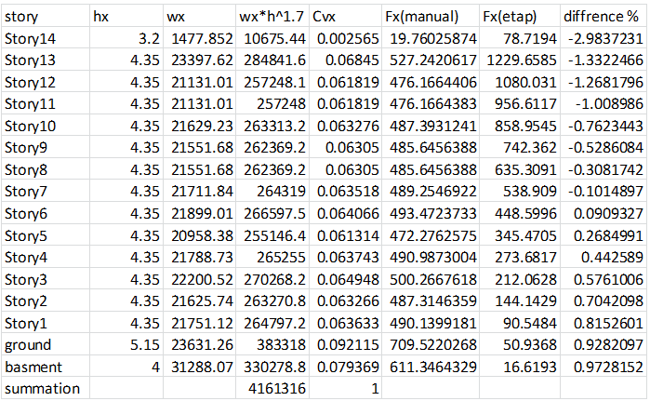

Verification of Structural Analysis:
Seismic Check:
4-Check Story Forces:
40

Slide 41
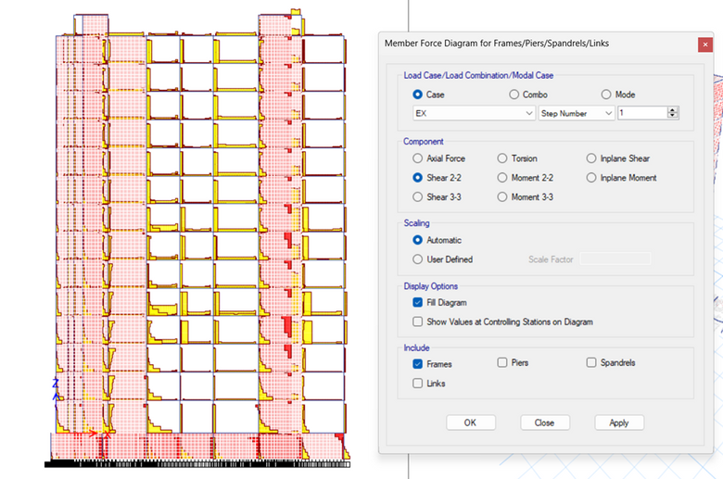
Verification of Structural Analysis:
Seismic Check:
5-Type of Lateral Force Resisting System:
Total force =7681 KN
Force from wall =4974
4974/7681=0.6........60%
This indicates that the system is dual system
41

Slide 42
Verification of Structural Analysis:
Structural Irrigularity:
Seismic design category is C
1-Horizantal Irregularity:
2- Vertical Irregularity:
Type | Commentary
1 | Does not exist
2 | Not applicable
3 | Not applicable
4 | Does not exist
5 | Exist
Type | Commentary
1 a | Not applicable
1 b | Not applicable
2 | Not applicable
3 | Does not exist
4 a | Not applicable
4 b | Does not exist
42

Slide 43
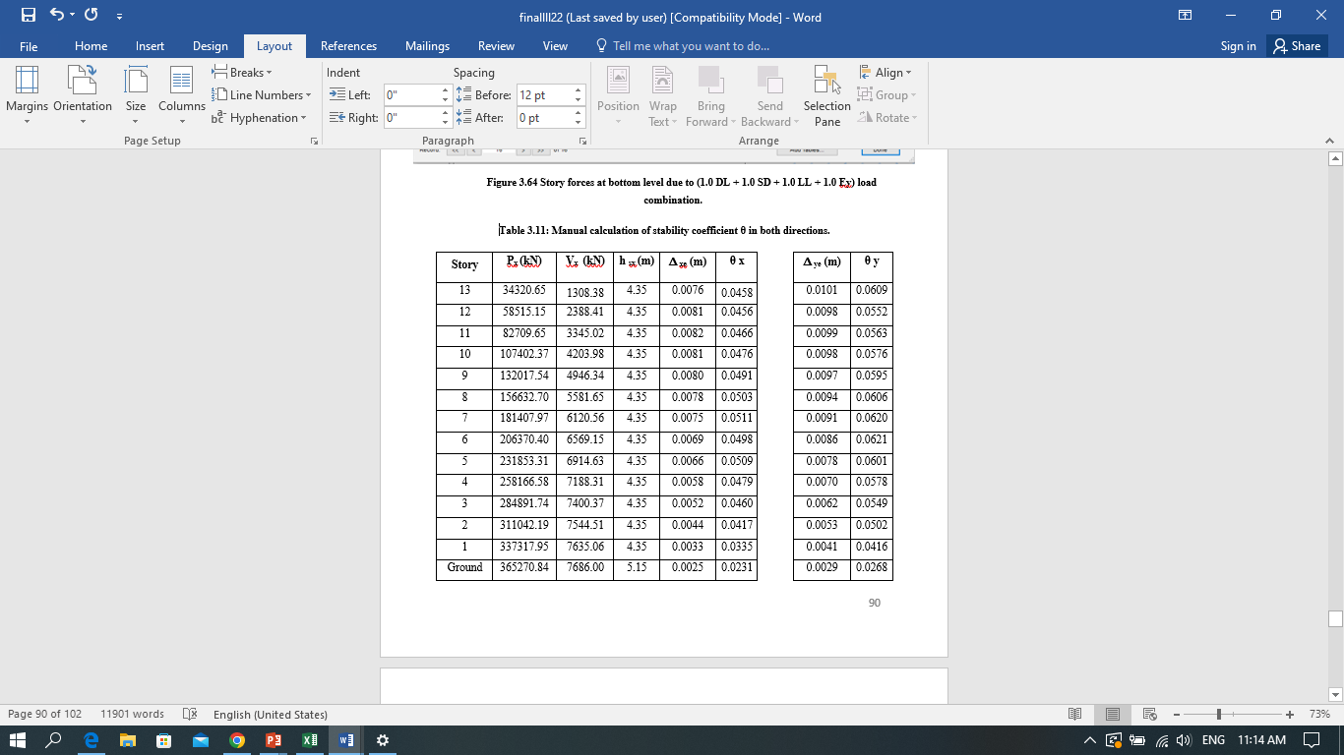
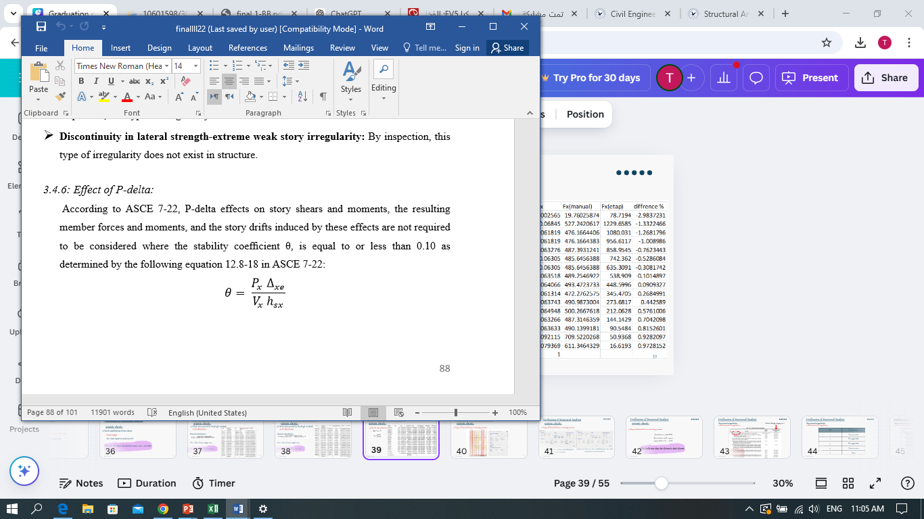

Verification of Structural Analysis:
Effect of P-delta:
If θ < 0.1 ----> the effect of P-delta
will be neglected
θ in both directions < 0.1
SO, the effect of P- delta neglected
43

Slide 44
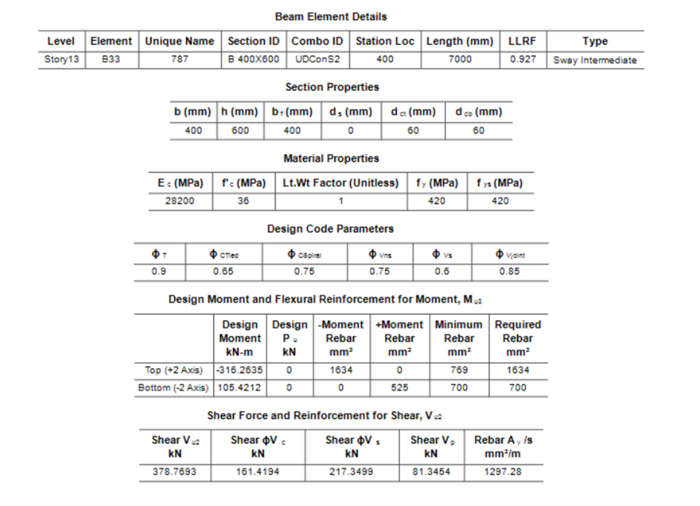
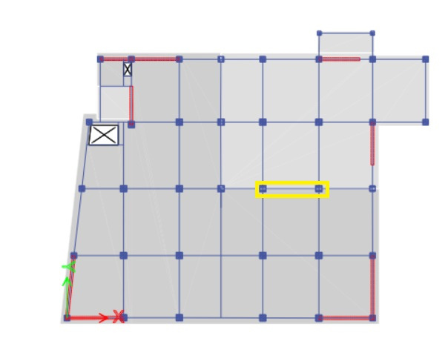
Verification of Structural Design:
Beam design verification:
:beam’s dimensions
width =400mm , depth =600mm ,
length =6.95 m
44

Slide 45


Verification of Structural Design:
Beam design verification:
1- Flexural design check:
Mu = 316.26 kN.m.
ρ = 0.0075
As = 1631 mm2
As From ETABS = 1634 mm2
Difference (%) = ((1634 / 1631)-1) * 100% = 0.18%< 10% %
45

Slide 46
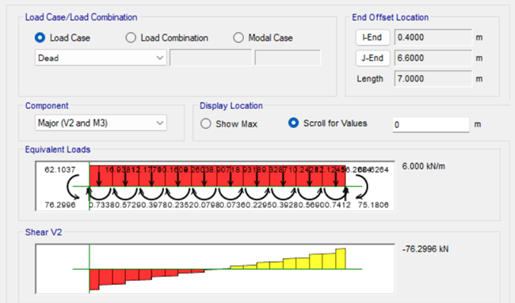
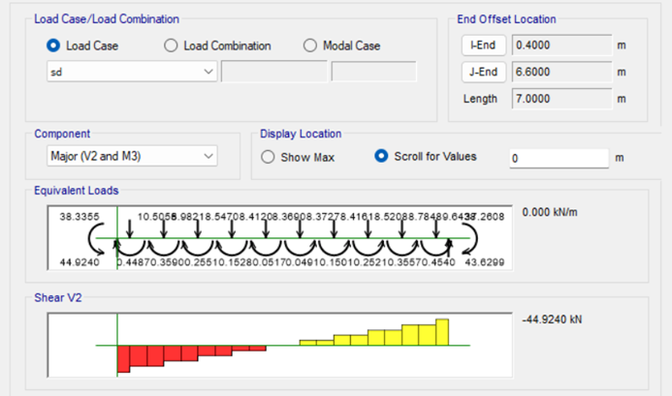
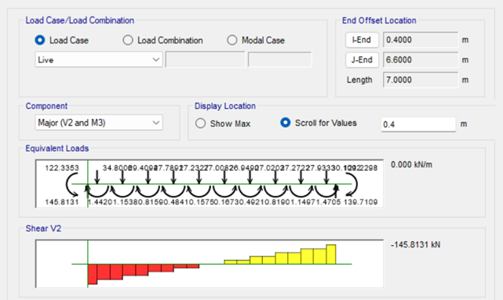
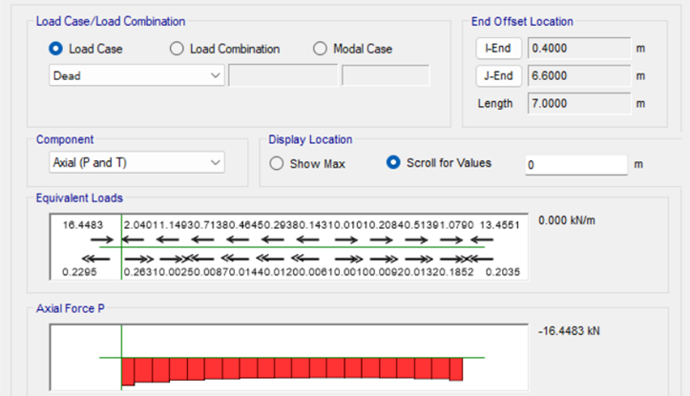
Verification of Structural Design:
Beam design verification:
2- Shear design check:
46

Slide 47
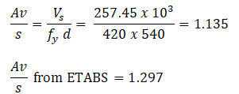
Verification of Structural Design:
Beam design verification:
2- Shear design check:
Vg = 1.2 (76.3 + 44.92) + 1.6 (145.8) = 378.744 kN.
∅Vc = 247.54 kN
Vs = 257.54 kN
Difference % = (1.135-1.297)/1.135=5.7%
47

Slide 48

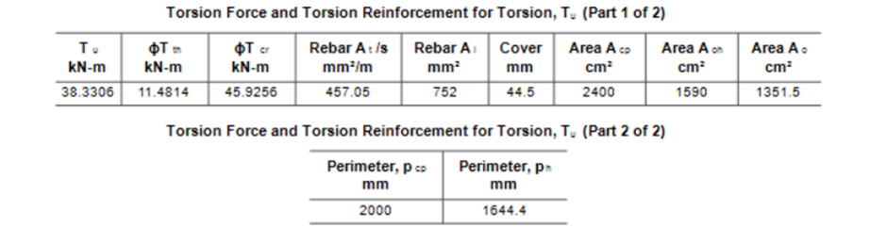
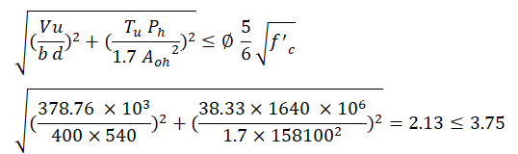
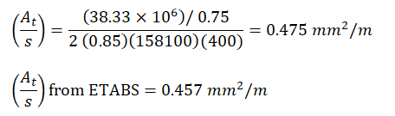
Verification of Structural Design:
Beam design verification:
3- Torsion design check:
Tu = 38.33 kN.m
Difference % = (0.475-0.457)/0.475 =3.8%
48

Slide 49
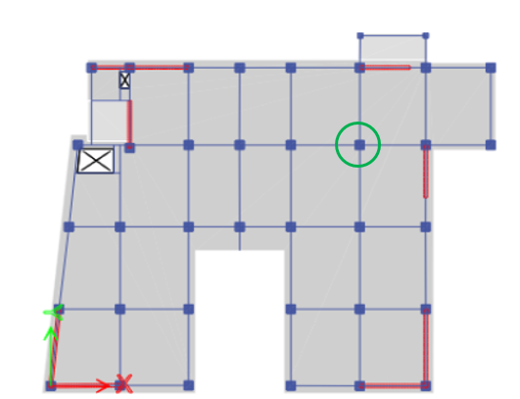

Verification of Structural Design:
Column design verification:
1- Longitudinal reinforcement:
Bresler equation:
49

Slide 50

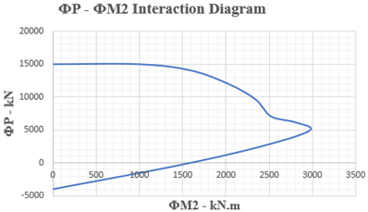
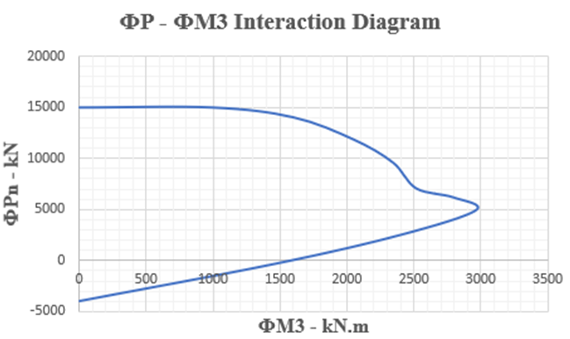

∅Pn = 15000 kN > Pu = 14971 kN --> OK
50

Slide 51
Verification of Structural Design:
Column design verification:
2- shear reinforcement:
∅Vc = 3174 kN
Vu (from ETABS) = 33.75 kN
∅Vc > Vu ⟶ No need for shear reinforcement
51

Slide 52
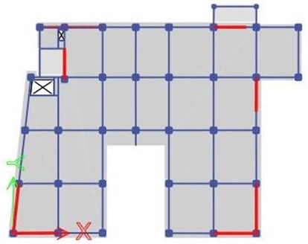

Verification of Structural Design:
Shear wall design verification:
:pier’s dimensions
width = 350 mm , height = 4.35 m ,
length = 7 243 mm
52

Slide 53
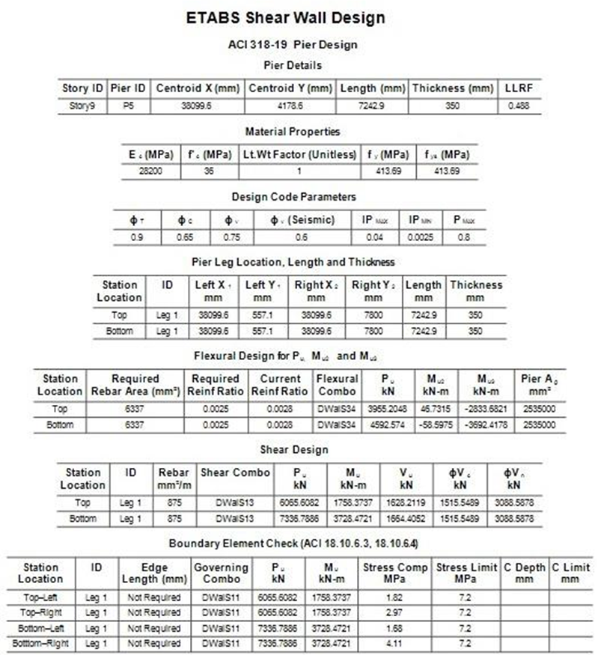
Verification of Structural Design:
Shear wall design verification:
1- Longitudinal reinforcement:
AS from ETABS = 6337 mm2.
Reinforcement = 6337 / (2×7.24) = 437.64 mm2/m.
use 1Φ16mm/250mm.
53

Slide 54
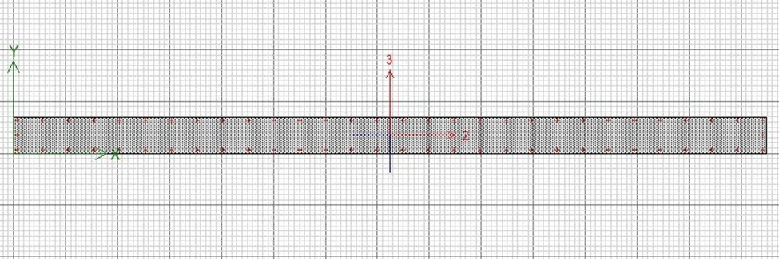
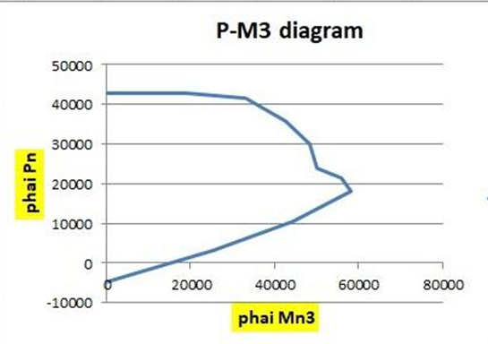
Interaction diagram for 0.0025 pier longitudinal reinforcement.
54

Slide 55
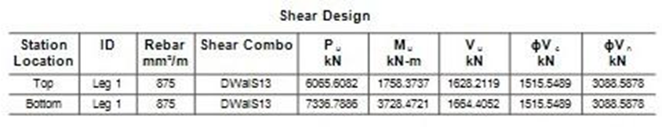
Shear design check:
Details of selected pier’s shear design:
Vn = 5248 KN
ф Vn = (0.6) 5248 = 3149 kN.
ф Vn (ETABS) = 3088.6 kN.
Difference % = 2% < 10% (OK).
Ф Vc = 1551.5kN.
Ф Vc (ETABS) = 1515.6 kN.
Difference % = 2.3% < 10% (OK) .
55

Slide 56
Structural Design
56

Slide 57
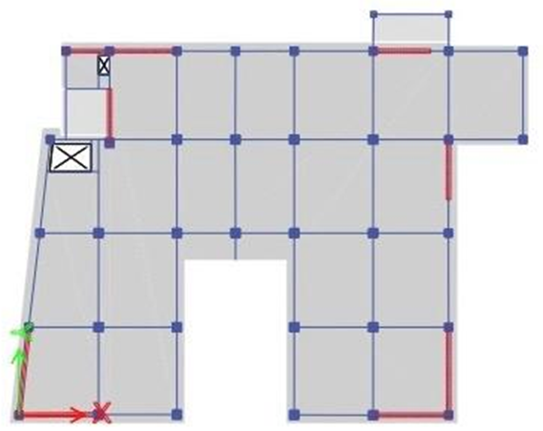
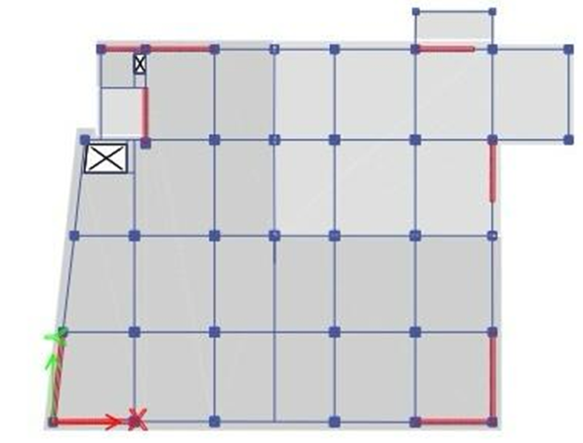
Design of slabs:
The selected slabs in the story 5 and story 13 ,will be designed according to ACI 318-19 code.
(Slabs thickness is 200 mm).
Selected slab to be designed in story 5.
Selected slab to be designed in story 13.
57

Slide 58

Check slabs for punching shear:
All columns in this structure are connected to beams or shear walls,
so there is no punching shear on the slabs.
Check slabs for wide beam shear:
∅Vc = 72.2 kN.
All values of shear in story 5 lower than ∅Vc, so there is no need for shear reinforcement in floor 5.
1Ø16 bar every 200 mm was added in both the X and Y directions to increase the slab shear capacity in story 13 .
58

Slide 59
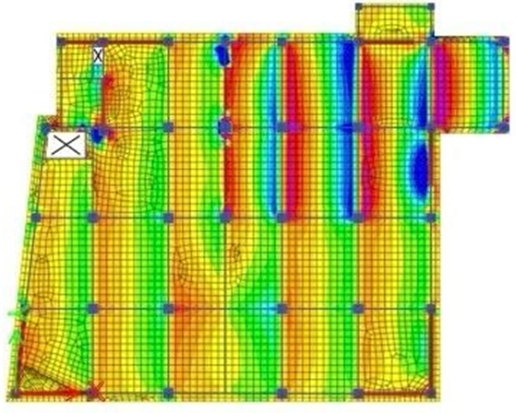
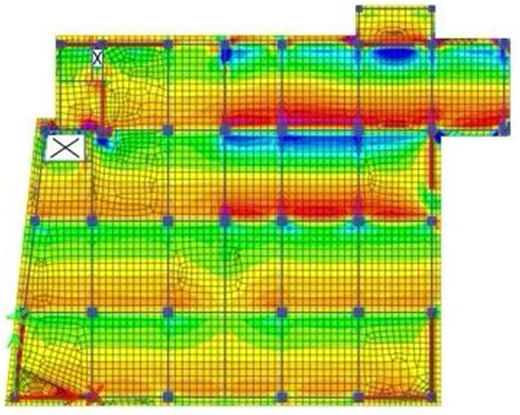
Check slabs for wide beam shear:
Ultimate shear force in the slab of story 13 in x-direction, V13.
Ultimate shear force in the slab of story 13 in y-direction, V23.
59

Slide 60
Design of slabs for flexure:
For flexure design, , additional 1Ø12 /400mm top steel reinforcement was only needed in the x-direction on the 13th floor.
Design of slabs detailing and requirements:
Bar development length , ldt = (0.48 × 420 /√36 )× db , For bars diameter less than 20 mm.
Bar splicing length , ls = 1.3× db
cover = 40 mm.
60

Slide 61
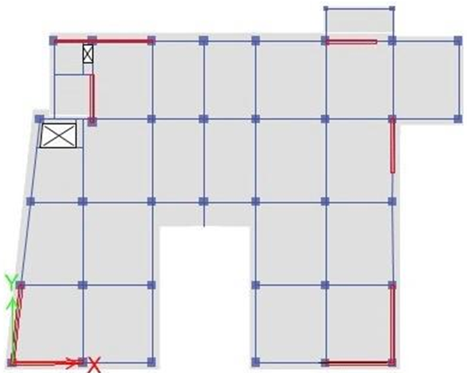

Design of Shear wall:
Design of piers:
The pier’s dimensions are :
height = 4.35 m
length = 7.26 m
width = 0.35 m
selected pier number 6 in the story 3 .
61

Slide 62
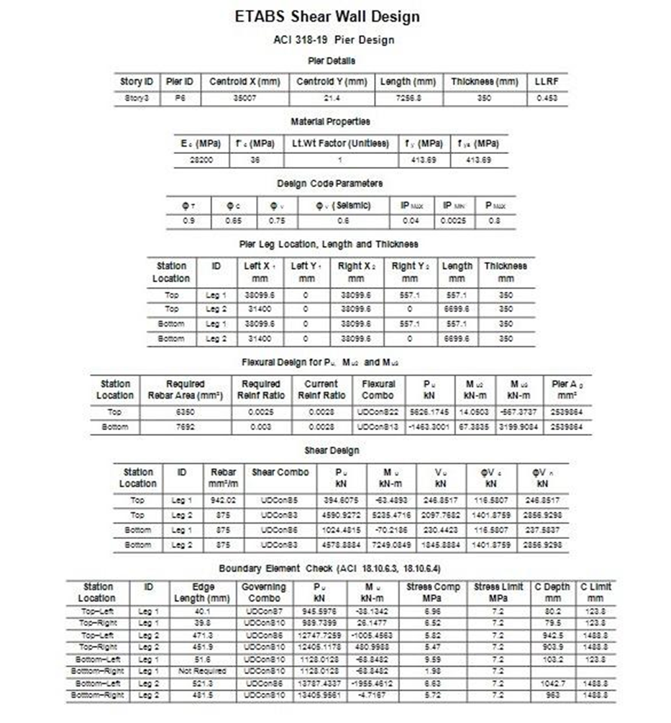
Design of Shear wall:
1- Longitudinal reinforcement:
Longitudinal reinforcement =
5 ф 12 /m at each face of the wall.
2 -Shear reinforcement:
Shear reinforcement =
4 ф 12/1 m at each face of the wall.
62

Slide 63

Design of Shear wall:
Cross section of selected pier:
63

Slide 64

Design of Beams:
Flexural design
Shear design
Torsion design
64

Slide 65



Design of Beams:
1- Longitudinal reinforcement:
65

Slide 66



Design of Beams:
2- Transvers reinforcement:
So, use S = 100 mm
66

Slide 67


Design of Beams:
Longitudinal section :
Cross section :
67

Slide 68

Design of foundation:
Mat foundation:
Thickness = 1400 mm
68

Slide 69

Design of foundation:
Mat foundation:
1- Punching check:
This check is to ensure the thickness of footing
All values ​​are less than 1, so the thickness was good.
69

Slide 70

Design of foundation:
Mat foundation:
2- Pressure check:
The soil pressure on mat foundation was less than 450 kN/m2
70

Slide 71

Design of foundation:
Mat foundation:
Flexural design:
The design was made using ETAPS:
71

Slide 72

Design of foundation:
Mat foundation:
Wide beam shear design:
72

Slide 73



Design of Stairs:
The staircase will be designed and detailed manually.
Landing:
use thickness=200mm
Live Load = 5 KN.
Superimposed Load =3.9 KN.
Self weight = (0.2) (25) = 5 kN.
73

Slide 74



Design of Stairs:
Staircase, flights:
74

Slide 75

Structural Design :
Design of stairs:
Staircase, flights.
75

Slide 76



Design of Columns:
1- Longitudinal reinforcement:
-Column dimensions are:
L = 0.9 m,
b = 0.9 m,
h = 4.35 m.
-Longitudinal reinforcement
= 10643 mm2 = 28 ф 22.
-Steel ratio =
= 1.31% < 3% -> OK
Longitudinal reinforcement
76

Slide 77

Design of Columns:
1- Longitudinal reinforcement:
77

Slide 78

Design of Columns:
2- Transverse reinforcement:
ℓo ≥ 1/6 ℓu
≥ Max. cross-sectional dimension of column
≥ 450 mm
s˳ ≤ 8 d/b
≤ 200 mm
≤ 1/2 smallest cross-sectional dimension of column
s1 = 200 mm
78

Slide 79


Design of water tank:
:Water tank’s dimensions
6.3 m x 6.9 m
4 m height
300 mm thickness
the environmental durability factor (Sd) will be used in the design
79

Slide 80


Design of water tank:
Vertical direction:
Flexural design:
The design moment = (Mu) (Sd) (seismic factor)
= (32.035) (1.23) (1.4) = 55.16 kN.m
ρ=0.0028 < ρ min=0.0035 ---> Use ρ min=0.0035
As= ρ b d=(0.0035)(1000)(230)=821.1 mm^2
use (1 ∅ 14 /150 mm) at each side of the wall.
80

Slide 81

Design of water tank:
Vertical direction:
Shear design:
The maximum ultimate shear = 62.7 kN
∅Vc = 112.53 kN
Vu < ∅Vc
No need for shear reinforcement.
81

Slide 82


Design of water tank:
Horizontal direction:
Flexural design:
The design moment = (Mu) (Sd) (seismic factor)
= (59.5) (1.23) (1.4) = 102.45 kN.m
ρ=0.0053 < ρ min=0.0035 ---> Use ρ =0.0053
As= ρ b d=(0.0053)(1000)(230)=1219 mm^2
82

Slide 83



Design of water tank:
Horizontal direction:
Torsion design:
The design Torsion = (Pu) (Sd) (seismic factor)
= (730.5) (1.96) (1.4) = 2004.5 kN.m
83

Slide 84

Design of water tank:
Horizontal direction:
Horizontal steel from:
-flexural design= 1219 mm2
-torsional design = 5303 mm2
-minimum horizontal steel at a side = (0.005/2) (1000) (300) = 750 mm2
Total horizontal steel at side of water = 1219 + (5303/2) = 3871 mm2 < minimum steel
use (1 ∅ 28 /150 mm) at inner side of the wall.
Total horizontal steel at outer side of water = (5303/2) = 2652 mm2 < minimum steel
use (1 ∅ 25 /150 mm) at outer side of the wall.
84

Slide 85

Design of water tank:
85

Slide 86
Thank you
86

