Slide 1


Implementation of Lean Manufacturing Tools
At AL- Majd Furniture Factory
Prepared by:
Abrar Shtayeh
Majd Tbealeh
Nadwa Salah
Suna Jayyousi
Supervised by:
Dr. Tamer Haddad

Slide 2

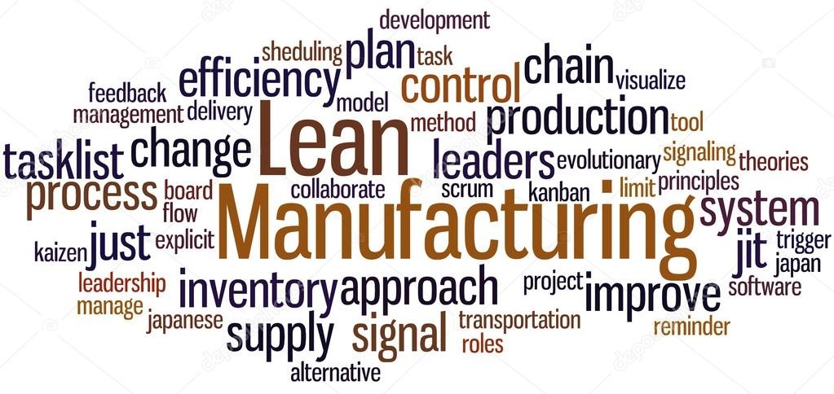
Outline
Introduction
Objectives
Methodology
Analysis & results
Conclusions
Recommendations

Slide 3

Introduction
About factory :
Al MAJD Furniture factory was founded as a family business in Nablus in 1995.
AL-MAJD is specialized in manufacturing all kinds of home and office furniture including luxury's sofa, bedrooms, children's bedroom…etc

Slide 4
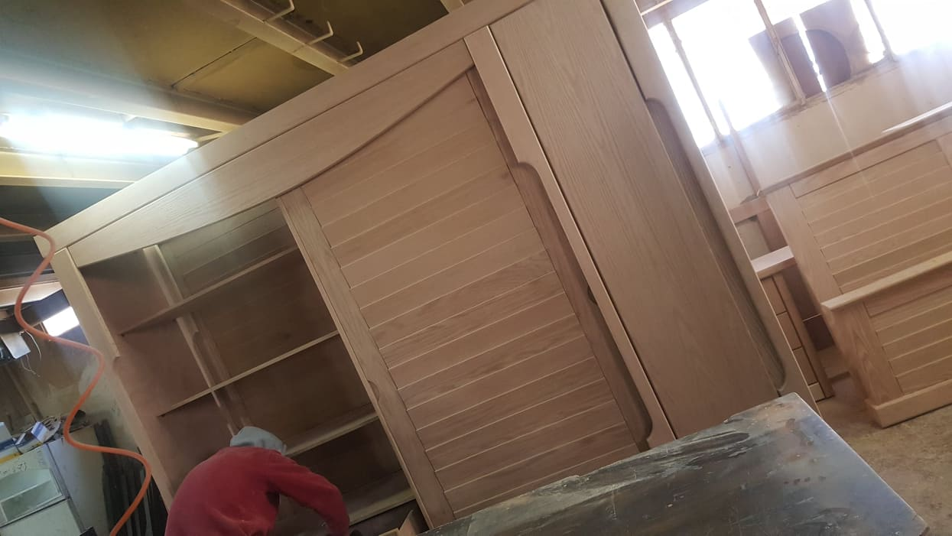
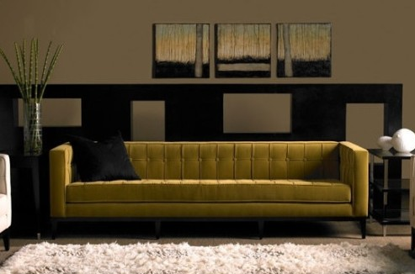
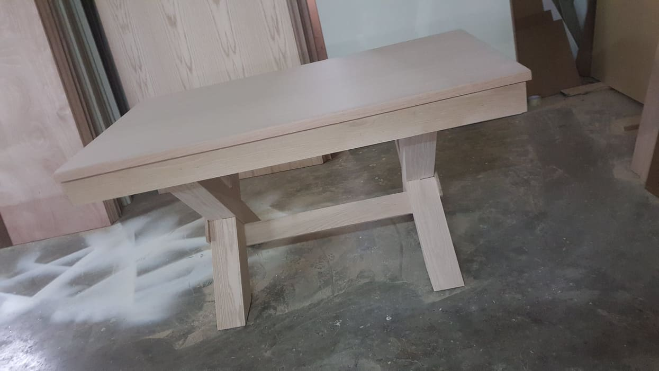
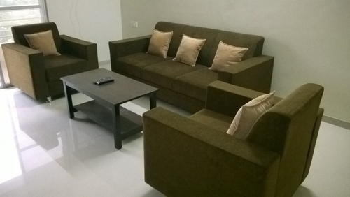
Introduction( some products )
.

Slide 5

Introduction
What is Lean ?
Lean manufacturing aims to achieve the same output with less input such as less time, less space, less human effort, less machinery, less material, less cost.

Slide 6

The main goal of this project is to apply a set of lean manufacturing techniques at to reduced the generated wastes especially scrap , in order to enhance the overall performance of plant floor.
Objectives

Slide 7
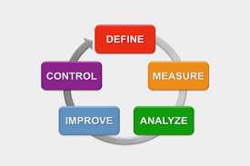
Methodology

Slide 8

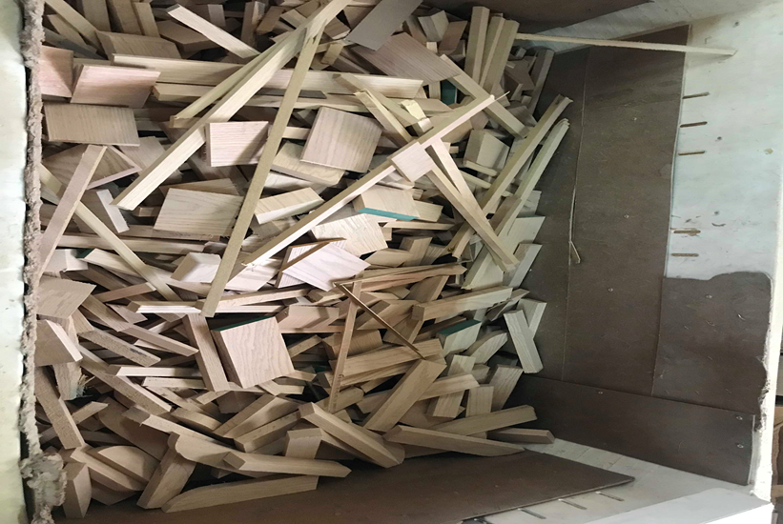
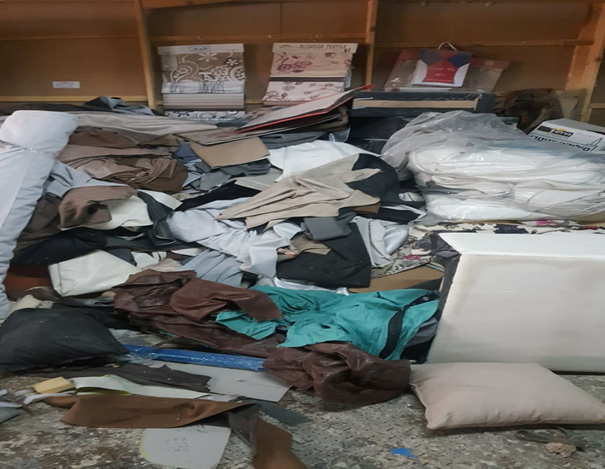
Define : (Problem Statement)
ALMAJD factory suffers from many problems:
Large amount of scrap material

Slide 9
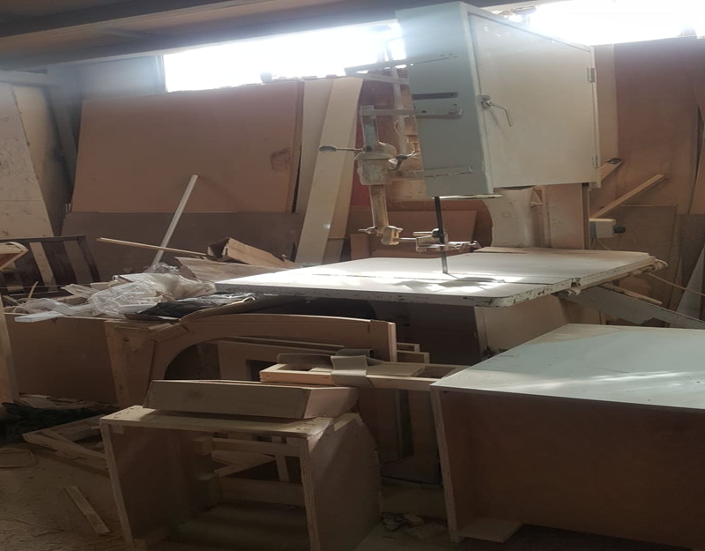
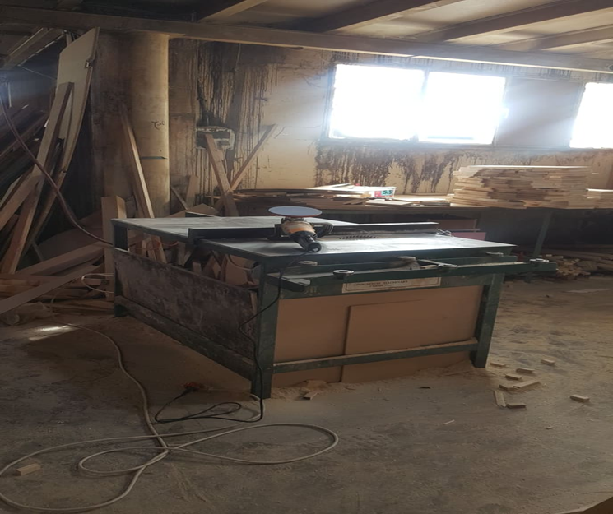
Define : (Problem Statement)
No clear production line

Slide 10
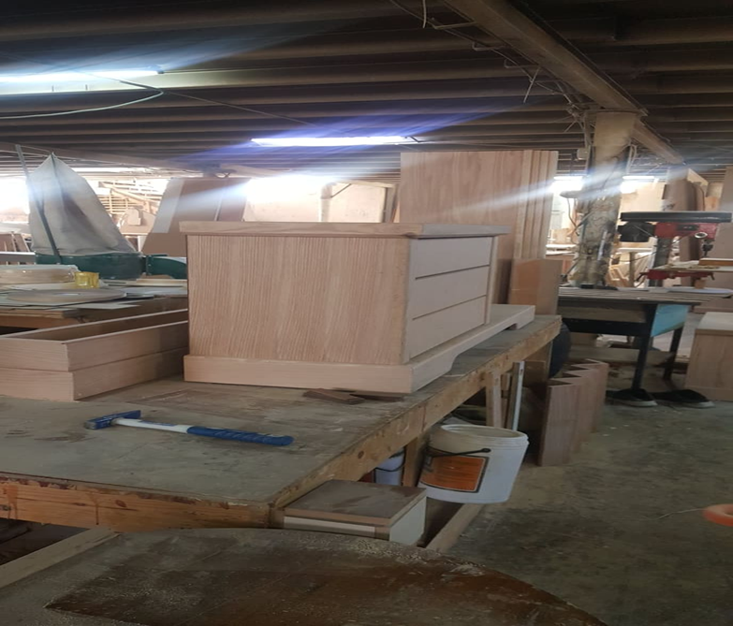
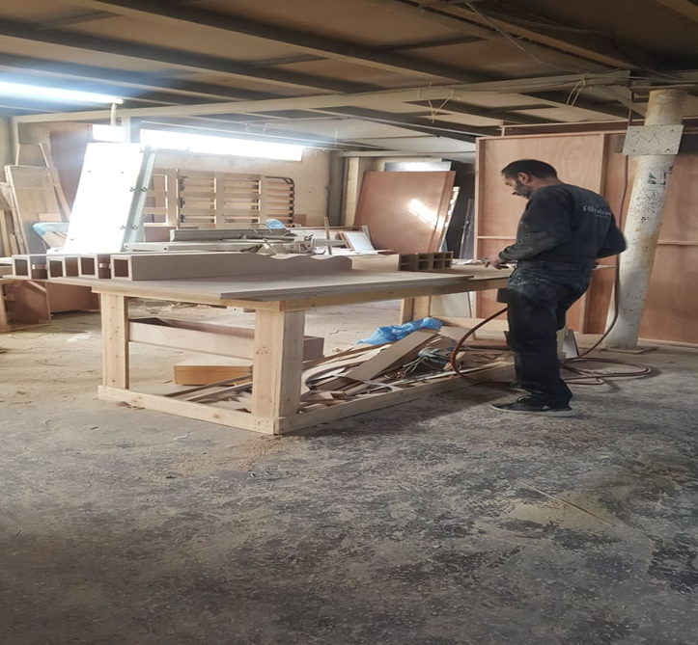
Define : (Problem Statement)
Un sufficient material handling system

Slide 11
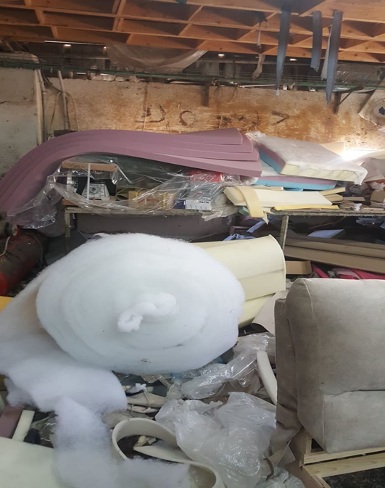
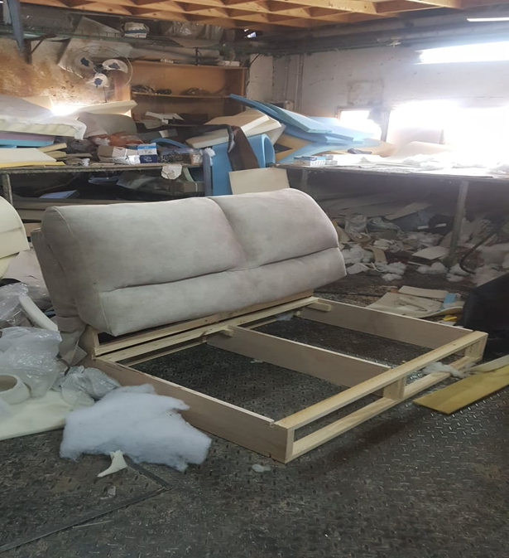
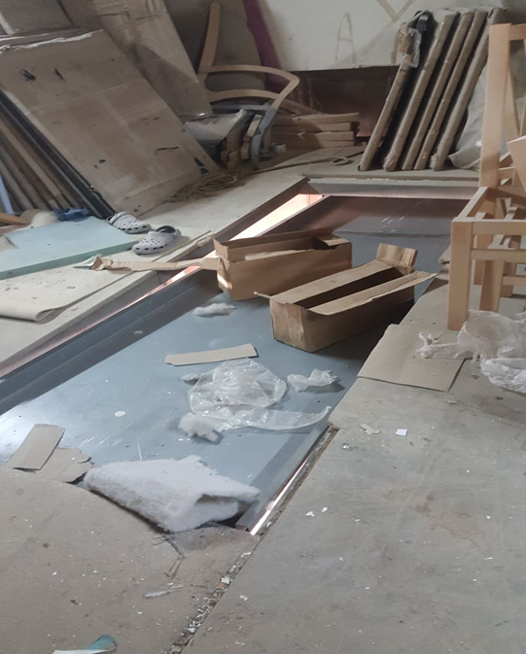
Define : (Problem Statement)
Lack of engineering scientific and administrative system

Slide 12
Define ( product )
Due to the wide variety of products we divided the products into two families and we chose one product to express each family where we chose the bed from the family of wood products and the sofa from the family of products that contain fabric

Slide 13
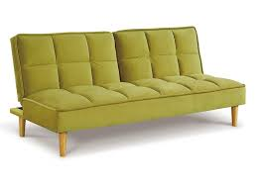
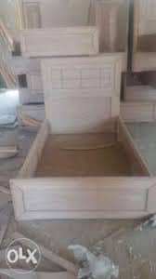
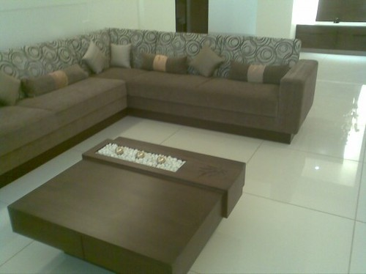
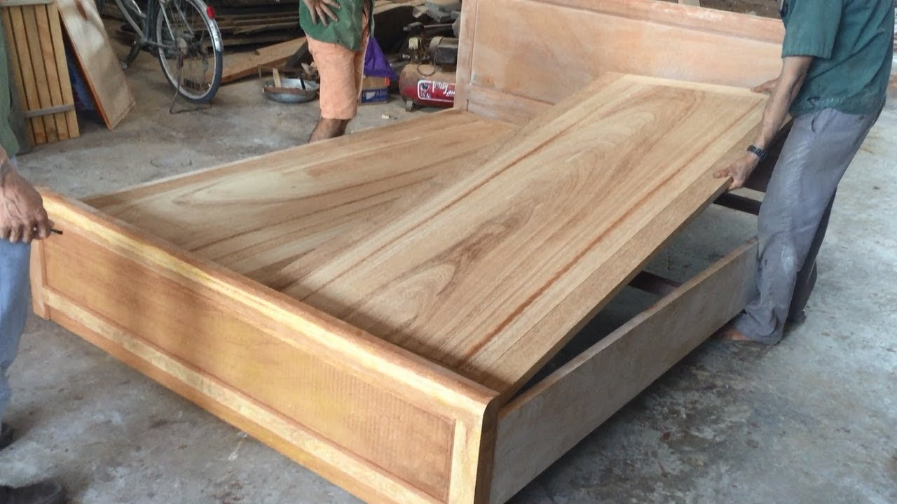
Define ( product )

Slide 14
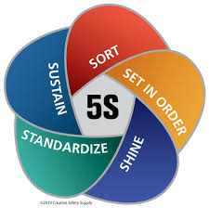
Define : (lean tools & Technique)
1- 5s tools were helped in
• Sort to removed items that are no longer needed
• straighten or set in order to organize the items to optimize efficiency and flow
• Shine to clean the area in order to more easily identify problems
• Standardize to implement color coding and labels to stay consistent with other areas
• sustain to develop behaviors that keep the workplace organized over the long term

Slide 15


Define : (lean Tools & Technique)
2- Value stream mapping (VSM) tool was implemented to present the current situation of the factory and to identify non value add activates and production process waiting time to reduce and eliminate it
3- layout analysis was implemented based on line balancing technique in order to reduce the idle time for the worker and increase the efficiency of the production line

Slide 16
Measure ( TIMWOOD wastes)
transportation
motion
Over processing
inventory
defect
waiting
waste through the distance from assembly station to second floor of plant
unnecessary movement of the workers during working shift like searching for tool, walking through plant floor
due to rework or repair of defects, materials used due to defect and rework
the workers carried out many things over the major production process and added many details and aesthetic that the customer does not request them
excessive work in process and raw material
operator waiting time for previous operation to complete its cycle

Slide 17
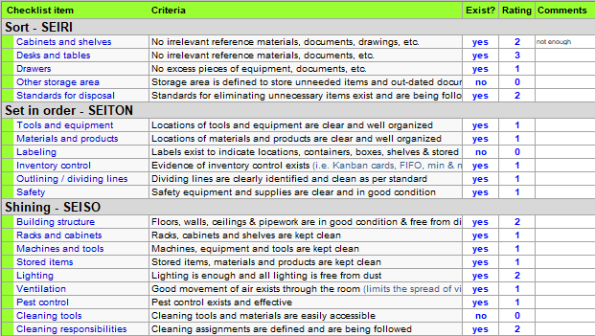
Measure (5s chick list )

Slide 18
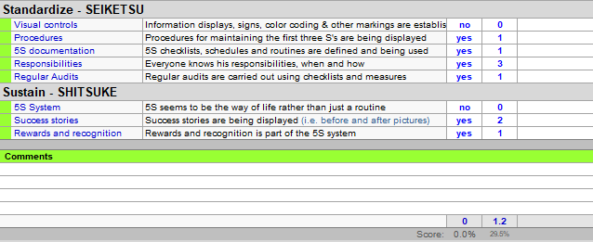
Measure (5s chick list )

Slide 19
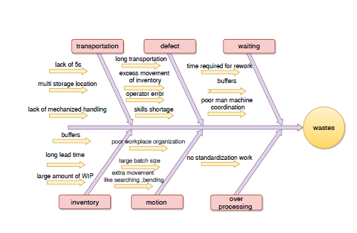
Analysis (using cause and effect diagram to analyze type of wastes)

Slide 20

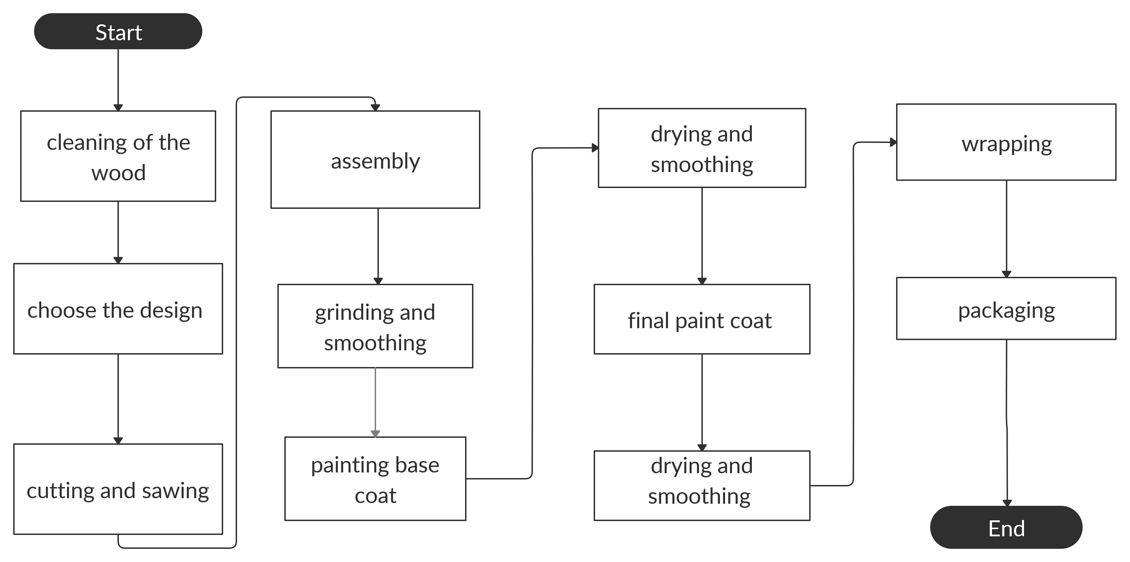
Analysis ( bed flow chart )

Slide 21
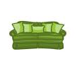
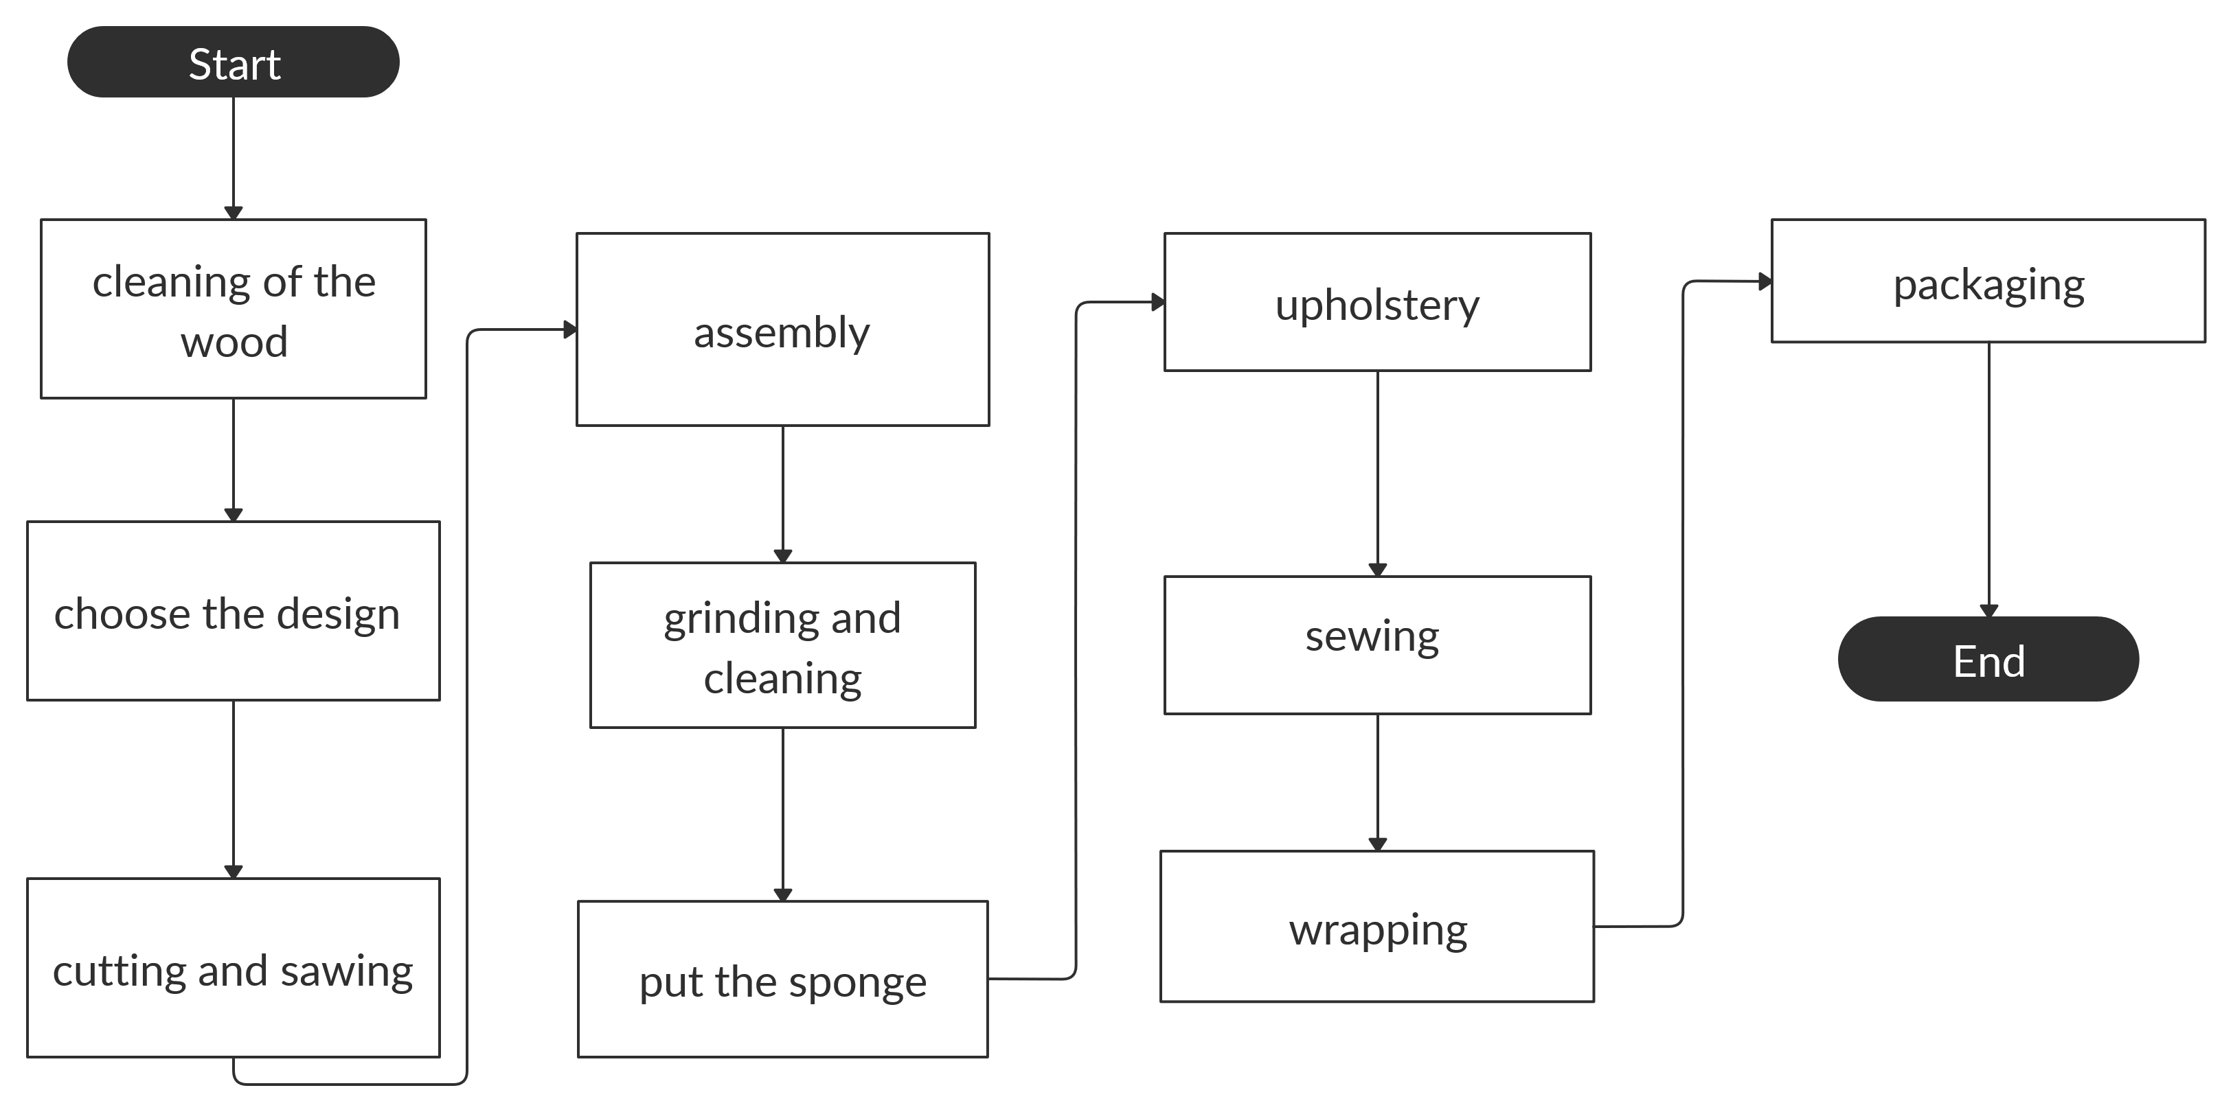
Analysis ( sofa flow chart )

Slide 22
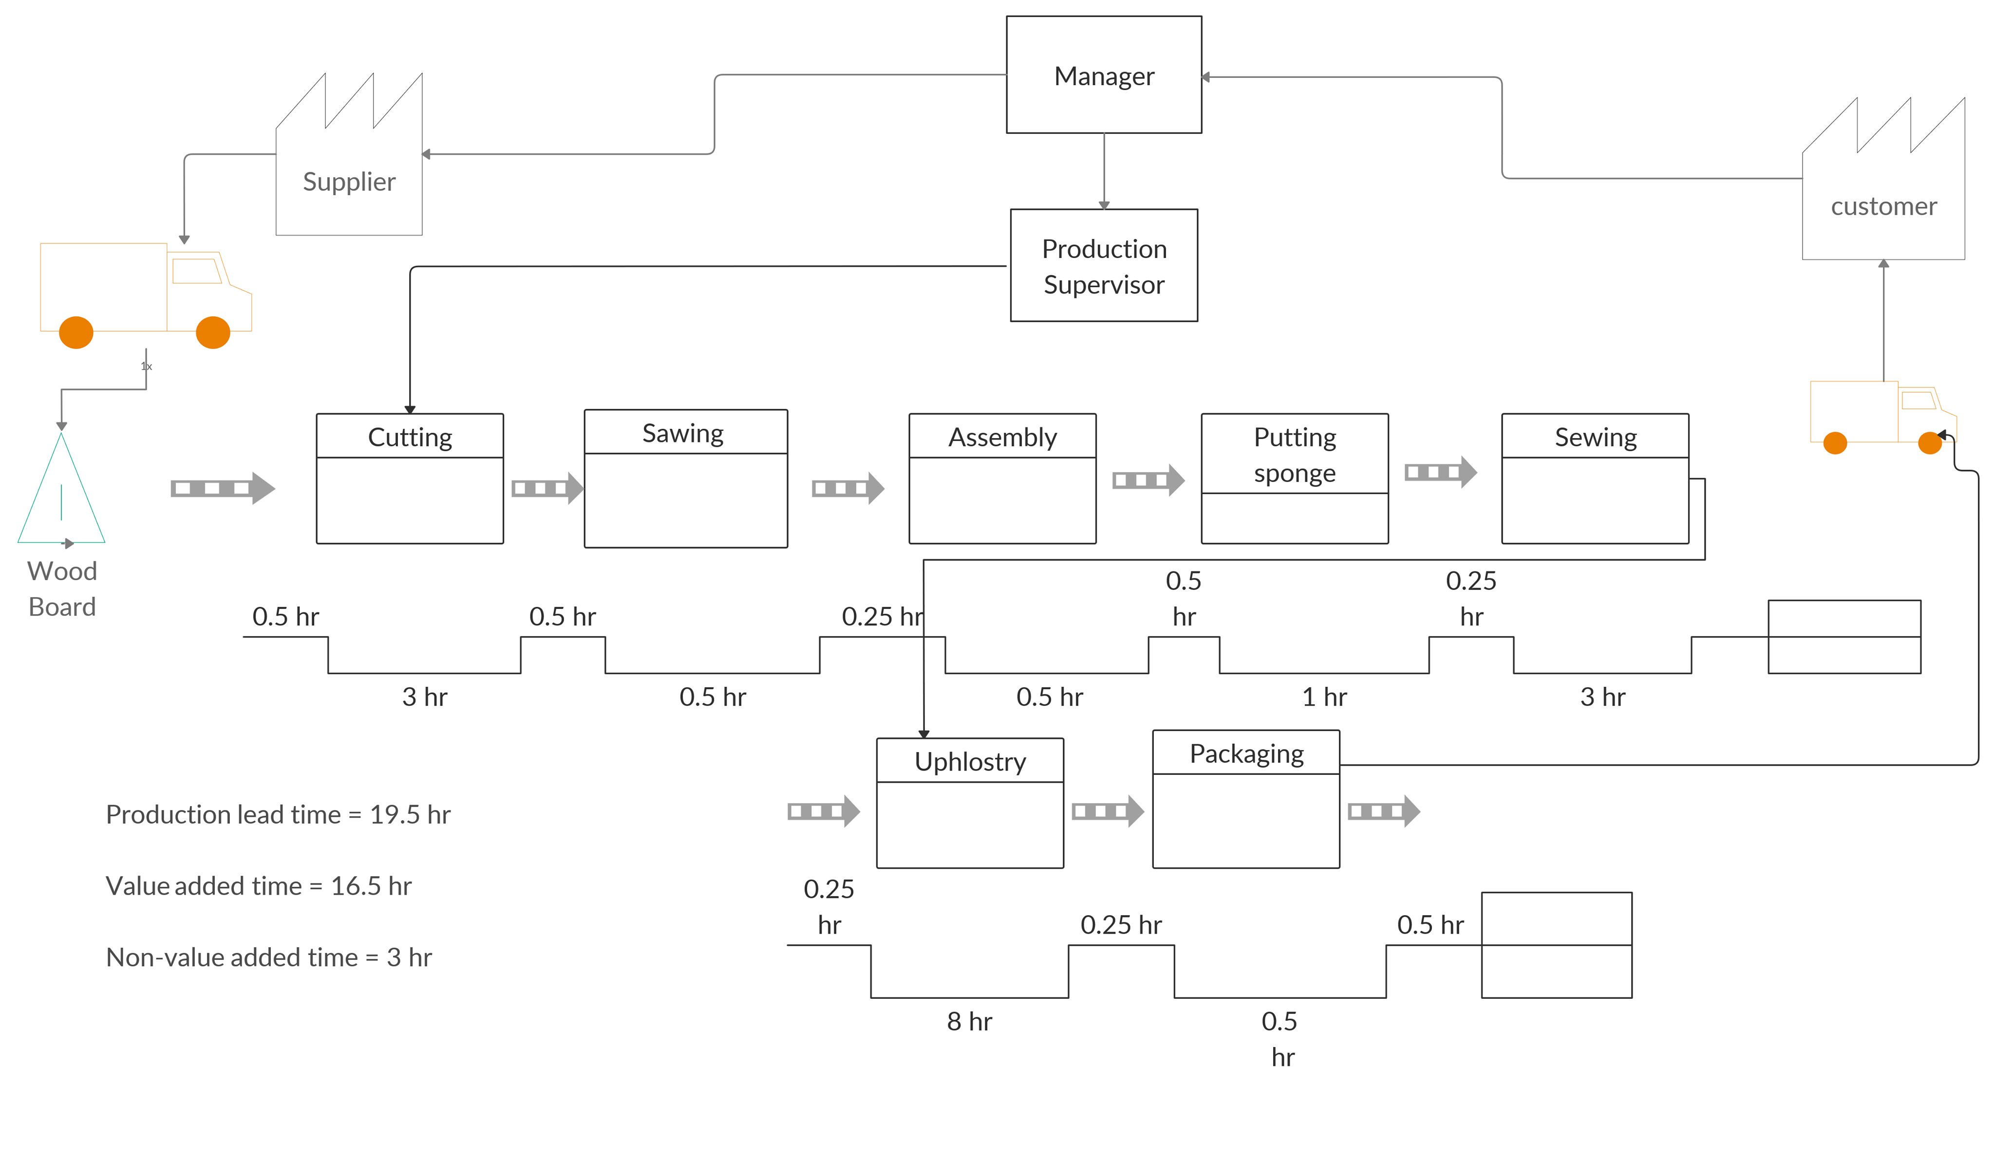
Analysis ( sofa value stream mapping )

Slide 23
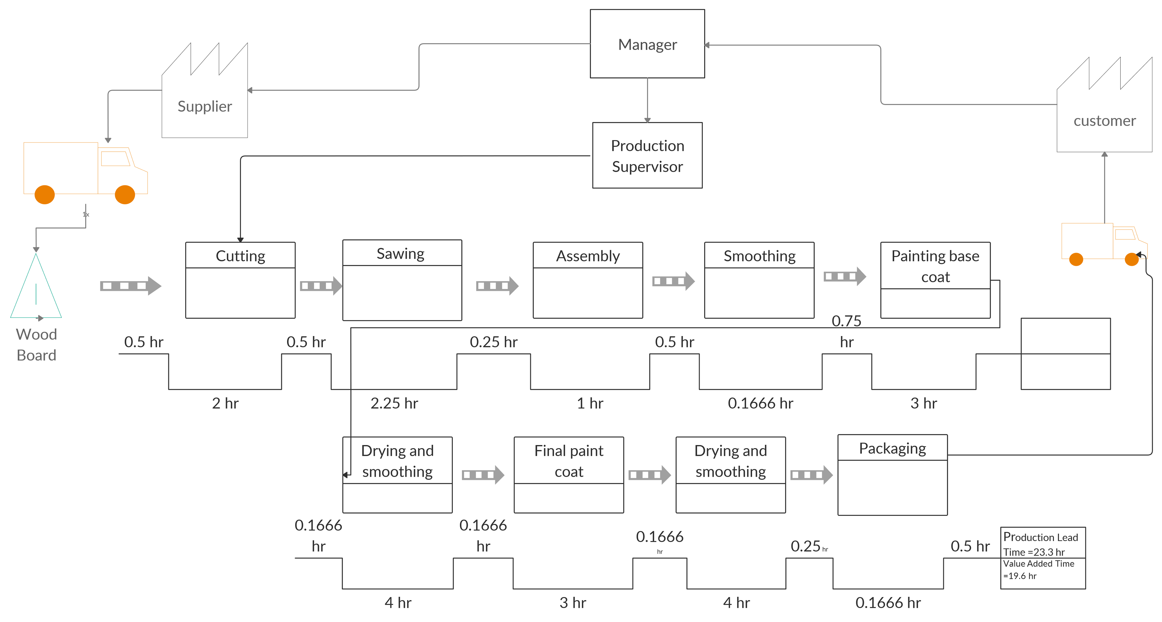
Analysis (bed value stream mapping )

Slide 24
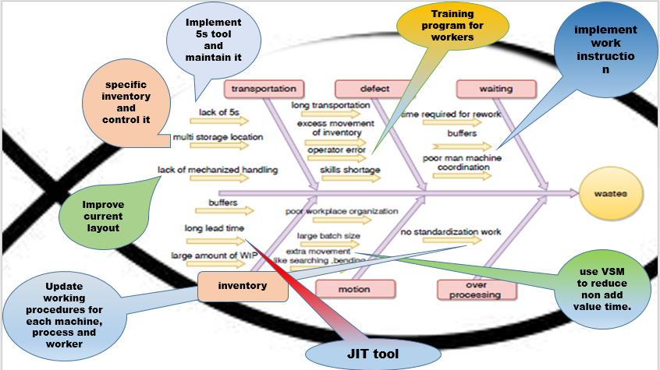
Improved ( solutions )

Slide 25
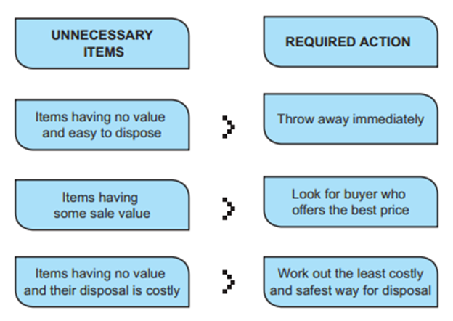
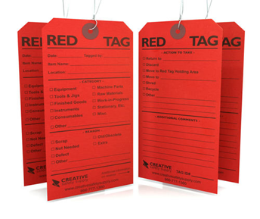
Improved 5s tool (S1 – SORT)
To implement the first S the Red-Tag process is commonly employed.

Slide 26
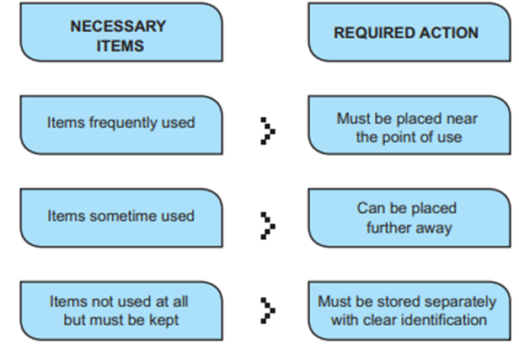
Improved 5s tool (S2 – SET IN ORDER )
The second S reflects a very popular saying: “A place for everything and everything in its place”.

Slide 27
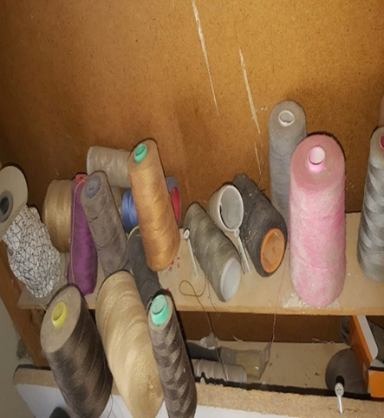
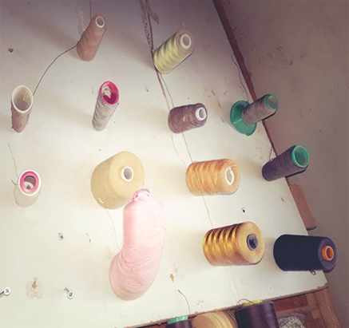
Improved : 5s tool (Sort & set and order )
The following figures show the differences between before & after implementing (sort and set in order)

Slide 28
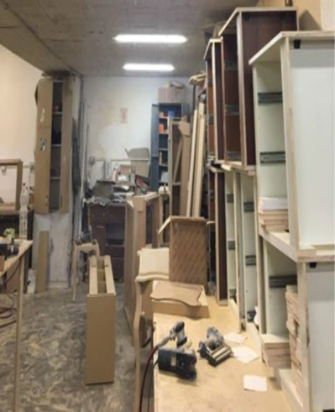
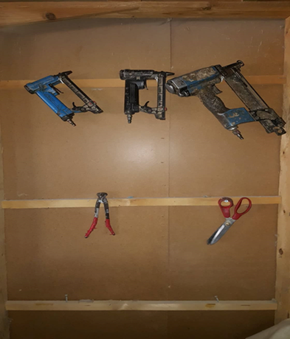
Improved 5s tool ( Sort & set and order )

Slide 29
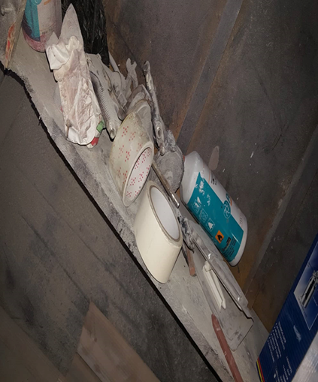
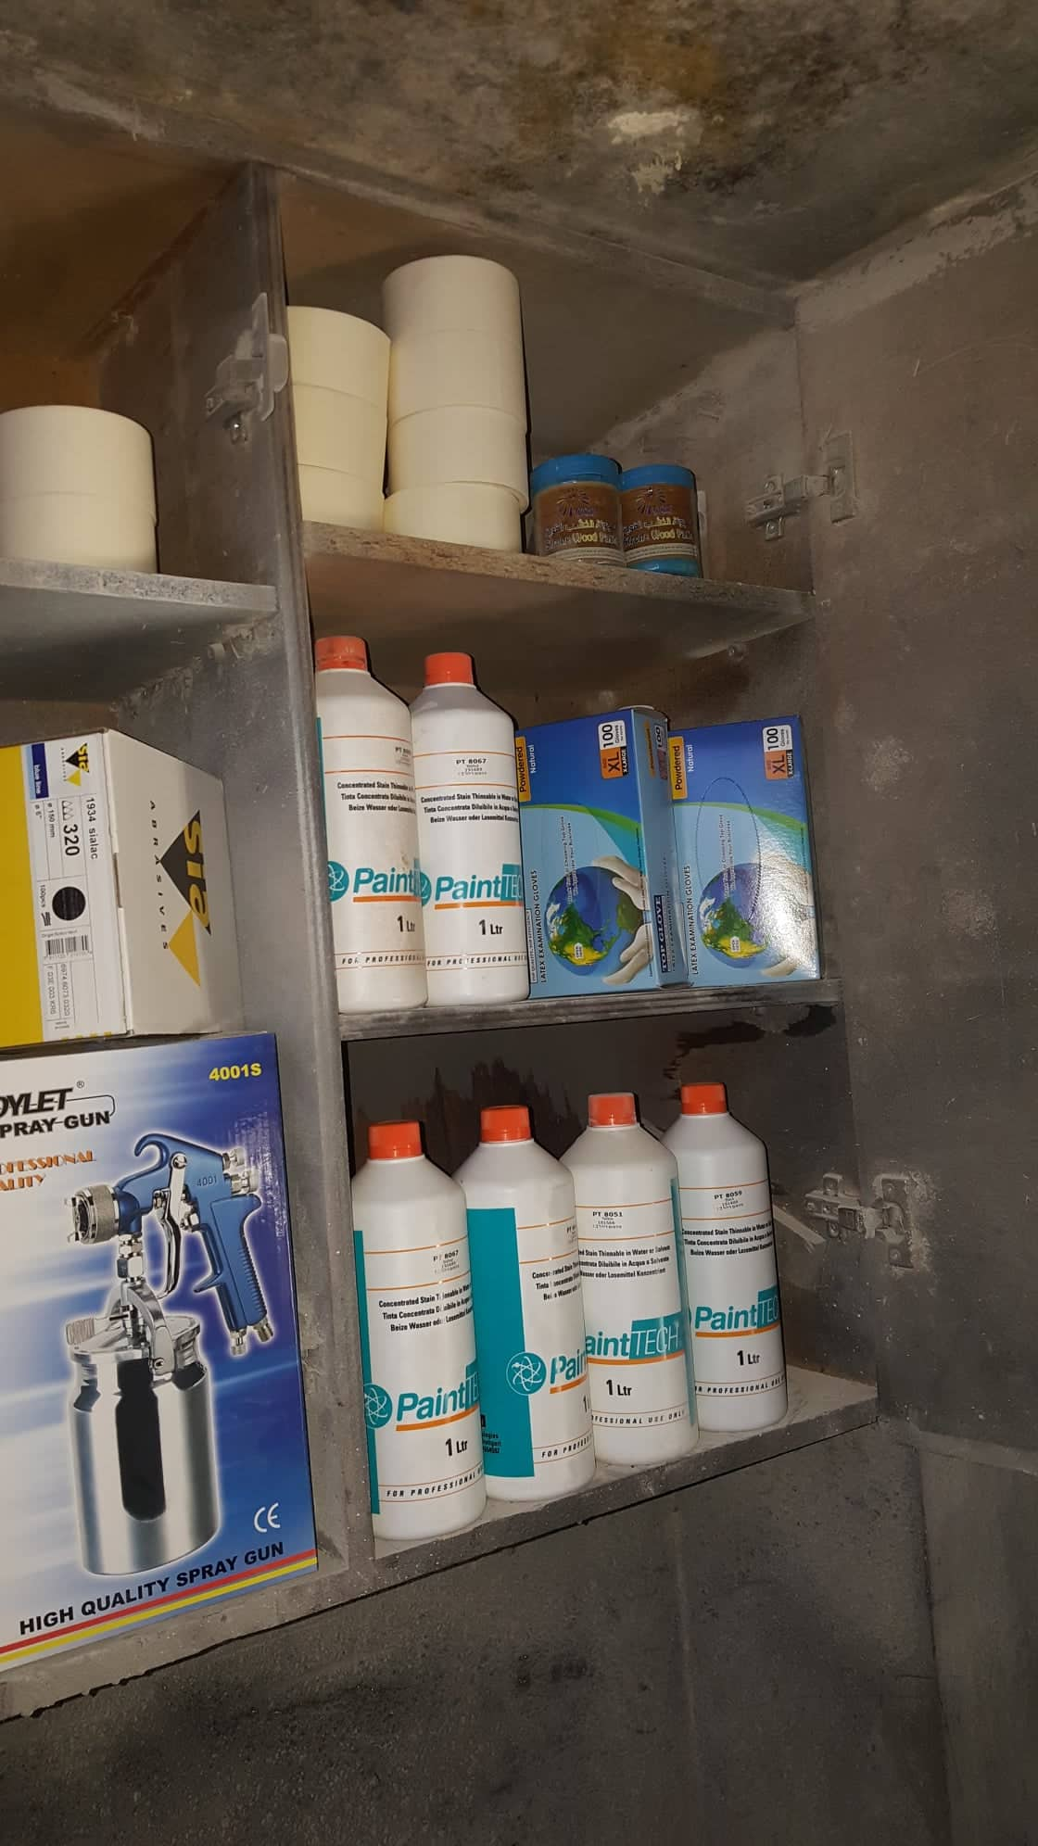
Improved 5s tool (Sort & set and order )

Slide 30
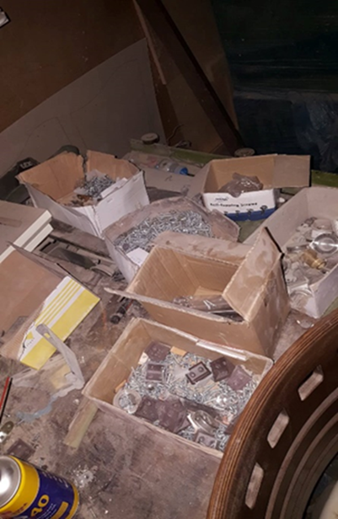
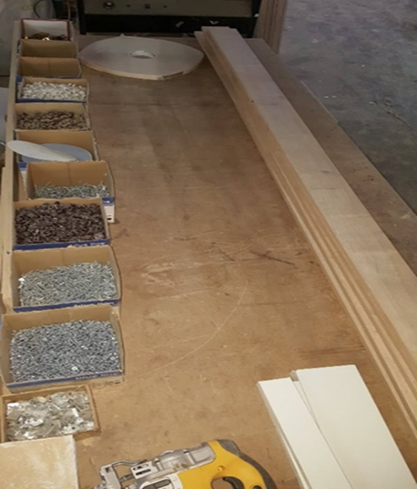
Improved 5s tool (Sort & set and order )

Slide 31
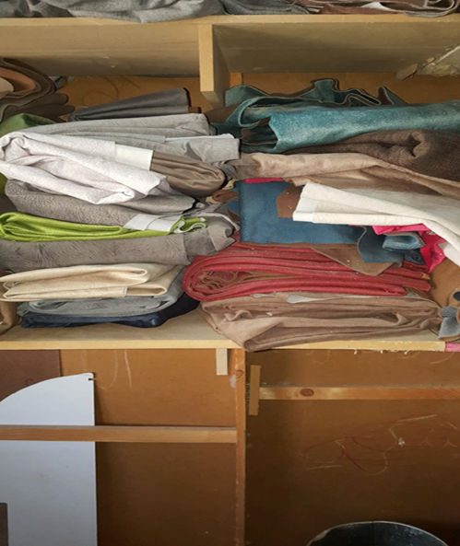
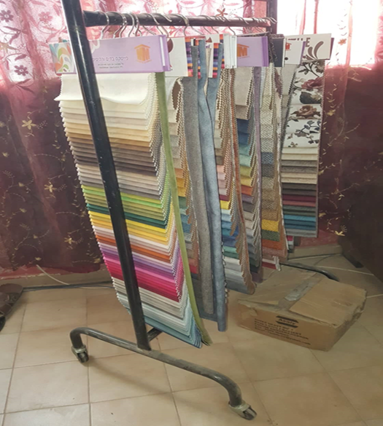
Improved 5s tool (Sort & set and order )

Slide 32
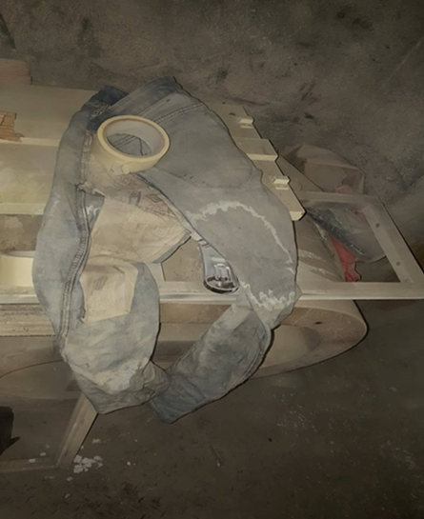
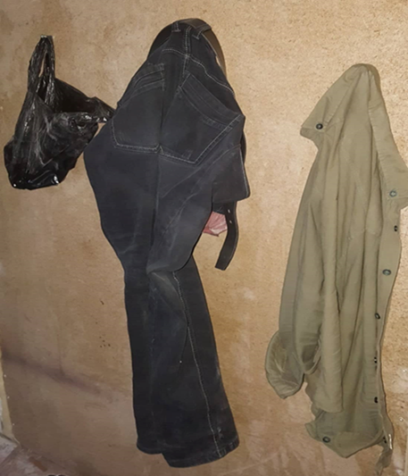
Improved 5s tool (Sort & set and order )

Slide 33
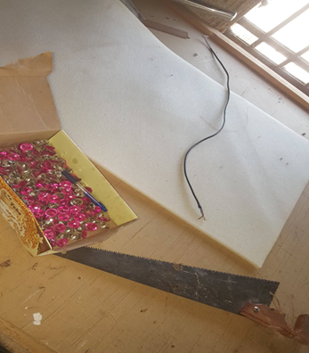
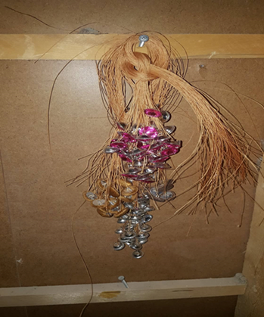
Improved 5s tool (Sort & set and order )

Slide 34
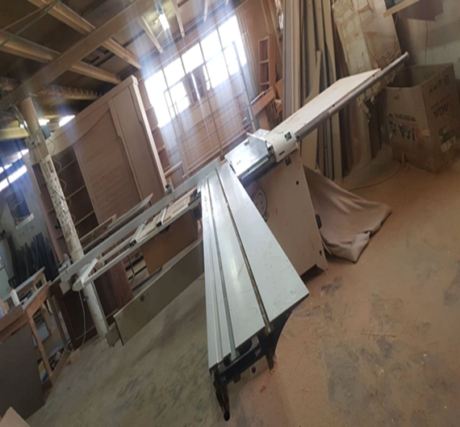
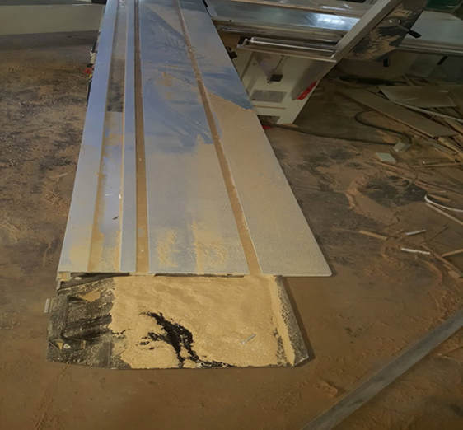
Improved 5s tool (S3 - Shine)
The third S stresses on cleanliness because it ensures a more comfortable and safer workplace, as well as better visibility, which reduces retrieval time and ensures higher quality work, product or service

Slide 35
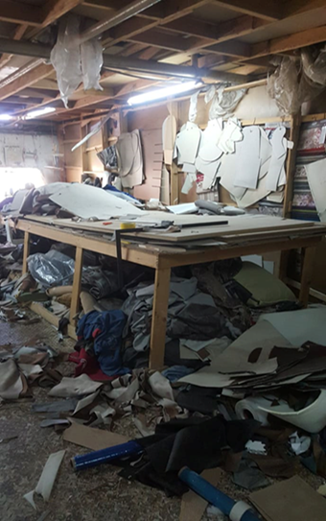
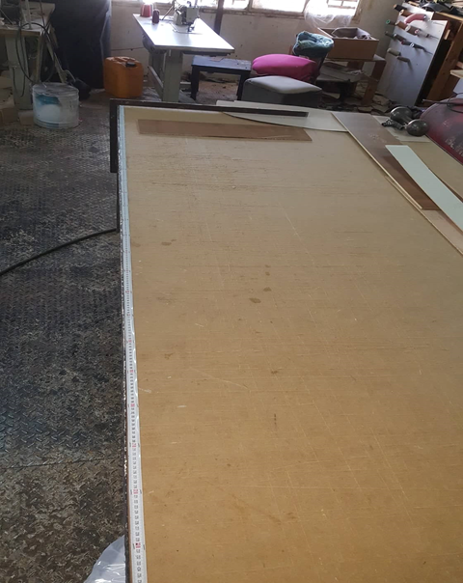

The following figures show the differences before & after implementing (shine) phase
Improved 5s tool (S3 - Shine)

Slide 36


Improved 5s tool (S3 - Shine)

Slide 37


Improved 5s tool (S3 - Shine)

Slide 38



S4 – STANDARDIZE
The continued employment of the 3S will ensure a high standard of workplace organization
Once the 3S are in place, the next step is to concentrate on standardizing best practices.

Slide 39




S4 – STANDARDIZE

Slide 40


S5 – SUSTAIN
A management auditing process should be put into practice to make sure that employees understand that maintaining the level of workplace organization is a top priority

Slide 41


Slide 42


Slide 43

Improved Layout
After visiting the factory and observing the physical arrangement of the machines and physical measurements were taken for their dimensions the layout sketch of each floor was drawn

Slide 44

Improved Layout
Ground floor layout

Slide 45

Improved Layout
First Floor Layout

Slide 46


Improved Layout(Line balancing(
According to the situation in the factory which there are two floors, the first floor only will be adjusted.
M1(cleaning machine) was excluded because cleaning must done at the first before the processing

Slide 47

Improved Layout(Line balancing
In our analysis of layout we considered line assembly balance where every worker's task takes the same amount of time
largest candidate rule algorithm was followed in line balancing.
cycle time for beds according to first floor machines is 4.4 hr and for sofa is 4 hr
so production rate (R_{p}) for bed is 0.22 assembly/hr and for sofa is 0.25 assembly/hr

Slide 48


Improved Layout(Line balancing
At first, the processing times of each product on each operation (T_{k}) and the precedence of the operations were collected

Slide 49

Improved Layout(Line balancing)
the work elements on each machine was listed in descending order based on total time in last Colum also take the precedence into account

Slide 50

Improved Layout(Line balancing)
as noticed M2 has the largest total work time (1.19) so it would be the base to arrange the machines into stations.

Slide 51

Improved Layout(Line balancing)
So here we have two stations and the maximum {TT_{k}} = 1.19 so balance efficiency (E_{b}) =1.19+0.345+…+0.0184/2*1.19 = 0.806 =80.6%
After this analysis a new proposed layout for ground floor was sketched

Slide 52
Conclusions
According to the inappropriate layout, there is a significant increase in the transfer of materials between machines, which reduces total productivity.
The non-added value activity for sofa before was 15.38 % but after it is 10.85% And for bed before = 26.14 but after = 20.9 % according to the value stream map generated to the carpentry
Factory continuous evaluation, follow 5S chick list and take corrective action when any error was accord

Slide 53

Conclusions
After applying the safety (signs and PPE), in the factory, the work environment became safer and more safe for workers and visitors, and more comfortable and convenient for work

Slide 54

Recommendations
Continuous evaluation of the factory by filling in the audit forms to maintain the level of
improvement.
There is a relationship between implementation .of 5s and the enhancing in the factory
we suggest purchasing the CNC machine because it will save costs and increase profits
on the long run.
Compliance with safety instructions, as well as wearing personal protective equipment, maintaining ventilation

Slide 55


