Slide 1


DESIGN AND SIMULATION OF AN AUTOMATIC
Sheet Metal Working Machine

Slide 2
TABLE OF CONTENTS
1
4
Introduction
Design
2
5
Litreture Review
Conclusion
3
Methdology

Slide 3

INTRODUCTION

Slide 4

LITERATURE REVIEW

Slide 5
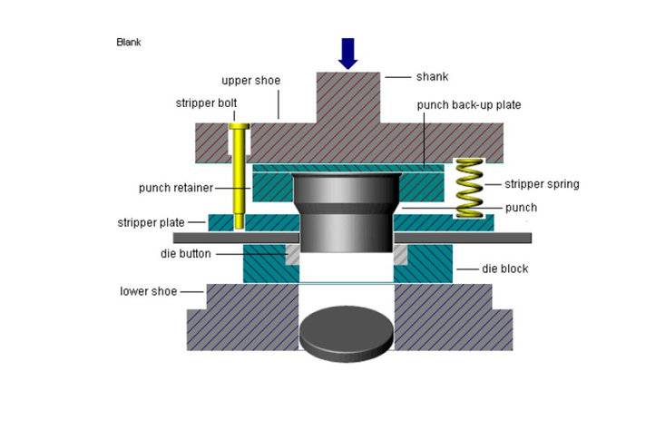
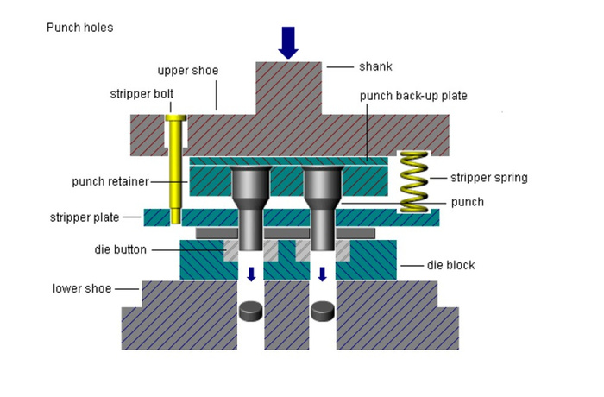
WHAT IS THE SHEET METAL DIES
  Sheet metal design is the process of creating three-dimensional parts from flat sheets of metal using various forming and cutting techniques
  Types of sheet metal dies: Simple Dies, Compound Dies , Pregressive Dies

Slide 6
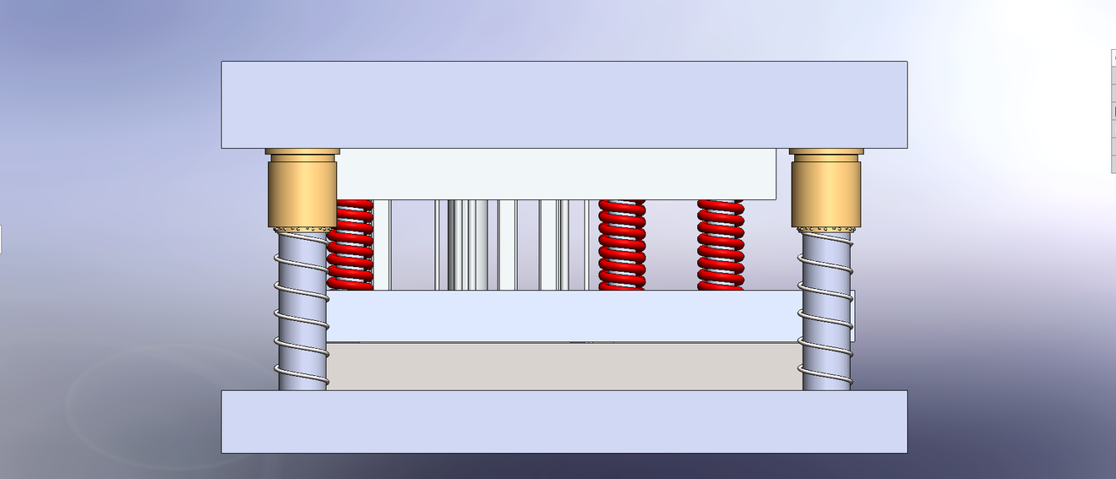
Progessive Die
Slotting
Piercing
Cutting
Bending

Slide 7
Use of spring Metal Dies
  Springs are important in die design because they help push parts like the punch back to their original position after cutting or forming. They also help hold the metal sheet in place and push the part out of the die. Springs make the die work more smoothly, reduce noise and shocks, and help improve the quality of the final product
  Calculating spring deflection is important to keep the spring safe from damage, ensure smooth die operation, and improve part quality. It helps control the force, avoid spring failure, and extend the die’s life.

Slide 8
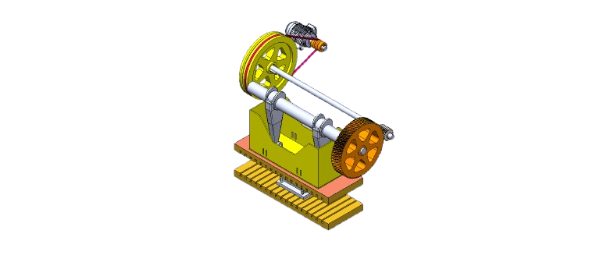
CRANK MECHANISM
  Crankshaft is the main rotating shaft
  Its function is to transmit rotational motion from the flywheel and convert it into controlled mechanical motion to drive the press mechanism shown in the figure

Slide 9
FLYWHEEL
  Flywheels-function and operation need
  Flywheels Material
  Design of Flywheels

Slide 10
FEED RATE & HEAT TREATMENT
  How To Calculate Feed Rate
  Heat treatment improves the mechanical properties of the die and punch.
  Hardening increases strength and wear resistance.
  Tempering follows hardening to reduce brittleness
  Tools made of tool steel (like AISI D2) require heat treatment for longer life

Slide 11

METHODOLOGY

Slide 12
DEFINE PART SPECIFICATIONS
  Determine material, dimensions, and required features
  Chose AISI 1010 sheet metal with defined thickness and dimensions
  Chose AISI 4340 for punches

Slide 13
DESIGN SYSTEM COMPONENTS
  Automatic feeder for continuous strip advancement
  Progressive die with process of piercing, slotting, cutting, and bending
  Mechanical press powered by crank-flywheel system

Slide 14
3D MODELING & CALCULATION
  Create detailed parts and assemblies using SolidWorks.
  Analyze stresses, spring deflection, and motion using FEA tools
  Design aligned with ASTM, AISI, and OSHA guidelines.
  Cutting force, clearance, spring force, and flywheel inertia , streper force, power estimation

Slide 15

DESIGN

Slide 16
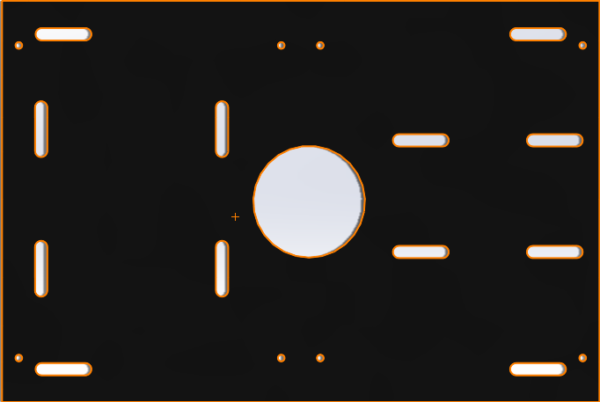
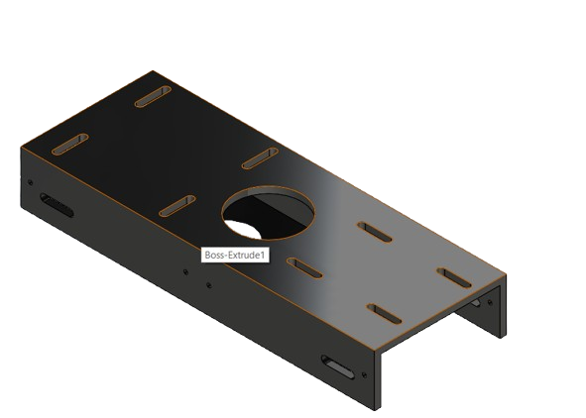
OUR PART

Slide 17




01
Piercing
04
02
PUNCH & DIES DIMENSIONS
Slotting
Bending
03
Cut off

Slide 18
Force Calculations

Slide 19
STRIPPER & SPRING FORCE
  We calculated the stripper force
  After calculated stripper force, we divided it by number of springs to measure the spring force
  Flywheel calculation

Slide 20
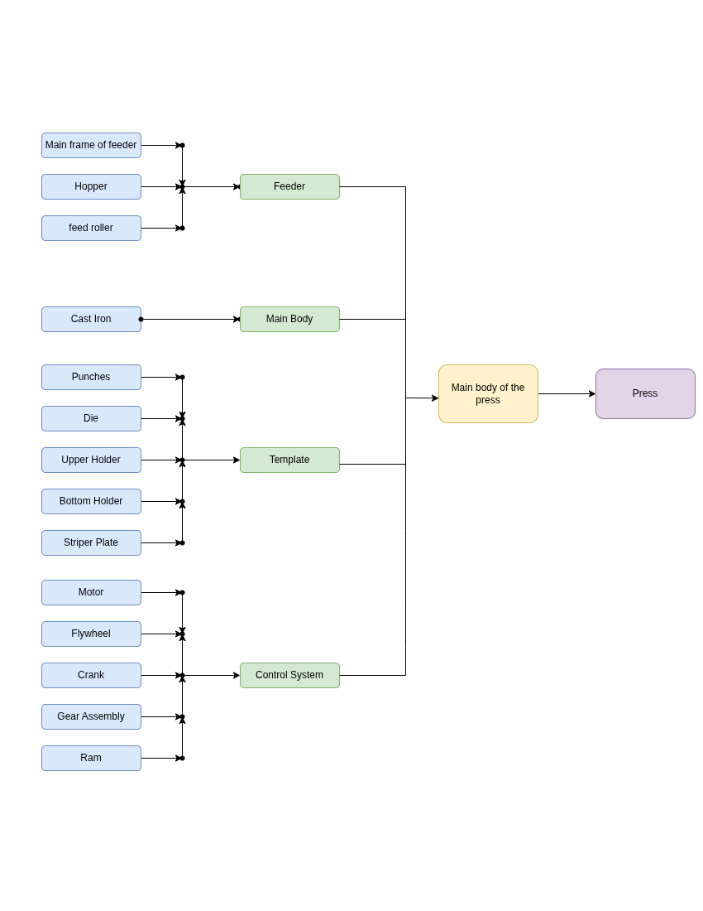
THE MAIN COMPOUND FOR THE PRESS

Slide 21
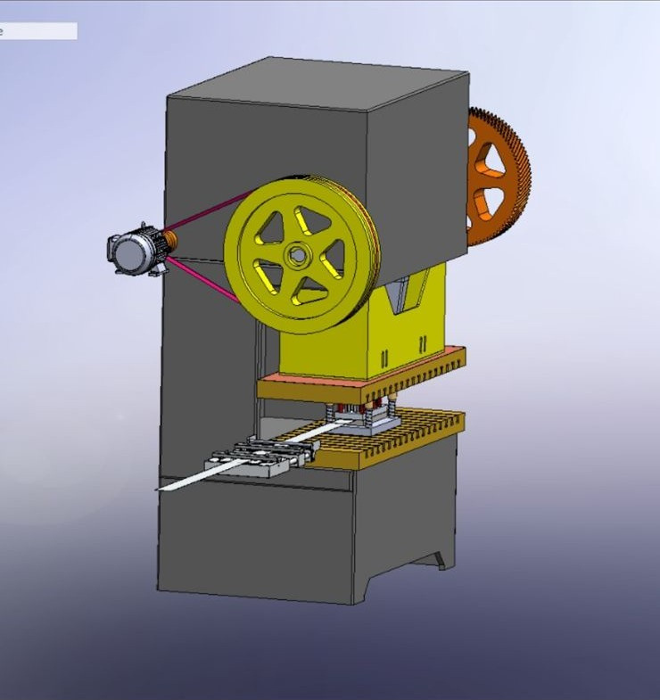
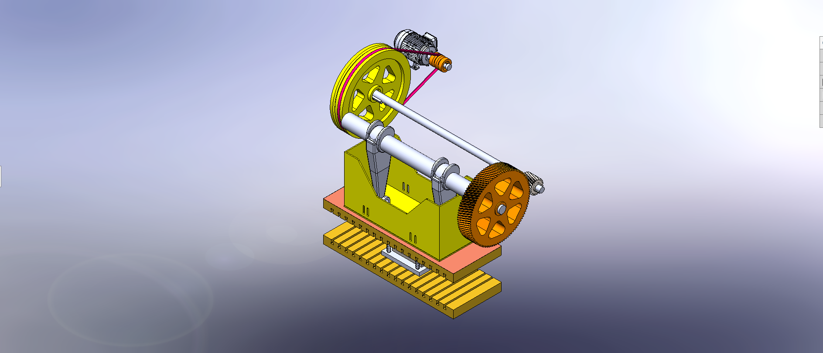
DESIGN

Slide 22
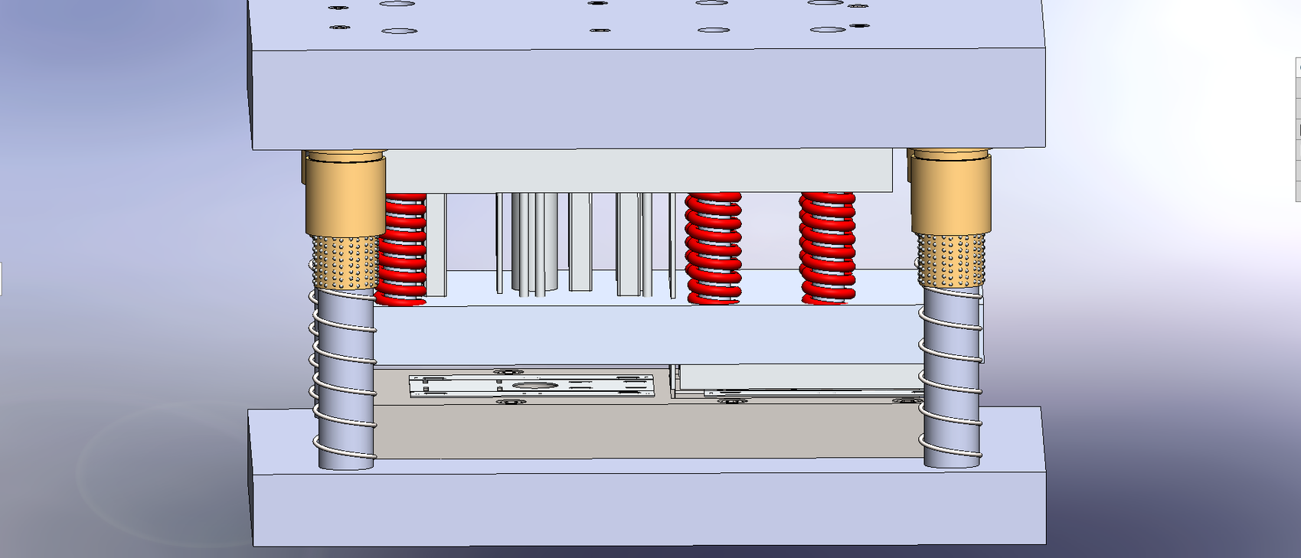
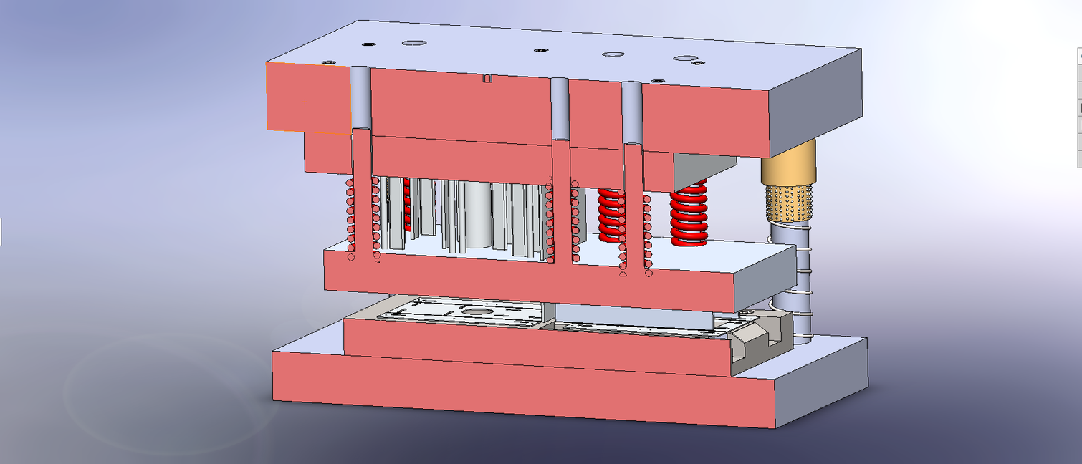
DESIGN

Slide 23
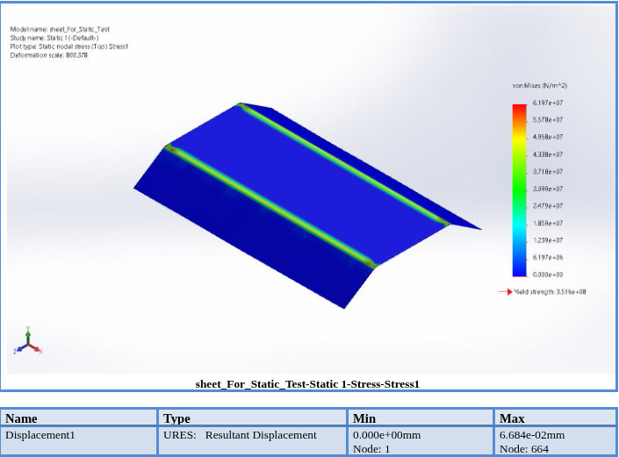
STRESS ANALYSIS

Slide 24
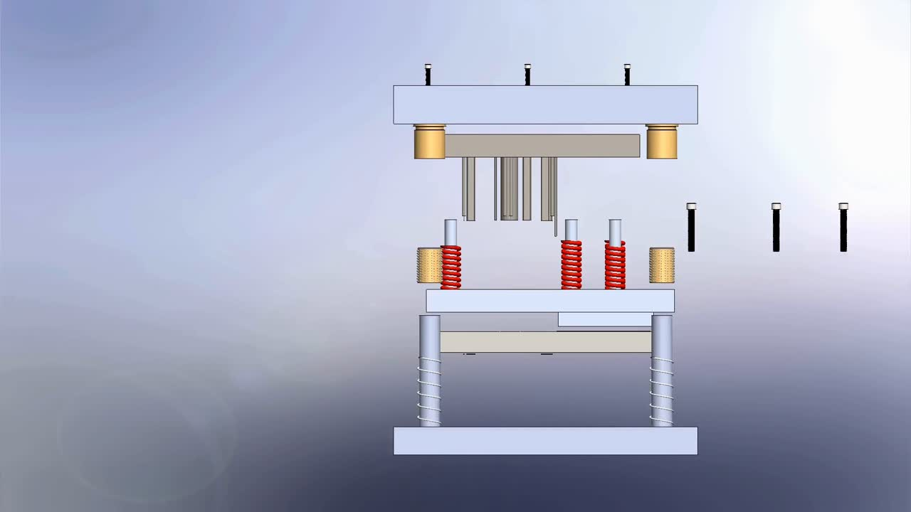
ASSEMBLY & DISASSEMBLY PROCESS

Slide 25
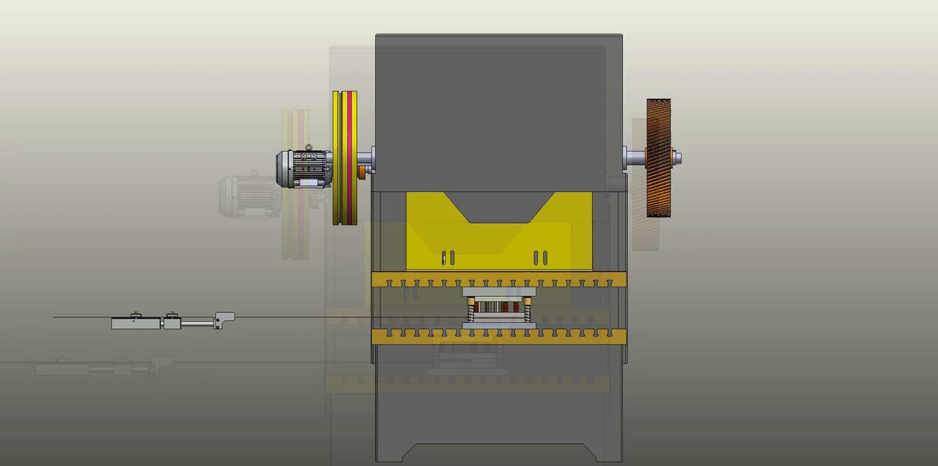
PRESS VIDEO

Slide 26
ANY QUESTIONS?

Slide 27
THANK U!

