Slide 1
Mechanical system for building of Palestinian telecommunication group “paltel group”
Prepared by :
10612603 Ameed mahmoud qzaih
10613800 Mohammad mustafa yaseen
10509606 Samer abdelrazaq khanfar
Supervisor :
Dr. Eyad Assaf

Slide 2
Presentation out line
- Building Description.
- Heating load calculation.
- Cooling load calculation.
- Duct Design.
- Plumbing System.
- Equipment Selection.
- Summary

Slide 3
Building Description
Building Location :
Country: Palestine.
City: Ramallah
Elevation: 840 m above sea level
Latitude: 32˚.
Building face sits at the south orientation.
The wind speed in Ramallah above 5 m/s.

Slide 4
Building details
usage | Floor number
Extra department & offices | Basement 1 & 2
Exhibition hall & main reception | Ground
Interconnect department & consultants | First floor
VP operation | Second floor
VP public & investment relations | Third floor
President (CEO) | Fourth floor
Main meeting hall & rest area | Fifth floor

Slide 5
Heating load
    The heat loss is calculated by this equation :
Outside design condition | Inside design condition | Parameters
4 °C | 22 °C | T: temperature
62 % | 50 % | Φ : relative humidity
3 g of water/kg of dry air | 8.3 g of water/kg of dry air | W : moisture content
9 °C |  | Tun: unconditioned temperature
7 °C |  | Tg : ground temperature

Slide 6
Summary for heating load
Heating load (ton) | Heating load (kw) | Floor
6.64 | 23.24 | Basement (– 2)
8.85 | 31 | Basement (– 1)
5.75 | 20.11 | Ground floor
8.37 | 29.29 | First floor
8.6 | 30.08 | Second floor
8.38 | 29.34 | Third floor
7.62 | 26.68 | Fourth floor
10.15 | 35,51 | Fifth floor
64.36 | 225.25 | Total

Slide 7
Cooling Load
Outside design condition | Inside design condition | Parameters
32 °C | 24 °C | T: temperature
57 % | 50 % | Φ : relative humidity
17.4 g of water/kg of dry air | 9.6 g of water/kg of dry air | W : moisture content
29.4 °C |  | Tun: unconditioned temperature
7 °C |  | Tg : ground temperature
    The general conduction equation in cooling calculation is:
For transmitted through glass:
For convection through glass:

Slide 8
Summary of cooling load
Cooling load (ton) | Cooling load (kw) | Floor
11.24 | 39.33 | Basement (– 2)
12.19 | 42.56 | Basement (– 1)
10.03 | 35.09 | Ground floor
12.85 | 44.97 | First floor
11.95 | 41.83 | Second floor
11.16 | 39.05 | Third floor
11.73 | 41.04 | Fourth floor
13.11 | 45.9 | Fifth floor
94.24 | 327.19 | Total

Slide 9
Duct Design
Design procedures
* Number of grills and diffusers are calculated and distributed uniformly.
* The total sensible heat of floor is calculated.
* The V_{circulation} of floor is calculated.
* The initial velocity for the main duct must ≤ 5 m/s.
* The pressure drop (∆P/L)=0.6 Pa/m
* The main diameter is calculated .
* The height and width of the rectangular ducts are determined from software program .

Slide 10

Sample calculation For Design duct :
FCU | section | Vcirc | ∆P/L | Area | D(cm) | velocity | H(cm) | W(cm)
03 | AB | 0.2727 | 0.6 | 0.074 | 30 | 3.7 | 30 | 25
 | BC | 0.11 | 0.6 | 0.04 | 20 | 2.8 | 20 | 17.5
 | BD | 0.11 | 0.6 | 0.04 | 20 | 2.8 | 20 | 17.5
 | BE | 0.11 | 0.6 | 0.04 | 20 | 2.8 | 20 | 17.5

Slide 11
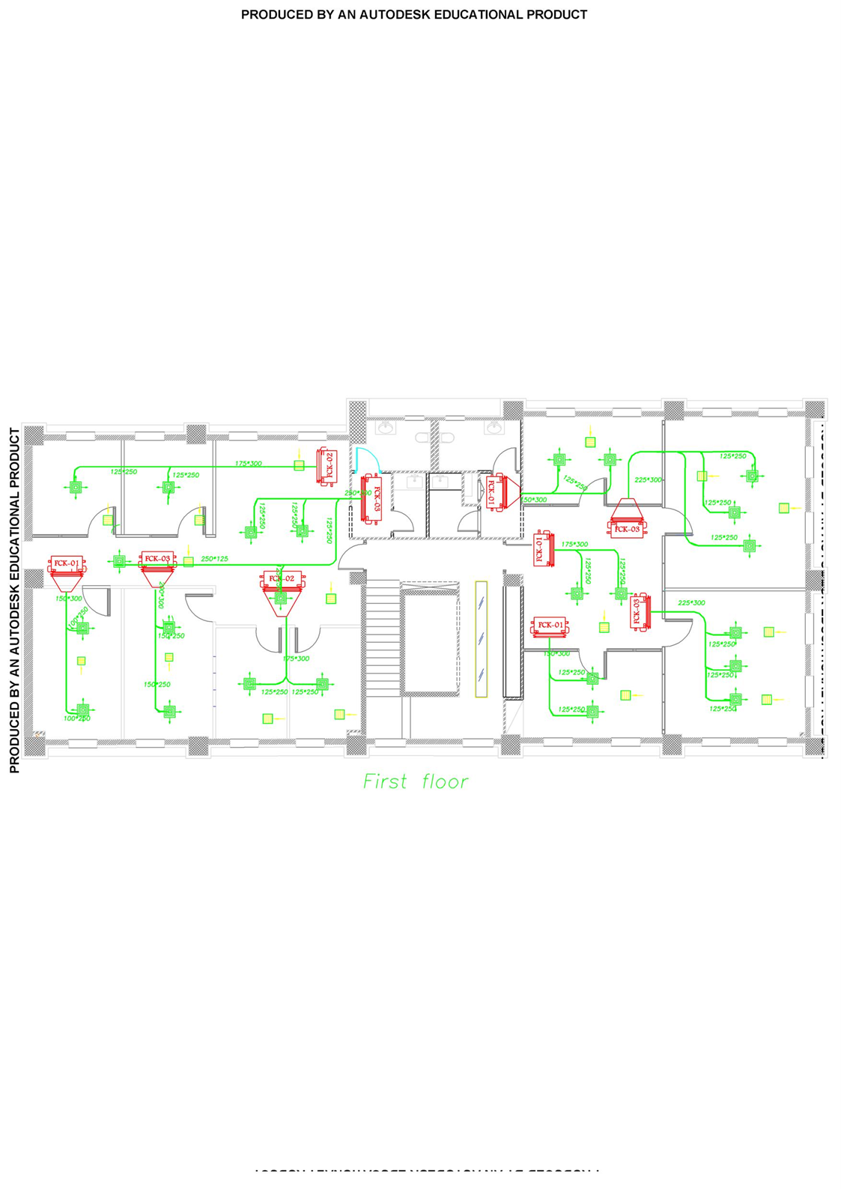

Slide 12
Plumbing System
Total demand water :
Demand Water (GPM) | Totally Fixture Unit | Type Of Supply Water
78 | 102 | Cold
33 | 35 | Hot
84 | 112 | TOTAL
main pipe size for riser :
Name of pipe | Size in inches
Municipality Line | 3/4 (standard)
Supply Line of pump 1 | 2
Pressurized pump 1 | 2
Pressurized pump 2 | 2

Slide 13
Sample of calculation for determined number of fixture unit:
Total Fixture |  |  | Quantity | Pipe Size |  | Fixture |  |  | Type
total | hot | cold |  | hot | cold | total | hot | cold
7 |  | 7 | 2 |  | 1/2 | 3.5 |  | 3.5 | W C
2 | 1.6 | 1.6 | 2 | 3/8 | 3/8 | 1 | 0.8 | 0.8 | Lavatory
6 | 4.6 | 4.6 | 2 | 1/2 | 1/2 | 3 | 2.3 | 2.3 | Mop sink
15 | 6.2 | 13.2 |  |  |  | 7.5 | 3.1 | 6.6 | Total Fixture
11 | 5 | 10 |  |  |  | 7 | 3 | 6 | Total Demand ( GPM )

Slide 14
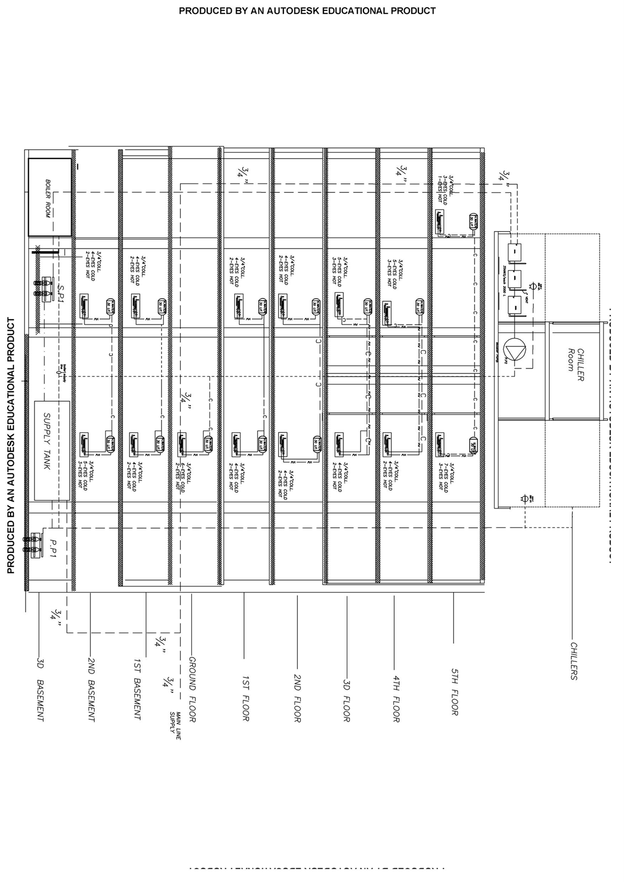

Slide 15
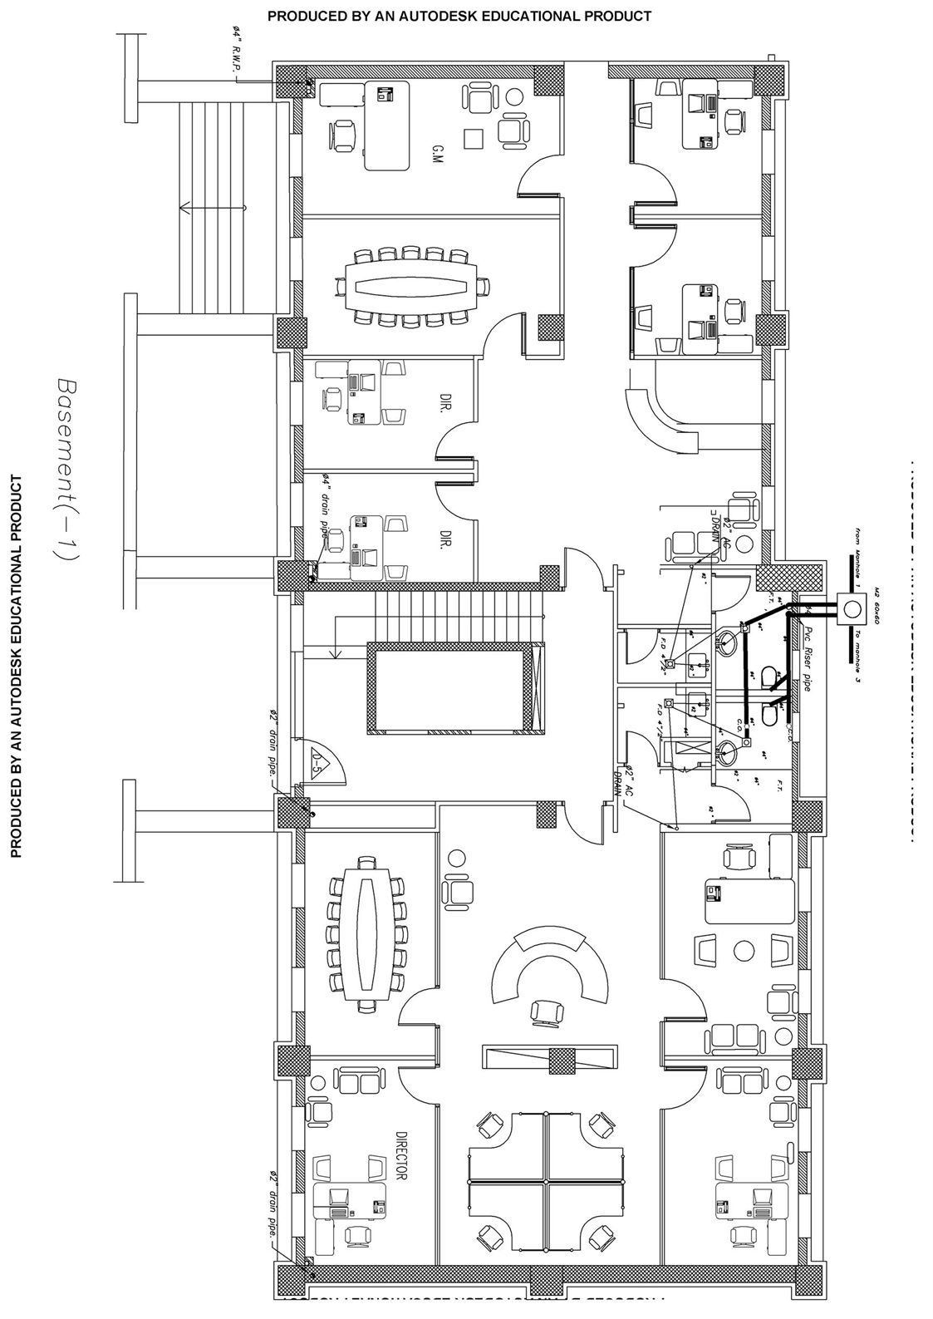

Slide 16
Equipment Selection
Boiler :
From mansour catalog of steam boiler is
250 kw. MS-10 which has capacity is
Chiller :
From Petra catalog we select a model
Which has capacity is 372 kw. A P S 75 2S AC
Fan coil :
RAC 4 H/C CBP 3
400 cfm

Slide 17
Equipment selection cont.
Fresh air and Exhaust fans:
From ROSENBERG program we select a fan according to total CFM for example. first floor UNO-ME50-355-4E , DH 355-4 D EX
respectively.
PUMPS:
From LOWARA company we select
1. Circulation pump for boiler GXS20
2. Centrifugal pump for potable water GTKS20
3.Transfer pump 4HM9
4.Drainge pump DOC3

Slide 18
SUMMARY
*All steps of design and plans of HVAC system are done.
*All steps of design and plans of plumping system are done.
*we select a suitable equipment for the system which satisfied the required conditions.

Slide 19
The end

