Slide 1

An - Najah National University Faculty of Engineering
Building Engineering Department
“EFFICIENCY OF DOUBLE SKIN FAÇADE
IN SOUTHERN ELEVATION”
Prepared by:
Mohammed Sanuora
Tawfiq Hijjawi
Amr Ramadan
1
0:05

Slide 2
Content
2
1:00
Introduction
Site description
Architectural Design
Structural Design
Environmental Design
Electrical Design
Mechanical Design
Fire and Safety Design
Operating & Maintenance
Quantity Surveying and Cost Estimation

Slide 3
Introduction
3
1:00
Double skin façade system has achieved a big fame in commercial constructions due to its advantages in achieving an attractive view along with sound and thermal insulation properties.
This project examines the efficacy of the system at the southern elevation in residential buildings in Palestine.
.

Slide 4
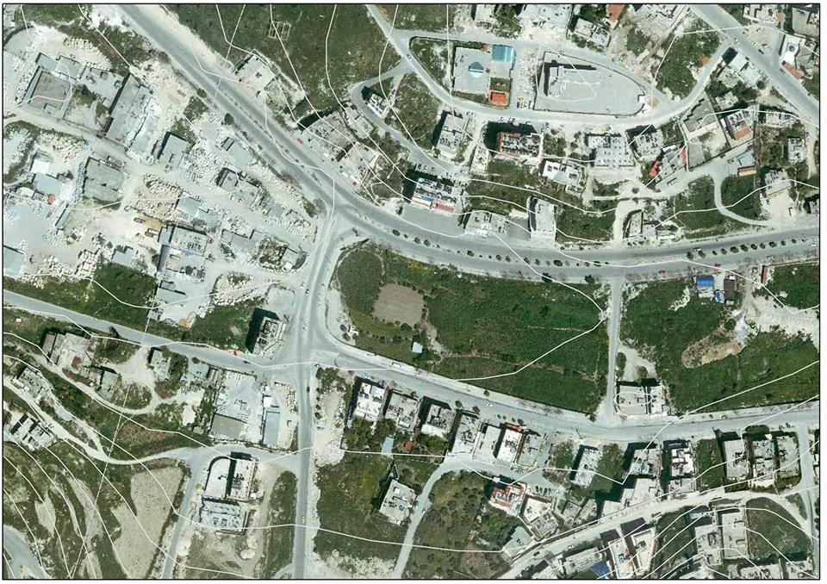
Site description and analysis
Al Toffah valley

Slide 5
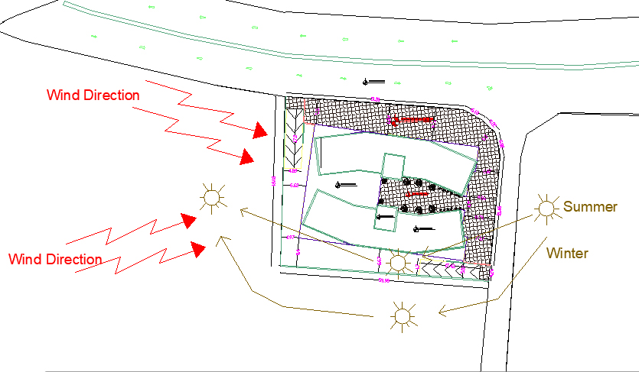
Site description and analysis
Sun path and wind direction

Slide 6
Architectural Design

Slide 7
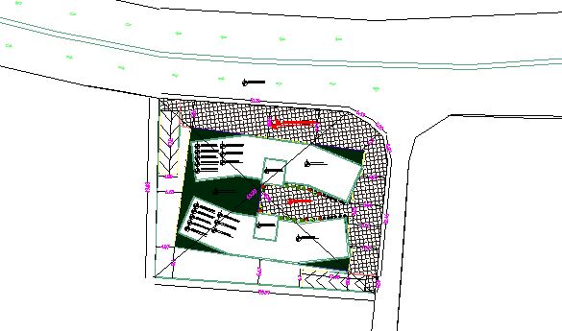
Architectural Design
Site Plan

Slide 8
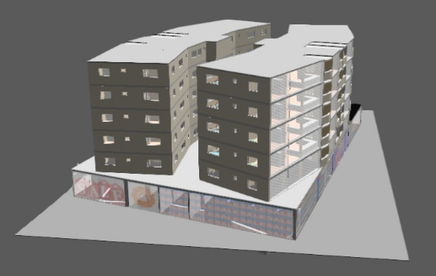
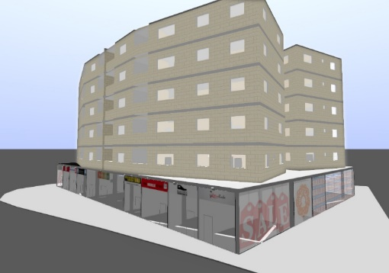
Architectural Design
Floor | Function | Area m^2
Basement | Parking | 1900
Ground floor | Commercial | 1500
1st | Residential | 470
2nd | Residential | 470
3rd | Residential | 470
4th | Residential | 470
5th | Residential | 470
2 X

Slide 9
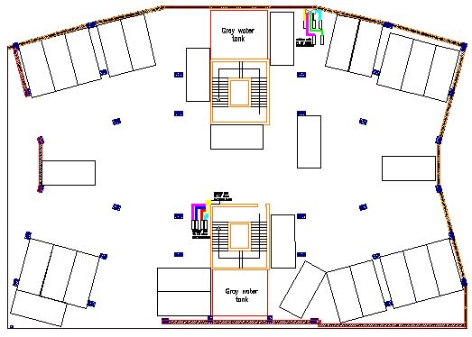
Architectural Design
Basement Plan

Slide 10
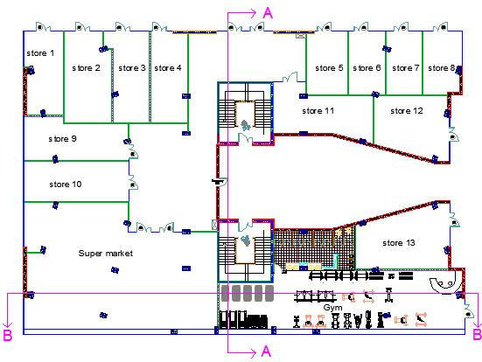
Ground floor “commercial” Plan

Slide 11
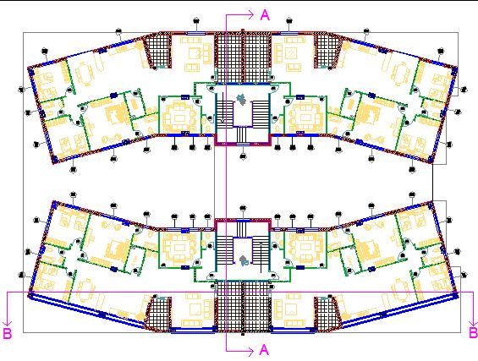
Residential floor Plan

Slide 12
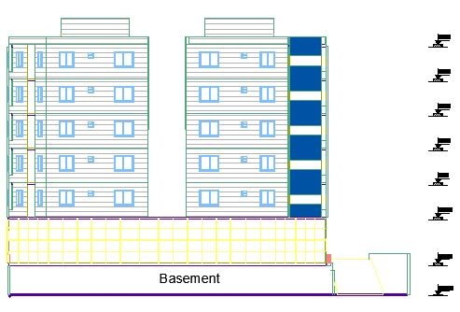
Eastern elevation

Slide 13
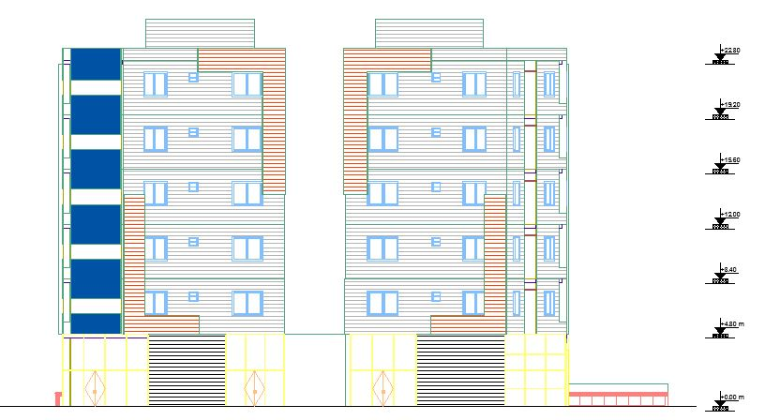
Western elevation

Slide 14
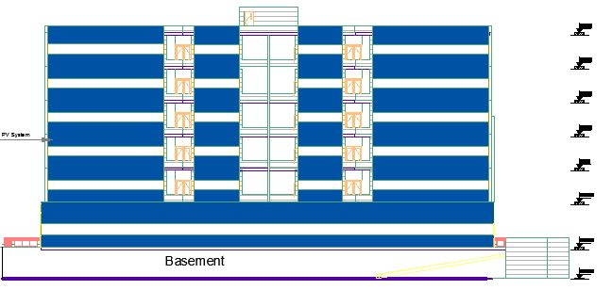
Southern elevation

Slide 15
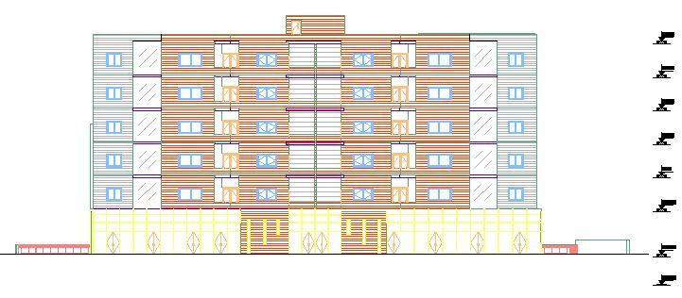
Northern elevation

Slide 16
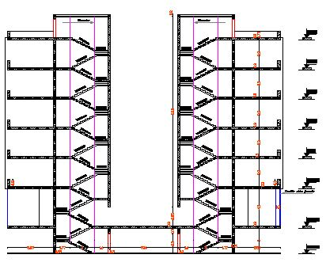
Section A-A

Slide 17
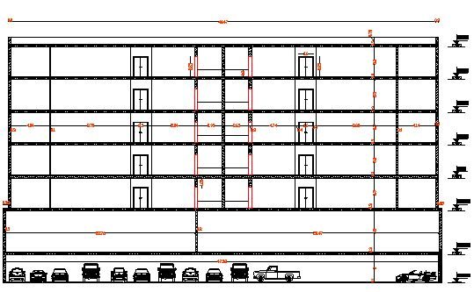
Section B-B

Slide 18

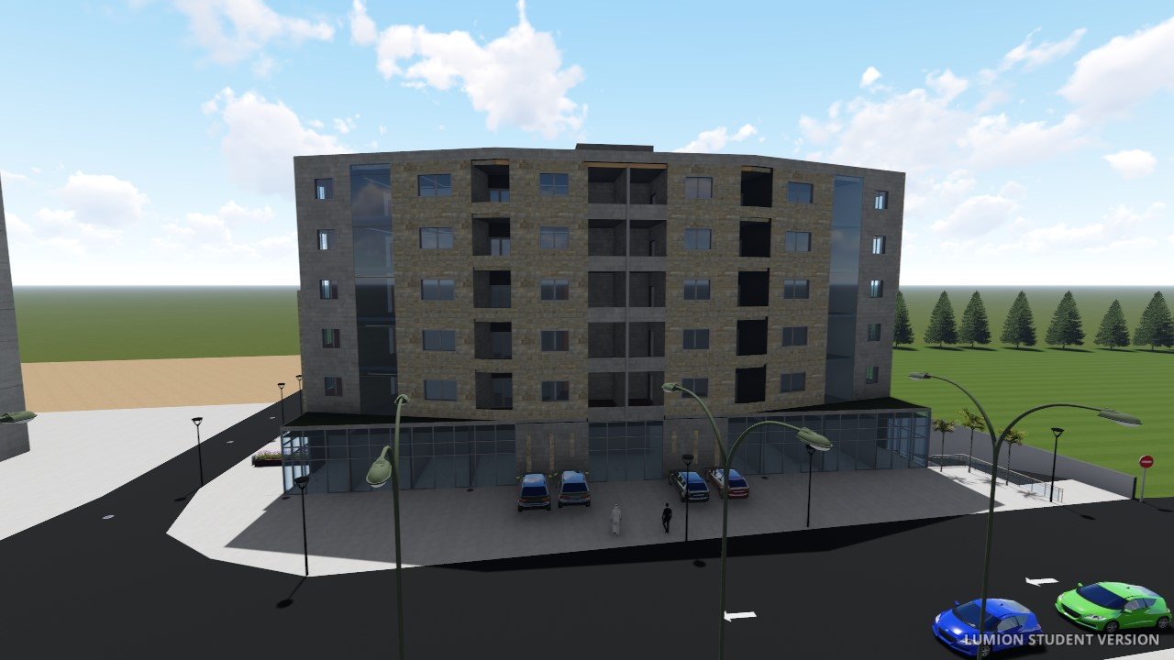
Architectural Design
3D VIEW

Slide 19
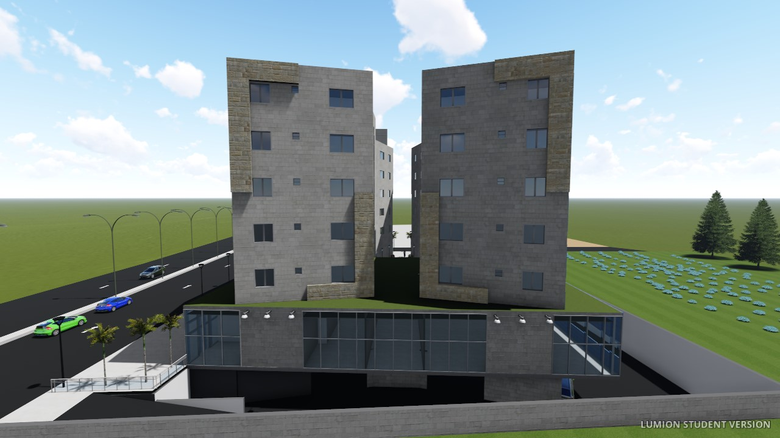
Architectural Design
3D VIEW

Slide 20
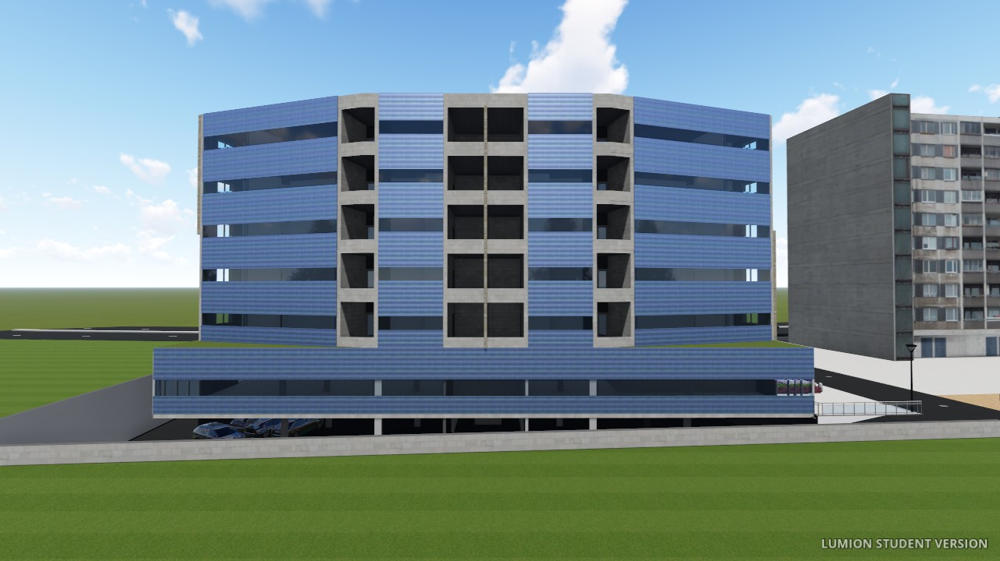
Architectural Design
3D VIEW

Slide 21
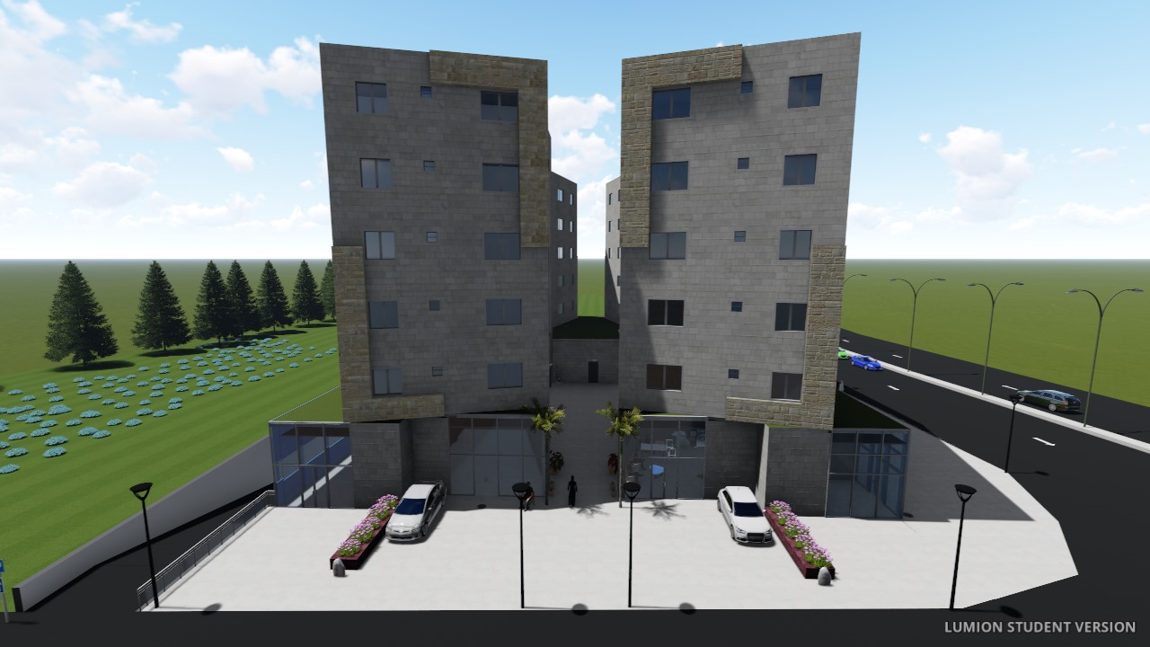
Architectural Design
3D VIEW

Slide 22
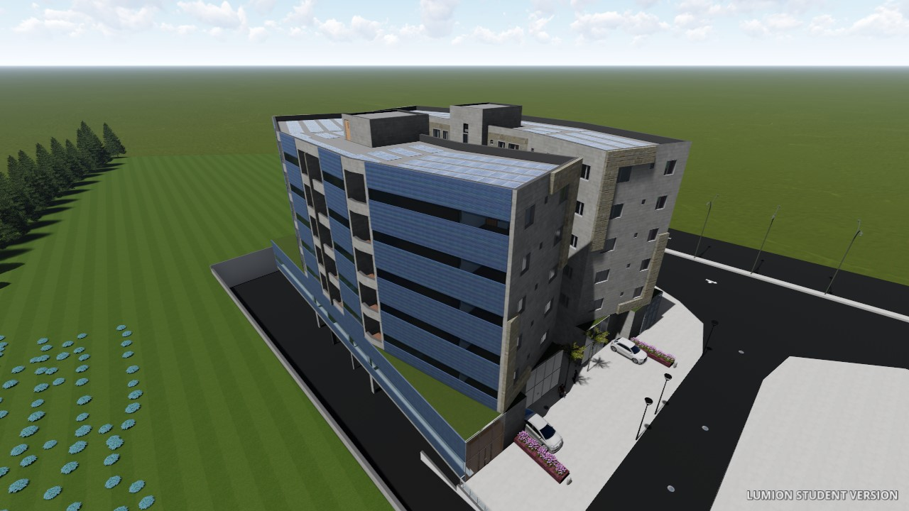
Architectural Design
3D VIEW

Slide 23
Structural Design

Slide 24
Structural Design
Design Data :
Concrete f ‘_{c}= 24MPa for slabs and beams
Concrete f ‘_{c}= 28MPa for columns and footings.
Slabs system used :- Two way ribbed slab. Load :
Super imposed dead load = 4.71 kN/m2
Live load = 3kN/m2 in residential and 5kN/m2 in commercial

Slide 25
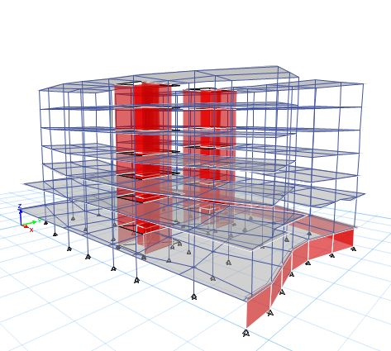
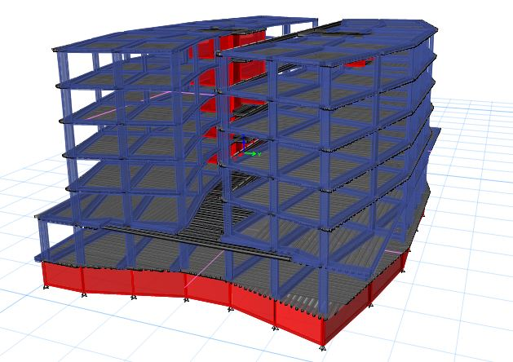
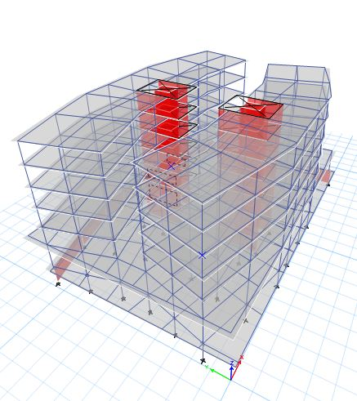
Structural Design
Etabs 3D MODEL

Slide 26
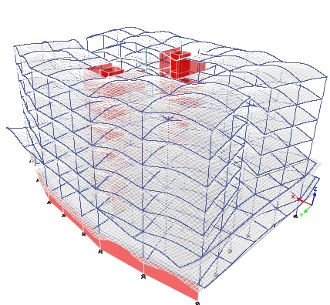
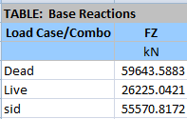
Structural Design
MODEL CHECKS
Compatibility check
Equilibrium check
Live load : %error = 0.57%
SID load : %error = 1.19%
DEAD load : %error = 2.69%
All of static analysis checks were satisfied

Slide 27
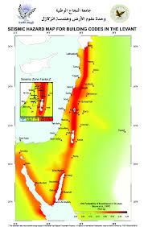
Seismic Design Data :
UBC 97
The soil profile type is “Sc”
Seismic zone factor (Z) = 0.2
Reduction factor (R) = 5.5
Seismic importance factor (I) = 1
Seismic coefficient (Cv) = 0.32
Seismic coefficient (Ca) = 0.24
Nablus lies in zone 2B

Slide 28
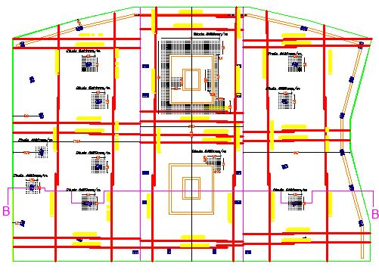
Footing Plan :
Structural-Elements

Slide 29
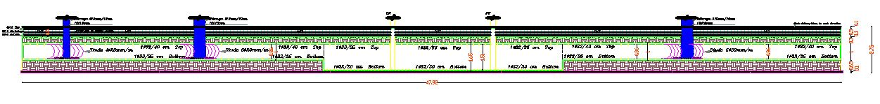
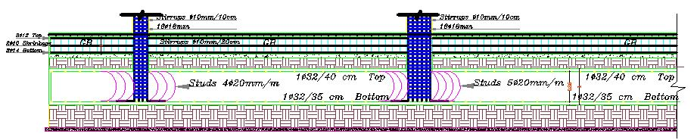
Footing Plan :
Structural-Elements

Slide 30
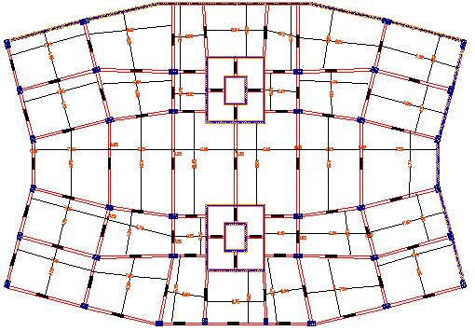
Tie Beam Plan:
Structural-Elements

Slide 31
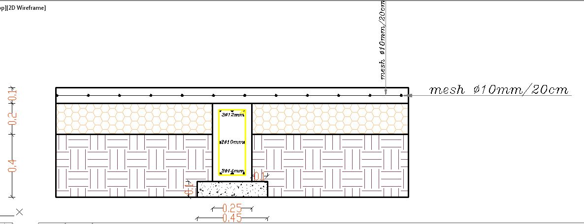
Tie Beam Plan:
Structural-Elements

Slide 32
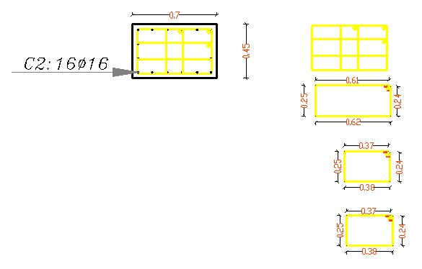
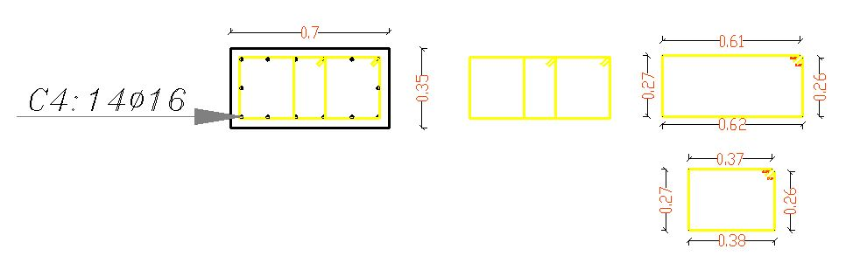
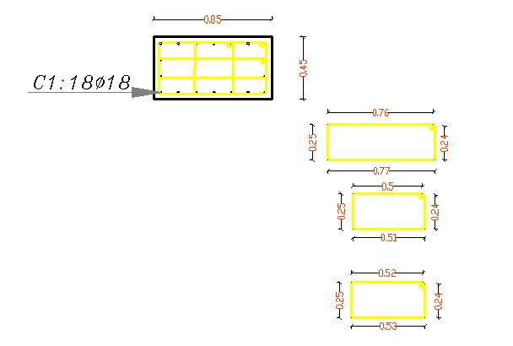
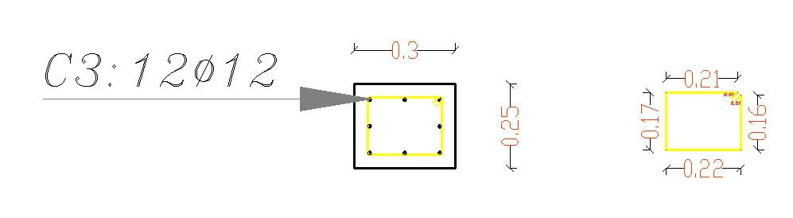
Column sections:
Structural-Elements

Slide 33
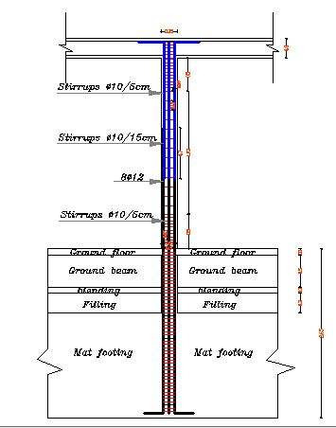
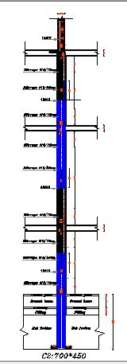
Longitudinal Column Sections :
Structural-Elements

Slide 34
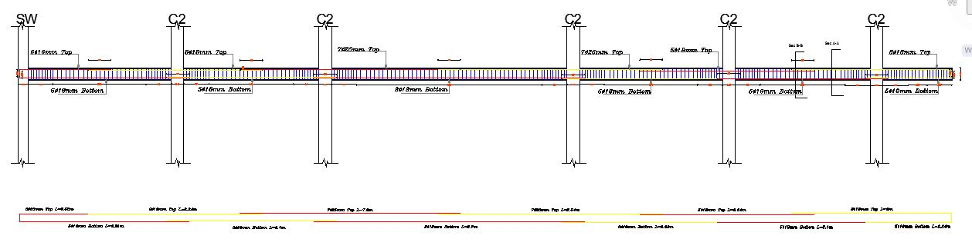
Beam Reinforcement :
Structural-Elements

Slide 35
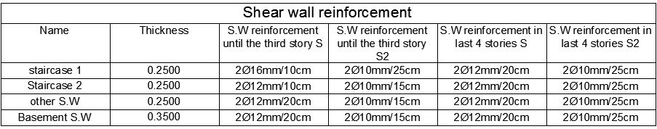
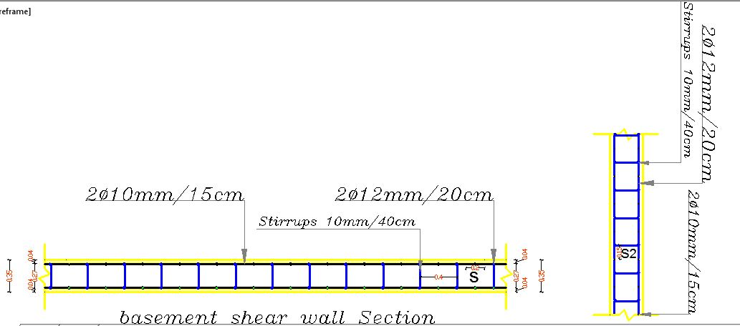
Shear Wall Reinforcement:
Structural-Elements

Slide 36
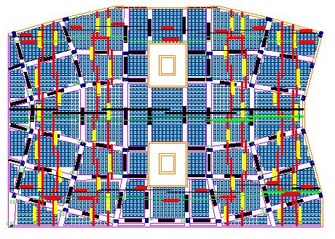
slab design in basement
Structural-Elements

Slide 37
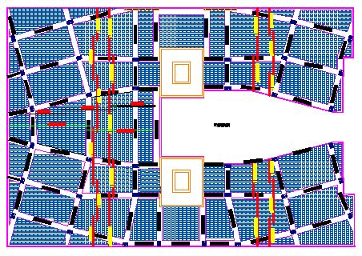
slab design in commercial
Structural-Elements

Slide 38
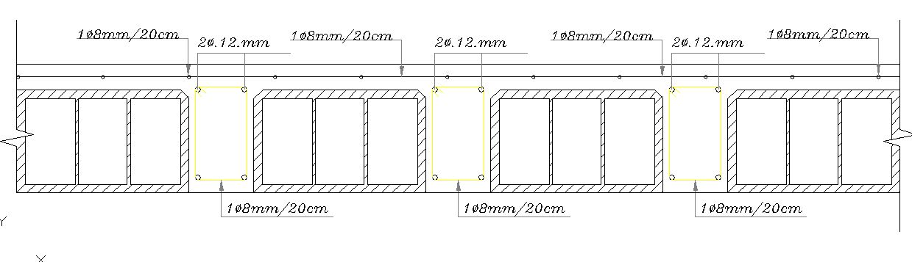
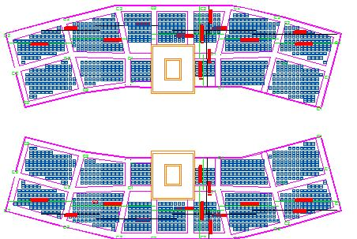
slab design in residential floor
Structural-Elements

Slide 39
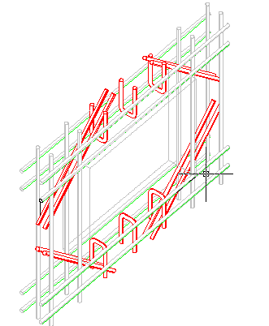
Structural-Elements
Reinforcement around windows:

Slide 40
Environmental Design

Slide 41
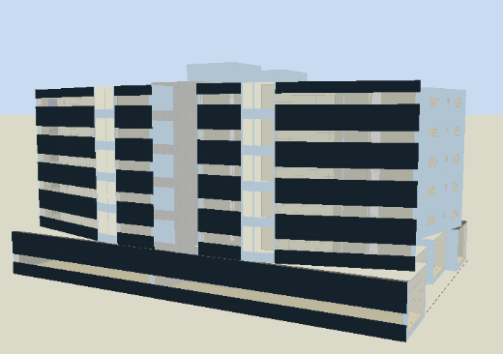
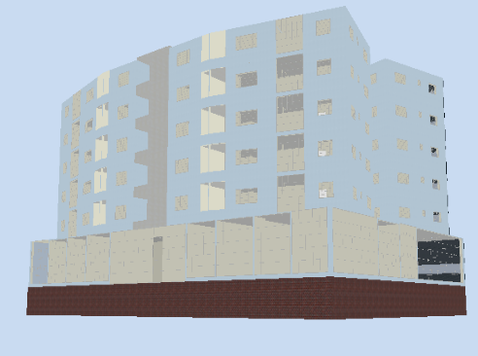
Environmental Design
Environmental simulation has been performed via Design Builder 5.2

Slide 42
Environmental Design
To discover efficacy of double skin façade system, insulation and both altogether on thermal loads.
Case 1 : Insulated building and DSF building
Case 2 : Insulated building and single skin façade
Case 3 : uninsulated building and single skin façade
Case 4 : uninsulated building and DSF building

Slide 43
Environmental Design
HEATING LOADS
Case 1
Case 2
Insulated & DSF
Insulated & single skin façade
Total heating design in the building = 150.55 kW
Zone sensible heating = 120.52 KW
Total heating design = 156 kW
Zone sensible heating = 124.83 KW
Case 3
Case 4
uninsulated & single skin façade
uninsulated & DSF
Total heating design = 277.76 kW
Zone sensible heating = 222.23 KW
Total heating design = 258.87 kW
Zone sensible heating = 201.14 KW

Slide 44
Environmental Design
COOLING LOADS
Case 1
Case 2
Insulated & DSF
Insulated & single skin façade
Total cooling design = 273.8 kW
Total cooling design = 277 kW
Case 3
Case 4
uninsulated & single skin façade
uninsulated & DSF
Total cooling design = 364.54 kW
Total cooling design = 353.44 kW

Slide 45
Environmental Design
Simulation
Case 1
Case 2
Insulated & DSF
Insulated & single skin façade
Intensity = 114.1 kW/m^2
Direct heating = 92,223 kWh
Direct cooling = 173,373 kWh
Intensity = 137.37kW/m^2
Direct heating = 88,854 kWh
Direct cooling = 235,595 kWh
Case 3
Case 4
uninsulated & single skin façade
uninsulated & DSF
Intensity = 156 kW/m^2
Direct heating = 166,384.72 kWh
Direct cooling = 227,269 kWh
Intensity = 132.81 kW/m^2
Direct heating = 153,067.21 kWh
Direct cooling = 175,519.84 kWh

Slide 46
Environmental Design
Comfort
Case 1
Case 2
Insulated & DSF
Insulated & single skin façade
-0.5 to 0.5
High comfort
-0.5 to 0.5
High comfort
Case 3
Case 4
uninsulated & single skin façade
uninsulated & DSF
-1.5 to 1.5
Accepted comfort
-1.0 to 1.0
Good comfort

Slide 47
Environmental Design
Savings
Case 1
Case 2
Insulated & DSF
Insulated & single skin façade
Annual energy consumption = 114.1 kW/m^2
Cost of annual energy consumption = 114 * 3641.88*0.6
= 290,622.024 ILS
Annual energy consumption = 137.37 kW/m^2
Cost of annual energy consumption
= 350,199.53 ILS
The savings = 59,577.506 ILS
About 17%

Slide 48
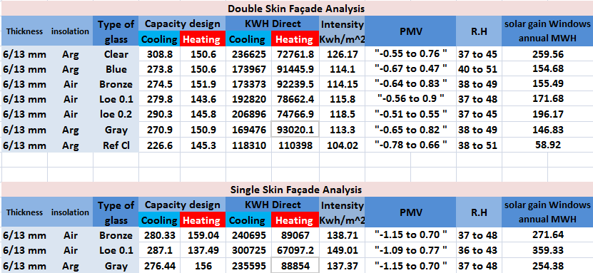
Final thoughts on environmental design
1. The system achieved comfort inside the space according to PMV, with and without HVAC.
2. It has been shown that blue glass gives better results with maintain 50% of light transmission. It is the most light-emitting type of colored glass.

Slide 49
Final thoughts on environmental design
3. Heating and cooling loads are very low in residential apartments with the traditional insulation and almost high in commercial floors. Thus, the double skin façade in residential building is not active as the same level in the commercial floor. This is why its widespread in commercial and offices buildings and in very few residential cases, the impact of the double façade appeared in the commercial floor much more than it is in the residential floors from energy saving and power saving perspectives.

Slide 50
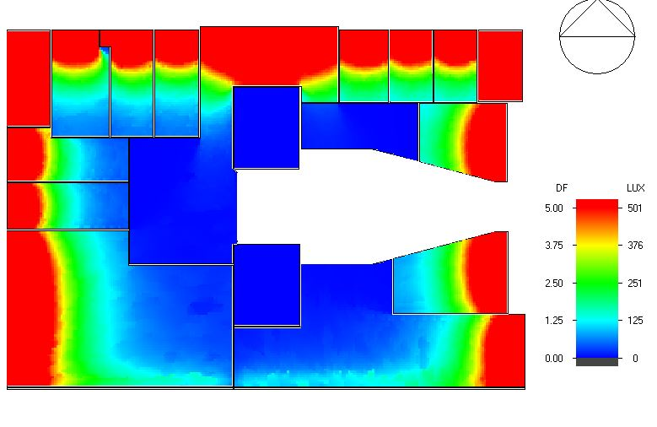
Daylight calculations
Commercial floor

Slide 51
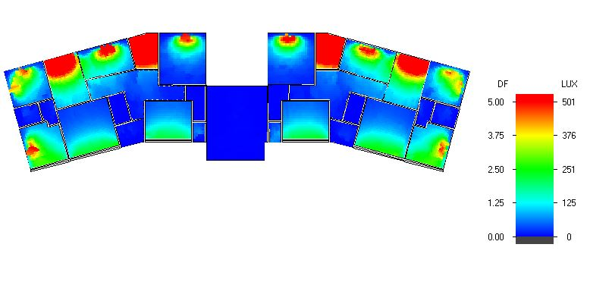
Daylight calculations
Residential floor

Slide 52
Artificial lighting Design

Slide 53
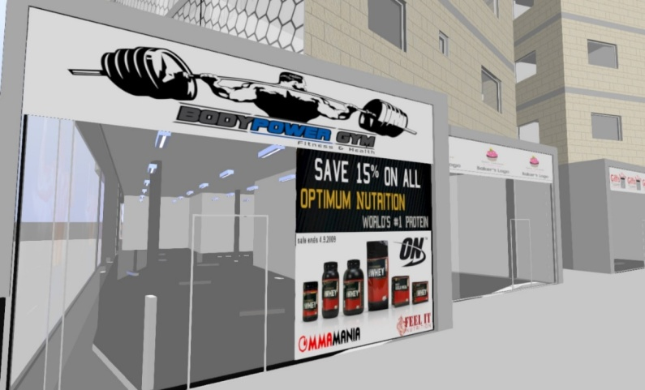


Artificial lighting Design
All spaces in this project have been designed with DIALux evo 7.1

Slide 54



Artificial lighting Design
Lighting requirements of each space have been achieved Illuminance, uniformity and Glare
A. Parking

Slide 55


Artificial lighting Design
A. Parking

Slide 56



Artificial lighting Design
B. Master Bedroom

Slide 57



Artificial lighting Design

Slide 58




Artificial lighting Design

Slide 59


Artificial lighting Design
Sockets plan
Electrical wires plan

Slide 60
Acoustics Design

Slide 61

Acoustics calculations
Noise level: ≈ 68 dB

Slide 62


STC calculations
1. STC for DSF wall

Slide 63


STC calculations
2. STC for insulated Palestinian wall

Slide 64

STC calculations
Insulated
Palestinian wall
VS.
DSF wall
62
54
VS.
could you please tell me which one is better !

Slide 65

STC calculations
*Double skin façade is weaker in blocking low frequencies like traffic noise from large vehicles, planes and heavy machinery.
Traditional insulted wall is better in blocking low frequencies.
It called resonance, the main reason for this refers to the nature of the material itself and how it behave when exposed to sound waves at different frequency.

Slide 66

STC calculations
There are parameters should be taken into account: site, cost, function, degree of insulation, noise frequency and what frequencies to be blocked.

Slide 67
STC calculations
Bedroom calculations
STC composed (external wall) = 49
IIC for bedroom = 58
STC internal wall = 54
remaining passing noise = 19 dB,
it is lesser than 35 dB (maximum allowable background noise in bedrooms )

Slide 68


STC calculations
RT60 for Bedroom
The transmitted 19 dB also will be distracted by

Slide 69
Acoustical calculations
To prevent water hammer, flow’s upper limit is
V = 4.89 = 5 ft/s

Slide 70
Photovoltaic system Design

Slide 71


Photovoltaic system
The idea was to improve an integrated system that works efficiently in almost all days per year
UTILIZING SUN’S ALTITUDE
Summer
Altitude 89
Winter
Altitude 35

Slide 72




Photovoltaic system
Summer
Winter
Roof flat system
Southern elevation system
Also shading system

Slide 73

Photovoltaic system: Integration
# of modules: 256
Pnom total: 73kWp
Produced energy: 118 MWh/year
# of modules: 308
Pnom total: 88 kWp
Produced energy: 90.3 MWh/year

Slide 74

Photovoltaic system: statistics
Total cost of PV systems = $ 77220
Payback period: 30 months
PV system coverage = 60 % in Winter
PV system coverage = 43% in Summer

Slide 75
Mechanical Design
Water Supplying System
Drainage Systems
Elevators
HVAC System

Slide 76

Water Supplying System

Slide 77

Drainage Systems

Slide 78
Drainage Systems

Slide 79

Drainage Systems

Slide 80

Drainage Systems

Slide 81

Drainage Systems

Slide 82

Drainage Systems

Slide 83

Drainage Systems

Slide 84


Drainage Systems

Slide 85
Elevators
elevator {2000 lb, 100 fpm}
The elevator type is motor driven with a sliding door.

Slide 86
HVAC System Design

Slide 87

HVAC System Design
Multi split units system has been used.
DAIKIN’s company catalog has been used to choose suitable indoor and outdoor units.

Slide 88

HVAC drawings

Slide 89

HVAC drawings

Slide 90
Fire fighting System

Slide 91

Fire fighting System

Slide 92

Fire fighting System

Slide 93

Fire fighting System

Slide 94

Fire fighting System

Slide 95
Fire fighting System

Slide 96

Fire fighting System

Slide 97

Fire fighting System

Slide 98
Operating & maintenance system

Slide 99

Operating & maintenance system
Operating & maintenance phase forms 60-70% of LC

Slide 100


Operating & maintenance system

Slide 101
Quantity surveying & cost estimate

Slide 102
Quantity surveying & cost estimate
Type of work | Cost ILS
Excavation, backfilling and site | 12057889
Concrete work | 15663505
Stone work | 59292
Concrete block work | 62761
Tiling and marble work | 306759
Plaster work | 195377
Steel work | 1264410
Painting work | 282493
Electrical work | 32755
Mechanical work | 42650
Solar system + PV | 503680
Fire system | 237300
Hvac system | 125000
Double skin façade | 252144
False ceiling | 106020
Glass on walls | 138384
Doors and windows | 247234
Blocks 10 & 20 cm | 153238
Total cost = 7.1 million ILS
Unit cost = 887.5 ILS/m^2

