Slide 1

An-Najah National
University
Faculty of Engineering
and information technology
Graduation Project Report II
Design of Wastewater Collection Networks for An-Nassariya Village
By:
Majde Surakje Reg: 11344389
Qutaiba Adham Deek Reg: 11344554
Under Supervision of: Dr. Abdhaleem khader
Submitted in partial fulfillment of the requirements for bachelor’s degree
in civil engineering
Spring 2021
جامعة النجاح الوطنية
كلية الهندسة
وتكنولوجيا المعلومات

Slide 2












Introduction
Introduction
Study Area
Significance of the Project
Existing Problems
Methodology

Slide 3
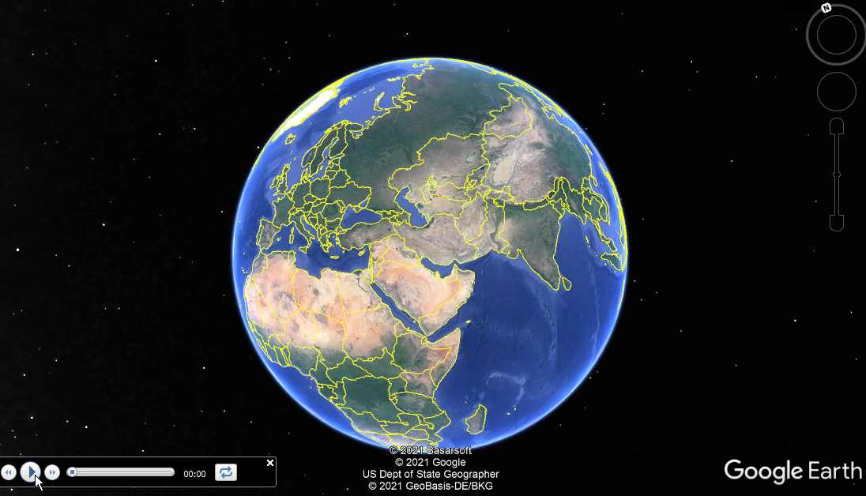

Slide 4
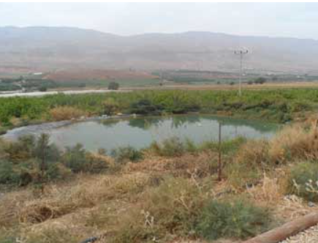
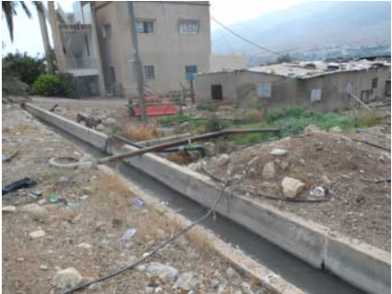
Existing Problems
There is no wastewater network.
The people using septic tank for draining their sewage .
The farmer using this wastewater for irrigation

Slide 5
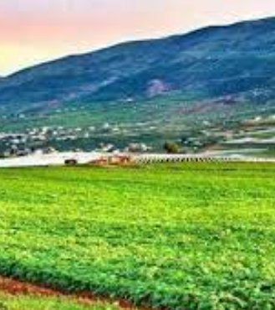
Significance of the Project
Design wastewater collection network for the village.
Avoid ground water pollutions.
Avoid health issues.
End the wrong thinking and habit of using the wastewater for irrigating crops.

Slide 6
Introduction
Description of the study area
Design the WWCN by SewerCad
Principal of design
Cost Estimation
conclusions and recommendations

Slide 7





DESCRIPTION OF THE STUDY AREA
Spatial information
Demographic information
Counting Period

Slide 8
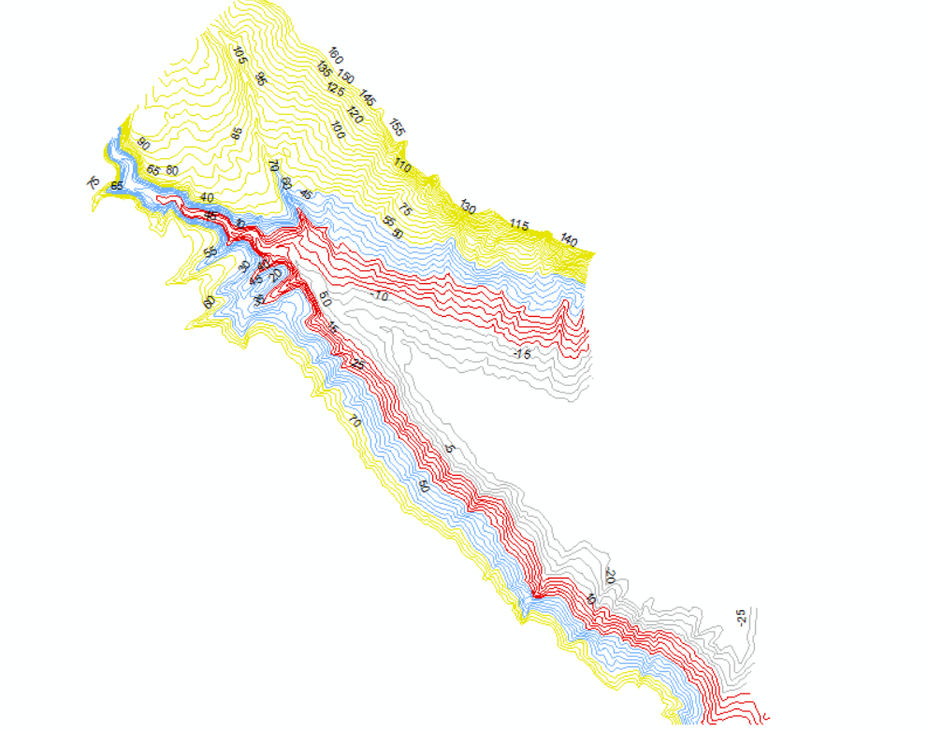
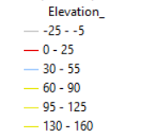
Spatial information
Collect contour lines and
Approved Urban Master
Using GIS (Geographic information system and)
Geomolg for contour maps and aerial photography.

Slide 9
Demographic information
Project period.
future population.
consumption of water

Slide 10
Design period | population
- | 1345 | 2007
10 | 1873 | 2017
25 | 4641 | 2046
Repair the water network and decreasing the loss in the network to be 10%.
Build a new tank with 500m³ volume.

Slide 11





PRINCIPLES OF DESIGN
Layout the Network
Type of Network
Manholes and Conduit
Hydraulic Calculations

Slide 12
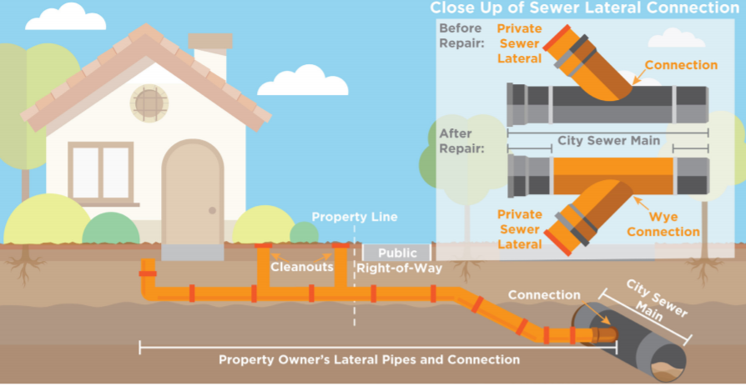
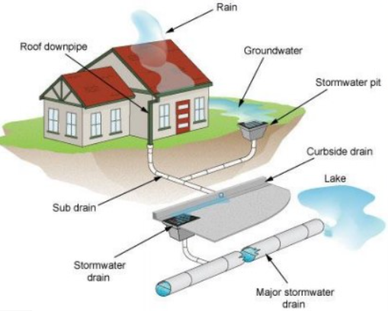

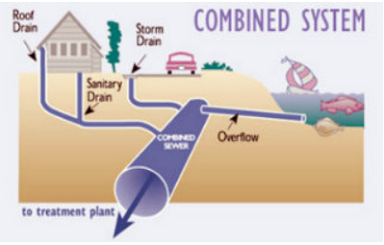
There are three types of Network :
Sewer network:
Storm water network network:
Combined network:
Type of Network

Slide 13
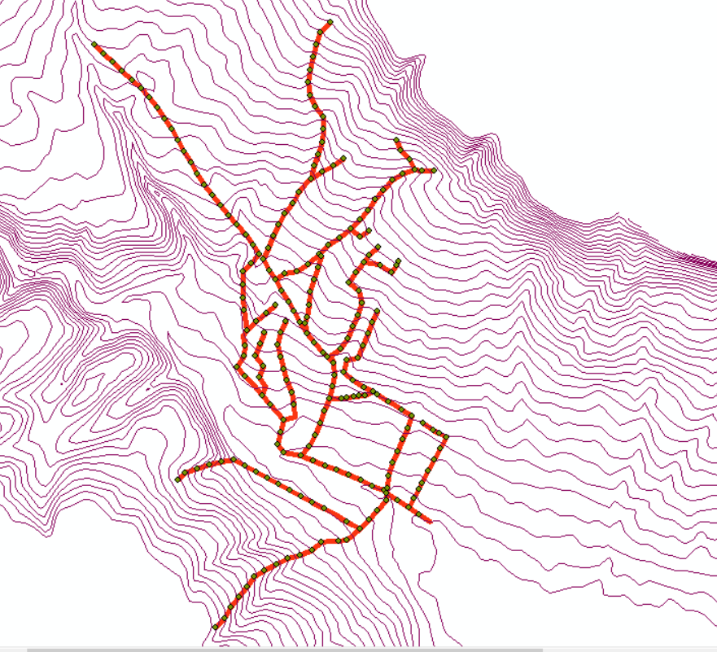
Layout the Network

Slide 14








Design the WWCN by SewerCad
Constraint
Diameters Results
Slop and Cover Result
Velocity Results

Slide 15
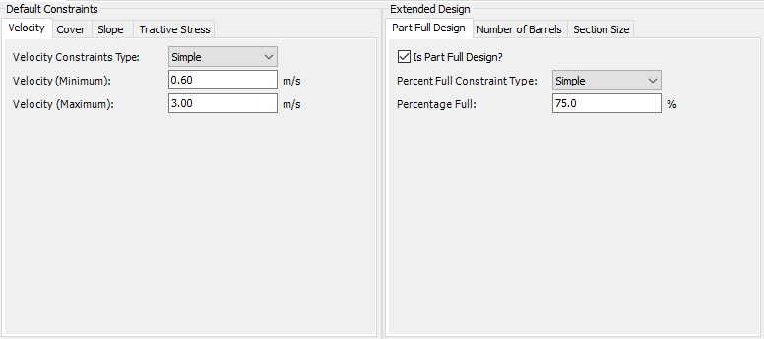
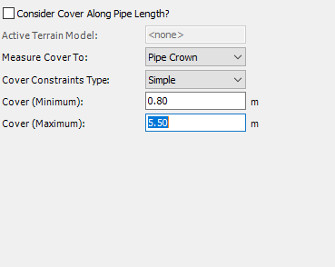
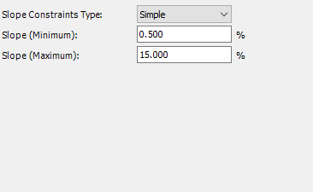
constraint
Velocity
Cover
Slope

Slide 16
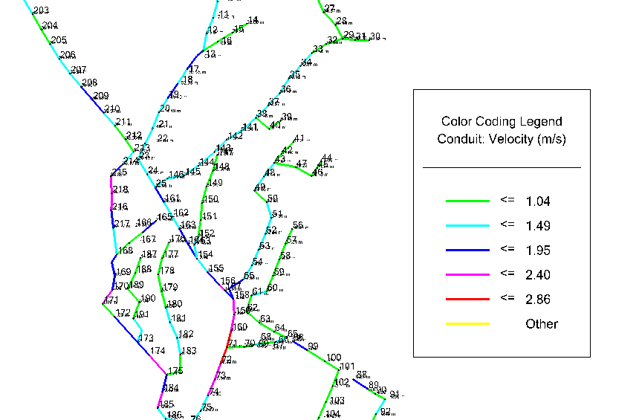
Velocity Results
Horizontal Alignment

Slide 17
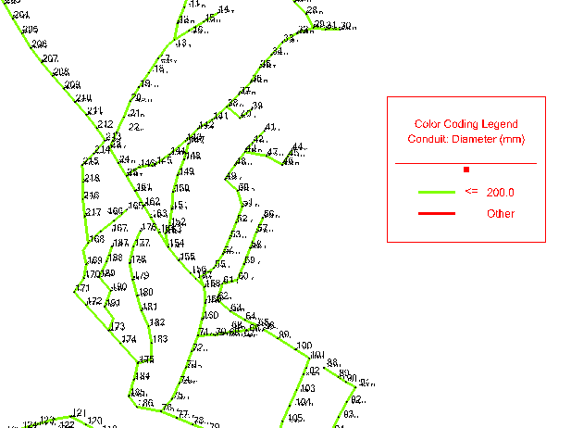
Diameters Results
Horizontal Alignment

Slide 18
Horizontal Alignment
Slop and Cover Result
5.01m
0.8m

Slide 19


Hydraulic Calculations
Mathematical relations used in calculating diameter and velocity

Slide 20
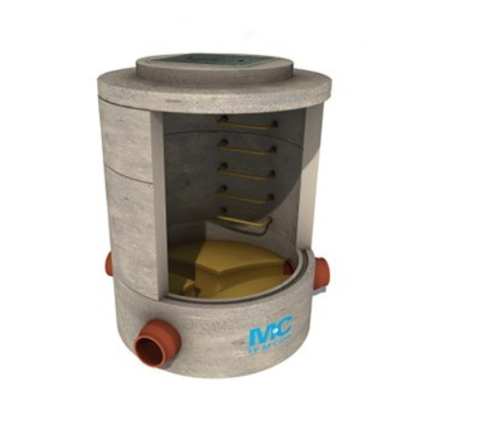
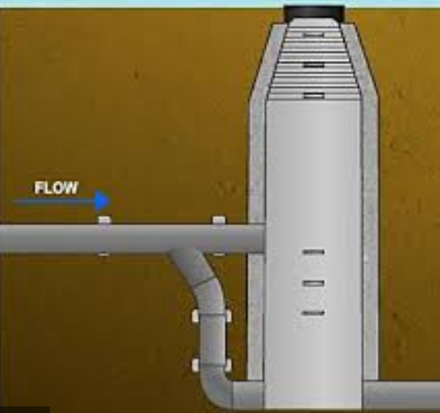
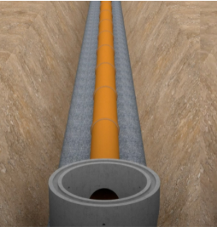
Manholes & Conduit
Manholes
Conduit

Slide 21





CONCLUSION AND RECOMMENDATIONS
Cost Estimation
Recommendations
Conclusion

Slide 22
Cost Estimation
Item | Cost $
Excavation | 389,090.4$
Sewer | 148,636.5
Manholes | 68,547
Asphalt | 146,291.04
Total Cost | 752564.94

Slide 23
Conclusion
Design result | Design Criteria | Result | Accpetable | Note
Velocity | In dry weather, not less than 0. 4m/s In rainy weather, it shall not be less than 0.6 m / s | 0.6 | yes | It accepteal espcailly at the begning of the netwrok
 | Max 3m/s | 2.86 | yes
Slope | Minimum 0.5% | 0.5% | yes
 | Maximum 15% | 12% | yes
Cover | Crumbled rock soil from 5-4m. Wet earth rocks from 6-5m. Cohesive rocks from 8-7m. | 5.01m | yes | The nature of the-Nassarius village wet rock and crumbled rock soil too because located on plain
 | Minmumm (0.8-1)m | 0.8m | yes
Diameters | Minmumm 200mm | 200mm | yes
 | Maximum 900mm | 200mm | yes

Slide 24
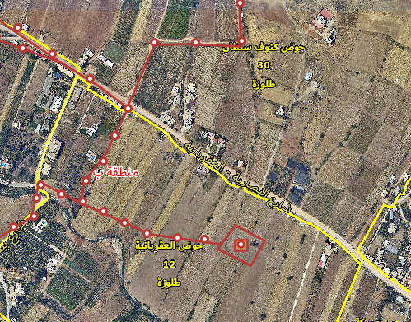
Recommendations
The main recommendations are:
1- Build a wastewater treatment planet
2- Raising environmental awareness about the dangers of using sewage water to irrigate crops

Slide 25


