Slide 1





Group Members:
Ala’ Saleh & Nariman Abu Sneineh
Supervisor:
Dr. Ashraf Armoush
© ShareKit 2013

Slide 2


Outline:
Why/What is ShareKit?
Methodology:
  The Data Storage
  The Graphical User Interface “GUI”
  The Implementation
Future Work
Demo Time

Slide 3
Outline:
Why/What is ShareKit?
Methodology:
  The Data Storage
  The Graphical User Interface “GUI”
  The Implementation
Future Work
Demo Time

Slide 4
Why/What is ShareKit?
Problem
Solution
“ShareKit”
Idea/Technology
Notes:
Problem:
Our society suffers from many critical problems especially the youths.
As we are a computer engineering students we have the responsibility of decreasing these problems as much as we can, also the responsibility of facilitating humans lives.
After a long time of digging for a problem, finally we found it from our little university experience that is ➔
The university students face a frequent and real problem after each semester has finished which they have a lot of educational stuff they don't know what to do with! On the other hand, most of the students suffer from finding their educational stuff because of either financial issues or just they don't know the suppliers for this stuff.
______________________________________________________
Solution:
Place to collect data
As aresult, ShareKit was born.
_______________________________________________________
Idea/Technology:
What is ShareKit?
ShareKit is an android mobile application gathers all the university students in one place in order to facilitate sharing their stuff with each others which saves their time, money and a lot of effort.

Slide 5
Outline:
Why/What is ShareKit?
Methodology:
  The Data Storage
  The Graphical User Interface “GUI”
  The Implementation
Future Work
Demo Time

Slide 6
Methodology:
The Data Storage.
The Graphical User Interface “GUI”.
The Implementation.

Slide 7
Outline:
Why/What is ShareKit?
Methodology:
  The Data Storage
  The Graphical User Interface “GUI”
  The Implementation
Future Work
Demo Time

Slide 8
The Data Storage:
The data storage in our application is divided into two sides:
Local Side Data Storage.
Server Side Data Storage.

Slide 9
Local Side Data Storage:
In our case, we used Android Shared Preferences.
What is Shared Preferences?
API from Android SDK.
The data in shared preferences will be persistent even though user closes the application or turn off the device.
Use it whenever need to share primitive data across all Activities in application package.

Slide 10
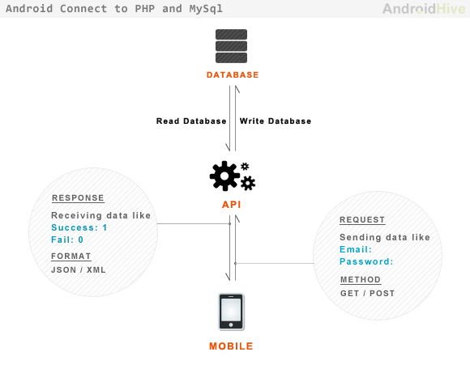
Server Side Data Storage:

Slide 11
Outline:
Why/What is ShareKit?
Methodology:
  The Data Storage
  The Graphical User Interface “GUI”
  The Implementation
Future Work
Demo Time

Slide 12
  Graphical User Interface “GUI”:
android 4.0
IceCreamSandwich
XML Tags
GUI

Slide 13
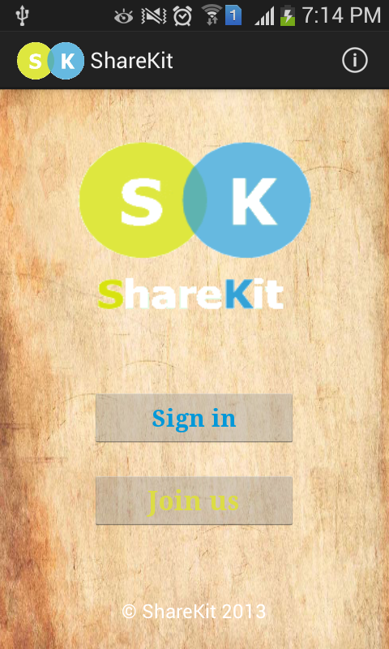
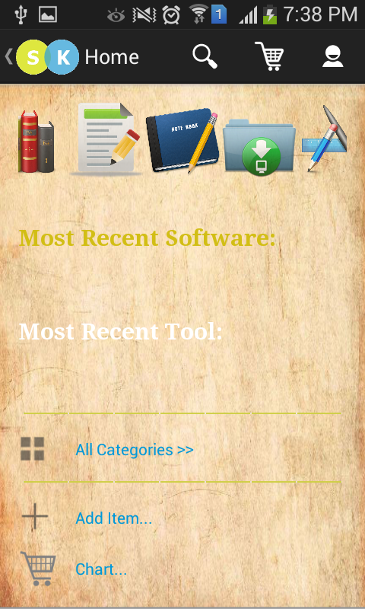
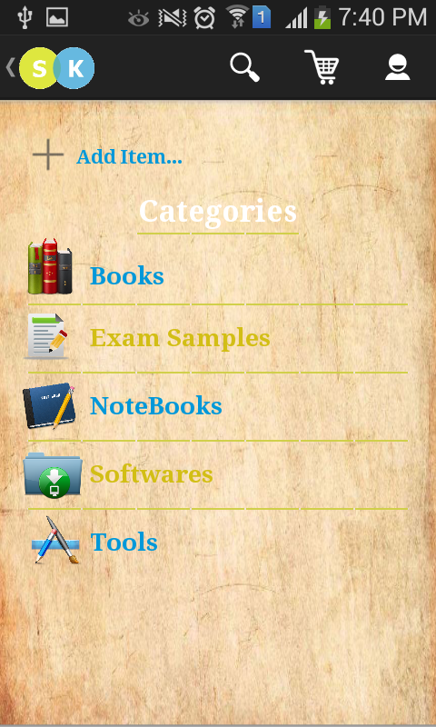
  Some examples of our GUI:
Main Activity
Home Activity
Categories Activity

Slide 14
Outline:
Why/What is ShareKit?
Methodology:
  The Data Storage
  The Graphical User Interface “GUI”
  The Implementation
Future Work
Demo Time

Slide 15
  Implementation:
Connect Android with PHP and MySQL
Security
Internet Connection.
Threaded Technique
Points Mechanism
Alerts

Slide 16
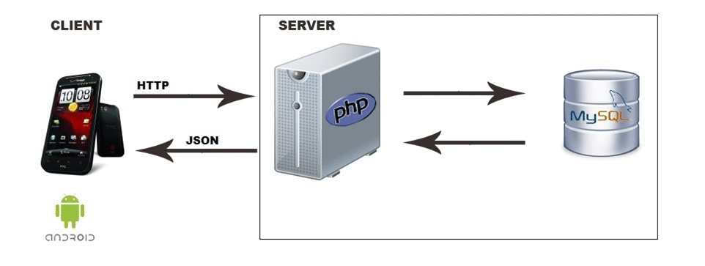
Connect Android with PHP and MySql:
How to perform basic CRUD?

Slide 17



Security:
Log in/out.
Encrypted password.
SQL Injection.
Internet Connection:
In order to avoid http exceptions.

Slide 18
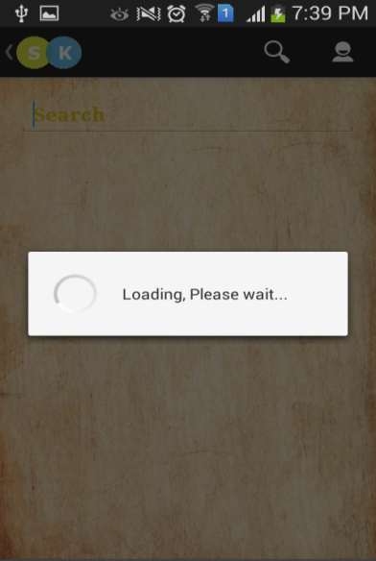
Threaded Technique:
Android implements single thread model.
AsyncTask is an intelligent thread for doing work in the background and re-integrating the result with the main thread.
Examples:
Get the desired data for each category.
Get data in search operation.
Etc.

Slide 19
Points Mechanism:
Encourage people to share out their educational stuff so that everyone can get its need eventually.
How to get points?
Sharing new stuff.
Each time the stuff is taken.
Cash.
when the student takes stuff his/her point will be decreased according to the stuff he/she takes.

Slide 20
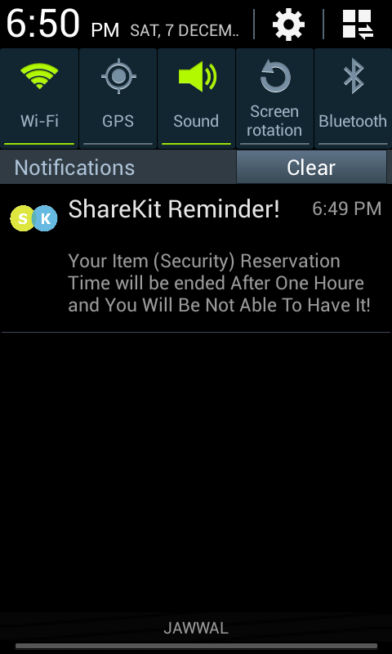
Alerts:
Add to Cat
47 hours
Alert On, Notification sent
No Action
Delete the Order

Slide 21
Add To Cart
Check Out
Enough Points
Doesn't Have Enough Points
Cancel
Add Stuff
No Action
Alert is On, Notification Sent
Check Out
Cancel
No Action
Order Deleted
Increase/Decrease Points

Slide 22
Outline:
Why/What is ShareKit?
Methodology:
  The Data Storage
  The Graphical User Interface “GUI”
  The Implementation
Future Work
Demo Time

Slide 23
  Future Work:
Buying Points.
All the Palestinian Universities.
Cross Platform Application.
Instructors.
Other Categories.
Rating.

Slide 24
Outline:
Why/What is ShareKit?
Methodology:
  The Data Storage
  The Graphical User Interface “GUI”
  The Implementation
Future Work
Demo Time

Slide 25

Demo Time

