Slide 1
Powders & Granules filling machine
Instructor: D.r Bashir Nouri
by:
Iyad ahmad abu rajab
Saqer shanabli
Sami zaid

Slide 2
Table of contents:
Introduction.
Advantages.
Mechanical Design.
Electrical Design.
The control of sequence of operation.
Conclusion.

Slide 3
1.Introduction:
The Age of speed and productivity and the role that technology plays.

Slide 4
2.Advantegs:
Get rid of the old methods of filling and weighing.
Higher productivity.
Reduce humanoid efforts and time.

Slide 5
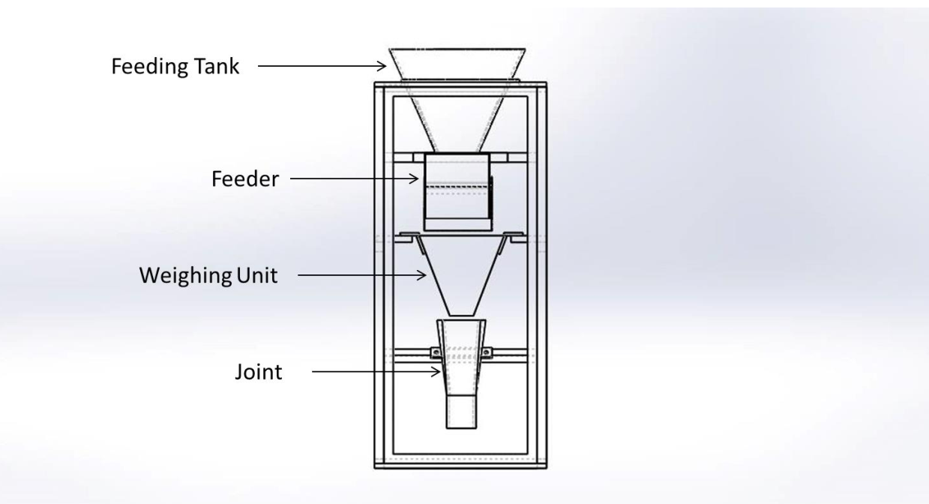
3.Mechanical Design:

Slide 6
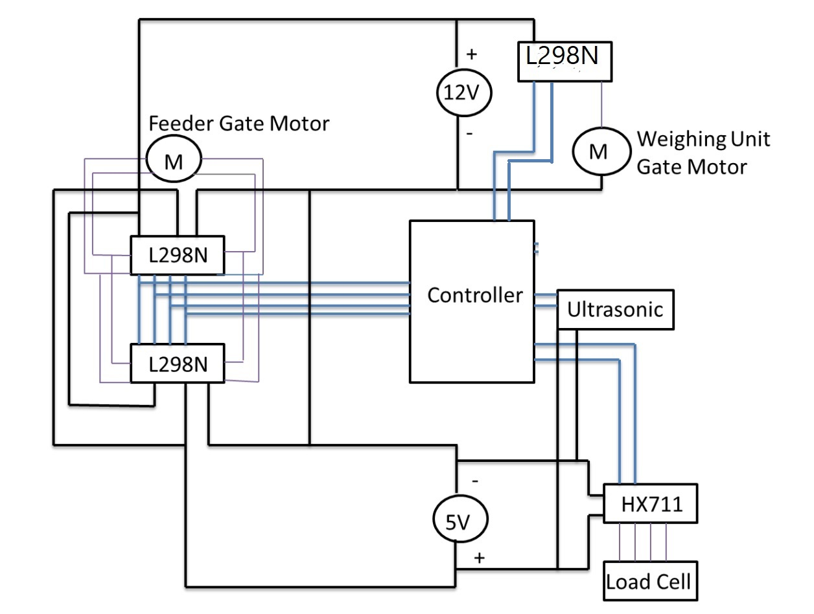
3.Electrical design

Slide 7
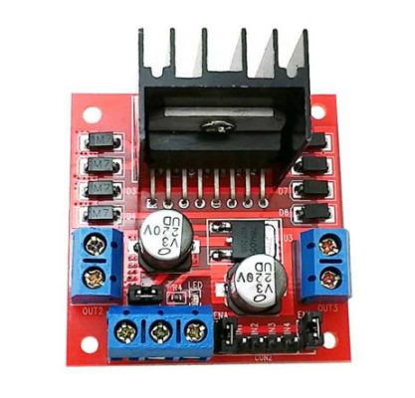
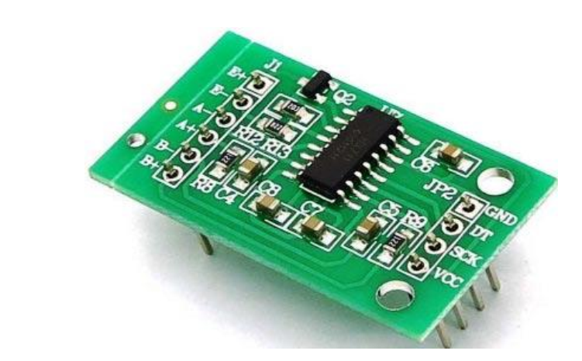
HX711
L298N

Slide 8

The control of sequence of operation:

Slide 9
6. Conclusion.
Finally, this machine will help many of those who have problems of speed and productivity in filling materials, and we have been keen to make a light machine and that it will take a small space so that everyone can use, and this offer is completed only thanks to all who helped us to access this place and the completion of this work

