Slide 1
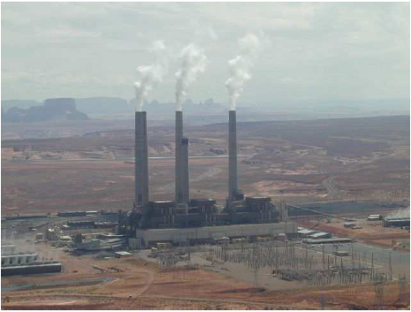
BEAT OMMAR NETWORK STUDY
Prepared by :
Iyad Obaid
Osama Yousef
Supervisor :
Dr. IMAD IBRIK
2010

Slide 2
INTRODUCTION
The electrical networks in the west bank are all considered as distribution networks , where around 97% of consumed energy were and still supplied by the IEC .
The range of voltages are (0.4 , 6.6 , 11 , 22 , 33 ) kv.
These networks are suffering from high power losses , low power factor , over loaded networks , poor system reliability , high prices of electricity due to high tariff determined by the IEC.

Slide 3
Project Overview
Our study is about Beat Ommar electrical network .
We will analyze this network by collecting data such as resistance and reactance , length , rated voltages , max power and reactive power on each bus .
We entered these data to the software and getting the results .
We will give recommendations and conclusions

Slide 4
Why we choose this project
To make a knowledge about the network.
To reduce the power losses in the network .
To reduce the drop of voltages.
To reduce the penalties by improving the P.F.
To increase the capability of the transformers.

Slide 5
To increase the reliability of the network .
Energy conservation study and suggestions .
To design PV system for Safa town

Slide 6
Chapter One
1.1 Electrical Supply
Beat Ommar distribution network is supplied by iec (Israel electrical company) from one connection point through overhead lines of 33 KV transmission line and the circuit breaker is at 127A. The max load demand is 5.391 kva.

Slide 7
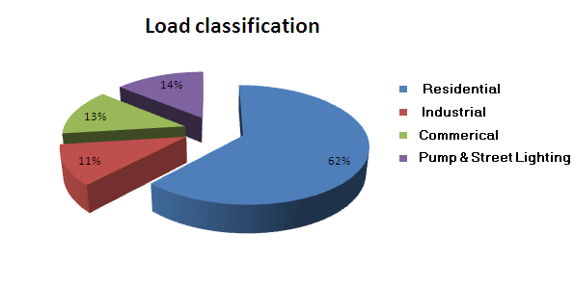
1.2 Energy Consumption
1.2.1 The nature of the load
The table shows the consumers classification and their size.
Type of load | Consumption %
Residential | 62%
Industrial | 11%
Commercial | 13%
Water pumps+ light | 14%

Slide 8
1.2.2-The growth rate of the load.
Year | Average monthly consumption in MWH | Percentage growth %
2006 | 646 | ---------------
2007 | 717 | 10.99%
2008 | 797 | 11.15%
2009 | 880 | 10.41%

Slide 9
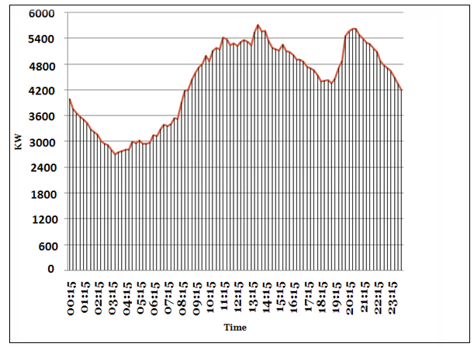
1.2.3 Daily load curve
The max power consumed is 5.463 MW and occurred at 1:45 pm
The max peak demand are occurred at two intervals :-
{ 10:30 am – 03:15 pm}
{07:30 pm – 10:00 pm }
The average demand is 4.1 MW .
Readings were taken in October 2009
Daily Load Curve

Slide 10
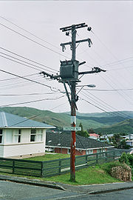
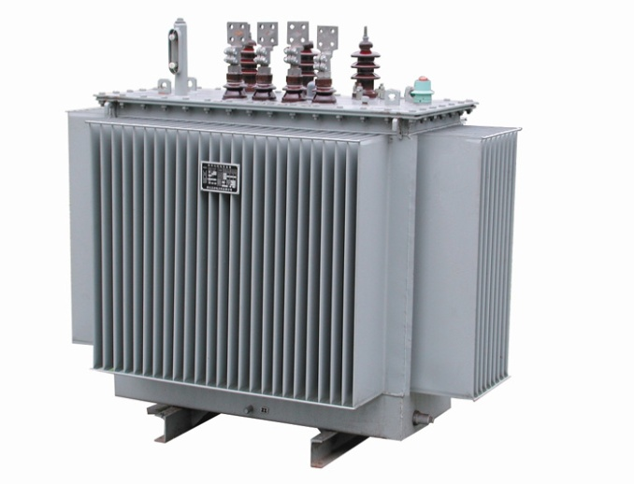
1.3 Elements Of Beat Ommar Network
1.3.1 Distribution Transformers:
Beat Ommar network consists of 26 Δ/Υ , 22/0.4 kv distribution transformers.
And the table shows the number of each of them and the rated KVA.
Number of Transformers | Transformer Ratings (KVA)
11 | 630
9 | 400
6 | 250

Slide 11
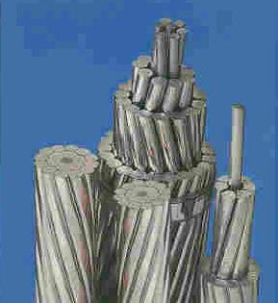
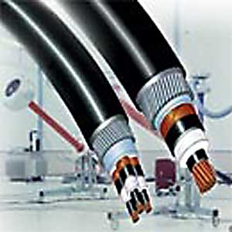
1.3.2 Medium voltage 22kv lines :
Overhead lines
The conductors used in the network are ACSR (50mm²)
Resistance R=(0.543/Km)and
Reactance X= (0.297 /Km)
Underground cables
The Underground cables used in the network are XLPE Cu (120 mm²)
Resistance R= (0.303 /Km)
Reactance X= (0.27 /Km)

Slide 12
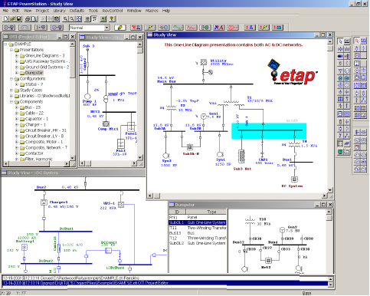
Chapter Two
2.1 Etap power station :-
ETAP PowerStation allows us to work directly with graphical one line diagram.
And it provides us with text reports such as:
complete report.
Input data.
Results .
Summery reports.

Slide 13
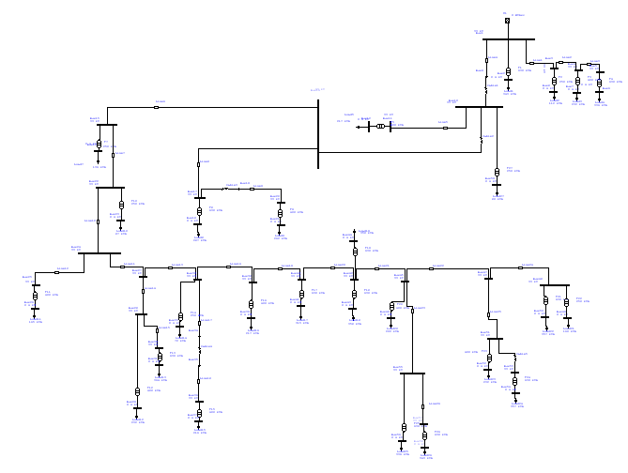
One line diagram

Slide 14
2.2 Data needed for the load flow analysis.
2.2.1 The real and reactive power OR apparent power and P.F OR Ampere and P.F.
And the given table gives the real and reactive power on each bus.

Slide 16
2.2.2 The length and R in (Ω/km) and X in (Ω/km)of the lines.
After formatting the one line diagram of the network ,and dividing it into buses we formed this table which shows the length of the lines and their resistance and reactance.

Slide 17
2.4 load flow analysis for max case.
2.4.1 The actual medium
voltages on each transformer

Slide 18
2.4.2 The actual low
voltages on each transformer

Slide 19
2.4.3 Power factor
We note that there is a lowest point the power factor reach it is 0.87 .
This causes more penalties on the total bill

Slide 20
2.4.4 Load factor
Somewhere it reaches 60% , and it drops to 13% in other buses .

Slide 21
2.4.5 SUMMARY OF TOTAL GENERATION, LOADING & DEMAND FOR THE MAX CASE
MW Mvar MVA % PF
========= ========= ========= ===== =======
Swing Bus: 5.463 2.896 6.183 88.4 Lag
Total Demand: 5.463 2.896 6.183 88.4 Lag
--------- --------- --------- --------------
Total Load: 5.391 2.646
Apparent Losses: 0.072 0.249
Losses percentage: 1.31 %
Total current : 108 A

Slide 22
2.5 load flow analysis for min case .
2.5.1 The actual medium
voltages on each transformer

Slide 23
2.5.2 The actual low voltages on each transformer

Slide 24
2.5.3 SUMMARY OF TOTAL GENERATION, LOADING & DEMAND FOR THE MIN CASE
MW Mvar MVA % PF
======= ======= ======= ==========
Swing Bus: 2.807 1.433 3.151 89.1 Lagging
Total Demand: 2.807 1.433 3.151 89.1 Lagging
--------- ------ --------- --------------
Total Load: 2.788 1.369
Apparent Losses: 0.019 0.065
Total current = 55 A.
The min load is equal to 50% of the max load

Slide 25
2.6 Problems Of The Network
The consumed power is reached the maximum limit , which causes over load currents . This result in disconnecting the supply on the town .
The P.F is less than 0.92 ; this cause penalties and power losses.
There is a voltage drop and power losses

Slide 26
2.7 Solutions And Recommendations
Increasing the supply from the IEC from the main circuit breaker .
Using capacitor banks to improve the P.F and so , reducing the power losses , and avoiding the penalties.
Managing the max peak demand
1. shift of max demand.
2.using other sources.

Slide 27
Conservation of energy .
Increasing the reliability of the system by developing another configurations ( Ring off ) .
design PV sysrem for some house

Slide 28
Chapter Three
THE ELECTRICAL NETWORK IMPROVEMENT
3.1 Power factor improvement:
3.1.1 The problem of low P.F is highly undesirable as it causes an increase in current, resulting in additional losses of active power in all the elements of power system from power station generator down to the utilization devices.
In addition to the losses the low P.F causes penalties, for example for every 1% P.F below 92% and above 80% costs us 1% of the total bill.

Slide 29
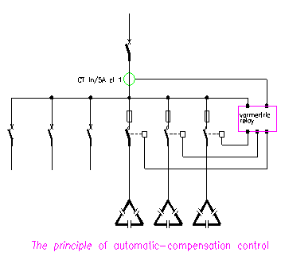
3.1.2 HOW TO IMPROVE THE PF:
COMPENSATION AT L.V. IS PROVIDED BY
  1- FIXED VALUES CAPACITOR.
  2- AUTOMATIC CAPACITOR BANKS.
AUTOMATIC COMPENSATION PF.
A bank of capacitors is divided into a number
of sections.
Each of which is controlled by a contactor.
A control relay monitors the power factor of
the controlled circuit(s) and is arranged to close
and open appropriate contactors to maintain
a reasonably constant system power factor
(within the tolerance imposed by the size of
each step of compensation).

Slide 30
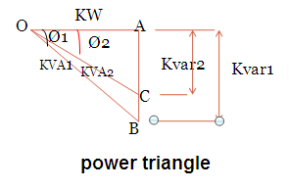

Where:
Qc: the reactive power to be compensated by the capacitor.
P: the real power of the load.
Ø_{old}: the actual power angle.
Ø _{New}: the proposed power angle.

Slide 31
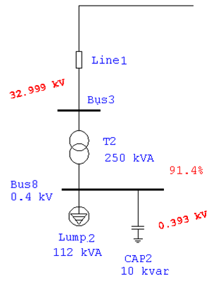
MAX CASE:
Qc = Q old – Q new =P [tan cos-¹(PF old) - tan cos-¹(0.92)]
P = 5.463 MW
PF old = 88.4%
PF desired = 92% and above
Qc ≈ 550 kVAr
The reactive power needed to reach 92% of P.F equals :
Q_{c} ≈ 550 kVAr
Which will cause the P.F in the min case to be 95.2% lag.

Slide 32
The following table shows the distribution of the capacitor banks and its effect on the P.F on each transformer.

Slide 33
Power factor after adding capacitors
Max case:
Min case:

Slide 34
Summary
Max case after P.F correction
Min case after P.F
correction
SUMMARY OF TOTAL GENERATION, LOADING & DEMAND
-----------------------------------------
MW Mvar MVA % PF
===== ===== ===== ======
Swing Bus: 5.494 2.374 5.985 91.8 Lagging
Total Demand: 5.494 2.374 5.985 91.8 Lagging
--------- --------- --------- --------------
Total Load: 5.426 2.139
Apparent Losses: 0.068 0.235
Total current =105 A. Before the capacitors the total current was 108A.
Saving in the real power P=4KW.
Saving in the reactive power Q=14Kvar.
SUMMARY OF TOTAL GENERATION, LOADING & DEMAND
---------------------------------------------
MW Mvar MVA % PF
===== ======= ======= =======
Swing Bus: 2.823 0.896 2.962 95.3 Lagging
Total Demand: 2.823 0.896 2.962 95.3 Lagging
--------- --------- --------- --------------
Total Load: 2.806 0.838
Apparent Losses: 0.017 0.058
Total current =52 A.Before the capacitors the total current was 55A.
Saving in the real power P= 2 KW.
Saving in the reactive power Q= 7Kvar.

Slide 35
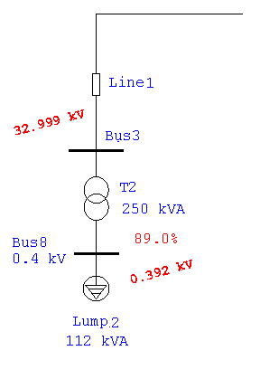
Comparison between the original and improved cases
Original case
Improved case

Slide 36
3.2 voltage correction
1. Swing bus control
2. Changing in transformer taps
3. Installation of capacitor banks (reactive power compensation)
The drop voltage on the high voltage equal to 0.82%. And on the low tension equal to 2.25%.
So there is no need to rise the voltages, but as a result of adding capacitors the voltages influenced slightly as shown in the table.

Slide 37
3.3 Simple pay back period
Average monthly consumption = 880000 kwh
Total bill (NIS/year) = 880000kwh * 12 month * 0.5(NIS/kwh)=5280000 NIS/year
Saving in penalties = (91.8-88.4) * 1% * 5280000 NIS/year
Saving in energy = ∆P * τ* (NIS/kwh)
= (0.072-0.0680)KW *2500h*(0.5)
Saving in energy = 5500 NIS/year
Saving per year = saving in penalties + saving in energy
= 179520 + 5500
Saving per year = 185020 NIS/year

Slide 38
Capital cost = cost of capacitors =Q(KVAR) * (15 JD/KVAR) * 6 NIS
= 550 * 15 *6
Capital cost = 49500 NIS
S.P.B.P = capital cost / (saving per year)
= 49500 / 185020
S.P.B.P = 0.2675 year = 3.21 month = 96 day
Note : since the S.P.B.P less than two years then the project is feasible.

Slide 39
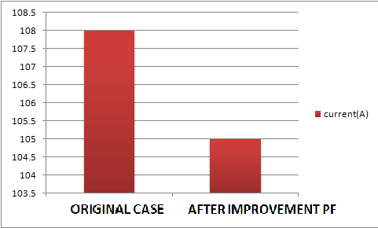
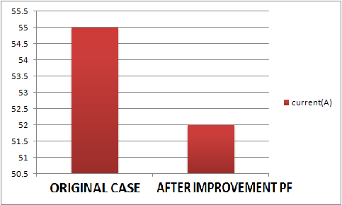
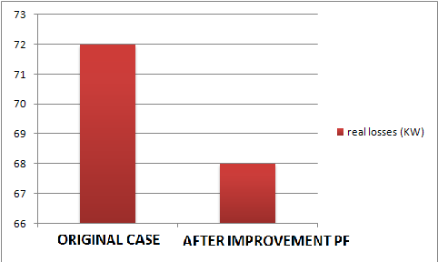
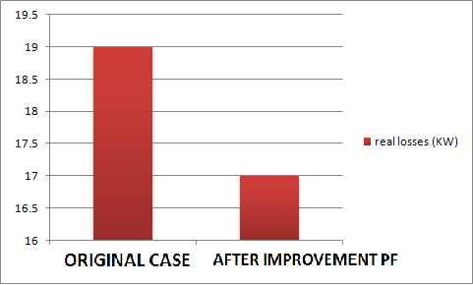
Current in max case
Current in min case
Losses real power (KW) in max case
Losses real power(KW) in min case

Slide 40
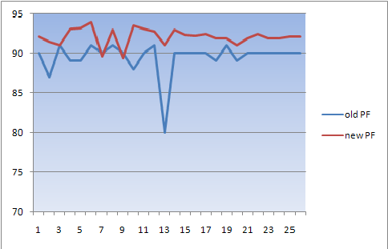
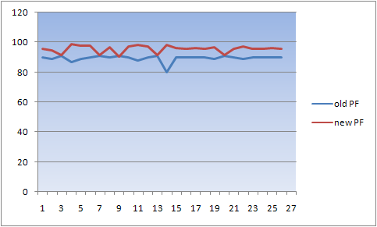
Power factor in max case
Power factor in min case

Slide 41
Chapter Four
Energy conservation
#of street lamps | Power (W) | After replacement | Saving energy(KWH)/year | Saving in cost NIS/ year
600 | 70 | 70 | 0 | 0
500 | 125 | 70 | 120450 | 66247
ΔP=(125-70)=55W, for each lamp.
Working hours per day=12 Hr, and 4380 Hr per year
Saving energy per year = ΔP *#of lamps*hrs per year. =55*500*4380/1000= 120450(Kwh)/year.
Cost of energy =0.55 NIS/Kwh.
Saving in cost=0.55*120450= 66247 NIS./year.
Cost of each lamp=250NIS and for all lamps = 125000 NIS.
S.P.B.P=capital cost/saving per ye =125000NIS/66247(NIS/year).
=1.8year
=1.8*12=22.64 months
Note : since the S.P.B.P less than 5 years then the project is feasible.
4.1 Energy conservation in street lighting.

Slide 42
4.2 Energy conservation in water pumps
#of motor | Output power(KW) | Efficiency% | Input power(KW) | ΔP(KW) | Working hours | Working time
4 | 55 | 90 | 61.1 | 6.1 | 18 | 5 am to 11 pm
2 | 75 | 86 | 87.2 | 12.2 | 11 | 5 am to 4 pm
Existing motors
#of motor | Output power(KW) | Efficiency% | Input power(KW) | ΔP(KW) | Working hours | Working time
4 | 55 | 94.4 | 58.2 | 3.2 | 18 | 5 am to 11 pm
2 | 75 | 94.5 | 79.36 | 4.36 | 11 | 5 am to 4 pm
New motors

Slide 43
4.2.1Economical study
By replacing motors old motors by new motors
The saving in real power
The first group of motors(4 motors)
ΔP=6.1-3.2= 2.9Kw for each
ΔP for 4 motors=2.9*4=11.6kw
The saving in energy of the motors
=11.6*18*365=76212kw per year
Saving in cost of motors
=065*76212=49537.8nis per year
The second group of motors
ΔP=12.2_4.36=7.84kw for each motor
ΔP=7.84*2=15.68kw for 2 motors
The saving in energy of motors
=15.68kw*11hr*365=62955.2 kw per year
The saving in cost of motors
=0.65*62955.2=40920.88nis per year
The cost of 75 hp motor and Efficiency =94.4 is 5000 $
Corresponds to 20000 NIS
The cost of 100hp motor and Efficiency =94.4 is 6000 $
corresponds to 24000 NIS
The total cost of 4 motors (75hp) =80000 NIS
The total cost of 2 motors (100hp) =48000 NIS

Slide 44
S.P.B.P
The first group of motors (75hp)
S.P.B.P =80000/49537.8=1.61 year =19 month
The first group of motors (100hp)
S.P.B.P =48000/40920.8=1.17 year=14 month

Slide 45
4.3 Energy conservation in residential sector.
 | Inc.lamp75w | CFL lamp15w
Price(NIS) | 1.5 | 25
Life time (hours) | 1000 | 10000
Cost over life time(NIS) | 10*1.5=15 | 25*1=25
Kwh in 10000 hr | 750 | 150
Energy cost in 10000 hr (NIS) | 0.65*750=487.5 | 0.65*150=97.5
Total cost(NIS) | 487.5+15=502.5 | 25+97.5=122.5
Saving in 10000 hr | 502.5-122.5=380 (NIS)
4.3.1 Replacing the incandescent lamps by the PL lamps.
Note: we have 2400 consumers.
We notice that we can save 380(NIS) by using the CFL lamps during the operating life for one lamp .

Slide 46
S.P.B.P for the total lamps we want to replace
Each home have about 4 lamps in average, and it work about 4 hours per day
Total lamps = 2400*5=12000 lamps.
Energy consumption per year ( Inc 75 W)
=75* 12000*5*365= 1642500 Kwh/year.
Energy consumption per year ( CFL15 W)
=15*12000*5*365=328500 Kwh/year.
Saving in energy = 1314000Kwh/year.
Saving in cost = 1314000 * 0.65 = 854100 NIS/ year.
Fixed cost/year = (8760/10000)*25*12000 = 262800 NIS
S.P.B.P = 262800 NIS /854100 (NIS/year) = 0.307year
=3.69 months.
.

Slide 47
S.P.B.P for each consumer
We see that the replacement is feasible and the consumer save 356 NIS per year.
Total lamps = 5 lamps.
Energy consumption per year ( Inc 75 W)
=75*5*365*5= 684.375 Kwh/year.
Energy consumption per year ( CFL15 W)
=15*5*365*5 =136.875Kwh/year.
Saving in energy =548Kwh/year.
Saving in cost = 584* 0.65 = 356.2NIS/ year.
Fixed cost/year = (8760/10000)*25*5 = 109.5NIS
S.P.B.P = 109.5NIS /356.2(NIS/year) = 0.307 year
=3.6months.

Slide 48
4.3.3 Energy conservation in refrigerators
Type of refrigerator | Size in(Ltr) | KWh/day | Cost (NIS) | Type of new one | KWh/day | Cost (NIS)
amcor | 430 | 2.9 | 1200 | LG | 1.2 | 3000
The table shown shows the old refrigerators and their size and their consumption in Kwh/day . And the new refrigerator to be replaced.
In Beat Ommar village 2600 refrigerators at least
1000 of its is old .if we replace it by new type
We notice the following
Life cycle for Amcor =5 years
Life Cycle for LG =10years
Annual fixed cost for Amcor =1200/5=240 NIS
Annual fixed cost for LG =3000/10=300 NIS
Running cost /year for Amcor
=2.9*365*.65=688NIS
Running cost for LG =1.2*365*.65=284NIS
Total cost /year =240+688 =928 NIS for Amcor
Total cost /year =300+284 =584 NIS for LG
Saving money /year =928_584=344NIS
Difference in cost =3000_1200=1800NIS
S.P.B.P= 1800/344=5.2 years

Slide 49
Chapter Five
Design of PV system for electrification of Safa Village
information about Safa village
Safa site is a small village that located north west of the town of Beat Ommar and away from it 4.5 km, which suffers from the problem of roads ,and electricity.
the houses lunch power from diesel generator ( 5KW, engine 9HP , fuel capacity 8 Gallons , run time at 50% load is 18 HR , number of hour operation is 14 HR as 8-12AM , 2-12 PM )

Slide 50
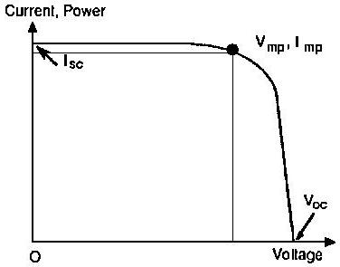
5.2 The electrical loads of household for Safa site
# of house = 3
Electrical energy consumption = 1270 * 3 = 3.810 Kwh/day
Total required power = (343*3)/D.V = 1029/1.25 = 823.2 W
We use multicrystalline 36 rectangular cell module type (KC 130 GHT – 2)
Peak power = 130 W
VMPP ≈ 0.8 * Voc =17.6 V
IMPP ≈ 0.9 * ISC = 7.39 A
Vo.c = 21.9v
I s.c = 8.02 A

Slide 51
5.3 Design of centralized PV system components for safa village
5.3.1 PV generating sizing
Ppv=( E/(ηv*ηR*PSH) )*S.F where PSH = 5.4 H in palestine
= 3.810 * 1.15/.9*.92*5.4 = 0.98 KWp
# of necessary PV module = NO.PV = Ppv/Pmpp
= 980/130=2.73 ≈3 PV module
Nominal voltage of PV generator = 48 V
# of module in series = NO.pvs=Vpv/Vmmp
=48/17.6 =2.73≈ 3
# of string = NO.pv/NO.pvs = 7.538/2.73 = 3 string
# of PV generator modulo = 3 * 3 = 9 modulo
The area of array is ( 3 * 1.425)*(3*0.652)=8.36 m²

Slide 52
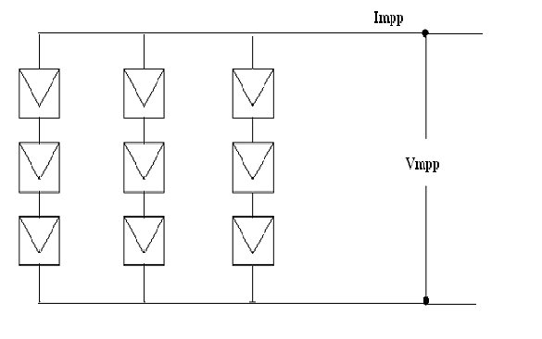
Impp = 3 * 7.39 = 22.17 A
Vmpp= 3 * 17.6 = 52.8 V DC
Vo.c = 3 * 21.9 = 65.7 V DC
Is.c = 3 * 8.02 = 24.06 A
The actual maximum power obtained from PV =Vmpp * I mpp
=52.8 * 22.17 =1.170 KWP

Slide 53
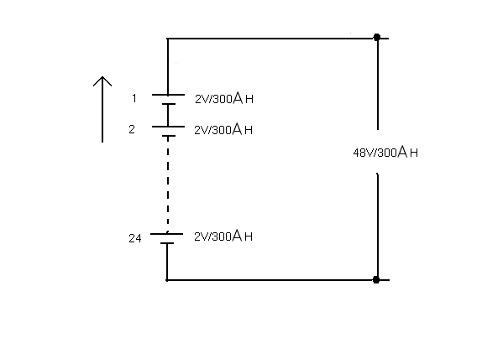
5.3.2 the battery , charge regulater , and invertor
The Battery
CAH = E /(Vb*DOD * ηv*ηB )
CAH for two day = 2*3.810/(48*.75*.85*.9)
= 276 .68AH
CWH = CAH * Vb= 276.68 * 48 = 13281 Wh
We use battery 2v/300Ah (sale this battery 63 $ , model No GFM-300G)
Charge Regulator
Voutput must be equal to Vnominal (PV) = 48*0.875-48*1.2 = (42-57.6)V DC
The appropriate rated power of CR must be equal Ppv = 1.170KWP ≈1.5KWP
Change regulator have been selected (30A-48V)
Efficiency must be not less of 92%
Inverter
Vinput has to be matched with battery block voltage = VCR output =(42-57.6) V DC
Voutput 230V AC ± 5% , one phase , 50 HZ
Power of inverter is Pnominal ≥ 1.278KW ≈ 1.5 KW
Efficiency must be not less than 90%

Slide 54
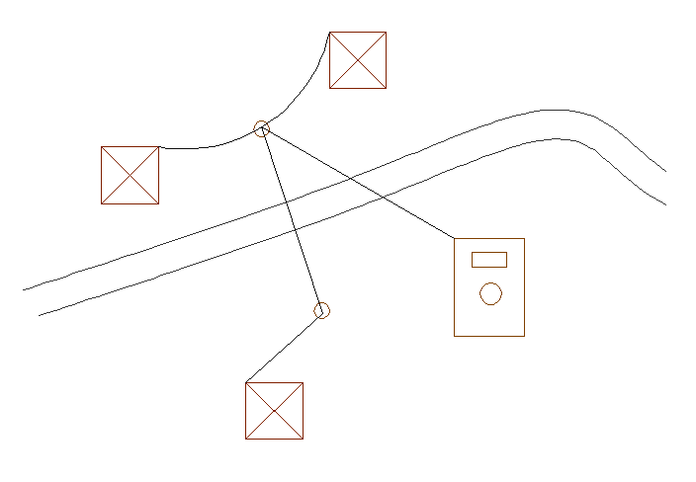
5.3.3 Electrical network map for centralized case

Slide 55
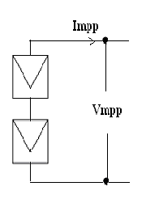
5.4 Design of decentralized PV system components for safa village
5.4.1 PV generating sizing
# of house = 3
Energy consumption = 1270 wh/day for each house
Ppv=( E/(ηv*ηR*PSH) )*S.F where PSH = 5.4 H in palestine
= 1270 * 1.15/.9*.92*5.4 = 300 Wp
# of necessary PV module = NO.PV = Ppv/Pmpp
= 300/130 ≈ 2 PV module
Nominal voltage of PV generator = 24 V
# of module in series = NO.pvs=Vpv/Vmmp
=24/17.6 ≈ 2
# of string = NO.pv/NO.pvs = 2/2 = 1 string
# of PV generator modulo = 2 * 1 = 2 modulo
The area of array = 2 * 1.425 * 0.652=1.86 m²
Impp = 1 * 7.39 = 22.17 A
Vmpp= 2 * 17.6 = 35.2 V DC
Vo.c = 2 * 21.9 = 44 V DC
Is.c = 1 * 8.02 = 8.02 A
The actual maximum power obtained from PV =Vmpp * I mpp
=35.2 * 7.39 =260.1WP

Slide 56
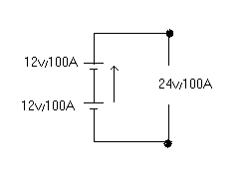
5.4.2 the battery , charge regulater , and invertor
The Battery
CAH = E /(Vb*DOD * ηv*ηB )
CAH for two day = 2*1270/(24*.75*.85*.9)
= 92.2 AH
CWH = CAH * Vb= 92.2 * 24 = 4420 Wh
We use battery 12v/100Ah (block battery 12v/100ah)
Charge regulator
Rated power Ppv=260.1w≈300w
10A-24V
Inverter
Output voltage 230v ± 5% AC
Nominal power Pnominal ≥375w≈400w

Slide 57
5.5 Economic Evaluation of Centralized and Decentralized PV System for Safa Village as Case Study
5.5.1 The cost of centralized and decentralized PV system for Tubas villages
The costs of the centralized PV system
Component | Quantity | Unit price $ | Total price $ | Life time year
PV-module (KC) | 1170 Wp | 4/Wp | 4680 | 25
Support structure | 2 | 100 | 200 | 25
Batteries (2V/300AH) | 24 | 63 | 1512 | 10
Charge regulator 1.5 KW | 1 | 600/KW | 900 | 12
Inverter 1.5 KW | 1 | 1000/KW | 1500 | 12
C.B & switches | -- | -- | 60 | 12
Others as * installation * material * cost * poles * conductors * civil work etc | -- | -- | 2780 | --
 |  |  | ∑ 11632 $
O & M = 180 $
S.V = 1200 $

Slide 58
The costs of the decentralized PV system
Component | Quantity | Unit price $ | Total price $ | Life time year
PV-module (KC) | 260.1 Wp | 4/Wp | 1040.4 | 25
Batteries (12V/100AH) | 2 | --- | 200 | 5
Charge regulator 300 W | 1 | 600/KW | 180 | 12
Inverter 400W | 1 | 1000/KW | 400 | 12
C.B & switches | -- | -- | 18 | 12
Others as * installation * material * cost * poles * conductors * civil work etc | -- | -- | 900 | --
 |  |  | ∑ 2738.4 $
O & M = 100 $
S.V = 500 $

Slide 59
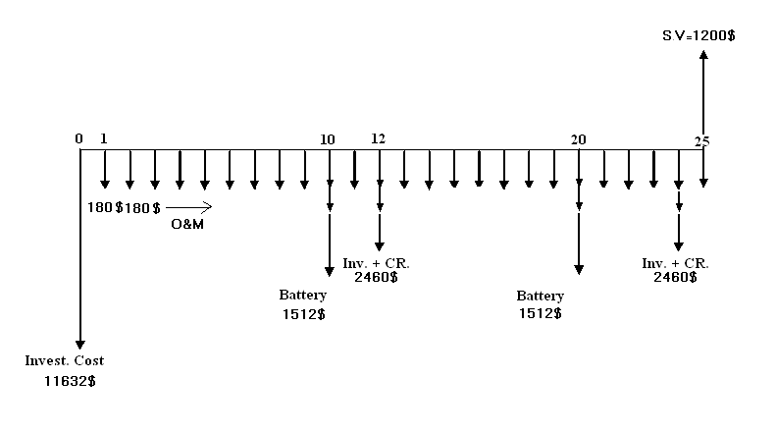
5.5.2 Which project we select centralized or decentralized ?
In this two case the output is fixed by using present worth method when the Output is fixed we select the min capital cost
5.5.2.1 cash flow for centralized PV system
Pc = 11632 +180[P/A,10%,25] +1512[P/F,10%,10]+1512[P/F,10%,20]
+ 2460[P/F,10%,12]+ 2460[P/F,10%,24]-1200[P/F,10%,25]
Pc = 14996 $

Slide 60
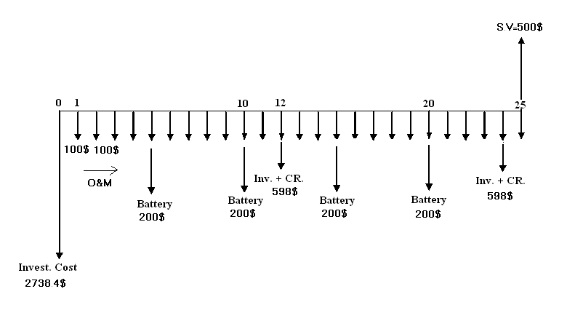
5.5.2.2 cash flow for decentralized PV system
Pc = 3*[ 2738.4 +100[P/A,10%,25] +200[P/F,10%,5]+200[P/F,10%,10]
+ 200[P/F,10%,15]+ 200[P/F,10%,20]+598[P/F,10%,12]
+ 598[P/F,10%,24]-500[P/F,10%,25]]
Pc = 12390 $
Pc decentralized < PC centralized
We select the decentralized project

Slide 61
5.6 Max overall efficiency for centralized and decentralized V system
For case centralized
Effecincy = Pomax/Pimax =[ Vmpp*Impp/G*Apv] * ζCR* ζInv* ζDistribution line
= [52.8*22.17/1000*8.36]*0.92*0.90*0.95
Eff = 11.01%
For case decentralized
Effecincy = Pomax/Pimax =[ Vmpp*Impp/G*Apv] * ζCR* ζInv* ζDistribution line
= [35.2*7.39/1000*1.86]*0.92*0.90*0.95
Eff = 11.38%
We note that ζ decentralized > ζ centralized

Slide 62
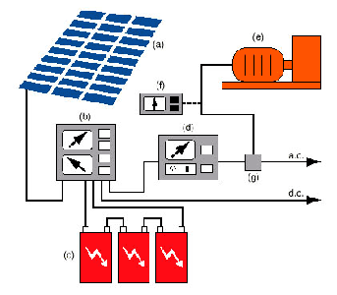
5.7 Building Integrated Photovoltaic (BIPV) System
the PV modules (which might be thin-film or crystalline, transparent, semi-transparent, or opaque);
a charge controller, to regulate the power into and out of the battery storage bank (in stand-alone systems);
a power storage system, generally comprised of the utility grid in utility-interactive systems or, a number of batteries in stand-alone systems;
power conversion equipment including an inverter to convert the PV modules' DC output to AC compatible with the utility grid;
backup power supplies such as diesel generators (optional-typically employed in stand-alone systems); and
appropriate support and mounting hardware, wiring, and safety disconnects

Slide 63


