Slide 1
Graduation project II
Wind tunnel for forced convectin
Supervisor: Dr. Luqman herzallah
Students:
Salah Brawish
Mahmoud Khamaysa
Alaa Khalayla
Ahmad Ghanem

Slide 2
Heat transfer heat transfer by three method:
1- Conduction
2- Radiation
3- Convection

Slide 3
Design of wind tunnel
Wind tunnel component :
1- Tunnel
2- Centrifugal fan
3- Data acquisition system
4- Sample

Slide 4
Data acquisition system
The data acquisition consists of:
1) Five thermocouples
2) The data acquisition board.
3) The anemometer
4) One computer

Slide 5
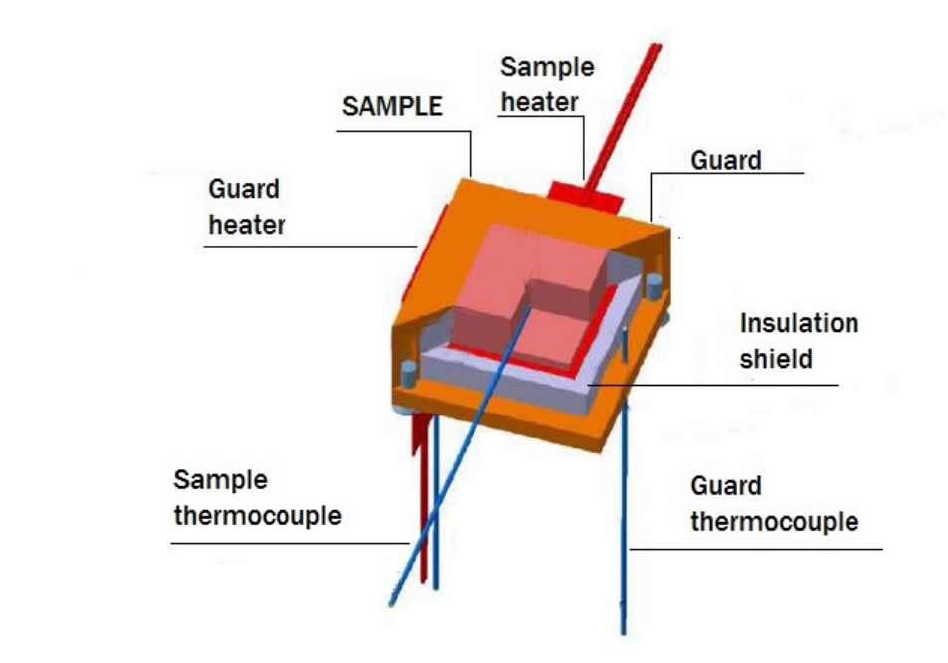
Sample

Slide 6
Result analysis
Consideration:
1) Take on the consider all heat transfer mechanism .
2) The wall temperature is constant along the tunnel

Slide 7

Result analysis
Convection equation :
$${\dot{Q}}_{conv}=hA_{s}(T_{s}−T_{a})$$
Conduction equation :
$${\dot{Q}}_{cond}=k(T_{c}−\left(\frac{T_{g1}+T_{g2}}{2}\right))$$
Radiation equation :
${\dot{Q}}_{rad}=$es$A({T_{c}}^{4}−{T_{w}}^{4})$
Electrical power :
$$Q_{electrical}=\frac{v^{2}}{R_{h}}$$

Slide 8


Result analysis
The convection transfer equation due to other mechanism on this experiment :
${\dot{Q}}_{conv}=Q_{electrical}−({\dot{Q}}_{cond}+{\dot{Q}}_{rad})$
Substituting each term by its equation we get :

Slide 9
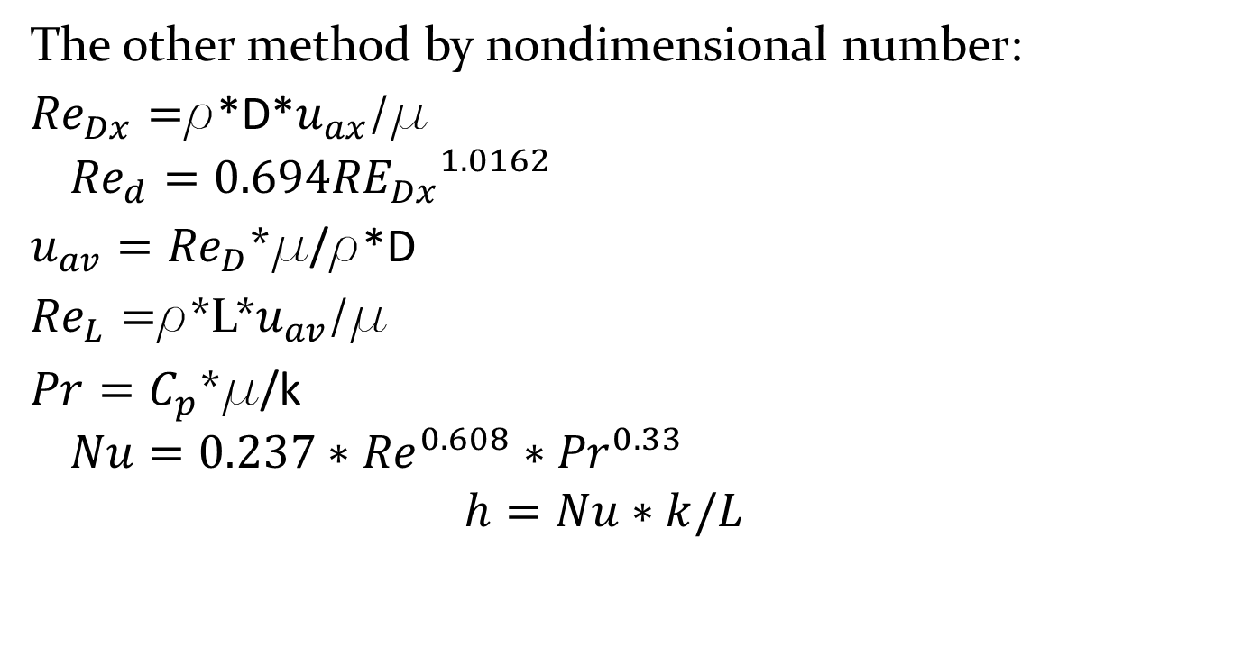
Result analysis
The other method by nondimensional number:
${Re}_{Dx}=$r*D*$u_{ax}$/µ
$${Re}_{d}=0.694{{RE}_{Dx}}^{1.0162}$$
$u_{av}={Re}_{D}$*µ/r*D
${Re}_{L}=$r*L*$u_{av}$/µ
$Pr=C_{p}$*µ/k
$$Nu=0.237∗{Re}^{0.608}∗{Pr}^{0.33}$$
$$h=Nu∗k/L$$

Slide 10
Result analysis
Sample calculation
H = 29.86
Nu | h | Tw | Tair | Tg2 | Tg1 | Tc | Rh | Vheater
22.72 | 29.86 | 301.43 | 303.13 | 336.58 | 336.47 | 336.64 | 25.73 | 1.8122

Slide 11

Result analysis
${Re}_{Dx}=\frac{3.28∗1.17∗0.18665}{1.8139∗{10}^{−5}}$= 39488
${Re}_{D}=0.694{∗39488}^{1.0162}$=32500
$u_{av}=\frac{32500∗1.8139∗{10}^{−5}}{1.17∗0.18665}$ = 2.6993
${Re}_{L}=\frac{2.6993∗1.17∗0.02}{1.8139∗{10}^{−5}}$ =3480
$Pr=\frac{1007∗1.8139∗{10}^{−5}}{2.6281∗{10}^{−2}}$ = 0.6950
$Nu=0.237∗{3480}^{0.608}∗{0.6950}^{0.33}$= 29.918
$$h=\frac{29.918∗2.6281∗{10}^{−2}}{0.02}=39.3131$$
H | Nu | Pr | ReL | Average velocity | ReD | Redx | Axial velocity
39.3131 | 29.918 | 0.6950 | 3480 | 2.6993 | 32500 | 39400 | 3.28

Slide 12
Result analysis
Error calculation :
The devise have an error percentage different between sample

Slide 13
Thank you

