Slide 1
Suggestions for Water Drainage in Bal’a Town.
Graduation Project II

Slide 2
Introduction:
Water in human being life goes through two levels:
Consumption.
Drainage.

Slide 3
Study Area

Slide 4
Bal’a Town

Slide 5
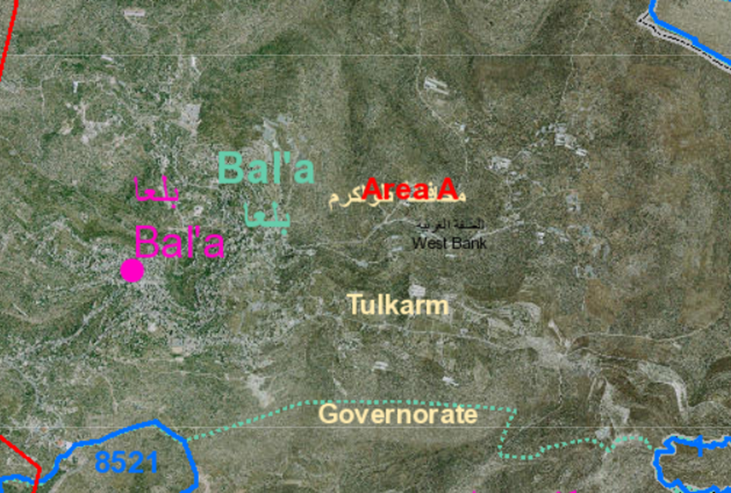
Bal’a Location
Bala’a Town lies on coordinates of 32° 19′ 59.4″ N, 35° 6′ 31.15″ E, in north eastern Tulkarm city in the north of Palestinian West Bank.

Slide 6
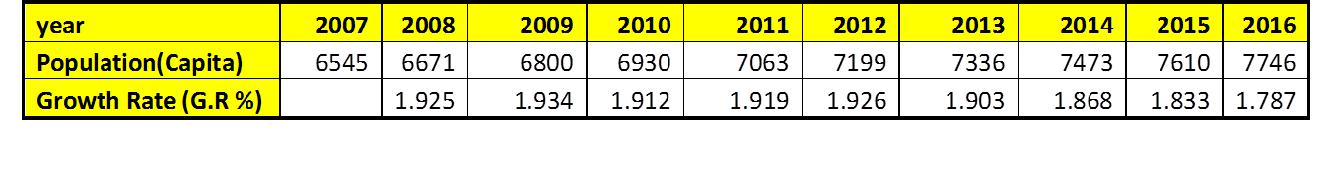
Population
Given from Palestinian Statistics Centre the following data of population and growth rate from 2007 to 2016 in Bal’a.
G.R= (𝑃(𝑙𝑎𝑡𝑒𝑟 𝑦𝑒𝑎𝑟)/𝑃(𝑝𝑟𝑒𝑣𝑖𝑜𝑢𝑠 𝑦𝑒𝑎𝑟) )^(1/𝑛)−1

Slide 7
After analysis .it appears that the relationship between years and population is linear, with R=99.98%.

Slide 8
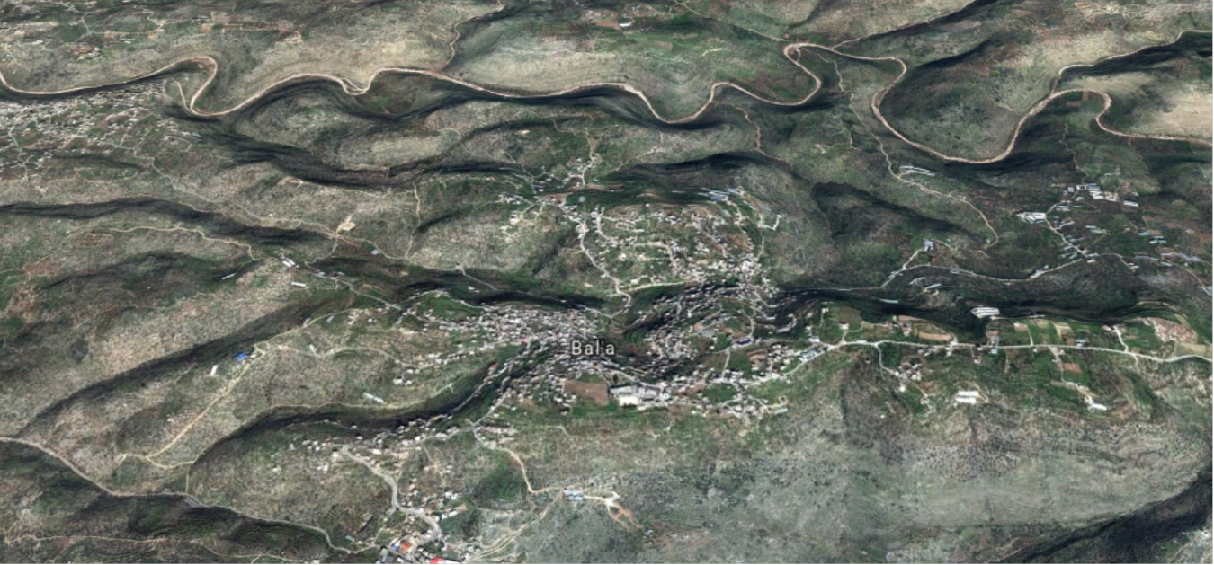
Terrain
Bal’a lies on four mountains it has an average height of 400 m on sea level and reaches to 500 m on some regions with high variance in elevation from site to site, with high steep slope.

Slide 9
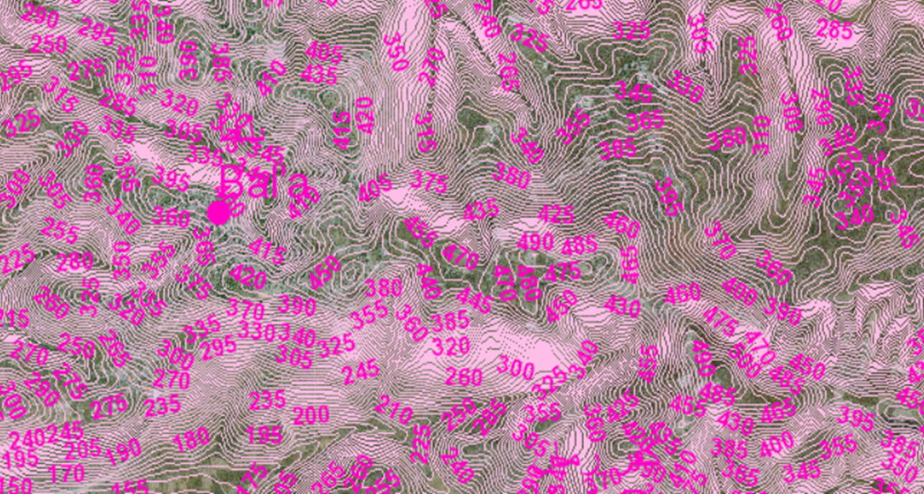
Contour map for Bal’a Town.

Slide 10
Rainfall readings
The average annual rainfall in Bal’a is 617.5 mm according to Palestinian Statistics center.
From Palestinian Metrologic Center :
year | 2013/2014 | 2014/2015 | 2016/2017 | 2017/2018
Annual depth(mm) | 366.6 | 655.8 | 457.4 | 376.4
Maximum day depth (mm) | 81 | 72.2 | 53 | 46.5

Slide 11
Problems Solved in Graduation Project I.
High losses in the existing Water Distribution net Work.
Unfair water distribution in Bal’a zones.
By designing a new Water Distribution Network using an additional Reservoir.

Slide 12
Problems to be solved in Graduation Project II.
Non Existence of sewer drainage system covers most Bal’a regions.
Floods occurs on Main Streets in Winter.
By
*Designing Sewer drainage system
And
*Designing Culverts on Main streets.

Slide 13
Sewer Drainage system Design for Bal’a Town.
By Sewer Cad Software.

Slide 14
Methodology
Doing calculations to find the expected population of the town in the future
Finding the expected produced waste water in the future
Preparing data as layers of the town
Using sewer cad to design the network depending on layers of (contour, building, road)
Checking the design to achieve the criteria of velocity and cover.

Slide 15
Criteria of the Design.
Natural water consumption (L/capita/day) | 120
Growth rate (%) | 2
Load distribution method | Equal distribution for each Manhole in planned urban zones
Design period(years) | 35
% product waste | 85%
Maximum velocity in conduits(m/sec) | 3
Minimum velocity in conduits (m/sec) | 0.6
Maximum allowable cover (m) | 6
Minimum allowable cover(m) | 0.8
Minimum allowable slope (%) | 1
Maximum allowable slope (%) | 12
Infiltration (%) | 20
Conduit Material | PVC

Slide 16
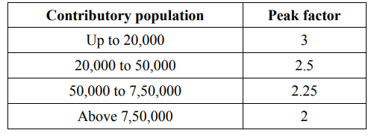
Load Calculations.
Daily Load on each Manhole= overall load/number of manholes
Overall Daily Load=expected population*peak factor*consumption *product waster percent + Infiltration percent*expected population*consumption*product waste
= )7822)*(1+0.2)^36(*3*120*0.85(+)0.2*7822)*(1+0.2)^36(*120*0.85 (
=5208m3/day
Daily Load on each Manhole =5208/562=9.27m3/day

Slide 17
Suggested Outfalls.
Tow outfalls:
the first is in the south which goes to AL-Zomar Valley
the other is in the west which goes to Ammar Valley which can go with Alsha’rawiya wastewater collection valleys

Slide 18
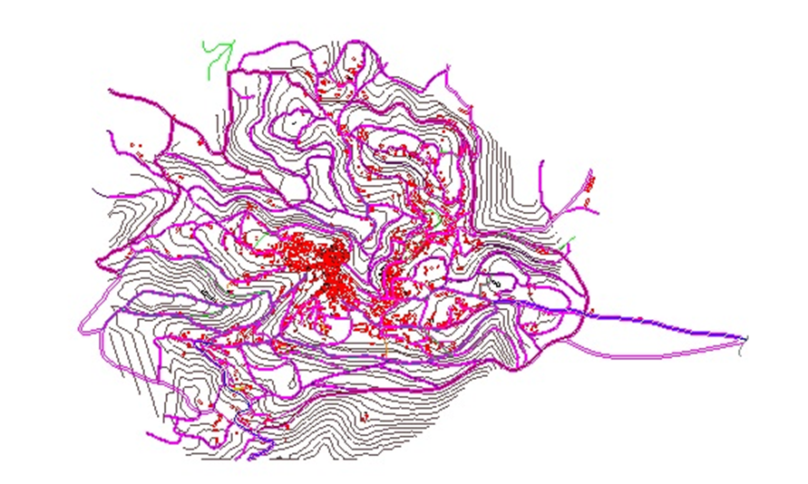
Steps
Adding Data

Slide 19
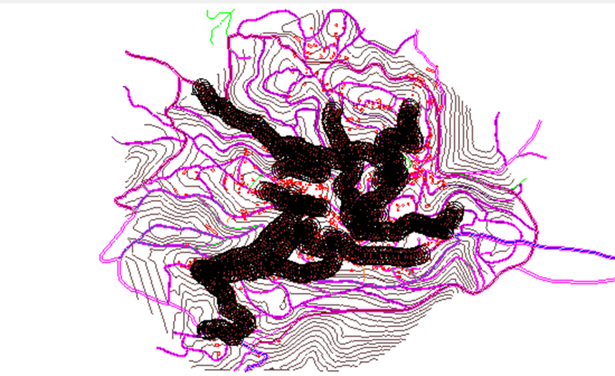
Drawing Manholes

Slide 20
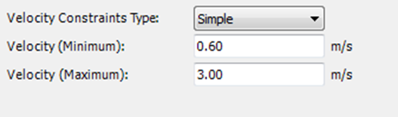
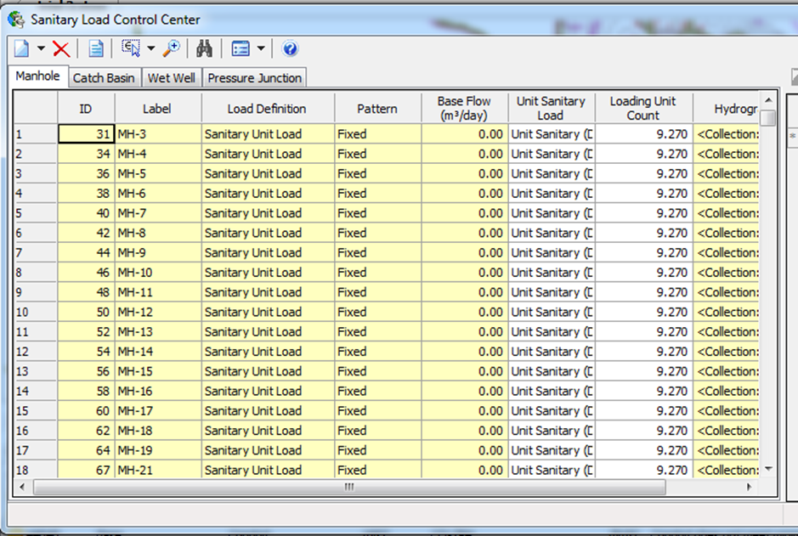
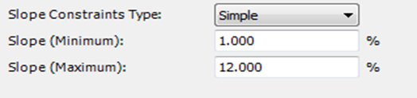
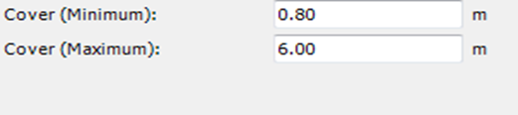
Inserting Loads and constrains

Slide 21
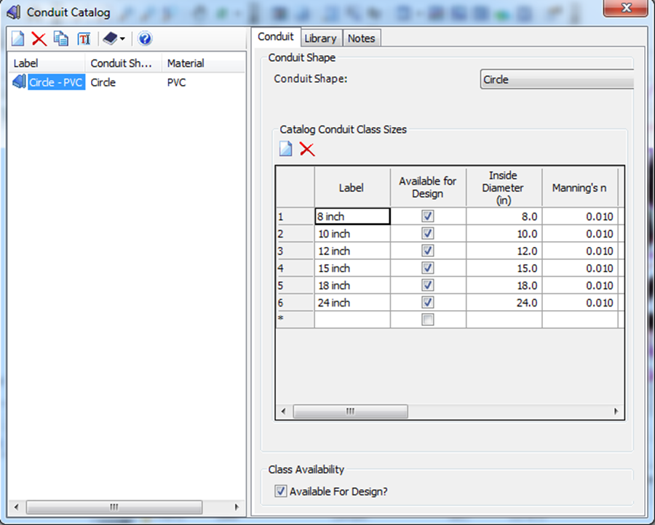
Conduit Catalog

Slide 22
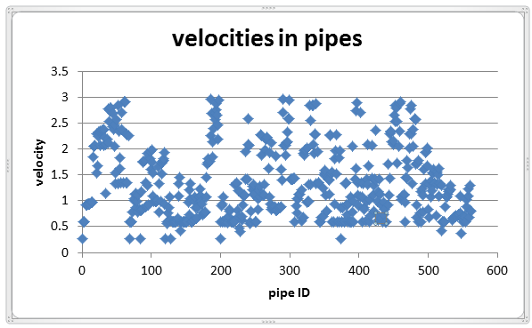
Results
Velocity (m/sec)
98% of conduits has velocities between 0.6 and 3 m/sec but low velocities appeared due to low collection in the first conduit of each branch.

Slide 23
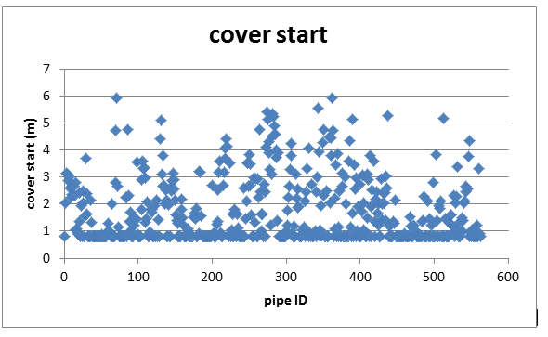
Cover Start

Slide 24
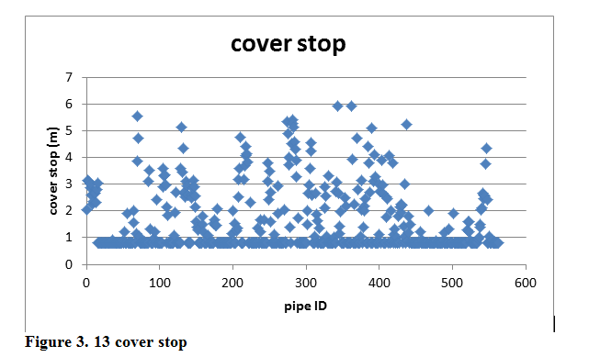
Cover Stop

Slide 25
Conduit Diameters.
All diameters has 8 Inch diameter.
Lengths between each manhole and the other is less than 30 m.

Slide 26
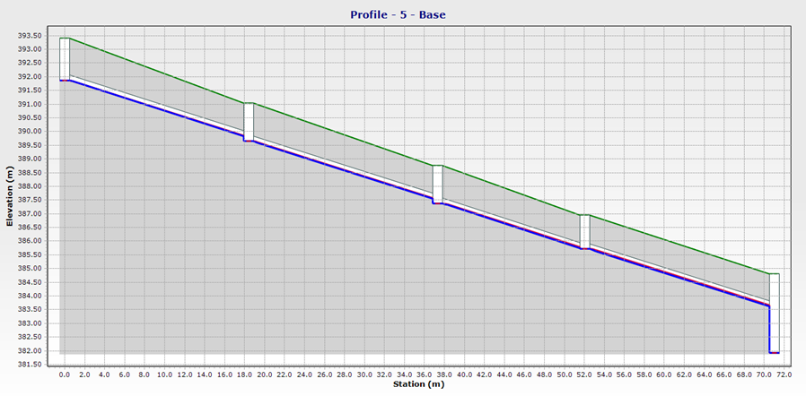
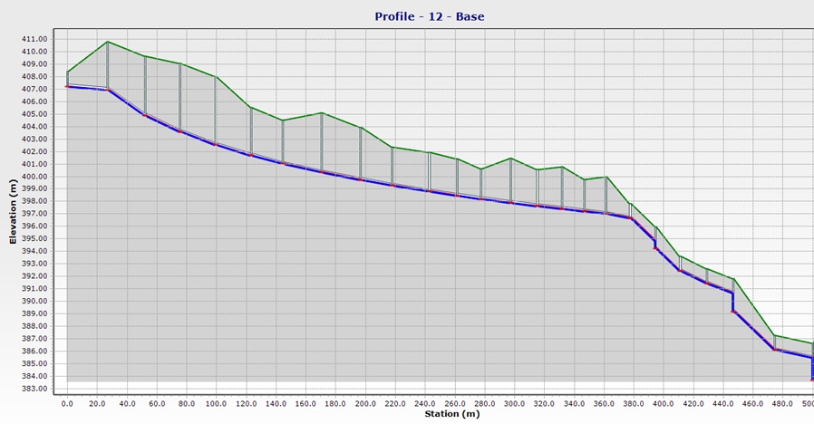
Sample Profiles

Slide 27
Culverts’ Design for Bal’a Main Streets.
By HY-8 Software.

Slide 28
Methodology.
Choosing the most critical streets when storm occurs.
Collecting Data of each street dimension and shape.
Suggesting points of culverts locations.
Determining Catchment areas of each suggested location by GIS.
Calculating the peak flow of a 10-year storm for each catchment by HEC-HMS.
Designing the culverts using HY-8.

Slide 29
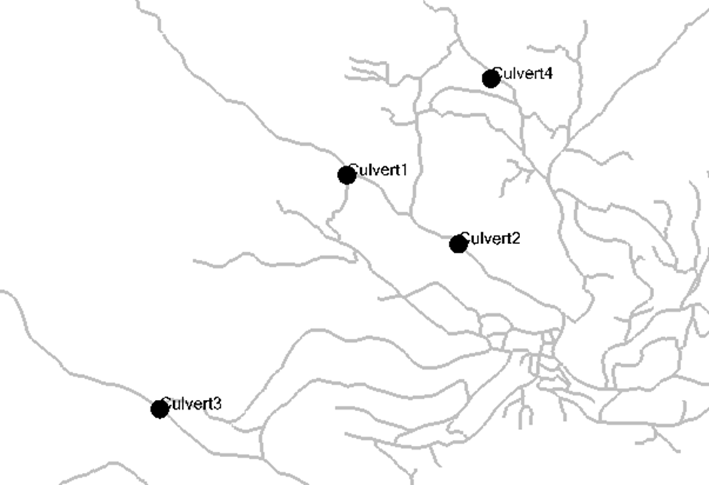
Culverts on streets.

Slide 30
Suggesting four location of culverts by site visit and GIS and the following coordinates are chosen

Slide 31
Catchments Data by GIS.

Slide 32
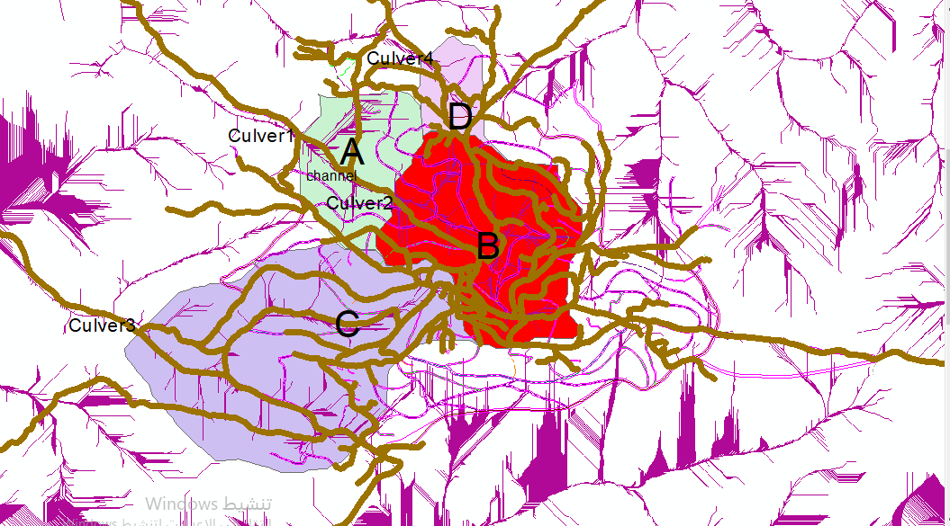
Catchments on each culvert By GIS.

Slide 33

Sample Calculation for Lag Time.
*Lag time for catchment A.
Lag Time=0.6*Tc
Tc=0.01947*〖865.95〗^0.77*〖0.1527〗^(-0.385)=7.34min
Lag time=0.6*7.34=4.4 min

Slide 34
Using IDF curve for 10-year return period.
There were no data for Bal’a to make IDF curve, Wadi Ara which lies near OM-Alfahm town is taken for design.
Om Alfahm town which is 20 KM northern Bal’a, has an annually rainfall of 625 mm which is very near of Bal’a’s one which is 617.5 mm, so it is acceptable to take this IDF curve for design.

Slide 35
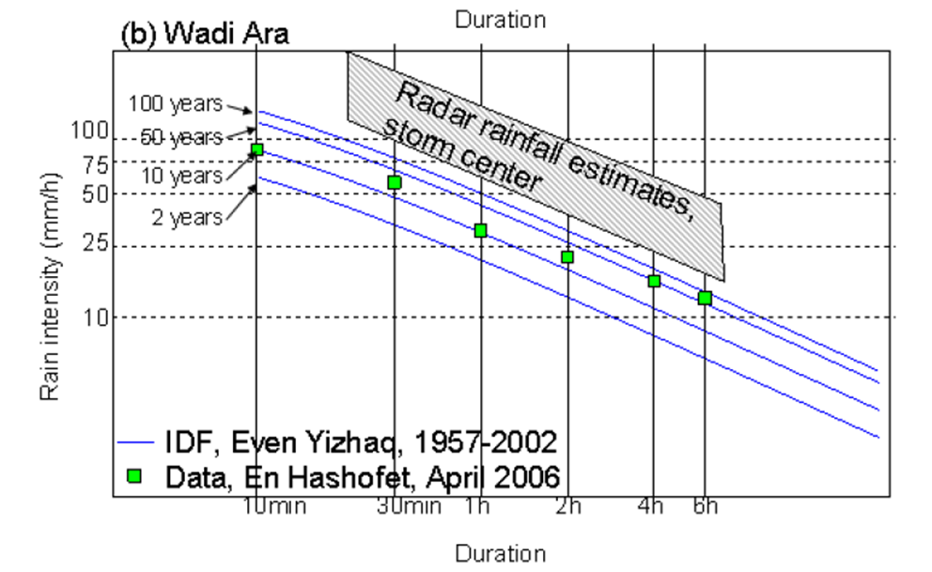
IDF Curve used.

Slide 36
IDF Curve analysis.

Slide 37
Mass curve

Slide 38
Partial duration depth required for HEC-HMS Inserting
Duration (min) | Partial-Duration Depth(mm)
5 | 7.29
15 | 20.2675
60 | 57.39583
120 | 83.0208
180 | 100.52
360 | 142.0208

Slide 39
Curve Number
A) Bal’a has a clay soil so it has soil type of “C” ACCORDING TO Curve Number classification.
Group C: clay loams, shallow loam, soils low in organic content, and soils usually high in clay
B) Bal’a has an urban area with impervious 10.52 % (the areas of buildings and paved roads)
According to this table it will have a curve number of 77.

Slide 40
Curve Number Table.

Slide 41
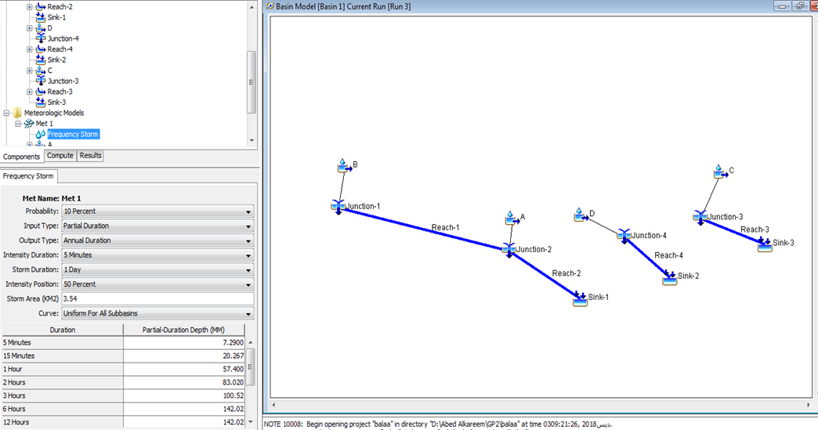
Simulation By HEC-HMS

Slide 42
Results from HEC-HMS
CULVERT Number | CATCHMENT OUTLET | Maximum flow (m3/sec)
1 | A | 21.3
2 | B | 14.7
3 | C | 24.4
4 | D | 2.7

Slide 43
Roads Data on each culvert location.

Slide 44
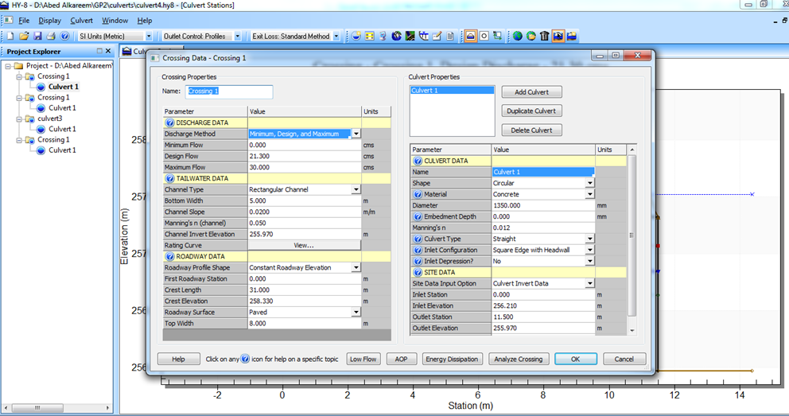
By HY-8 .

Slide 45
Final Suggested Design.
Culvert number | Diameter(mm) | Number of barrels | Slope (%)
1 | 1350 | 5 | 2.09
2 | 1200 | 4 | 3.8
3 | 1550 | 4 | 4.64
4 | 1000 | 1 | 4.57

Slide 46
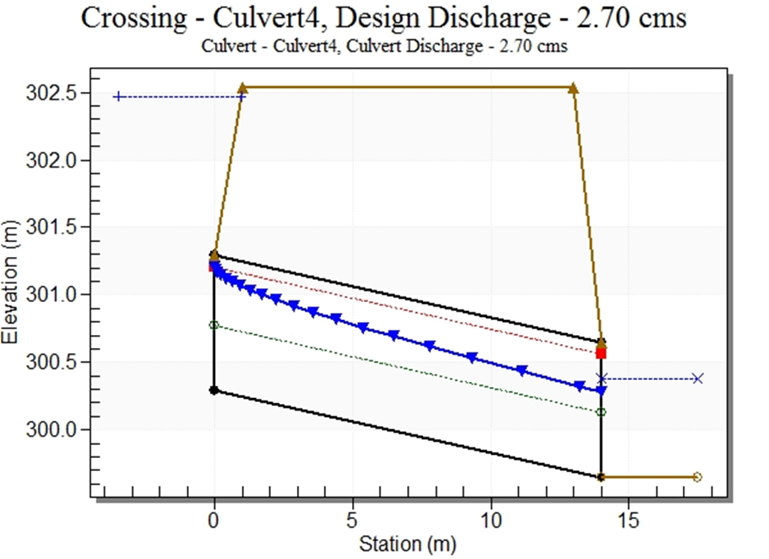
Sample Culvert 4.

Slide 47
Discussions and Recommendations.

Slide 48
THANK YOU

