Slide 1
pH Neutralization Control System
By: Firas I.Dweekat, Hafiz K.Irshaid.
Supervised by: Dr. Raed Alqadi, Dr. Ashraf Armoush.
Notes:
firas

Slide 2
Outlines
Abstract
pH Problem
Fuzzy control
Methodology
  System Architecture
  Tank controller
  Master controller
  Controller communication (DLL)
  MATLAB GUI
Result
Notes:
f

Slide 3
Abstract
Controlling pH degree
Fuzzy logic
MATLAB
Notes:
h

Slide 4
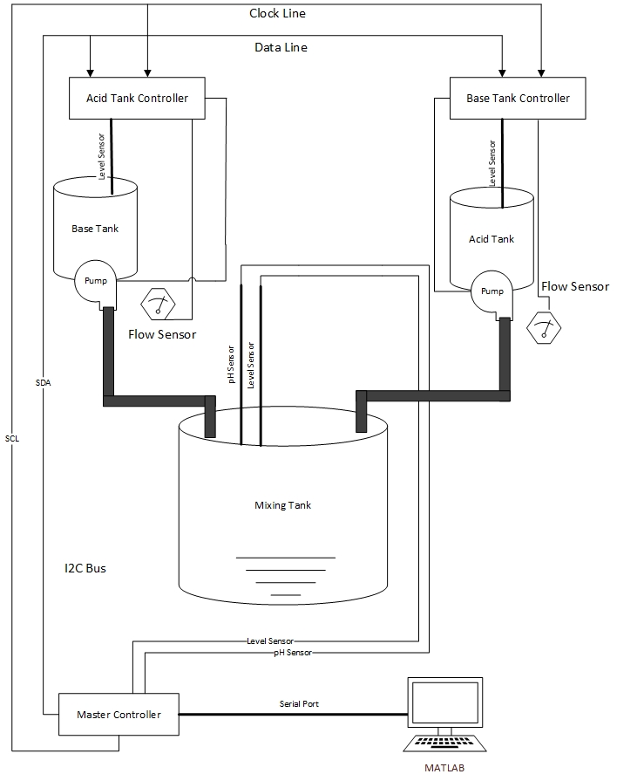
Notes:
h

Slide 5
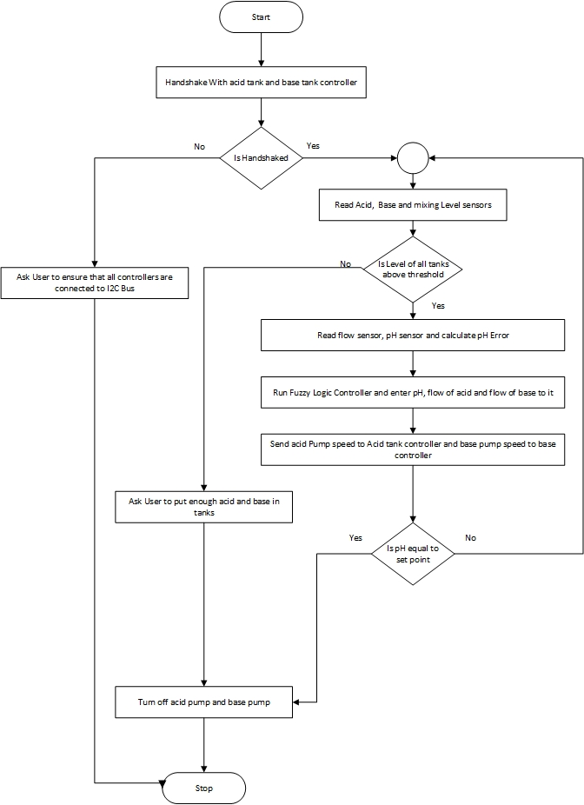
Notes:
h

Slide 6
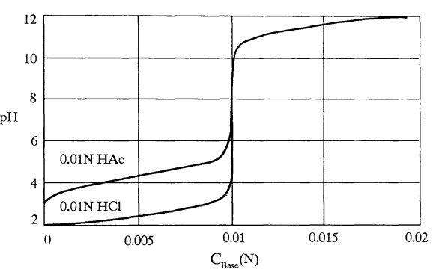
pH Problem
pH= - log[H+]
Notes:
f

Slide 7
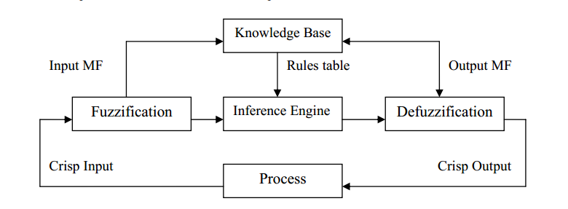
Fuzzy control
Notes:
h

Slide 8
Methodology

Slide 9
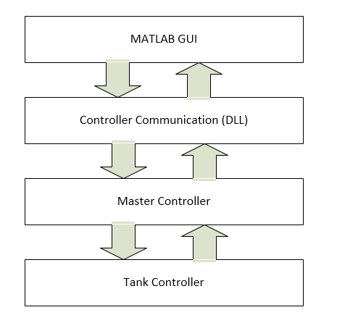
System Architecture
Notes:
f

Slide 10
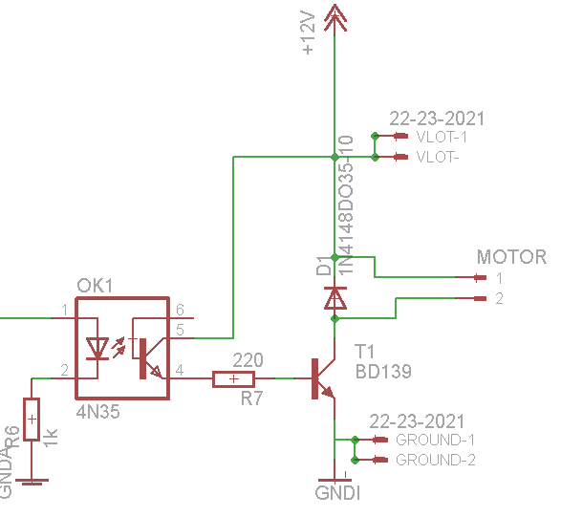
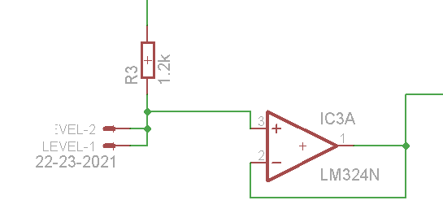
Tank controller
PiC18f6420
eTap continues level sensor.
Water pump.
Notes:
f

Slide 11

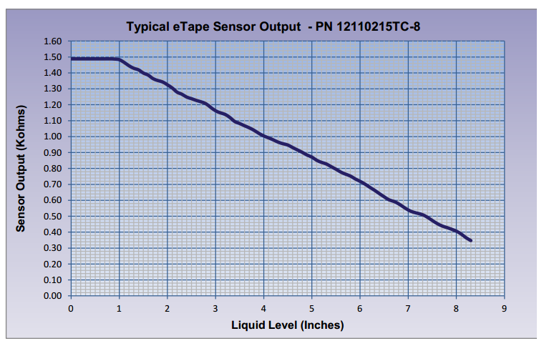
Etap continuous level sensor
Sensor output: 1500 empty, 150 per inch 20%
Notes:
f

Slide 12
Master controller
Controlling tank microcontrollers.
Arduino UNO.
pH Meter with analog output.
Level sensor.
Notes:
f

Slide 13
I2C Protocol
Packet Types | Description
TYPE_HANDSHAKE_TANKS | To handshake between master and slave
TYPE_DISCONNECT_PC | if the PC is disconnected, shut down the program
TYPE_ACK | Acknowledgment
TYPE_REQUEST_FLOW | To request the flow sensor
TYPE_REQUEST_LEVEL | To request the level sensor
TYPE_BAD_PACKET | If the check sun is incorrect
TYPE_REQUEST_ALL_SENSORS | To request all sensors
TYPE_SET_PUMP_SPEED | To set the pump speed
TYPE_NACK | Negative acknowledgment
Notes:
f

Slide 14
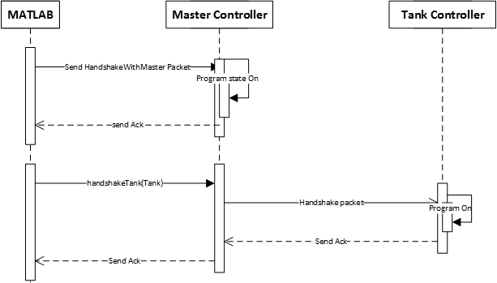
Handshake sequence diagram
Notes:
f

Slide 15
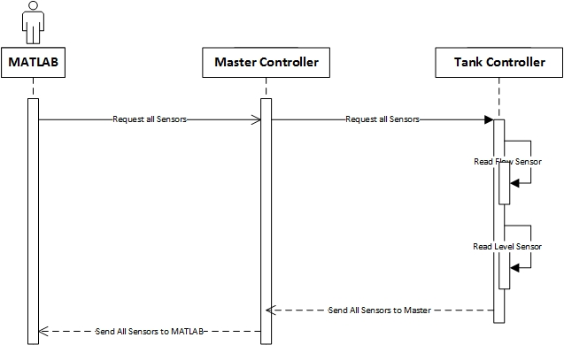
Getting sensors sequence diagram
Notes:
f

Slide 16
Controller communication (DLL)
Packet Type | Description
TYPE_PACKET_HANDSHAKE_PC | To handshake with PC
TYPE_HANDSHAKE_TANKS | To handshake with tanks
TYPE_DISCONNECT_PC | To tell the microcontroller that the program wants to disconnect
TYPE_ACK | Acknowledgement
TYPE_NACK | Negative Acknowledgement
TYPE_REQUEST_FLOW | To request flow sensor
TYPE_REQUEST_LEVEL | To request level sensor
TYPE_REQUEST_GAS | To request Gas Sensor
TYPE_REQUEST_pH | To request pH sensor
TYPE_REQUEST_TEMP | To request Temp
TYPE_BAD_PACKET | If the check sum is incorrect
TYPE_REQUEST_ALL_SENSORS | To request all sensors from all microcontrollers
TYPE_SET_PUMP_SPEED | To set pump speed to one of the controllers
TYPE_REQUEST_SCAN_I2C | To scan I2C bus
Notes:
h

Slide 17
MATLAB GUI
Why we used MATLAB ?
Easy to change the controller
Can be used by non expert in microcontroller
Notes:
h

Slide 18
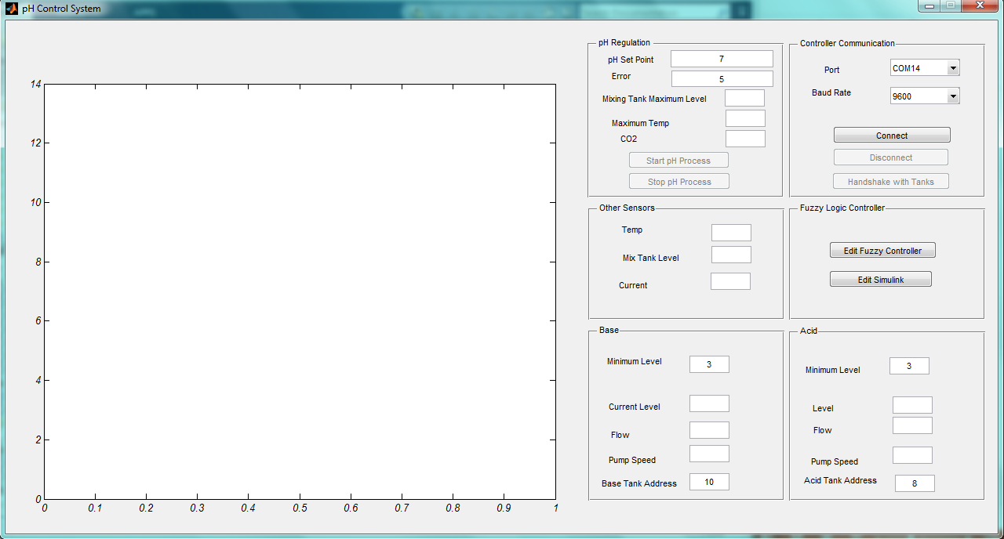
MATLAB GUI

Slide 19
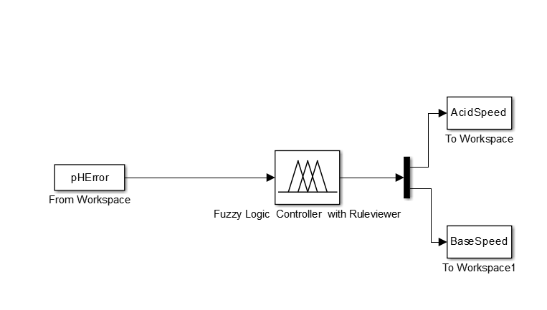
Fuzzy Controller
Notes:
h

Slide 20
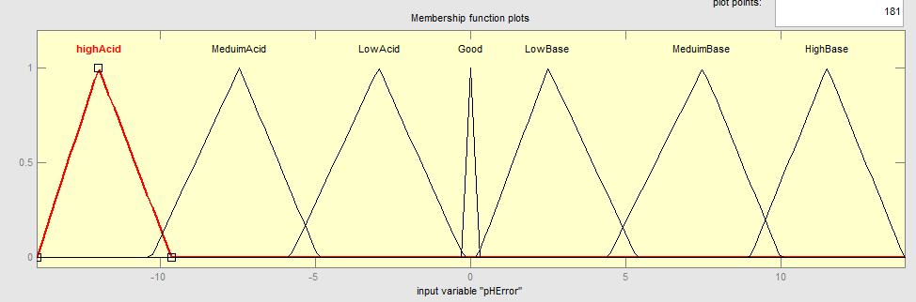
Fuzzy inputs
pH Error
Notes:
h

Slide 21
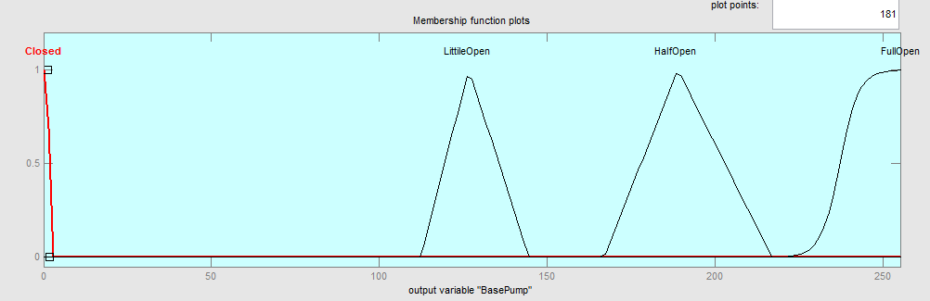
Fuzzy Outputs
Acid and base pump speed
Notes:
h

Slide 22
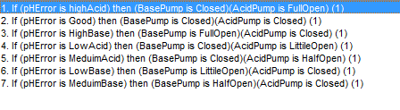
Fuzzy Rules
Notes:
h

Slide 23
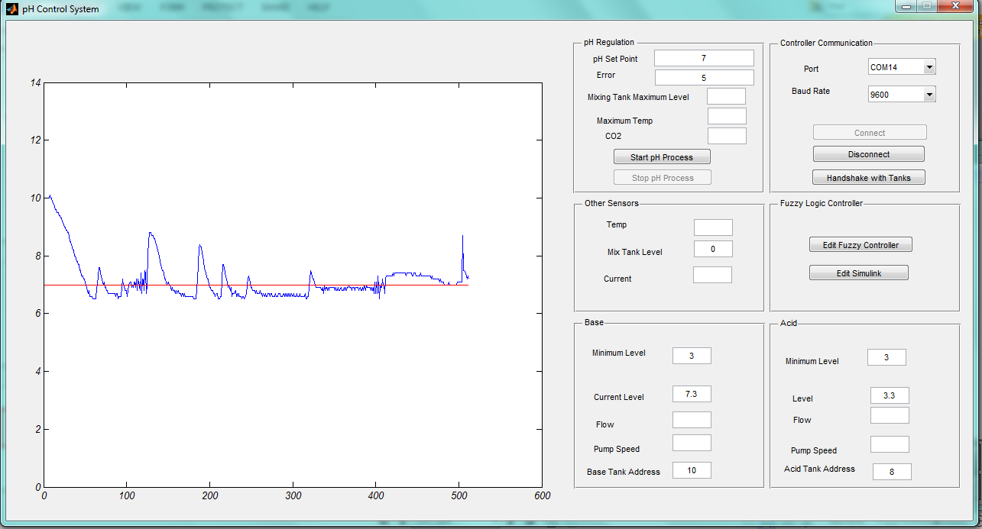
Results and conclustion
Notes:
h

Slide 24
Future work
More accurate sensors
Powerful microcontrollers
Adding more sensors
  Flow
  pH sensor for each tank
Notes:
f

Slide 25
Big Thanks
Notes:
f

