Slide 1

Prepared by:
Jameela Rabaya
Fatima Darawsha

Slide 2
What is Palestine Hotels Finder
Pal Hotels Finder is a smart phone android application.
It supports Open Street maps capabilities like: GPS, assign location, search about location and add new information to Open Street Map.

Slide 3
Why Pal Hotels Finder
To search for the best hotel offers in the local area via GPS Local Search.
To find out about the location and facilities of the hotel.
Book your hotel room at the best possible price, without additional costs, and without having to provide your credit card or additional payment details.
Integrated with map view.

Slide 4
Cont.
Using this application, we could bring information
about places in Palestine.
Wide selection of hotels.
Intuitive search feature with sorting and filtering option.
GPS Local Search feature .

Slide 5
Cont.
Detailed information provided for each hotel together with photos ,rate and description.
Book either rooms or restaurant or wedding hall in just a few steps.
Make bookings without a credit card.
Get directions to the hotel.

Slide 6
Cont.
Display hotel recommendation rate in hotel details.
Your feedback is highly appreciated via email, Call, Facebook and twitter.
It contains two parts:Client side and Server side.

Slide 7
Requirements
Functional Requirements
Search: Search about hotels and details about it.
Filter: filter hotels based on the distance, price, and stars.

Slide 8
Cont.
Get path: get direction to the selected hotel.
Get details: get details of a hotel such as rate, photo, room etc…

Slide 9
Requirements
Non Functional Requirements
Usability: our application is user friendly and easy to use.
Scalability: The application can contain many users at a time and can be scalable to have more users.

Slide 10
Background
Our application contains three parts:
1. Database and Server side.
2. API.
3. Android Application.

Slide 11
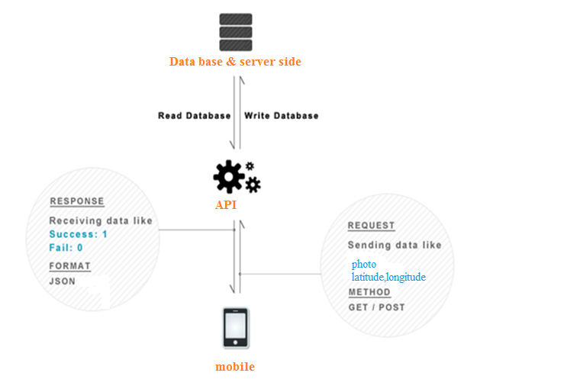
Application Parts
Figure ‎1‑1: connect android with database among API

Slide 12
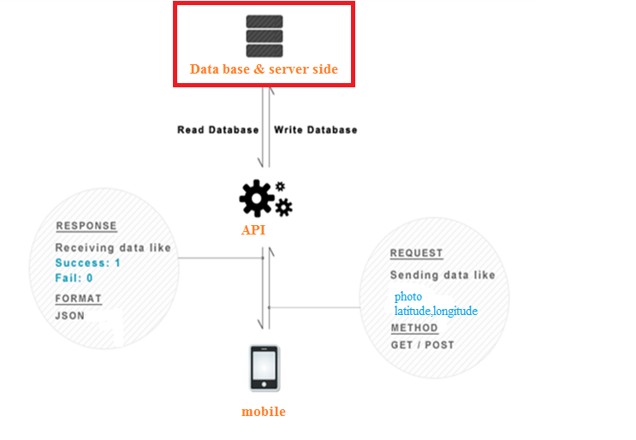
Application Parts
Figure ‎1‑2: connect android with database among API

Slide 13
Database and Server Design
Our database is My SQL database (PHP My Admin).
it contains eleven tables:
- adminTable. - image Table
- info Table. - restaurant Table
- excluded Table. - reservation Table.
-included Table. -reserve table.
-room Table -Wedding Hall Table
-reserve wedding Table.

Slide 14
Cont.
Server Languages:
PHP 2. JQuery 3. AJAX 4. Java Script.
MVC model pattern design.
There is one admin .
Get ability to add a hotel or delete it. And every feature for hotel such as room, photo, restaurant and wedding Hall .

Slide 15
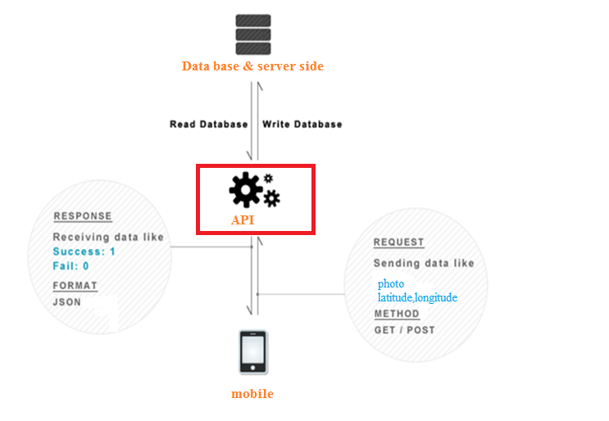
Application Parts
Figure ‎1‑3: connect android with database among API

Slide 16
API Design
We stored data and retrieved it by PHP script.
The data is sent to the server using HTTP requests.
The response from server is JSON.
The PHP scripts on the server send queries to the database to select data for a hotel, or to store data about reservation form.

Slide 17
Requests to the PHP Scripts:
We used Apache HttpClient library that simplifies handling HTTP requests.
We retrieved and sent data via the HttpClient class.
The HttpClient uses HttpUriRequest to send and receive data. Important subclass of HttpUriRequest are HttpGet and HttpPost.

Slide 18
Handling the responses of the PHP Scripts
We extracted the data that returned from the PHP scripts using JSON library.
JSON, Java Script Object Notation, is a text-based open standard designed for human readable data interchange.
The JSON format is often used for serializing and transmitting structured data over a network connection.

Slide 19
Cont.
We used JSON parser class that has a method which will make http request to get JSON data and returns a JSON Object.
In order to parse the JSON data we used pluggable streaming library.

Slide 20
Cont.
JSON Parser used for large data .
JSON Parser more faster than XML so this is better for device.
JSON is much easier and Human readable.

Slide 21
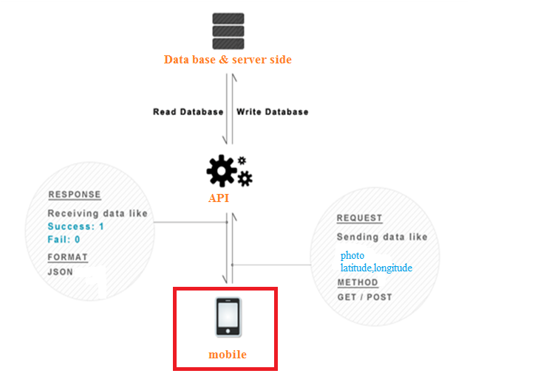
Application Parts
Figure ‎1‑4: connect android with database among API

Slide 22
Android Application
Our android application consist of:
Manifest File : this file contains the permissions like:
- Internet Permissions.
- Network State Permissions.
- GPS location Permission.
- GPS location Coarse Permission. - CALL_PHONE Permission. - WRITE_EXTERNAL_STORAGE Permission.

Slide 23
Cont.
Layout Files.
SRC folder.
Library folder.
Drawable Folder.

Slide 24
Technologies used in our project
Firstly, we work on using Google Maps in Android.
In order to use Google Map in your application you should obtain Google Maps API Key.
Extract the MD5 fingerprint.
Use Google Places API.

Slide 25
Problems !!!!!!!
No Palestinian Hotels Found.
we success to add places to Google Places API and retrieve it .
No Details on Google Map for Palestine found.
search for another Maps.

Slide 26
Open Street Map
IN order of using OSM in Android you need :
Using< org.osmdroid.views.MapView> element to display the OSM in your activity.
Using the <RelativeLayout> element to position the map within the activity.

Slide 27
Cont.
Android defines a package called slf4j-android-1.5.8.jar which includes:
MapView.
OverlayItem, Path Over Layer and MyLocationOverlay.
MapController.
ItemGestureListener.
ResourceProxy.
Tileprovider.
GeoPoint.

Slide 28
Cont.
We retrieve the latitude and longitude of each hotel from the database and place them on the Map as a bubble.
Support the following request:
-Hotels Search.
- Hotels Details.
- Hotels Filtering.

Slide 29
GPS
We used android Location API in addition to mobile GPS in order to overcome GPS limitations and support search locally.
Android contains the android.location package which provides the API to determine the current geo position which contains:
- LocationManager.
- LocationProvider.
- LocationListener.

Slide 30
Async Task
It is a class in the android that enables proper and easy use of the UI thread.
allows to perform background operations and publish results on the UI thread without having to manipulate threads and/or handlers.

Slide 31
Application in depth
When the application starts:
Run the main activity of the application to enable the user start the application.
Press start button, then switch to the Login Activity.

Slide 32
Main Activity
The Map view is representing the main activity, which is the map of the current location.
It checks if the user has internet access otherwise it will ask to connect to the internet.
It brings the current location either from GPS or from Wi-Fi Access using the Location API in Android.

Slide 33
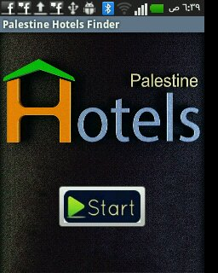
Wajha &Main Activities
Figure1.5:Mainwajha activity

Slide 34
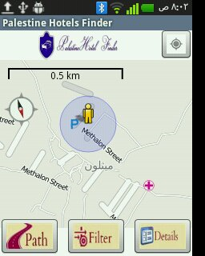
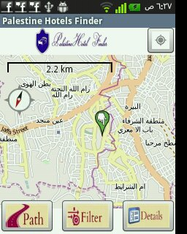
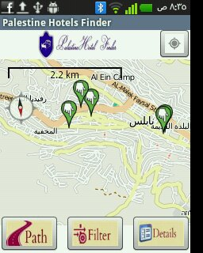
Snap shot from application
Figure ‎1‑6: GPS activity
Figure ‎1‑7: Loading Hotels in Ramallah and Nablus city

Slide 35
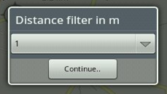
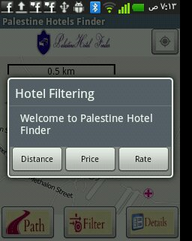
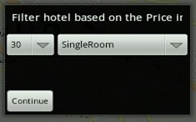
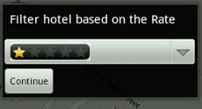
Snap shot from application
Figure ‎1‑8: Filtering activity

Slide 36
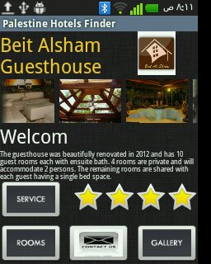
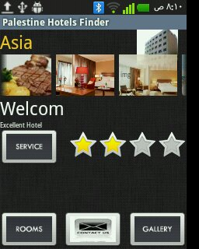
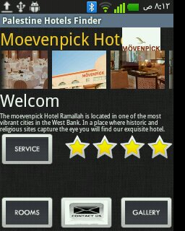
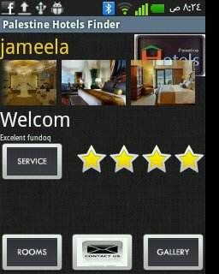
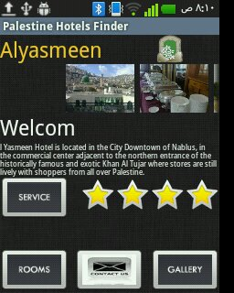
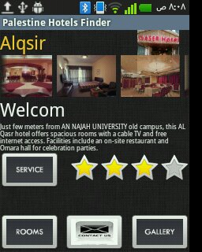
Snap shot from application
Figure ‎1‑9: Hotel information activity

Slide 37
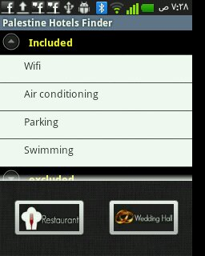
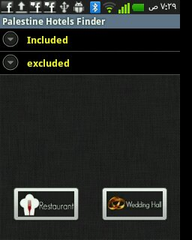
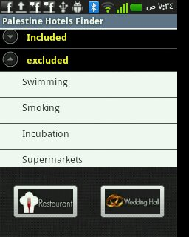
Snap shot from application
Figure ‎1‑10: service activity

Slide 38
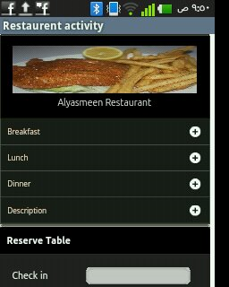
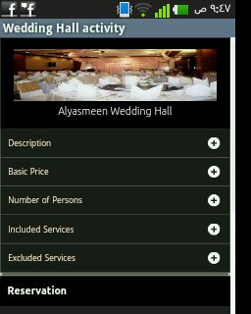
Snap shot from application
Figure ‎1‑11: service activity for restaurant and wedding hall

Slide 39
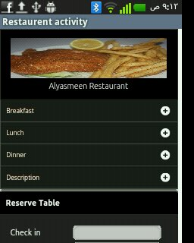
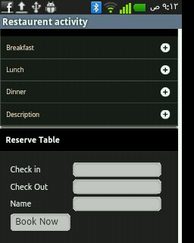
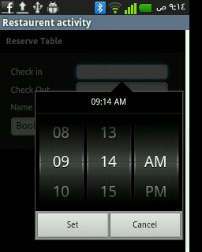
Snap shot from application
Figure ‎1‑12: restaurant reservation

Slide 40
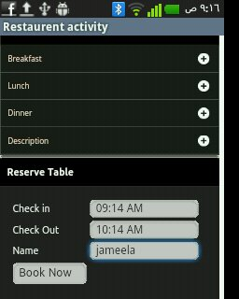
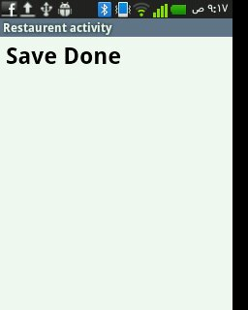
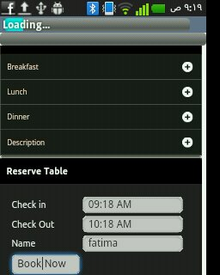

Snap shot from application
Figure ‎1‑13: restaurant reservation cots..

Slide 41

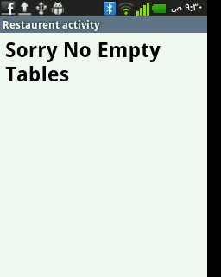
Snap shot from application
Figure ‎1‑14: restaurant reservation conts….

Slide 42
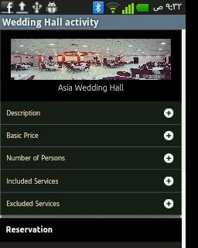
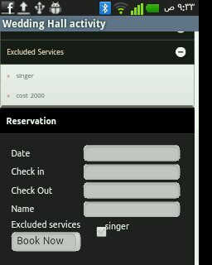
Snap shot from application
Figure ‎1‑15:Wedding Hall

Slide 43

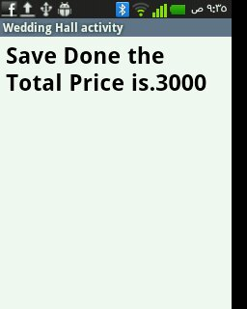
Snap shot from application
Figure ‎1‑16:Wedding Hall reservation

Slide 44
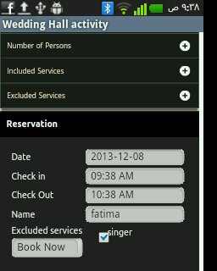
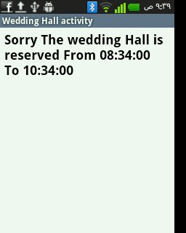
Snap shot from application
Figure ‎1‑17:Wedding Hall reservation conts….

Slide 45
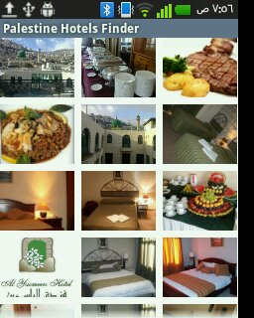
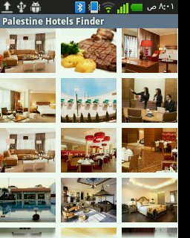
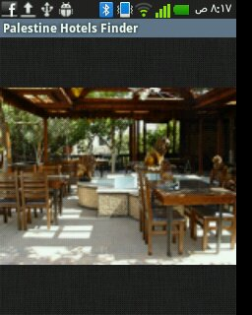
Snap shot from application
Figure ‎1‑18:Photo Gallery activity

Slide 46
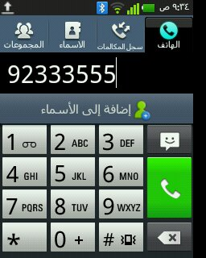
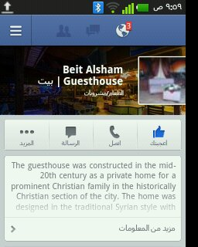
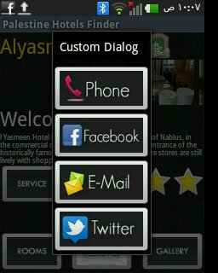
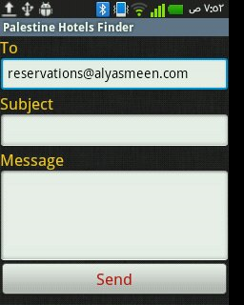
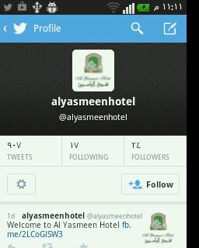
Snap shot from application
Figure ‎1‑19:‎Contact us dialog

Slide 47
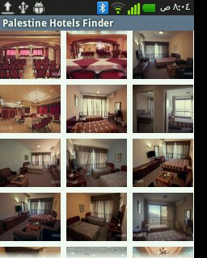
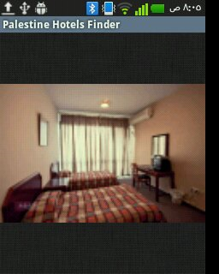
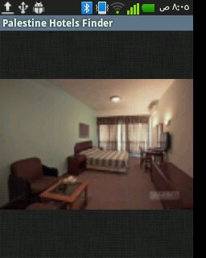
Snap shot from application
Figure ‎1‑20:‎Room activity

Slide 48
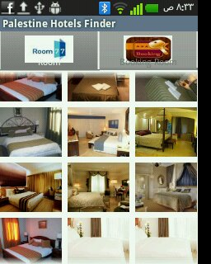
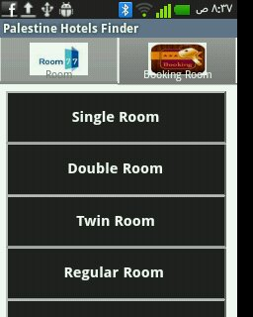
Snap shot from application
Figure ‎1‑20:‎Room activity

Slide 49
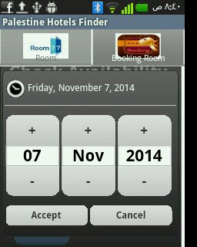
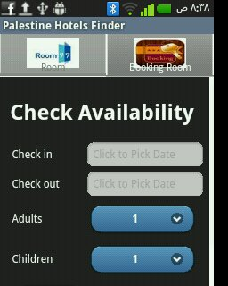

Snap shot from application
Figure ‎1‑21:‎Room reservation

Slide 50



Snap shot from application
Figure ‎1‑22:‎Room reservation conts…

Slide 51


Snap shot from application
Figure ‎1‑23:‎Room reservation conts….

Slide 52
Conclusion
On Server
Build Database
Using PHP My Admin
API
Write PHP Scripts to be the interface or API between Database and Application.
Final Results
Application connects both to API and to Server Database
Application connects to OSM API's and connects to Distributed Database to bring the data and show it on map.
OSM API's
Build server side for add hotel, room, photo, service, etc…..
Figure ‎1‑24: Methodology in the Project

Slide 53


Slide 54


