Slide 1

Design of Mohammed Ibn Rashed Al-Maktoom Street in Nablus City.
Under Supervision of:
Dr.Amjad Issa.
Prepared by:
Rula Sarris.
Saja Sholi.

Slide 2
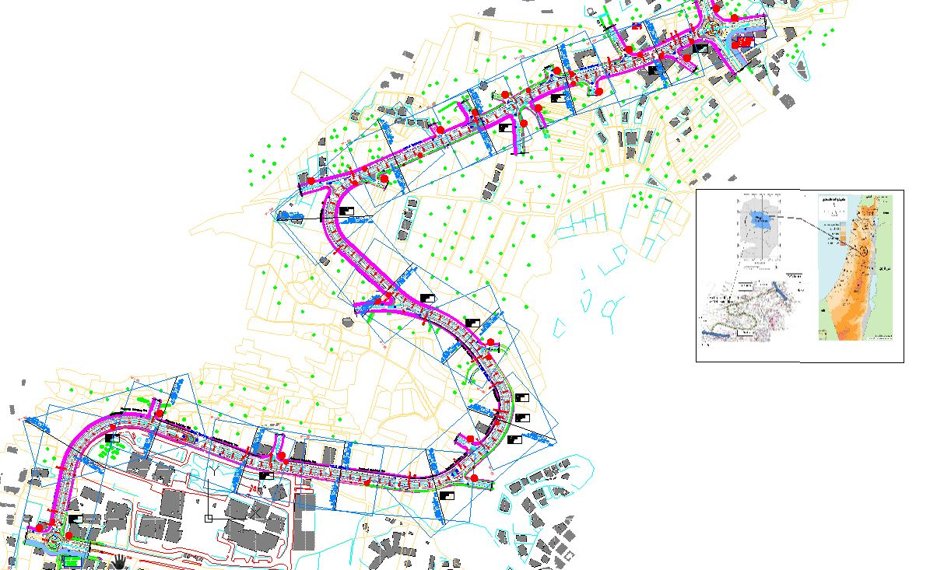
Design of Mohammed Ibn Rashed Al-Maktoom Street in Nablus City.

Slide 3
1
Study Area
2
Objectives and Importance of the project
Methodology
3
4
Data collection
5
Analysis and Design
6
Conclusion and Recommendation

Slide 4

Study area

Slide 5
STUDY AREA
The targeted street is located in the western part of Nablus. The street starts from Zawata roundabout to Al-Kori intersection. The length of the road is about 2.5 km.The right of way is 25 m based on Master plan. The functional classification of the road is urban arterial road

Slide 6
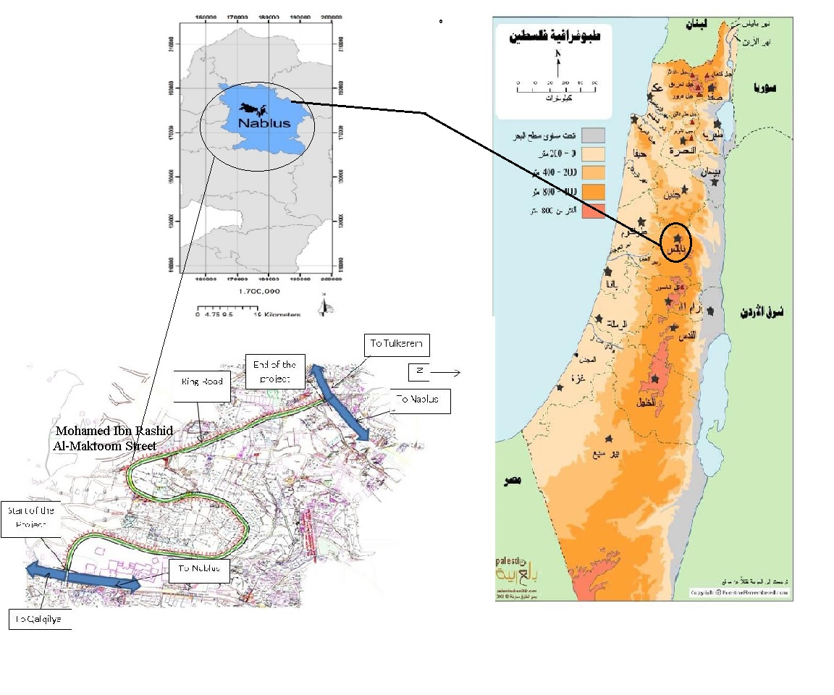
Location of Mohamed Ibn Rashid Al-Maktoom Street
N

Slide 7
Objectives
Evaluate and redesign the existing road and find proper solution for it’s problems.
Contribute in solving congestion problem with new campus (An-Najah National University) area by widening the street that provide easier transition for the students in entrance and exit points.
Additionally, the design and reconstruct the targeted road is expected to eliminate the illegal parking along the existing road. Consequently, this will enhance the safety for both pedestrians and drivers.

Slide 8
IMPORTANCE OF THE PROJECT
N
The targeted road is located in an important location representative by residential area as well as serves the students of the new campus of An-Najah National University. This contributes to a relatively high traffic volume. The proposed road is used currently by the students coming from Tulkarm, Jenin and Tubas areas.

Slide 9
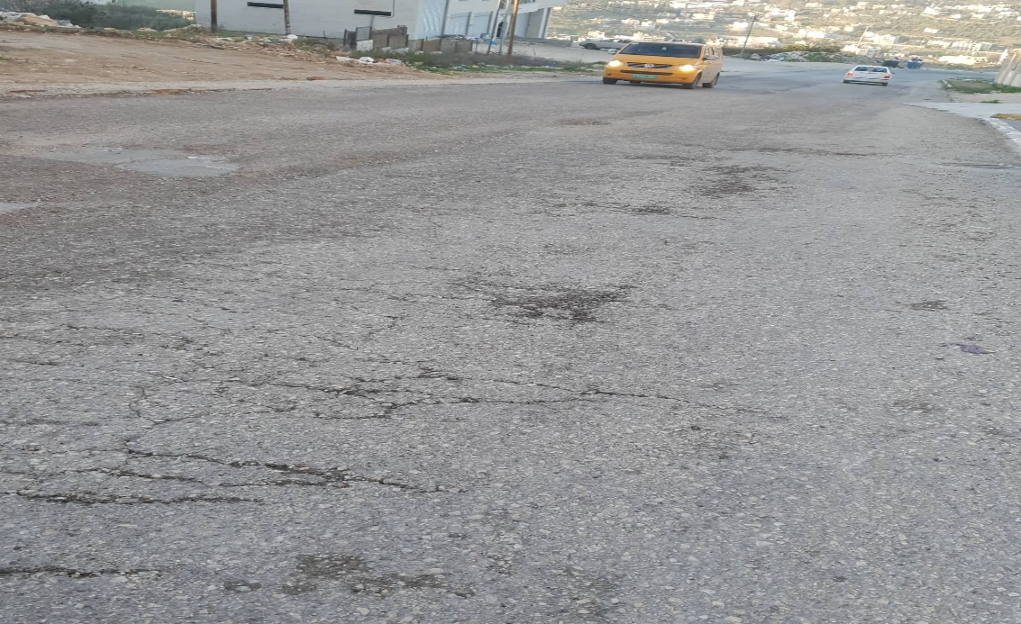
PROJECT CONSTRAINS
N
1. Bad Pavement of the surface if the road

Slide 10
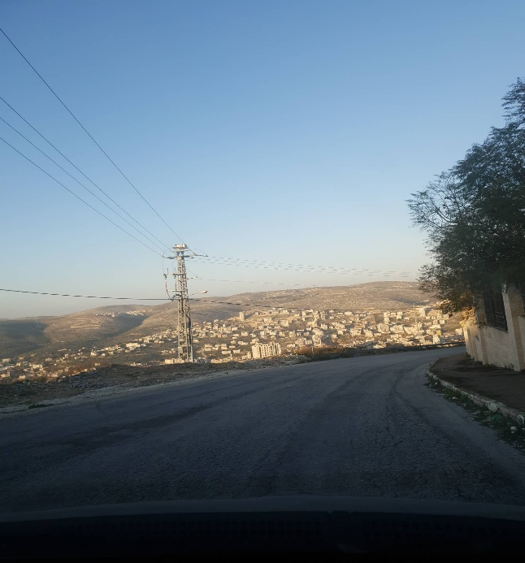
PROJECT CONSTRAINS
2. Sight Distance is not enough

Slide 11
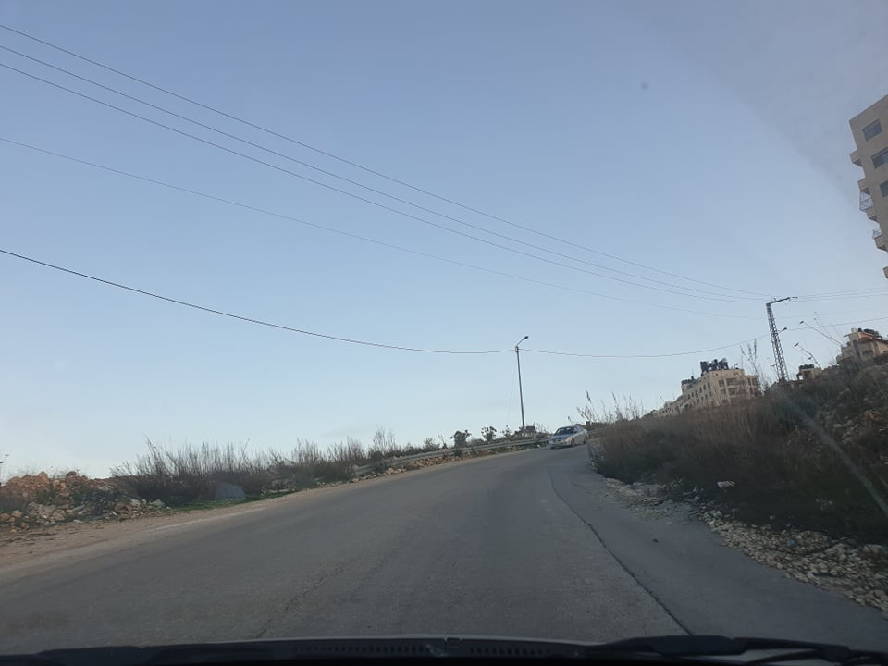
PROJECT CONSTRAINS
3.Problem in super elevation

Slide 12
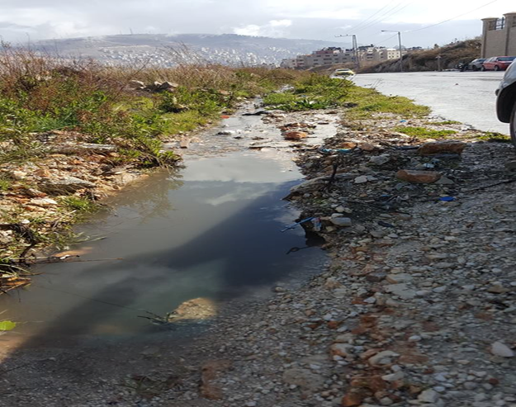
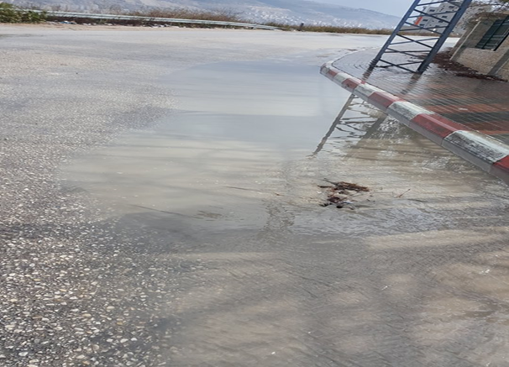
PROJECT CONSTRAINS
4. Bad Drainage System

Slide 13
METHODOLGY

Slide 14

Methodology
Visit Nablus Municipal
Data collection
Identify study area
Data analysis
Assessment and design
Conclusion and Recommendations

Slide 15
1-Visiting Nablus municipality :
The project team visited municipality of nablus where they met with
municipal engineer , and discussed with her the main locations suffering
From traffic problems in the city.
2-Identifying the study area:
The graduation project aims to assessing the targeted road Mohammed Ibn-Rashid Al-Maktoom Street .
3-Data Collection:
The project team will collect all relevant data, document, drawing, maps and plans that are needed for assessing the targeted street . Moreover, the project will conduct traffic volume count in 2 different periods (7:30- 9:30) a.m and (1:30- 3:30) p.m in the same days.

Slide 16
4. Traffic analysis and design.
After collection the needed data, the project team used the Civil 3d 2019 software to design the road considering the coming 20 years. The current and future level of service for the road were also checked using HCS software. Moreover, the students proposed the proper geometric and pavement design needed.

Slide 17
DaTA COLLECTION

Slide 18
Traffic volume studies:
The first steps in analyzing the intersections are studying the current existing situation through conducting traffic studies. The project team visited the site location for each intersection and collected data by counting the traffic entering the intersections considering classifications and the directional movements which are documented in a special form and during specific periods (15 minutes). The main output of the analysis process is the level of service.

Slide 19
Traffic counting:
The team used the manual method to count the traffic volume at the intersections which indicate the nature of traffic in the intersections.
Analysis of the traffic volume is used to evaluate the existing and future (LOS) in the intersections. The collected data is presented in the appendix.

Slide 20
Based on the collected data (PHV) was collected
Peak Hour Volume (PHV): is the maximum numbers of vehicles that pass in the intersections during a period of four quarters consecutive (PHVs) numbers are used for:
A-Design the geometry of the highways.
B-Functional classification of highways.
C- Improvement of programs related to traffic operations.
D-improvement of parking regulations.
E-Capacity analyses.

Slide 21
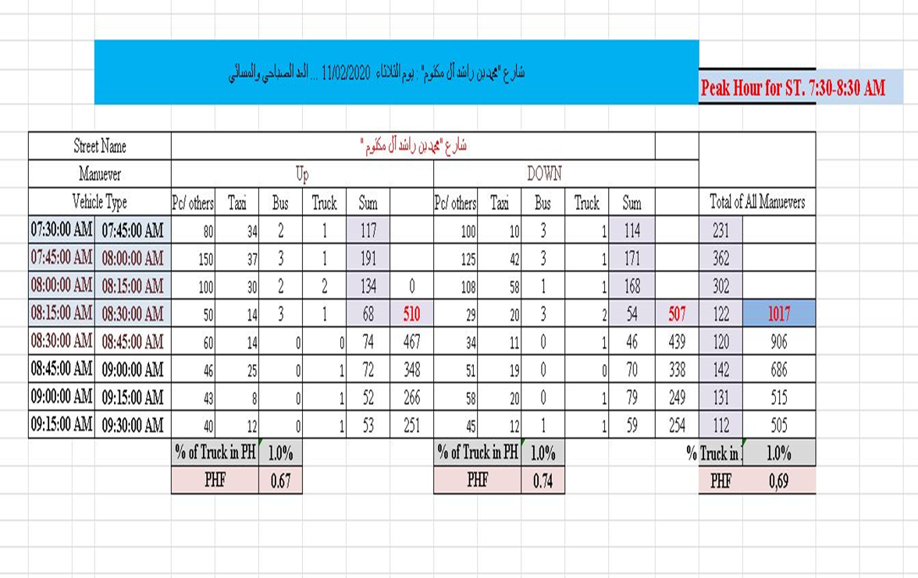
Traffic volume counting for Mohammed Ibn Rashid Al-Maktoom (Morning)
.

Slide 22
Periods of counting.
Name of street | Time | Date | PH | PHV | PHF
Mohammed Ibn Rashid Al-Maktoum | 7:30 Am-9:30 Am 1:30 Pm-3:30 Pm | 11-2-2020 | 7:30 am -8:30 am | 1017 Veh/hr | 0.69

Slide 23
Analysis & Design

Slide 24
Functional Classification of the Road.
The targeted project passes through an urban area, and the road is classified as arterial, based on Nablus Municipality master plan. Accordingly, the road is classified as urban arterial.
According to the expected degree of use, the road can be classified as a main road so it is an Urban Arterial Road. The number of lanes is assumed to be four lanes “two lanes in each direction, in order to carry the expected traffic for the coming twenty years”, so it classified as a multi-lane highway. Urban Arterial allowed higher grades for design compared with rural arterial, and accordingly this is more suitable in this project due to the difficult topography .

Slide 25
Design speed
The design speed depends mainly on the topography of the highway location and the classification of the highway. As the project is classified as an urban arterial highway with mountainous and steep topography, according to the AASHTO, the range of design speed in this case is 60-90 km/hr. The design speed is considered to be 60km/hr with min. radius of 123m. However, this speed could be reduced in some location with sharp curves.

Slide 26
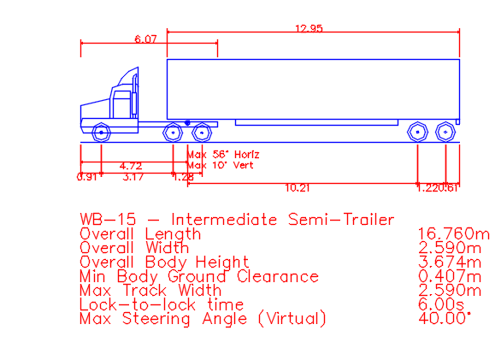
Design Vehicle
Design vehicle, is a vehicle whose characteristics represent all vehicles expected to use the highway. It’s important to consider the dimensions of the vehicle (length, width and height), the turning radius and the operation characteristics. By coordination with the municipality engineer, WB-15 is selected as a design vehicle.
The characteristics of this vehicle as described in AASHTO 2011 are:
Overall Height = 3.674 m
Overall Width = 2.59 m
Overall Length = 16.76 m

Slide 27
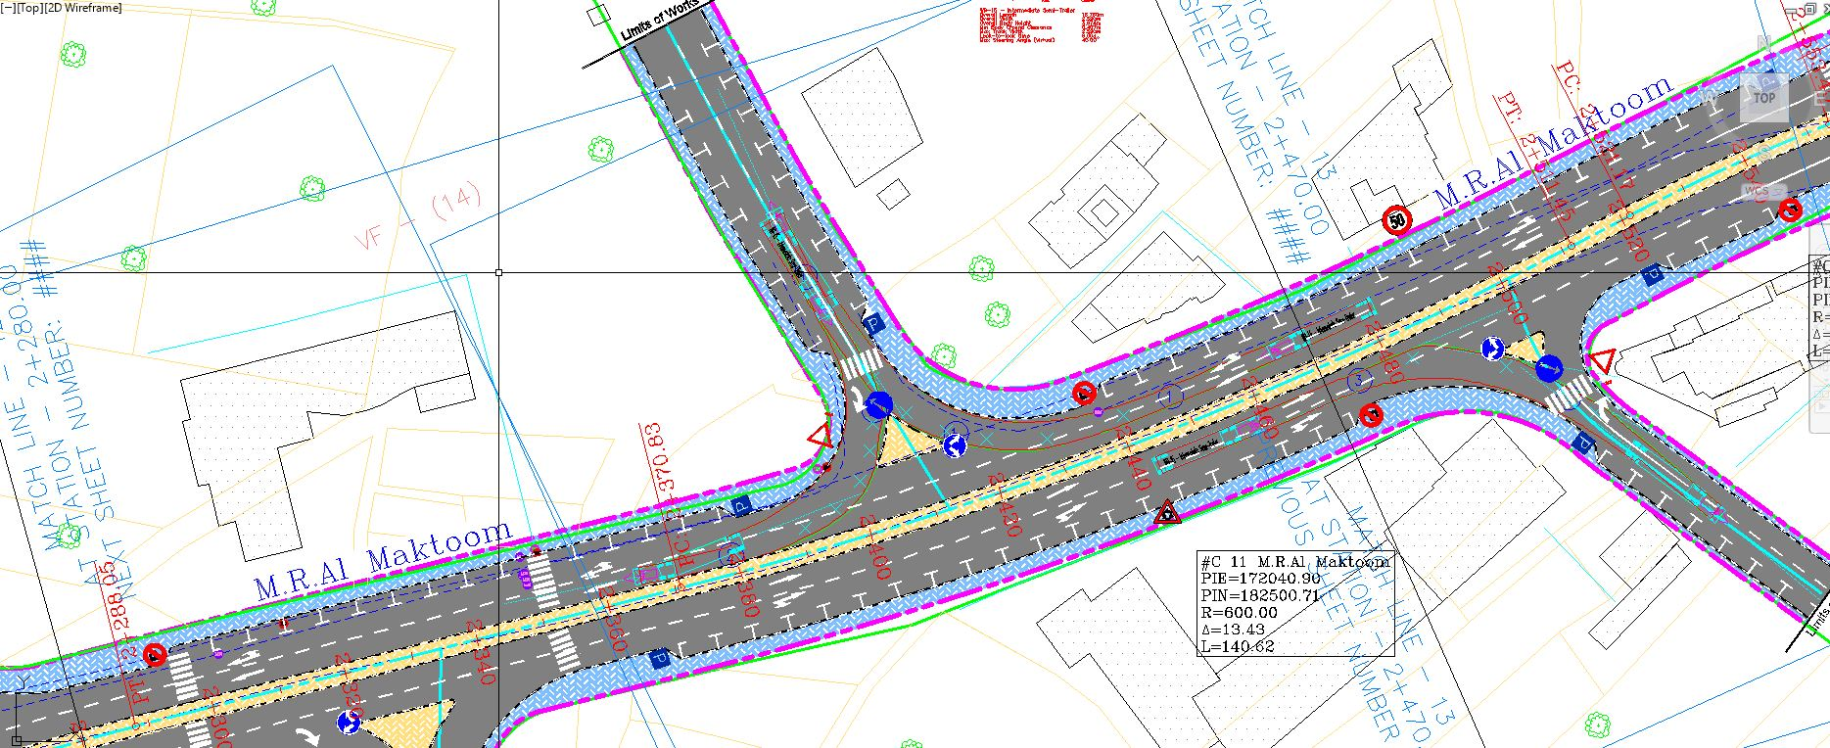
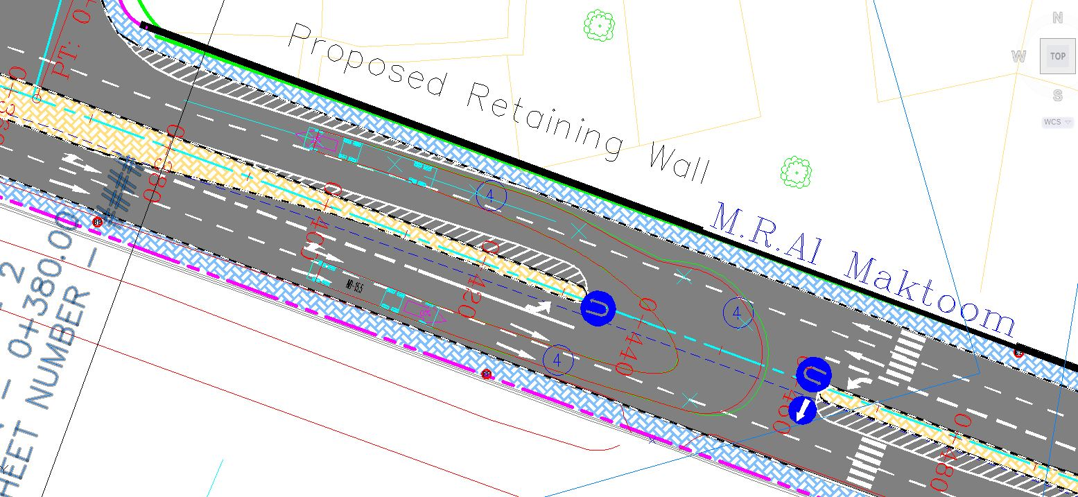
Design Vehicle
Minimum turning radius is taken into account in the intersections design. And for making sure that the design is true, the Vehicle Tracking Check is used for that purpose as shown:

Slide 28
Evaluating and Examination the Existing Design
This segment of the ring road is in a mountainous area and this will cause occurrence of sudden sharp curves and high grades and this contributing in reducing the speed in some areas or make changes in the existing centerline, also the high grade will cause a high cut and fill.
The alignment of the road is opened approximately with length of 2.5 km with variable width between 20 m to 25 m the fully width. The grade of the existing road is high in certain specifications because of the mountainous topography. After 1.780 km from the beginning of the existing road there is residential area. Finally, the nature of the existing asphalt layer is loose at some location of road specially at the beginning due to traffic and rain water runoff.

Slide 29
Design of Horizontal Alignment
Horizontal alignment consists of straight lines (tangents) connected by curves. They are usually a segment of circle having a radii which used to have a smooth traffic flow along the curve. The design of the Horizontal Alignment is based on design criteria in AASHTO 2011. The most important elements to be checked are horizontal curve related elements. The Civil 3D software is used to developed the H.A.
List of design criteria
1. Design speed: The design speed is selected to be 60 km/hr.
The 60km/hr (could be reduced in some sections up to 50 km/hr).
Speed = 60 km/hr → from station 0+00 to 1+100
Speed = 50 km/hr → from station 1+100 to 1+850
Return to Speed = 60 km/hr →from station 1+850 to the end of the street.
2. Minimum radius: The radius corresponding to design speed 60 km/hr = 125m. The radius corresponding to design speed 50 km/hr = 80m.
3. Super elevation: Maximum super elevation = 6%.
4. Minimum length of the curves:
In this project, V = 60 km/hr → L = 3*60 = 180m
if the speed is reduced to 50 km/hr → L = 150m

Slide 30
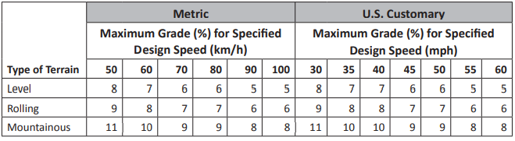
Design of Vertical Alignment
The vertical alignment of a road consists of gradients (straight lines in a vertical plane) and vertical curves. The vertical alignment is usually drawn as a profile, which is a graph with elevation as vertical axis and the horizontal distance along the center line of the road as the horizontal axis. Just as a circular curve is used to connect horizontal straight stretches of road, vertical curves connect two gradients.
List of design criteria
1. Topography
In the project design the topography of the existing terrain is mountainous topography,
2. Grades
*MAX IMUM GRADE :
The maximum design grade should be used infrequently in the most cases of the highway according to AASHTO 2011. as shown in the table below:
*MIN GRADE:
A minimum grade for usual case is 0.5%. In the vertical design

Slide 31
Design of Vertical Alignment
Because we are restricted by the right of way and centerline that has been set from municipality, it was very difficult to keep slope to a maximum grade 10% for the selected grades as recommended by AASHTO for design speed of 60 km/hr. If we considered the maximum grade of 10%, values of cut could reach very high value in some locations which is very difficult and expensive to be constructed, so that the maximum grade will be considered as 16.9%.
The considered grade is achieved in the design profile except two locations, 16.9 % grade from station (0+024 to 0+169.63) and 13.83% grade from station (0+169.63 to 0+242.53).
3. Highest Cut and Fill
Based on AASHTO standards of the cut and fill, the maximum height value for cut or fill is 30m. In the project, the maximum value of cut and fill range from 8-10 m.
4. Design Controls for Sag Curves: K=13

Slide 32
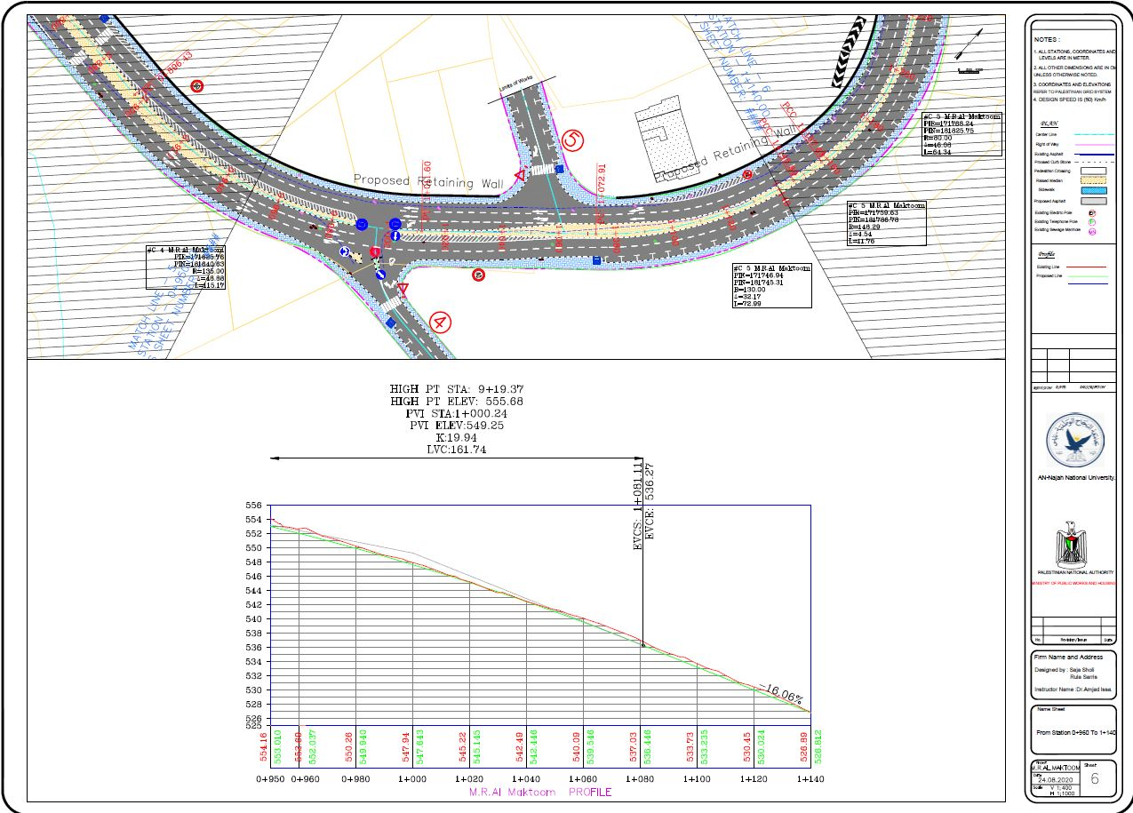
Profile & Plan.

Slide 33
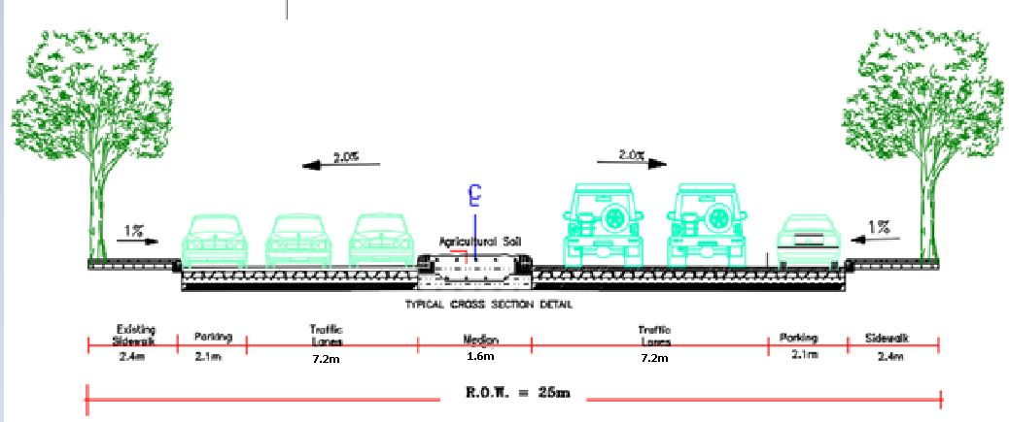
Design of cross section element:

Slide 34
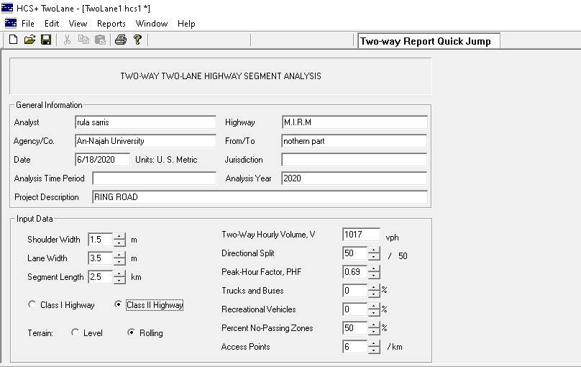
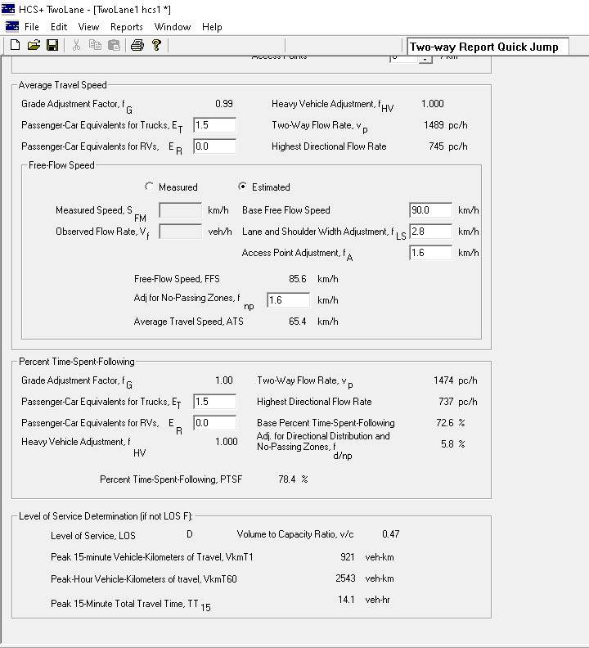
HCS DESIGN :

Slide 35
HCS DESIGN OUTPUTS :
Type of lane | LOS
Existing (2 lane) | D
Existing (2 lane) after 20 years | D
Multilane | B

Slide 36
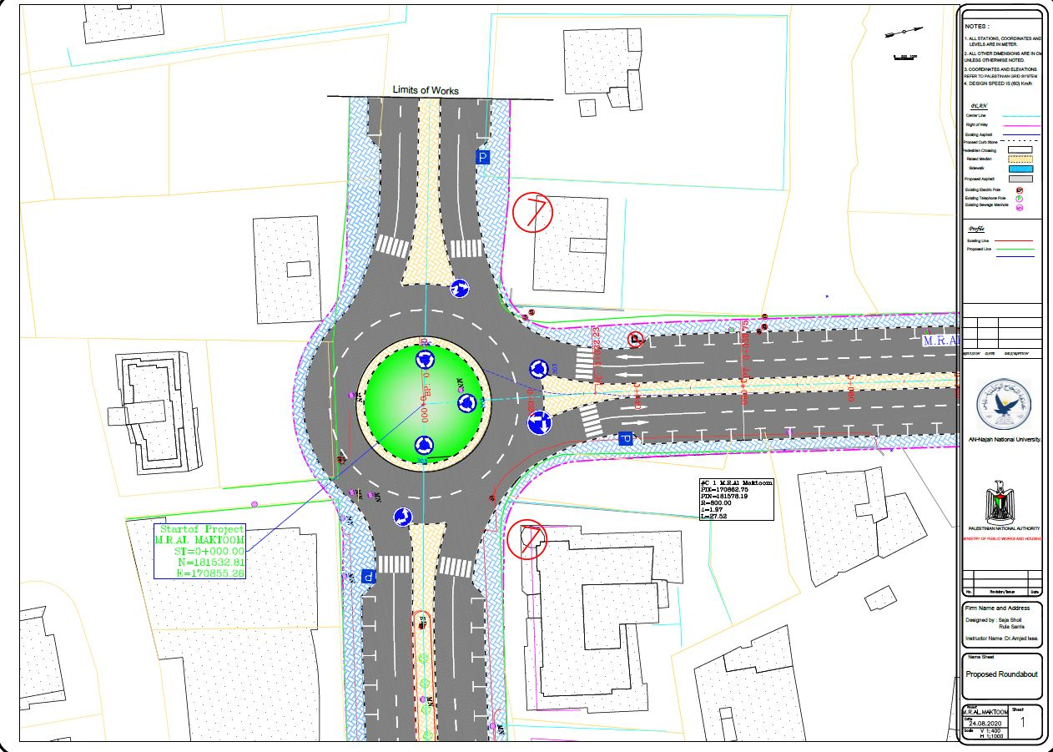
DESIGN OF INTERSECTIONS :

Slide 37
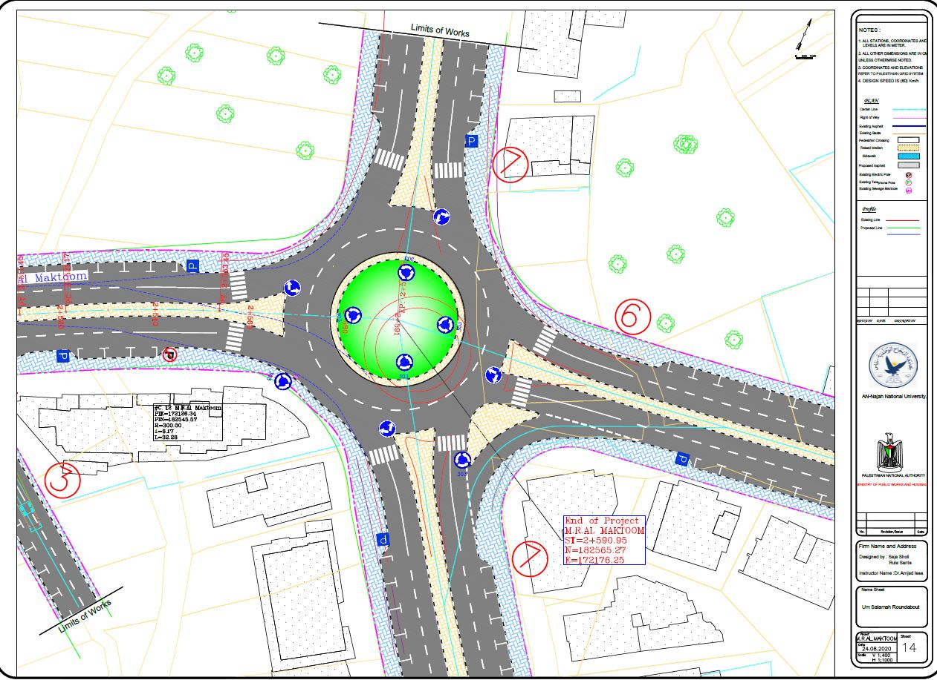
DESIGN OF INTERSECTIONS :

Slide 38
PAVEMENT DESIGN

Slide 39
Structural Components of Flexible Pavement
California Bearing Ratio (CBR) Test
Minutes | Penetration (mm) | Division | Force (KN)
0 | 0 | 0 | 0
0.5 | 0.635 | 35 | 0.448
1 | 1.270 | 73 | 0.934
1.5 | 1.905 | 100 | 1.28
2 | 2.540 | 117 | 1.50
2.5 | 3.175 | 129 | 1.65
3 | 3.810 | 139 | 1.78
3.5 | 4.445 | 148 | 1.89
4 | 5.080 | 156 | 2.00
4.5 | 5.715 | 162 | 2.07
5 | 6.350 | 168 | 2.15
5.5 | 6.985 | 174 | 2.23
6 | 7.620 | 179 | 2.29
6.5 | 8.255 | 185 | 2.37
7 | 8.890 | 192 | 2.46
Based on Graduation Project in 2016 "Evaluation of Existing Pavement Distresses of the Ring Road”
The project team took the values of CBR for sub grade and it is illustrated below:

Slide 40
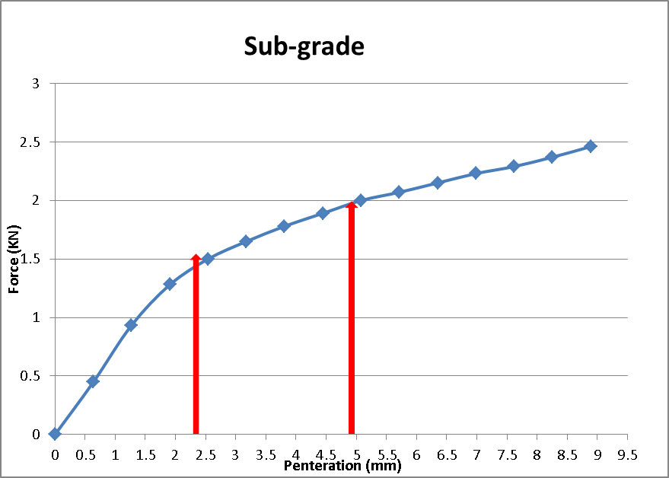
CBR test for Sub-grade.
Penetration = time * speed = 0.5 *1.27 = 0.635 (mm)
Force = Div * factor = 02559/2 * 35 = 0.448 (KN)
%CBR = (unit load of sample at 0.1 or 0.2 in)/(standard load of crushed stone at the same level)*100%
%CBR at 0.1 In (2.5 mm) = 1.3/13.24*100% = 9.8%
%CBR at 0.2 In (5 mm) = 1.8/19.96 * 100% = 9 %
Accordingly, the design CBR value is equal 9.8%.

Slide 41
Structural Number:
SN = a₁D₁ + a₂D₂m₂ + a₃D₃m₃
Where:
a₁, a₂, a₃ = structural-layer coefficients of the wearing surface, base, and sub-base layers, respectively,
D₁, D₂, D₃ = thickness of the wearing surface, base, and sub-base layers in inches, respectively,
and m₂, m₃ = drainage coefficients for the base and sub-base, respectively.

Slide 42
Initial ESAL Calculation:
Classification | PH Veh/hr | % of Vehicles | Current 24-Hour Traffic Count | ESAL factor | Initial ESAL
Taxi | 245 | 24% | 3538 | 0.0004 | 1.42
Passenger car | 742 | 73% | 10760 | 0.0004 | 4.30
Bus | 20 | 2% | 295 | 0.21 | 61.95
Truck | 10 | 1% | 147 | 0.98 | 144.06
Sum | 1017 | 100% | 14740 |  | 211.73
Where:
Design ESAL= Initial ESAL*fd*Grn*365
Design ESAL= 211.73*0.45*26.87*365 = 0.93*10^6
Annual growth rate = 3% (for Nablus city),
Design life = 20 years, Grn = [(1+0.03)20 – 1]/0.03 = 26.87
Lane factor = 0.45 (for Multilane Highway)

Slide 43
Layers Design using nomograph :
In order to design the pavement structure, the following assumptions are proposal:
Standard deviation(S.) = 0.45 (range is 0.4-0.5)
Initial Serviceability Index = 4.5
Terminal Serviceability Index = 2.5
∆Psi = 4.5-2.5 = 2
Now the nomograph is used to determine the SN through the following steps:
For SN1:
Step1. Draw a line joining the reliability level of 95% and the standard deviation (S.) of 0.45, and extend this line to intersect the first turning line
Step2. Draw a line joining the TL to the ESAL with 0.93*106, and extend this line to intersect the second TL
Step3. Draw a line joining the second TL with base course Resilience modulus which equals 35*103, and extend this line to intersect the design serviceability loss chart
Step4. Draw a horizontal line from the previous point to intersect the ∆PSI which equals 4.5- 2.5 = 2, then draw a vertical line to intersect the horizontal structural number line the you have

Slide 44
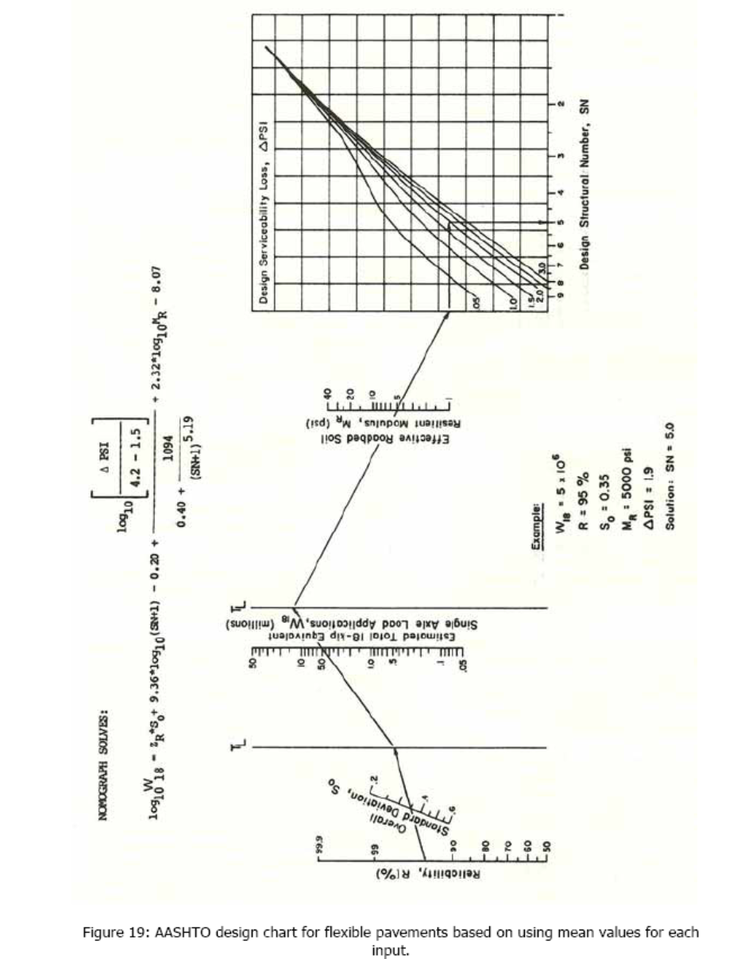
Layers Design using nomograph :
Where:
Resilience modulus of asphalt concrete= 450000 Ib/in2
Resilience modulus of Base course concrete= 35000 Ib/in2
Resilience modulus of Sub base concrete= 20000 Ib/in2
CBR of sub-grade = 9
Mr of sub-grade = 1500(CBR) = 1500(9) = 13500 Ib/in2
Since the pavement is to be designed as urban arterials road pavement then the reliability equals 0.95 range (80-99)%

Slide 45
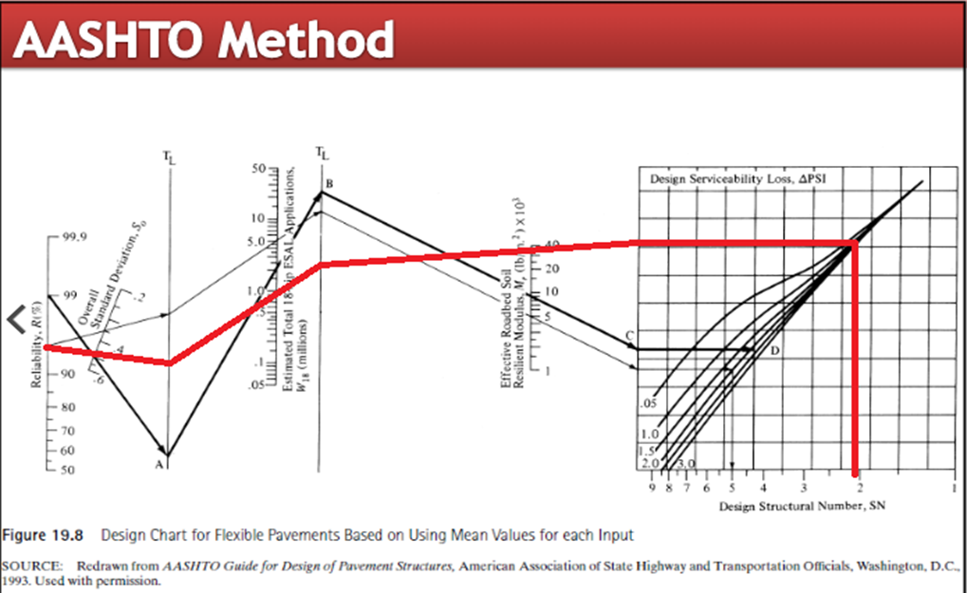
Layers Design using nomograph :
Design Chart for Flexible Pavement(SN1)
SN1 = 2.1
By following the same steps :
SN2 For sub-base =2.65
SN3 For sub-grade = 3

Slide 46
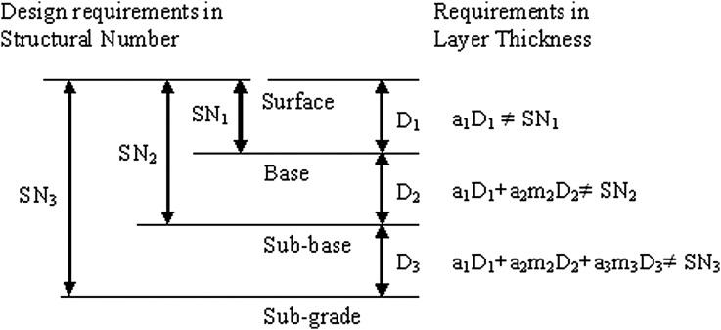
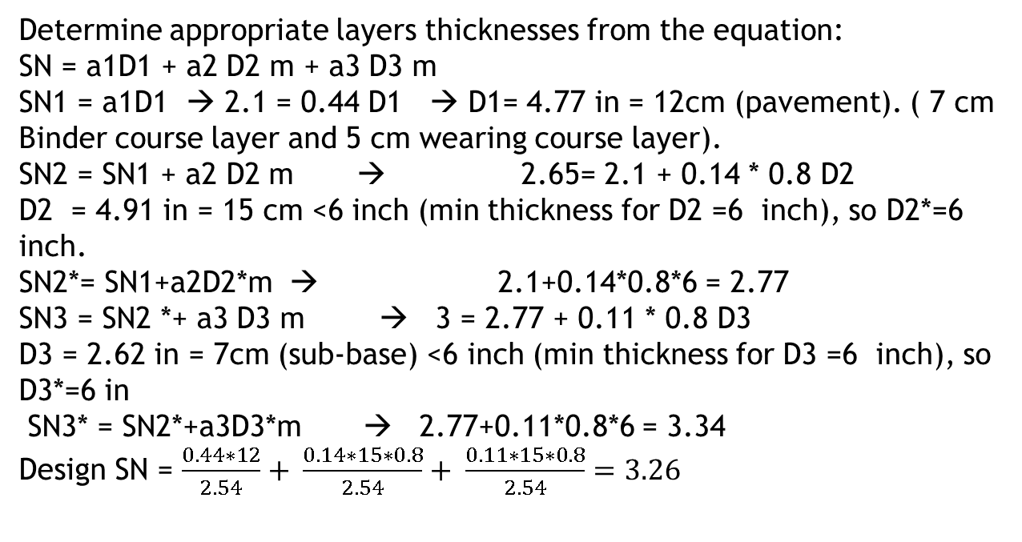
Determine appropriate layers thicknesses from the equation:
SN = a1D1 + a2 D2 m + a3 D3 m
SN1 = a1D1 → 2.1 = 0.44 D1 → D1= 4.77 in = 12cm (pavement). ( 7 cm Binder course layer and 5 cm wearing course layer).
SN2 = SN1 + a2 D2 m → 2.65= 2.1 + 0.14 * 0.8 D2
D2 = 4.91 in = 15 cm <6 inch (min thickness for D2 =6 inch), so D2*=6 inch.
SN2*= SN1+a2D2*m → 2.1+0.14*0.8*6 = 2.77
SN3 = SN2 *+ a3 D3 m → 3 = 2.77 + 0.11 * 0.8 D3
D3 = 2.62 in = 7cm (sub-base) <6 inch (min thickness for D3 =6 inch), so D3*=6 in
SN3* = SN2*+a3D3*m → 2.77+0.11*0.8*6 = 3.34
Design SN = $\frac{0.44∗12}{2.54}+ \frac{0.14∗15∗0.8}{2.54}+ \frac{0.11∗15∗0.8}{2.54}=3.26$

Slide 47
COST ESTIMATION

Slide 48
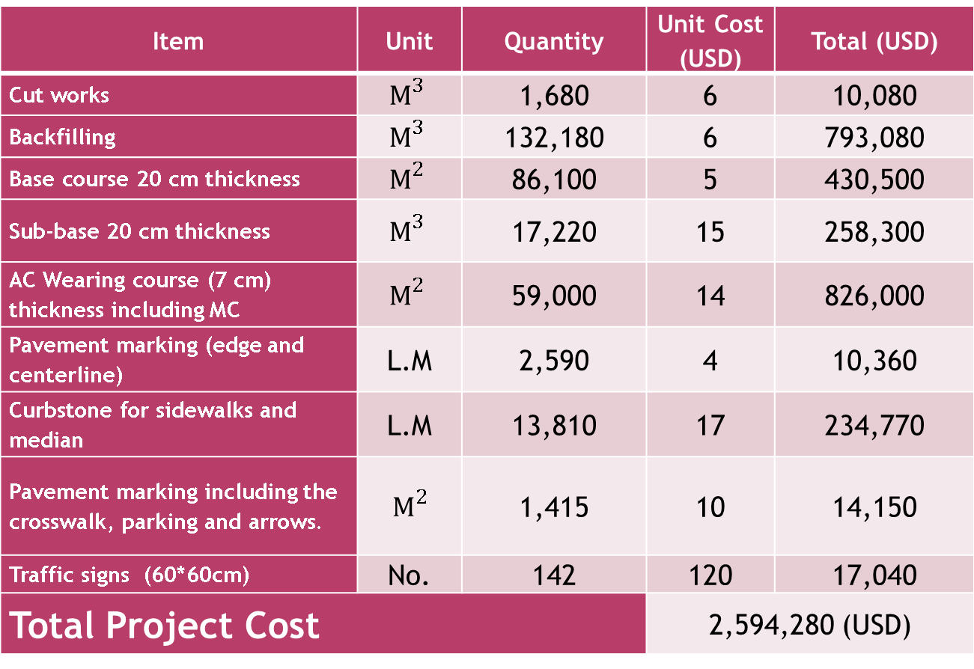
COST ESTIMATION
The following table illustrates the quantities of the main items in the project and the corresponding unit price and cost estimate.
These prices are compatible with the marketing prices.
Item | Unit | Quantity | Unit Cost (USD) | Total (USD)
Cut works | $$M^{3}$$ | 1,680 | 6 | 10,080
Backfilling | $$M^{3}$$ | 132,180 | 6 | 793,080
Base course 20 cm thickness | $$M^{2}$$ | 86,100 | 5 | 430,500
Sub-base 20 cm thickness | $$M^{3}$$ | 17,220 | 15 | 258,300
AC Wearing course (7 cm) thickness including MC | $$M^{2}$$ | 59,000 | 14 | 826,000
Pavement marking (edge and centerline) | L.M | 2,590 | 4 | 10,360
Curbstone for sidewalks and median | L.M | 13,810 | 17 | 234,770
Pavement marking including the crosswalk, parking and arrows. | $$M^{2}$$ | 1,415 | 10 | 14,150
Traffic signs (60*60cm) | No. | 142 | 120 | 17,040
Total Project Cost |  |  | 2,594,280 (USD)

Slide 49
Conclusion and Recommendation

Slide 50
Conclusions:
The following points can be concluded from the design of northern part of Nablus Ring Road:
1.The redesign of the targeted road contributes is expected to decrease the congestion problem in An-Najah National University new campus area. The new proposed design is achieved by proposed an additional lane for both sides of the existing road. The new widening will enhance and facilitate the movement of all riders and students at specific.
2.The design and reconstruct the targeted road will eliminate the illegal parking along the existing road by design new parking spaces in some locations along the road, especially in the northern entrance for An-Najah National University.
3.The students designed the pavement for the road which will improve the structural and functional characteristics of the road and facilitate the riding quality.
4. The students trying to solve the problem of the drainage by redesign the road vertical alignment.
5. It was very difficult to meet all the design requirements for a highway at the Ring Road route. The topography of the site is very difficult. The design in the horizontal alignment was constrained to a great extent by the specified ROW limits.
6. The new design is expected to improve safety for both pedestrians and drivers.

Slide 51
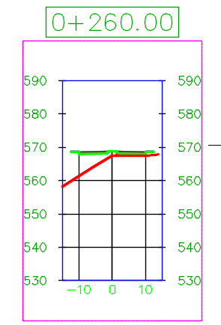
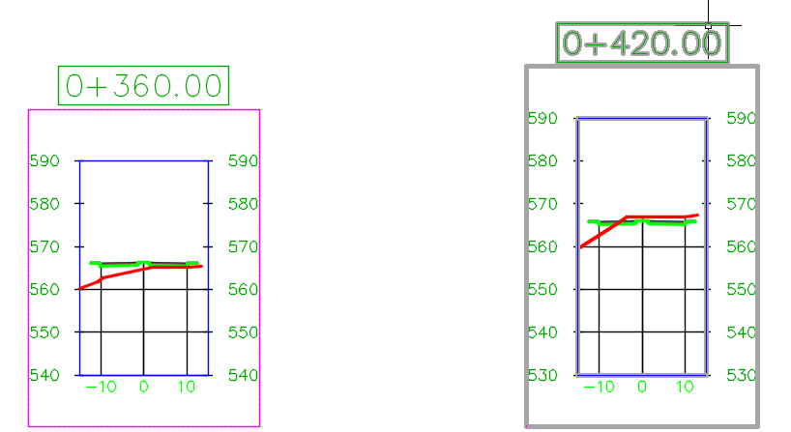
Recommendations:
The students recommended the following:
The students recommend Nablus municipality to benefit from the new design as it is expected to improve mobility and safety.
To improve safety and benefit from the total width of right of way, team project suggested to construct new two retaining wall due to high difference in elevation and the location in critical locations: the first retaining wall is located at the following station: (0+260 to 0+460 )with height around 10m (left side).The Second retaining is located at the following station: (0+860 to 0+900) with height around (left side).

Slide 52
Recommendations:
3. The team project suggested to design alternative vertical alignment deigned with catch basin (مصيدة ماء) at station 0+320m because this station have a low point with high density of water flow.
4. The new design is expected to minimize traffic follow problem on Yaser Arafat road by using the new road for students leaving the university.

Slide 53


