Slide 1

An-Najah National University
Faculty of Engineering
Civil Engineering Department
Transportation System Management of
Al-Masyoon Area in Ramallah City
Supervisor : Dr. Khaled Al-Sahili
Prepared By : Ahmad Salah Judeh
Maher Omar Abu Haweleh
Mohammad Sameer Sulaiman

Slide 2
In it’s simple meaning TSM is a process , which involves both planning and operations of a unified urban transportation system.
TSM focusing on Low-Cost and Quick to Implement operations.

Slide 3
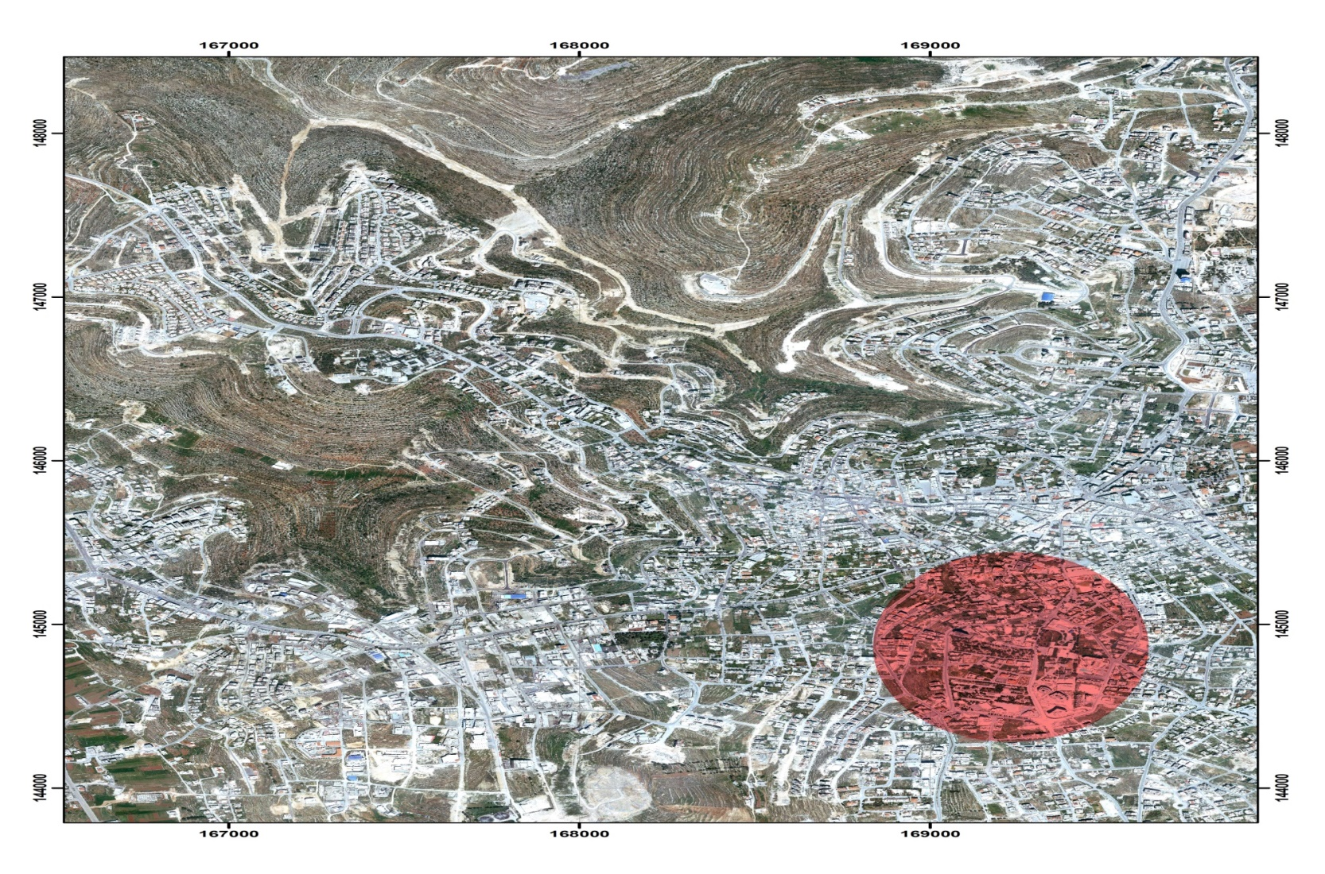
Introduction

Slide 4
Located in the northern part of the West Bank, in the south east of the city of Ramallah.
Vital area located close to the municipality and the old city of Ramallah.
Experiencing a huge development in the traffic movement due to commercial, industrial, and construction businesses.
The area is currently experiencing:
  Ssevere Delays
  Congestion
  Severe Parking Shortages
  Growth of Traffic
So , it is a very important task to keep the traffic systems in the region in very good conditions for the existing time and for the future.

Slide 5
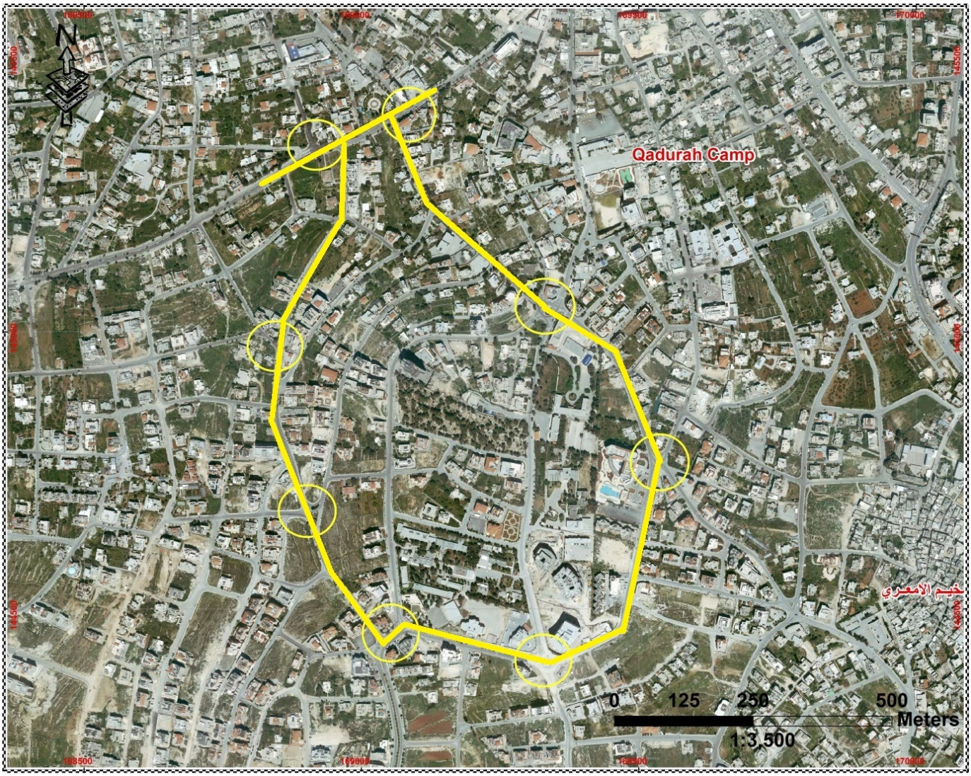
General Description of the study area

Slide 6
This is the base point for conducting this project. This was of great importance, since it has helped as in eye inspection and give us a background imagination of the problems that exist on the streets.
As an example of that let us take :
Intersection of Al-Sahel Street with Jaffa Street:
Signalized T-intersection
Drainage water facilities exist at this intersection
Traffic feeding the intersection is high most of the time
Aziz Shaheen Intersection:
Shaped by five approaches and experiences relatively complex movements regarding vehicles and pedestrians.
Traffic at his intersection is mostly heading towards Mahmoud Darwish intersection.
Al-Shabab Intersection:
This intersection is a roundabout fed by six links.
The movement of traffic toward the main CBD is considerably dense.

Slide 7
DATA COLLECTION
Types of Collected Data:
1. Inventory study: aerial photographs , AutoCAD files .
2. Traffic volume counts.
Sources of Collected Data:
1. Site visits 2. Ramallah Municipality. 3. Field data collection.
Methods of Conducting Volume Counts:
In this project, the manual method was used, and a team of 2-4 persons were needed to conduct intersection traffic volume and vehicle classification counts.
Counting Period:
The counting periods were from 7:00-9:00 AM and 1:30-4:30 PM. These were identified in coordination with Ramallah Municipality engineers.

Slide 8
DATA ANALYSIS
Volume Characteristics:
-Peak hour (PH), peak hour volume (PHV), and peak hour factor (PHF).
-Vehicle classification (percent of heavy vehicles).
Functional classification of the network streets :
The streets included in the study area are considered to be urban collector street system since the streets are major streets and existed within an area almost level with very limited grades.
Level of Service (LOS):
In this project LOS was determined using two methods; HCS and SYNCHRO software.
The results of two methods and comparison between each will be introduced in the coming slides of this presentation.
Peak Hour Determination:
We will take some sample results of analysis

Slide 9
Intersection of Al-Sahel Street with Jaffa Street
Mövenpick Intersection
Intersection of Khalil Abu Rayya Street with Al-Raja Street and Edel Azer Street
1:30 PM to 4:30 PM | 7:00 AM to 9:00 AM | Period
3:00 – 4:00 | 7:15 – 8:15 | PH
1462 | 1762 | PHV
0.92 | 0.93 | PHF
0.62 | 0.91 | % of heavy vehicles
1:30 PM to 4:30 PM | 7:00 AM to 9:00 AM | Period
2:15 – 3:15 | 7:30 – 8:30 | PH
1252 | 1399 | PHV
0.79 | 0.82 | PHF
0 | 0.36 | % of heavy vehicles
1:30 PM to 4:30 PM | 7:00 AM to 9:00 AM | Period
2:45 – 3:45 | 8:00 – 9:00 | PH
1457 | 1100 | PHV
0.85 | 0.69 | PHF
3.71 | 2.73 | % of heavy vehicles

Slide 10
WARRANTS
Traffic signals can be used to eliminate many conflicts.
There is a delay to vehicles in all streams, so it is important that traffic signals be used only when necessary.
The Manual of Uniform Traffic Control Devices (MUTCD) describes eight warrants in detail, at least one of which should be satisfied for an intersection to be signalized.
The factors considered in the warrants are:
Warrant 1 , Eight-hour vehicular volume
Warrant 2,Four-hour vehicular volume
Warrant 3,Peak hour
Warrant 4,Pedestrian volume
Warrant 5,School crossing
Warrant 6,Coordinated signal system
Warrant 7,Crash experience
Warrant 8,Roadway network

Slide 11
Regarding the previous mentioned warrants, only two of them were checked in details due to availability of sufficient information about them. These two warrants are : Four-hour vehicular volume and Peak hour .
After checking the warrant requirements for the intersections under study, the following intersections were found warranted:
Intersection of Khalil Abu Rayya Street with Al-Raja Street and Edel Azer Street .
Intersection of Khalil Abu Rayya Street with Barreyeh-shobak streets .
Aziz Shaheen Intersection .
Note : in the advanced stages of this project, it is not necessary to use the results of this chapter in our scenarios. This results may be useful for the municipality and for other future development plans.

Slide 12
PARKING
Inventory of Existing parking Facilities and Field Studies:
It is a detailed listing of the location and all other relevant characteristics of each legal and illegal parking facility, private and public, in the study area. It includes both on- and off-street facilities.
Field Studies:
The following AUTOCAD figure depicts the study area and block designation.
Parked vehicles were counted at half-hour intervals beginning at 9:00 AM and ending at 4:00 PM.
Parking Space Inventory
The inventory revealed a total of 1484 spaces within the study area. Of this total, 205 spaces (13.8 percent of total space) are located in off-street lots and 1279 spaces (69.2 percent of total spaces) are available along the curb, as illustrated in the following figure:

Slide 13
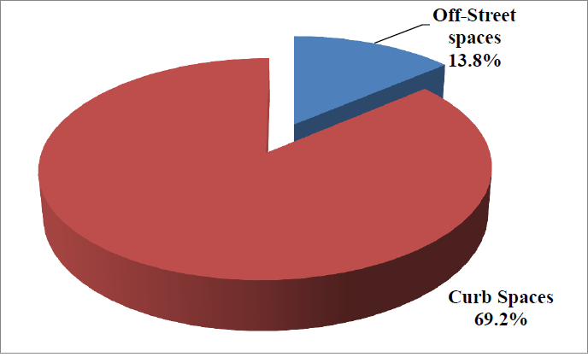

Slide 14
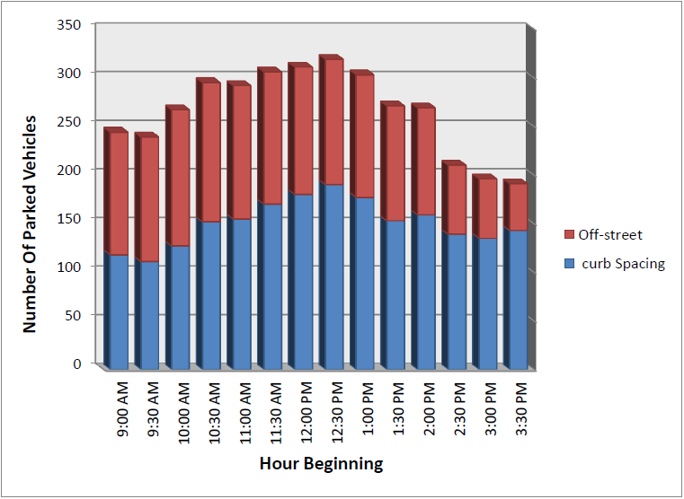
Parking Characteristics-Accumulation of Parked Vehicles :
Half an hour counts were made of the number of vehicles parked a long each block face and in each off-street facility during the period from 9:00 AM to 4:00 PM on a typical day. The following figure is a graphical depiction of parking data :

Slide 15
Conclusion and Recommendations :
It was noticed that the parked vehicles accumulate around Aziz Shaheen Intersection, Mahmoud Darwish Roundabout and Mövenpick Intersection.
The curb parking along streets that connect the main intersections of study region indeed doesn’t make a progressive problem to the traffic movement.
The peak accumulation of parking for whole region was at 12:30 PM with more than 300 parked vehicles.
Based on field studies, two off-street parking locations are suggested to reduce the parking problem at the region of study as illustrated in the following Figure

Slide 16
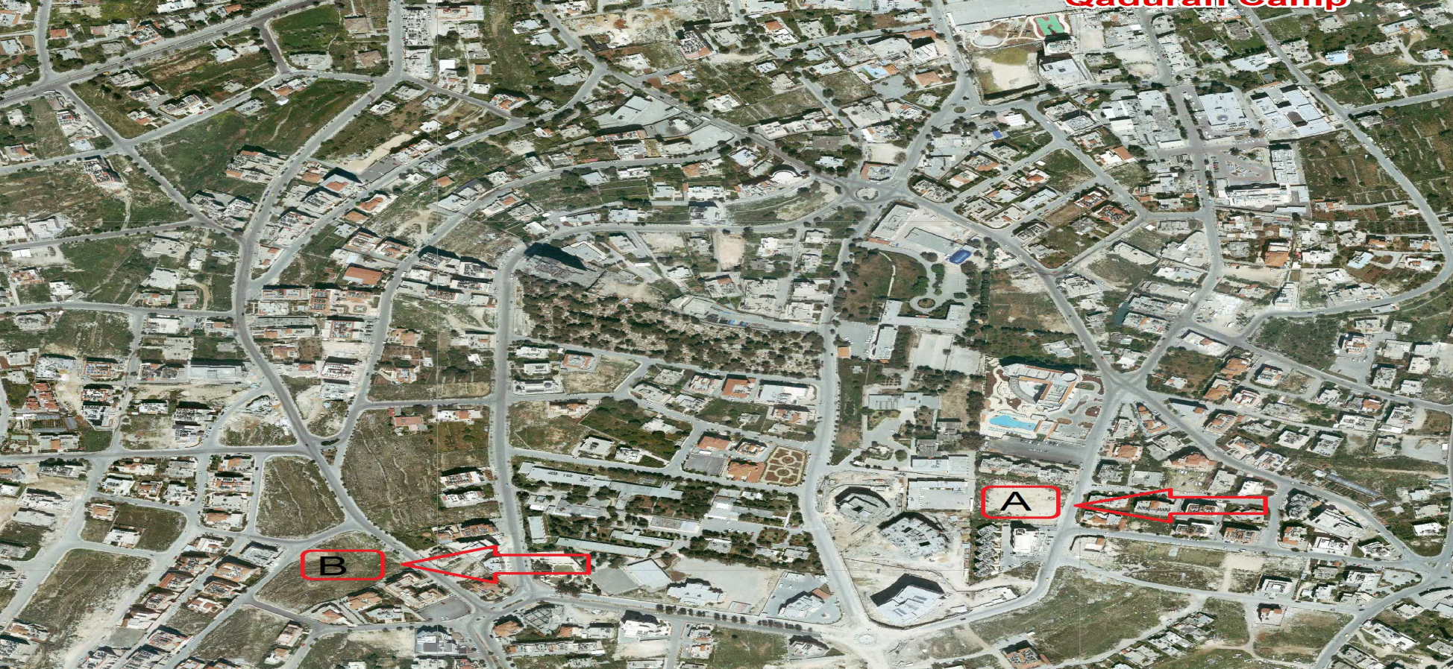
Bothe of them will introduce a capacity of 500 parking at a minimum.

Slide 17
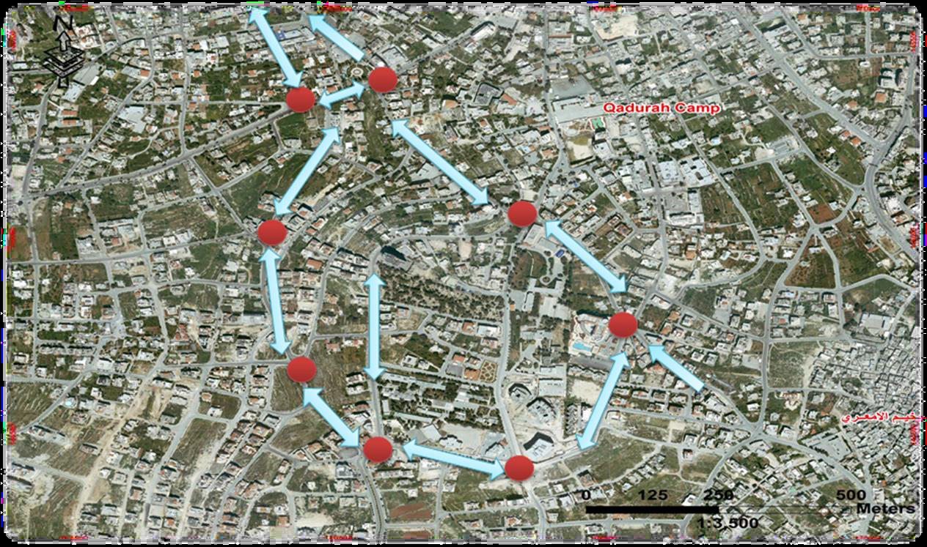
TRAFFIC MODELING and PROPOSED SOLUTION SCENARIOS

Slide 18
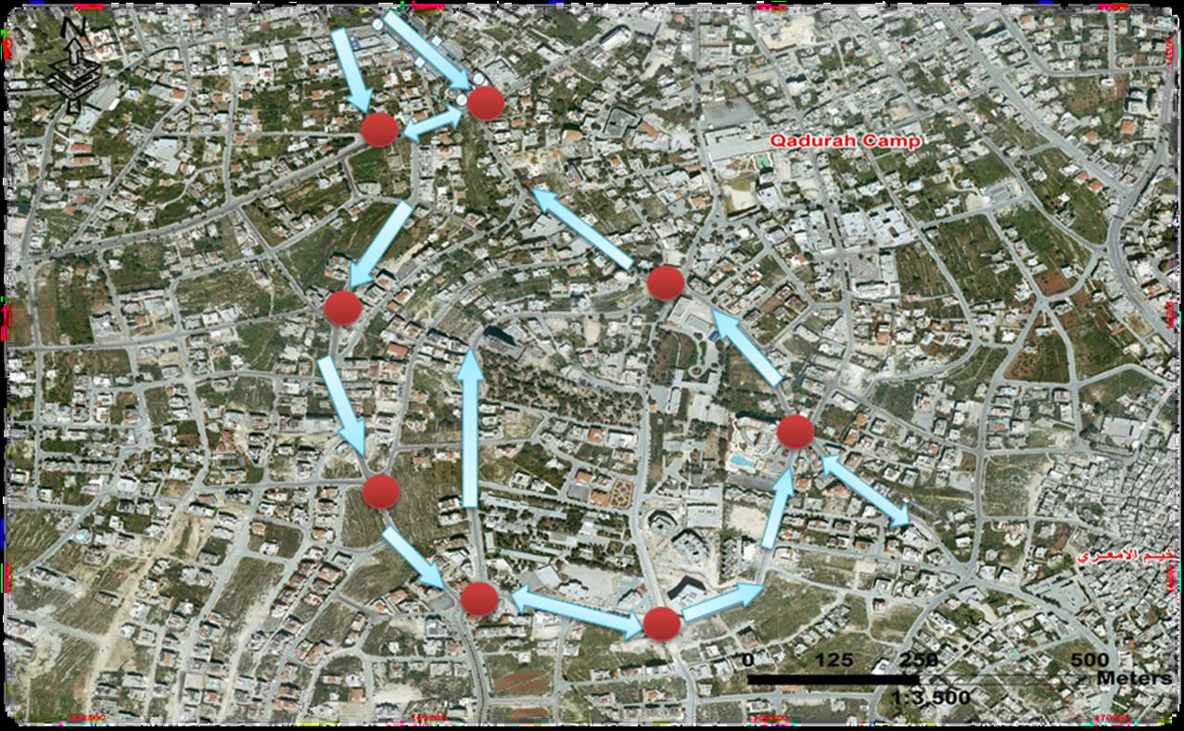
The system proposed is a One-Way circular system beginning counter clockwise from Intersection of Al-Sahel Street with Jaffa Street and ending with Intersection of Jaffa Street with Khalil Al-Sakakini Street.

Slide 19
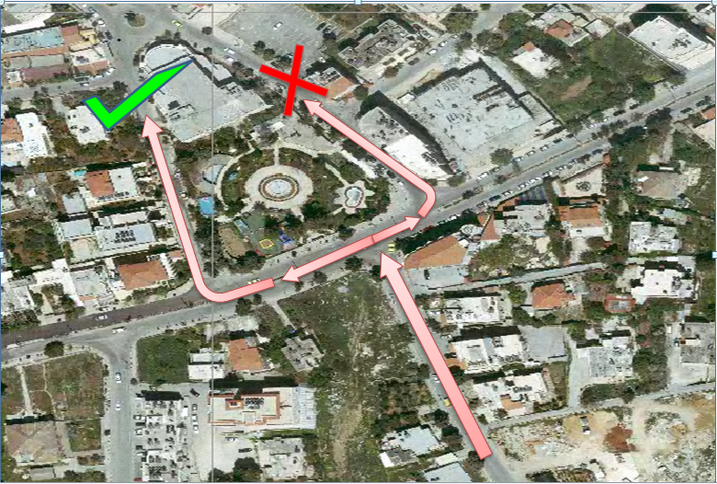
In the following we will light some prime changes made in the proposed scenario:
Regarding two Signalized Intersections : Traffic movements and phasing design were altered.
The traffic movement coming from Khalil Al-Sakakini Street toward Municipality Street heading toward Ramallah Municipality was forced to follow the following path as shown in the lower figure :

Slide 20
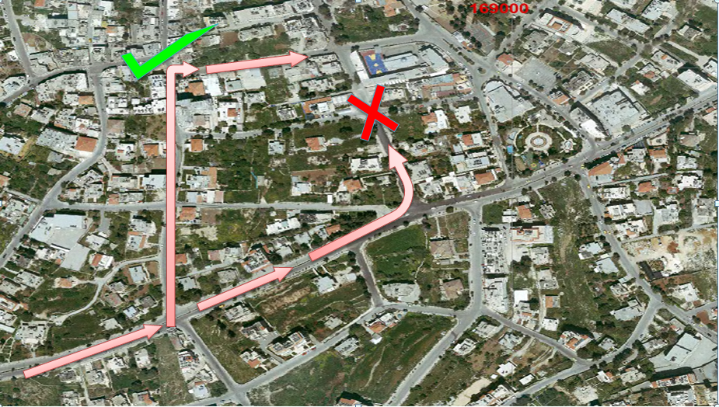
Al-Sahel Street has been changed to One-Way Street entering the intersection.
Traffic movement that take left turning from Jaffa Street toward Al-Sahel Street can make that maneuver at the intersection that proceed as illustrated in the following figure:

Slide 21
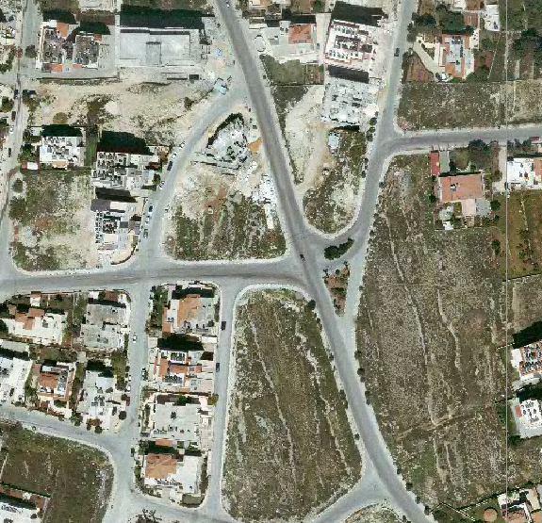
Intersection of Khalil Abu Rayya Street with Al-Raja Street and
Edel Azer Street: Closing Edel Azer Street

Slide 22
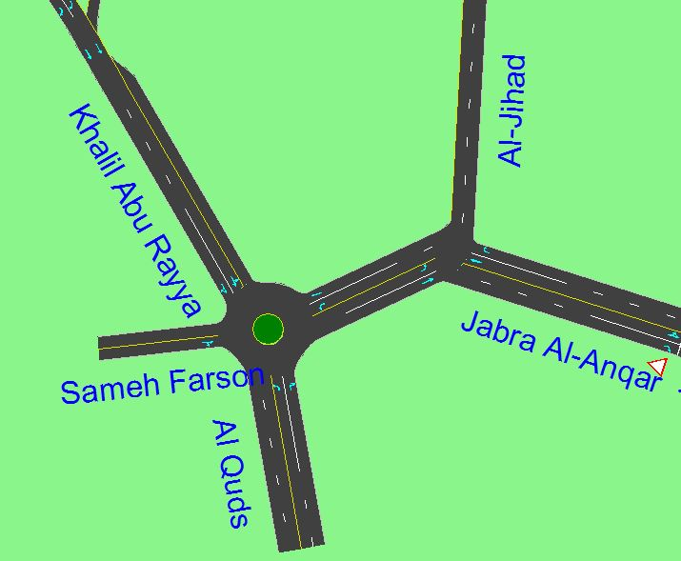
Aziz Shaheen Intersection :
Region 1: it was left un-signalized .
Region 2: a roundabout was proposed.

Slide 23
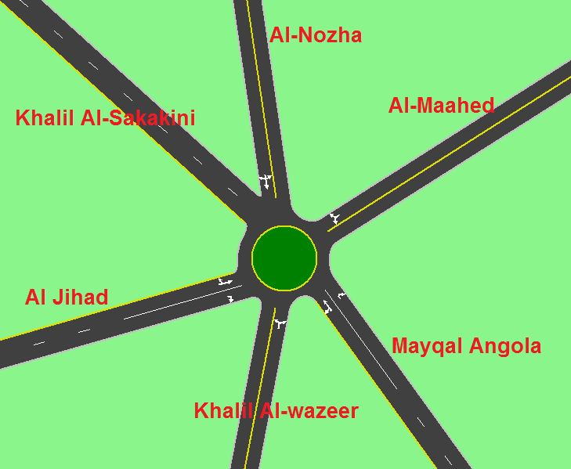
Al-Shabab Intersection : Al- Jihad street is changed to One-way street entering the roundabout and regarding the volume leaving the roundabout toward Al- Jihad street it was terminated to Khalil Al-wazeer street.

Slide 24
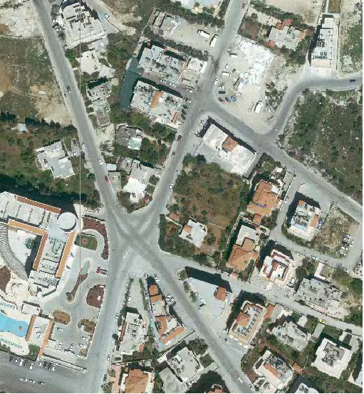
Mövenpick Intersection: converting the street that collects Kofor Qasem and Stanes streets to Two-way street entering the intersection .
Note : HCS deals with each intersection alone and isolate it from the whole network. Contrary to this, SYNCHRO deals with the network as a whole, so the results obtained from SYNCHRO considered more reliable.

Slide 25
 | LOS
Condition | Existing Using HCS | Existing Using SYNCHRO | Solution without growth | Solution with growth
Intersection of Jaffa Street with Khalil Al-Sakakini Street | F | F | B | B
Intersection of Al-Sahel Street with Jaffa Street | F | F | A | A
Intersection of Khalil Abu Rayya Street with Barreyeh-Shobak Streets | D | D | B | B
Intersection of Khalil Abu Rayya Street with Al-Raja Street and Edel Azer Street | F | C | A | A
Aziz Shaheen Intersection (Region 1) | F | F | A | A
Aziz Shaheen Intersection (Region 2) | F | F | 0.92 ( max V/C ratio) | 1.12 (max V/C ratio)

Slide 26
 | V/C
Condition | Existing Using HCS | Existing Using SYNCHRO | Solution without growth | Solution with growth
Mahmoud Darwish Roundabout | 0.81 | 0.81 | 0.73 | 0.87
Mövenpick Intersection | 0.69 | 0.55 | 0.45 | 0.55
Al-Shabab Intersection | - | 1.83 | 0.97 | 1.35

Slide 27
Recommendations
The study was carried out on a specified geographic area of Ramallah city. A comprehensive traffic study for a larger area is warranted as the impact of one area influences and is been influenced by adjacent areas; a city-wide traffic study is needed.
The municipality must ensure effective enforcement on any new development in the region to provide a traffic impact study as part of the permitting process, and to provide required parking spaces on site.

Slide 28


