Slide 1
Q&A Project
Performed by:
Taha shashtari
Mahmoud shaka’a
SUPRVISED BY: - Dr. Luai Mlhis
- Mrs. Manar Qamhyia

Slide 2
What have we built?
It’s a Question and Answers system for educational purposes.
Just like StackOverflow, but for education.

Slide 3
Why have we built it?
To make the process of helping students with their problems very easy and less time consuming.
To help students gain more experience from other students.
To create a place for discussions between students on specific topics.
To make new students more familiar with their majors as early as possible.

Slide 4
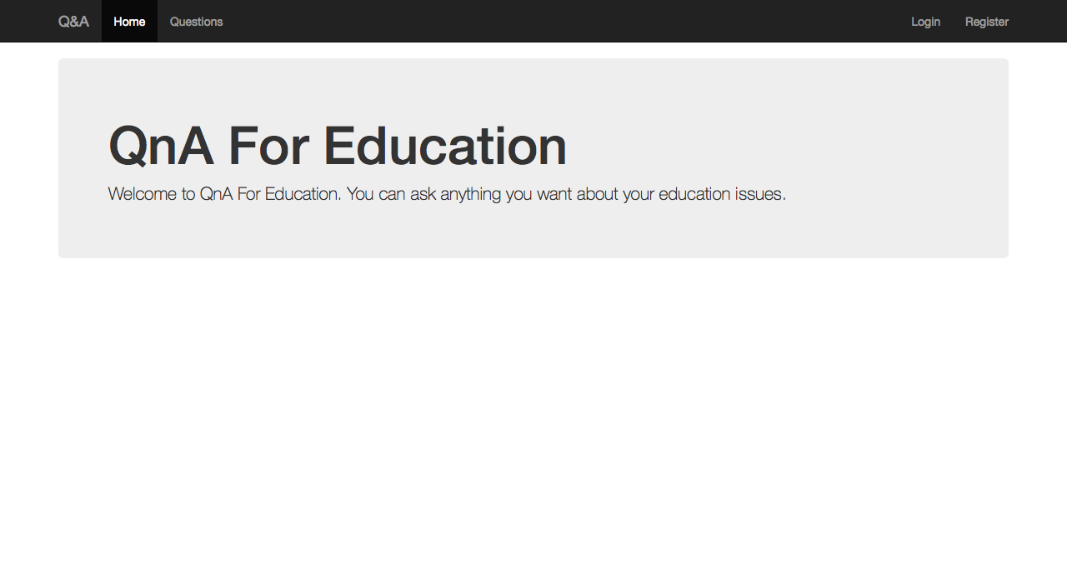
How it works?
Have a problem
Ask a question
Wait for answers
Rank answers
Have a discussion through comments
Mark the best answer

Slide 5
Features
Filtering Levels (University, Faculty, Department)
Tagging
Authorization (Admin, Moderator, Student)
Quick Access

Slide 6
DEMO

Slide 7
Implementation
The implementation is divided into two parts:
  Front-End
  Back-End

Slide 8
Front-End Work
Includes the following:
  Layout Design (using bootstrap)
  Interactivity (using jQuery + bootstrap => JavaScript)
  Ajax Requests
  Add some responsiveness

Slide 9
Tools used in the front-end
HTML5
CSS3 / Bootstrap
JavaScript (ES5) / jQuery / Bootstrap

Slide 10
Back-End Work
Includes the following:
  Database (design & implementation)
  Server-side programming
  Business Logic

Slide 11
Tools used in the back-end
PHP / Laravel Framework
Mysql (with migrations)

Slide 12
A quick look at the database schema

Slide 13
Security
Protecting ourselves from the following attacks:
  SQL Injection (By using ORM)
  CSRF Attacks (By using a token for each request)
  XSS Attacks (By encoding the html before displaying it)
  Stealing user’s email & password (By using login throttling)

Slide 14
Future Work
Private messaging between students and teachers.
A fast notification system to keep the user up to date with recent activities.
Holding custom discussion groups (e.g. per class) instead of general ones.
Convert it into an API-Centric web application (for other devices).

Slide 15
The ultimate goal
What if we convert it into an installable application?
Fully-customizable.
Not just for education.

Slide 16
Thanks!
Any questions?

