Slide 1
Automated Hydroponics system
Prepared by : Supervisors:
Eman Zaid Dr.Asmaa Afifi ,Hanal Abu-Zant
Braah Sharaqa Dr.Luai Malhis.

Slide 2
Outlines :
Introduction
Motivation
Design model
Software & Hardware tools
Demo
Constrains
Future work

Slide 3
Introduction
Hydroponics is a subset of hydroculture, which is a method of growing plants without soil by instead using mineral nutrientsolutions in a water solvent. Terrestrial plants may be grown with only their roots exposed to the nutritious liquid, or the roots may be physically supported by an inert medium such as perlite or gravel.
Plants commonly grown hydroponically include tomatoes, peppers, cucumbers, lettuces, and marijuana.

Slide 4
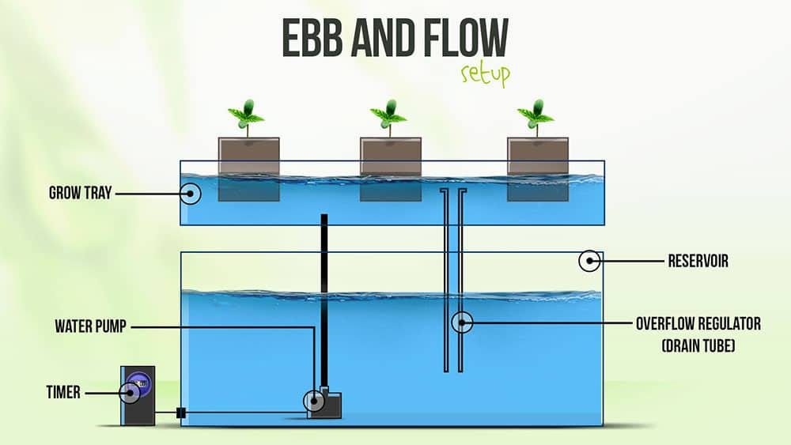
Hydroponics system

Slide 5
Motivations :
Make better use of space and location.
Climate control like in greenhouses, hydroponic growers can have total control over the climate - temperature, humidity.
Hydroponics is water-saving.
Better growth rate.
Fewer pests & diseases

Slide 6
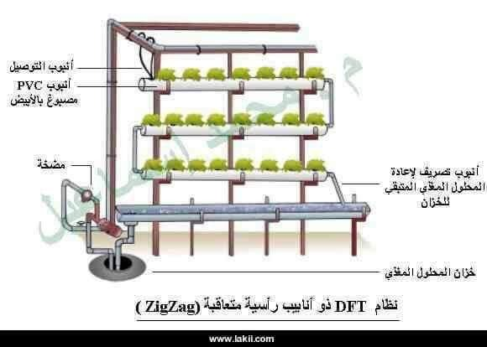

Slide 7
Design model

Slide 8
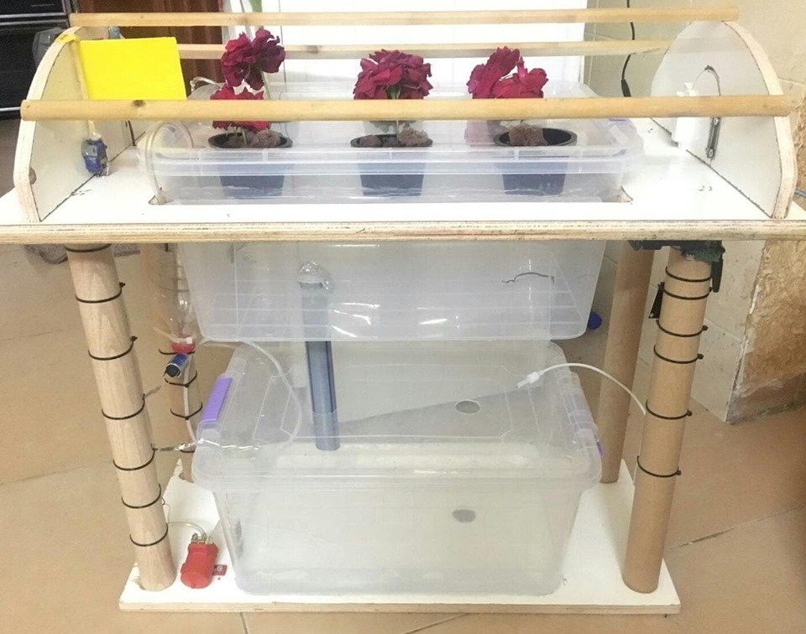

Slide 9

Software tool
Arduino IDE

Slide 10
Hardware tools

Slide 11
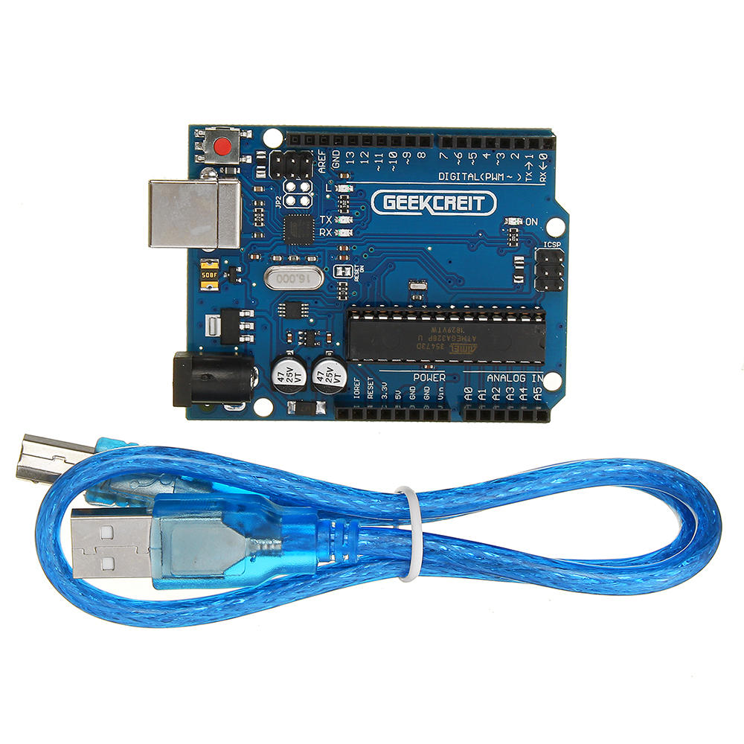
Arduino Uno

Slide 12
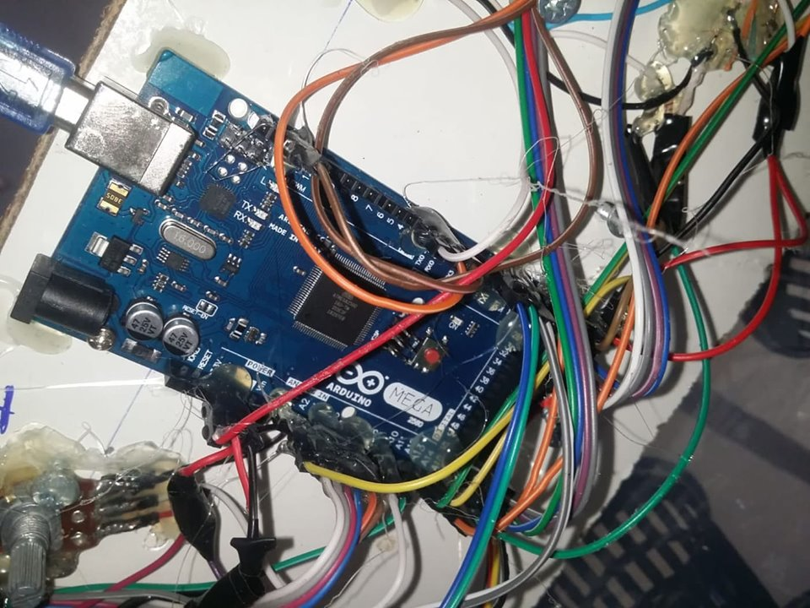
Arduino MEGA

Slide 13
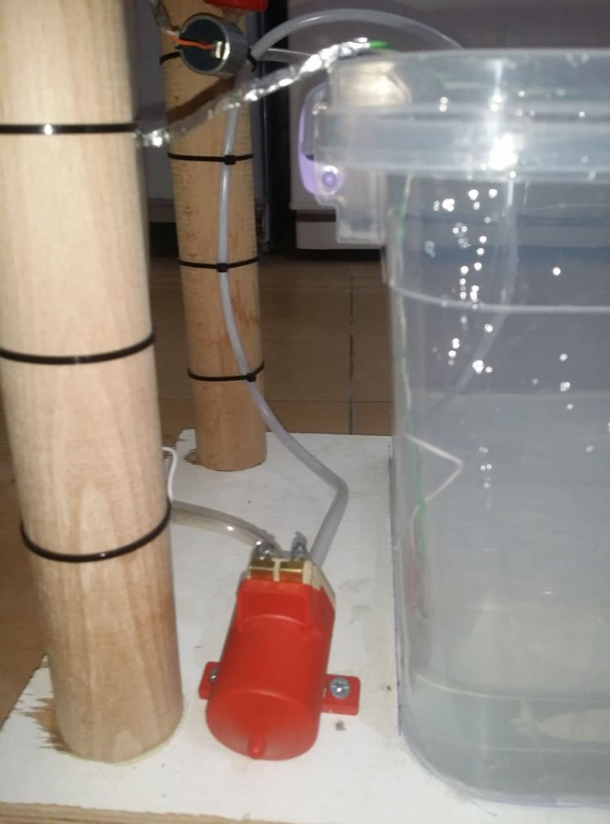
12 volt Pump

Slide 14
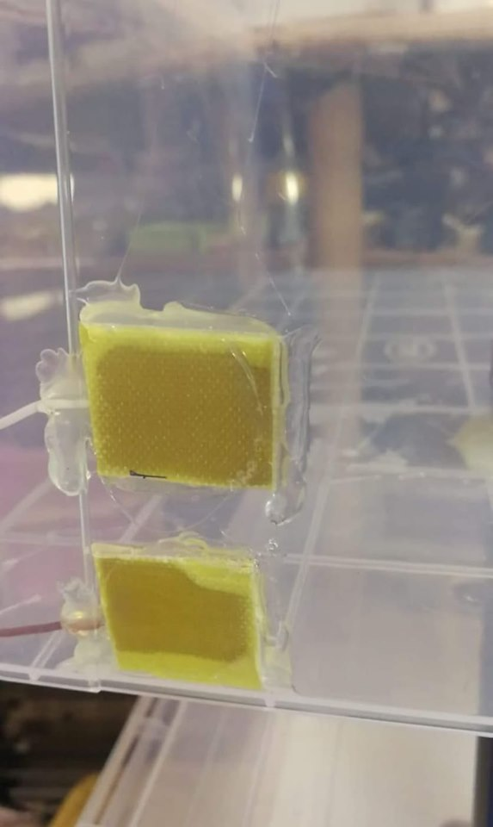
Level of water sensors

Slide 15
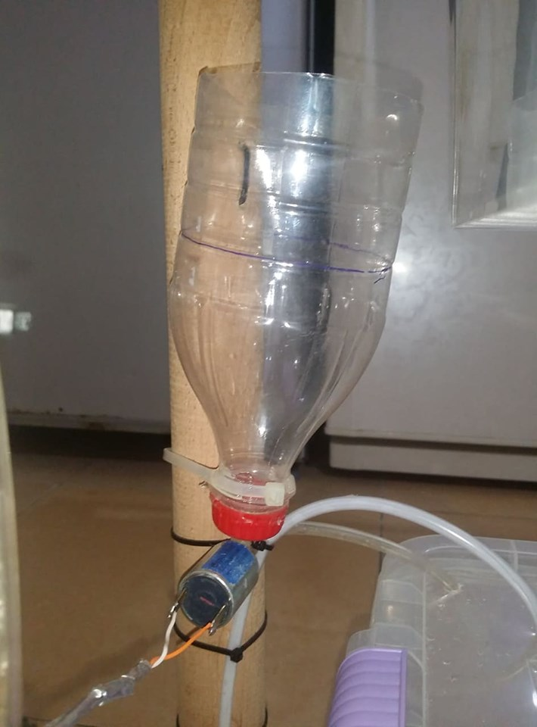
12 volt valve

Slide 16
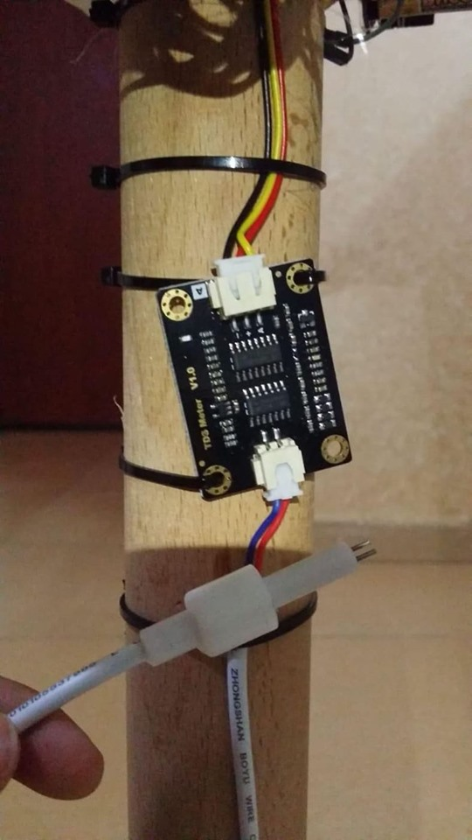
TDS sensor

Slide 17
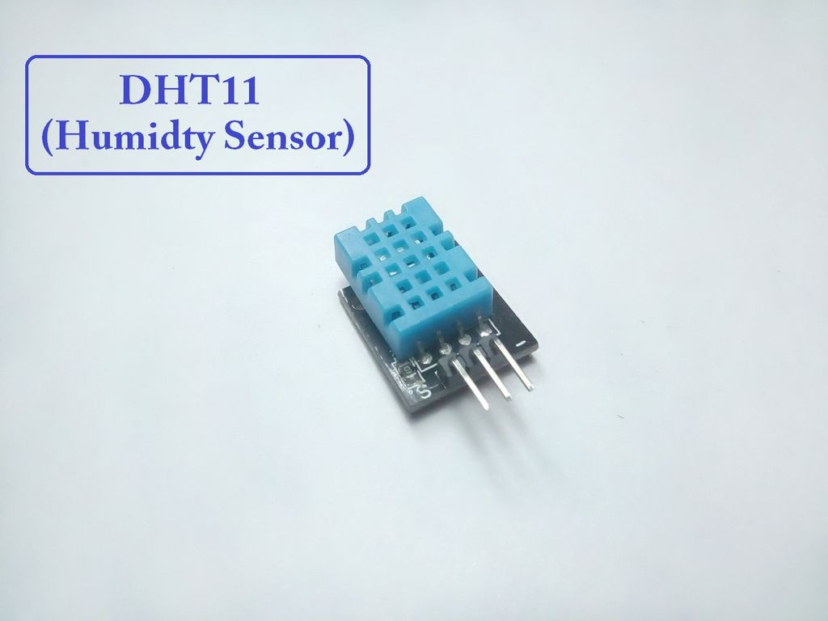

Slide 18
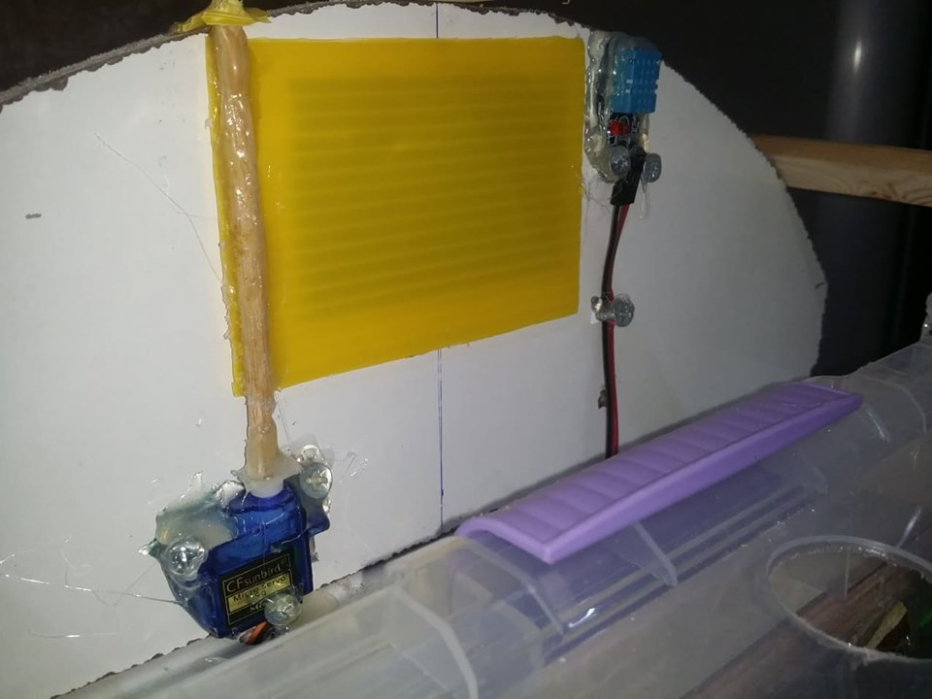
3 Servo motors

Slide 19
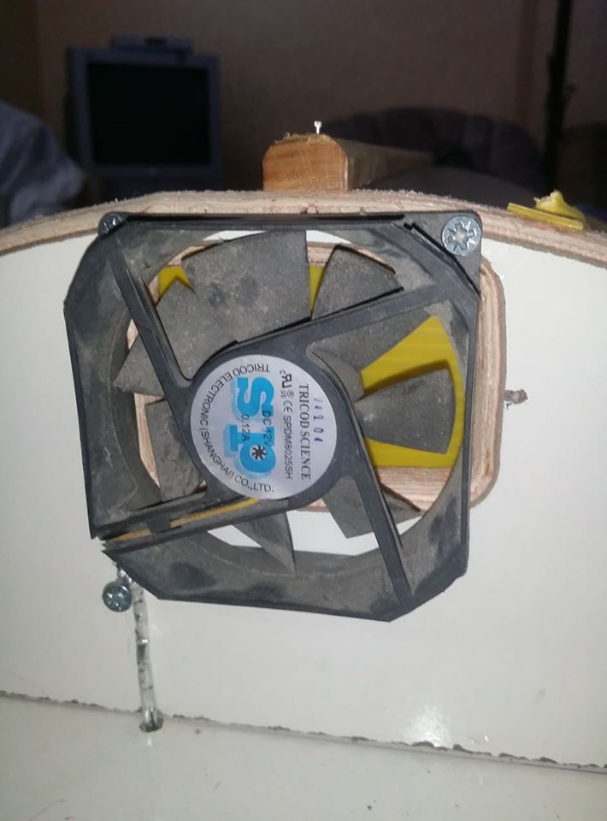
12 volt FAN

Slide 20
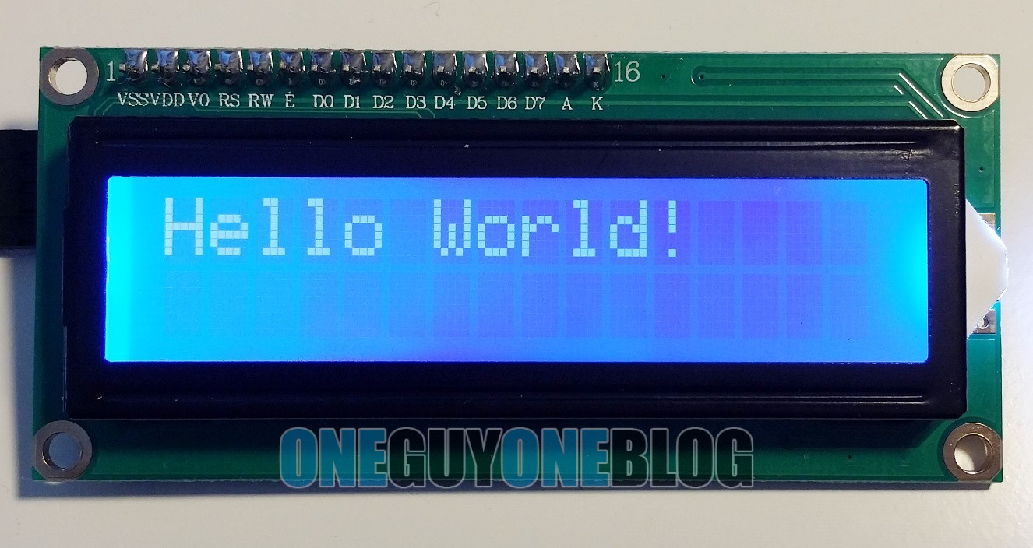
LCD

Slide 21
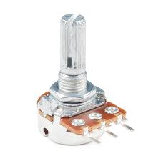
2 potentiometers

Slide 22
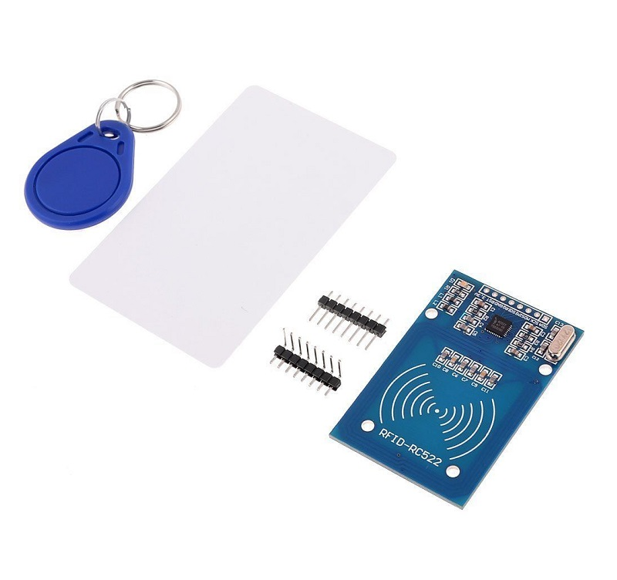
RFID

Slide 23
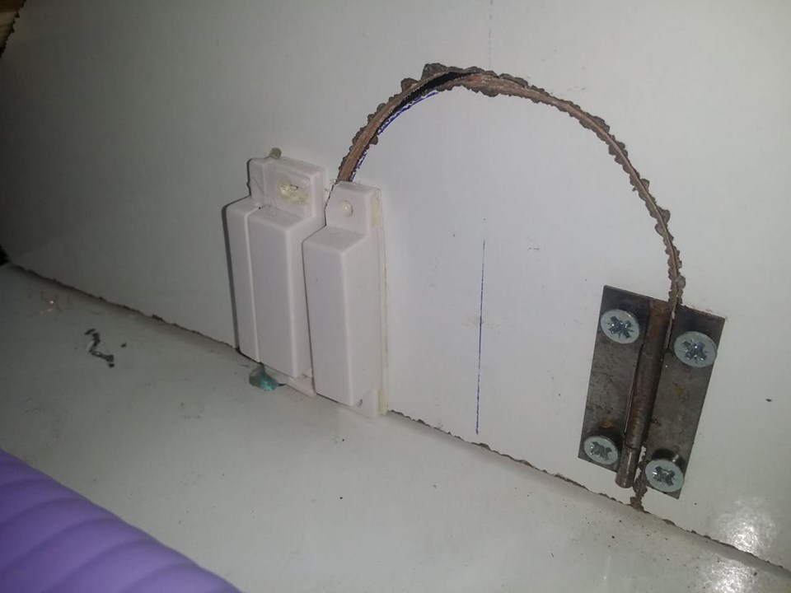
Read switch

Slide 24
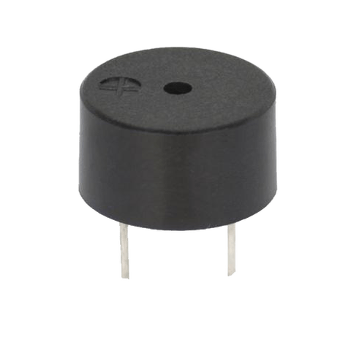
Buzzer

Slide 25
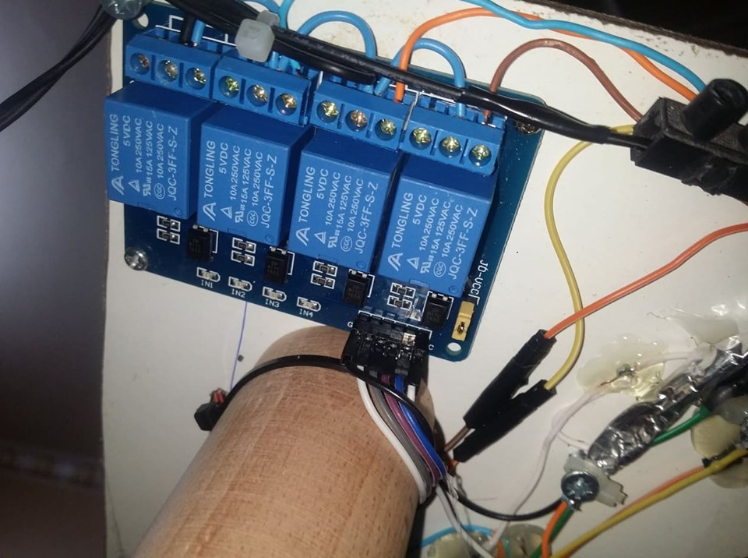
Relays

Slide 26
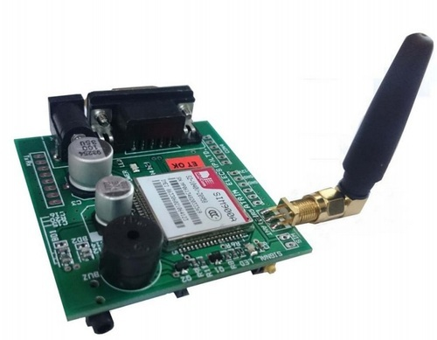
GSM

Slide 27
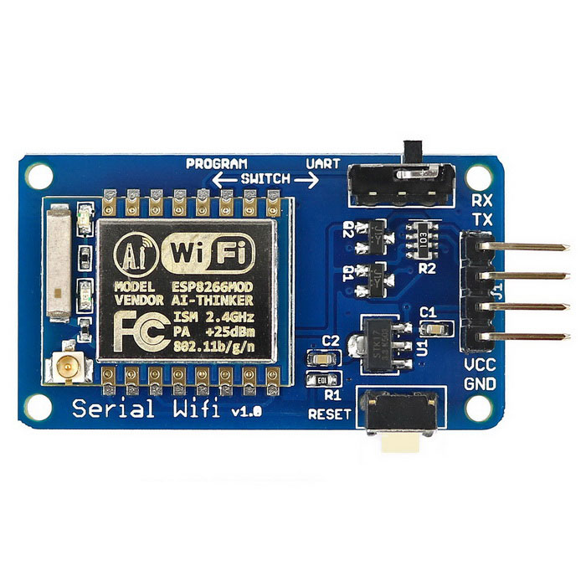
ESP

Slide 28
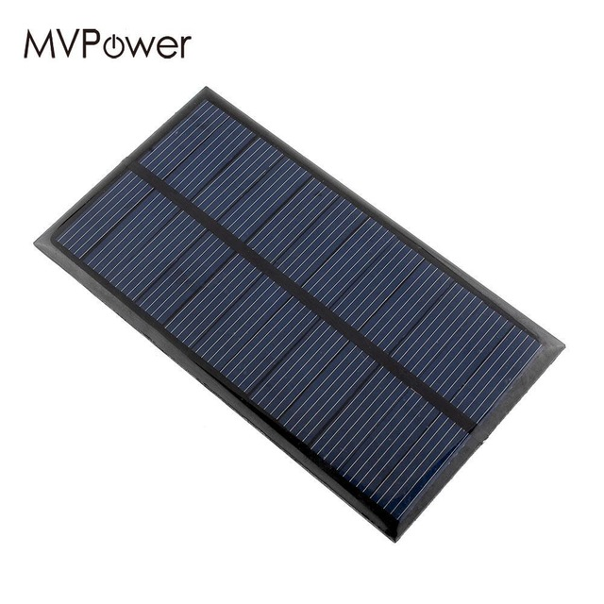
2 solar cells panel

Slide 29
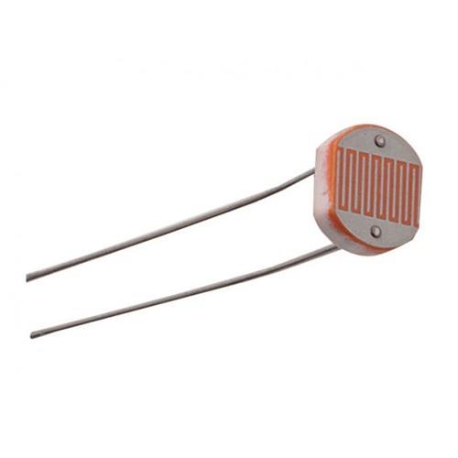
4 LDR sensors

Slide 30
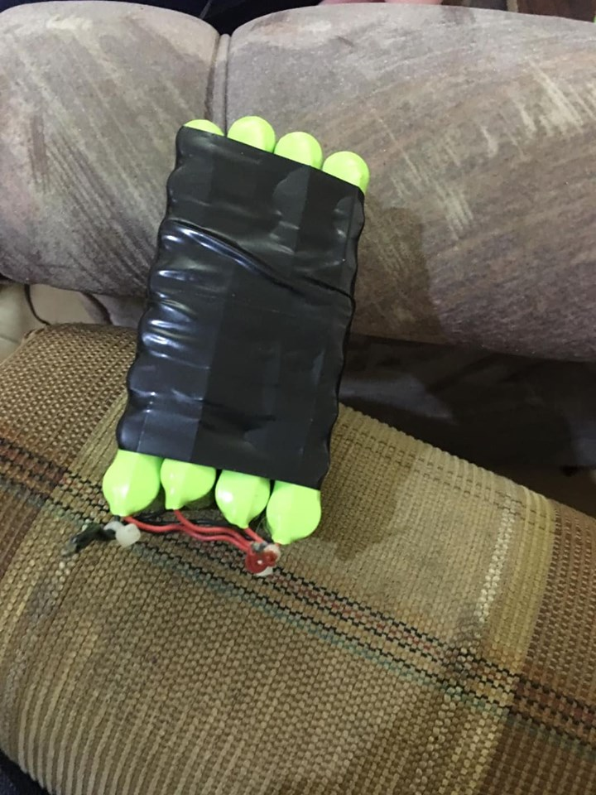
Batteries

Slide 31
DEMO

Slide 32
Constrains :
Design system
Measure the level of water
TDS sensor
Solar cells

Slide 33
Future work
Build the system in a closed building and the plants is supplied with an alternative to the sun using a special light that is controlled by the Chlorophyll dye in the plant through an intelligent system .
Insect protection system and pump the insecticides in a healthy way

Slide 34
Thank You

