Slide 1
Supervised by
Dr. Mutasem Baba’
Second Graduation project
Redesign of Qortoba School
Prepared by: Diala Issa Emad Burghal Mutaz Abu Zahra

Slide 2
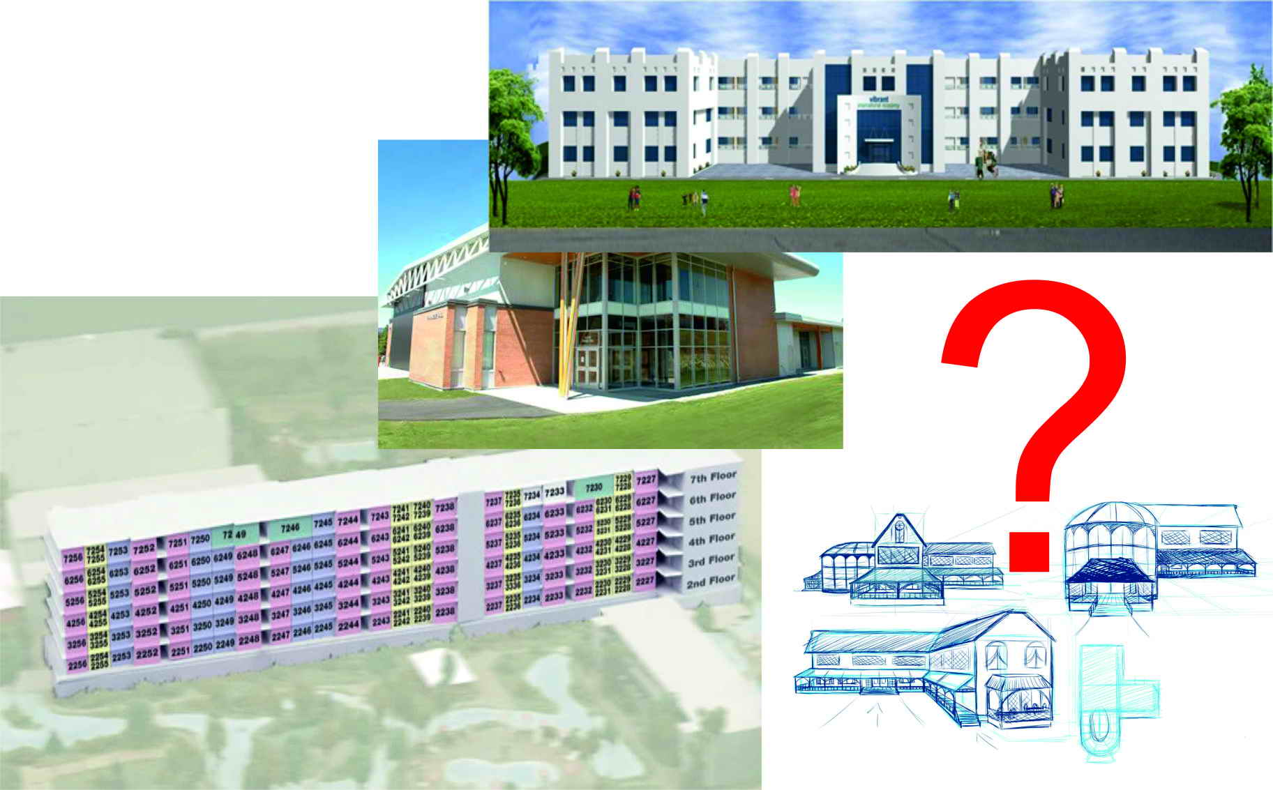

Highlights:
In Graduation Project I “Third Generation Schools” we talked about
green school and studied :
-main elements of green school.
-requirement of applying green system
-possibility of applying
-obstacles maybe faced
Notes:
In the first graduation project we studied the third generation of green schools which use green systems.
And several sides were studied in depth from the point view of its requirements ,elements, its green system and possibility of applying, and obstacles maybe faced

Slide 3
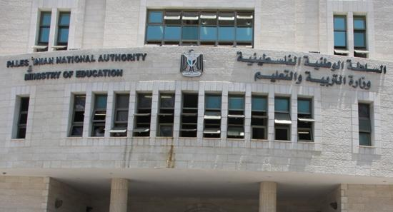

Committee Recommendations:
Following the level of where the ministry of education were reached in applying green schools systems
Notes:
Your recommendations were to follow the level reached in the designing of green schools by the ministry of education.
and really they reached to advance level of design and they apply most of green schools systems

Slide 4
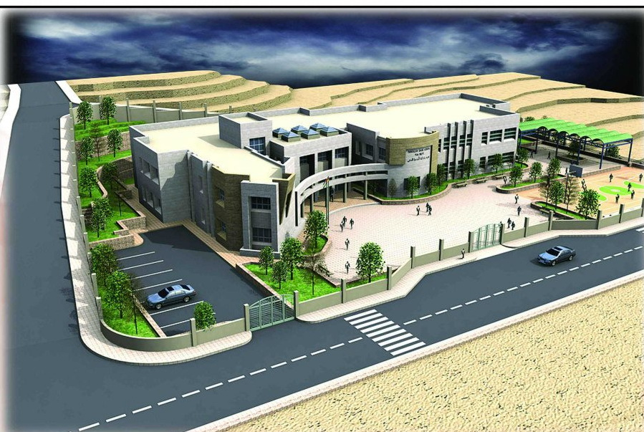
Applied systems
They're Stepping strides in the design of green schools
Notes:
Here “Ein Monjed” school the recent constructed school which was opened by the ministry in the year of 2012

Slide 5
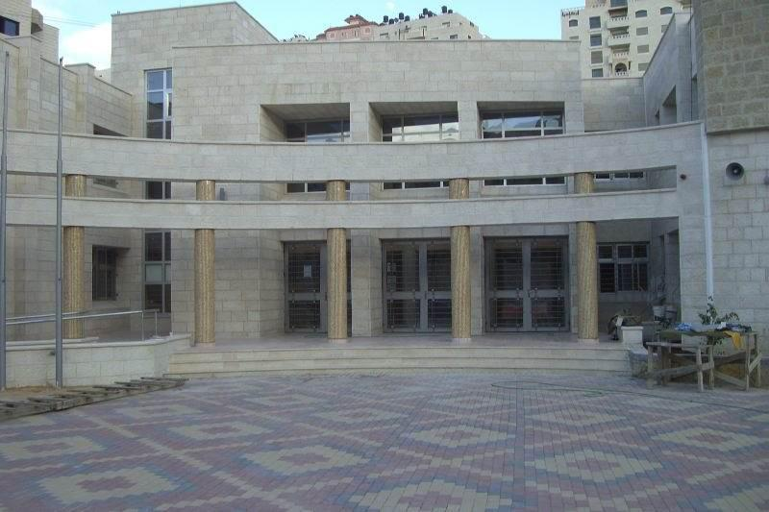
Applied systems
Achieve most of earthquake-resistant design requirements
Notes:
Earth quakes resistant design is considered and the details of reinforcement were applied

Slide 6
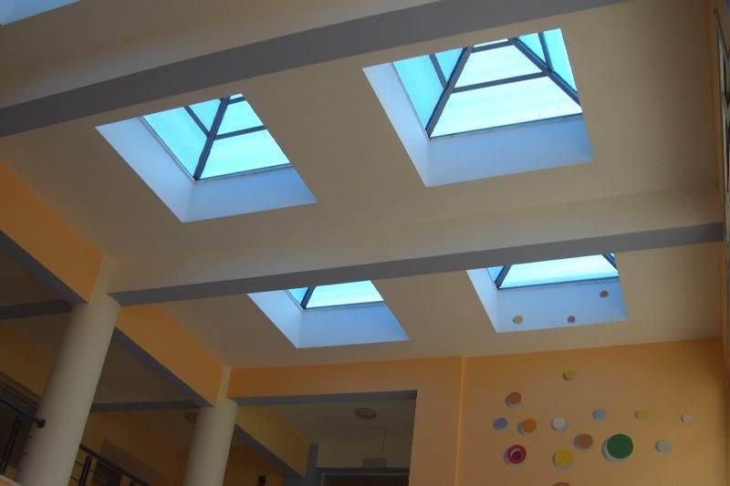
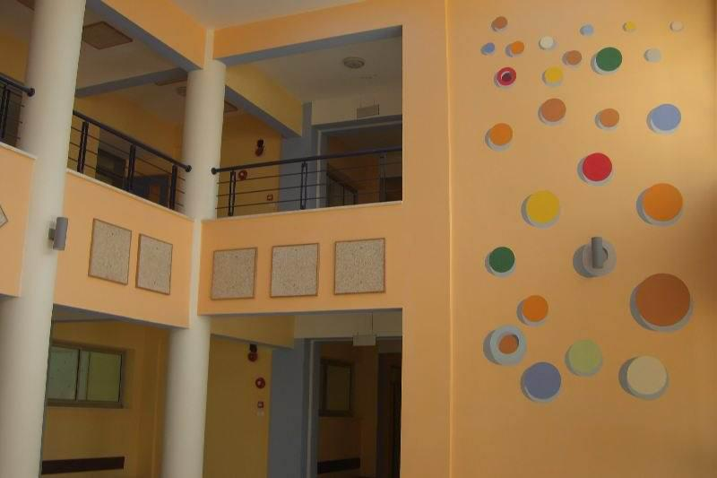
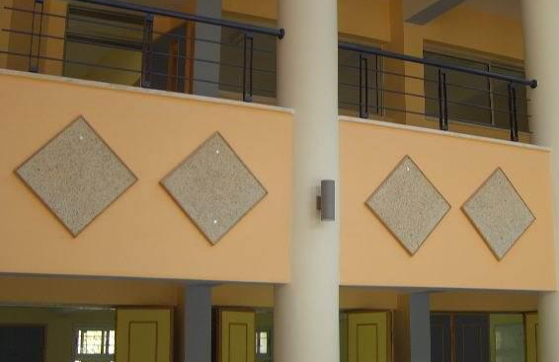
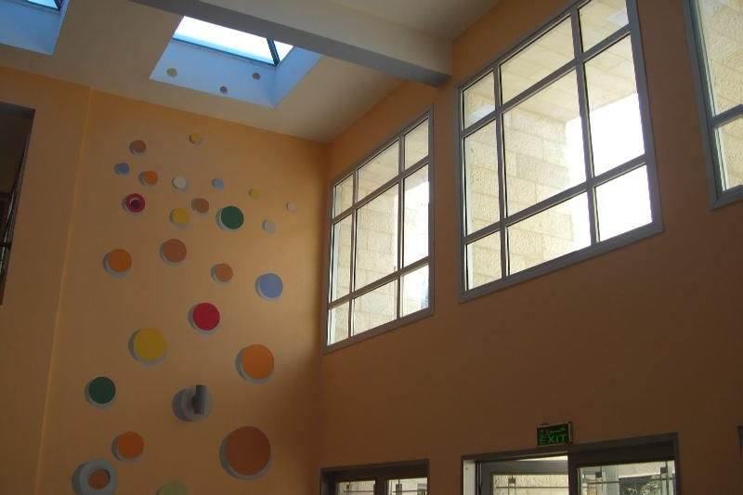
Applied systems
Skylight and acoustical panels
Notes:
Skylights and acoustical panels were used in corridors and entrances

Slide 7
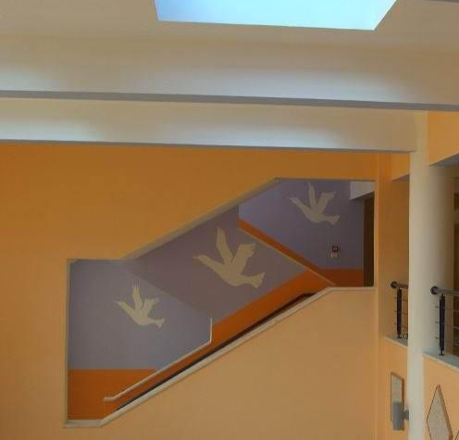
Applied systems
Philosophy of colors and comfortable scenes
Notes:
Also philosophy of Appling comfort and refreshing colors were used

Slide 8
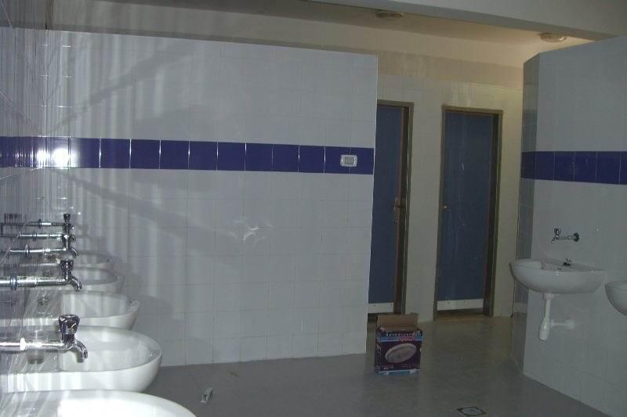
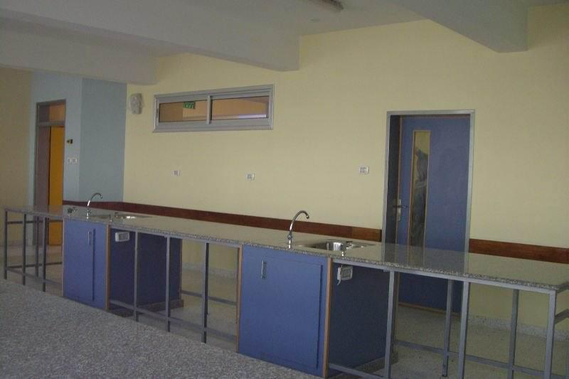
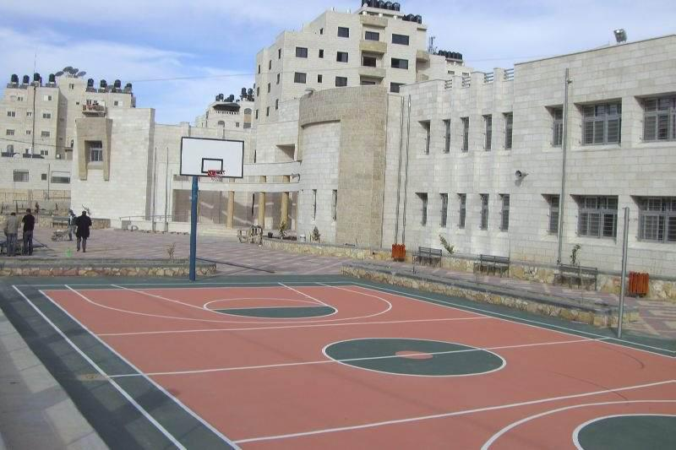
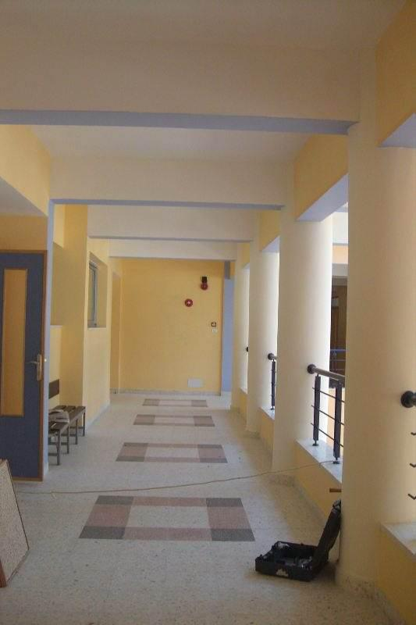
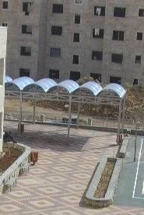
Applied systems
Notes:
Also reuse of grey water system and the interested in ventilation in baths, planting of accessories plants inside and out side the schools, adequate arenas and playground within possible standards

Slide 9

Evaluation of the applied system
Most of systems were applied BUT,
Neglecting its requirements and
the how of use !!!
Notes:
As we saw most of green systems were applied. but unfortunately all these system were applied without taken into account the needed requirements of Appling these systems. For example, the use of acoustical panels were just for decorative purposes over the milestone of the reverberation time use.

Slide 10

Second Graduation Project
Redesign of “Qortoba” school in order to:
Design a green school from zero point according to required calculations and standards .
Studding the possibility of greening the constructed schools.
Notes:
In the second graduation project
To hit to birds by one stone, the trend was to redesign Qortoba school to achieve two purposes:
1-design a green school from zero point according to required calculations and standards .
2-studing the feasibility and the possibility of greening the constructed schools.

Slide 11
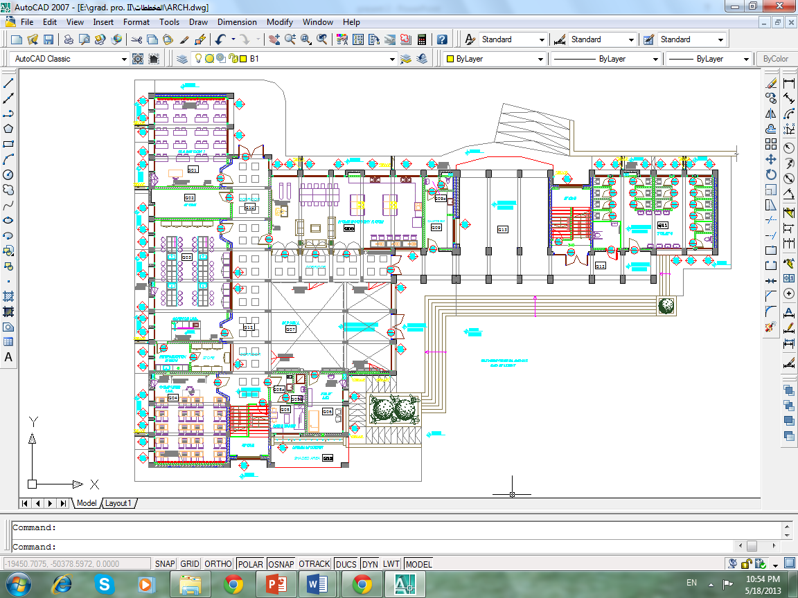
Architectural Design
Qortoba school has a classical design
consist of rectangular shape with 3 floors
Notes:
Let us start with the architectural design of the school which was kept as its with limited change on the function of some spaces to avoid some potential integrated problems

Slide 12
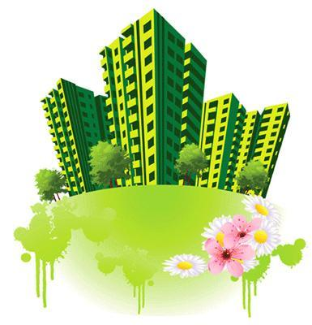
Environmental Design
Analysis of thermal loads and insulation
Required Shading dimensions
Analysis of daylight and artificial lighting
Analysis of reverberation time
Reuse of grey water
Disposal of bad odors
Recycling of papers*
Notes:
In the environmental design several sides of greening systems were used such that:
-Analysis of thermal loads and insulation
- Required Shading dimensions
- Analysis of daylight and artificial lighting
- Analysis of reverberation time
Reuse of grey water
Disposal of bad odors
Philosophy of colors

Slide 13
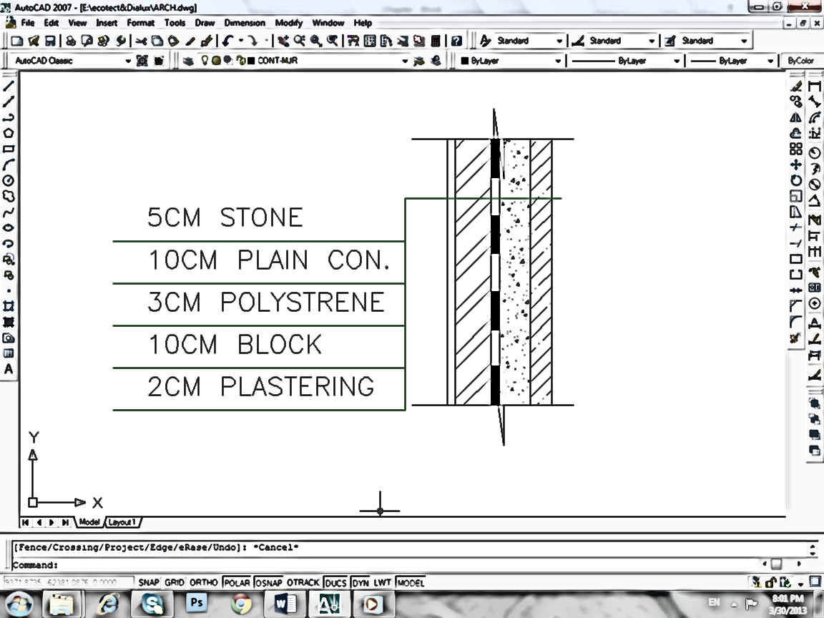
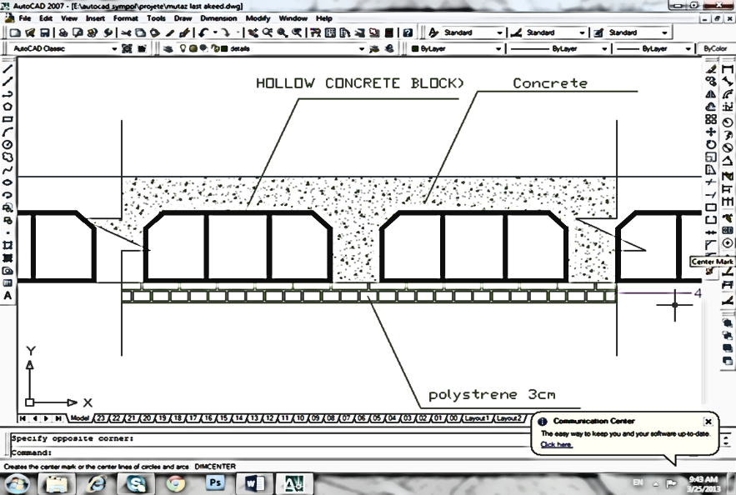

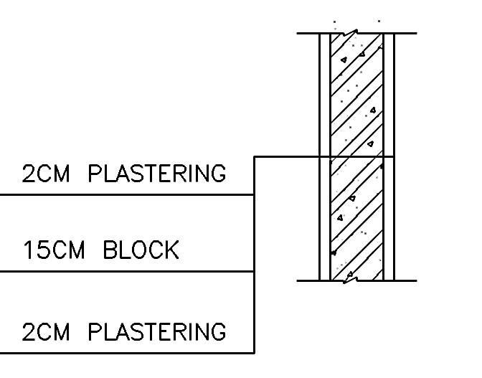
Thermal Loads and insulation
(Ecotect) software was used to calculate the thermal loads
Notes:
Ecotect was used in calculating of thermal loads taken into consideration the time when the school used in.
And manual calculation was conducted to check the results.
And here the used sections in external and internal walls and the last floor slab.

Slide 14
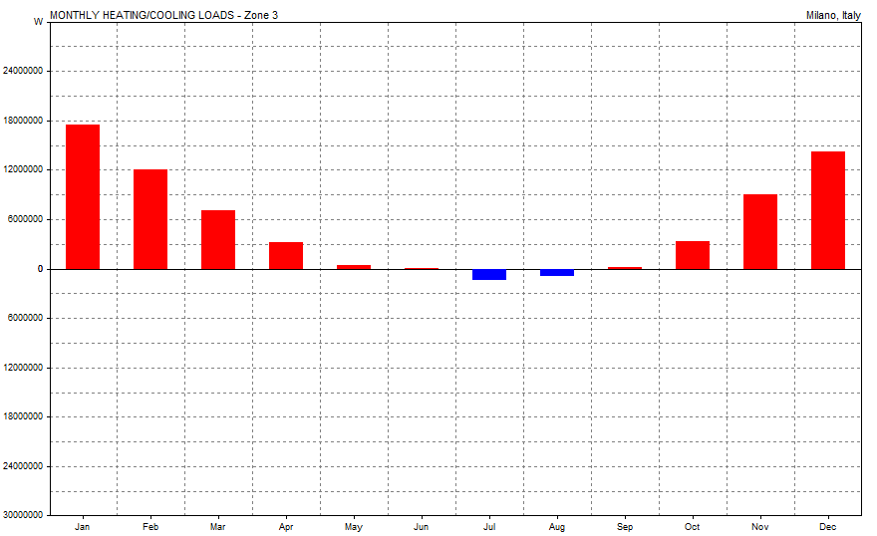
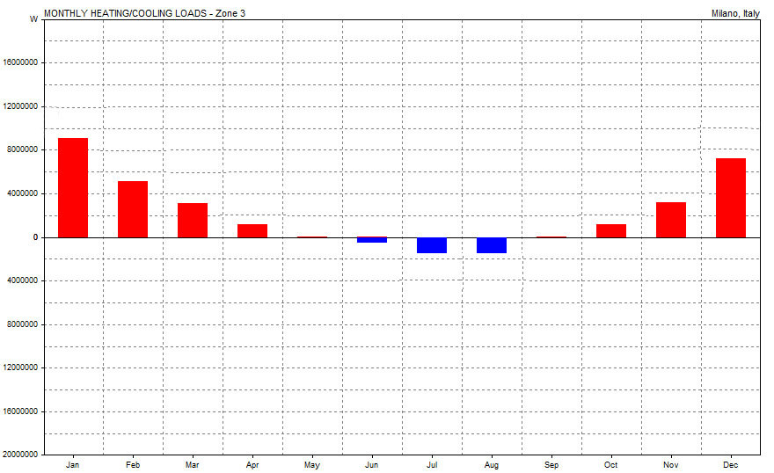
Thermal Loads and insulation
Operation: Weekdays 07-15, Weekends 00-00.
Thermostat Settings: 18.0 - 26.0 C
Max Heating: 105950 W at 08:00 on 18th January
Max Cooling: 52221 W at 14:00 on 7th August
For the third last floor
Heat loss =11kw after the use of insulation
Heat loss =53 kw with out insulation
Notes:
And here a noticeable different appears in the result shown after and before the use of insulation

Slide 15
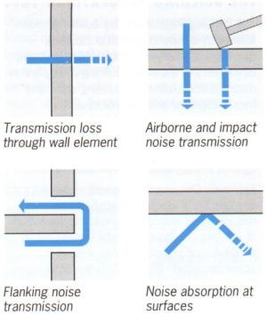
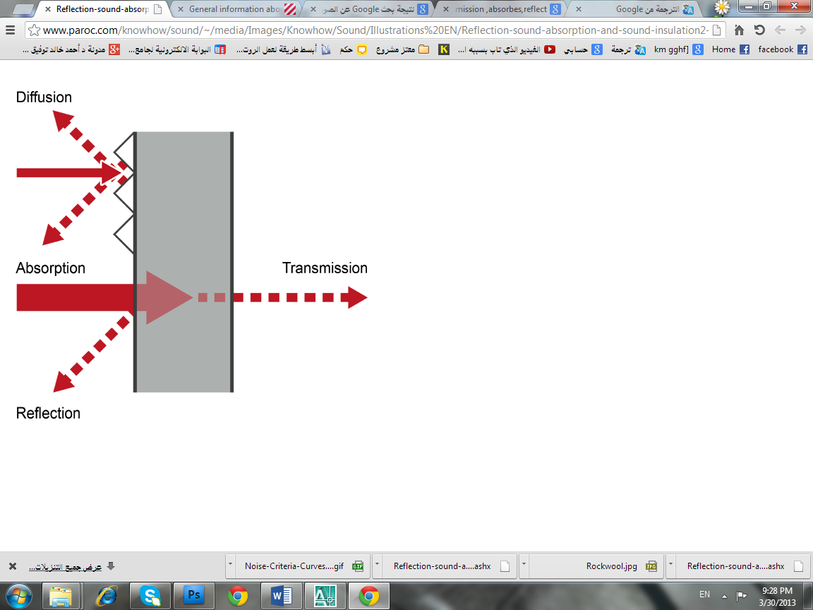
Acoustical analysis
Ecotect also used in calculating reverberation time for different functional spaces
Sources of noise:
-The noise sources of the surrounding environment
-The movement of student on the upper floors caused an impact noise
-The sound reflection in corridors
FREQ. | ABSPT. | RT(60) | RT(60) | RT(60)
 | Total | Sabine | Nor-ER | Mil-SE
500Hz: | 34.095 | 0.78 | 1.83 | 0.62
Results of teachers room
Notes:
Noise analysis one of the vital element in green schools
thus, we analyzed for reverberation times using ecotect.
Results of reverberation time were within range.
And also to solve the other acoustical problems we use :
-double glazing windows to reduce sound transmission from outside noise sources.
-absorber material in floors to reduce airborne noise between each upper and lower spaces.
-absorption panels in corridors ceiling and walls to reduce the reflection of
sound .

Slide 16
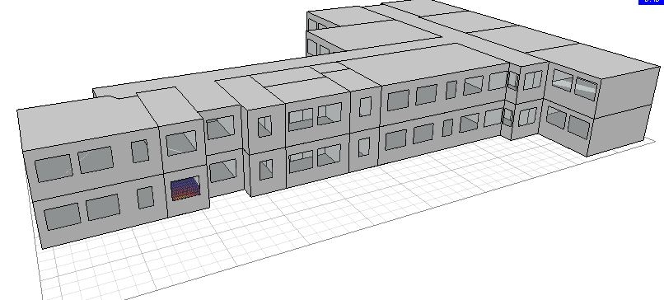
Daylight and shading analysis
Main problems were:
-non uniform distribution of day light
-high or low day light level in some spaces
-forming of shadow on students' desk
Notes:
Also a modeling for day lighting analysis were performed, and some problems appeared like the non uniformity of distribution and the high or low level of daylight.
The suggested solution were.to use adequate shading and adequate position and area of windows. And to use artificial lighting wherever the daylight is not enough

Slide 17
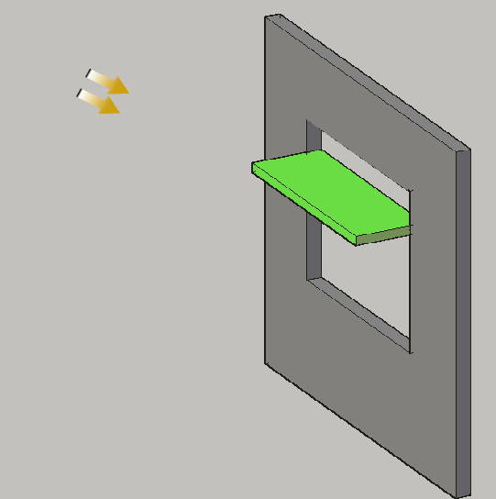
Shading analysis
Notes:
As all of us know, shading is essential element in green school.
So its designed in its adequate form and appropriate dimensions.
And the design of shadings in this technique will provide in direct daylight without increasing the heat gain

Slide 18
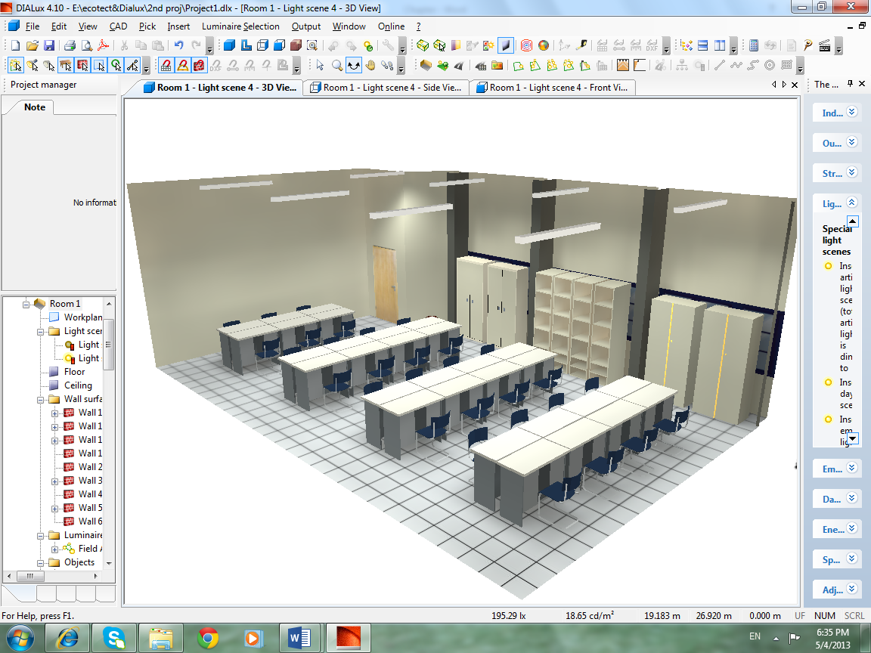
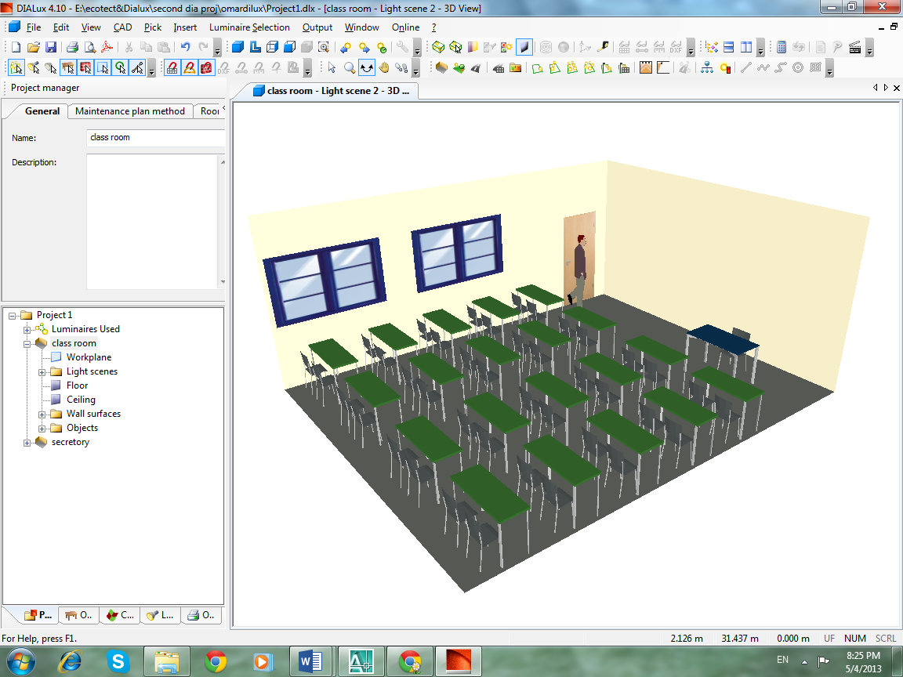
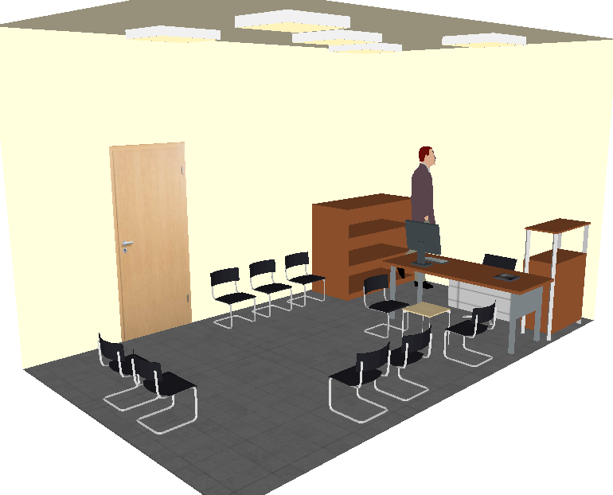
Artificial lighting analysis
Notes:
When ever the daylight is not enough artificial lighting is needed.
Dialux software was used for analyzing.
And the milestone were to take into consideration during electrical deign to switch on the luminaires that closed to windows separately.

Slide 19
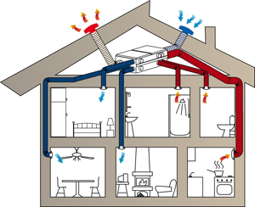

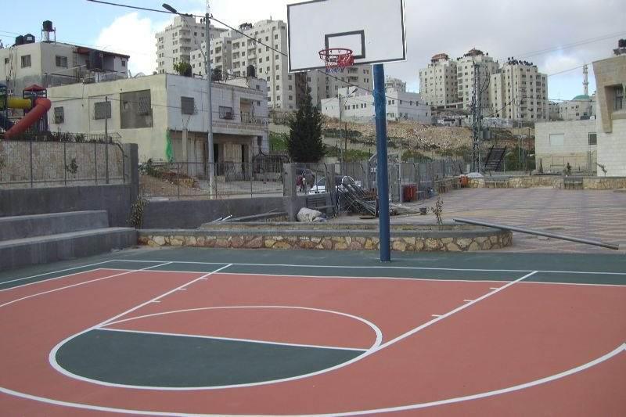
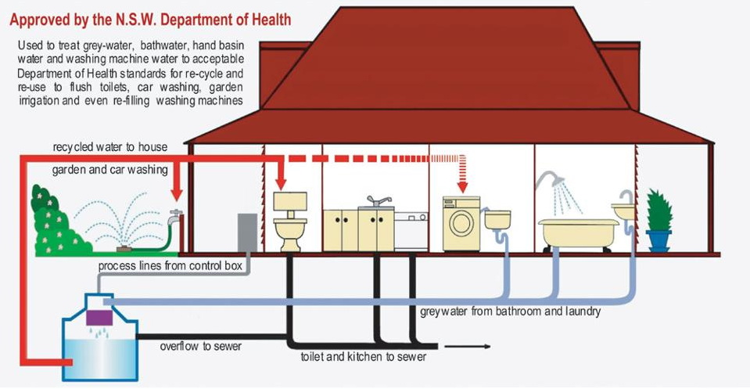
Other considerations
Notes:
Other considerations were also taken a place
Such that. Ventilation and disposal of bad odors ,playground and arenas and its place, planting , special need people requirements.

Slide 20
Electrical design
Power Design.
Lighting Design.

Slide 21
Lighting Design:
Natural lighting(Day light): Natural lighting reduce the need to turn on electric lights during the day, cutting lighting energy consumption by 50 to 80 percent, according to the U.S. glass is the best way to get day light.
Artificial lighting :we used lumen method to design the lighting system for the School to calculate the number of lightning units and select the types of lamps used.

Slide 22
Artificial lighting
Type of area | Em(lux) | Hm (m) | Type of lamps | N | P(watt)
Class room | 500 | 3.25 | Fluorescent | 8 | 576
Computer lab | 250 | Bench(3.25) | Fluorescent | 8 | 576
Store | 150 | Floor(4) | Fluorescent | 4 | 160
Science lab | 200 | Bench(3.25) | Fluorescent | 9 | 216
Teachers Room | 350 | Desk(3.25) | Fluorescent | 8 | 576
Social Work | 200 | Desk(3.25) | Fluorescent | 3 | 216
Head Master | 400 | Desk(3.25) | Fluorescent | 5 | 360
Adm. Secretary | 400 | Desk(3.25) | Fluorescent | 5 | 360
library | 500 | Desk(3.25) | Fluorescent | 10 | 1152
Corridor | 150 | Floor(4) | Fluorescent | 8 | 480
Kitchen | 150 | Kit. Sink(3.5) | Fluorescent | 2 | 120
Toilet unit | 150 | Floor(4) | Saving lamp | 6 | 432

Slide 23
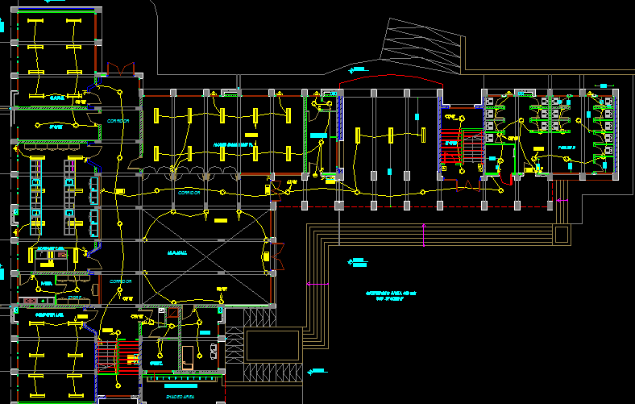
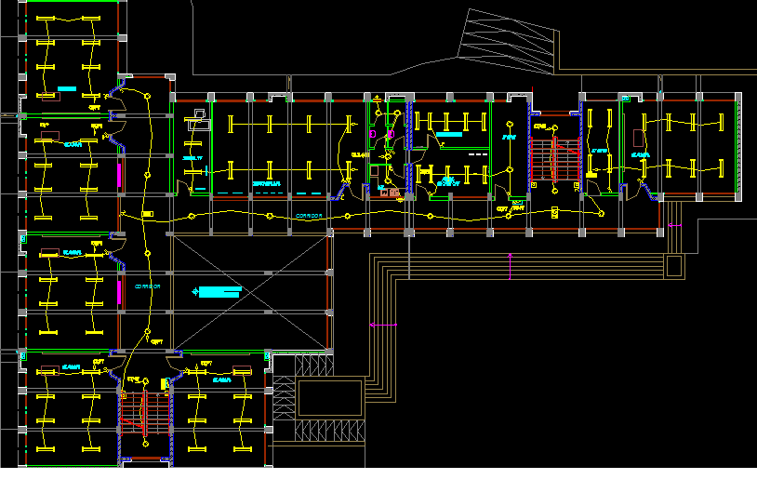
Artificial lighting
Lighting distribution for Ground floor
Lighting distribution for First floor

Slide 24
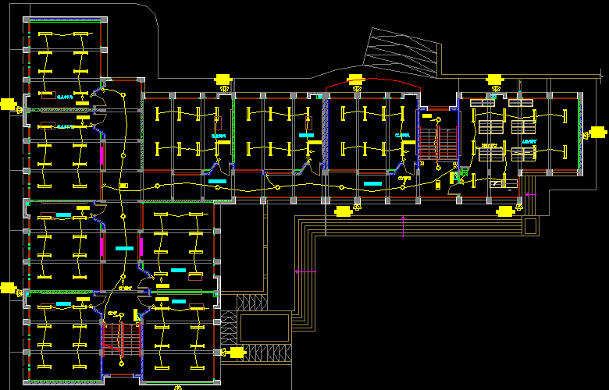
Lighting distribution for Second floor

Slide 25
power required for sockets
& Number of socket
Power Design
Type of area | Number of socket | Power (w)
Class room | 4 | 1408
Computer lab | 18 | 6336
Store | 2 | 704
Science lab | 9 | 3168
Teachers Room | 4 | 1408
Social Work | 4 | 1408
Head Master | 4 | 1408
Adm. Secretary | 2 | 704
library | 8 | 2816
Corridor | 4 | 1408
Kitchen | 2 | 704
Toilet unit | 2 | 704

Slide 26
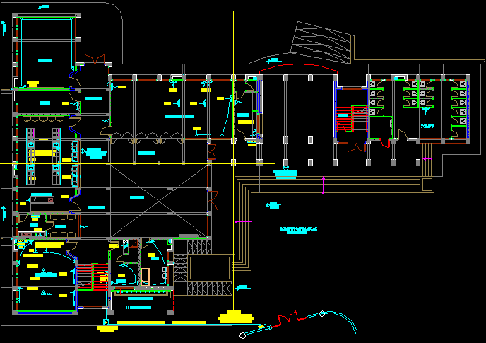
Socket distribution for Ground floor

Slide 27
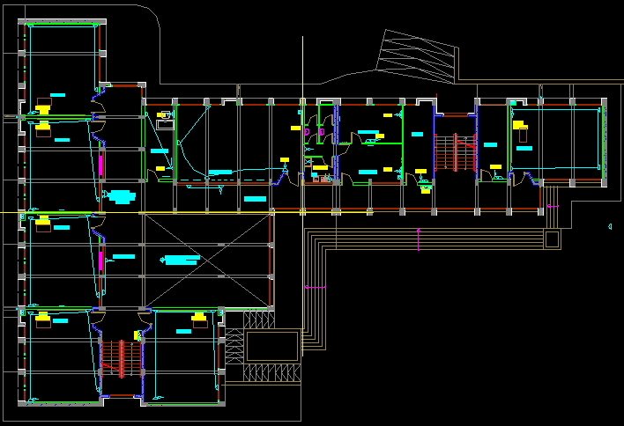
Socket distribution for First floor

Slide 28
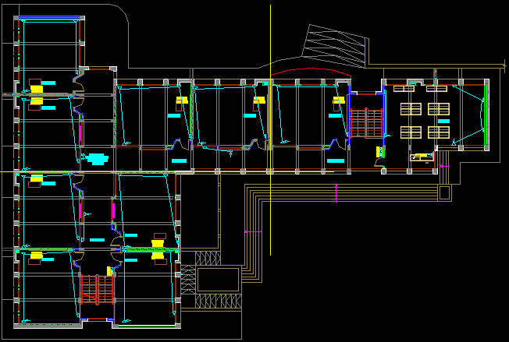
Socket distribution for second floor

Slide 29
Circuit breaker
I rated circuit breaker for ground floor = 40 Amp
use 2 C.B for lights in this floor.
&1C.B for special load.
I rated circuit breaker for first floor= 45 Amp
use 4 C.B for lights in this floor
&1C.B for special load.
I rated circuit breaker for second floor = 40 Amp
use 4 C.B for lights in this floor
I rated M.C.B=60 Amp

Slide 30
Cables Cross Section Area Calculation
The cross section area of The cables Of lights which carried 10 Amp must be 1.5 mm²
The cross section area of The cables Of sockets which carried 15 Amp must be 2.5 mm²
I cable = I circuit breaker * safty factor

Slide 31
Summary
floor | Power lighting (watt) | Power socket (watt) | M.C.B (Amp) | Sectional area cable (mm)
Ground floor | 3080 | 16544 | 40 | 6
First floor | 5690 | 17248 | 45 | 6
Second floor | 6816 | 16896 | 40 | 6

Slide 32
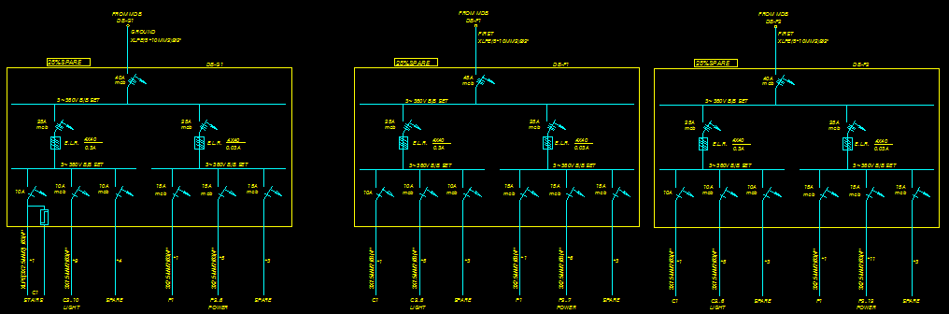
Electric boards

Slide 33
Mechanical design
A- Sanitation system
-Clean water
-Rain water
-Grey water
-Black water
B- Fire fighting

Slide 34
Sanitation system
Clean water
Feed water to the school is divided into two main sections:
cold water supply.
hot water supply.(active&passive energy).

Slide 35
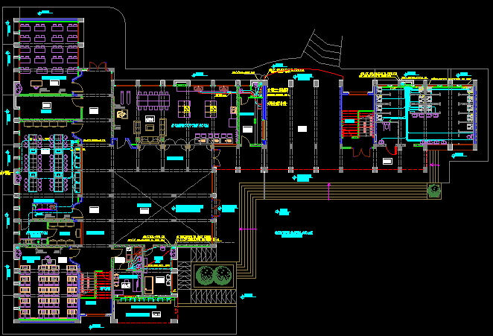
Water Supply system
Zone B
Zone D
Zone A
Zone C

Slide 36
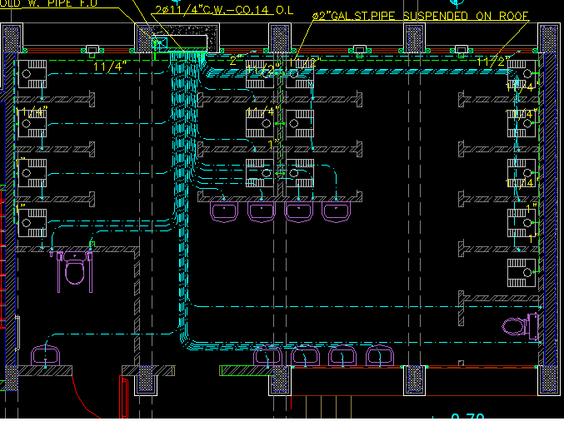
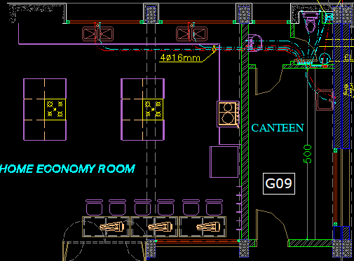
Water Supply Network
Ground floor-zone A
Ground floor-zone B

Slide 37
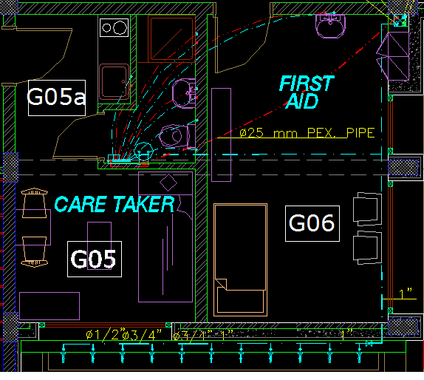
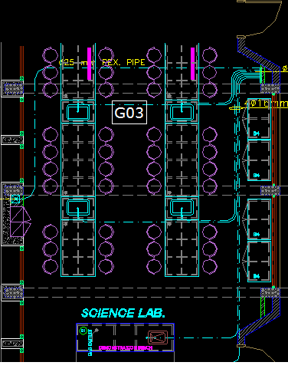
Water Supply Network
Ground floor-zoon C
Ground floor-zone D

Slide 38
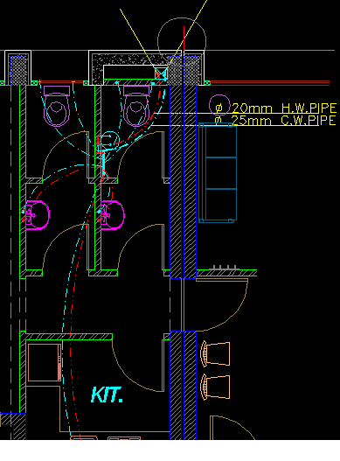
Water Supply Network
First floor-zone B

Slide 39
water demand for each zone:
Water supply system
Zone | Number of fixture unit | water demand (gpm)
A (ground floor) | 222 | 95
B(ground floor) | 24 | 38
C(ground floor) | 40 | 46
D(ground floor) | 24 | 38
B(first floor) | 28 | 40

Slide 40
Piping size for each zone:
2- Zone B
1- Zone A
Selected pipe | Main feeder | Horizontal | Branch
Diameter | 2.5 ‘’ | 2 ‘’ | 3/4 ‘’
Pressure(psi) | 3.2 | 0.11 | 3.7
Selected pipe | Main feeder | Horizontal | Branch
Diameter | 2’’ | 1.5’’ | 3/4 ‘’
Pressure(psi) | 3.2 | 1.05 | 5
3-Zone C
4-Zone D
Selected pipe | Main feeder | Horizontal | Branch
Diameter | 2’’ | 1.5’’ | 3/4 ‘’
Pressure(psi) | 1.78 | 4.32 | 6.2
Selected pipe | Main feeder | Horizontal | Branch
Diameter | 2’’ | 1.5’’ | 3/4 ‘’
Pressure(psi) | 2.1 | 7.35 | 7

Slide 41
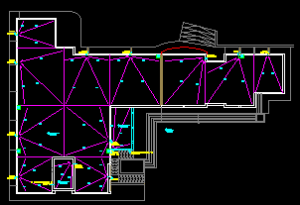
Rain water is collected from the roof of the school ,these collected water is treated and used in flush toilet, its collected in tank and passing through filters to clean it, after that its pumped to flush toilet, and also to the fire fighting pipe
Rain water

Slide 42
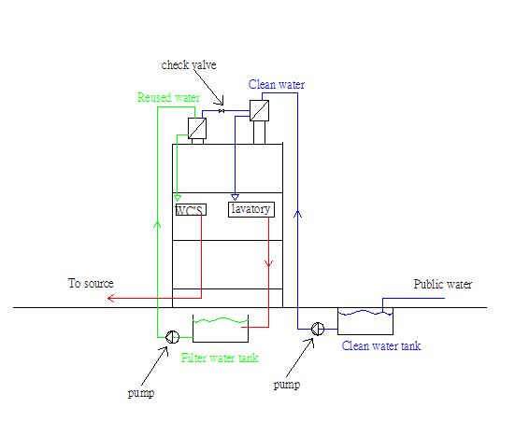
Tank system for water supply
System used:
Roof Tank with basement storage.

Slide 43
Drainage Systems
Grey water :lavatories
Black water :WCS & kitchen sink

Slide 44
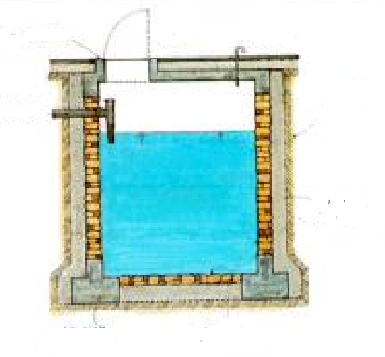
Grey water
The grey water is comes from the Laundries,it well be collected by 4 inch pipes to an underground tank .this tank is from reinforcement concrete, it has an Open sealed,and filter for water treating and pump to pump to flush toilet.

Slide 45
Grey water
Stack diameter
Vent diameter
Zone | A | B | C
Fixture unit | 9 | 3 | 13
Stack diameter | 2” | 2” | 2”
Zone | A | B | C
Fixture unit | 9 | 3 | 13
Vent diameter | 2” | 2” | 2"

Slide 46
Black water
The water collected from WC's and kitchen sinks is classified as black water; this type is collected by suitable pipes to the basic stack then connected with a septic tank and seepage to sewerage and sanitation of Nablus municipality.
Stack diameter: vent diameter:
zone | A | B | C | D
Fixture unit | 17 | 7 | 2 | 6
Stack diameter | 5" | 4" | 4" | 4"
zone | A | B | C | D
Fixture unit | 17 | 7 | 2 | 6
Vent diameter | 2" | 2" | 2" | 2"

Slide 47
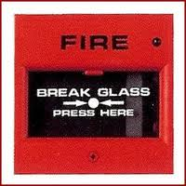
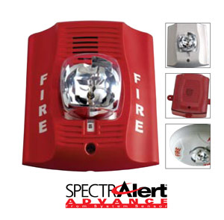
Fire fighting
Fire alarm system and fire protection system were designed for the building, since Saving lives is a primary consideration in the event of fire within buildings.
Fire Alarm system:
Manual Fire Alarm Automatic Fire Alarm

Slide 48
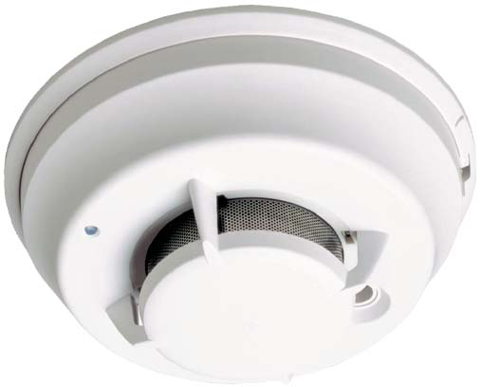
Fire fighting
fire protection
Smoke Detector Heat detector

Slide 49


Design of Fire fighting
Smoke and heat detectors.
Sprinklers system.
Fire Extinguishers system.

Slide 50
Design of fire sprinkler system
number of sprinklers needed in Ground Floor.
Number of sprinkler needed in first floor.
Facility | Area (m2) | Hazard | # of Sprinkler
M.P.Hall | 113 | low | 6
First Aid | 15.6 | medium | 2
Store1 | 5.2 | medium | 1
Store2 | 15.74 | medium | 2
Store3 | 15.74 | medium | 2
Science lap | 83.79 | high | 10
corridor | 64.5 | low | 3
Total |  |  | 26
Facility | Area (m2) | Hazard | # of Sprinkler
Store1 | 12.36 | medium | 2
Store2 | 16.07 | medium | 2
Corridor1 | 82 | low | 4
Corridor2 | 64.5 | low | 3
total |  |  | 11

Slide 51
Design fire sprinkler system
number of sprinklers needed in Second Floor.
Facility | Area (m2) | Hazard | # of Sprinkler
Corridor1 | 82 | low | 4
Corridor2 | 64.5 | low | 3
library | 80 | high | 9
total |  |  | 16

Slide 52

Design of Fire fighting fire protection&sprinkler distribution for Ground floor:

Slide 53


Design of Fire fighting
fire protection&sprinkler distribution for First floor:
fire protection&sprinkler distribution for Second floor:

Slide 54
STRUCTURAL DYNAMIC ANALYSIS
AND DESIGN

Slide 55
Design code:
- The American Concrete Institute code ACI 318-08.
- The seismic design according to UBC-97&IBC-2009.
- Analysis method : 3D model by SAP program.
Notes:
In the first graduation project we studied the third generation of green schools which use green systems.
And several sides were studied in depth from the point view of its requirements ,elements, its green system and possibility of applying, and obstacles maybe faced

Slide 56
Material:
Material | Unit weight (KN/m³)
Reinforced concrete | 25
Plain concrete | 23
Sand | 18
Aggregate | 17
Blocks | 12
Polystyrene Extruded | 0.3
Masonry stone | 27
Light weight block | 6
Tile | 26
Notes:
In the first graduation project we studied the third generation of green schools which use green systems.
And several sides were studied in depth from the point view of its requirements ,elements, its green system and possibility of applying, and obstacles maybe faced

Slide 57
Design of slab :
Structural system : One way solid slab.
Slab thickness = 30 cm.
Analysis method : 3D model by SAP program.
Notes:
In the first graduation project we studied the third generation of green schools which use green systems.
And several sides were studied in depth from the point view of its requirements ,elements, its green system and possibility of applying, and obstacles maybe faced

Slide 58

use( 30) cm slab with 52 cm rib width.
Across section of the ribbed slab as shown in Figure.
Section of the ribbed slab .
Notes:
In the first graduation project we studied the third generation of green schools which use green systems.
And several sides were studied in depth from the point view of its requirements ,elements, its green system and possibility of applying, and obstacles maybe faced

Slide 59


ribbed slab .
Notes:
In the first graduation project we studied the third generation of green schools which use green systems.
And several sides were studied in depth from the point view of its requirements ,elements, its green system and possibility of applying, and obstacles maybe faced

Slide 60

Model Checks.
Compatibility check.
Notes:
In the first graduation project we studied the third generation of green schools which use green systems.
And several sides were studied in depth from the point view of its requirements ,elements, its green system and possibility of applying, and obstacles maybe faced

Slide 61

Model Checks.
Equilibrium Checks.
Base Reaction = A * LL * # of floor
= 850 * 4.5 * 3
= 10867.5
Base reaction from SAP program = 10550.
e = 1% < 5 % ……………… ok.
Notes:
In the first graduation project we studied the third generation of green schools which use green systems.
And several sides were studied in depth from the point view of its requirements ,elements, its green system and possibility of applying, and obstacles maybe faced

Slide 62

Samples.
Notes:
In the first graduation project we studied the third generation of green schools which use green systems.
And several sides were studied in depth from the point view of its requirements ,elements, its green system and possibility of applying, and obstacles maybe faced

Slide 63

Footing.
Notes:
In the first graduation project we studied the third generation of green schools which use green systems.
And several sides were studied in depth from the point view of its requirements ,elements, its green system and possibility of applying, and obstacles maybe faced

Slide 64

Col.
Notes:
In the first graduation project we studied the third generation of green schools which use green systems.
And several sides were studied in depth from the point view of its requirements ,elements, its green system and possibility of applying, and obstacles maybe faced

Slide 65

Shear Wall.
Notes:
In the first graduation project we studied the third generation of green schools which use green systems.
And several sides were studied in depth from the point view of its requirements ,elements, its green system and possibility of applying, and obstacles maybe faced

Slide 66

Stairs
Notes:
In the first graduation project we studied the third generation of green schools which use green systems.
And several sides were studied in depth from the point view of its requirements ,elements, its green system and possibility of applying, and obstacles maybe faced

Slide 67

Dynamic Analysis
Check for dynamic
seismological
Hazard Map of Palestine.
Notes:
In the first graduation project we studied the third generation of green schools which use green systems.
And several sides were studied in depth from the point view of its requirements ,elements, its green system and possibility of applying, and obstacles maybe faced

Slide 68


Dynamic Analysis
Seismic Zone Factor: Z = 0.20 For Nablus; see figure below:
periodical time from SAP by response spectrum method
Notes:
In the first graduation project we studied the third generation of green schools which use green systems.
And several sides were studied in depth from the point view of its requirements ,elements, its green system and possibility of applying, and obstacles maybe faced

Slide 69


Dynamic Analysis
Design of Boundary region
Section in window
Notes:
In the first graduation project we studied the third generation of green schools which use green systems.
And several sides were studied in depth from the point view of its requirements ,elements, its green system and possibility of applying, and obstacles maybe faced

Slide 70

Dynamic Analysis
Reinforcement of the upper beam in the door
Notes:
In the first graduation project we studied the third generation of green schools which use green systems.
And several sides were studied in depth from the point view of its requirements ,elements, its green system and possibility of applying, and obstacles maybe faced

Slide 71


