Slide 1

AN-Najah National University
Faculty of Engineering & Information Technology
Mechanical and Mechatronics Engineering Department
Graduation Project 1
A Semi-Active Vibration Isolation System For Car Seats
DONE BY:
Yazan Dabbas
yazan.dabbas@stu.najah.edu
SUPERVISOR:
Dr. Mohammad Abuabiah
m.abuabiah@najah.edu
Dec/2020

Slide 2
Outline
Introduction
Challenges
Literature Review
Proposed System
Model Design
Electrical Components
Conclusions
2/15

Slide 3
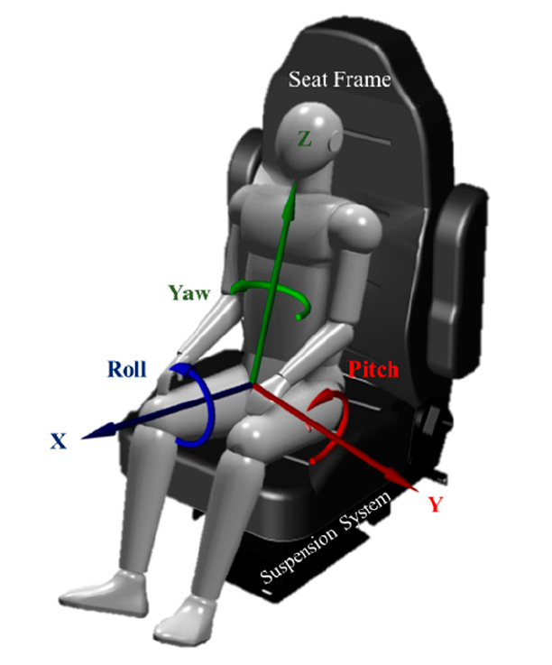
Introduction
Human bodies are often exposed to vibrations while driving.
Exposure to such vibrations for prolonged period could have severe effects on health.
These unwanted vibrations normally distributed in a range between (0.5- 25) Hz
The car’s main suspension can’t isolate these vibrations.

Slide 4
Introduction
The project focuses on building a full-scale prototype vibration isolation system for the low-frequency excitation region of seats in B-segment and C-segment cars.
B-segment cars are the second smallest cars in the European category, They are also called supermini.
C- segment cars are the largest category of small cars, they are also referred as a small family car.

Slide 5
Challenges
As in any project, there are many challenges of designing a system combining all requirements, which they are:
Compactness
Compatibility with different weights
Low-power consumption
Reliability and Simplicity
Affordability

Slide 6
Literature Review
Many research papers, scientific articles, and journals have been read.
All the systems that are trying to solve the vibration isolation problem for seats have been developed for large and heavy-duty vehicles
There is NO system applicable for small vehicles, especially for B-segment and C- segment cars
6/15

Slide 7
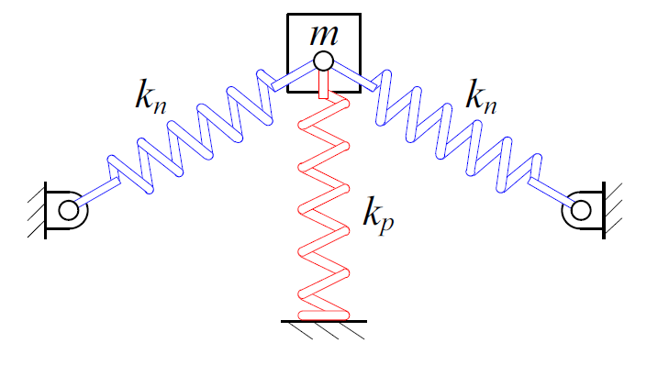
Proposed System
The proposed system (Quasi-zero stiffness) consists of:
A vertical spring to support the load (positive stiffness).
Two oblique springs also connected to the load (negative stiffness).
The stiffness can reach values around zero without affecting the stability of the system

Slide 8
Proposed System
The QZS system alone is not enough, it needs enhancements to meet our requirements :
In order to support load variation, an Air Spring parallel with the vertical spring is chosen
As a horizontal adjustments to adjust the ratios, two linear actuators are chosen

Slide 9
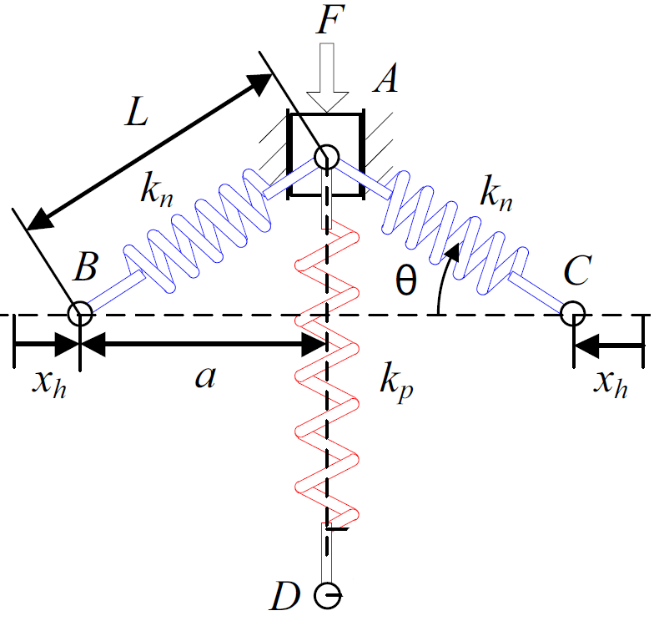
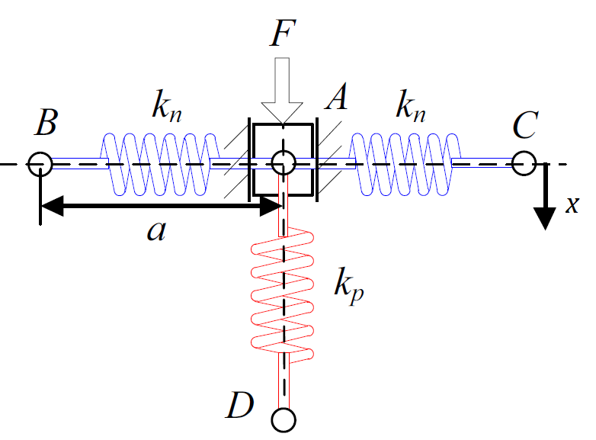

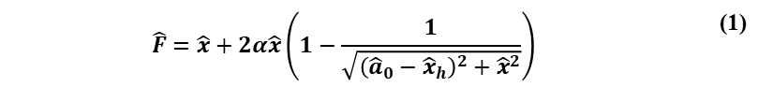
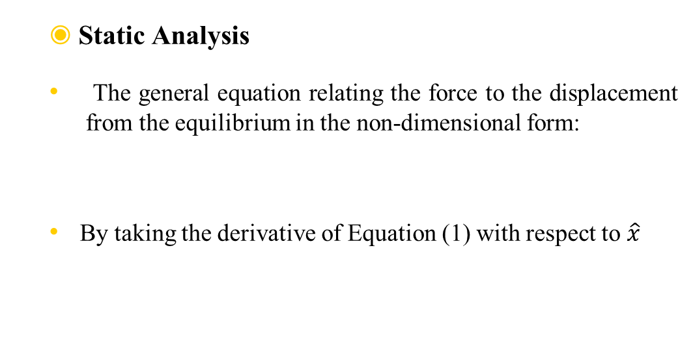
Proposed System
Static Analysis
The general equation relating the force to the displacement from the equilibrium in the non-dimensional form:
By taking the derivative of Equation (1) with respect to $\hat{x}$
$$\hat{F}=\hat{x}+2α\hat{x}\left(1−\frac{1}{\sqrt{{\left({\hat{a}}_{0}−{\hat{x}}_{h}\right)}^{2}+{\hat{x}}^{2}}}\right)$$ | (1)
$$\hat{K}=1+2α\left(1−\frac{{\left({\hat{a}}_{0}−{\hat{x}}_{h}\right)}^{2}}{{\left[{\left({\hat{a}}_{0}−{\hat{x}}_{h}\right)}^{2}+{\hat{x}}^{2}\right]}^{3/2}}\right)$$ | (2)
9/15

Slide 10

Proposed System
Approximation to the stiffness of the QZS system
Equation (1) can be simplified to the third order polynomial using Taylor expansion around equilibrium:
Then the stiffness will be:
$$\hat{F}\left(\hat{x}\right)≈\frac{α}{{\left({\hat{a}}_{0}−{\hat{x}}_{h}\right)}^{3}}{\hat{x}}^{3}$$ | (3)
$$\hat{K}=\frac{d\hat{F}}{dx}≈\frac{3α}{{\left({\hat{a}}_{0}−{\hat{x}}_{h}\right)}^{3}}{\hat{x}}^{2}$$ | (4)
10/15

Slide 11
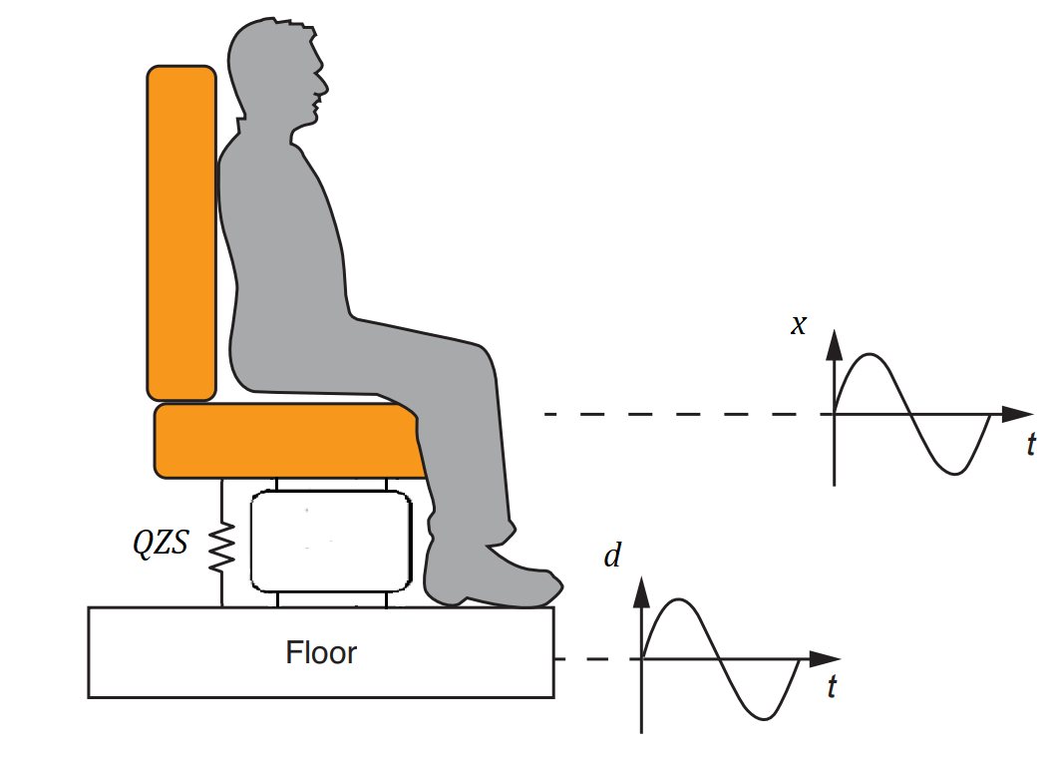


Proposed System
Dynamic Analysis
Converting Equation (3) into the dimensional form and Adding the base displacement gives
By taking the derivative of Equation (5) with respect to $x$
The general dynamic equation :
$$F=\frac{k_{n}L_{0}}{{\left(a_{0}−x_{h}\right)}^{3}}{(x−d)}^{3}$$ | (5)
$$K=\frac{3k_{n}L_{0}}{{\left(a_{0}−x_{h}\right)}^{3}}{(x−d)}^{2}$$ | (6)
$$m\ddot{x}+C\left(\dot{x}−\dot{d}\right)+\frac{k_{n}L_{0}}{{\left(a_{0}−x_{h}\right)}^{3}}{(x−d)}^{3}=0$$ | (7)
11/15

Slide 12
Proposed System
Bode diagram of the proposed system for different amplitudes
Bode diagram of the proposed and linear systems for different loads
12/15

Slide 13
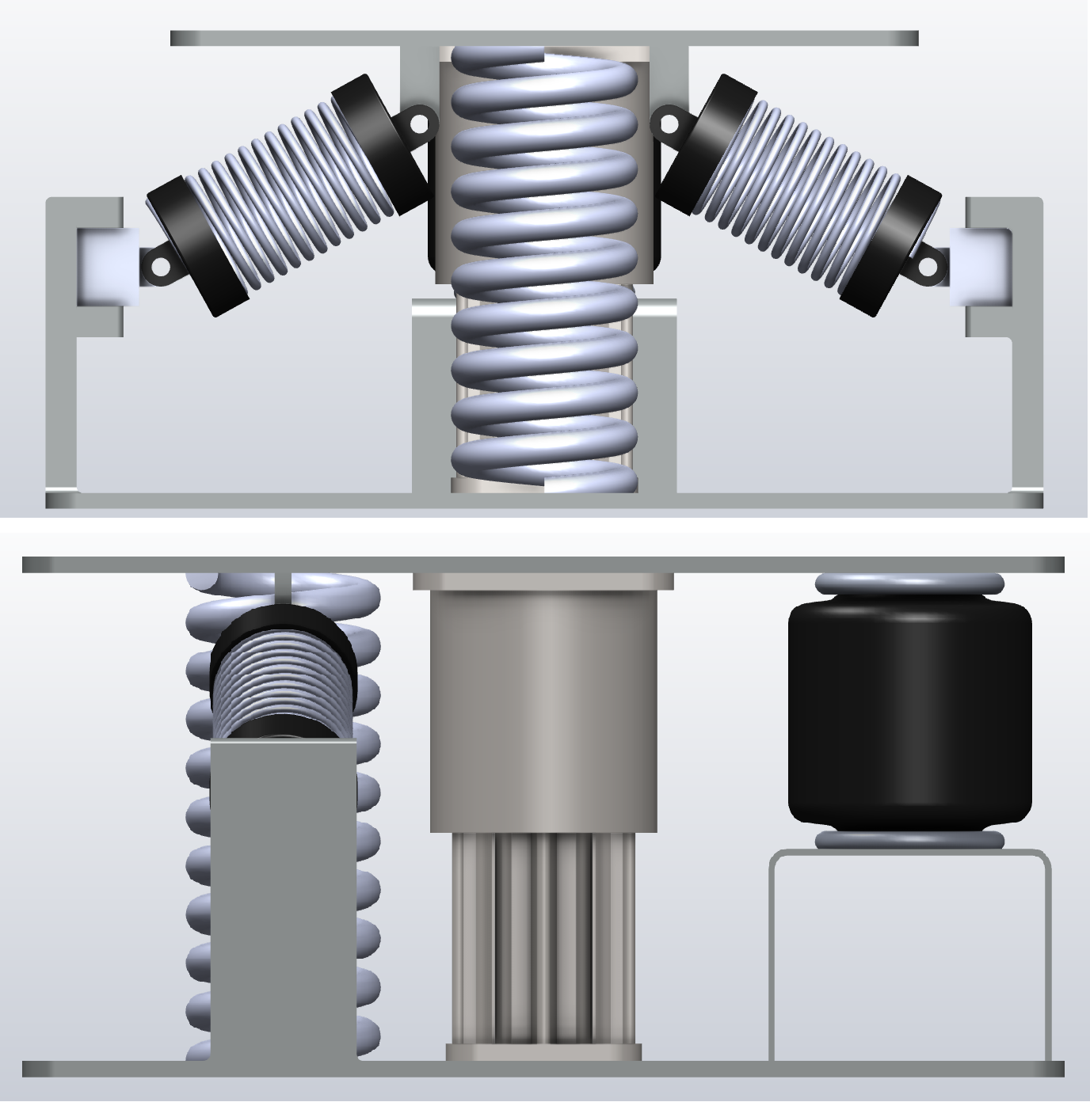
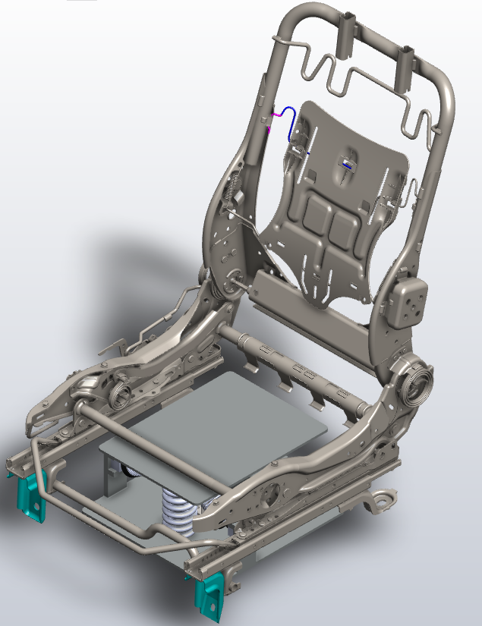
Model Design
Isolator Model
Expected Final View
13/15

Slide 14
Electrical Components
A high airflow rate, and heavy-duty compressor will be used to inflate the air spring, in order to keep up with the fast change in amplitude.
The air spring can be dealt with as a single acting cylinder, thus a 3/2 way pneumatic solenoid direction valve would do the job.
An accelerometer sensor to measure the base and the isolated seat accelerations.
A microcontroller to combine the mentioned components is needed, and what better choice than the Arduino UNO
To simulate the input frequency excitation and support the load in static and dynamic cases, a heavy-duty linear actuator is needed
14/15

Slide 15
Conclusions
The proposed system fulfills the desired requirements
The proposed system shows better isolation performance over the linear equivalent by around 60% in most cases.
As a future work, finding a way to reduce the cost even more by getting rid of the two linear actuators without losing performance would be one of the main goals.
Attempting to build a complete workstation would be the focus of the second part of this graduation project.
15/15

