Slide 1
Quantity survey and cost estimate for Kafr Ni'ma basic school
Prepared by
1- Adnan I Jardaneh
2- Amr W Zuhud
3- Momen S Salameh
Supervisor: Eng. Reema Nassar

Slide 2
What is the projects?
According to Saleh Mabrouk A project as ‘‘a temporary endeavor undertaken to create a unique product, service, or result. The key words in this deﬁnition are temporary and unique: any project must have a starting point and an ending point, and it must have a deliverable product or service that is unique.

Slide 3

Project key participation
1. Owner (client)
2. Design Professional
3. The contractor
4. The subcontractor

Slide 4
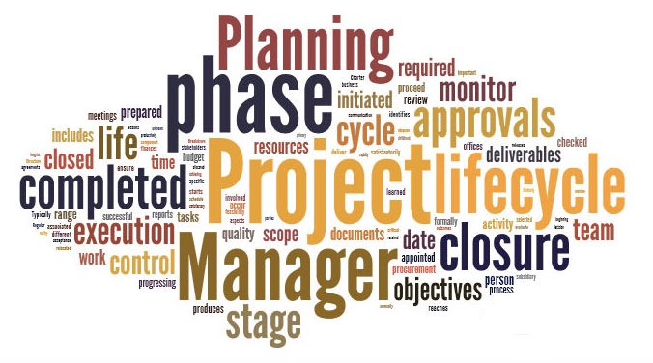
Life cycle of the projects
There are the major phases in the project life cycle
Startup
Planning phase
Design phase

Slide 5
The design process involves three phases
Schematic design
Design development
Contract documents

Slide 6
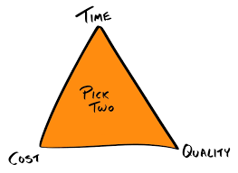
Project Constraints

Slide 7
  Project Delivery System
Project delivery method describes how the relationship is organized between the participants to transforming the idea of owner project to the facility also the method by which project is executed.

Slide 8
Type of PDS
Traditional
Design-build (Turnkey)
Self-performance system
Professional construction management method (PCM)
Build-Operate-Transfer

Slide 9
Parties to a Construction Contract
Simplest from: Two parties:
Owner and A/E.
Owner and Contractor.
More complex: multiple parties:
Owner and several contractors simultaneously.
by trade: electrical, mechanical, plumbing, etc.

Slide 10
Contracts
Types of Contracts:
Lump Sum Contract.
Unit Price Contract.
Cost-Plus Contract.
Guaranteed Maximum Price Contract.

Slide 11
  Project management
Project management is the application of processes, methods, skills, knowledge, and experience to achieve specific project objectives according to the project acceptance criteria within agreed parameters. Project management has final deliverables that are constrained to a finite timescale and budget.

Slide 12
Why is Project Management important
Project management is important because it ensures what is being delivered, is right, and will deliver real value against the business opportunity.

Slide 13


Slide 14
  Scheduling
You have to ask yourself three questions to start:
What needs to be done?
When will it be done?
Who will do it?

Slide 15
  Scheduling Methods
    Bar charts (Gantt Charts)
    Critical path Method (CPM)
    Line of balance

Slide 16
Quantity surveying
Quantity takeoff is a process of measuring the work of the project in form of a series of quantified work items. Each item considered in the takeoff is measured according to a uniform set of rules on how to be measured

Slide 17
  Construction costs
Direct cost include
Materials costs
Labor costs
Equipment costs
Indirect cost include
Overhead
Indirect labor
Profits

Slide 18
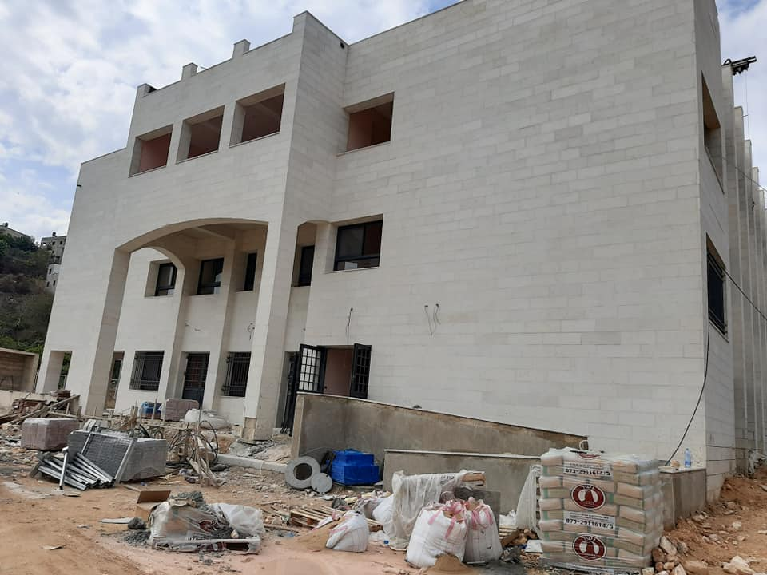
Project Introduction
Project delivery system:-
Design-Bid-Build.
Project contract:-
Unit price.

Slide 19
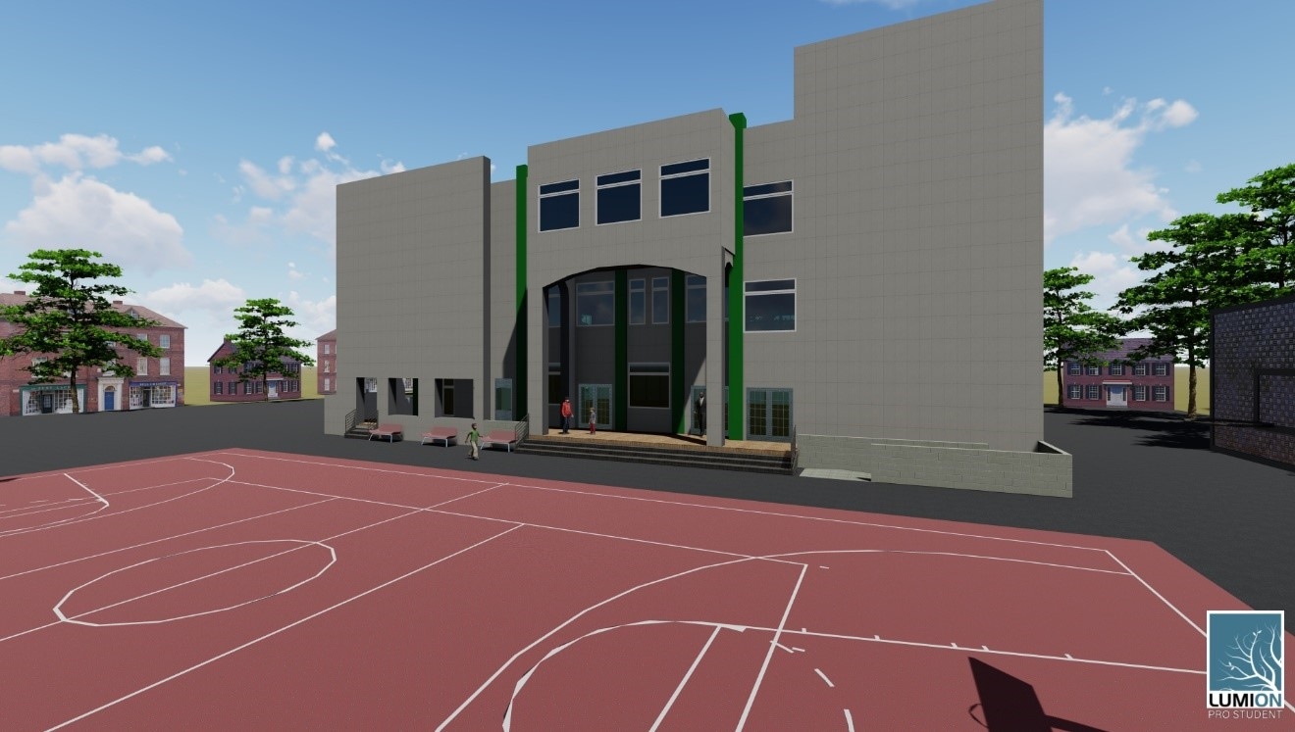
Render.

Slide 20
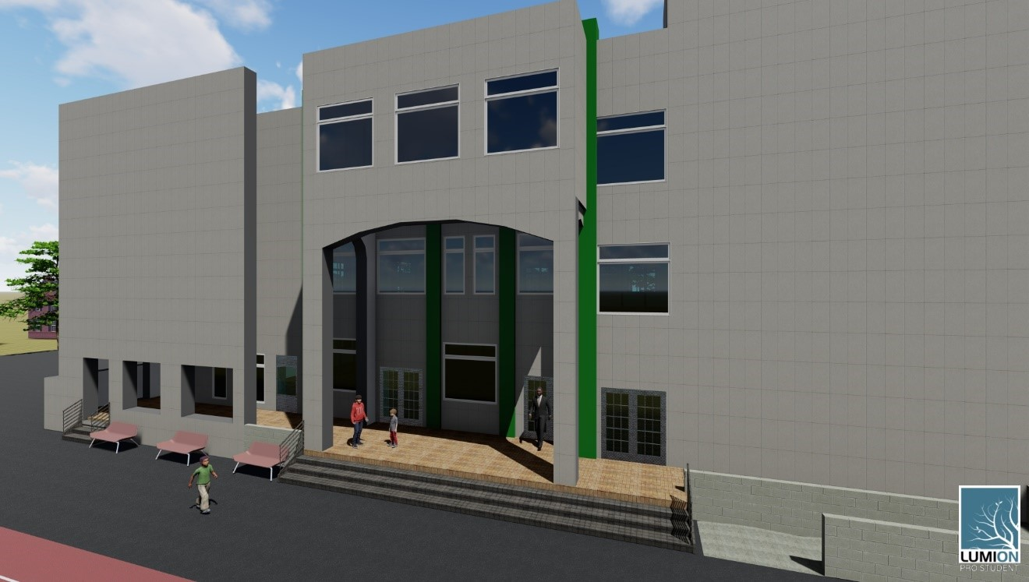

Slide 21
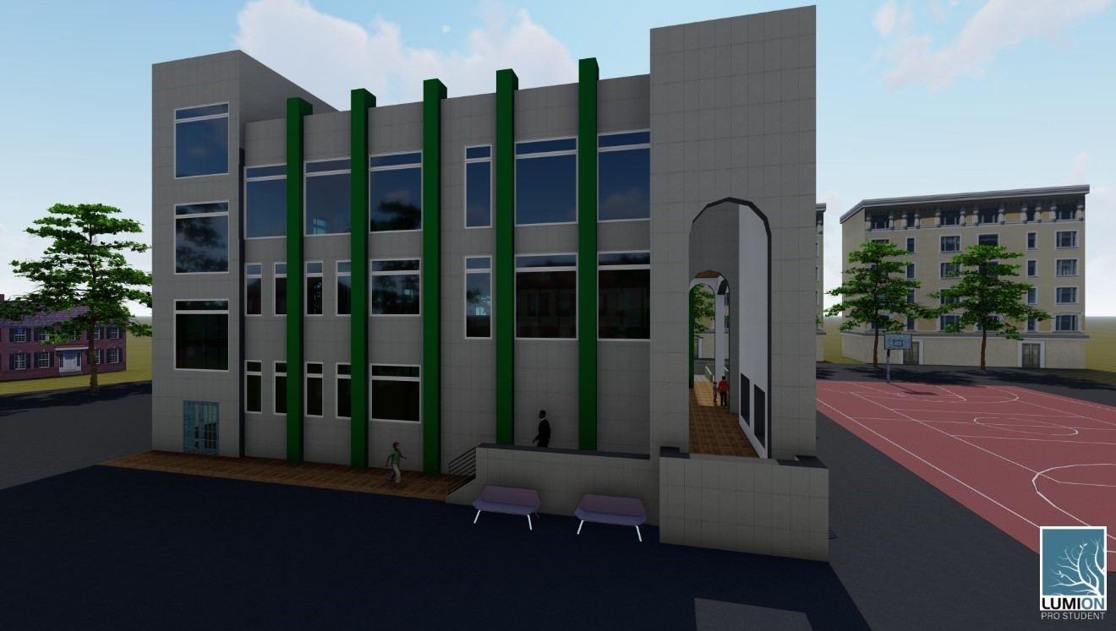

Slide 22
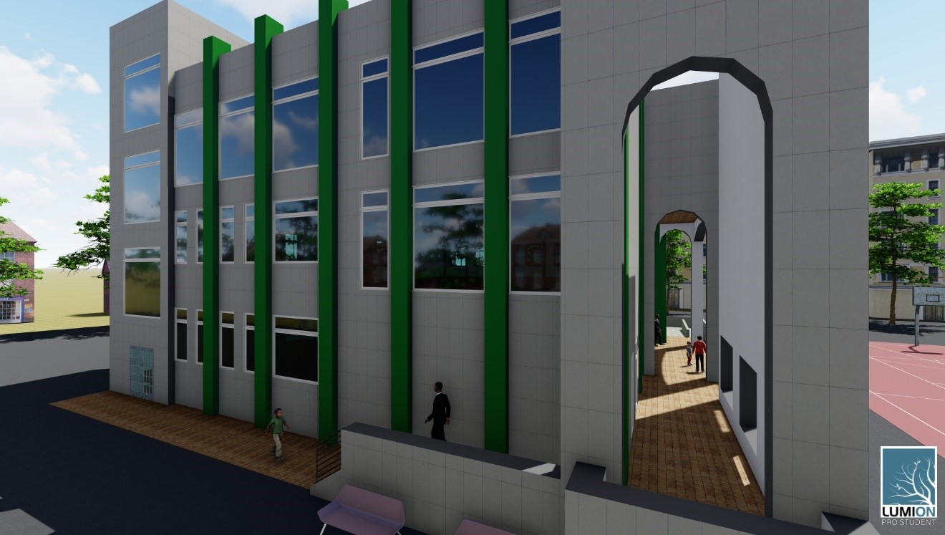

Slide 23
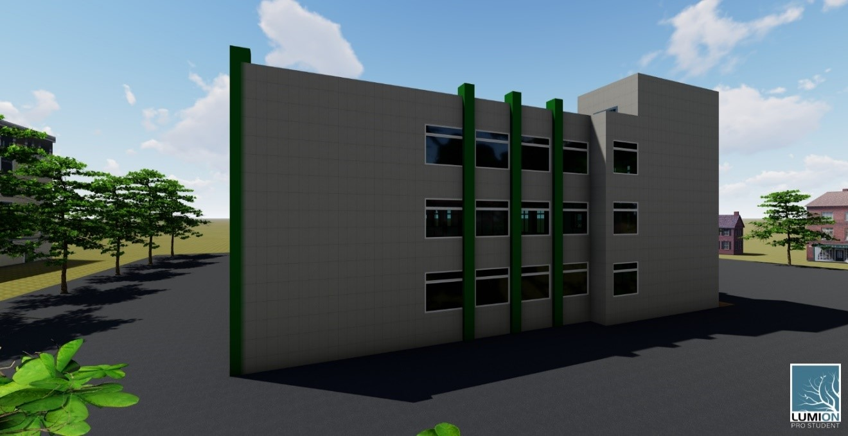

Slide 24
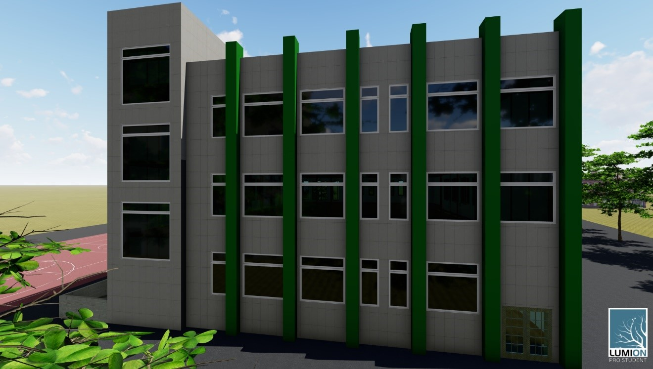

Slide 25
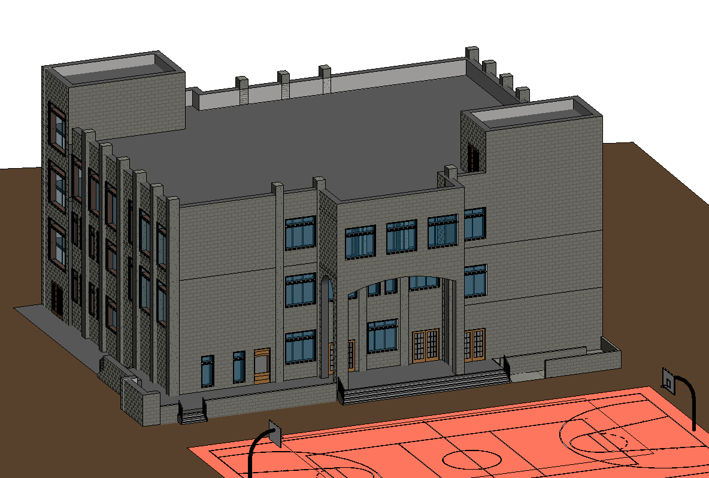
Quantities Surveying Using Revit Software

Slide 26
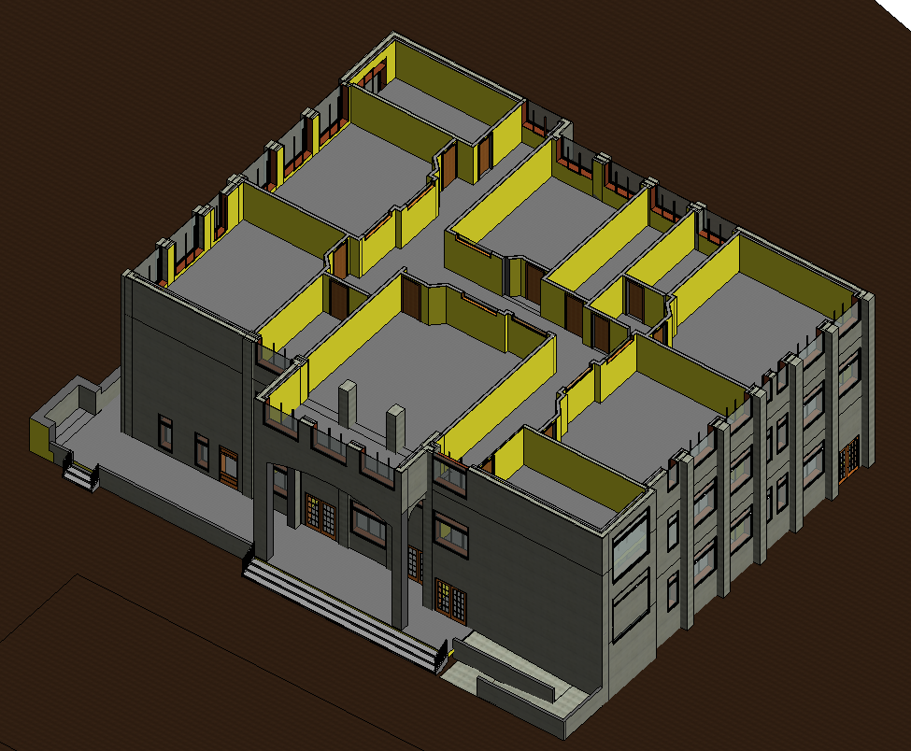
Architectural Model

Slide 27
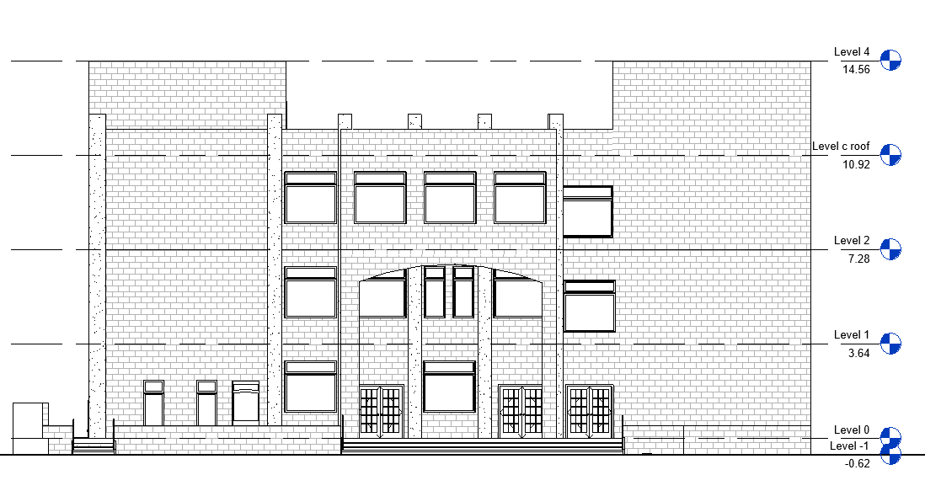
  Models build up in Revit

Slide 28
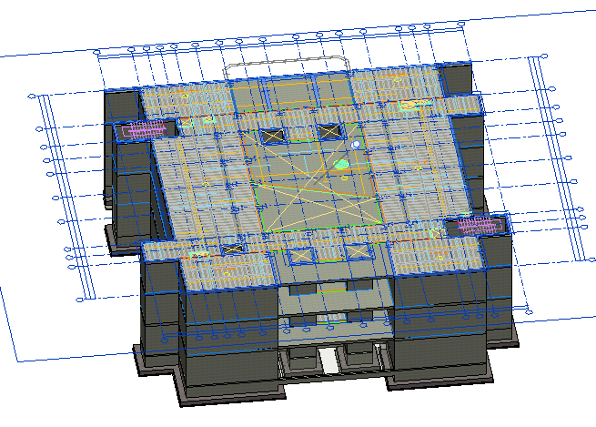
Link CAD Importing for Drawing

Slide 29
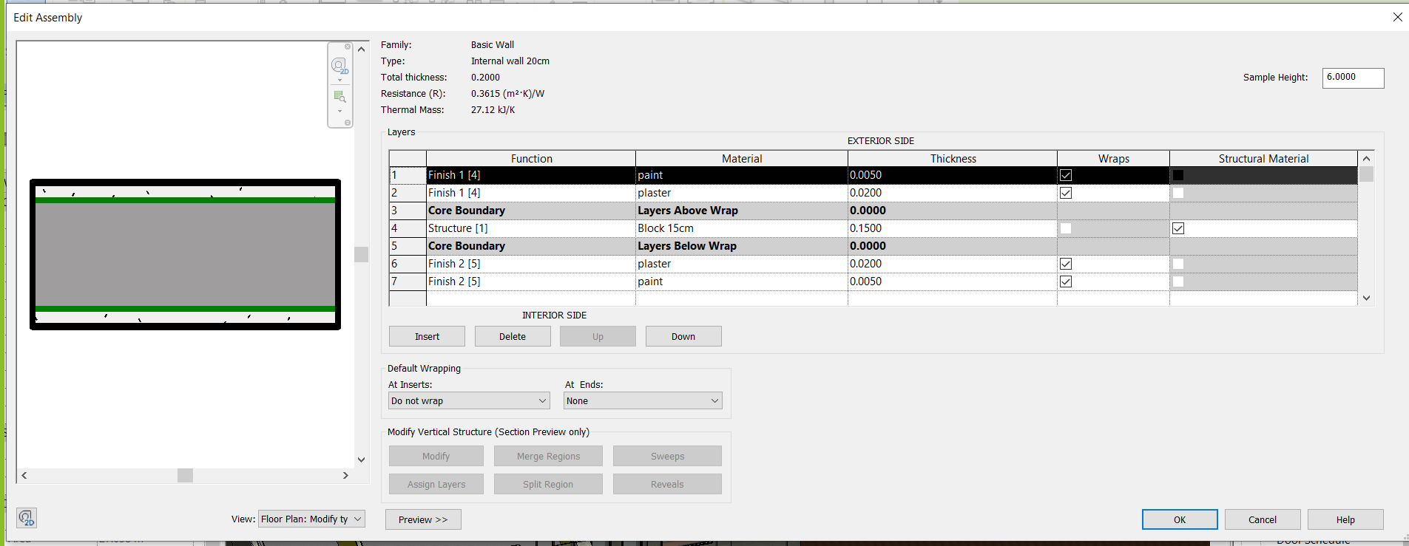
Section definition
Internal Wall 20cm.

Slide 30
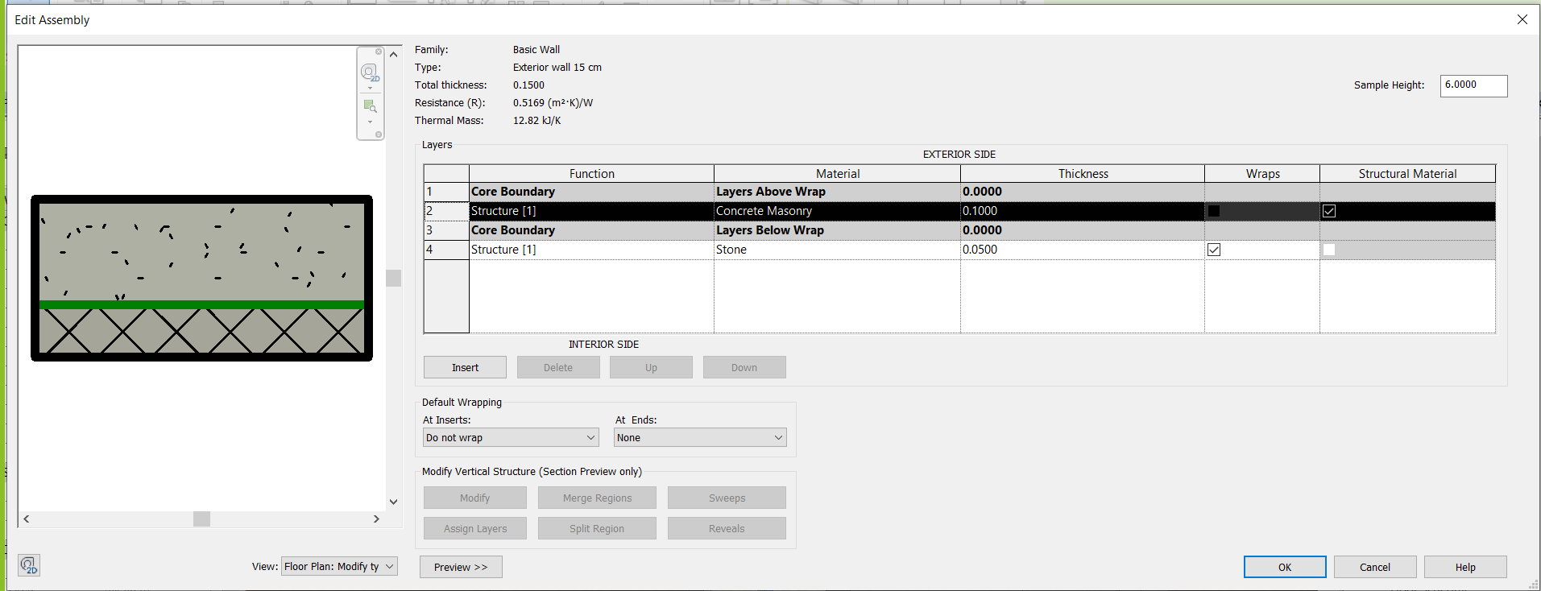
Section definition
Exterior Wall 15cm.

Slide 31
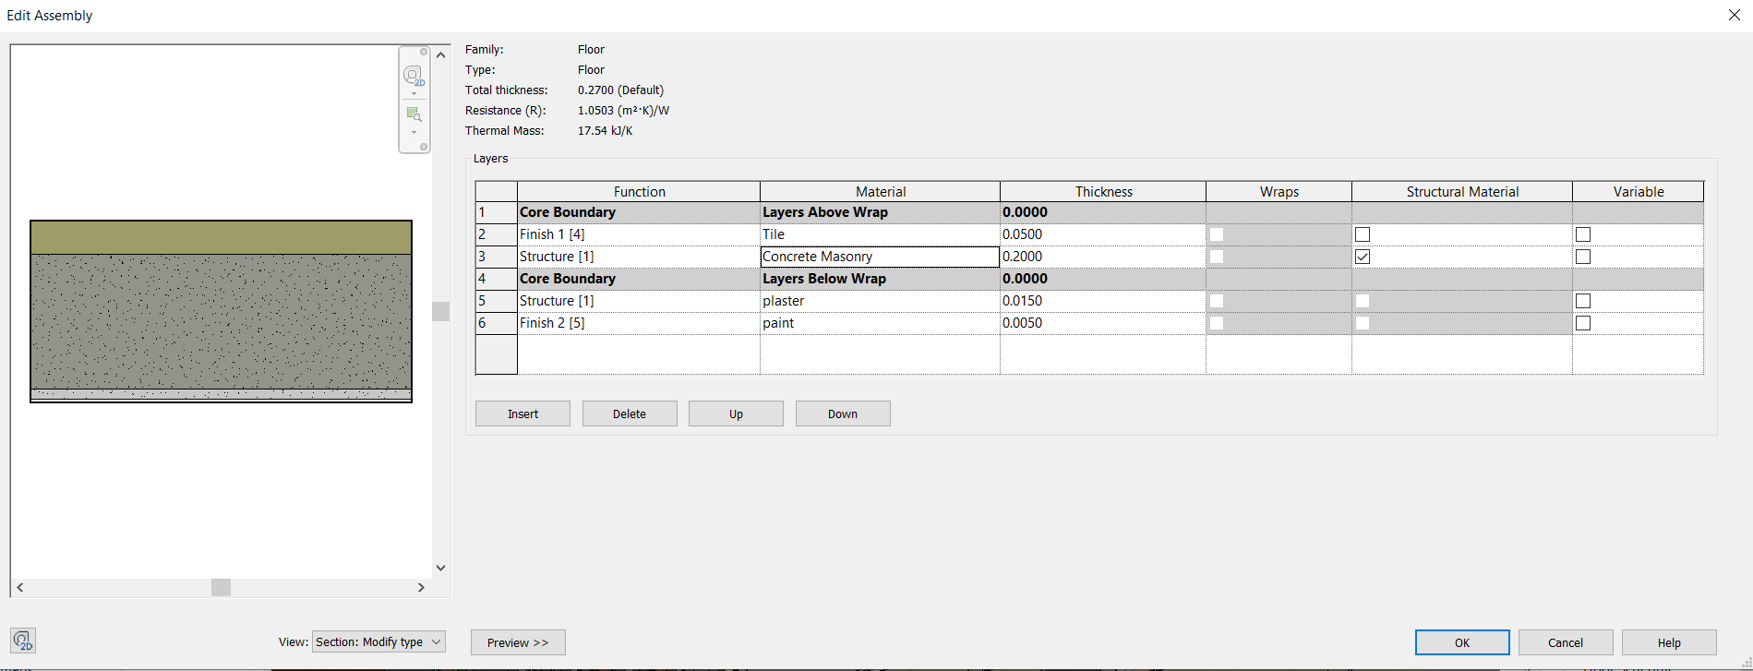
Section definition
Floor details

Slide 32
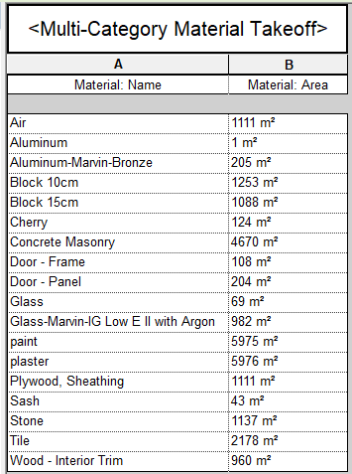
Final Results from Revit

Slide 33
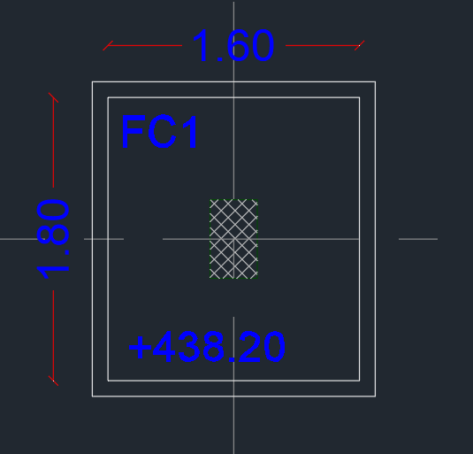
Sample calculation for footing excavation
R.L=439.7

Slide 34
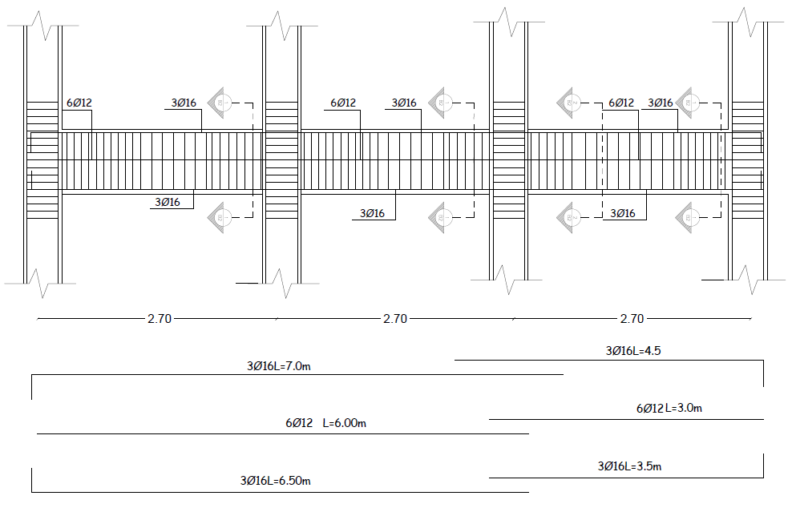
Sample calculation for steel reinforcement

Slide 35
Sample calculation for concrete volume
Depth =0.5m

Slide 36
BOQ
Item | Measured quantity | Unit
Item | Measured quantity | Unit
Excavation for footing | 1033.00 | CM
Excavation of tie beam | 120.00 | CM
Backfill works | 1010.00 | CM
Concrete for footing | 88 | CM
Blinding concrete under footings B150 | 21 | CM
Formwork of footings | 5.15 | CM
Steel reinforcement of footings | 6.3 | Ton
Formwork of C.N | 3.93 | CM
Steel reinforcement of C.N | 2.30 | Ton
Concrete for C.N | 32.60 | Ton
stirrups in C.N | 1940 | #
Formwork of G.B | 4.10 | CM
Steel reinforcement of G.B | 0.76 | Ton
Concrete for G.B | 51.75 | CM
stirrups in G.B | 2308 | #
Formwork of S.G | 0.15 | CM
Steel reinforcement of S.G | 0.69 | CM
Concrete for S.G | 86 | Ton
Formwork of G.F slab | 12.92 | CM
Steel reinforcement of G.F slab | 14 | Ton
Blocks 14cm for G.F slab | 3340 | Peace
Concrete placing for G .F slab | 86 | CM
Steel reinforcement of G.F beam,… | 4.6 | Ton
stirrups in beams | 4190 | #
Formwork of 1st.F slab | 28.20 | CM

Slide 37
BOQ
Item | Measured quantity | Unit
Item | Measured quantity | Unit
Blocks 14cm for 1st.F slab | 8048 | Peace
Concrete placing for 1st.F slab | 190 | CM
Steel reinforcement of 1st.F lintels,… | 12 | Ton
stirrups in beams | 9492 | #
Formwork of slab | 1.45 | CM
Steel reinforcement of slab | 2 | Ton
Concrete placing for slab roof | 10 | CM
Steel reinforcement of Beam roof | .25 | Ton
stirrups in beams for beam roof | 366 | #
Formwork for column | 55.25 | CM
Steel reinforcement | 1.44 | Ton
Concrete For coulm | 238 | CM
stirrups in all column | 12290 | #
Formwork for stairs | 4.38 | CM
Steel reinforcement | 5 | Ton
Concrete for stairs | 37 | CM
Block 15 | 1088 | Peace
Block 10 | 1253 | Peace
Plastering works | 5976.00 | SM
tile works | 2178.00 | SM
Painting works | 5976.00 | SM
Wood Doors | 115.00 | SM
Steel Doors | 44.00 | SM
Shaved wood door | 45.00 | No.
Shaved steel door | 15.00 | No.
Aluminium | m² | 205.00
براطيش | m² | 39.00
stone work | m² | 1130.00

Slide 38
BOQ
Item | Measured quantity | Consultant quantity | Variance reason
Excavation for footing and tie beam | 1353 CM Without allowance =305 CM | 325 | Because we can’t know the exact allowance of the project,
Blinding Concrete B150 under foundations, footings & tie beams. The thickness should be 10cm or according to drawings. | 210 MS | 204 MS | -
Supply and Cast Reinforced Concrete Grade 'B 250' a). Foundations and Wall Footings with column neck | 120CM | 110CM | -
Supply and Cast Reinforced Concrete Grade 'B 250'. For Slab on | 573SM | 536 SM
Supply and Cast Reinforced Concrete Grade 'B 300' for 20 cm thick suspended ribbed slabs. Price to include projected beams, | 1455 SM | 1380 SM | Because of the method of evaluating the exact volume of beam and slab

Slide 39

Time Schedule Using Primavera Software

Slide 40

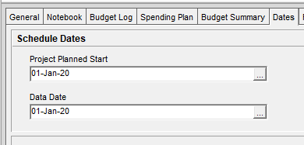
The parameters needed to define the project in Primavera software:

Slide 41
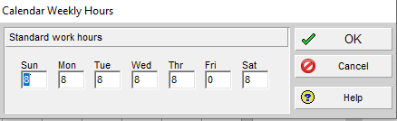
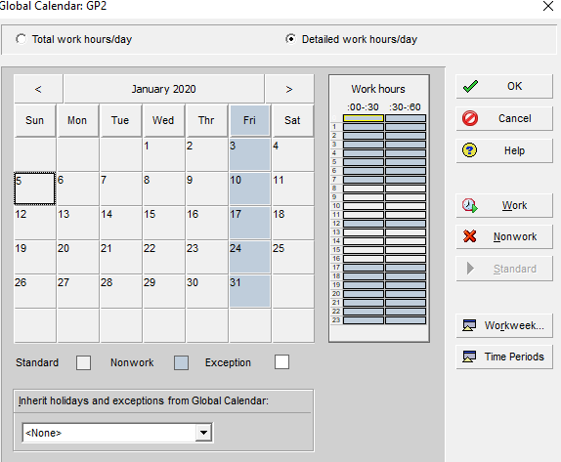
Calendar Definition:

Slide 42
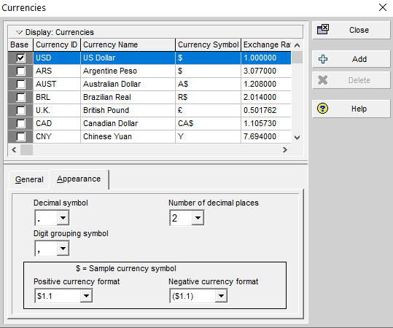
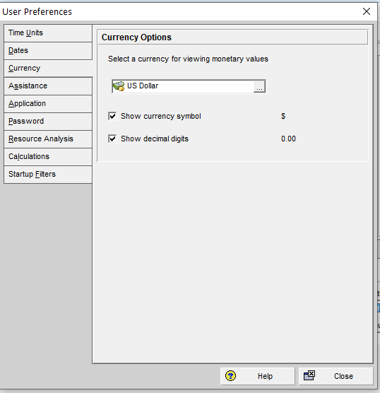
Currency Definition

Slide 43
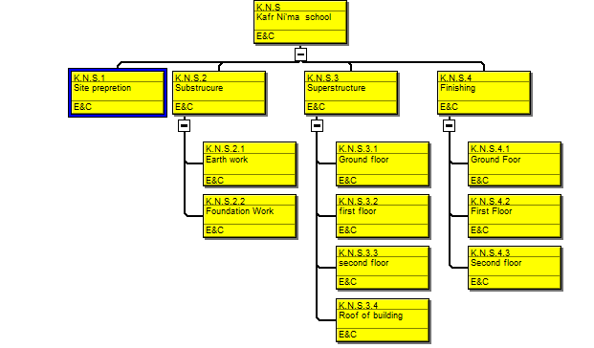
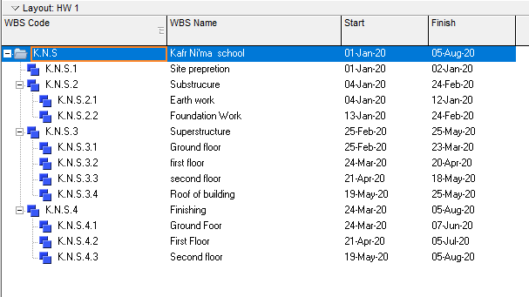
Work breakdown structure

Slide 44
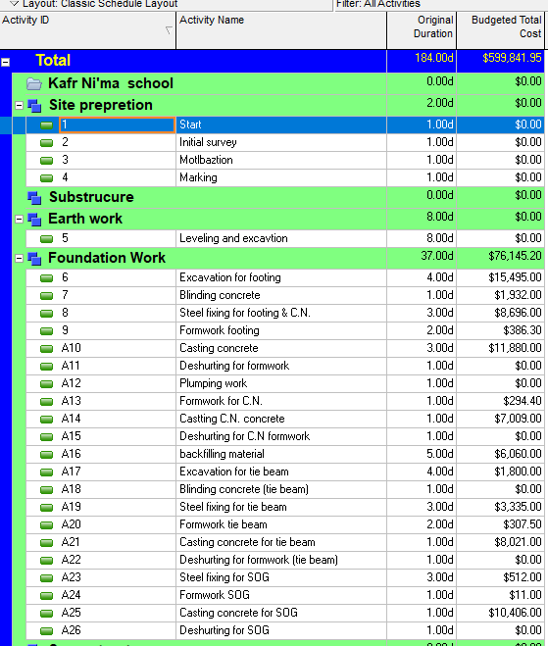
Project activities

Slide 45
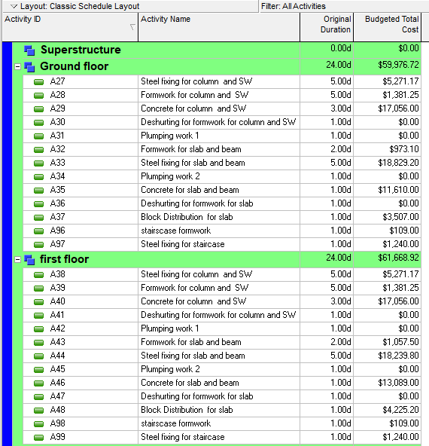
Project activities

Slide 46
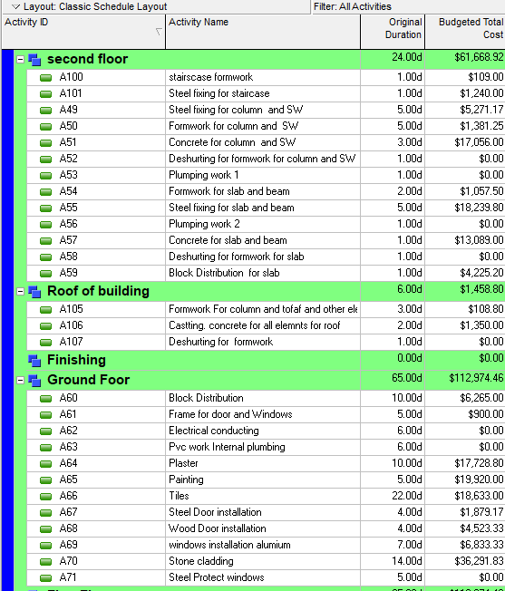
Project activities

Slide 47
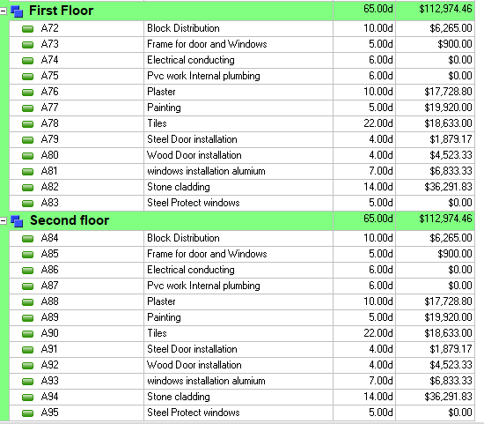
Project activities

Slide 48
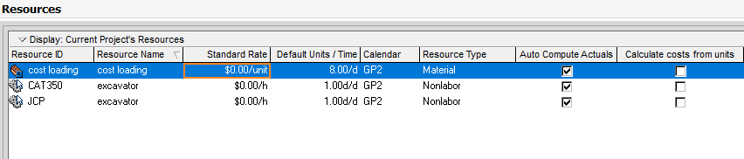
Resource in P6

Slide 49
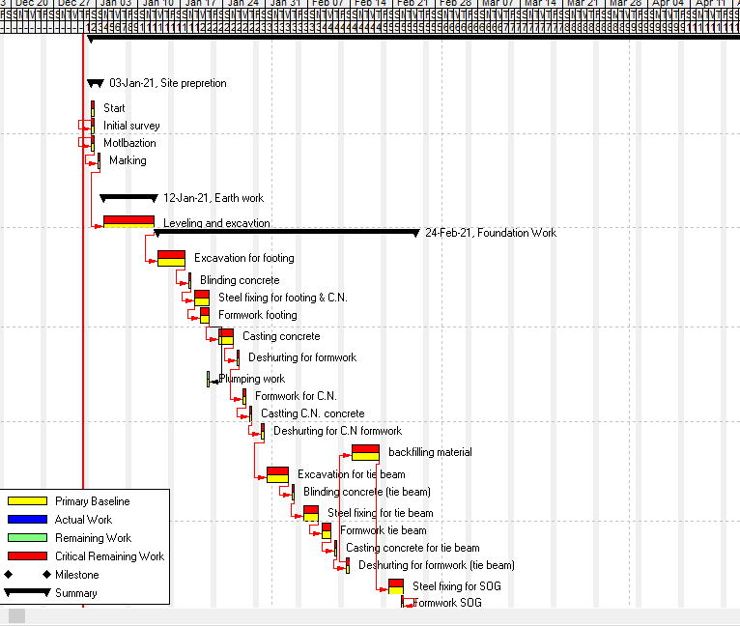
Bar chart

Slide 50
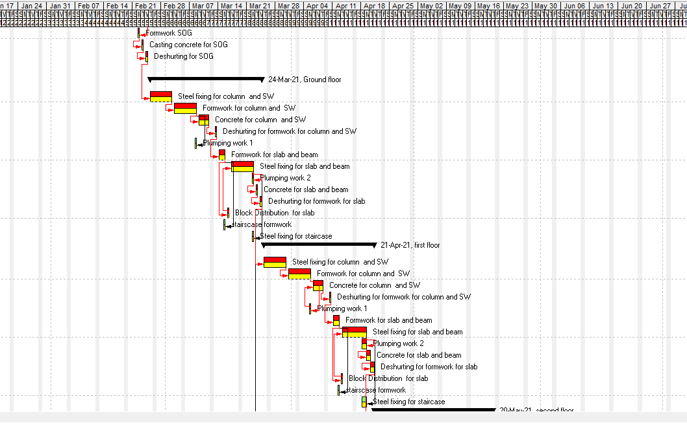
Bar chart

Slide 51
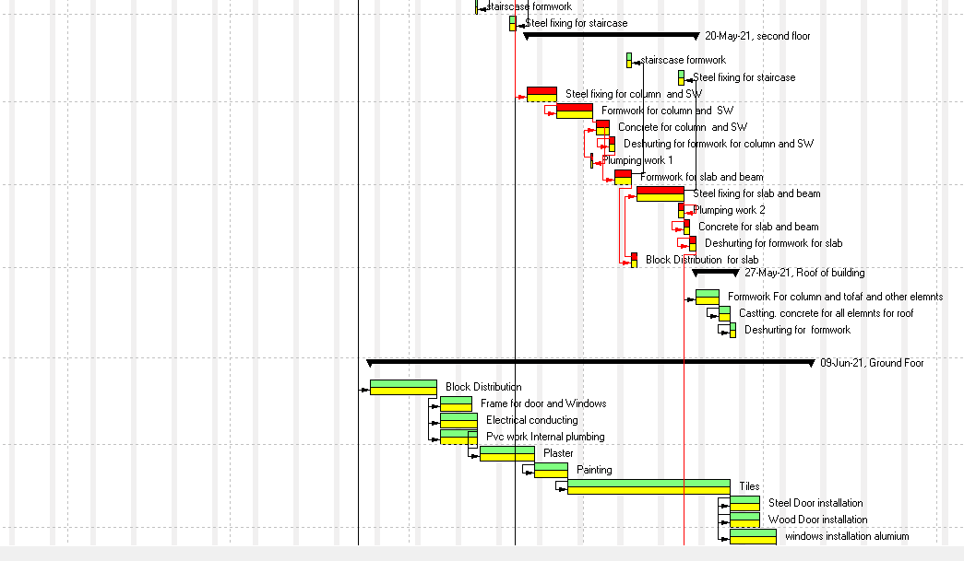
Bar chart

Slide 52
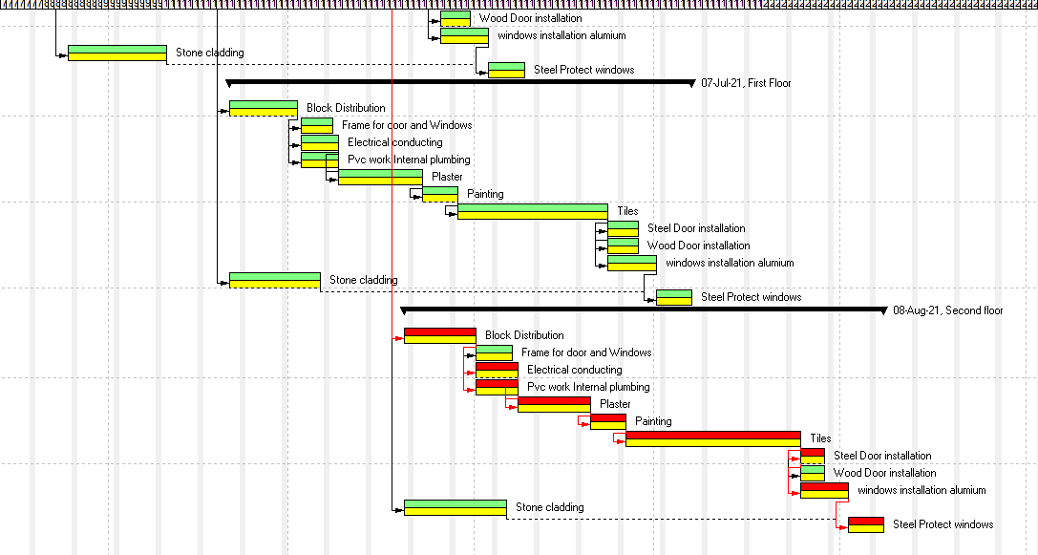
Bar chart

Slide 53
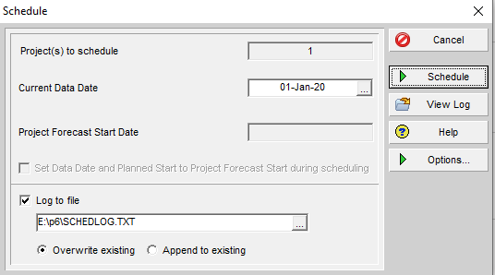
Schedule (Run)

Slide 54
Item | Measured quantity | Consultant quantity
Excavation for footing and tie beam | 1353 CM Without allowance =305 CM | 325
Blinding Concrete B150 under foundations, footings & tie beams. The thickness should be 10cm or according to drawings. | 210 MS | 204 MS
Supply and Cast Reinforced Concrete Grade 'B 250' a). Foundations and Wall Footings with column neck | 120CM | 110CM
Supply and Cast Reinforced Concrete Grade 'B 250'. For Slab on | 573SM | 536 SM
Supply and Cast Reinforced Concrete Grade 'B 300' for 20 cm thick suspended ribbed slabs. Price to include projected beams, | 1455 SM | 1380 SM

Slide 55
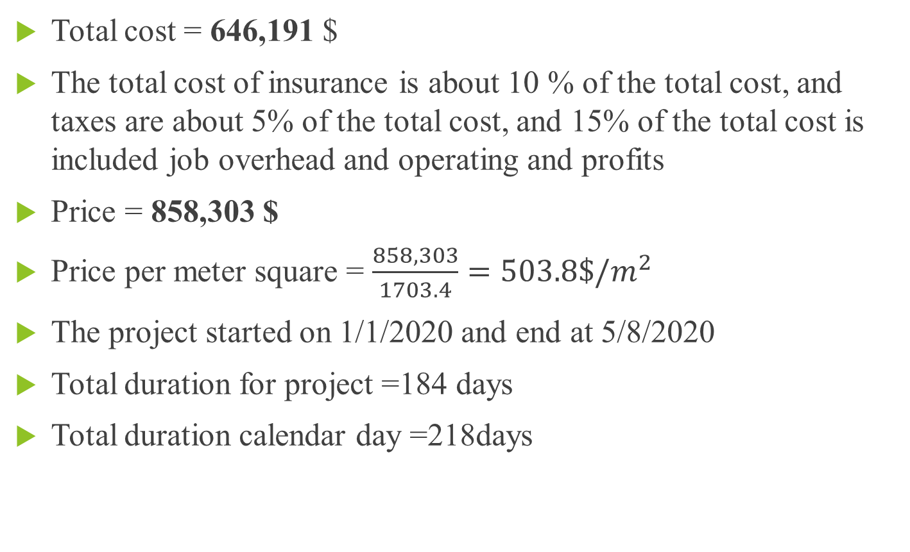
Results and Conclusions
Total cost = 646,191 $
The total cost of insurance is about 10 % of the total cost, and taxes are about 5% of the total cost, and 15% of the total cost is included job overhead and operating and profits
Price = 858,303 $
Price per meter square = $\frac{858,303}{1703.4}=503.8\$/m^{2}$
The project started on 1/1/2020 and end at 5/8/2020
Total duration for project =184 days
Total duration calendar day =218days

Slide 56


