Slide 1
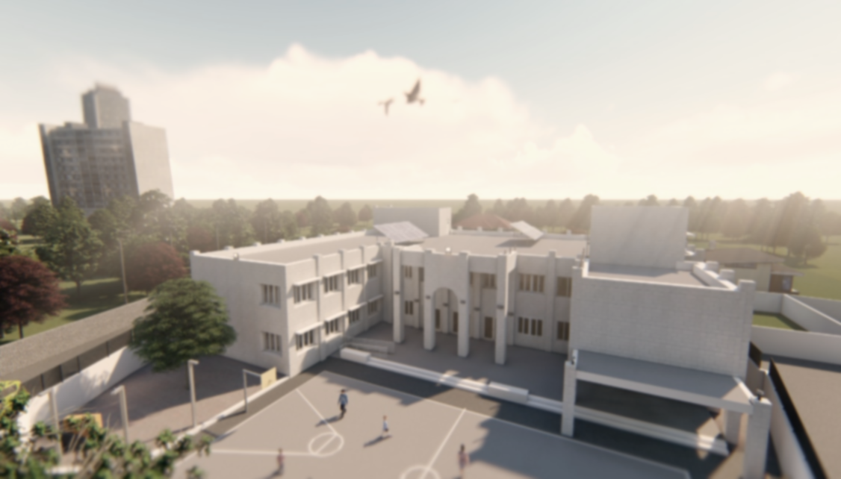

An-Najah National University
Building Engineering Department
HAJJA BASIC SCHOOL
Prepared By:
Baha 'a Mohammad
Haitham Awayes
Odai Said Salahat
Supervisor:
Eng. Ala’a Shaheen

Slide 2
Contents
Introduction
Cost estimation
Site and location
Fire and safety
Architectural
Electro- Mechanical Design
Environmental design
Structural Design

Slide 3
Introduction
The school environment is a part of the general environment, and has its own characteristics that are different from other environments.
Statistics indicate an increase in the number of students year after year and the need for new schools continuously to provide a good educational environment for children.
Total number of students is 288 ( 2019/2020).
Total number of employees is 12 .

Slide 4
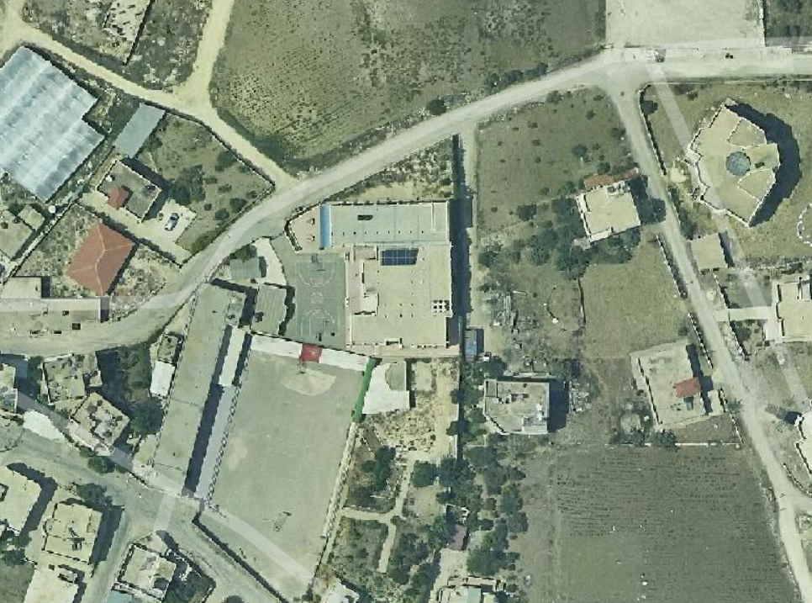
Site Description
Located to the east of Qalqilya.
Total area of the site is 2052 m².
It is surrounded by Secondary school from west, and there are houses at east .
The facility is reached by one road has an entrance leading inside, the road has a width of 6 m.

Slide 5
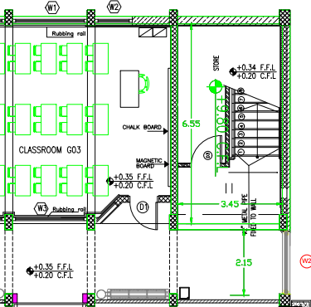
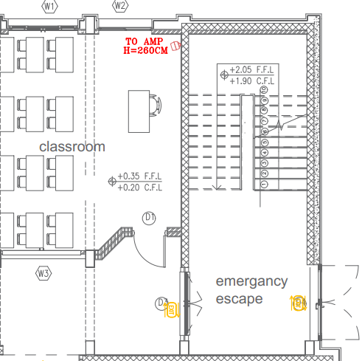
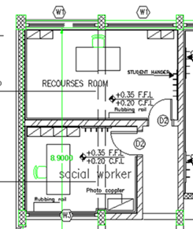
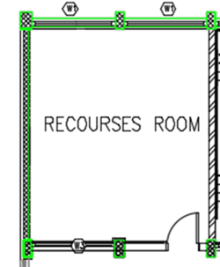
Architectural Modifications
Emergency stairs
Recourses Room
Before
After
Before
After

Slide 6
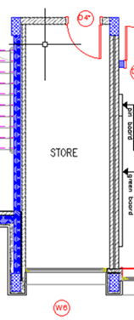
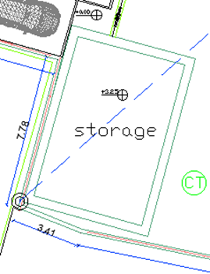
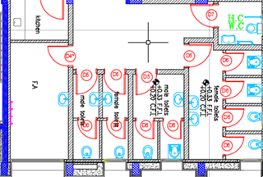
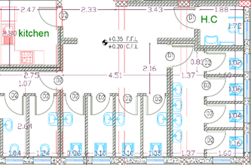
Architectural Modifications
Toilets
Storage
Before
After
Before
After

Slide 7
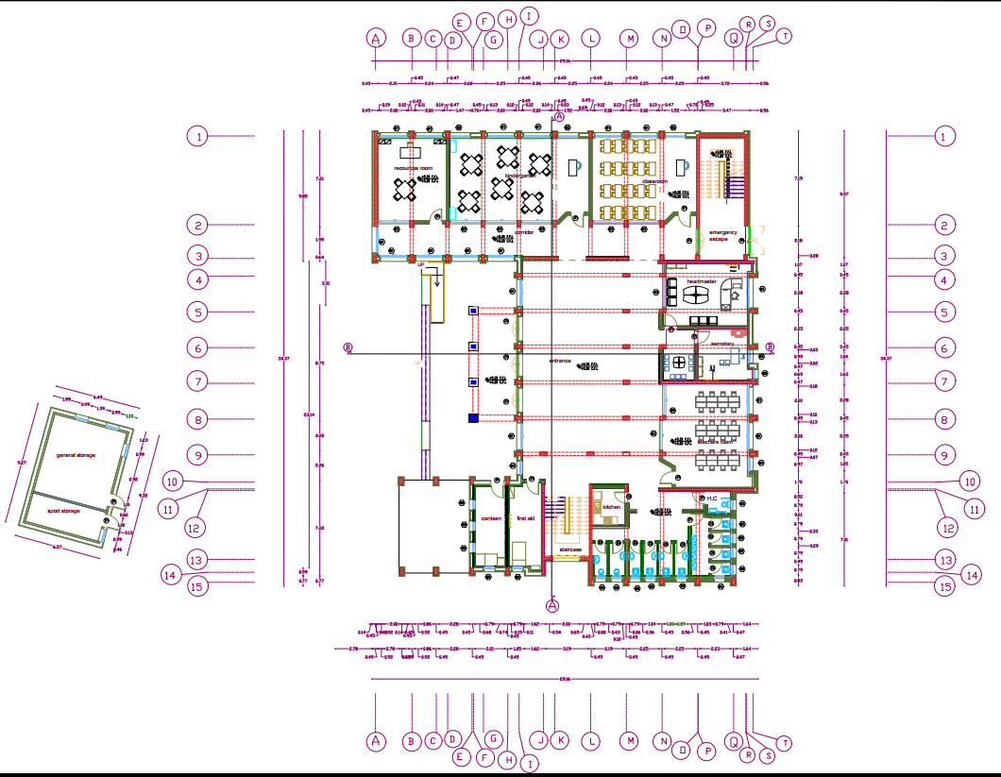
Architectural Plans
Ground Floor plan

Slide 8
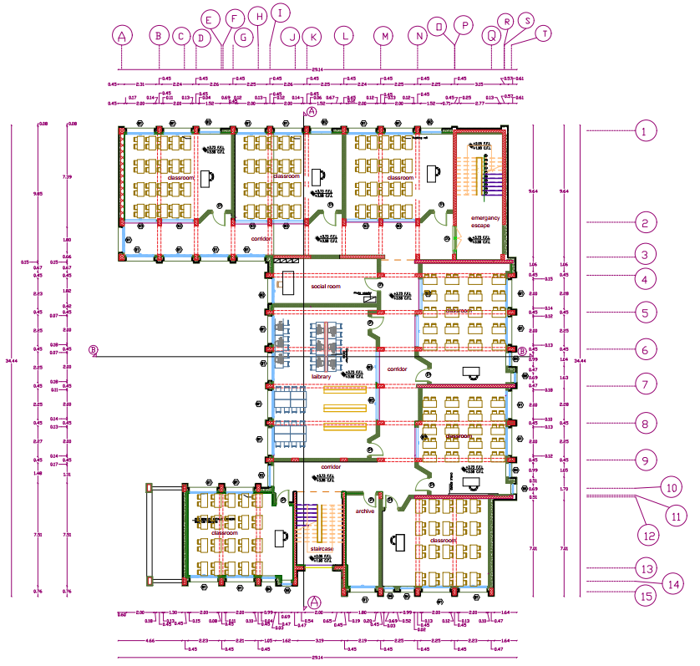
First Floor plan

Slide 9
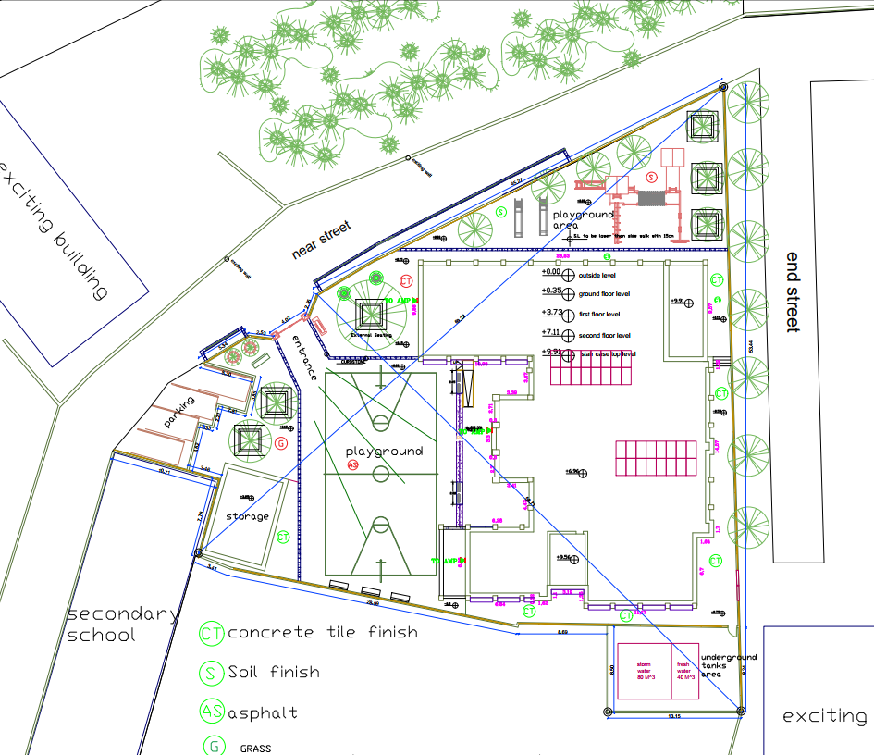
Site plan

Slide 10
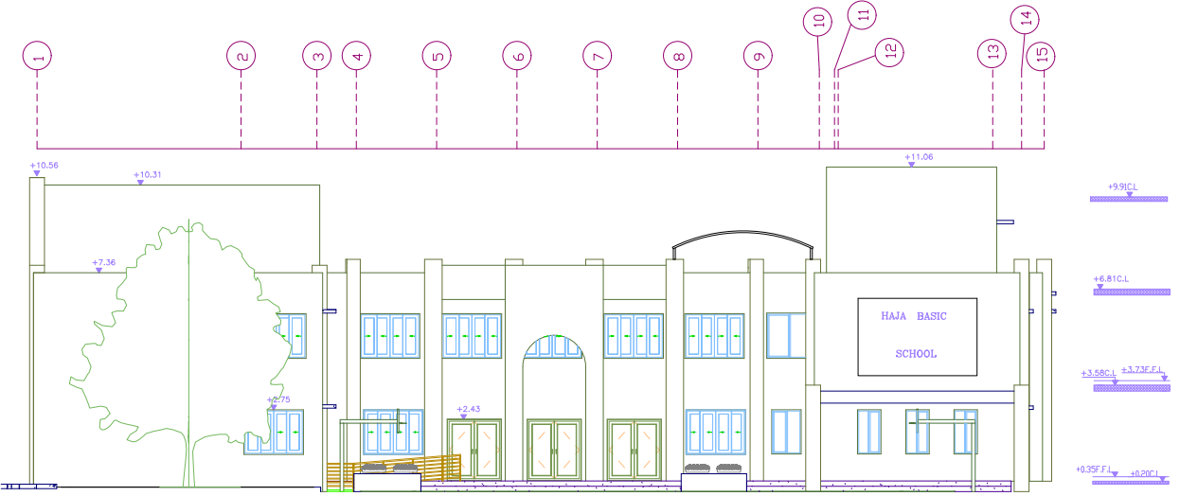
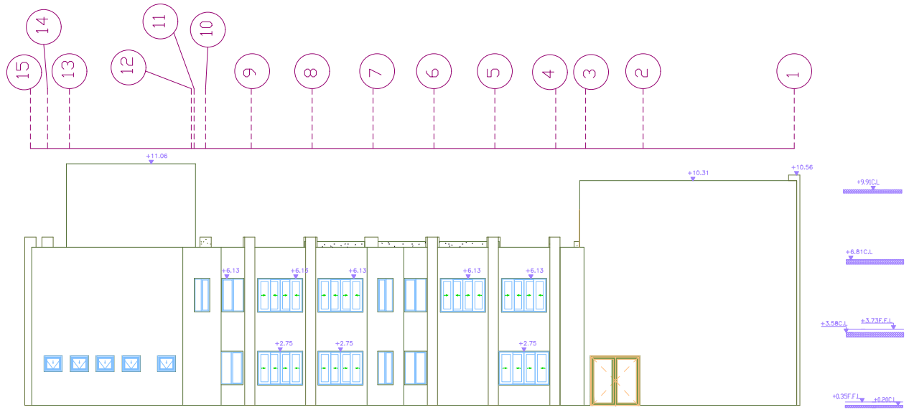
Elevations
West
East

Slide 11
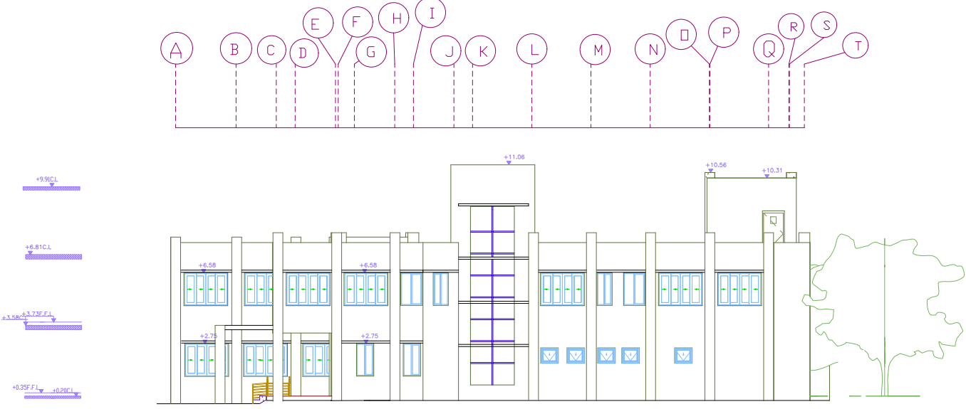
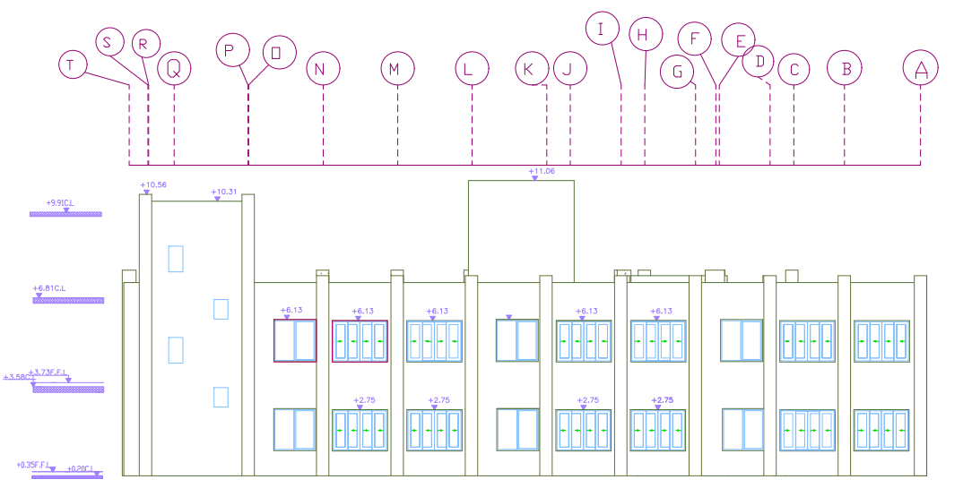
Elevations
South
North

Slide 12
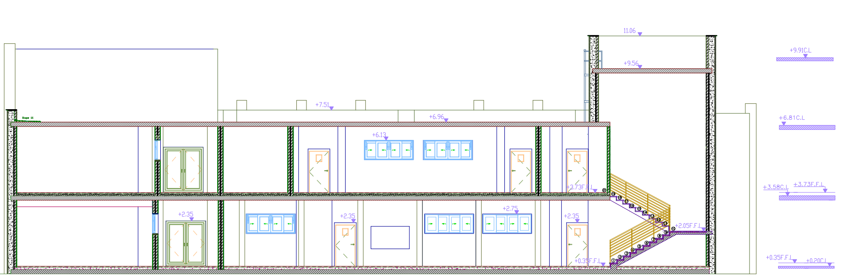
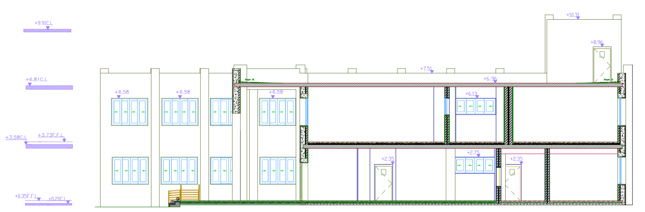
Sections
Section A-A
Section B-B

Slide 13

Environmental design
Material properties
Thermal behavior
Ventilation
Daylighting
shading
Acoustical Comfort

Slide 14
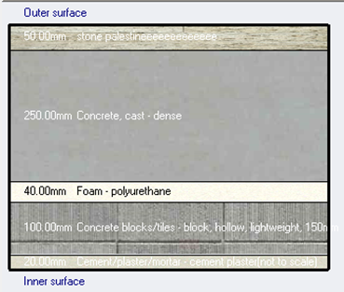
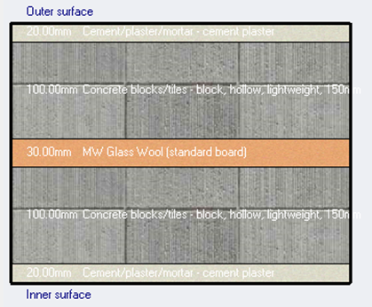
Material properties
External wall
Internal wall
U – value
0.5 w/m².k
U – value
0.657 w/m².k

Slide 15
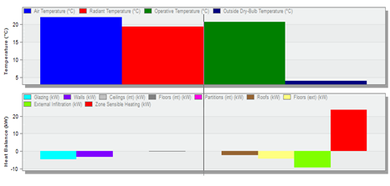
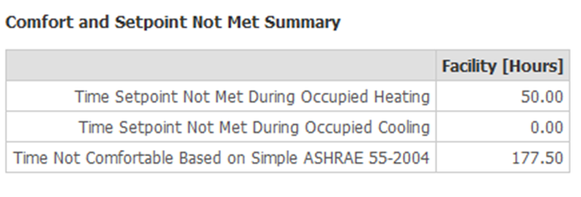
Thermal Analysis
Thermal comfort Analysis
Temperature
22 C
Total design heating capacity = 50 kW
Number of uncomfortable hour = 177.5 hour/year .

Slide 16
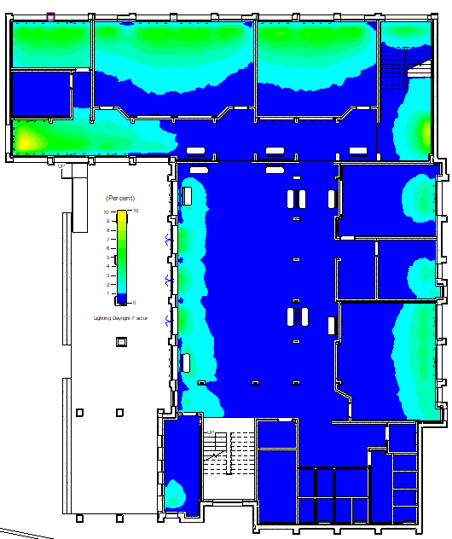
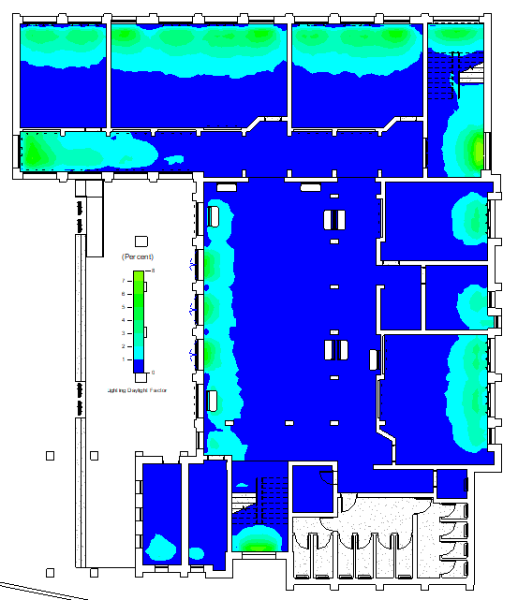
Daylight analysis
Daylight analysis for the model for the ground floor before and after modification
Before
After

Slide 17
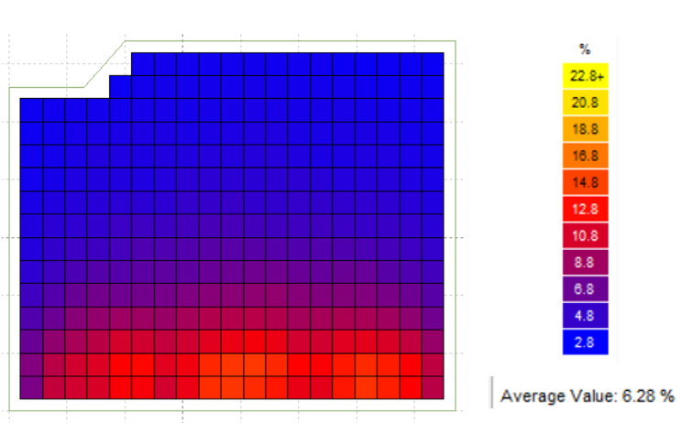
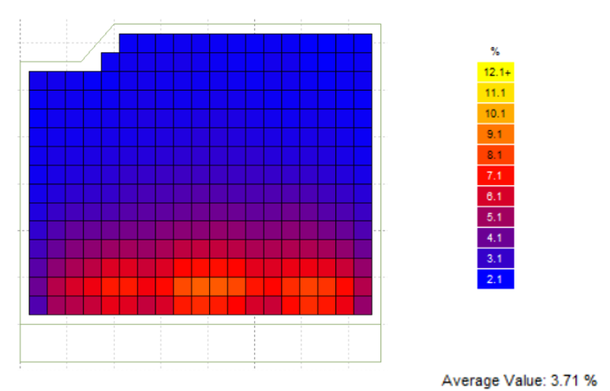
Daylight analysis
Daylight analysis for southern classroom before and after modification
Before
After

Slide 18
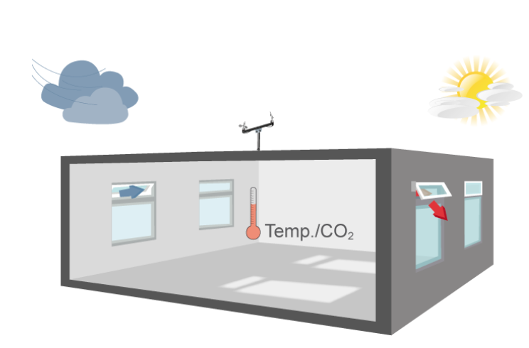
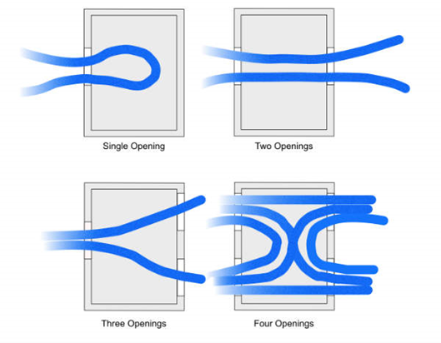
Ventilation
Natural ventilation is obtained through cross way.

Slide 19
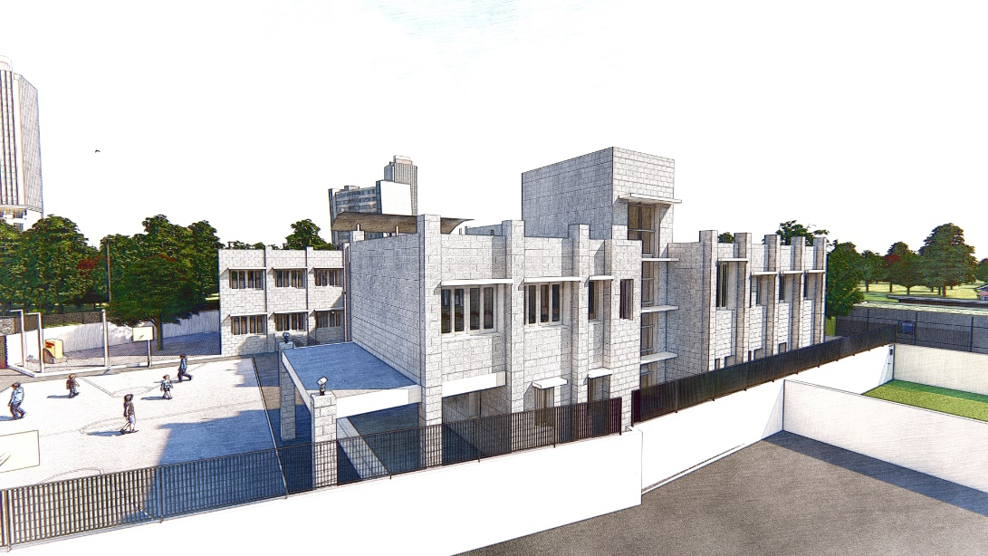
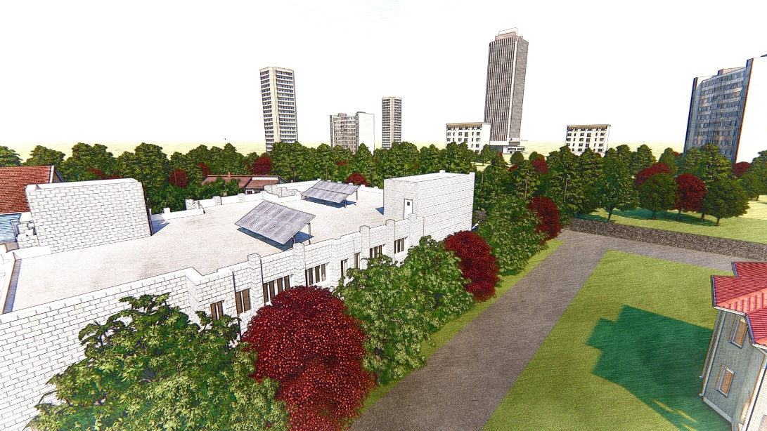
Shading
Horizontal cantilevers were added to windows in south facade for the decreasing process of solar gain through glass, and deciduous trees use for east elevation.

Slide 20
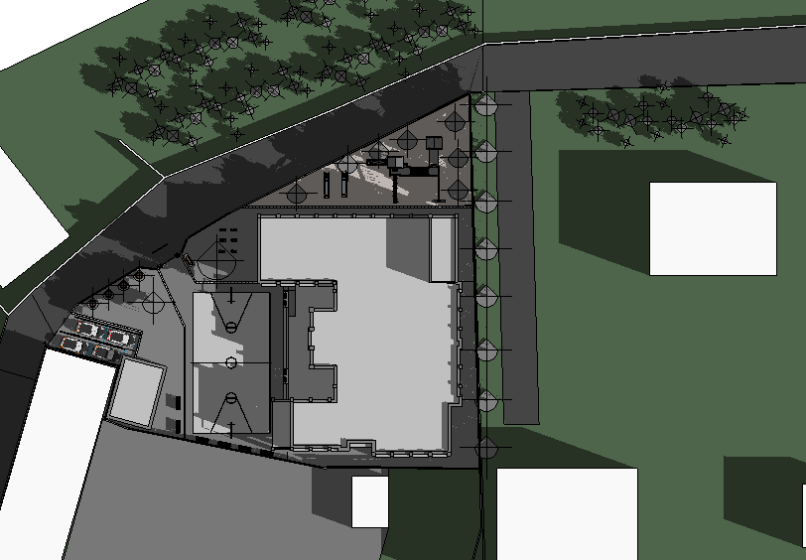
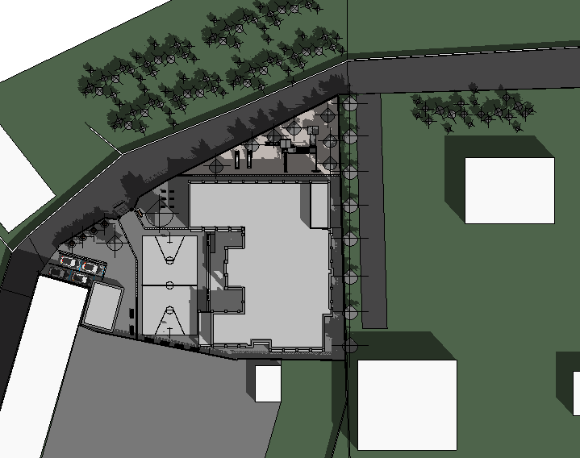
Over Shadowing
The overshadowing analyses show that the amenity have at least 2 hours during
work time for 50% and more of sunlight which is within the standard.
Shading in 21/3 at 8:00AM
Shading in 21/3 at 10:00AM
20

Slide 21
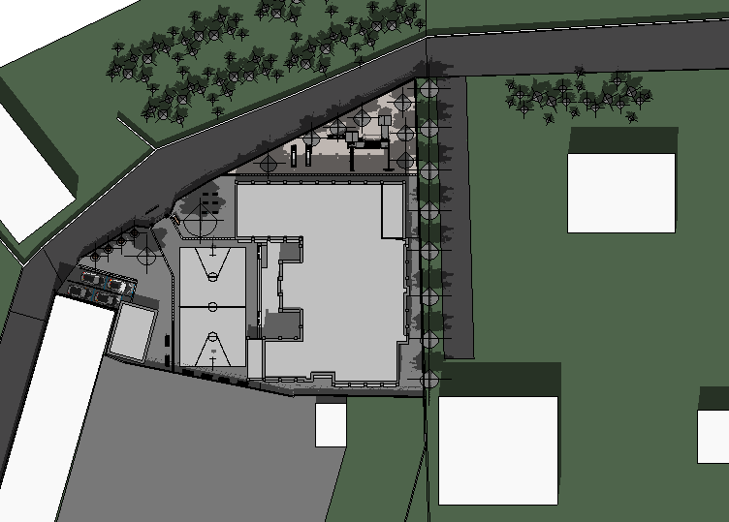
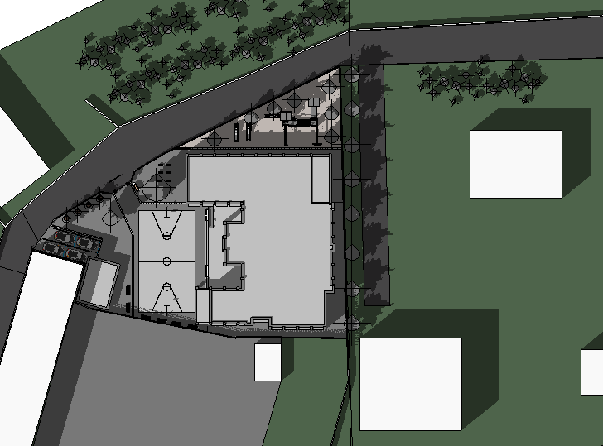
Shading in 21/3 at 12:00PM
Shading in 21/3 at 2:00PM
21

Slide 22
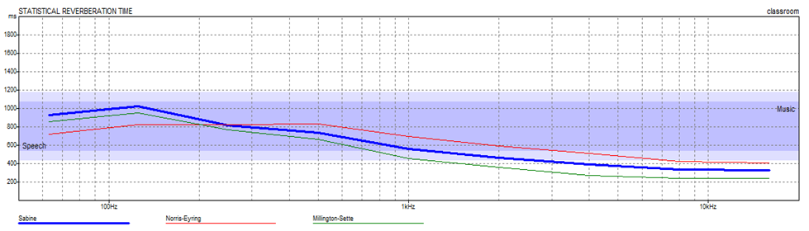
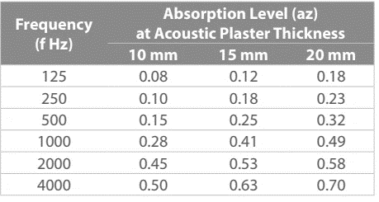
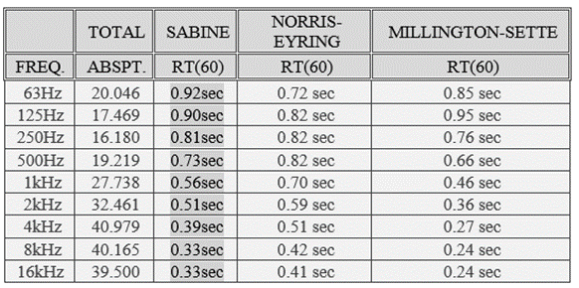
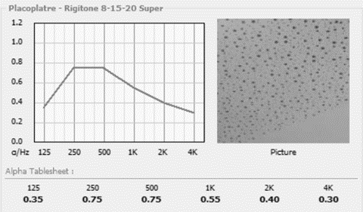
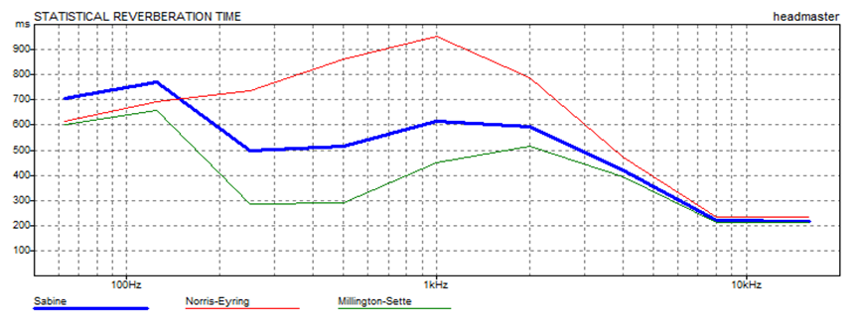
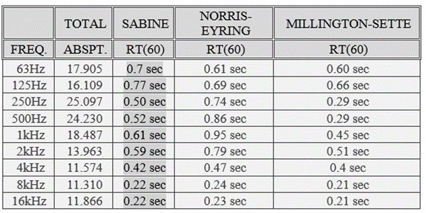
Acoustical Design
Designed spaces:
Classroom
Entrance
library
Corridor
Office
First aid room
Outside

Slide 23
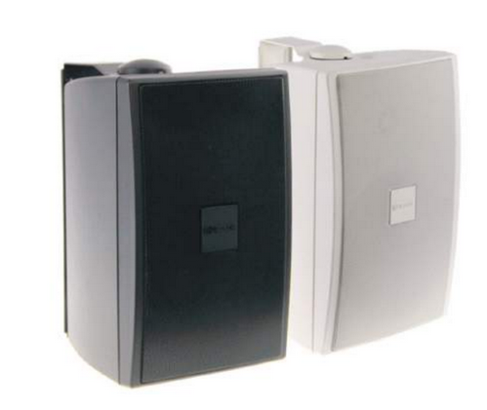
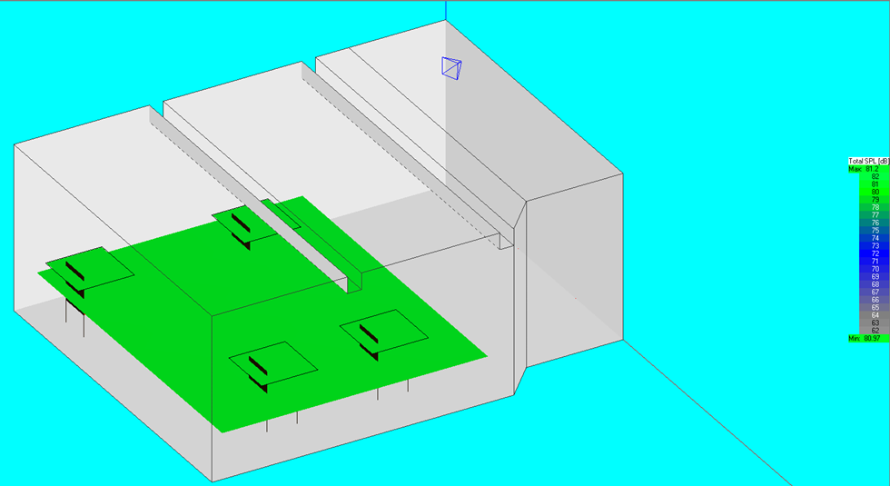
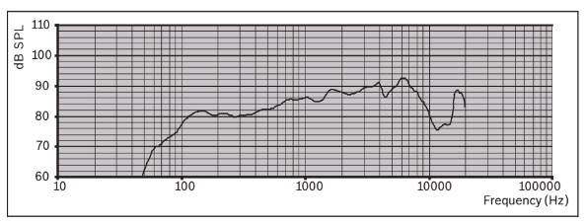
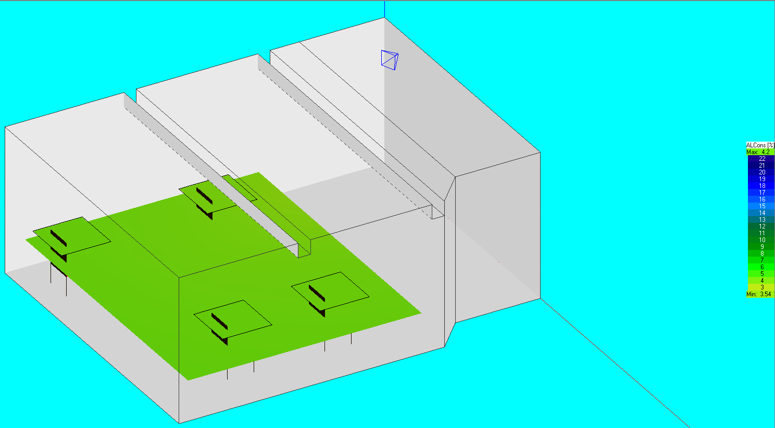
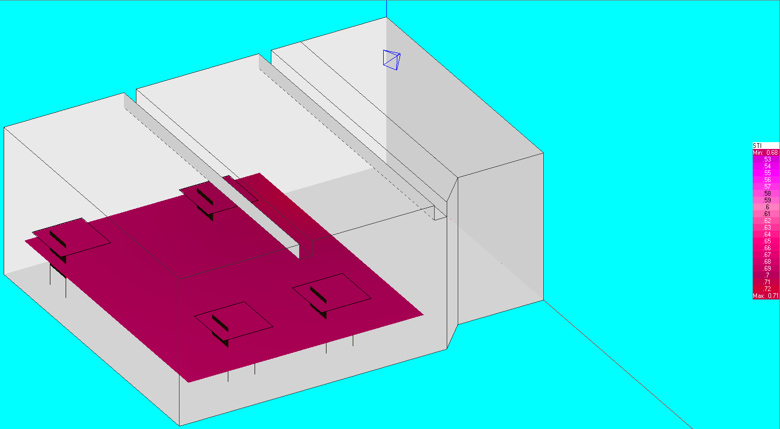
Acoustical Design
Loudspeakers
Classroom
Entrance
Outside

Slide 24
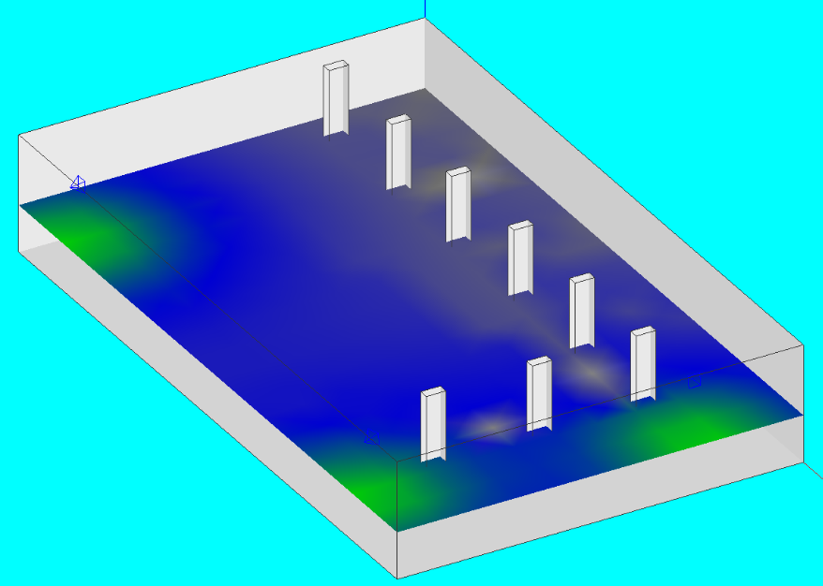

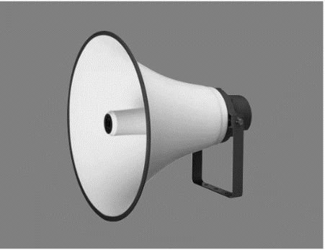
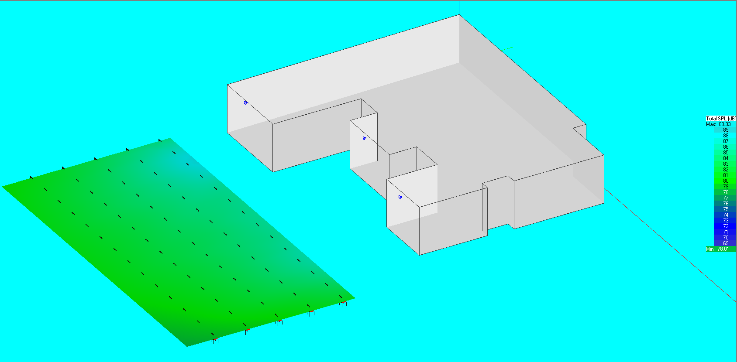
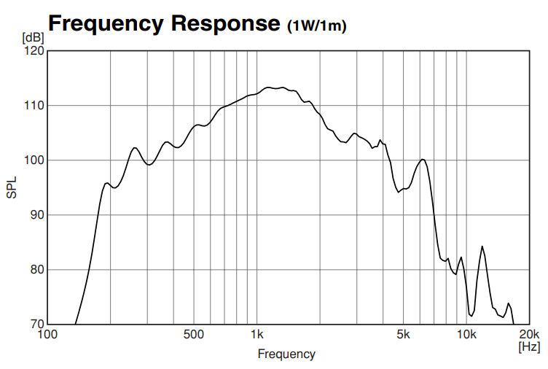

Classroom
Entrance
Outside

Slide 25


Loud speaker for ground floor

Slide 26



STC & OITC

Slide 27
Structural Design
Material properties
Verification checks
Seismic checks
Design and detailing
Codes

Slide 28

Structural Design
Codes
ACI 318M-14
ASCE
UBC 97
AISC LRFD
Material Properties
Reinforced Concrete
Property | Value
Compressive strength fʹc for substructure | 28 MPa
Compressive strength fʹc for super structure | 24 MPa
28

Slide 29


Reinforcing Steel Structural Steel
Property | Value
Grade | Grade 60
Modulus of elasticity | 200 GPa
Yielding strength | 420 MPa
Ultimate strength | 620 MPa
Property | Value
Grade | Grade 50
Modulus of elasticity | 200 GPa
Yielding strength | 250 MPa
Ultimate strength | 450 MPa
Load | Value
Live load | 5 kN/m²
Super imposed dead load | 4.5 kN/m²
Snow load | 0.5 kN/m²
Wind load | 0.7 kN/m²
Designed Loads
29

Slide 30
seismic load
Seismic zone factor Z = 2B
Soli profile: Stiff soil with site classification C
Seismic coefficient Ca =0.24
Seismic coefficient Cv = 0.32
Force reduction factor R=5.5
30

Slide 31

Structural blocks
31

Slide 32

Columns center
32

Slide 33


Verifications checks
Compatibility check
Equilibrium check
Internal Forces check
Block 2
Block 1
33

Slide 34


Verifications checks
Equilibrium check
Block 1
Block 2
34

Slide 35
Verifications checks
Internal Forces check
Block 2
Block 1
35

Slide 36


Seismic load checks
Mass participation ratio for modal analysis check
36

Slide 37


Seismic load checks
Drift check
Block 1
Block 2
37

Slide 38
Structural aspects
ETABS Checks
Base Shear check
For this check make sure base shear from response spectrum cases equal or more than base shear from equivalent static method through modifying scale factor.
Base Shear check for Block 1
Base Shear check for Block 2
38

Slide 39

Slab system
Block 1 – one-way ribbed slab 20 cm – Drop beams
39

Slide 40

Slab system
40
Block 2 – one-way ribbed slab 20 cm – Drop beams

Slide 41

Slab Section
One-way ribbed slab section
41

Slide 42



Beams Design
42

Slide 43


Columns Design
Longitudinal reinforcement steel design
Column | Rebar % | Width | Depth | As used | Middle | S (stirrups)
 |  | mm | mm | mm² | bars | mm
C1 | 1.00% | 200 | 500 | 1000 | 8Ø14 | 1Ø10/200
C2 | 1.00% | 250 | 500 | 1250 | 10Ø14 | 1Ø10/200
C3 | 1.00% | 400 | 500 | 2000 | 10Ø16 | 1Ø10/200
43

Slide 44


Shear wall Design
44

Slide 45


Footing Design
45

Slide 46



Footing Design
46

Slide 47


Footing Design
47

Slide 48



Water tank
48

Slide 49


Steel Design
49

Slide 50



Steel Design
Group | Section (mm)
Purlins | TUBO 30×60×3.6
Beams | TUBO 600×600×5.9
columns | TUBO 600×600×5.9
50

Slide 51



Connection Design
51

Slide 52


Connection Design
Base plate
52

Slide 53

Stairs Design
53

Slide 54




Mechanical design
Water system
Drainage system
Central Heating system
Fire Fighting

Slide 55

Water system

Slide 56


Water system
Diameter Of Pipes
Vertical | Horizontal | Branch
2 '' | 1.25'' | 0.75''

Slide 57


Drainage system

Slide 58


Drainage system
Rain water drainage

Slide 59



Central Heating system
Total Design Heating load = 50 kW

Slide 60


Distribution of Radiator for the ground floor

Slide 61


Distribution of Radiator for the first floor

Slide 62






Fire Fighting

Slide 63


Fire Fighting

Slide 64



Emergency Exits

Slide 65




Electrical design
Socket distribution
Artificial lighting
Low Voltage System
PV system

Slide 66



Electrical design
Socket distribution

Slide 67







Artificial lighting
The selected Luminaires
Lighting with switches

Slide 68





Illuminance result from DIALux evo for the classroom .

Slide 69




Result from DIALux evo
Headmaster room
Library

Slide 70


Light and switch distribution

Slide 71

Light and switch distribution

Slide 72


Low voltage distribution

Slide 73





PV system
Cash flow chart
73

Slide 74
Quantity surveying and cost estimation
1. Total project cost is ILS 2260000
2. Unit cost for project ILS 1350 per m²
3. Unit cost for structural work ILS 960 per m²
4. Unit cost for mechanical work ILS 50 per m²
5. Unit cost for electrical work ILS 120 per m²

Slide 76


