Slide 1
Kashaf 2.0
Students:
Mohammed Shammout
Alaa Bishtawi.
Advisors:
Dr. Mona Dmedi
Dr. Emad Natsheh.

Slide 2
Introduction
Kashaf is a General-Purpose navigation Robot.
Provides the main Navigation functionality.
It serves as a base for other more complex robots.

Slide 3
Functionality
Exploration: explore and map unknown environments.
  Manual.
  Automatic.
Navigation: move autonomously to any point on the map.

Slide 4
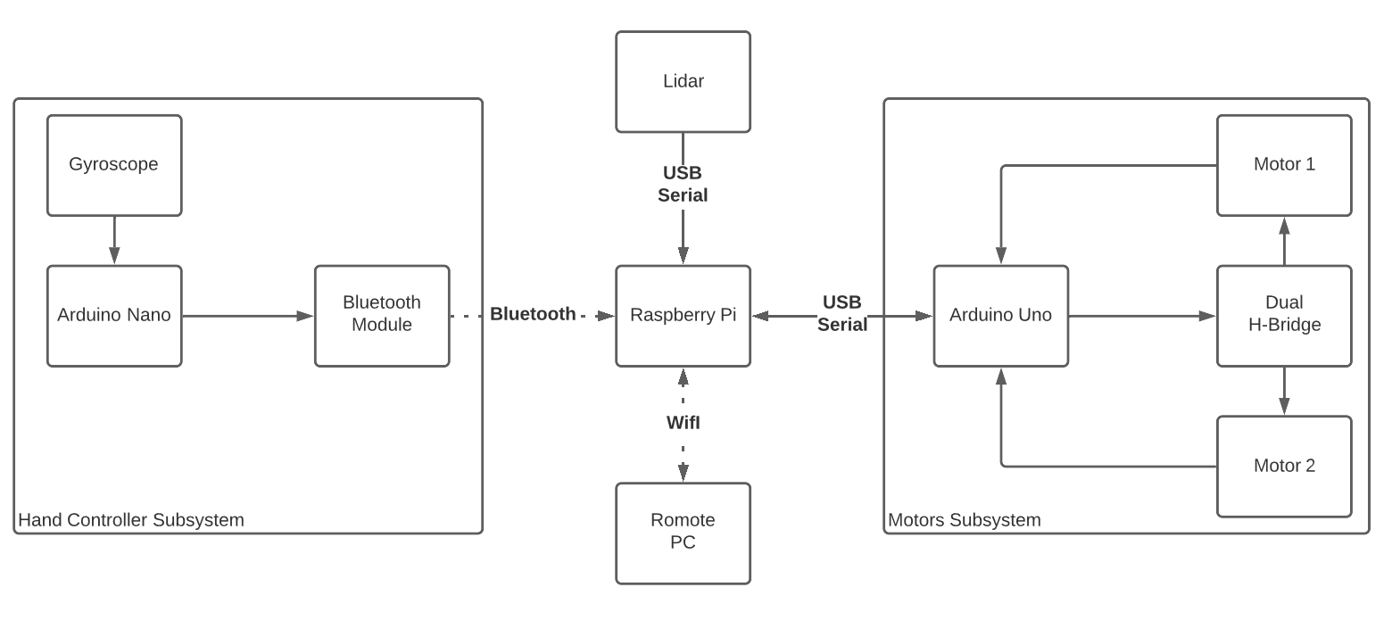
Hardware Architecture

Slide 5
Software
Robotic Operating System (ROS).
Publisher/subscriber Architecture.
Run on Multiple machines.

Slide 6
SLAM
Simultaneous Localization and mapping.
Create the map and provide robot location relative to map.
Uses LIDAR scan.
Example Algorithms: Hector SLAM, Gmapping.

Slide 7
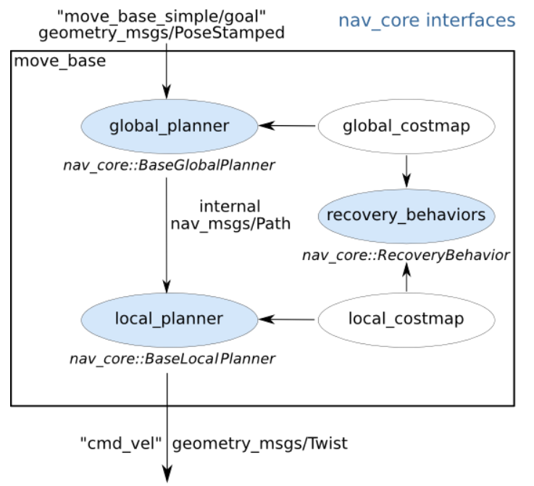
Navigation
Move_base package.
Provides the functionality for navigation.
  Costmaps
  Path Planning
  Recovery.

Slide 8
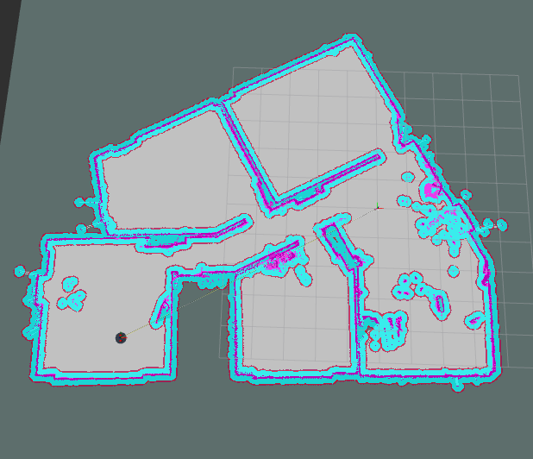
Costmap
Global Costmap
Local Costmap

Slide 9
Path Planning
Global Planner
Local Planner
Determines the general Path.
Provides the path for local planner.
Uses global Costmap.
Uses Dijkstra Algorithm.
Determines the next step.
Provides velocity commands.
Uses local Costmap.
Uses Trajectory Rollout.

Slide 10
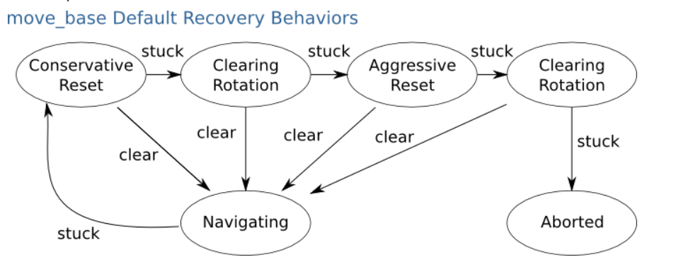
Recovery

Slide 11
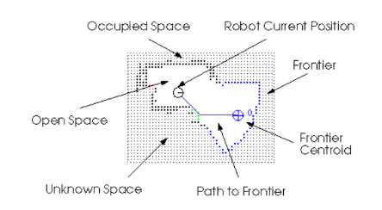
Exploration.
Use explore lite Package.
Extracts frontiers from the map.
Sends the goal for navigation.

Slide 12

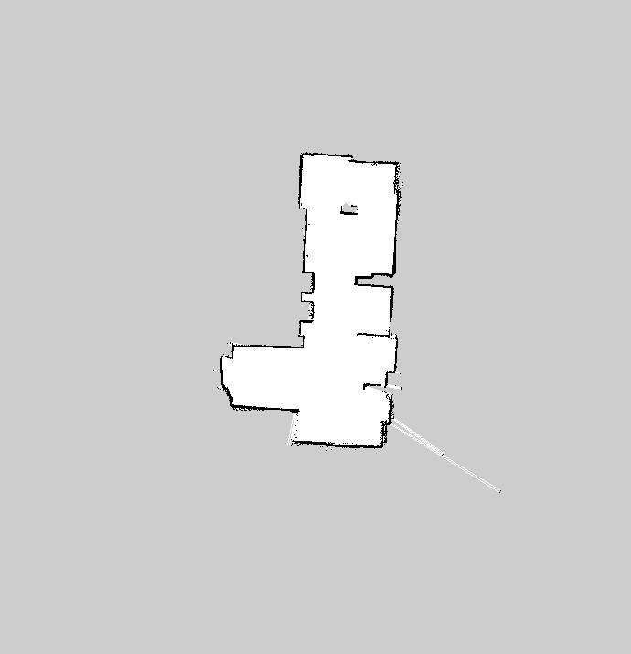
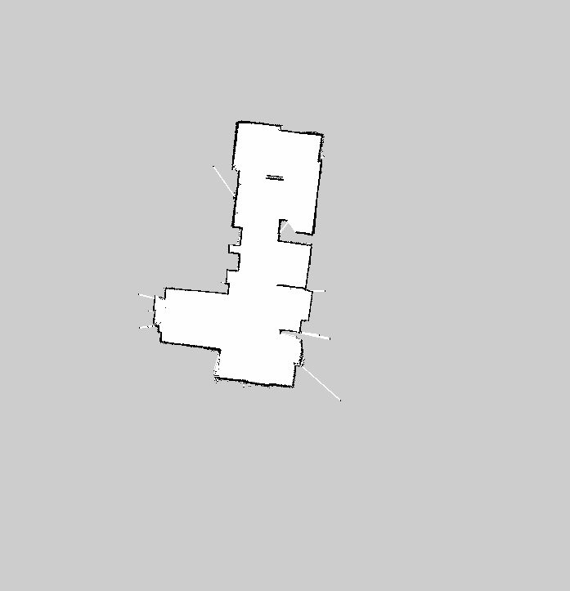
Results

