Slide 1
Firefighting Autonomous Mobile Robot

Slide 2

OUTLINE
INTRODUCTION
ROBOTICS
ROBOT DESIGN
PRACTICAL PART
FUTURE WORK

Slide 3
INTRODUTION

Slide 4
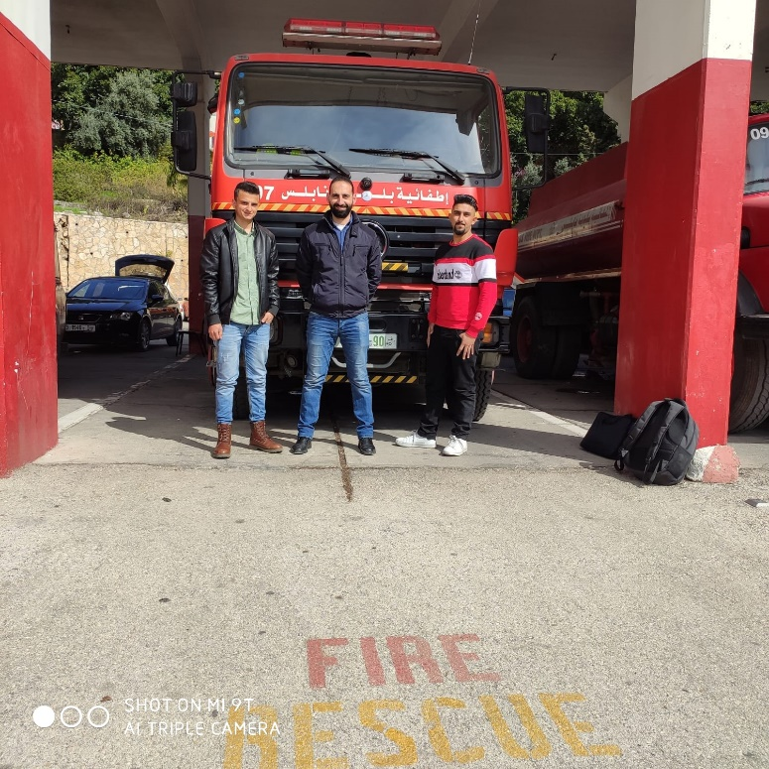
Danger.
Site visit.
Eng. Shams Abu Ghazaleh.

Slide 5
ROBOTICS

Slide 6
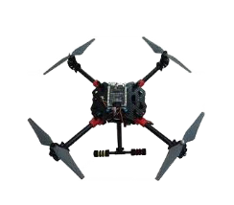
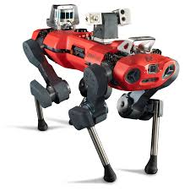
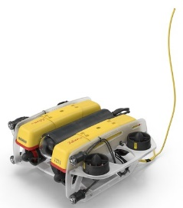
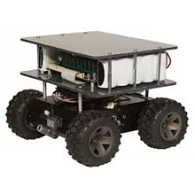
Mobile Robots
Legged Mobile Robots
Aerial Mobile Robots
Water-Based Mobile Robots
Wheeled Mobile Robots

Slide 7
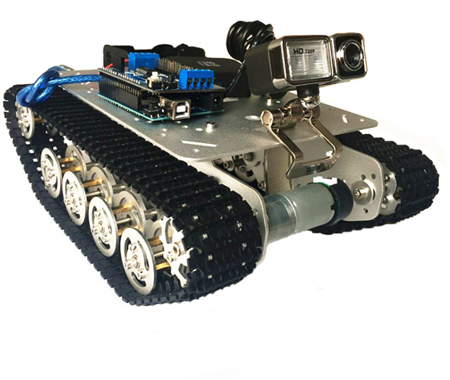
Tracked Mobile Robots
Advantages
•Spread load out for a low PSI rating.
•Makes climbing much easier.
•Handles more aggressive terrain.

Slide 8
ROBOT DESIGN

Slide 9




Robot Design
Mechanical
Electrical
Control
Firefighting

Slide 10
MECHANICAL DESIGN

Slide 11
The Mechanical Components needed for this project are:
Tracks.
Pulleys.
Chassis.

Slide 12
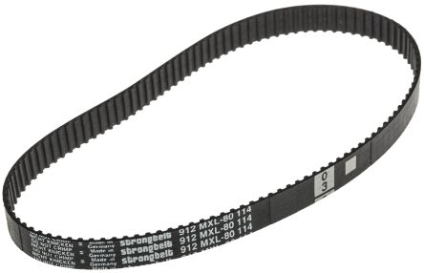
Flexible tracks
Timing belt
Advantages:
Suitable for low speed.
Surface friendly.
Light weight.
Reduced noises and vibration.

Slide 13
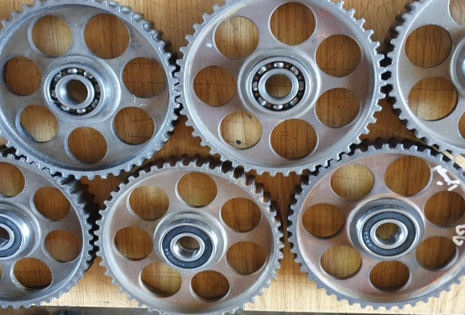
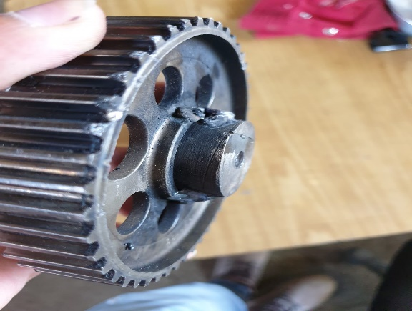
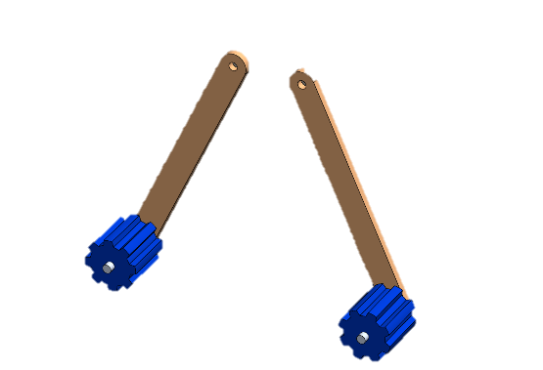
Main pulleys
Secondary pulleys
Guiding pulleys

Slide 14
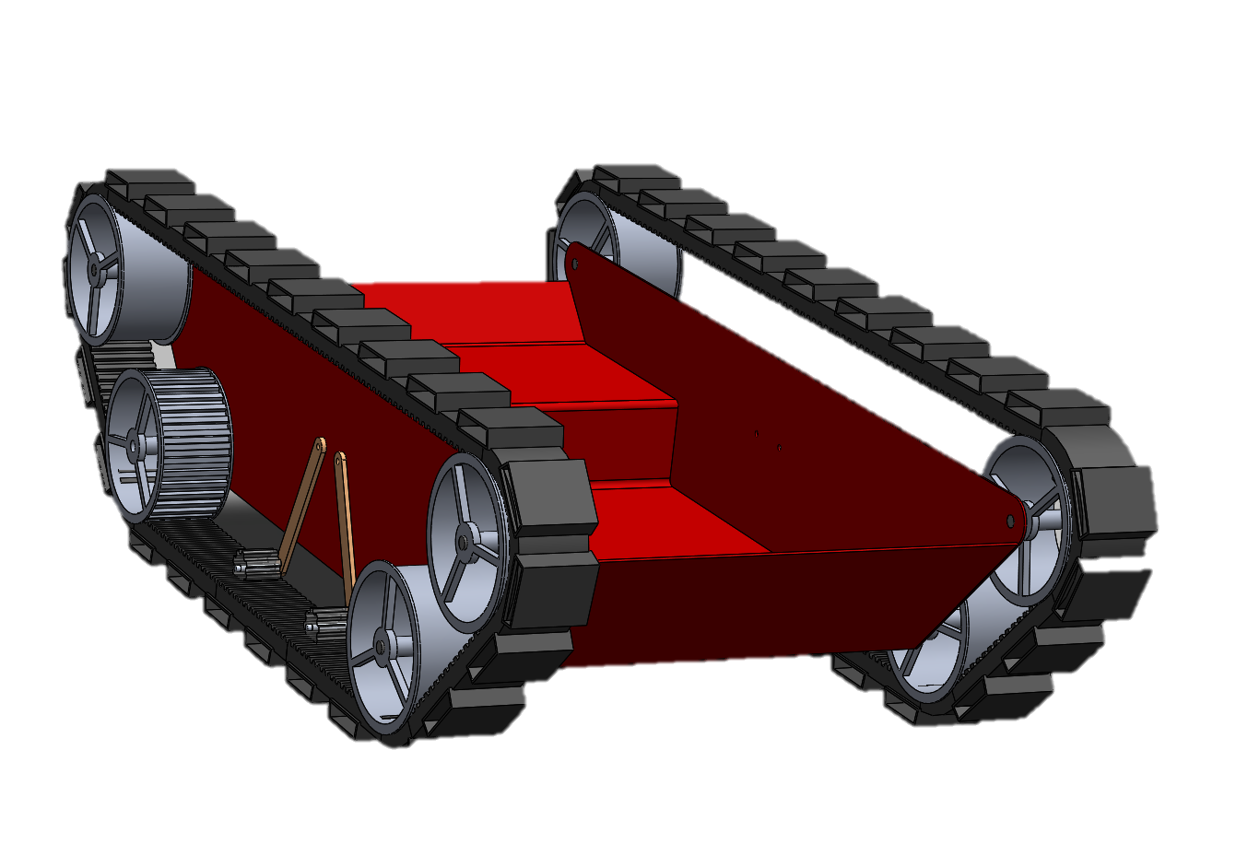
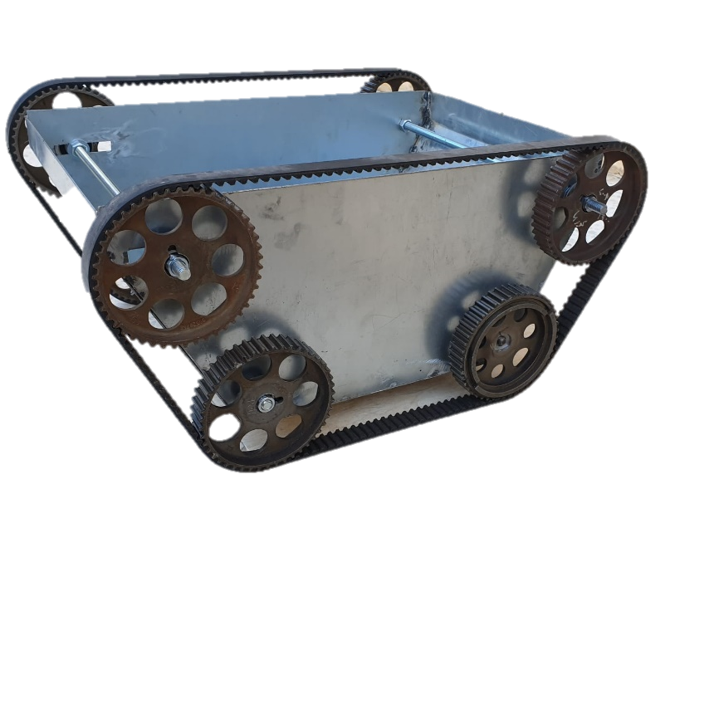
Final Mechanical Design

Slide 15
ELECTRICAL DESIGN

Slide 16
The Electrical Components needed for this project are:
Brushed DC Motor.
Ultrasonic sensor.
Actuator Driver.
Fire Detectors.
Battery.

Slide 17
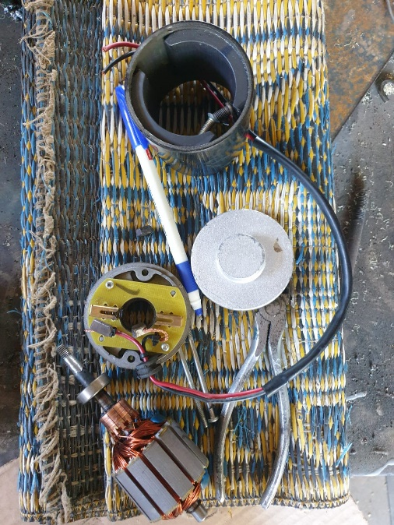
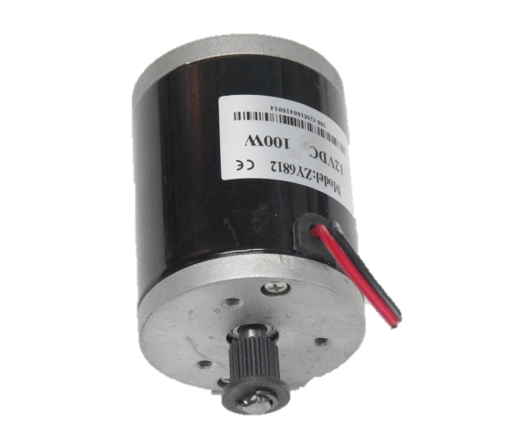
BRUSHED DC MOTOR
Power.
Used.
Maintenance process performed.
Advantages.

Slide 18
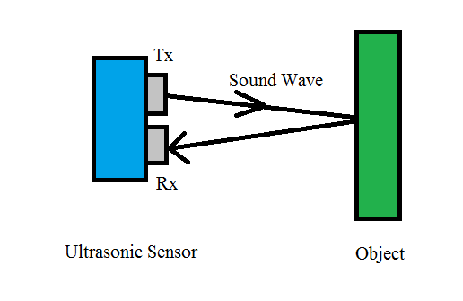
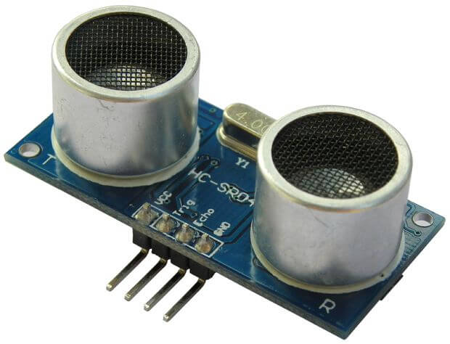
Ultrasonic sensor
Principle.
Range.
Application.

Slide 19
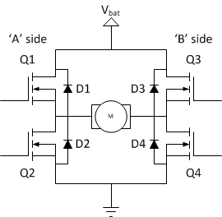
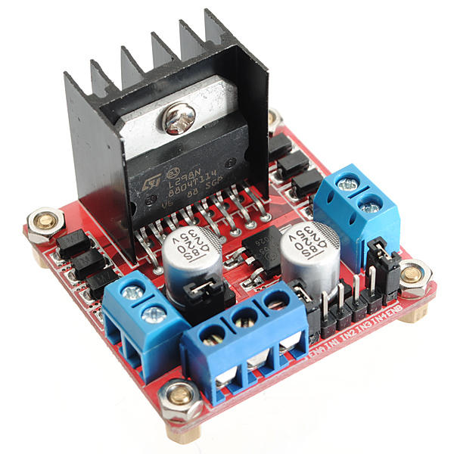
Actuator Driver
L298N.
Rotation direction.

Slide 20
Fire Detectors
Fire Detectors
Smoke detectors
Ionization/
Photoelectric
Photoelectric
Heat detectors
Ionization

Slide 21
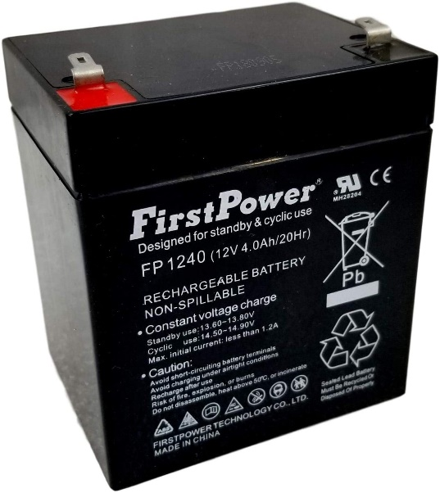
Battery
First Power
Advantages:
Weight.
Power.
Available in the market.
Cheap.

Slide 22
CONTROL

Slide 23
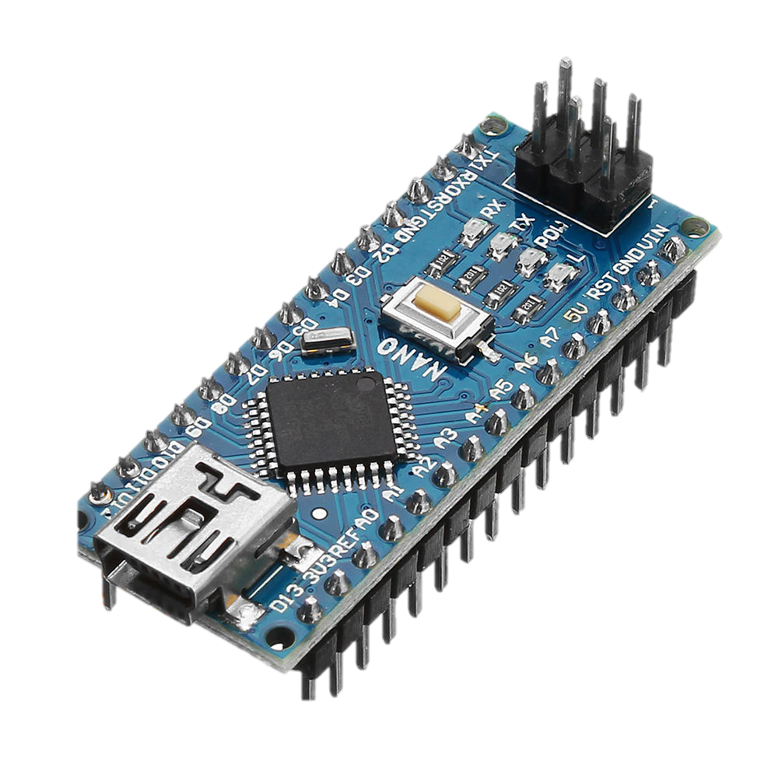
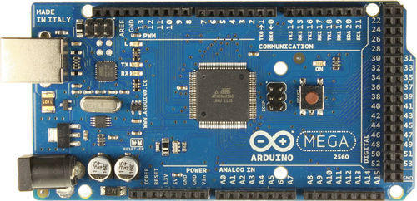
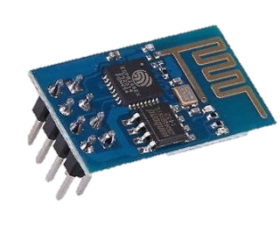
Control
Microcontrollers
Arduino Mega
Arduino Nano
WIFI Module

Slide 24
DC Motor Control
DC motors can be controlled by varying current with time.
Armature current.
Field current.

Slide 25
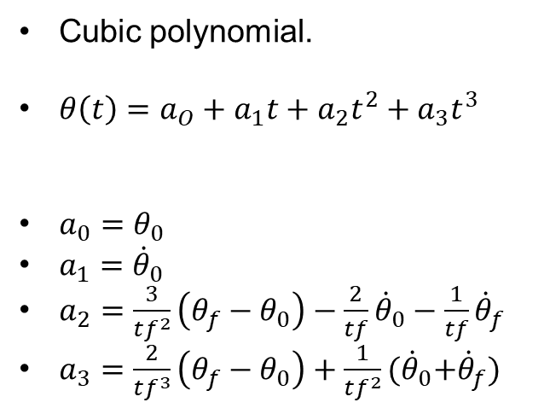
Go to target techniques
Cubic polynomial.
$θ\left(t\right)=a_{O}+a_{1}t+a_{2}t^{2}+a_{3}t^{3}$
$a_{0}=θ_{0}$
$a_{1}={\dot{θ}}_{0}$
$a_{2}=\frac{3}{tf^{2}}\left(θ_{f}−θ_{0}\right)−\frac{2}{tf}{\dot{θ}}_{0}−\frac{1}{tf}{\dot{θ}}_{f}$
$a_{3}=\frac{2}{tf^{3}}\left(θ_{f}−θ_{0}\right)+\frac{1}{tf^{2}}{(\dot{θ}}_{0}+{\dot{θ}}_{f})$
Speed feed back.
Time parameter.
Via points marks.

Slide 26
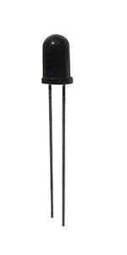
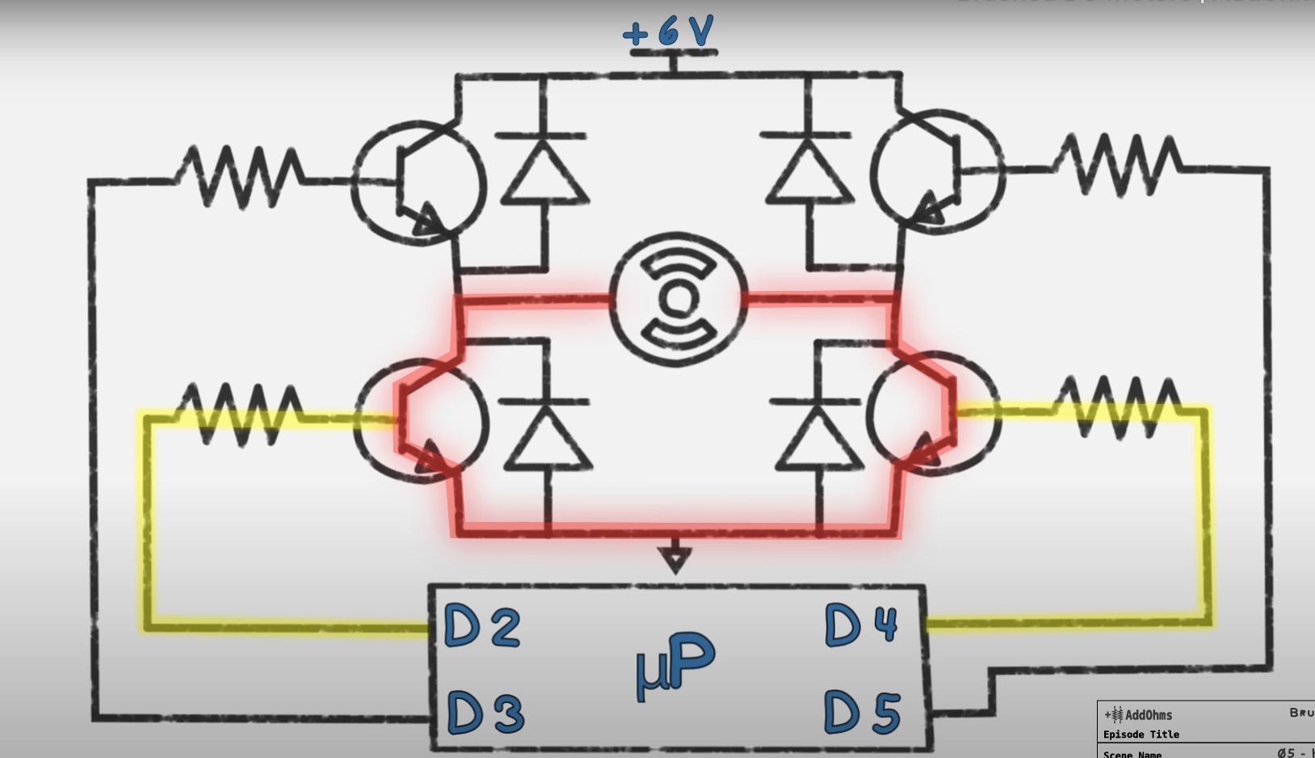
Via points marks
Floor lines.
IR sensors.
Braking.
Return to station.

Slide 27
Firefighting

Slide 28
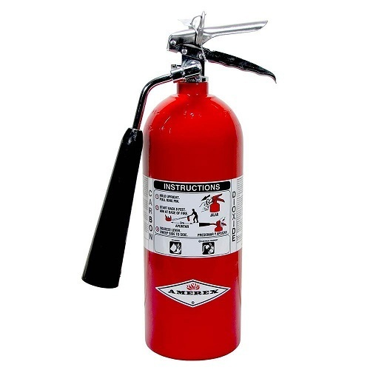
Fire extinguisher
2.5Kg Co₂ fire extinguisher.
No suffocating.
Field of view.
Volatile.
Controllable.

Slide 29
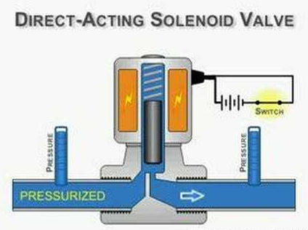
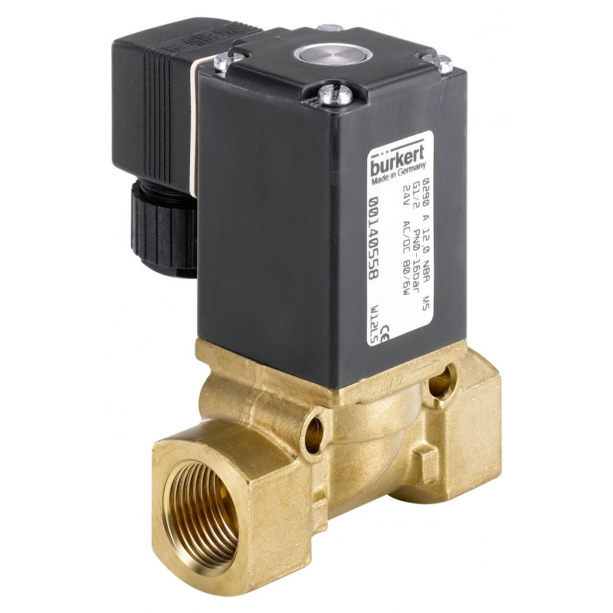
Valve
Direct operated solenoid valve.
Simple.
Cheap.

Slide 30
PRACTICAL PART

Slide 31
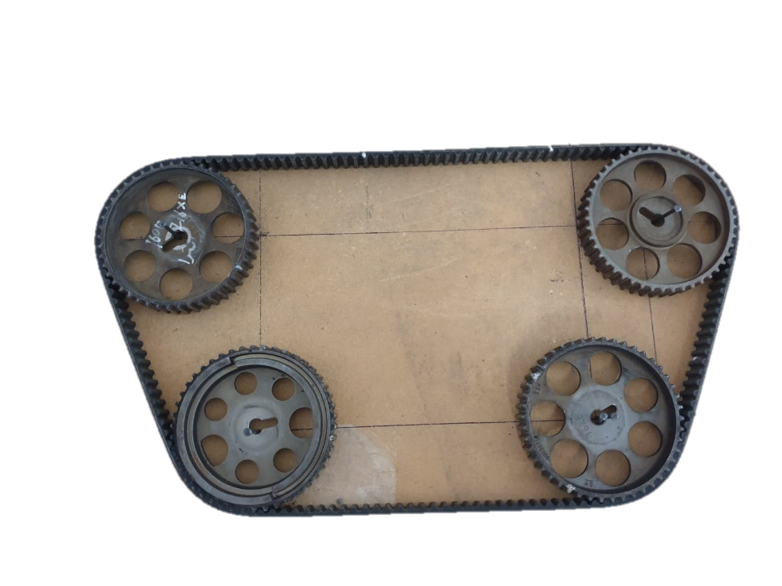
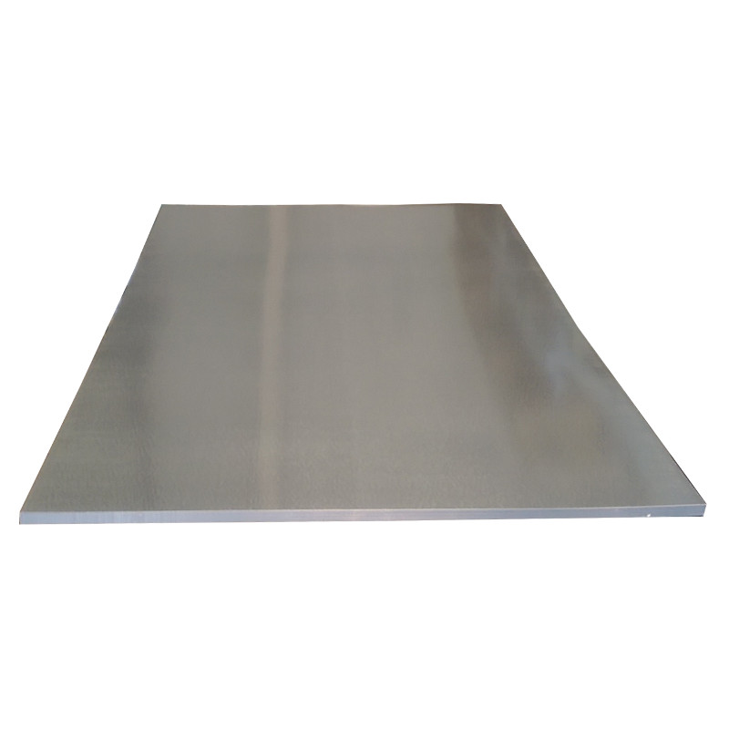
Choosing components
Calvinized metal sheets.
Pulleys.
Track.
Template.

Slide 32
Sheet processing
Cutting.
Bending.
Drilling.

Slide 33
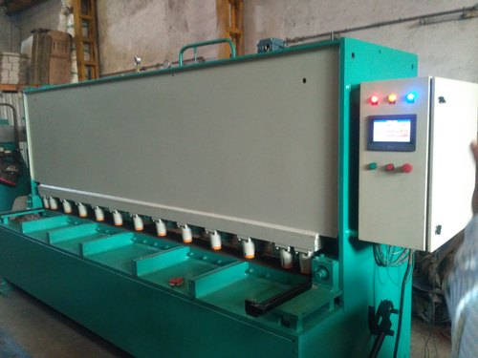
Cutting
Base metal sheet.
Sides metal sheet.

Slide 34
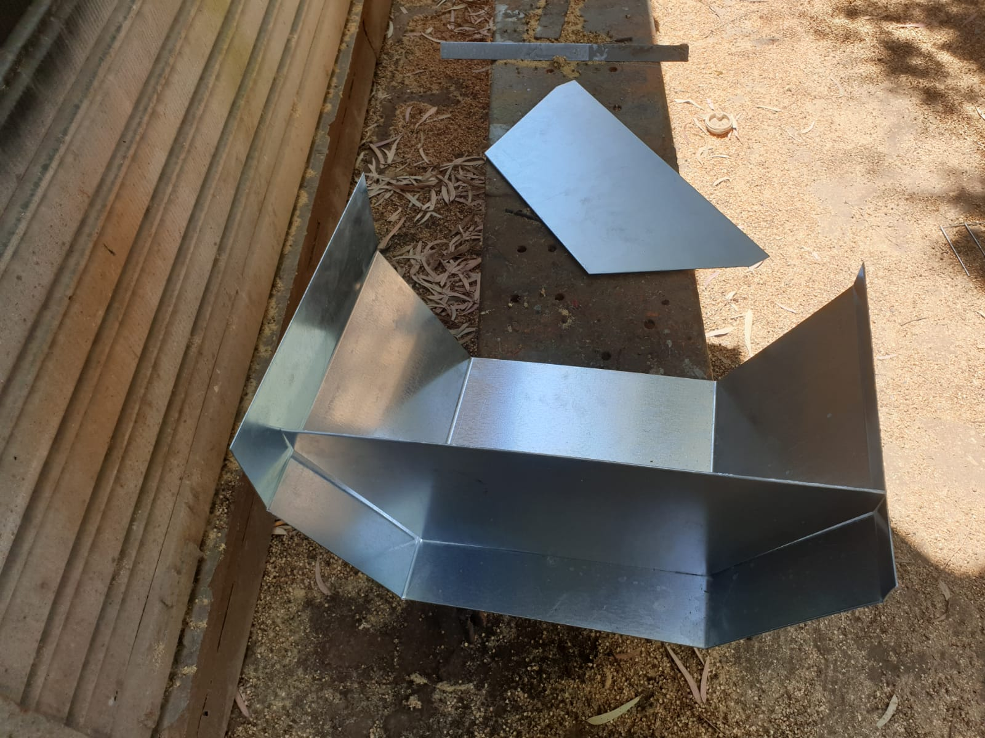
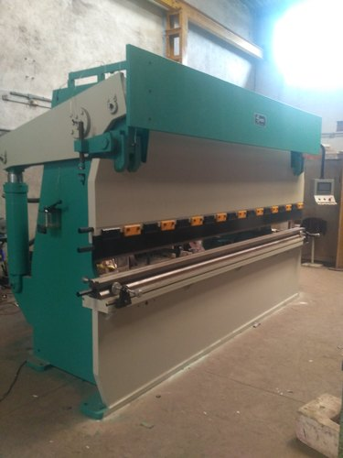
Bending

Slide 35
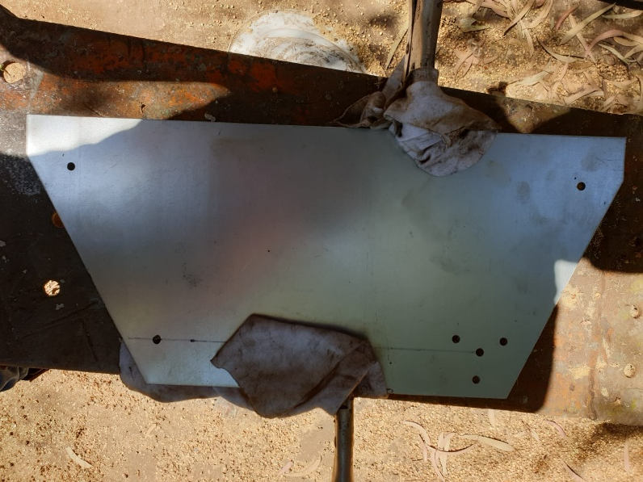
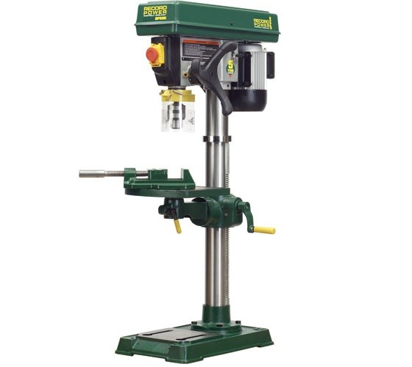
Drilling

Slide 36
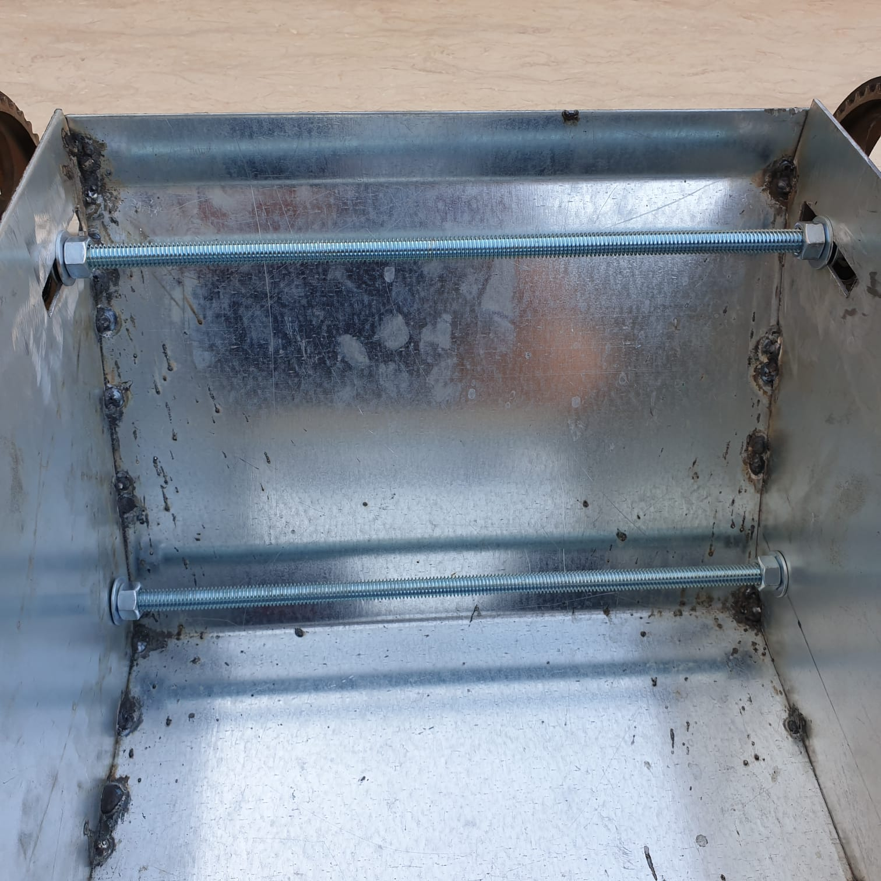
Welding
Arc welding.
2mm electrode.

Slide 37


Pulleys processing
Main pulleys.
Secondary pulleys.

Slide 38
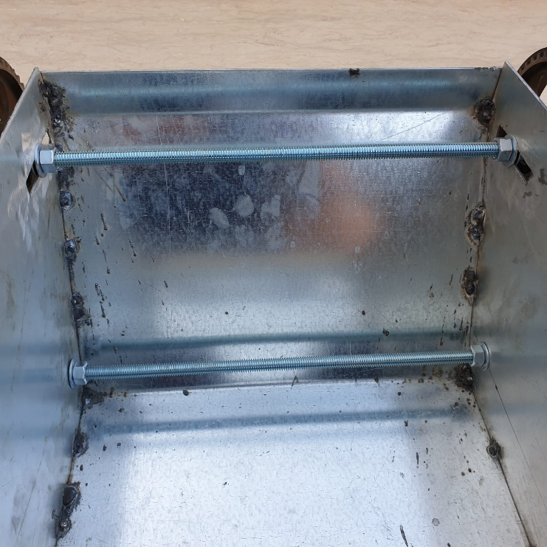
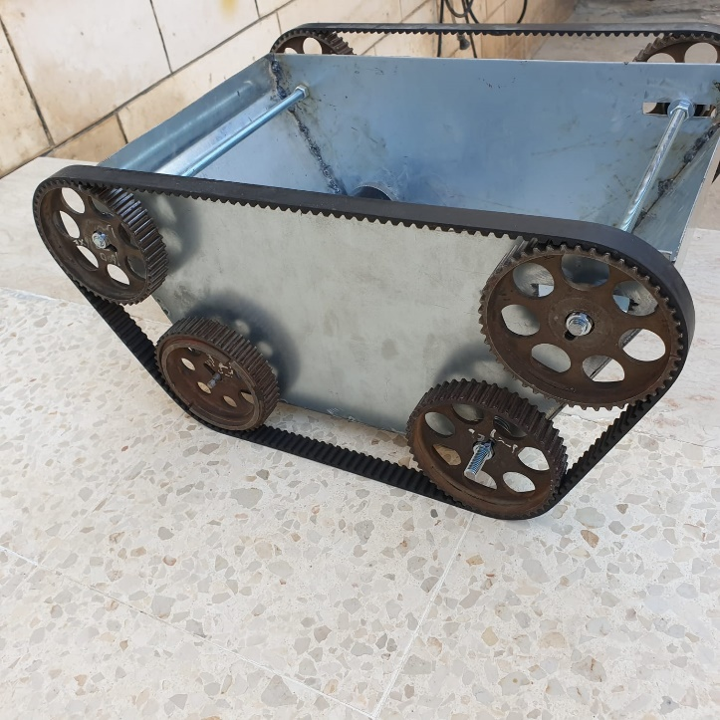
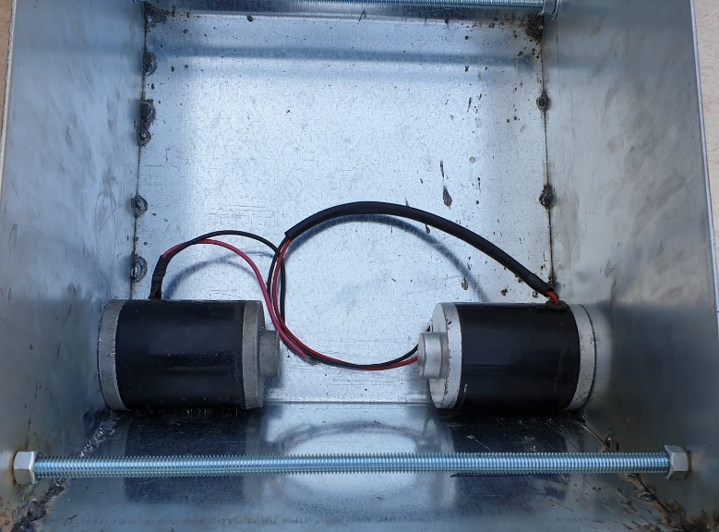
Robot assembly
Motors.
Pulleys.
Belt.
Adding a flipped belt.

Slide 39
Future Work

Slide 40
Future Work
Obstacles Avoidance.
Smart Home Integration.

Slide 41
Thank you

